Slide 1
Overview of Target Initiatives for the First Target Station
Mark Wendel
Acting Group Leader,
Source Development and Engineering
SNS Accelerator Advisory Committee Meeting
February 16–18, 2016

Slide 2
Contents
History of targets and leaks
Recent happenings since 2014 leaks
Goals for reliability
Initiatives to reach the goals
Benefit
Highlight
Development
Summary

Slide 3
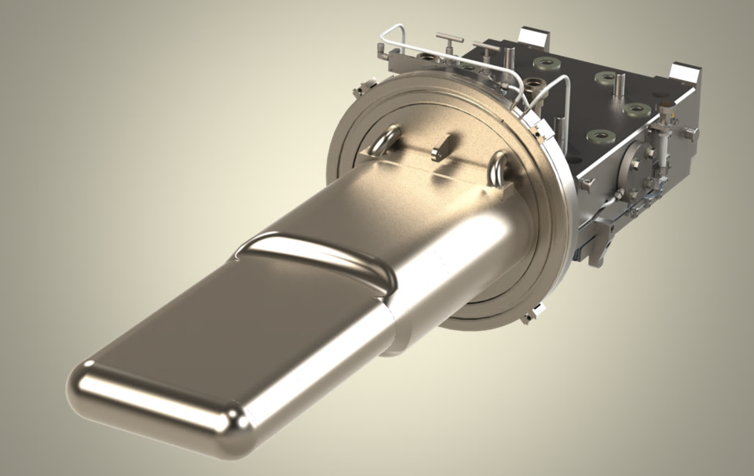
T13 is now in service, capable of handling the SNS nominal power of 1.4 MW
23 kJ/pulse at 1.4 MW
700 ns pulse, 60 Hz
5 x 10⁶ pulses/day
1.3 m
Proton beam
Notes:
The target module is not a safety credited component.
We do thorough engineering to assure reliable service to account for what is known.
Acknowledging that a first of a kind component like this has uncertainties, not safety crediting it is prudent.

Slide 4
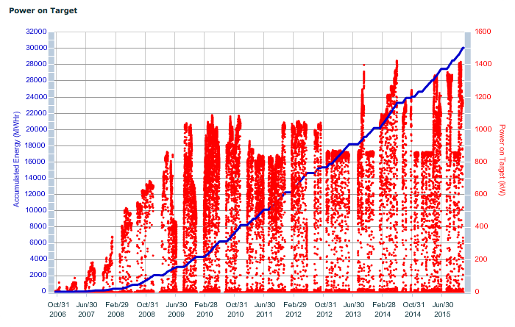
Target change-outs for SNS (13 targets in 10 years)
T10
T9
T13
[Baumgartner, Target Breakout]
T6
T11
T12
T3
T5
T7
T2
T4
T8
T1

Slide 5
The targets that failed early came in pairs
Target | Exposure (MW-hrs) | Avg. Power (KW) | Failure
 | 3055 | 379 | None (Removed from Service)
 | 3145 | 771 | None (Removed from Service)
 | 2791 | 845 | Unknown
 | 3252 | 782 | None (Removed from Service)
 | 2362 | 938 | None (Removed from Service)
 | 617 | 916 | Transition cover plate weld
 | 98 | 943 | Transition cover plate weld
 | 3750 | 851 | None (Removed from Service)
 | 4195 | 1033 | None (Removed from Service)
 | 601 | 1052 | Front / transition weld
 | 167 | 1116 | Transition cover plate weld
 | 4445 | 964 | TBD – leaked on nose
 | 1565 | 1000 | In service
1
2
3
4
5
6
2012
Fabrication Improvements
7
8
9
10
2014
Design Improvements
11
12
13
x
Original target
x
Jet-flow target
x
Original target plus

Slide 6
For the nineteen target modules that have been manufactured…
Six have been operated and removed from service with no indication of a leak
Six have been operated and removed from service due to a mercury leak
Four leaked early (< 617 MW-hr)
Two leaked later (2791 and 4445 MW-hr)
Six have not yet been used
Two are on site
Four are at some stage of fabrication
One is in service now (>1500 MW-hr)

Slide 7
Inventory projection indicates that another order should be placed soon in order to remain 4 targets deep
Winter 15/16 Shutdown | Early 16 | Summer 16 Shutdown | Late 16 | Winter 16/17 Shutdown (IRP) | Early 17 | Summer 17 Shutdown | Late 17 | Winter 17/18 Shutdown | Early 18 | Summer 18 Shutdown | Late 18 | Winter 18/19 Shutdown | Early 19
 | MTX-009 |  | MTX-010 |  | MTX-011 |  | MTX-011 |  | MTX-013 |  | MTX-012 |  | MTX-008
 | ORTE-003 |  | ORTE-003 |  | ORTE-003 |  | ORTE-003 |  | ORTE-003 |  | ORTE-003 |  | ORTE-003
 | MTX-010 |  | MTX-013 |  | MTX-013 |  | MTX-013 |  | MTX-012 |  | MTX-008
 |  |  | MTX-011 |  | MTX-012 |  | MTX-012 |  | MTX-008
 |  |  | MTX-012 |  | MTX-008 |  | MTX-008
Installed
Ready Spares
Arriving Spares
[Winder, Target Breakout]
Lead time for a new target is typically 18 months

Slide 8
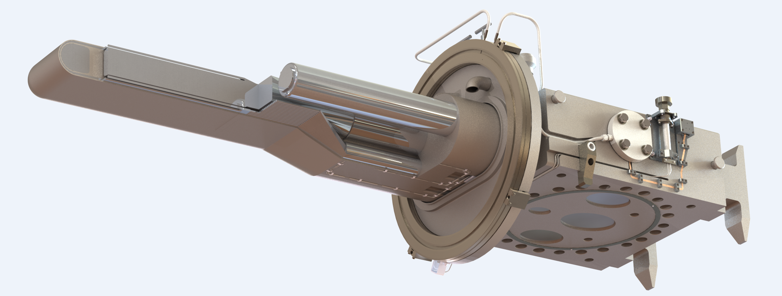
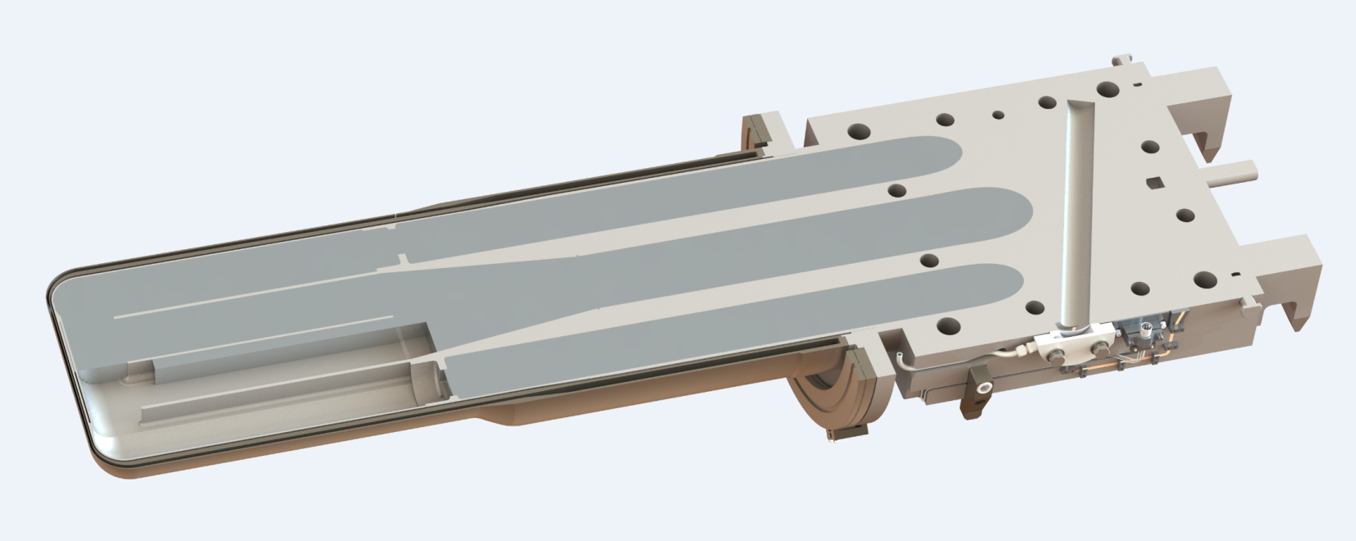
We have identified the leak locations for all but one of the 6 targets that leaked
T10 Leak – Jet-flow target (early/weld)
T3 Leak – late/undetermined
T6, T7, T11 Leak (early/weld)
T12 Leak (very late)

Slide 9
DOE Office of Science Independent Review conducted for Feb. 24-25, 2015
Almost all recommendations by committee were accepted
Significant progress already made on most recommendations
Vibration diagnostic and weld-annealing were considered but not implemented
Target development funding was provided
Target initiatives were organized
Still continuing weekly meetings to track progress

Slide 10
Also, since the Feb 2015 review…
Strategic goals have been set for SNS targets
1.4 MW operation
No more than 2 target changes per year
Predictable target change-outs
STS CD1 effort has been funded
FTS expected to receive 2 MW, requiring more robust target design
Need to evaluate FTS for power exceeding 2 MW
Two more targets have been operated
Target T12 set longevity record at 4445 MW-hr
Target T13 is still operational at 1567 MW-hr

Slide 11
Progress toward goal of 1.4-MW reliable operation with ≤ 2 changes per year
Operated 4 targets between 1.3 – 1.4 MW
T8 for 1 cumulative-day* (no leak)
T9 for 15 cumulative-days (no leak)
T12 for 25 cumulative-days before a leak
T13 for 15 cumulative-days and still going (no leak yet)
T9 was operated
6 months above 1 MW
3 months above 1.2 MW
did not leak mercury
New “improved” designs are on their way
T13 (in service) already has several improvements over T12
T14 has even more improvements
*for 6-months of time, there are 104 cumulative-days of operation based on a 5000-hr year

Slide 12
Engineering challenges to target design & build must be addressed
Multiple failure modes interact through non-linear relationships
Beam-induced cavitation
High-cycle fatigue
Corrosive/erosive actions of mercury
Cannot approach the 1.4 MW goal slowly
Long lead times
A minimum of two years is required to respond to any issue that is identified
Post-irradiation examination (PIE)
Design and analysis
Fabrication
There is no encompassing design criteria … yet!

Slide 13
Current initiatives should help reach both short and long term performance goals
Re-design of the targets
Hg vessel strain measurements during SNS beam
Fabrication improvements
Gas injection
Increase the pump speed
Improve PIE capabilities

Slide 14
Re-design of the targets
Benefit: Structure is robust to applied loads
Highlight: Four targets already modified, including one “on deck”
Developing: Next generation design
Gas injection
Tapered wall
[Winder, Target Breakout]
Full-penetration welds

Slide 15
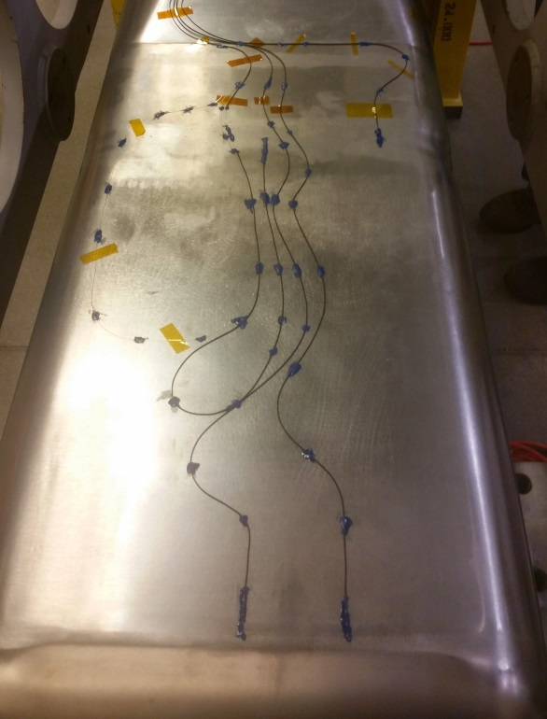
Strain measurements in situ at SNS
Strain sensors on target vessel
Benefit: Direction for design
Calibration of analysis
Diagnostic for gas injection and other design changes
Highlight: Strain data already collected
Developing: More extensive data (time and space)
Beam Pulse Strain Measurement
Calculation
Measurement
[Wendel, Target Breakout]

Slide 16
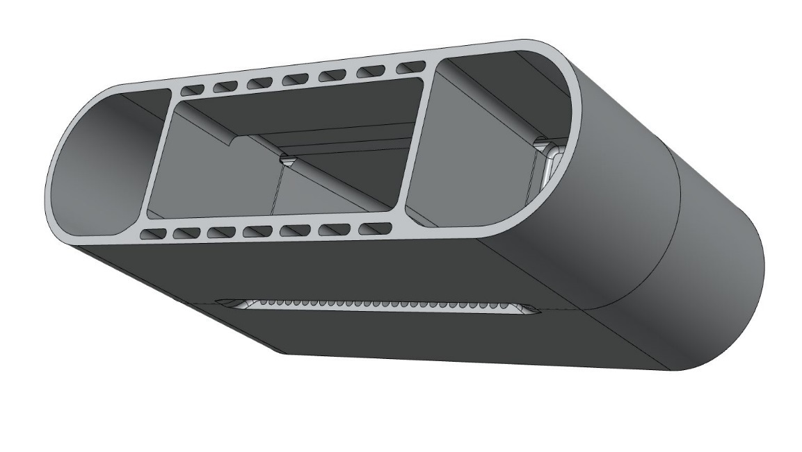
Fabrication improvements
Benefit: Reduce fabrication vulnerabilities
Highlight: TIG vs. E-beam welding mock-up
Developing: Weld distortion test, specifications update
New weld technique
Weld mockup for weld distortion test
[Winder, Target Breakout]

Slide 17
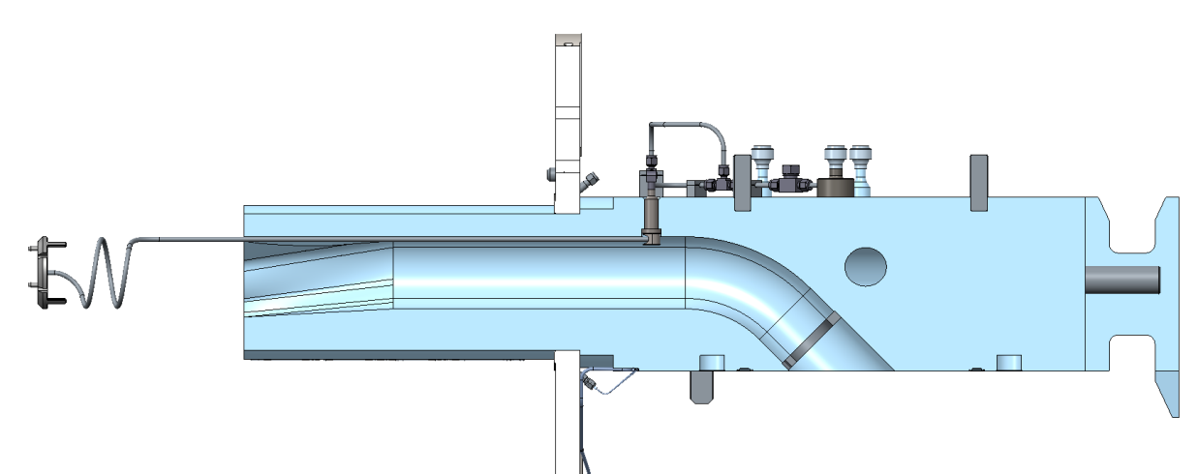
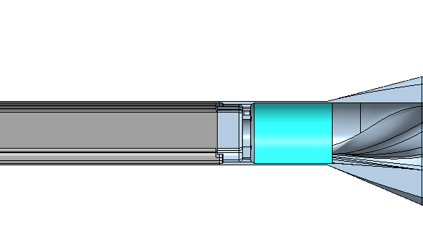
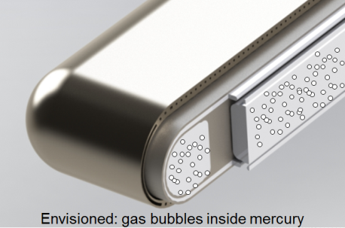
Gas injection
Benefit: Reduction of pulsed structural loads and cavitation erosion
Highlight: Target retrofit fabrication begun
Developing: Gas supply, longer-term implementation
[Winder/Riemer, Target Breakout]

Slide 18
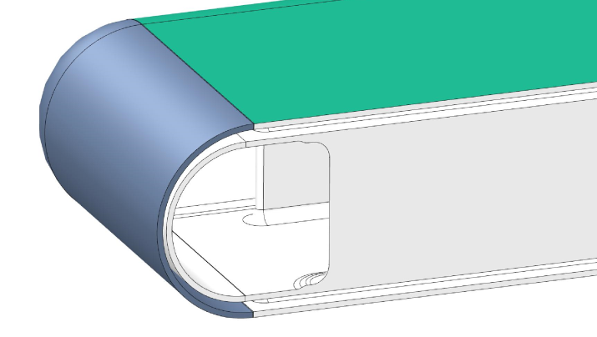
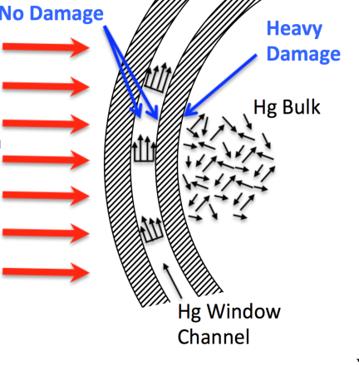
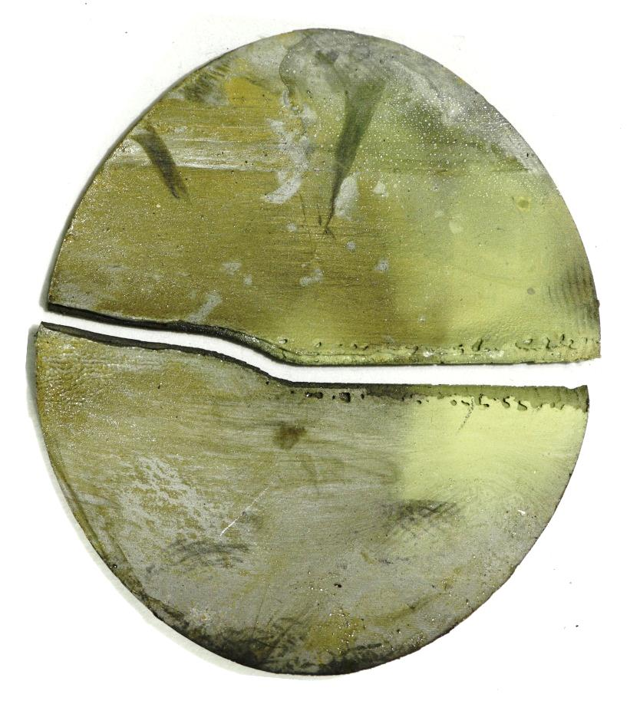
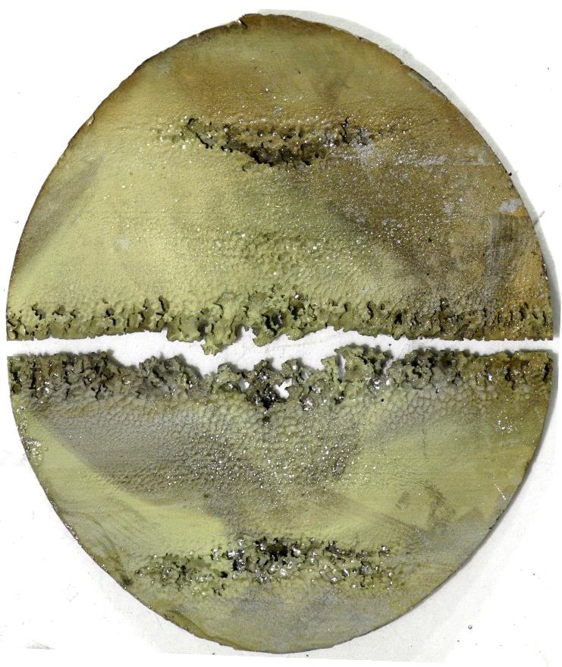
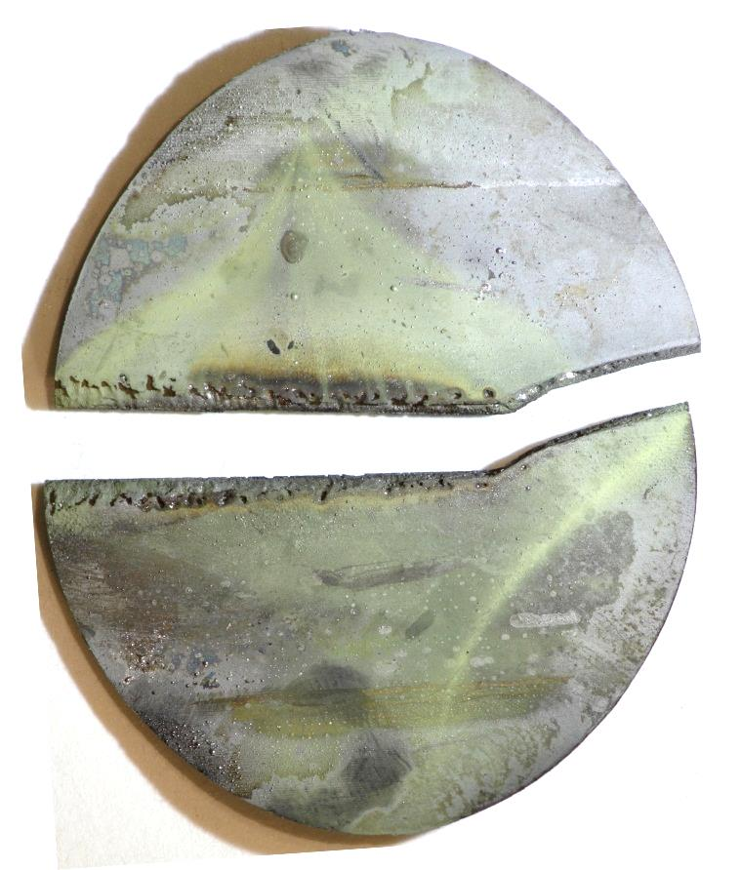
Increased pump speed
Benefit: Lower thermal stresses and reduced beam-pulse induced cavitation
Highlight: Running successfully at 350 RPM
Past 10⁸ cycles at 1.4 MW
Unexpected improvement of window flow
Developing: PIE of T13 and consideration of flow erosion experiments
BEAM
Inner wall cavitation damage
Decreased
Window Flow

Slide 19
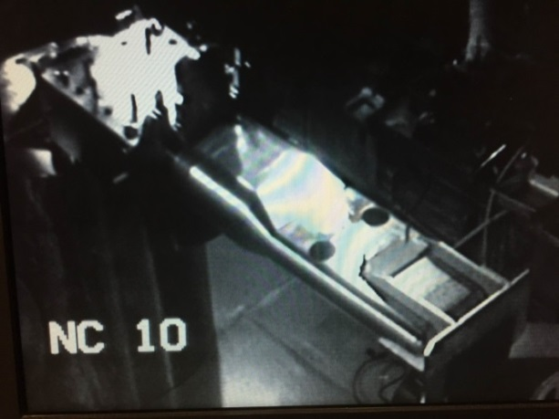
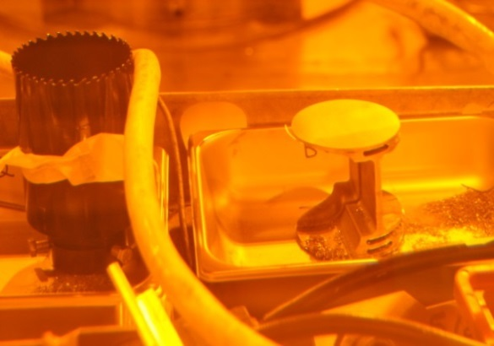
Improved PIE
Benefit: Truest source for design guidance
Highlight: T10 leak sample extracted with new tool
Developing: Characterization of specimens
Holes from cuts
[Baumgartner/Riemer, Target Breakout]
Microscopy and metallurgical testing

Slide 20
These six current initiatives increase opportunity to reach reliability goal
Higher flow rate
Already implemented on T13
Incremental changes to materials and geometry
On-deck for installation (T14)
Modified jet-flow target to arrive in August, 2016
Early gas injection at low flow rate
Should be ready in CY2017
Future design changes that directly address failure modes (e.g. recent results from T12)

Slide 21
Target Breakout session
Overview of target station operations (M. Baumgartner)
Charge, and target strategies and resources (M. Wendel)
Information update
PIE (B. Riemer)
Instrumentation on target module (M. Wendel)
Design and Analysis (D. Winder)
Gas injection (B. Riemer)

Slide 22
Summary
Much work was accomplished this year in response to 2015 DOE Review Committee recommendations
Short-term 1.4 MW goal is challenging, but may be within reach
Long-term 2+ MW goal will require more development effort
We need the committee advice on our priorities and strategies

