Slide 1
Introduction to Cryogenics
Neutron LifeCycle
Talk 3
Harish Agrawal
SE Team Lead – HFIR
ORNL
June 30th 2016

Slide 2
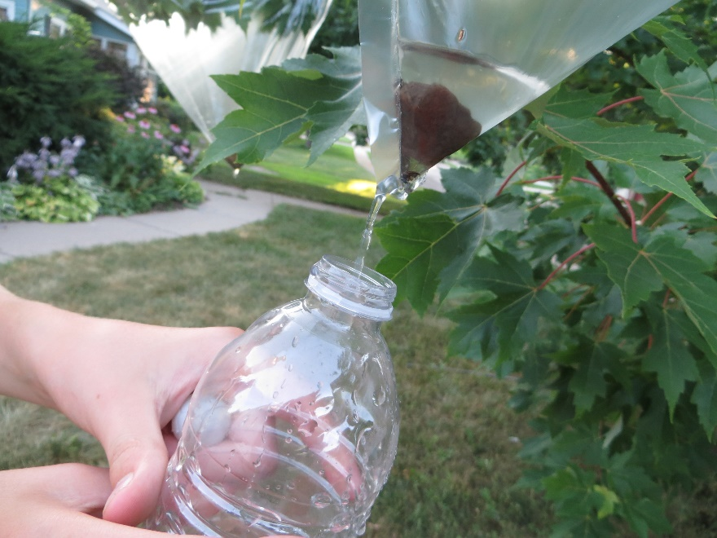

Condensation during winter:

Slide 3
Ideal Gas Equation:
P V = m R T
P = Pressure
V = Volume
m = Mass
R = Real Gas Constant
T = Temperature
V, m and R = Constant
P α T

Slide 4
Contents of this talk:
Introduction
Cryogen free closed cycle refrigerator (CCR)
Variable temperature insert (VTI)
Helium-3 system (3He)
‘Wet’ dilution refrigerator (DR)
‘Dry’ dilution refrigerator (DR)
Some typical failure modes

Slide 5
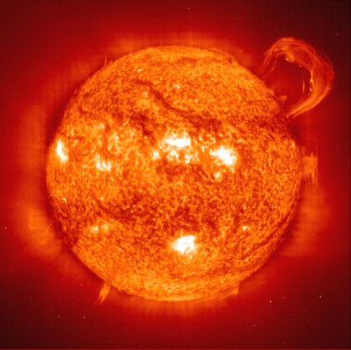
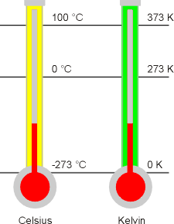
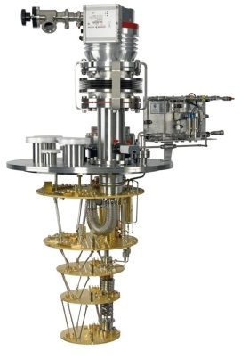
What do we mean by Ultra Low Temperature (ULT)?
Sun~ 6,000 K
X 20
Room temp ~ 300K
X 30,000
<1 K is called ULT
D/R system~10mk

Slide 6
‘How do we get there?’

Slide 7
Let starts with Basics:
Cryogenics
Cryo
Genics
Cold
To produce

Slide 8
How do we get there to 10mK?
Cryogenics
0.01K (10mK)
Pumped LHe3+LHe4 Mixture
Dilution Refrigerator
4.2K
Cryostat
Liquid Helium
Or CCR
Superconducting
Magnet
1.5K
Pumped LHe4
Variable Temperature
Insert
0.3K (300mK)
Pumped LHe3
3He insert
ULT

Slide 9
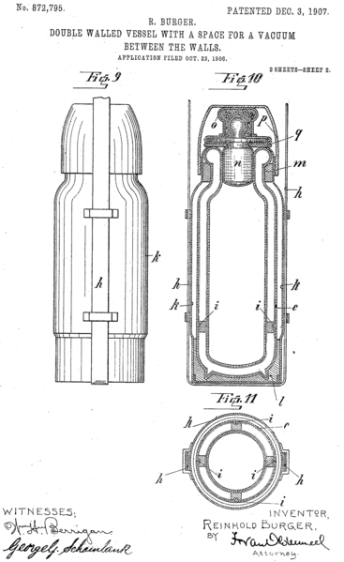
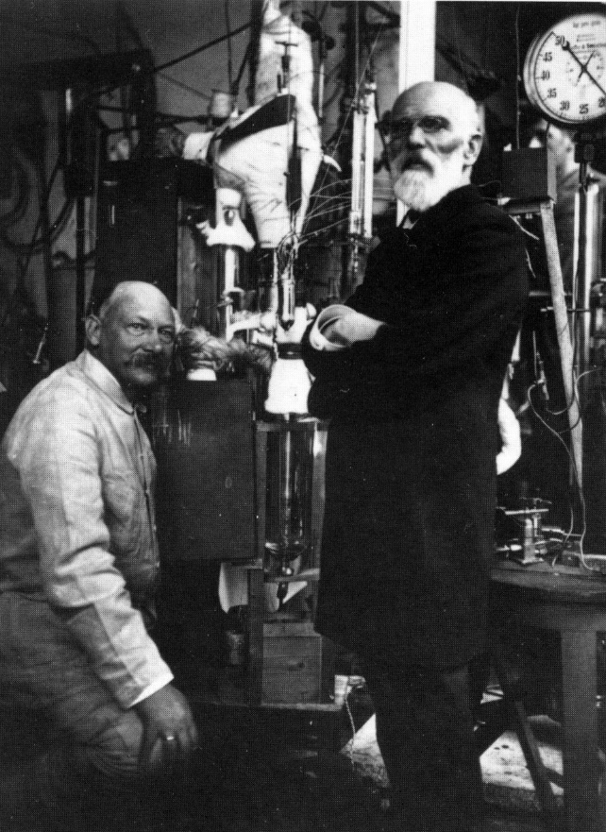
First step for ULT: need 4K
2 Ways to achieve 4K
First method – Wet Systems’ (Liquid helium)
Heike Kamerlingh Onnes (left) and Johannes Diderik van der Waals in 1908 in the Leiden physics laboratory, in front of the apparatus used later to condense helium. (Source: Museum Boerhaave, Leiden)

Slide 10
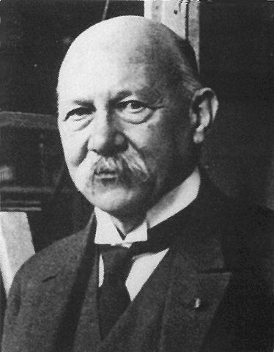
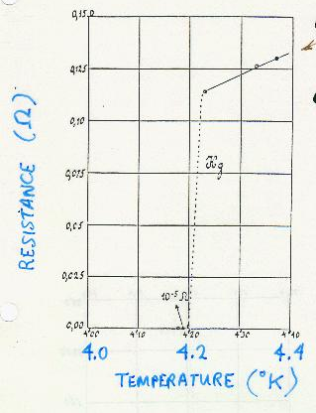
Dramatic events in Leiden
~106 Years ago
H. Kamerlingh Onnes
appointed to a chair of physics in Leiden aged 29
experimentalist, engineer and
organisational genius
1884 Constructed a cascade liquefaction plant for oxygen, nitrogen and air
1906 Liquefied hydrogen
1908 First liquefaction of helium
Discovered superconductivity (in mercury)
Received the Nobel Prize for his studies of the
properties of matter at low temperatures

Slide 11
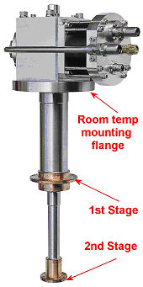
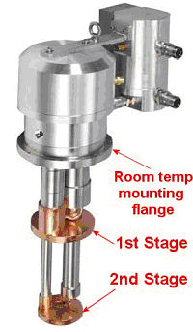
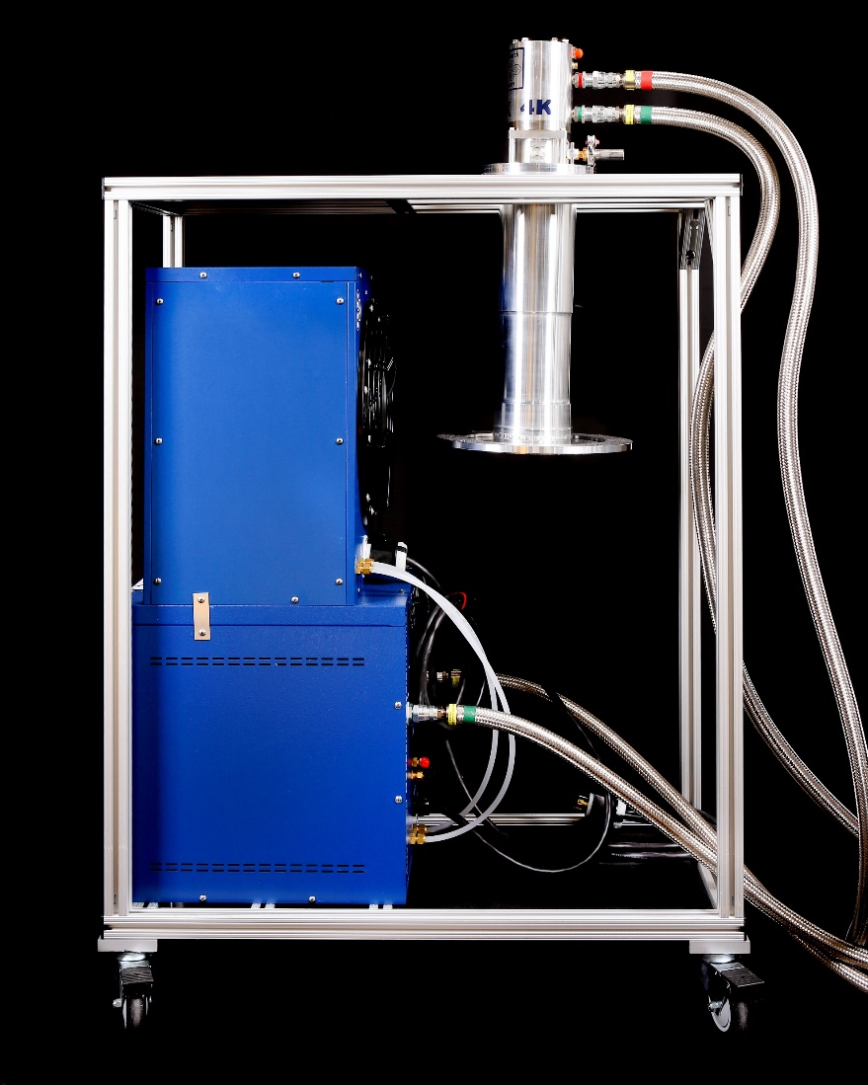
2nd method for 4K - ‘Dry systems’
GM Cold Head
PTR Cold Head

Slide 12
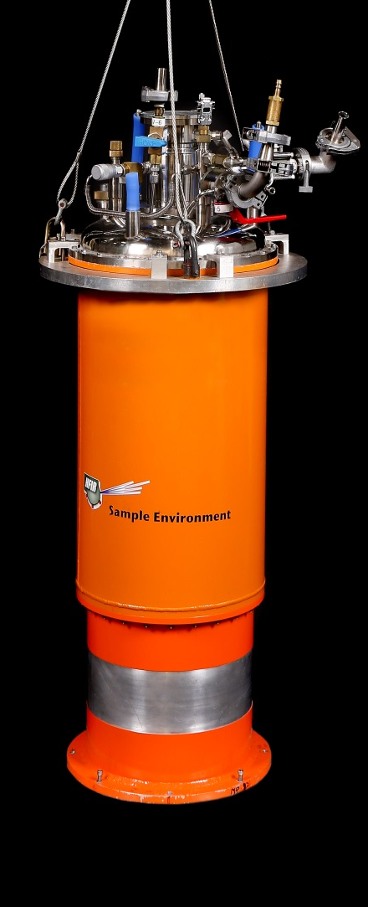
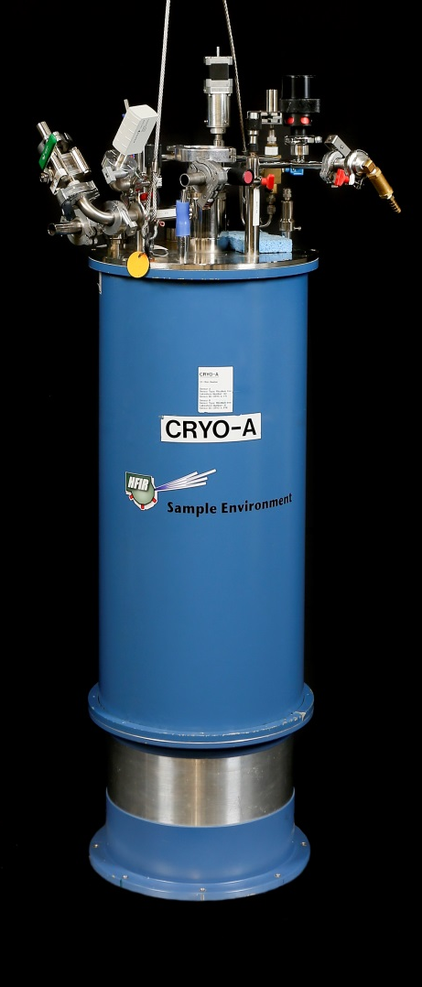
Second Step for ULT:
Requires 1.5 K environment:
Color doesn’t matter as long as it achieves low temperature
And we don’t have to refill the cryostat twice a day

Slide 13
P V = m R T
P = Pressure
V = Volume
m = Mass
R = Real Gas Constant
T = Temperature
V, m and R = Constant
P α T

Slide 14

2nd Step -1K pot (VTI) ~1.5K
1K pot pumping line
IVC pumping line
OVC with LN₂
shield or
superinsulation
L ⁴He
IVC
1 K pot
Needle
valve
milliKelvin
refrigerator
X

Slide 15

Now we need Helium-3 or mixture of Helium-3 and Helium-4 gas to go to lower temperatures
Helium has two stable isotopes 4He and 3He
  At room temperature, both isotopes are chemically identical and difficult to distinguish from one another.
  4He-It is usually extracted from natural gas wells, predominantly in Qatar, US, Algeria and Russia
  3He is incredibly rare.
    It is only in the last 50 years that significant quantities of 3He have become available to allow experiments to be performed.
    3He is a bi-product of nuclear processing

Slide 16
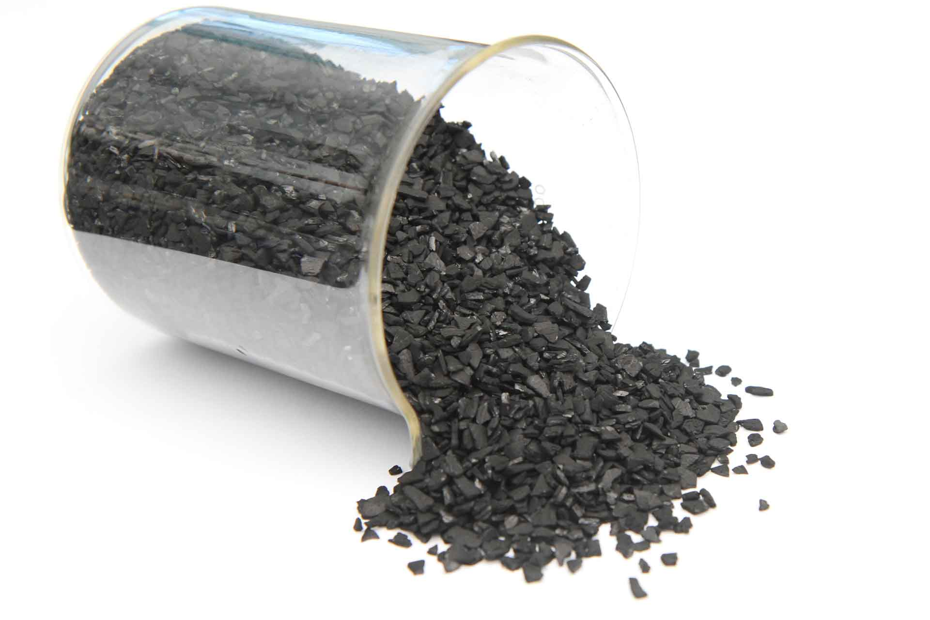
Helium-3 Systems:
Base Temperature <300mK
Activated Carbon has extremely high absorption capabilities at low temperatures~ 0.5lt of helium per gram of charcoal
Single Shot System: By cycling the Carbon between 1K and 40K an absorption and desorption cycle can be generated
During the absorption cycle the effective pumping speed and ultimate base pressure on the 3He far exceeds that achievable by external pumping means

Slide 17
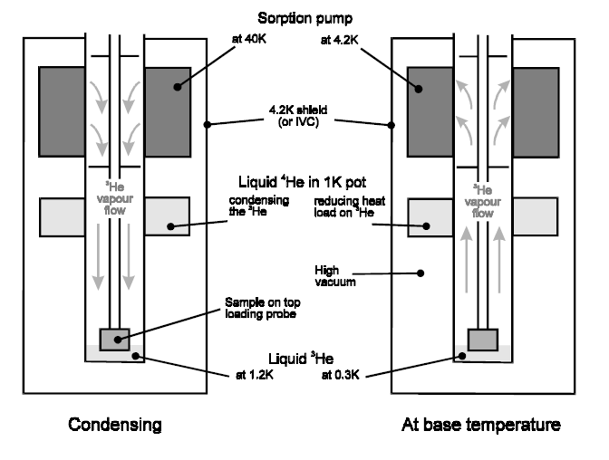
Principle of Operation of Helium-3 System:

Slide 18
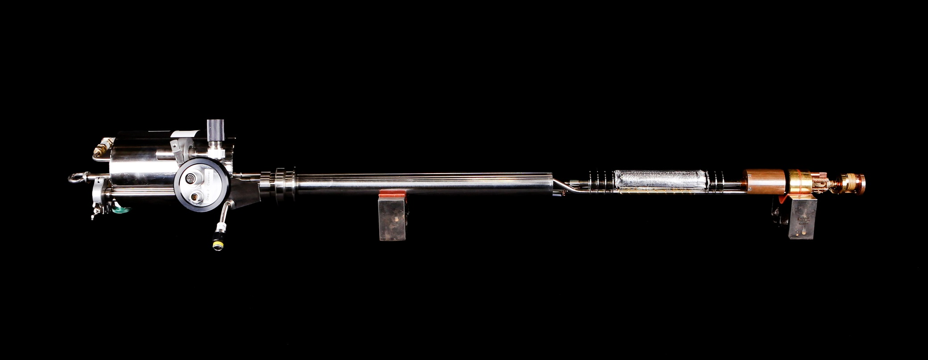
Helium-3 insert – in real life
Sorb
1K Stage
Helium-3 Gas Tank
Helium-3 Pot

Slide 19
P V = m R T
P = Pressure
V = Volume
m = Mass
R = Real Gas Constant
T = Temperature
V, m and R = Constant
P α T
Mixture of 3He and 4He

Slide 20
Properties of ³He & ⁴He – phase separation
Dilution Refrigerator Systems:
Mix 3He and 4He at room temperature
As the temperature drops below 0.87Kelvin, 3He separates out of the mixture
Gravity pulls the heavier fluid to the bottom of our container, while the lighter pure helium-3 floats on the top
The phase boundary exists
This effect occurs in the mixing chamber
The mixing chamber
³He
6% ³He in ⁴He

Slide 21
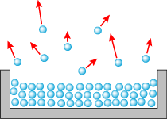

Properties of ³He & ⁴He cont. – boiling in the still
If you heat a mixture of ³He & ⁴He atoms the lighter ³He atoms boil-off leaving the heavier ⁴He atoms behind
The Still
³He atoms boil-off
⁴He left in the still

Slide 22
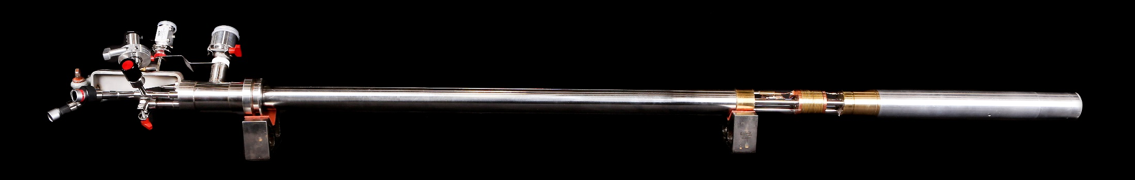
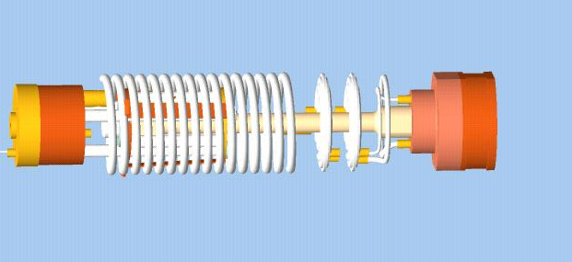
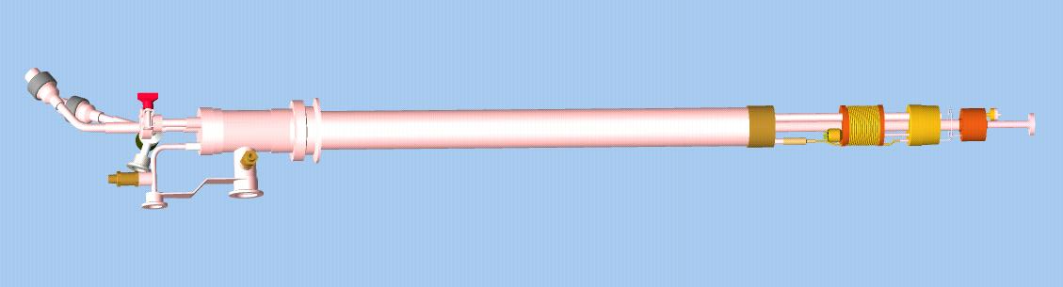
Dilution Refrigerator – in real life known as KelvinoxVT
Outer diameter < 50 mm to suit 50 mm diameter VTI
Coiled tube heat exchanger
Greased cone seal for IVC
Dilution unit
Coiled tube condenser line for ³He gas
Still
Sintered silver heat exchangers
Mixing chamber

Slide 23
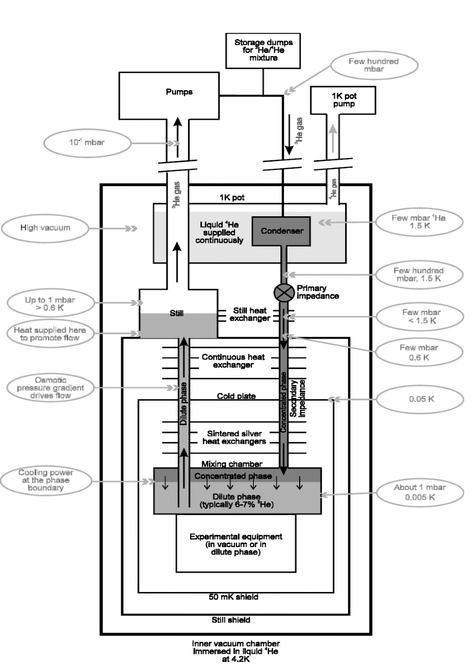
Helium-3 circulation path

Slide 24
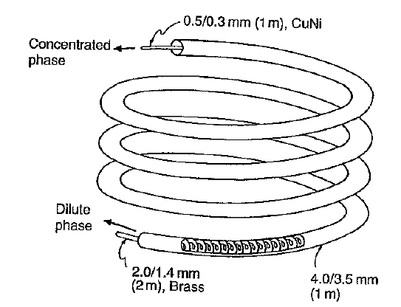
Coil Heat exchanger

Slide 25
Silver Heat exchangers
Warmer Helium-3 returning into system on route to mixing chamber
Silver sinter both sides of foil
‘Colder’ Helium-3 from mixing chamber on route to the still
Cooled Helium-3 on route to mixing chamber

Slide 26
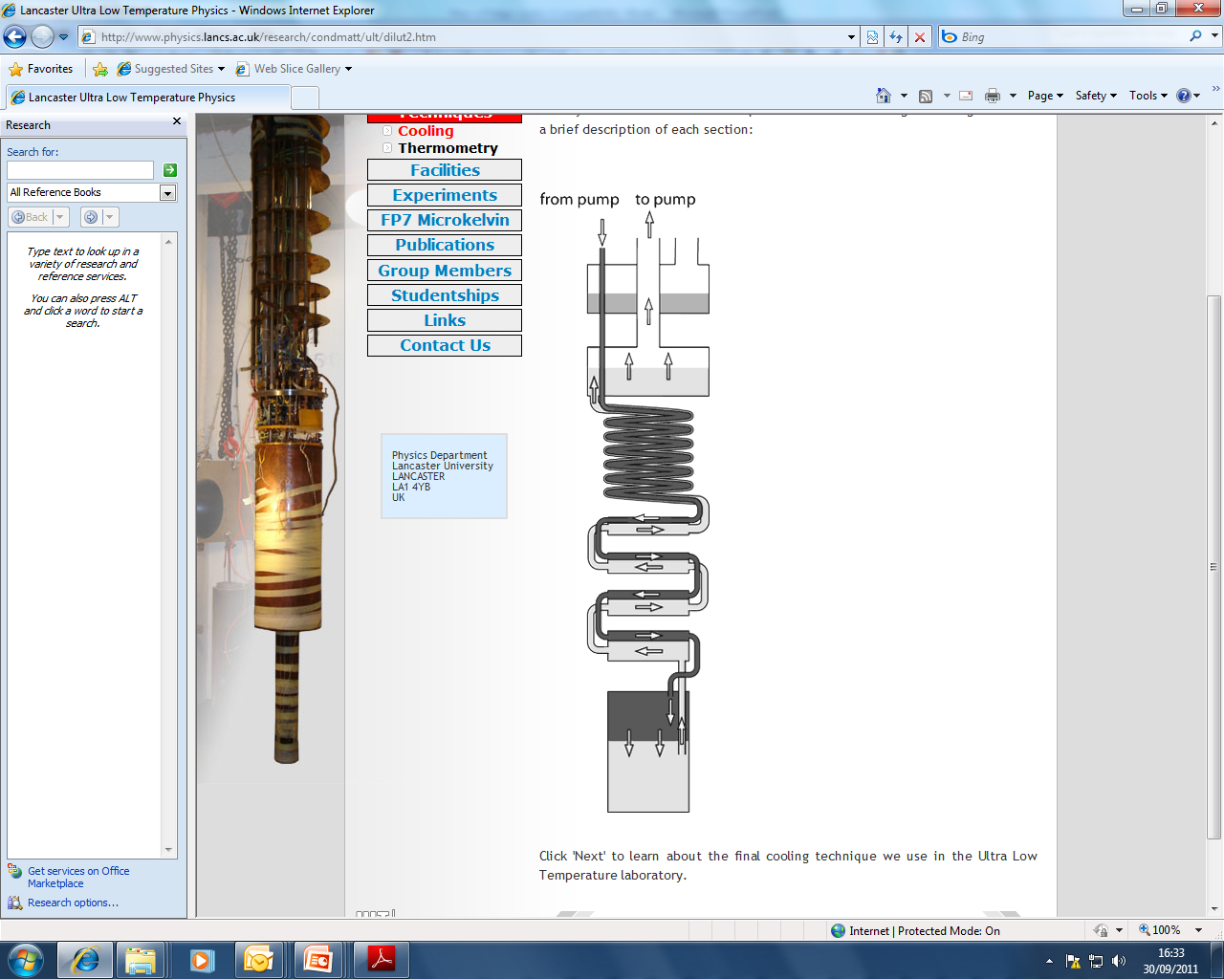
Dilution refrigerator -Basic principle
1K pot
Still
Helium-3 boils out of still
Coil Heat exchanger
Silver Heat exchangers
Mixing chamber
Phase boundary

Slide 27
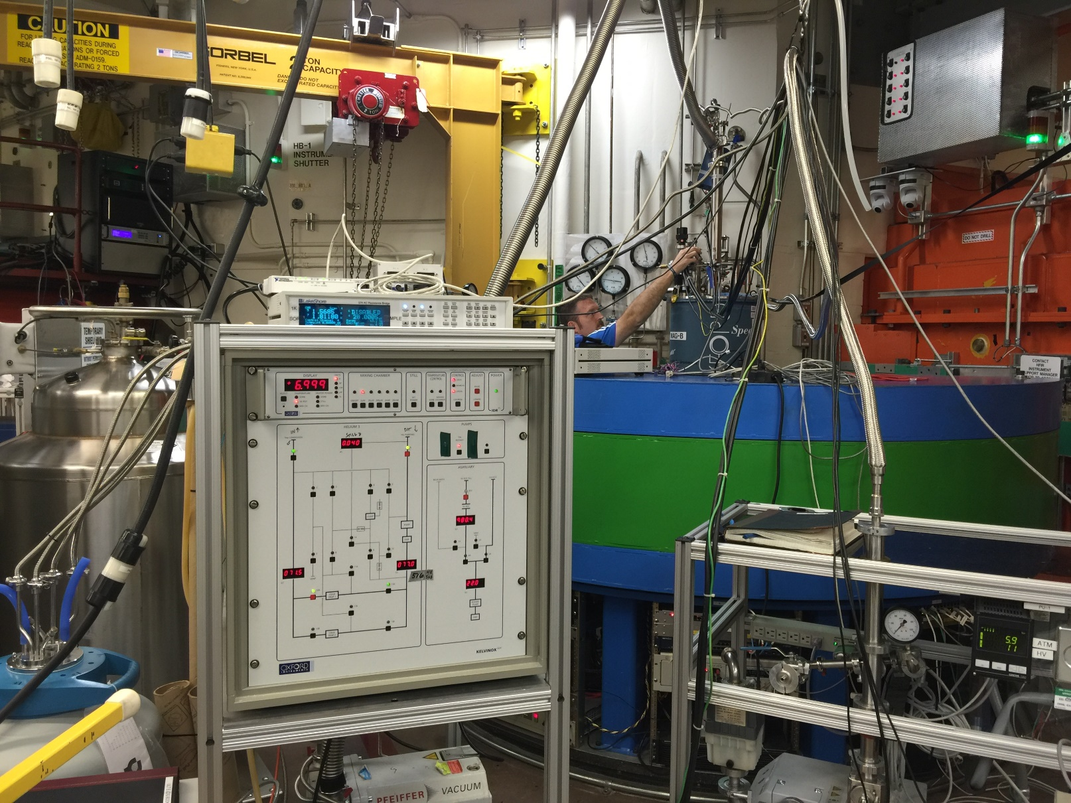
DR Experiment at HB2A

Slide 28
‘Dry’ Dilution Refrigerator
Supplier uses a pulse tube cooler to achieve a starting temperature of 4Kelvin or below

Slide 29

Condensing Helium-3 at 4K
Compressor
P₁T₁
P₂T₂
Heat Exchangers
The Joule Thomson valve is a simple device that cools gas through a nozzle due to expansion from high pressure to low pressure gas.
Precooling stage
JT valve
A simplified liquefier

Slide 30
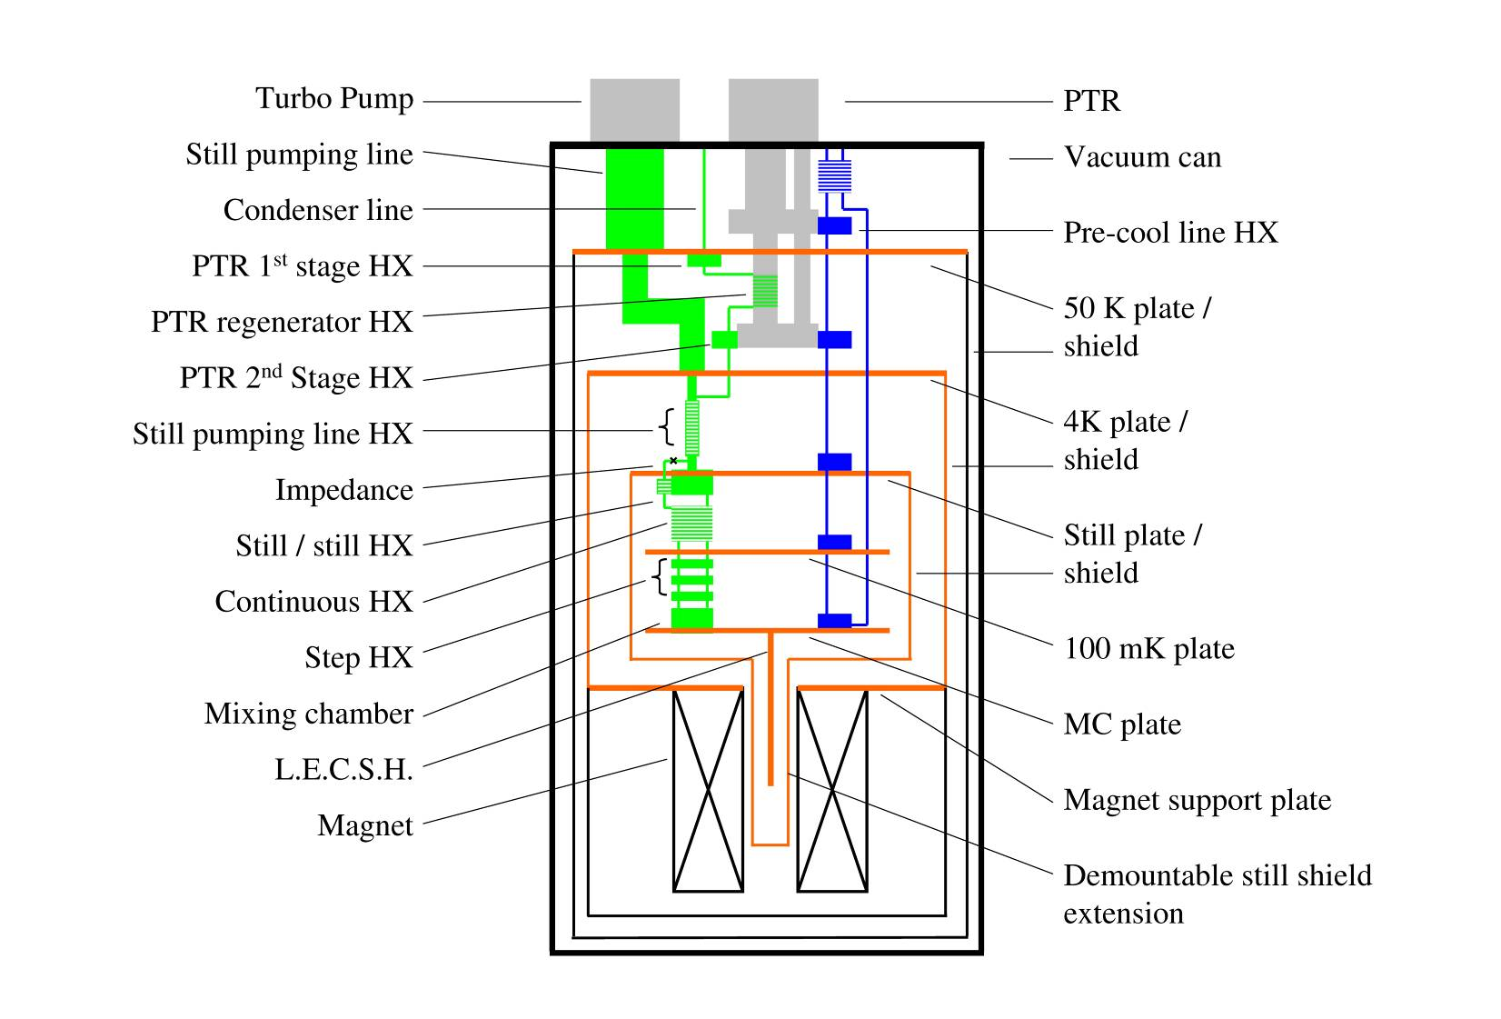
The Dry Dil Fridge concept
Special pre-cool line to cool unit dilution unit to 4K without exchange gas

Slide 31
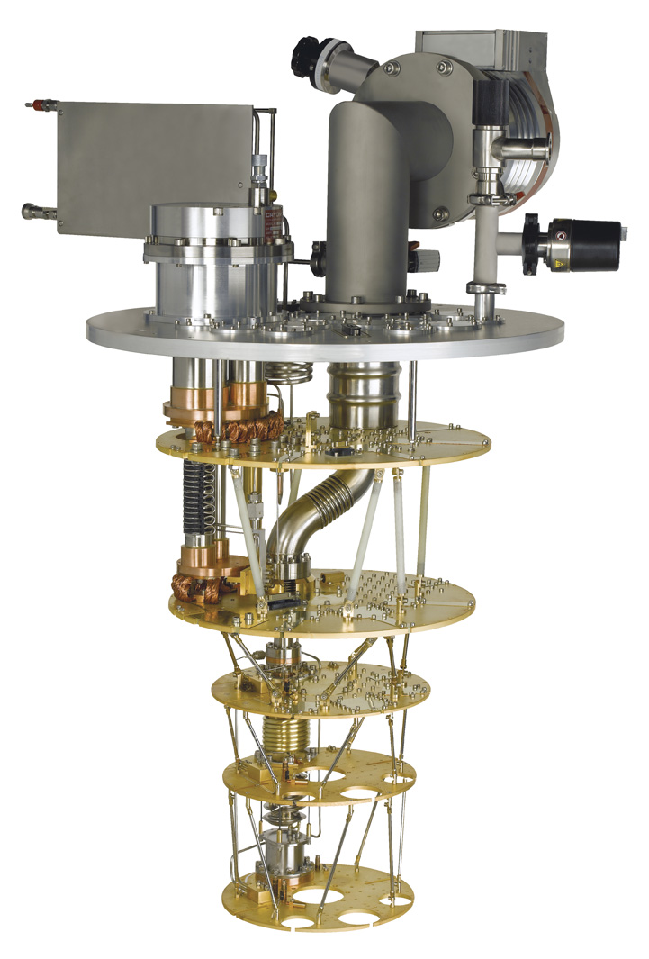
Cryogen-free dilution refrigerators
The Triton cryogen-free
dilution refrigerator
No liquid cryogens
Base temperature <10 mK
Cooling power 400 uW at 100 mK
Temperature control possible > 30 K
240 mm diameter mixing chamber plate
Open structure for easy experimental access
Fully automated cool down from room temperature in < 24 hours
Courtesy: Oxford Instruments

Slide 32
What can possibly go wrong?
1. IVC Leaks through cone seal
Helium is superfluid, ‘tiny’ holes on atomic scale will pass helium & destroy cryostat vacuum
2. Heat Load from radiation or touch
Holes in shields pass 46mW/cm², so holes as small as ~1mm² can impact performance – cover all the radiation holes with Al tape
3. Blockages
Contamination in tubes or air leaks can cause blockages in cold traps
4. Bolted connections/thermal contact
There are lots of bolted connections on ULT systems PTR, shields, mixing chamber ,all need securing.

Slide 33
Useful Books
G.K.White and P.J.Meeson:
  Experimental Techniques in Low Temperature Physics
  (Oxford University Press 2002)
F.Pobell:
  Matter and Methods at Low Temperatures
  (Springer, 1996)
R.C.Richardson and E.N.Smith:
  Experimental Techniques in Condensed Matter Physics at Low Temperatures
  (Addison-Wesley, 1988)
D.S.Betts:
  Refrigeration and Thermometry Below 1 K
  (Sussex University Press, 1976)
O.V.Lounasmaa:
  Experimental Principles and Methods Below 1 K
  (Academic Press, 1974)

Slide 34
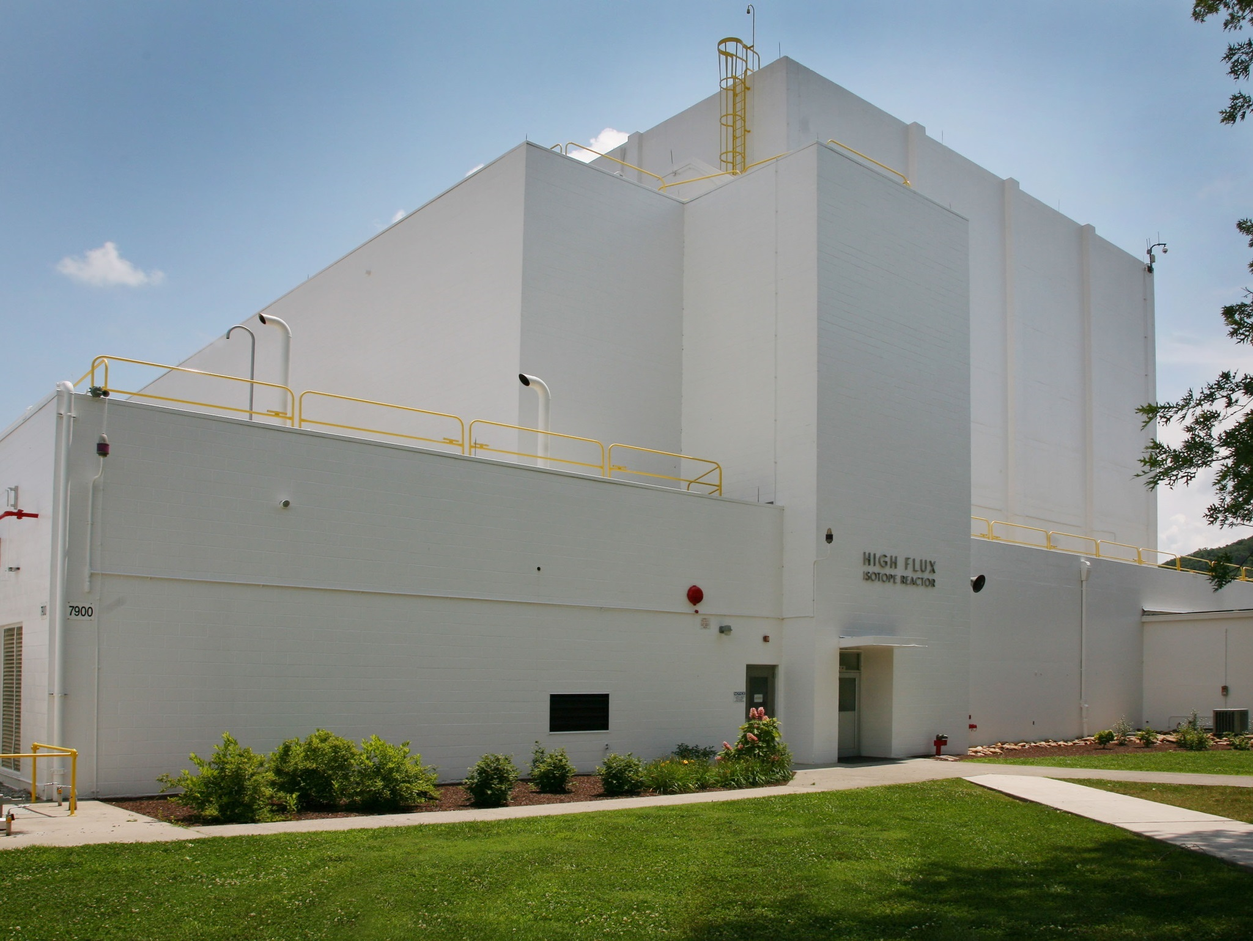
Questions?

