Slide 1
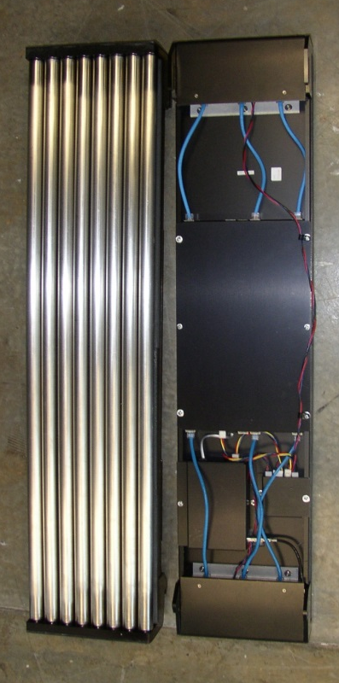
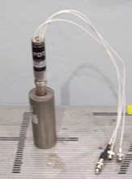
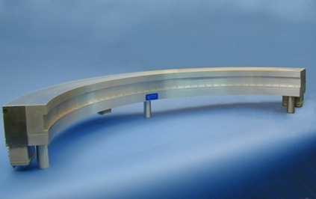
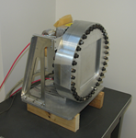
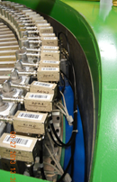
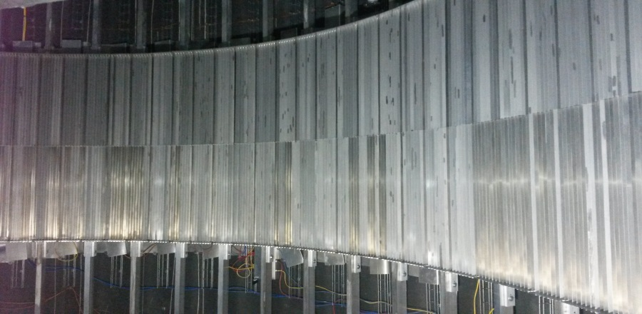
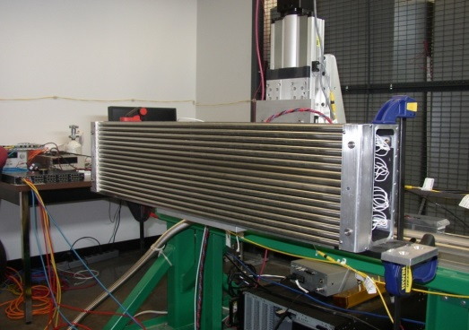
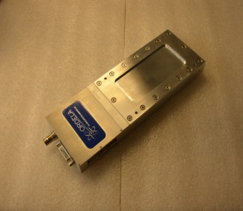
Neutron Lifecycle Series:
Helium-3 Gas Detectors
at the SNS
and HFIR
July 21, 2016
Kevin Berry

Slide 2
At SNS, ~ 2/3 of the operating instruments that the Detector Group supports use ³He detectors

Slide 3
… as well as most of the instruments at HFIR

Slide 4
Single output tubes – used individually or arranged into 1d array

Slide 5
Linear Position Sensitive Detectors (LPSDs) vacuum compatible, typical installations cover large areas (10s of m²) (GE Reuter-Stokes)
1 meter

Slide 6
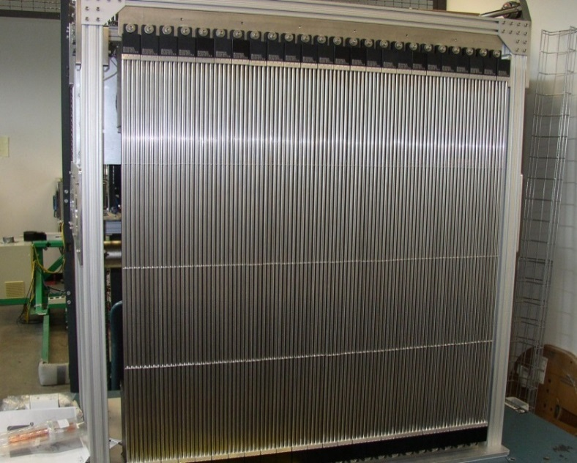
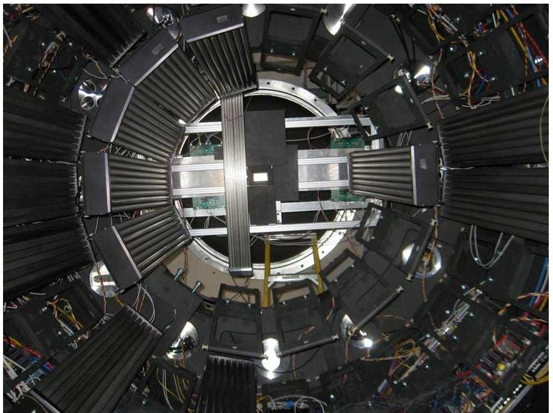
Wide variety of configurations – linear, radial, or curved about horizontal or vertical axis

Slide 7
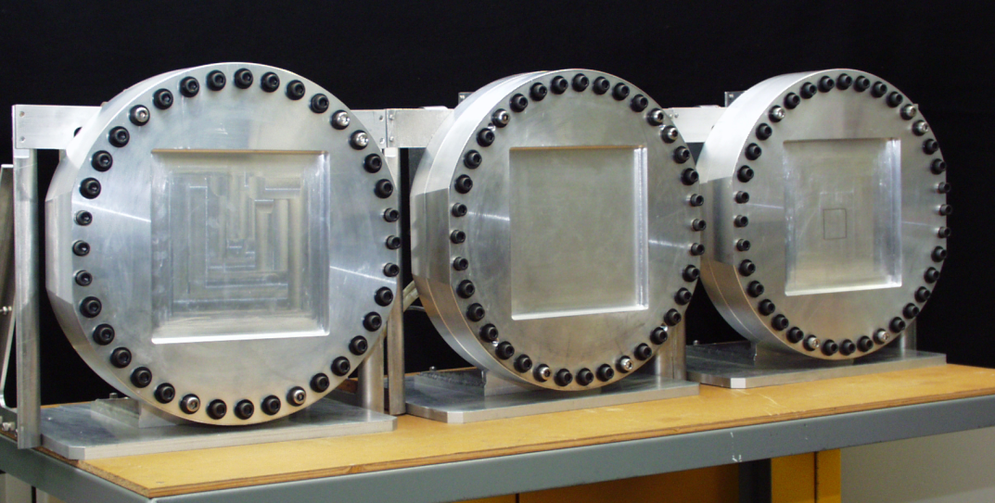
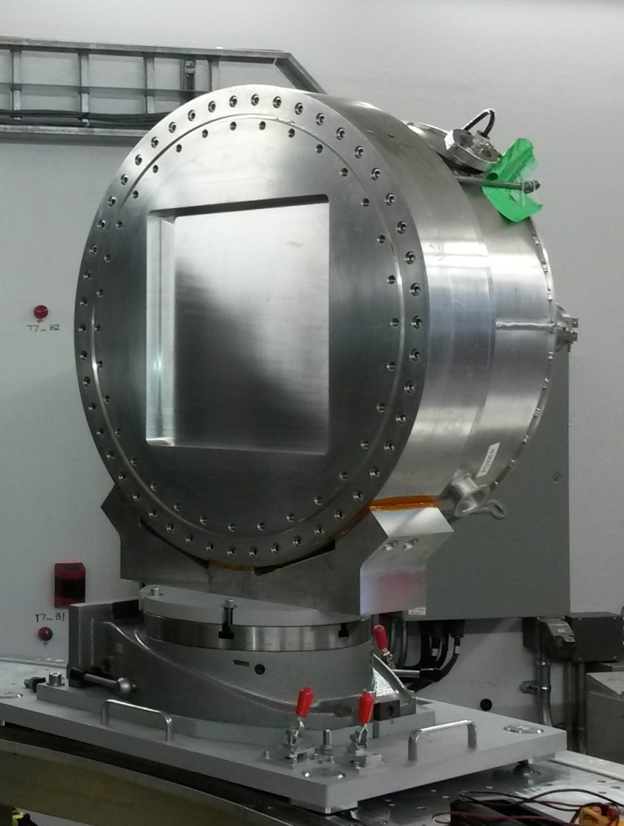
Multi-wire, areal coverage (common gas space)

Slide 8
Brookhaven Multi-Wire Proportional Detector for WAND (HB-2C at HFIR)
120º Curved Multi-Wire Proportional Counter (Brookhaven National Lab)
Currently at PCS Instrument in Los Alamos National Lab, N.M.
Scheduled for delivery to ORNL end of summer

Slide 9
And of course the neutron beam monitors

Slide 10
Helium-3 Detector Deployment at SNS and HFIR
Over 4600 tubes installed at SNS; ~ 600 at HFIR
Active lengths from 10 cm to 200 cm
Tube diameters from 0.8 cm to 5 cm
Four multi-wire area detectors (soon to be 5)
Helium-3 pressures from 4 atm to 30 atm

Slide 11
Why do we need to ‘detect’ neutrons ? Detectors provide us with the information we need to learn about how neutrons interact with our samples What do the detectors actually ‘detect’ ? What we want to know is intensity (relative to the incident beam) as a function of scattering angle 2θ and neutron wavelength λ What detectors measure is neutron interaction location (and at the SNS, time) location x, y, z → θ time t → λ ( v = L / t ; p = mv = h/λ ) The ‘effective’ size of the detection element is important (spatial and temporal measurement uncertainty), need for different detector types, no ‘one size fits all’ How do we ‘detect’ neutrons ?

Slide 12
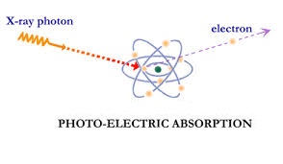
How do we detect neutrons?
A neutron must interact with matter in a such a way that it gives some indication of its presence
With zero net electrical charge, interaction with atomic electrons is not possible (as in X-ray, gamma, electron detectors)
Instead we must rely on the only interaction available to us –
a nuclear reaction with an atomic nucleus
³H (Tritium)
n ³He p

Slide 13
What materials can we use for neutron detection ?
It turns out there are only a few isotopes for which the neutron has a high probability of interaction with the atomic nucleus, and can be considered candidates for practical thermal neutron detectors

Slide 14
Relative Cross Sectional Areas (at 1.8 Å)
Cross section has units of area [barns]
It can be thought of as the effective size of the target nucleus
1 barn
diameter ~ 11 fm
1 barn = 10⁻²⁸ m² = 10⁻²⁴ cm² = 10² fm²
(1 fm = 10⁻¹⁵ m)

Slide 15
Important Nuclear Reactions for Neutron Detection
In addition to having a high absorption cross section (probability), the nuclear reaction must produce charged daughter products which can then be detected by more conventional detection technologies
n + ³He → ³H + ¹H + 0.764 MeV
n + ⁶Li → ⁴He + ³H + 4.79 MeV
n + ¹⁰B → ⁷Li + ⁴He + 0.48 MeV γ-ray + 2.3 MeV (93%)
→ ⁷Li + ⁴He + 2.8 MeV ( 7%)
Note the Q values - thermal neutron kinetic energy (10s of meV) cannot be directly measured

Slide 16
Helium-3
Natural abundance 0.000137%
By-product of radioactive decay of tritium (nuclear weapons program)
³H → ³He + e + v_{e} T_{1/2} = 12.3 y
U.S. mass production of tritium ceased in the mid 1990’s (weapons reduction)
U.S. demand increased after Sept 11, 2001 (portal monitors, border security)
In 2008 a critical shortage of helium-3 in the U.S. was realized (supply << demand)
Efforts to develop alternate detector technologies for large area coverage
Straw Tube detectors, Multi-blade detectors (¹⁰B)
BF₃ commonly used as neutron gas detector prior to the widespread availability of He-3
but BF₃ is a toxic, corrosive gas (He-3 is inert)
nevertheless, some facilities have recently revisited BF₃ due to the He-3 shortage

Slide 17
The n-³He reaction: n + ³He → ³H + p + 764 keV
Momentum Conservation – trajectories antiparallel
Energy Conservation – KE split inversely proportional to mass (3:1)
proton kinetic energy = 573 keV
triton kinetic energy = 191 keV
Reaction products lose energy
through interactions with gas atoms
(excitation and ionization)
Average energy per pair W ~ 30 eV
~ 25,000 electron-ion pairs (4 fC)
W > IP (ionization potential)

Slide 18
Proton Range in 1 bar He-3 ~ 5-6 cm
Proton range inversely proportional to pressure – i.e. range ≈ 5-6 mm in 10 bar He-3

Slide 19
Detector Fill Gases: Stopping and Quench
Stopping gases are added to reduce size of charge cloud
Ar, C₃H₈, CF₄ in common use
In addition, polyatomic gases needed for photon quenching
UV/Vis photons emitted via excitation interactions, must be absorbed to prevent secondary ionization elsewhere in tube
Polyatomic gases de-excite non-radiatively (rot, vib modes)
C₃H₈, CF₄, CO₂ in common use
stopping gas can also act as the quench gas
No electronegative gases
propane plus 6 atm He-3

Slide 20
The Helium-3 Gas Proportional Detector
Positive HV on wire, E field falls off as 1/r (strong near wire)
Electrons drift in toward wire (anode), ions drift out toward grounded tube wall (cathode), but at velocities ~ 1000 times slower
Current pulse is measured, proportional to charge collected on wire (Shockley-Ramo theorem)
4 fC is impractical, need gas gain to amplify charge signal

Slide 21
Electric Field and Gas Gain
In large E fields, electrons can attain sufficient KE between collisions to ionize a neutral gas atom, producing an electron-ion pair, process creates an avalanche of charge
(Townsend discharge)
Monte Carlo simulation
Matoba, et al.
IEEE Trans Nuc Sci, Vol. NS-32, No. 1, 1985

Slide 22
Gas Gain
Diethorn Model
ln|G| = (V ln|2|/∆V ln|b/a|) [ ln{V/pa ln|b/a|} - ln |K| ]
Gain approximately exponential
with voltage G ~ e^{V}
Factors include:
applied voltage V
anode and cathode radii a and b
gas pressure p
gas specific parameters ∆V , E_{C}/p
∆V = potential difference between ionizing collisions
E_{C} = critical electric field for gas multiplication
Plot Courtesy of GE Reuter-Stokes
Gas gain of LPSDs typically a few hundred (charge ~ 1 pC)

Slide 23
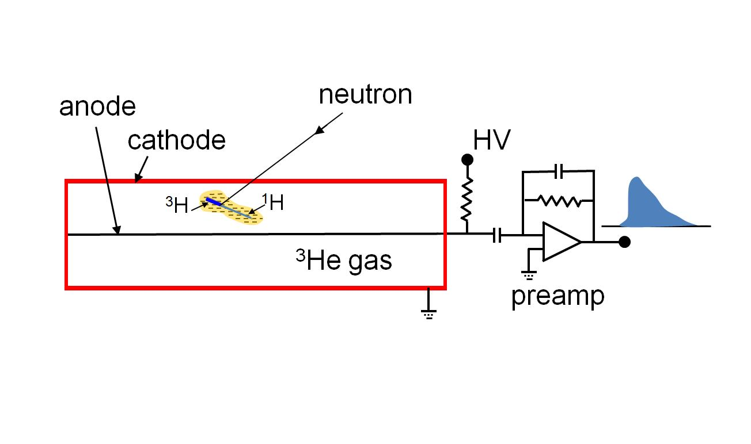
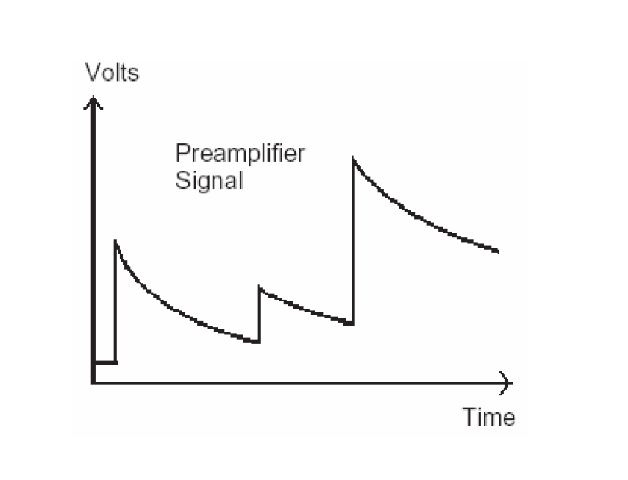
Preamplifier signal current in → voltage pulse out

Slide 24
Differential Pulse Height Distribution and the “Wall” Effect
For interactions which occur near the tube wall, either the proton or the triton can reach the wall before giving up all of its energy to the gas.
The result is less than the full amount of charge collected on the wire.

Slide 25
Discriminator
Circuit which passes all signal above an (adjustable) threshold voltage, and rejects everything below it
Some circuits contain both upper and lower discriminators, and pass only what falls between

Slide 26
Wall Effect and Discriminator Setting
Typically set discriminator just below the low energy neutron shelf to reject counts due to gammas and electronic noise
Wall effect more pronounced in small diameter (larger surface to volume) or high pressure detectors (short attenuation length)

Slide 27
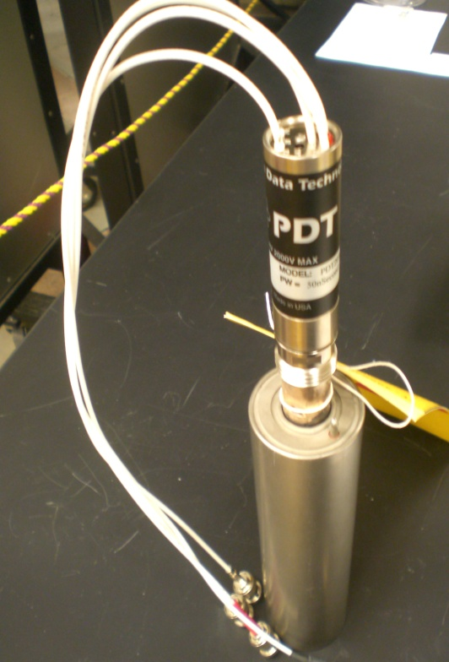
Single Ended Tubes – Triple Axis and Powder Diffractometer (HFIR)
Charge sensitive preamplifier plus voltage discriminator
High voltage applied to anode wire
All pulses with voltage above discriminator level are counted as neutrons
No positional information
other than event occurred somewhere inside the tube
essentially a counter

Slide 28
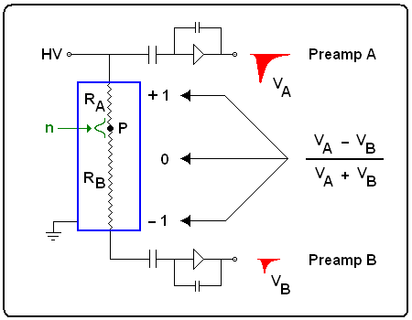
Linear Position Sensitive Detectors (LPSDs) and Resistive Charge Division
Modular Assembly “8 packs”
Resistive anode (few 1000 ohms)
Anode at HV (1.5 - 2 kV typ)
Preamplifier at each end of tube
Current divides according to resistance it sees to preamps
Current from both preamps is measured, compared
Mathematical expression
(A – B)/(A + B)
determines interaction location

Slide 29
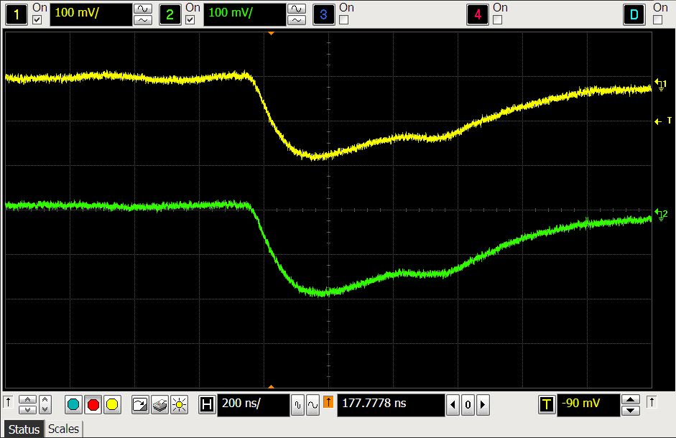
Wide Range of Pulse Shapes are possible …
Pulses at right are from interaction near tube end
Pulses below are from interaction near tube center

Slide 30
Neutron detection response along the anode wire

Slide 31
Area Detectors – BNL MWPC, WAND
Multi-Wire Proportional Counter
(Brookhaven National Laboratory)
WAND Detector
(Ordela, Inc)

Slide 32
Multi-Wire Proportional Counters from BNL (SNS Reflectometers)
These detectors date back to the 80’s, and still are in service!
20 cm x 20 cm active area
1.5 cm gas depth (³He + C₃H₈)
X and Y orthogonal cathodes with anode between at + high voltage
Charge at anode induces signal on cathodes
Preamps every 7th wire (1.1 cm)
Resistive charge division between each pair of nodes (preamps)
Low noise, low gas gain (~ 25)
1.5 mm spatial resolution (x and y)
Recirculating gas pump and filter
4 μs dead time per pulse
Interpolation based on signals from three wires
(C – A) / (A + B + C)

Slide 33
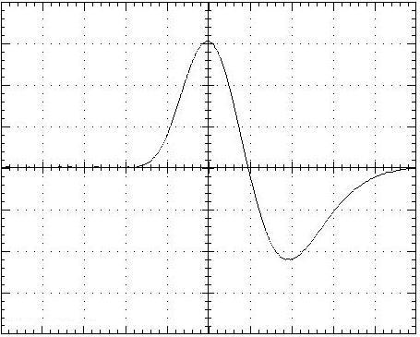
PSDs with Rise Time Encoding (HFIR Neutron Residual Stress Mapping Facility)
10 cm long x 5 cm wide active area
2 cm active depth
³He + CF₄ at 6.9 atm to give
efficiency > 65% at 2 Å
Entrance window 2.5 mm 6061 Al
Anode and Cathode wire planes
RC or “rise time” encoding
(Borkowski-Kopp)
Two preamps – one at each end of cathode
Bipolar shaping of signal pulses
Difference in zero-level crossover times is linearly proportional to neutron position
Ordela model 1155N PSD
Bipolar Pulse

Slide 34
Neutron Beam Monitors (Ordela)
Low gain (~ 7) gas proportional detector
Two or four anode wires
Low efficiency (10⁻³ - 10⁻⁵ typ)
³He or ¹⁴N conversion gas
(¹⁴N cross section ~ 1.9 barns)
Note: beam monitor gas is essentially non-attenuating, but the wall thickness is 2 mm 6061 aluminum x 2 = 4 mm per monitor
attenuation ~ 1% per mm (for 1Å)

Slide 35
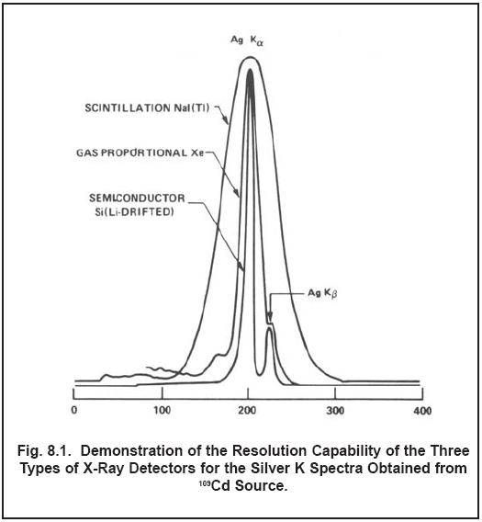
What properties are important in the selection of a neutron detector ? … some or all depending on the instrument
Resolution is the ability to distinguish between two closely spaced events (in space, time, energy)
Spatial Resolution
Timing Resolution
Detection Efficiency
Count Rate Capability/Dynamic Range
Gamma Efficiency/Discrimination
Cost/Areal Coverage
Long Term Reliability/Maintainability
Borrowing an Example from X-Ray Spectroscopy
Courtesy Philip G. Burkhalter and William J. Campbell
U.S. Bureau of Mines, College Park, Maryland

Slide 36
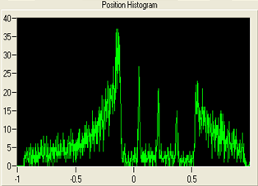
Slit Mask to Measure Spatial Resolution
Three Slits in Neutron Shielding Mask (BAL)
Detector Response Through Three Slit Mask

Slide 37
Timing Resolution and Parallax
Finite detector depth d contributes to uncertainty in measurement of detection time
Parallax contributes to spatial (and to lesser extent) temporal uncertainty
d
Δx
n
Worst Case Δt ~ d / v_{n}
n
θ
At the SNS, neutron events are time stamped to a precision of 100 ns
But what is the uncertainty in this measurement (for 1.8 Å neutrons, v_{n} ~ 2 mm/μs)

Slide 38
Neutron Detection Efficiency
efficiency = 1 – exp(- npσd)
Plots below for gas depth d = 1 cm
p = 20 atm
n = number density
= 2.7 x 10¹⁹ /cm³-atm
p = gas pressure [atm]
σ(λ) = cross section [cm²]
(function of λ)
d = gas depth [cm]
p = 10 atm
p = 5 atm
For beam monitors, efficiency ≈ npσd

Slide 39
Gamma Efficiency
Gamma rays interact with matter primarily through
Photoelectric
Compton
Pair Production (>1.02 MeV)
Strong dependence on Z
Combine this with low number density of gases ~ 10¹⁹ - 10²⁰
Helium-3 detectors have low gamma efficiencies
(typically < 10⁻⁶)

Slide 40
Lifetime and Aging
Formation of polymers which deposit on wires
hot spots or dead areas
Polymerization depends on gas purity and composition, also count rate
Question –
How long will it take to use up the helium-3 in a typical gas detector
Answer –
Assume 10⁴ n/s per cm³ x π x 10⁷ s/yr
10 atm = 3 x 10²⁰ gas atoms per cm³
So, would deplete ~ 1 in 1,000,000
He-3 atoms in 1000 years !
Images courtesy of
P. Krizan, Ionization Counters

Slide 41
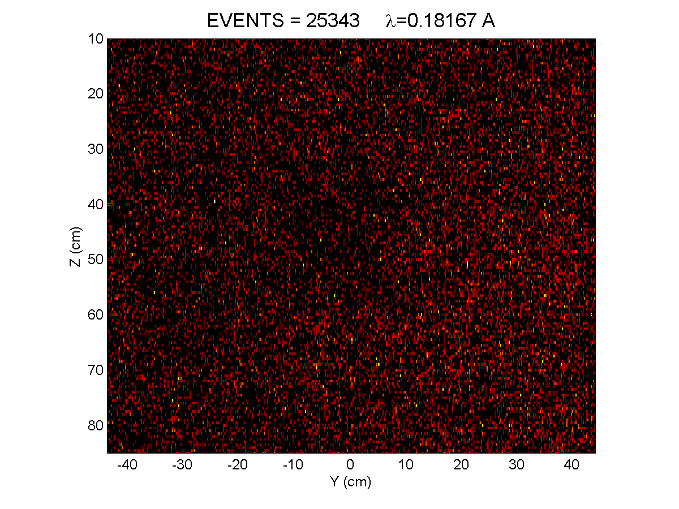

Slide 42
Thank You for Your Time and Attention
Acknowledgements:
Jack Carpenter
Lee Robertson
Kent Crawford
Ron Cooper
Yacouba Diawara

