Slide 1
Reduction and Analysis of Neutron Data
G. E. Granroth
Scientific Data Analysis Group Lead
Neutron Data Analysis and Visualization Division

Slide 2
Examples of Analysis and Reduction
Overview
Early Days at ORNL
An example of magnetic excitations in Gd
  Studying this magnet as
    Instruments change, data sizes increase, and analysis methods change
Novel Processing – Event based Reduction
  Continuous T scans
  Pulsed Magnet
Complex analysis
  Moving from simple fitting to more complex models to computing intensive codes
    Ab-initio

Slide 3
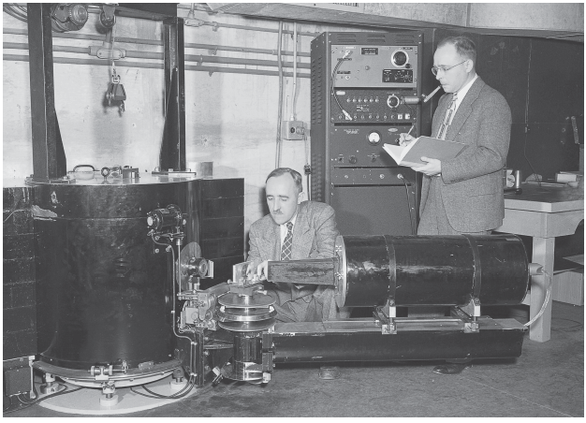
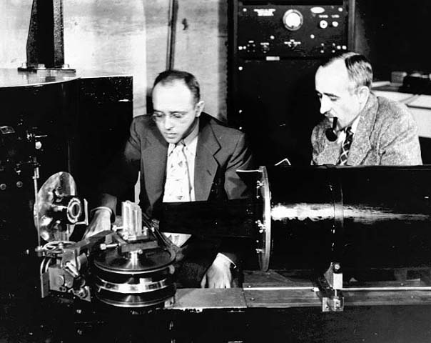
Wollan teams with Shull
In the early days counts were fastidiously recorded in a notebook.
Shull and Wollan at the Graphite reactor
1994 Nobel Prize

Slide 4
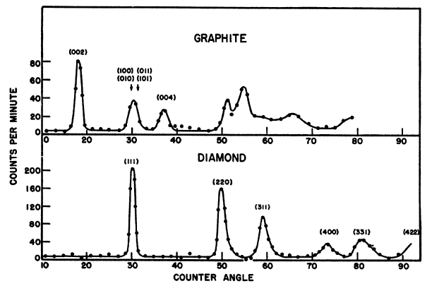

First neutron powder diffraction
Pioneered by Wollan and Shull in the late 1940’s.
Monochromatic
$$λ=2d\sin{θ}$$
E. O. Wollan and C. G. Shull, The diffraction of neutrons by crystalline powders, Phys. Rev. 73, 830-841 (1948).

Slide 5
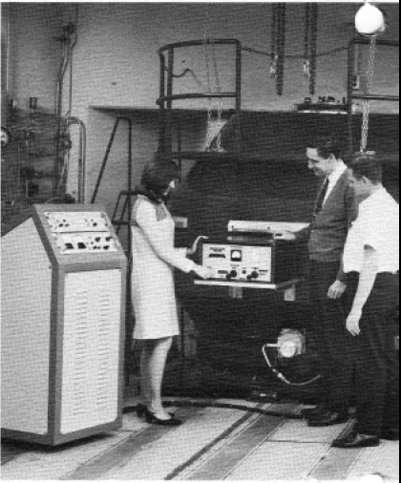
Computer controlled acquisition
Increased Flux (New high flux reactor)
More efficient detectors
Sharron King (left), adjusting the rf spin reversal circuit with Ralph Moon (middle), and Jim Sellers.
Notes:
Sharron King Took care of the Reduction and Analysis resources for HFIR until ~ 2000

Slide 6
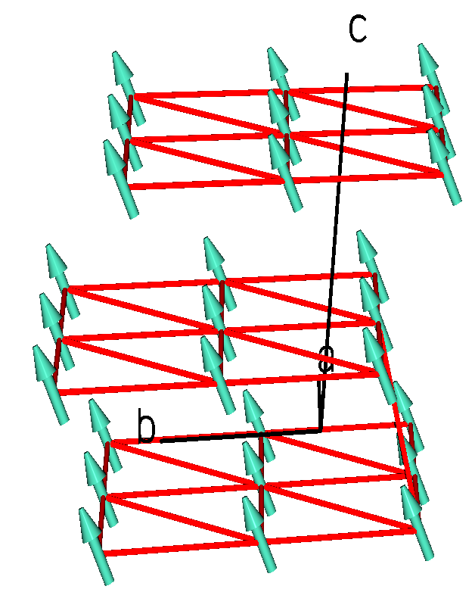
Gd
  Study Spin waves to understand interactions
    Conduction electrons mediate exchange
Sample
  “Textbook” HCP localized Ferromagnet?
  7.6μ_{B} moment
  Hexagonal lattice a=b=3.643, c=5.781
  μ canted ~ 30º from c
    PR 165, 733 (1968); PRB 5, 997 (1972)

Slide 7
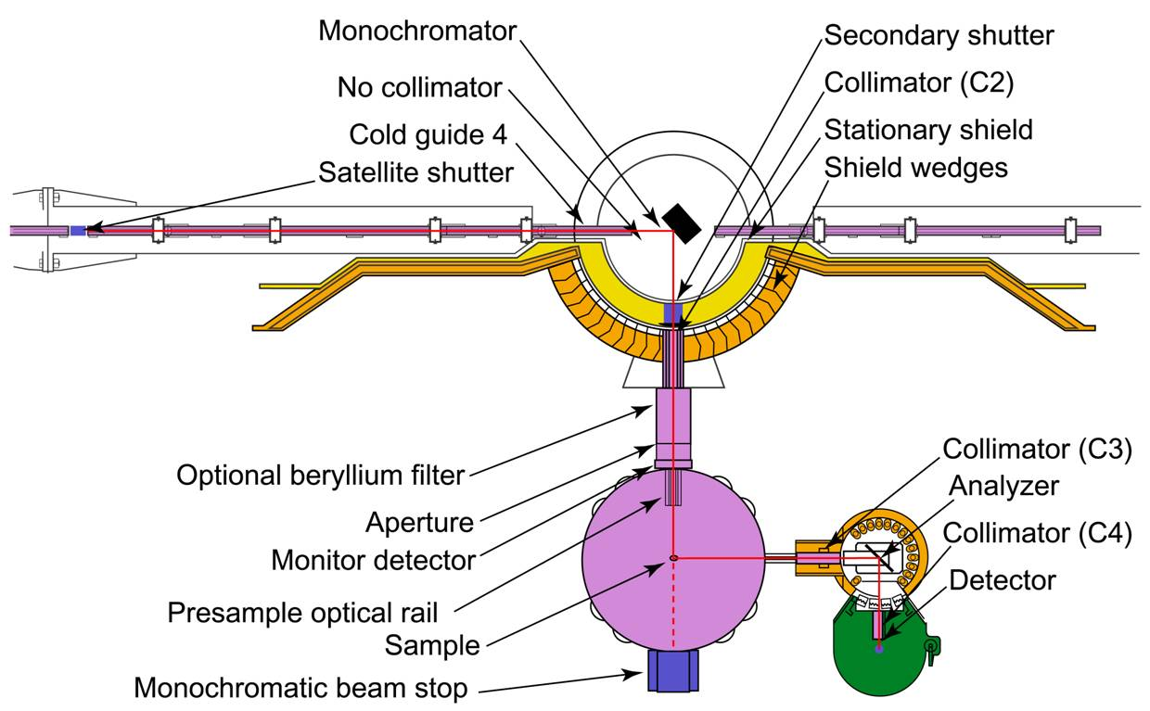
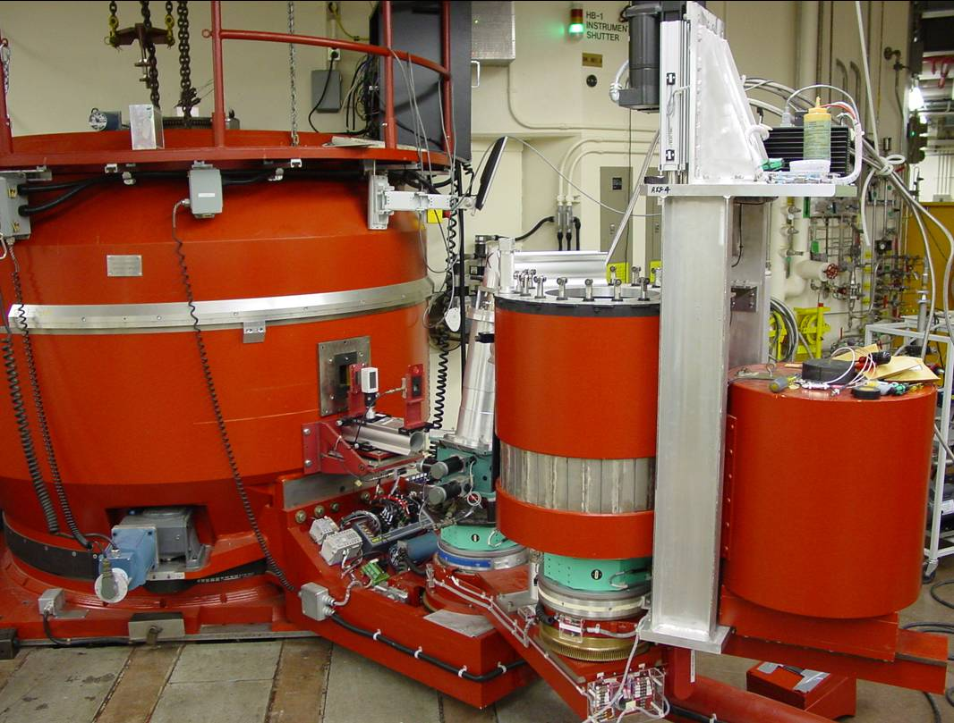
Triple axis is useful for measuring spin waves
Monochromator crystal (axis 1) selects a narrow incident energy wavelength distribution
Analyzer crystal (axis 3) selects a narrow final energy distribution
Axis 2 selects orientation of sample
Straight forward to perform scans in E at constant Q or vice versa

Slide 8
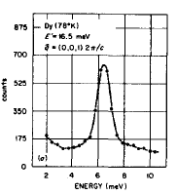
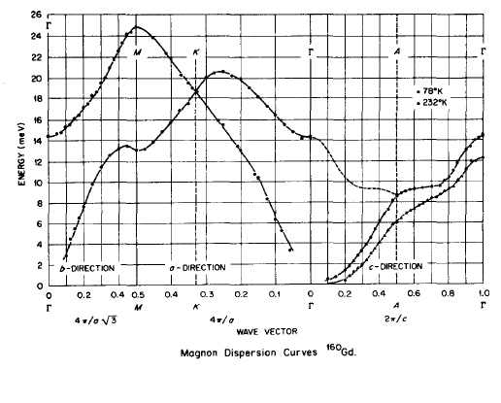
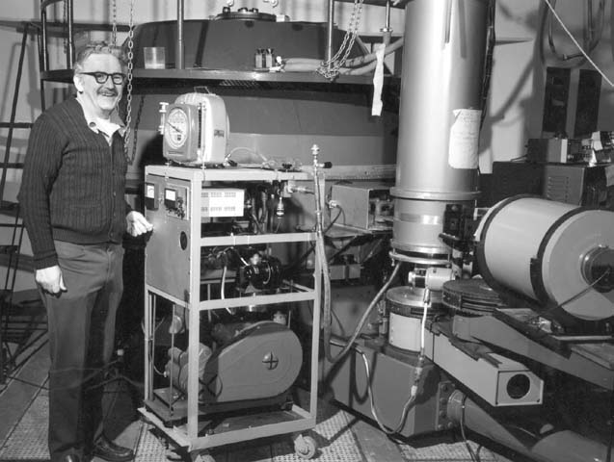
Mapping the Dispersion
Take a series of constant Q scans
  Along high symmetry directions
Fit the peak of each scan
Plot the peak position vs. Q
Koehler et al. PRL 24, 16 (1970).

Slide 9
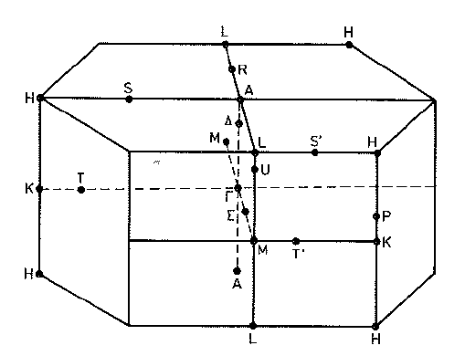
Data Analyzed
Used Multiple exchange parameters to characterize RKKY interaction
Γ 0,0,0 ; K ⅓,⅓,0; M ½,0,0; A 0,0,½
P. Lindgård PRB 17, 2348(1978)

Slide 10
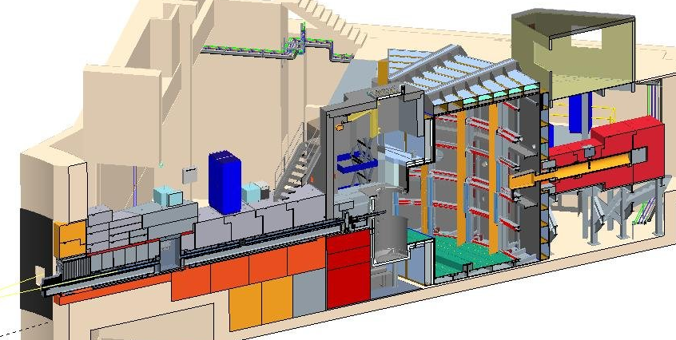
SEQUOIA – highly pixelated array
Enclosure
Detector Vessel
Sample Equipment Lift
Poly External Shielding
Incident Beamline
Vacuum
Crane
Control Cabin
T₀ Chopper
DAS System
Monitor
Steel Shielding
Beam Stop
Get Lost Tube
Beam Stop Support Frame
detectors
Detector Frame
Internal Shielding
Guide
Fermi Choppers
Monitor
Sample Vessel and
Vacuum Isolation Valve
Concrete Shielding
G. E. Granroth et al. Physica B 385-386, 1104 (2006). J. Phys.: Conf. Ser. 251, 012058 (2010).

Slide 11
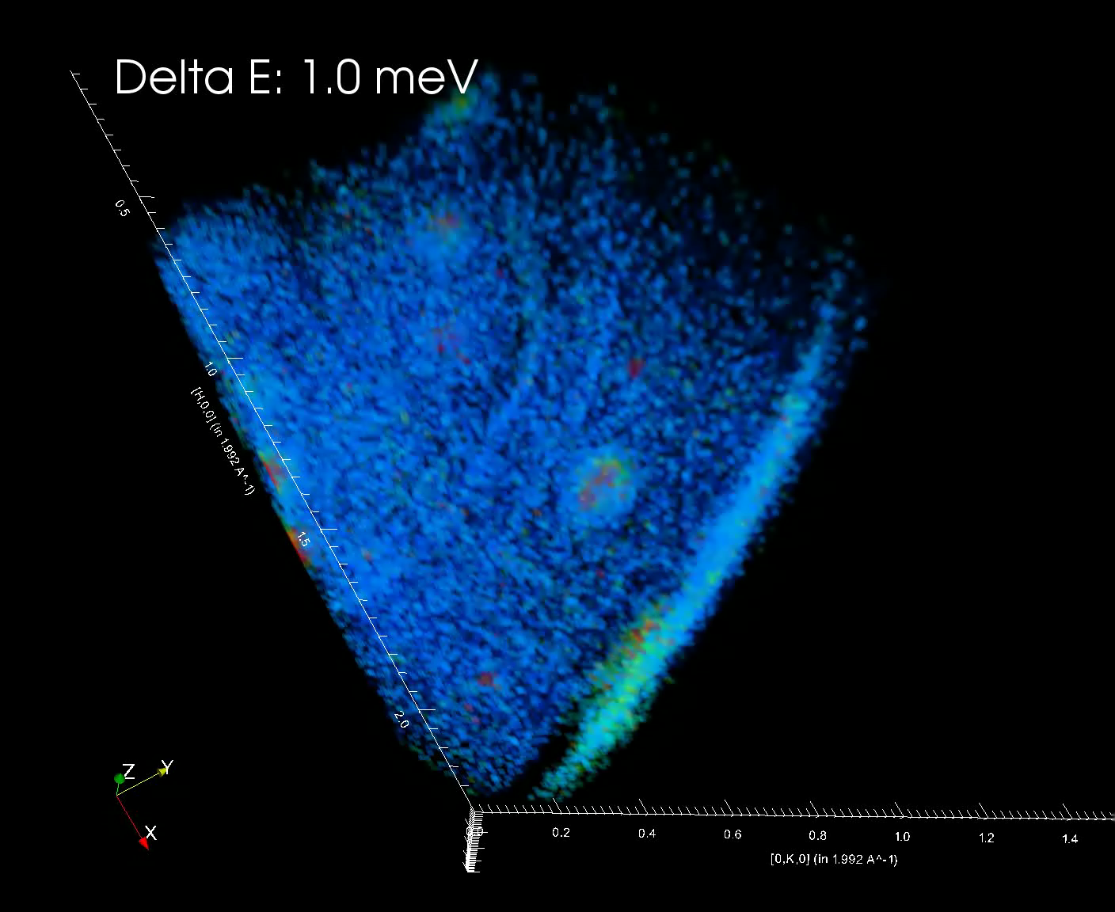
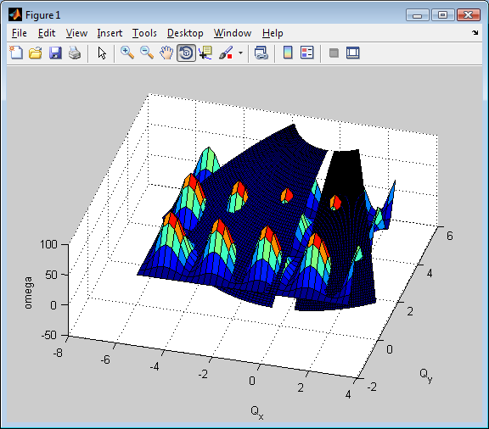
Volumes of Data collected overnight
Take a series of constant E slices
Each orientation adds a new one.

Slide 12
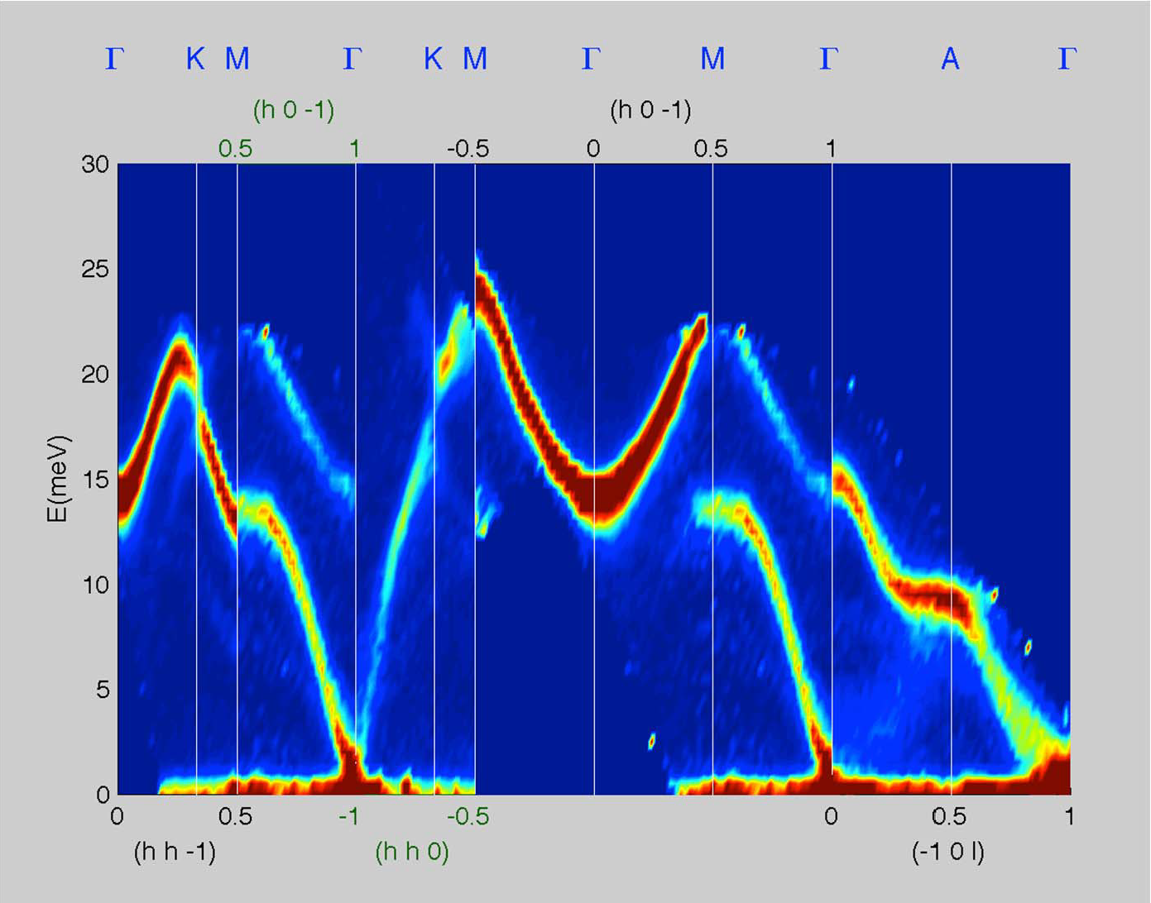
Data reduced in similar way
Cutting volume data
Also lots of intensity information
Provides details of itinerant compontent

Slide 13
More Modern Analysis
Modeled with Spin W

Slide 14
Event Data Processing
Neutrons are recorded on an event by event basis
  A list of pixel positions and time of detection
  Can do
    Continuously changing parameters such as
      Temperature
      Sample rotation
      Battery charge
      Gas loading
      AC electric field
    Time synchronized collection like pulsed magnet
  For details of the algorithms for event data see
    P. F. Peterson et al. NIMA 803, 24 (2015)

Slide 15
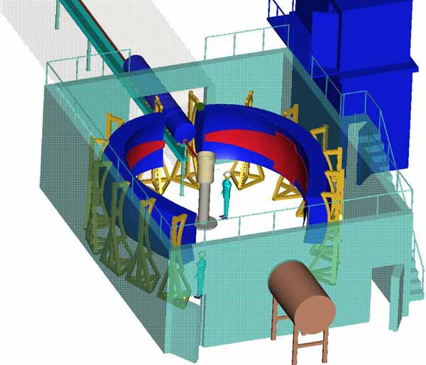

POWGen
Powder diffractometer
Fixed detector array
Tof encoded wavelength
Data typically displayed in d
$$λ=2d\sin{θ}$$

Slide 16
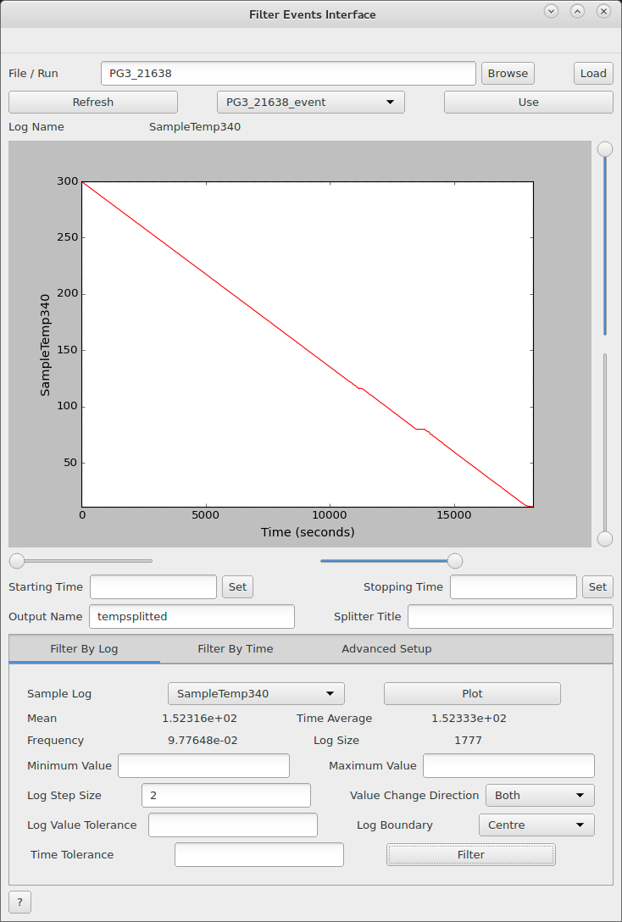
Powder Diffraction – Event Filtering
Routine for continuous T scans
  Scan pauses when beam down
Interface for facilitating filtering
Notes:
Utilizes MD workspaces.

Slide 17
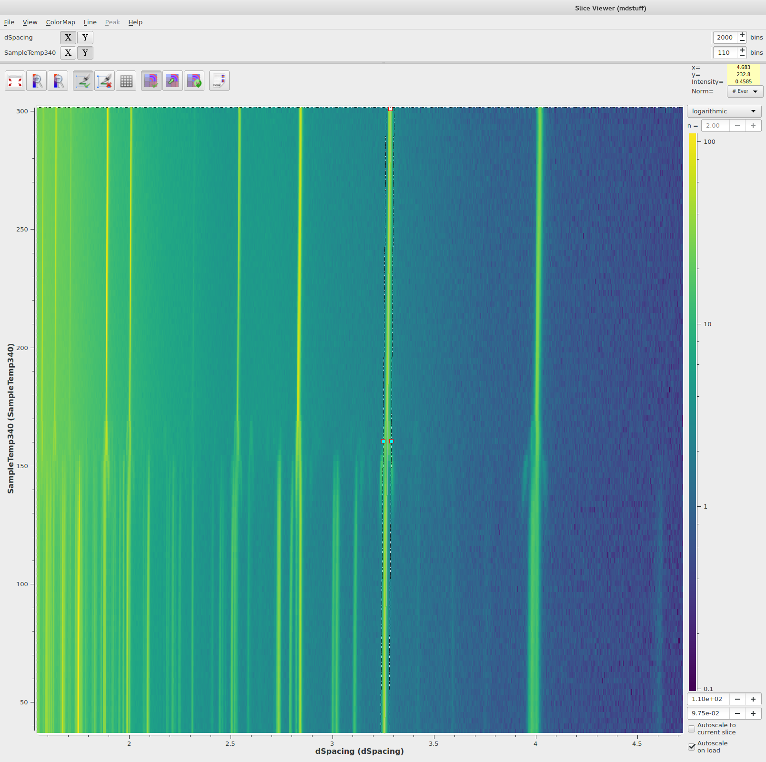
Working with Event filtered data
Split into as many T bins as one wants in this case every 5 degrees
Plot as another dimension

Slide 18
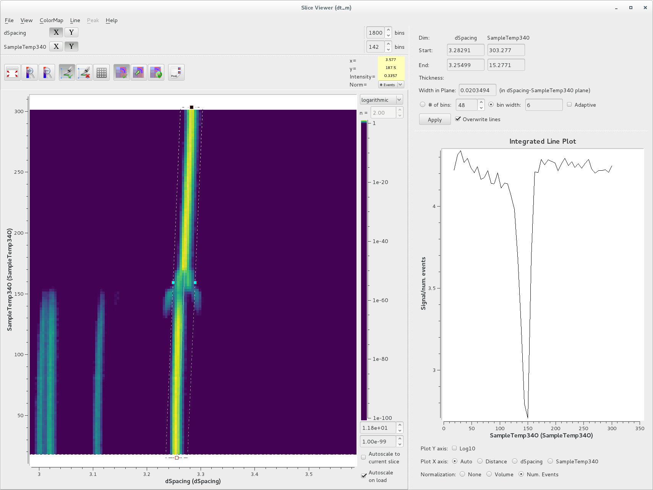
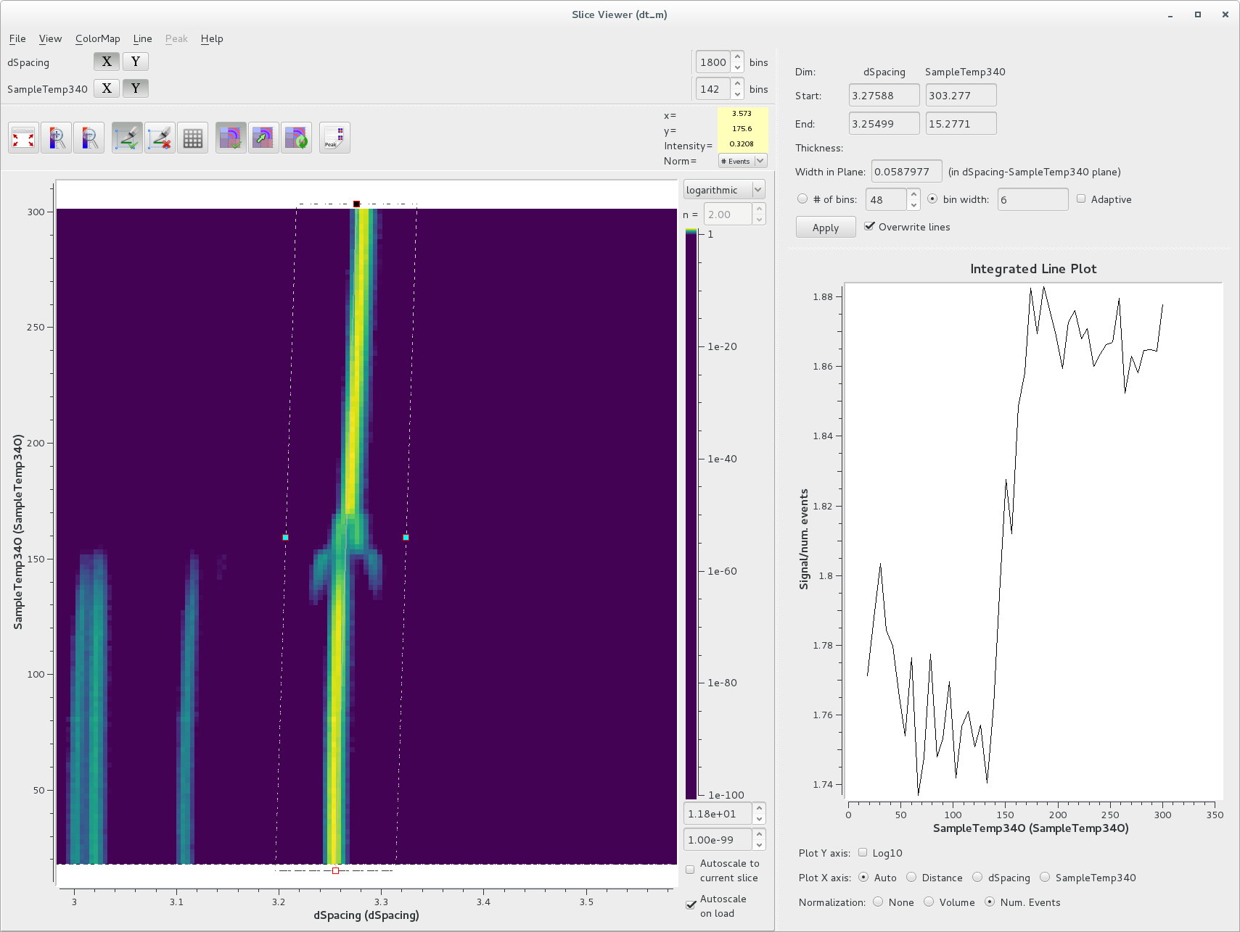
Slice viewer for MultiDimensional data sets
Allows one to produce cut that takes into account lattice dimension change
Helps with identifying phase transitions

Slide 19
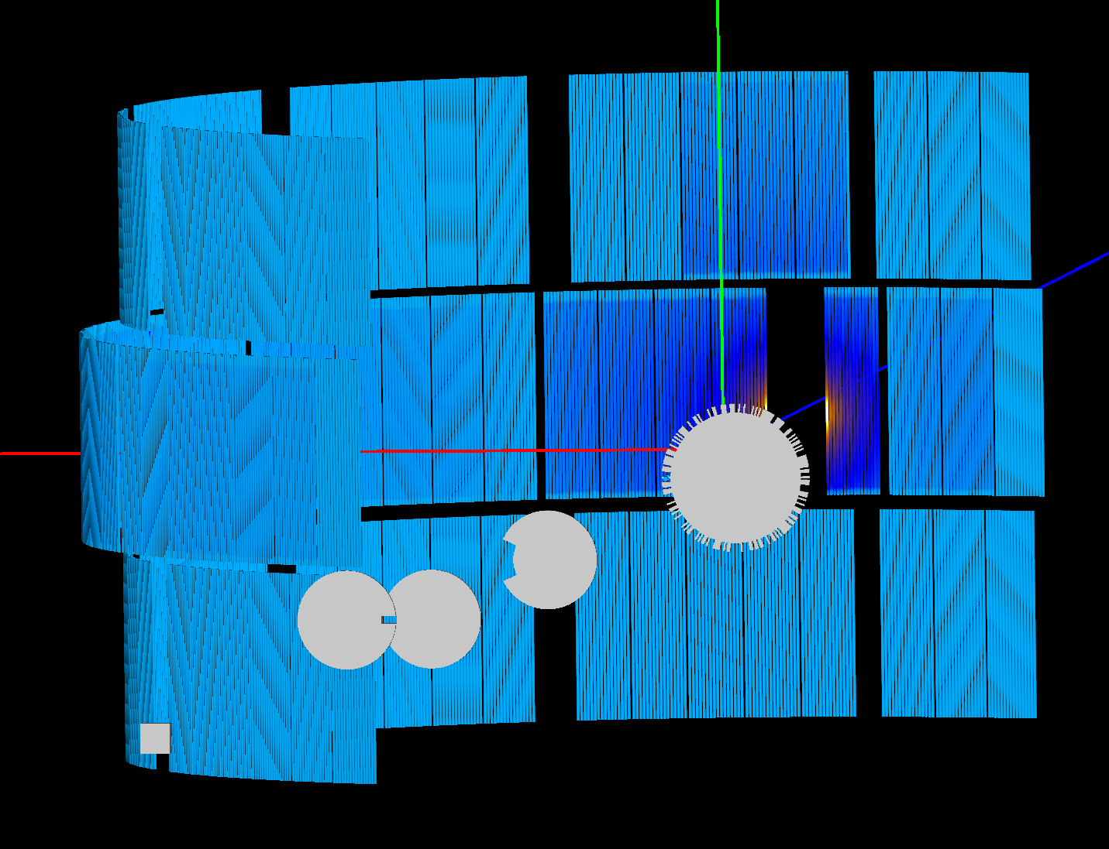

Corelli
Single Crystal diffractometer
Designed for diffuse scattering
Can discriminate elastic and inelastic scattering truly elastic scattering
Also has low angle bank, ideal for magnetic scattering
Fixed detector array
$$λ=2d\sin{θ}$$

Slide 20
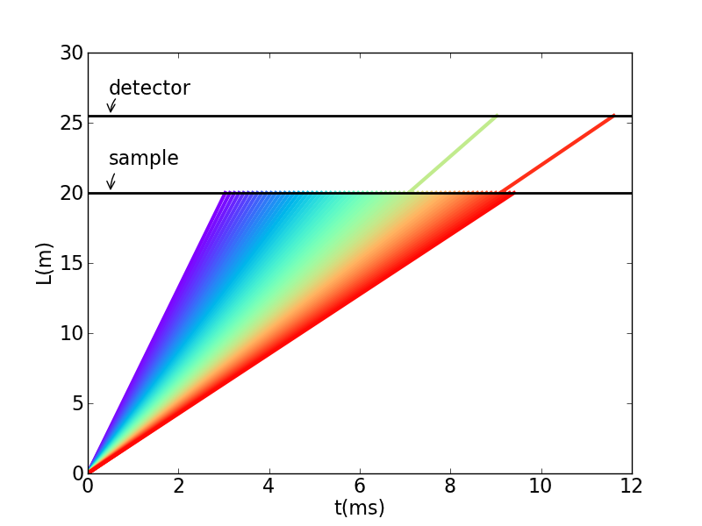
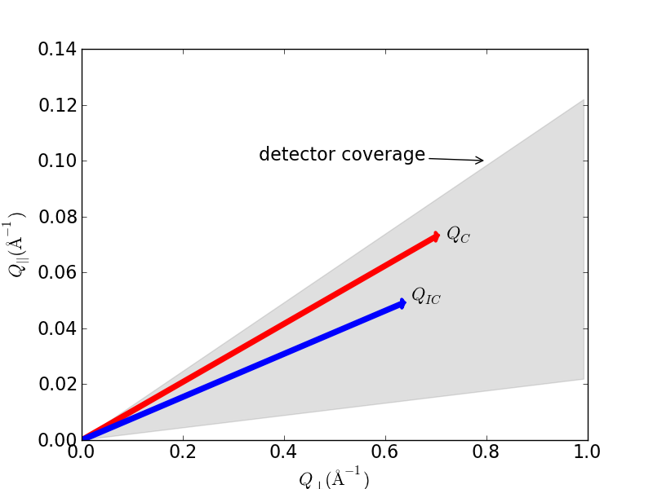

TOF Neutron Diffraction
wavelength is encoded in TOF
Fixed detector array
Laue pattern; but TOF allows identification of individual peaks
Means multiple Bragg reflections for a single orientation
$$λ=2d\sin{θ}$$

Slide 21
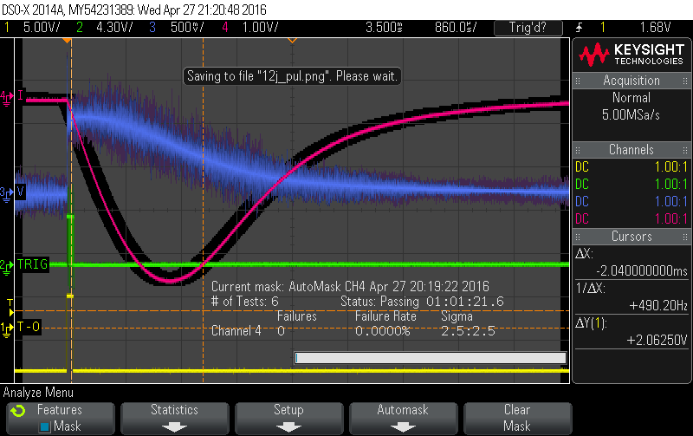
Interface to pulsed magnet
Send trigger based on when proton hits the target.
Use offset to set field at a given wavelength

Slide 22
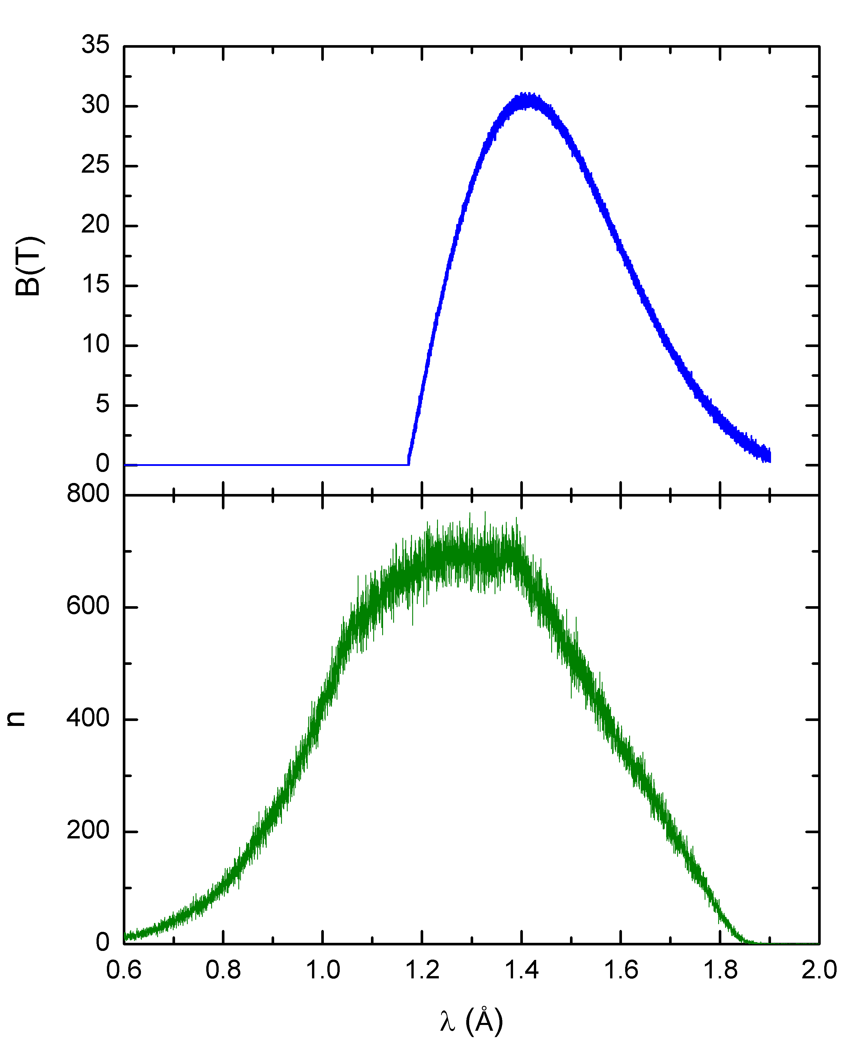
TOF neutrons + pulsed magnet
Independently vary field and wavelength band as a function of time

Slide 23
Adding additional filters
Filter out temperature excursions too, multiple filters can be applied

Slide 24
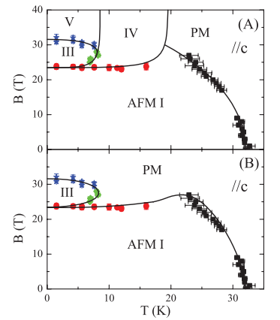
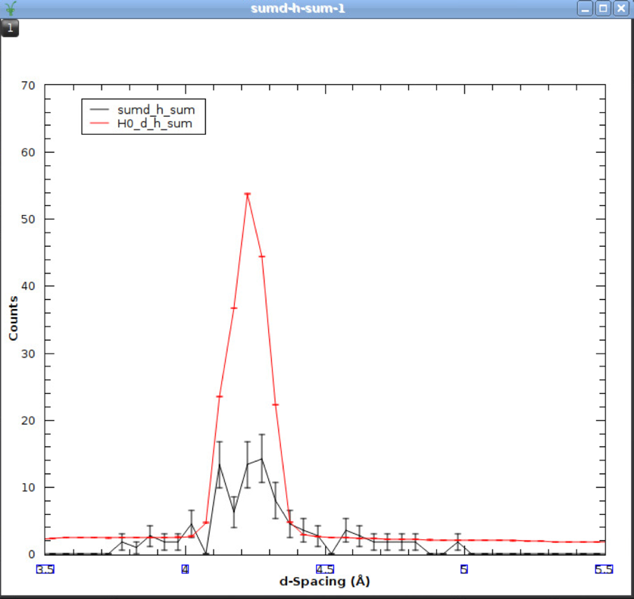
UPt₂Si₂
Field dependence of 1 0 0 peek consistent with the PM phase
T=14K
D. Schulze Grachtrup et al. PRB 85, 054410 (2012)

Slide 25
Vision
Inverse Geometry
  Crystal analyzers select a specific final energy
  Initial energy is determined by TOF
  Focuses large scattering volume onto a few detectors

Slide 26
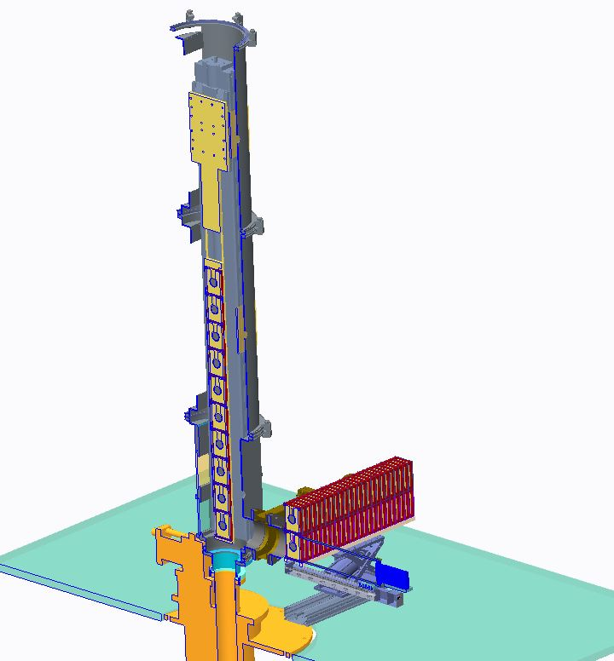
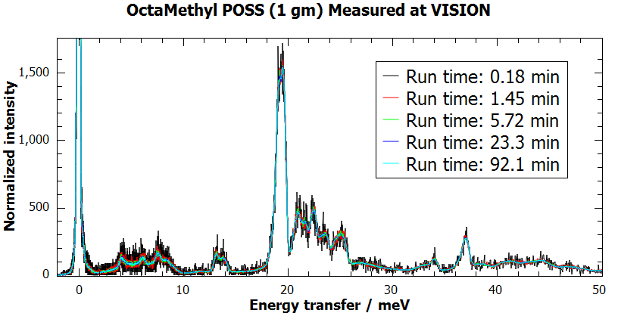
VISION: world’s first high-throughput inelastic neutron scattering instrument
4000 x TOSCA at ISIS, 1 TB of data/day
INS measurement in a few minutes to a few hours
Sample changer is being designed and will be ready by 2016
Expecting tens of samples a day to be analyzed
DFT modeling of INS spectra is essential in data analysis and interpretation
Major challenges in computation
Dedicated computer cluster required

Slide 27
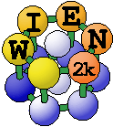

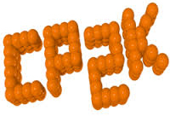


Density Functional Theory
Assumes only valence electrons are relevant
uses effective wave functions to describe bonding
Works on each atom in a unit cell
Thus determines (without fitting)
  Structure
  Electronic structure
  Lattice vibrations
  Well suited to molecular vibrations
Many packages
Require a lot of computing resources
Walter Kohn
Nobel Prize Chemistry 1998

Slide 28
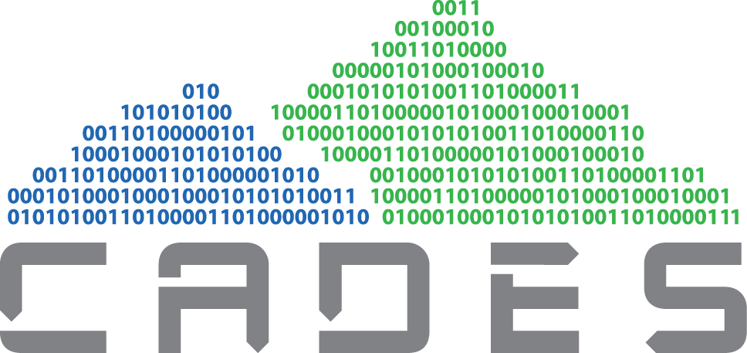
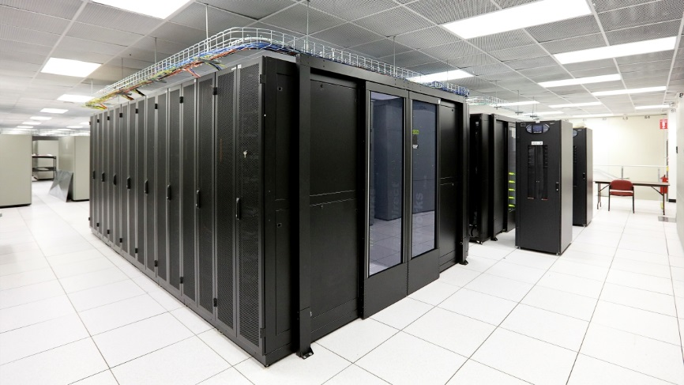
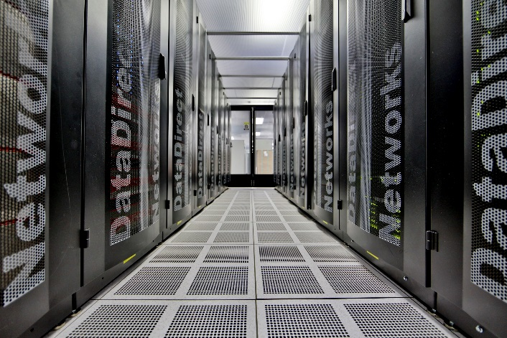
VirtuES Cluster – Hardware Specs
Dual 16 core Intel Haswell E5-2698v3 2.3 GHz Processors per node
50 compute nodes
1,600 (non-hyperthreaded) cores
128 GB memory/node
6.4 TB Total memory
Each node has 10Gbe and Infiniband networking for connectivity.
Installed as part of the ORNL Compute and Data Environment for Science (CADES)

Slide 29
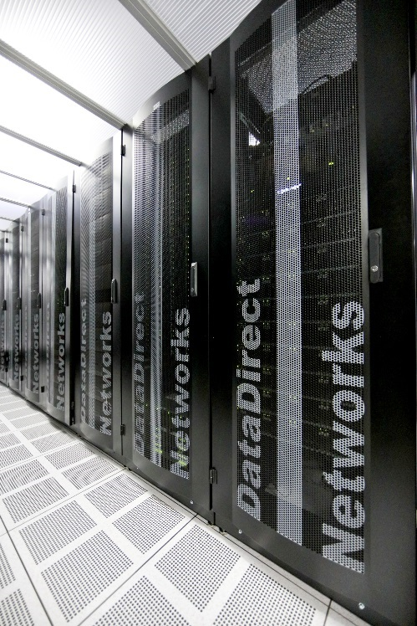
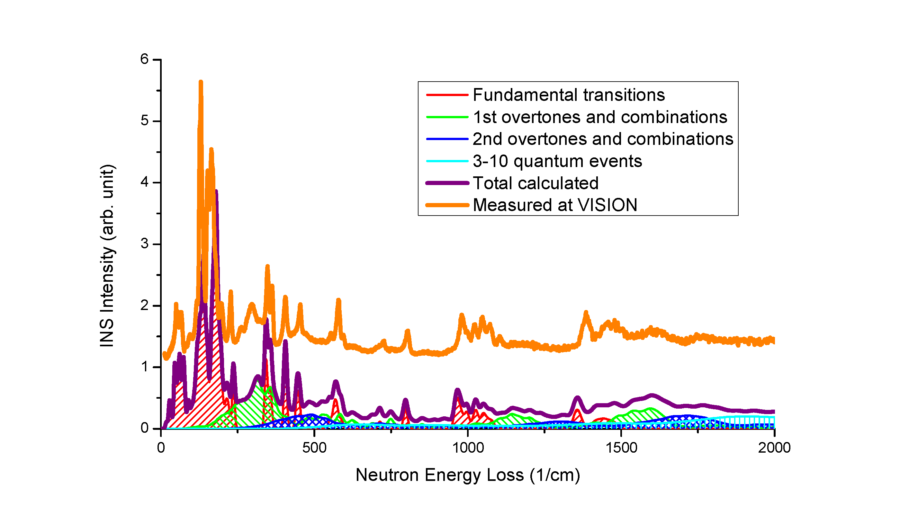
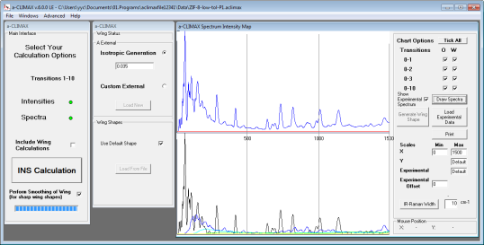
Integrated modeling for Vision
Computer modeling is crucial to understand and interpret INS data.
CASTEP
VASP
Quantum Espresso
Gaussian
Vibrational modes and frequencies
INS simulation (aClimax)
Simulated INS spectra
Measured INS spectra
Sample
VISION
Data reduction and analysis (Mantid)
Measured diffraction
Structure-dynamics correlation
Understanding mechanisms and properties at atomic level
Peak assignment
(An)harmonicity
Mapping out the local potential energy profile using finite displacement, frozen phonon, molecular dynamics
Phase transition
Revealing the kinetics and the transition pathway

Slide 30
Summary
Gd
  Can now map volumes of excitations (~30GB of data)
  Volumes reveal information about symmetry
  Tools like Spin W or Spinwave Genie make spin wave calculations common place
  Similar changes have been seen for other techniques, e.g. diffuse scattering
Event based data enables new types of experiments
Integration of ab initio codes and HPC is enabling more science

Slide 31
Acknowledgements
NDAV members
  Jean Bilheux
  Jose Borreguero
  Stuart Campbell
  Mathieu Doucet
  Steve Hahn
  Ricardo Leal
  Jiao Lin
  Vickie Lynch
  Daniel Olds (Joint with CEMD)
  Peter Peterson
  Andrei Savici
  Ross Whitfield
  Wenduo Zho
  Steve Hartman
  Greg Guyotte
  Matt Pearson
  Vlad Sedov
DuPont
  Mike Crawford
Tohoku University
  Hiroyuki Nojiri
ORNL – CEMD
  Luke Daemen
  YQ Cheng
  Ashfia Huq
  Timmy Ramirez-Cuesta
  Pam Whitfield
ORNL – QCMD
  Adam Aczel
  Jaime Fernandez-Baca
  Masa Matsuda
  Steve Nagler
  Feng Ye
  Jooseop Lee
ORNL – ISD
  Matt Rucker
  John Wenzel
  Andrei Parizzi
  Harley Skorpenske

Slide 33
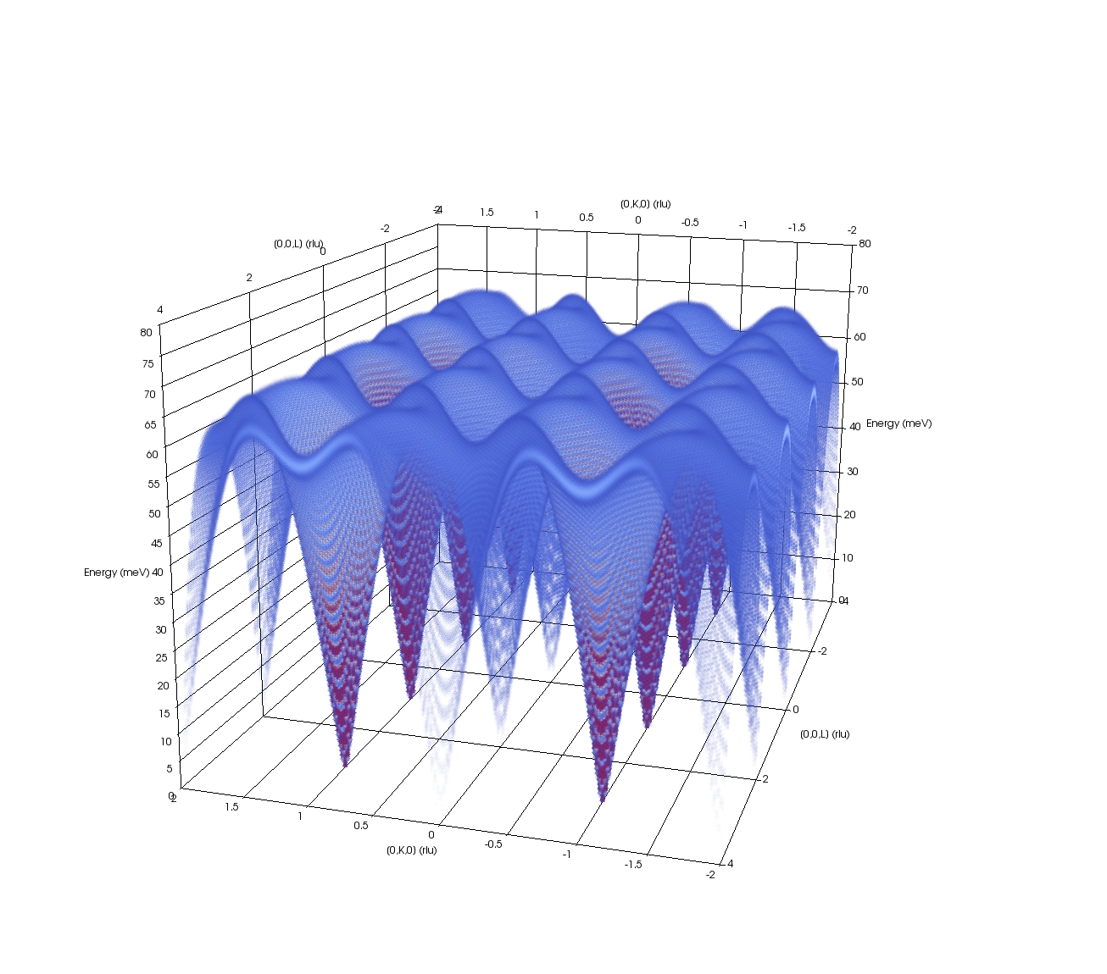
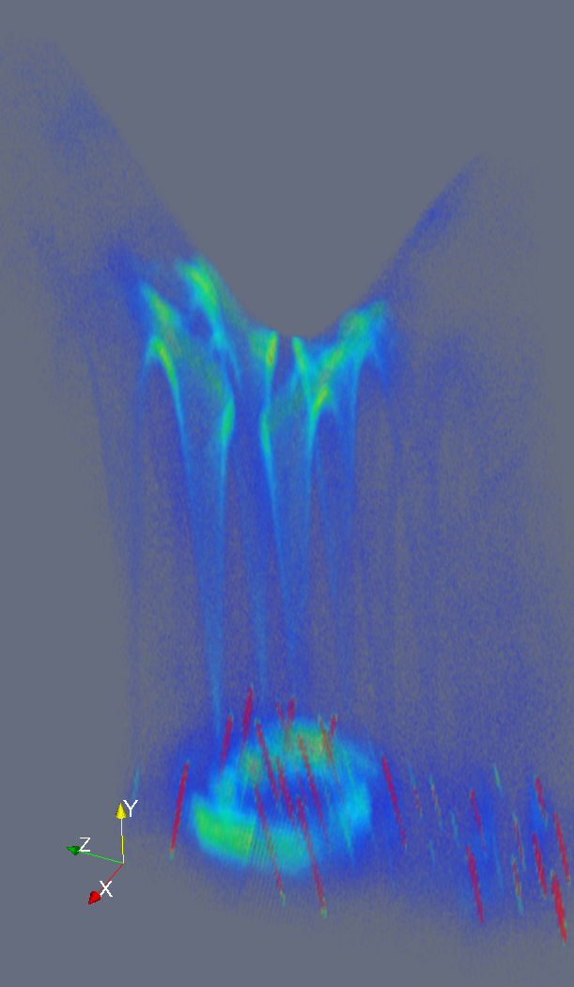
YFeO₃ a more complex system
Many exchange terms
Viewed with Mantid/Paraview
Modeled with Spin Wave Genie
S. E. Hahn et al. PRB 89, 014420 (2014)

Slide 34
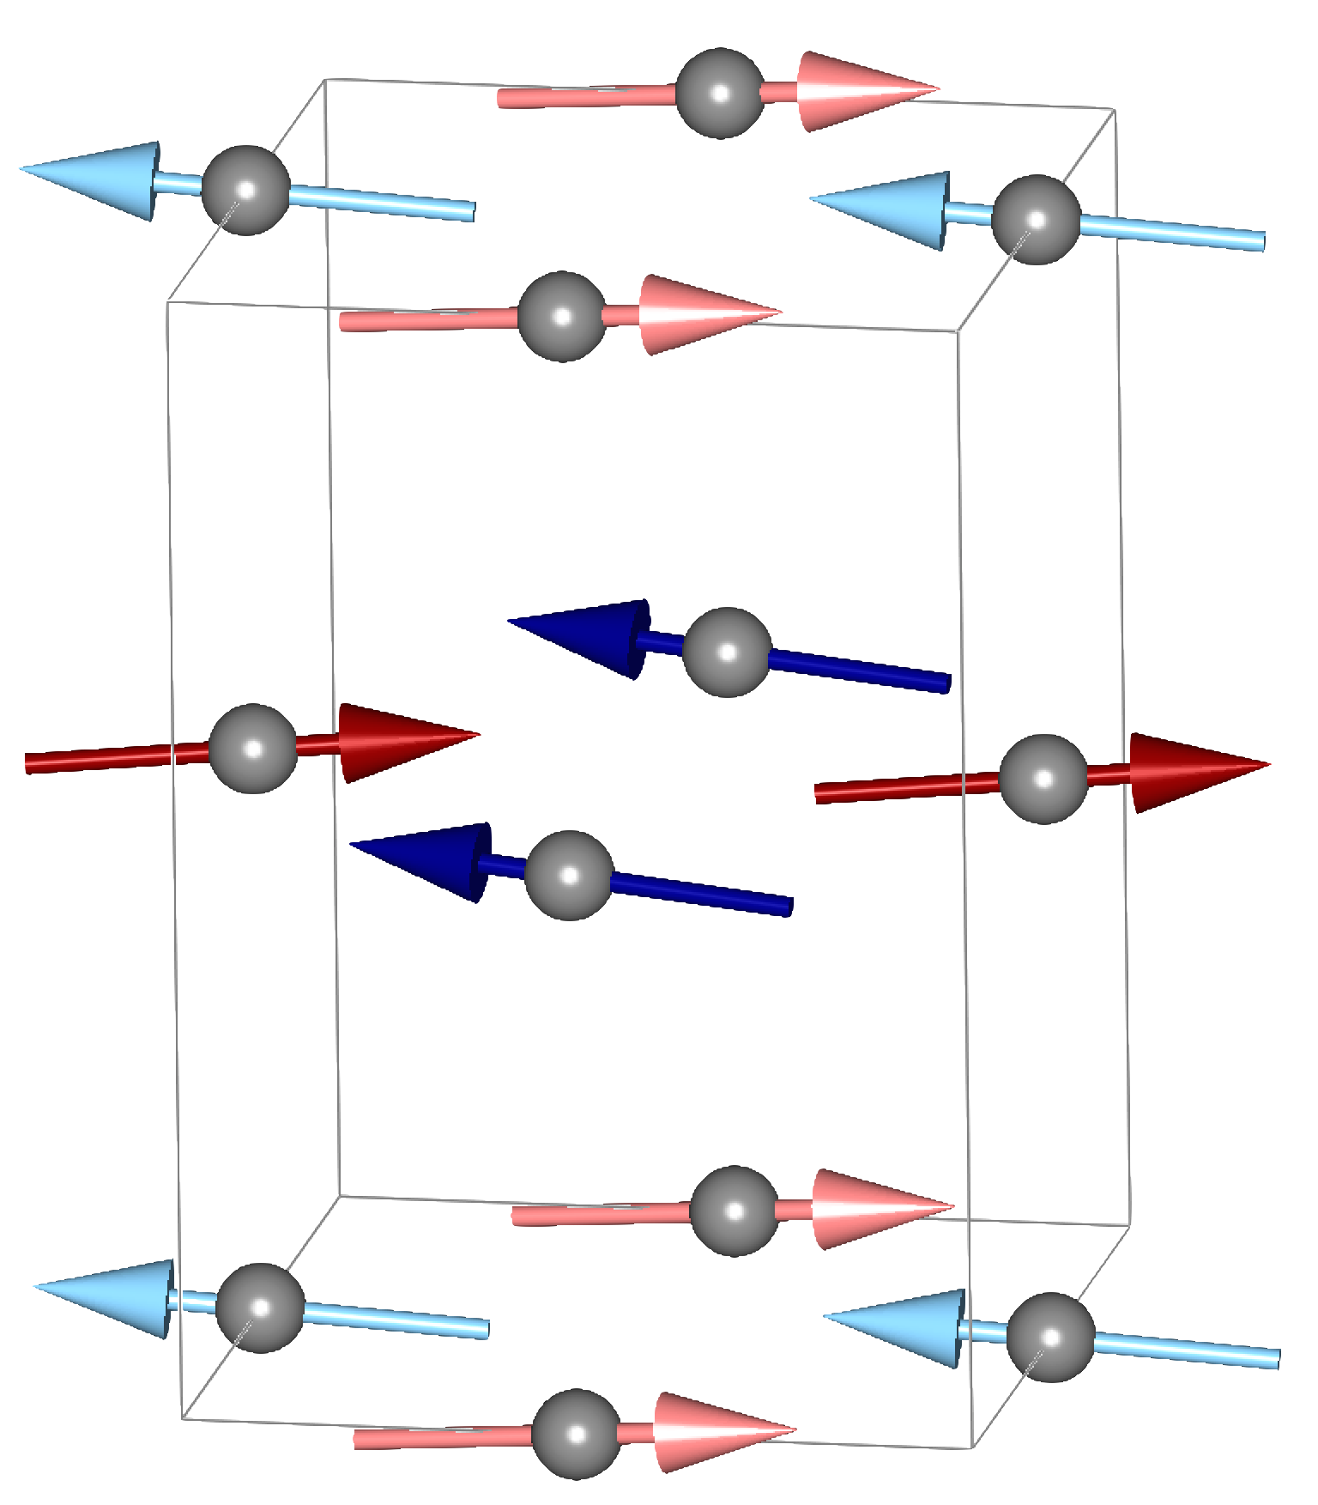
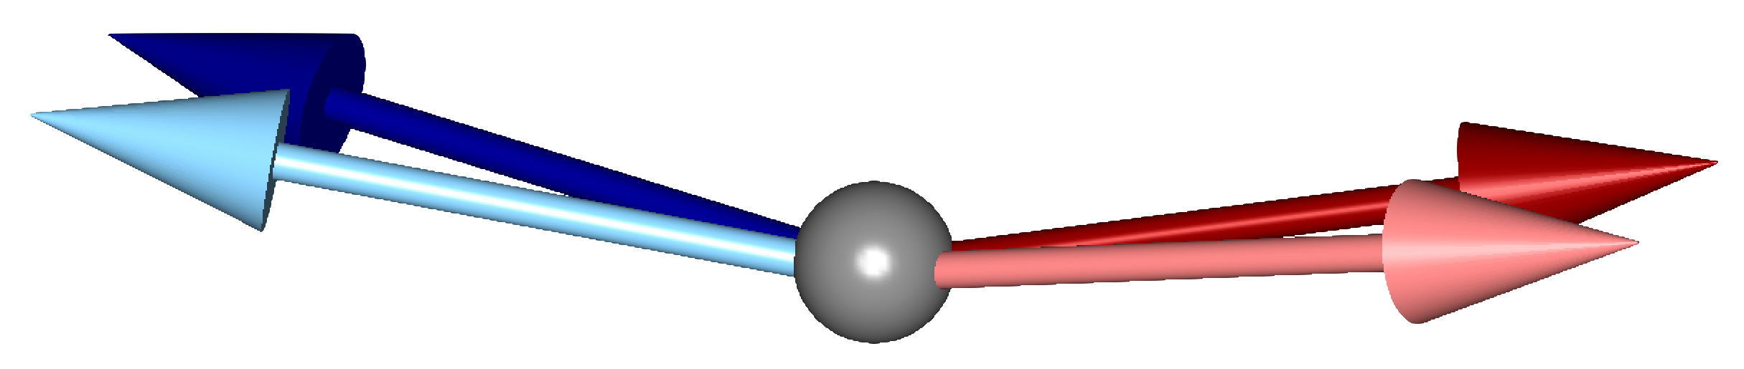
YFeO₃ A more Complex System
J₂
J₁
3
2
1
4
S. E. Hahn et al. PRB 89, 014420 (2014)

Slide 35
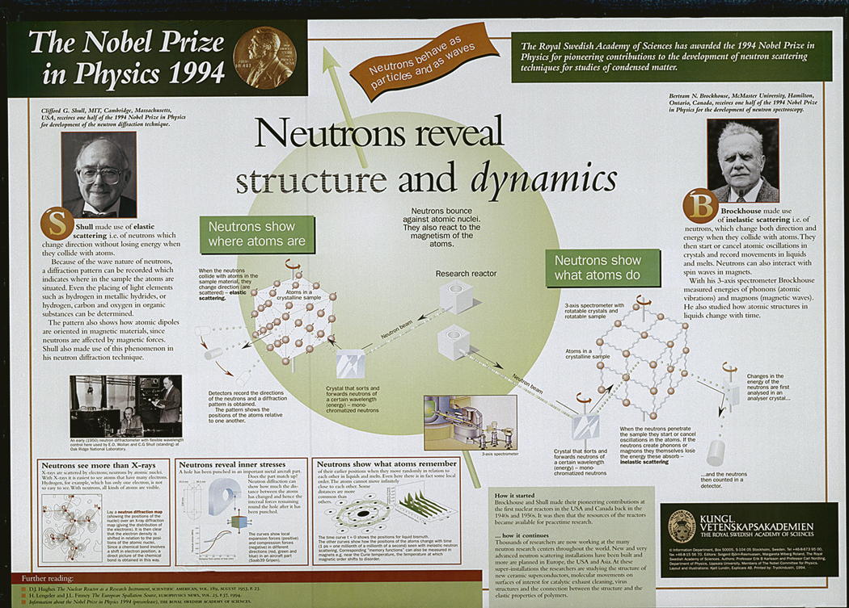
Wollan died in 1984. His surviving family members were Shull’s guests at the Nobel ceremonies.

