Slide 1
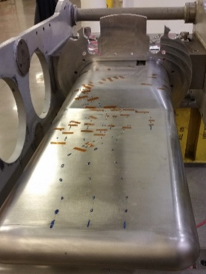
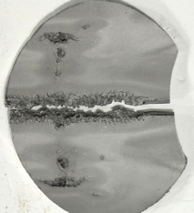
Path to 2 MW: Critical Target Milestones Required for PPU
SNS Target Operations
Demonstrate
1.4 MW operation
PIE confirms Jet-flow effective for erosion mitigation
PIE further demonstrates cavitation erosion reduction with low-flow gas & jet-flow
Measure 40% strain reduction with low-flow gas injection
Extended run with low-flow gas injection
March 2016
Oct 2017
March 2018
Oct 2018
March 2019
CD-1, 3a
CD-2, 3b
Strain reduction is equivalent to power reduction
Provides confidence in 2 MW structural design with high flow
Erosion mitigation: gas and flow show clear evidence of erosion mitigation
Provides confidence in 2 MW operation with high flow
PPU Target Design

Slide 2
Path to 2 MW: Critical Target Milestones Required for PPU
SNS Target Operations
Demonstrate
2 MW operation
Extended run with corner directed flow
PIE confirms corner erosion mitigation with directed flow
Reliable 1.4 MW operation with target improvements
Demonstrate
1.7 MW operation
FY
2019
2020
2021
2022
2023
2024
2025
CD-2, 3b
CD-3 target
CD-4
PIE informs decision to extend target lifetime
Reliable 1.4 MW operation solidifies 2 MW erosion basis
2 MW target installed
PPU Target Design
Notes:
2017 – 2018 targets will inform PPU target design (current target management plan draft)
Low flow gas injection (GI3), jet-flow and thickened outer beam window … we will assess pressure wave (strain measurements) and cavitation mitigation (PIE)
Beyond 2018:
Last 1.4 MW target that can influence PPU target design must be taken out of service in early 2019, i.e., the 1st “Blue” target (flow improvement at sides of outer window)
Needs time for PIE, analysis and interpretation, concept development to CD-2 level
Perhaps one more target beyond current target management plan could be operated
Strain measurements; time for informative PIE is questionable under current operating plan (2/y)
After CD-2b, must allow time for final design & analysis, target fabrication, installation and commissioning
“Chinstrap” target potential features for 2018-19 operation
Swirl bubblers and / or modest increase in gas flow: smaller bubbles in greater volume fraction
Further flow modifications for cavitation mitigation
Incorporate improve pulse simulation techniques if available

Slide 3
Operations linkage to PPU 2 MW target development
Operations achievement | PPU 2 MW Impact
40% strain reduction | Degree of strain reduction needed for 2 MW Will calibrate high-flow gas injection requirement for PPU
Engineered directed flow in nose (jet-flow) impact on cavitation erosion | Provides confidence in erosion mitigation in area of primary beam intensity
1.4 MW operation | Provides confidence in target lifetime at higher power
Extended target run with low-flow gas injection | PIE erosion comparison with/without gas injection provides further confidence in erosion mitigation
Extended run with engineered directed flow in corners (blue-target) | Provides confidence in erosion mitigation in corners where erosion is also observed
Multiple runs of 1.4 MW with above improvements | Provides confidence in 2 MW target design assumption robustness

Slide 4
backup

Slide 5
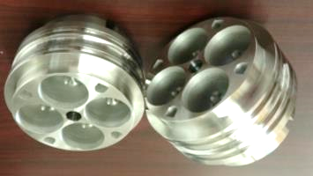
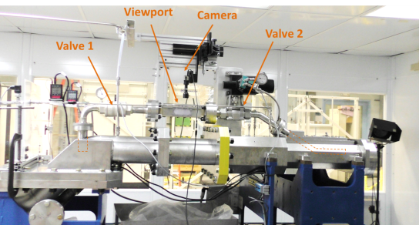
PPU R&D also affects 2 MW target design
R&D outcomes (finishes end FY20)
Swirl bubblers
  Optimized high flow swirl bubbler (10x initial gas implementation)
    Bubble populations inside target assessed
  Gas wall configuration for target nose
  Mercury process piping system gas removal
Experimental Hg Target Test Facility
FY
2017
2018
2019
2020
2021
2022
2023
2024
CD-2
Target design
finalized
Target fabrication start
Target delivered
PPU complete
PPU Target Design
Target design incorporating bubbler and gas wall
  75% pulse strain reduction
  Maximum cavitation erosion rate reduction
Gas supply pressure and flow requirements defined
Recirculating gas system
Safety concerns addressed & designs approved
Notes:
FY timeline

Slide 6
PPU Summary Schedule
Year 0
Year 1
Year 2
Year 3
Year 4
Year 5
Year 6
Year 7
CD-4
(L)

Slide 7
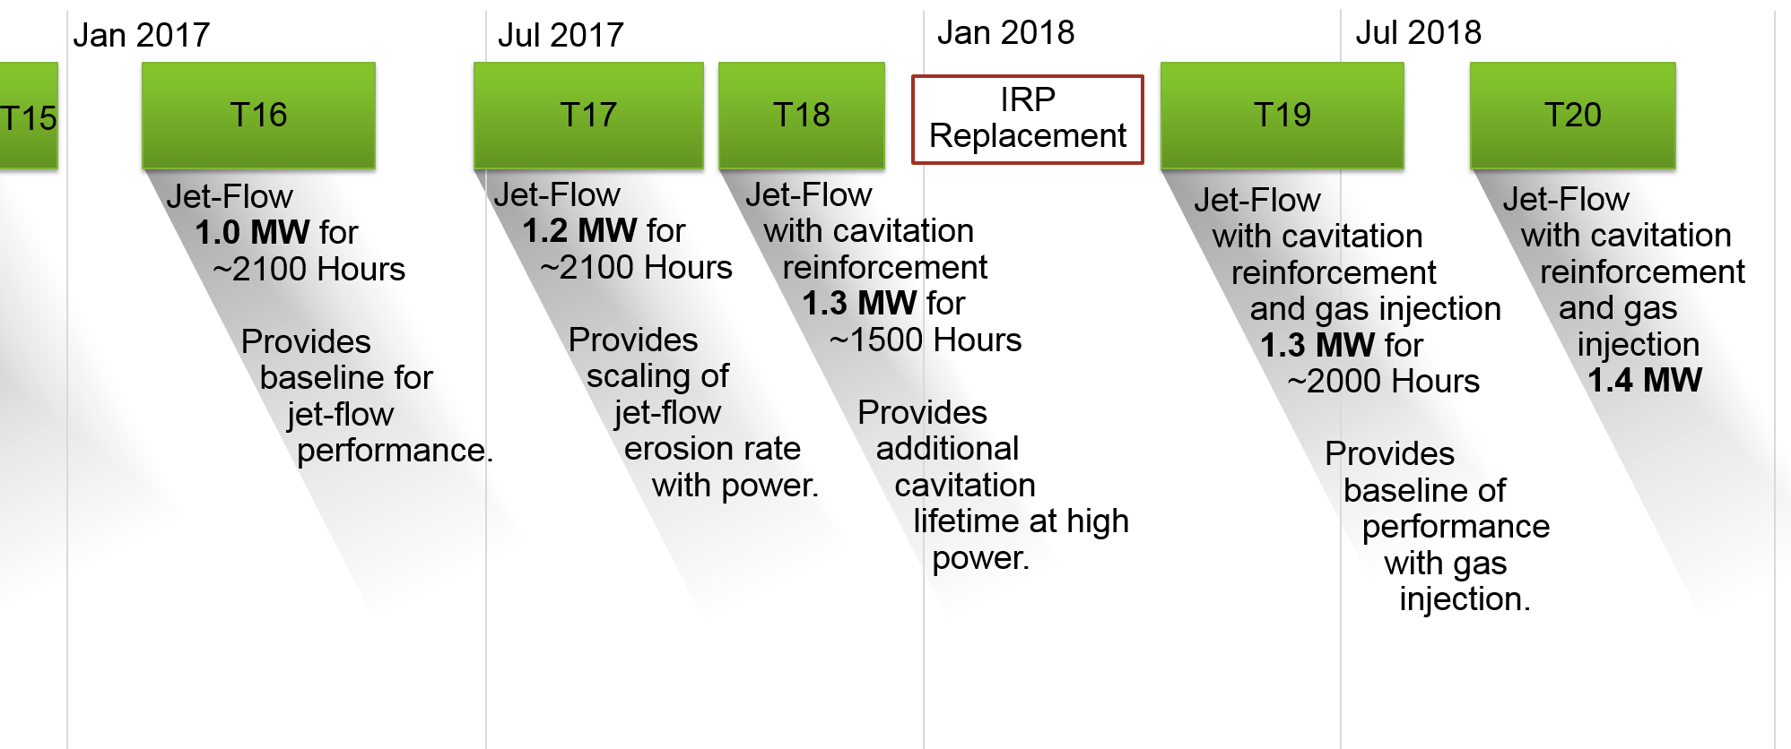
The proposed schedule supports a plan for target usage and learning that enables reliable progress to 1.4 MW operation
Update this
Notes:
RAD

Slide 8
GI3 / operations achievement ties to PPU 2 MW target development
Achievement | PPU 2 MW Impact
40% strain reduction | Degree of strain reduction needed for 2 MW Will calibrate high-flow gas injection requirement for PPU
Extended target run with low-flow gas injection | Erosion assessment during PIE and comparison to no-gas injection target will calibrate target high-flow gas injection requirement for PPU Operational stability will be used to calibrate mercury loop simulations and testing with high-flow gas injection Requirements for GLS and other safety features to be clarified
Engineered directed flow | Jet-flow in beam region Directed flow in corners
Thicker outer window w/o gas extends target life margin | Confirmation that thickening alone has life benefit
1.4 MW operation | Cumulative effects of design changes and gas injection demonstrate techniques are effective even if for 2 months of operation 2 MW and longer operation possible if techiques extended

Slide 9
Small gas bubbles will improve fatigue life
A reduction of pulse stress of is ~equivalent to reducing power
A 40% reduction in 2 MW pulse stress by small gas bubbles has good prospects for acceptable fatigue life, for 4 targets / y operation
8 – Inner Window
7 – Front Upper Rib
6 – Side Baffle Base
5 – Center Baffle Base
4 – Front Lower Rib Channel
3 – Center Baffle Front Lower
2 – Front Lower Rib
1 – Center Baffle Front Upper
8
7
5
6
4
3
1.20 MW
2
1
0.85 MW
1200 h
2500 h
Notes:
Fatigue life outlook for 2 MW beam on a JFM target.
Weld fatigue life will be less than base material.
This analysis is for base material.
It does not account for effects of mercury, radiation, or synergistic effects of cavitation erosion and fatigue.

Slide 10
Milestones for PPU P.5 schedule
First measurement of strain reduction with gas injection- 10/31/17- predecessor to results from GI3 available
Repeatable strain reduction of at least 40% measured on two targets- 12/31/18- predecessor to CD-2 and also linked to preliminary design (without pushing it)
Erosion reduction due to gas injection demonstrated- 12/31/18- predecessor to CD-2 and also linked to preliminary design (without pushing it)
Start operation at 1.4 MW 10/31/2018- predecessor to CD-2
Demonstrate stable operation with gas injection- 7/30/18- predecessor to CD-2 and also linked to preliminary design (without pushing it)
Improvements due to jet flow demonstrated -7/31/17- - predecessor to CD-2 and also linked to preliminary design (without pushing it)
Notes:
1-6: Barbara’s list from meeting

Slide 11
Off-project milestones to add to PPU schedule
 | Trigger date | Risk ID
The proton beam window in use at the time of PPU will be made of aluminum | 01/01/2020 | T-P.5-003
Upgrades to moderator cryogenic systems for reliable 2 MW operation completed | 12/31/2023 | T-P.5-008
PPU beam capable IRP ready | 12/31/2022 | T-P.5-009
Results from GI3 operated targets available in time to inform direction of PPU target gas injection | 12/31/2017 | T-P.5-010

Slide 12
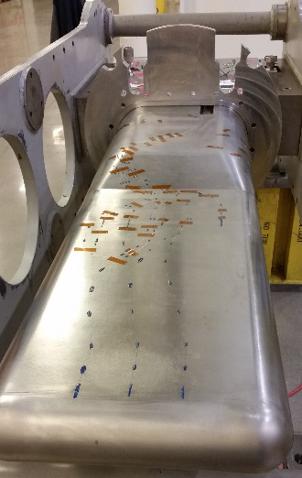
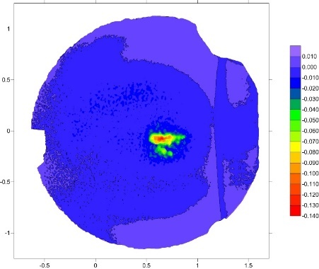
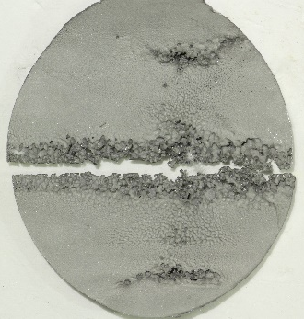
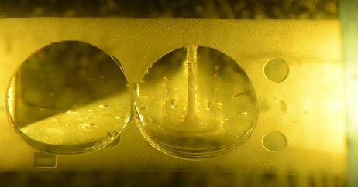
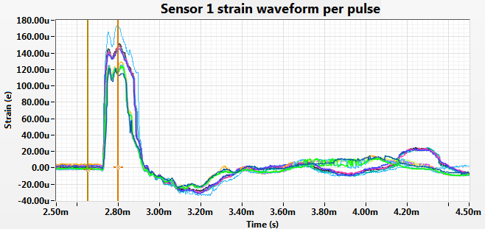
PPU 2 MW target plans build upon ongoing FTS target activities
Depth of erosion
T13
[in]
Continuous performance evaluation through
Ongoing PIE, target instrumentation and R&D
Input to design evolution
2016
2017
2018
2019
2020
2021
2022
2023
2024
FTS Target reliability improvements
Structural & fabrication
Initial gas injection GI3
Hg flow improvements
1.4 MW reliable operations
PPU
CD-2
PPU target fabrication start
PPU complete
PPU Scope
2.0 MW evaluations @ 1.3 GeV of FTS target systems
Increasing power on mercury target
Neutronic impact on FTS systems
Shielding performance
Facility safety authorization
Water & gas utility systems
Core vessel & monolith systems
Upgrades to selected systems
Ortho-para LH2 converters & diagnostics
Hg vessel design upgrade
High gas-rate small bubbles
Protective gas wall
Recirculating target gas
Hg process loop gas removal
2nd additional MOTS delay bed
Notes:
2017 – 2018 targets will inform PPU target design (current target management plan draft)
Low flow gas injection (GI3), jet-flow and thickened outer beam window … we will assess pressure wave (strain measurements) and cavitation mitigation (PIE)
Beyond 2018:
Last 1.4 MW target that can influence PPU target design must be taken out of service in early 2019, i.e., the 1st “Blue” target (flow improvement at sides of outer window)
Needs time for PIE, analysis and interpretation, concept development to CD-2 level
Perhaps one more target beyond current target management plan could be operated
Strain measurements; time for informative PIE is questionable under current operating plan (2/y)
After CD-2b, must allow time for final design & analysis, target fabrication, installation and commissioning
“Chinstrap” target potential features for 2018-19 operation
Swirl bubblers and / or modest increase in gas flow: smaller bubbles in greater volume fraction
Further flow modifications for cavitation mitigation
Incorporate improve pulse simulation techniques if available

Slide 13
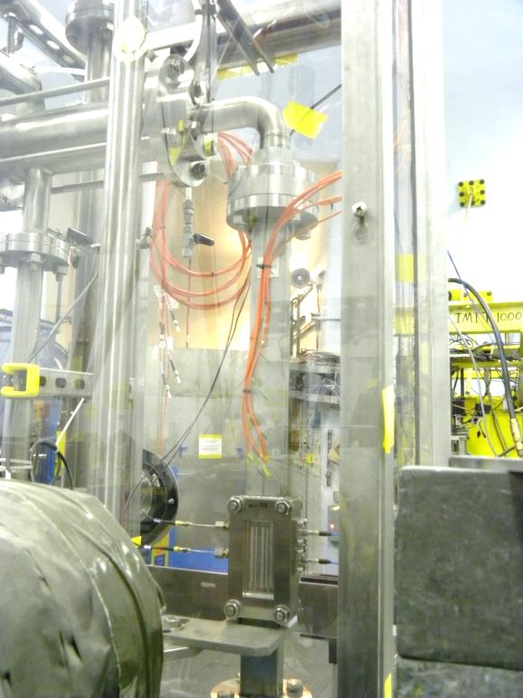
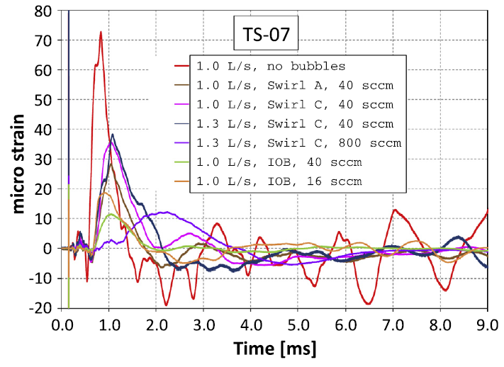
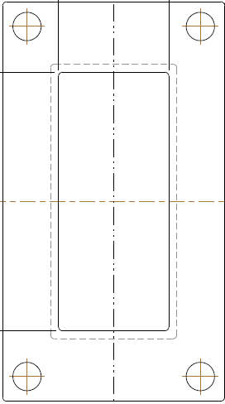
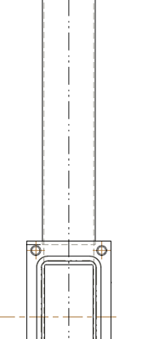
20+% pulse stress is achievable –
Fatigue reduction by SGB demonstrated in SNS target development experiments
SNS experiments at the LANSCE – WNR showed significant strain reduction at locations some distance from incident beam spot
Vertical mercury flow inside 25x50x1.5 mm rectangular tube
Injected gas
fraction 0.067%
Gas bubbles reduced strain magnitude and cycles
50 mm
50 mm
92 mm
50 mm
TS-07
8 mm
81 mm
100 mm
  B.W. Riemer et al. / Journal of Nuclear Materials 450 (2014) 192–203
  Beam spot on target
  1 and 2 σ outlines
  Bubbler test loop at WNR
Strain reduction in / near the beam spot was less clear
Notes:
Experimental evidence from both in-beam and offline testing done by SNS and by J-PARC.
This example is from our most recent experiment, done in 2011
LANSCE – WNR: Los Alamos Neutron Science Center – Weapons Neutron Research facility. 800 MeV protons; 0.3 micro-sec pulses; ca. 3x10¹³ protons per pulse
Note: injected gas fraction for 40 sccm helium / 1 L/s mercury is 6.7E-4 or 0.067% - similar to GI3
Swirl C 800 sccm case

Slide 14
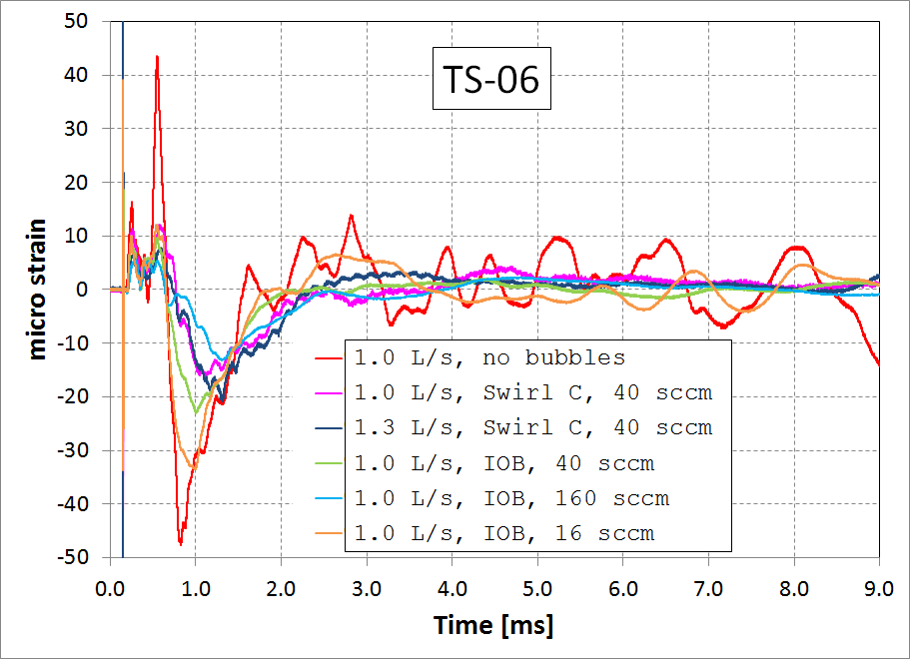
Experimentally demonstrated strain reduction in mercury targets with gas bubble injection
Injected gas
fraction 0.067%

