Slide 1
Management Overview and response to 2017 AAC/TAC recommendations
Presented at the
SNS Accelerator & Target
Advisory Committee Meeting
Fulvia Pilat
Research Accelerator Division Director
May 15-17 2018

Slide 2
Outline
Introduction and management updates
Progress since March 2017
Priorities and challenges
Response to 2017 recommendations
Presentation overview and charges

Slide 3
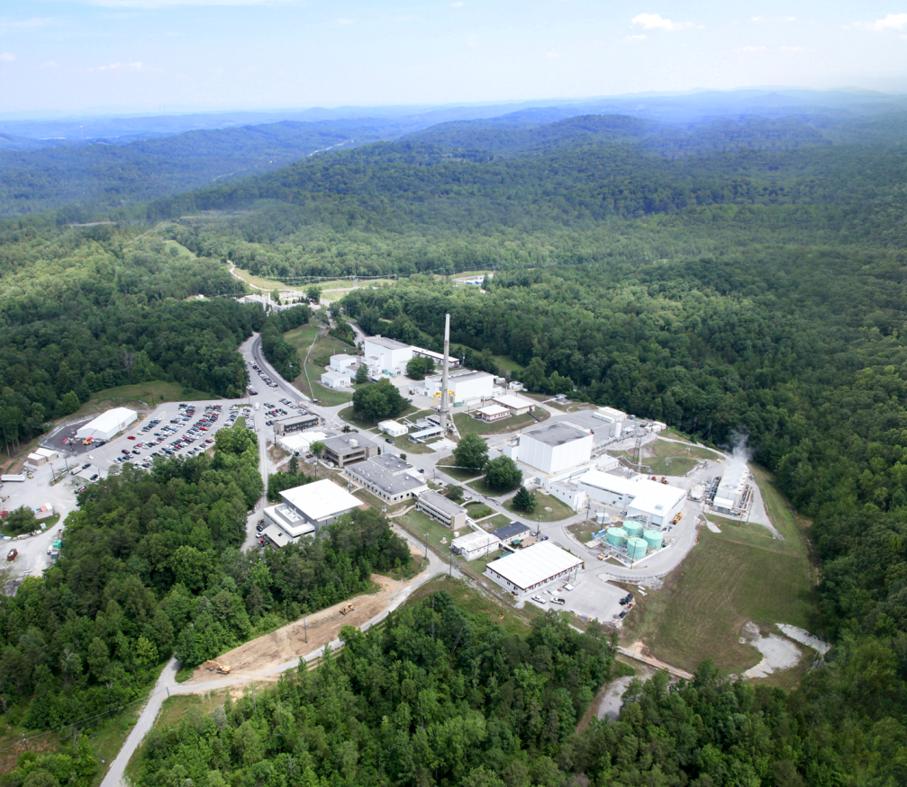
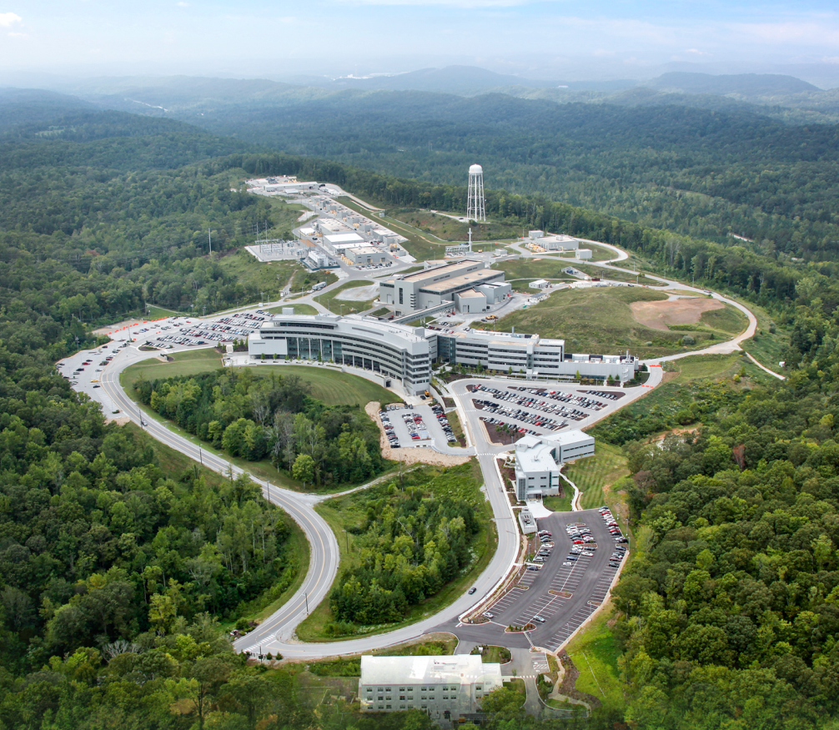
The Neutron Sciences Directorate (NScD) at Oak Ridge National Laboratory (ORNL) operates two advanced neutron scattering user facilities
Spallation Neutron Source (SNS)
World’s most powerful pulsed neutron source
High Flux Isotope Reactor (HFIR)
Intense steady-state neutron flux, high-brightness cold neutron source
Notes:
3

Slide 4
Our neutron scattering user facilities exceeded FY17 DOE performance objectives
HFIR: Operating at 85 MW
Operated | 12 beam lines
Completed | 52 years of operation Fabrication of new inner control cylinder Installation of new sulfuric acid tank Preparations for spent nuclear fuel shipping Additional missions of isotope production and materials irradiation and activation
SNS: Operating at 1.0 – 1.2 MW
Operated | 19 beam lines 3 targets
Completed | 11 years of operation Developed SNS Target Management Plan Revised operating schedule to allow 3 target changes per year Located and mitigated water leak on IRP-1 Prepared for scheduled long outage
SNS | Goal | Actual
Unique users | N/A | 794
Neutron production hours | 4700 | 4807.3
HFIR | Goal | Actual
Unique users | N/A | 511
Operating hours | 3,900 | 4,165

Slide 5
Neutron Sciences Directorate
Associate Laboratory Director Paul Langan
Jeanine Evans, Executive Secretary
Neutron Scattering
Richard Ibberson
Neutron Technologies
Graeme Murdoch
Research Accelerator
Fulvia Pilat
Research Reactors
Tim Powers
Partnerships and Programs
Shull Wollan Center: Joint Institute for Neutron Sciences
Center for Structural Molecular Biology
Jülich Outstation
US-Japan
Proton Power Upgrade
John Galambos
Scientific and Program Services Office
Crystal Schrof
Matrix Support
Bonnie Hébert, HR Manager
Lorie Hickey, Business Manager
Kelley Smith, Communications Coordinator
The AAC/TAC looks at the work of the Research Accelerator (RAD) and Neutron Technologies (NTD) Divisions and advises the Associate Laboratory Director

Slide 6
RAD (Research Accelerator Division) organization
Research Accelerator Division
Fulvia Pilat, Director
George Dodson, Deputy Director
Accelerator Operations
Glen Johns
Beam Science and Technology
Sarah Cousineau
Control Systems
Karen White
Electrical and RF Systems
Mark Champion
Superconducting Linac Systems
Sang-Ho Kim
Mechanical Systems and Operations
Mike Baumgartner
SNS Site Operations Support
Sam McKenzie (A)
RAD mission:
Facility operations (accelerator and target)
Facility support

Slide 7
NTD (Neutron Technologies Division) organization
Neutron Technologies Division
Graeme Murdoch, Director
Instrument Methods, Projects, and Technologies
Ken Herwig
Instrument Data Acquisition and Controls
Steve Hartman
Instrument Engineering
David Anderson
Source Development and Engineering
Mark Wendel
NTD mission:
Instrument technology and development
Target development and R&D

Slide 8
The core Neutron Sciences mission at SNS is supported by three Field Work Proposals (FWP) with additional funds for PPU/STS
Budget & Reporting Code
Sponsor
B&R Code Boundary
DOE/SC/BES
High Flux Isotope Reactor
FWP
HFIR OPS FWP
FY17 - $65.0M
ENG FWP
FY17 – $28.7M
PPU/STS FWP
FY17 - $6.8M
SCIENCE FWP
FY17 - $69.0M
SNS OPS FWP
FY17 - $93.0M
AIP Funds ($2.1M)
OPERATIONS FWP funds IT functions in SPSO and in-kind support for NSD
Flow of funding to Organizations
SCIENCE FWP funds support functions in SPSO, NTD, RRD
Organizations
RRD
NTD
NSD
SPSO
RAD
Research Reactors Div.
Neutron Technologies Div.
Neutron Sciences Div.
Scientific & Program Services Office
Research Accelerator Div.
Flow of work at Facilities
Facilities
HFIR
SNS

Slide 9
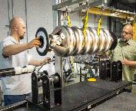
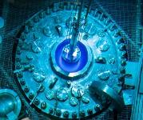
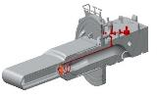
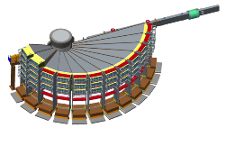
The Neutron Sciences Directorate focuses on five key organizational goals
Routine and reliable operation of SNS accelerator at 1.4 MW
3 SNS mercury target changes per year
7 cycles per year at HFIR
>400 scientific publications from our beam lines per year
$10M per year available for investments in neutron scattering capabilities
POWGEN upgrade
Long outage December 2017 -May 2018 (RFQ, IRP, linac energy) will allow operations at 1.4 MW
Strategic decision in early FY17 to move to 3 targets per year
(Target Management Plan)
Achieved
Exceeded
Execution of projects (upgrade or new instrument) is in progress
The Research Accelerator Division (RAD) owns the responsibility for reliable operation of the accelerator at 1.4 MW, the Neutron Technology Division (NTD) owns the engineering and manufacturing challenge of delivering a 1.4 MW capable target and related infrastructure

Slide 10
SNS operations performance

Slide 11
Progress since last AAC/TAC Meeting
The SNS delivered 4807 hours of neutron production in 2017 at 87.5 % availability
Availability without impact of IRP leak (354 h): 94%
PPU received CD-1 in April 2018 and substantial FY18 funding
3 targets operated, according to the target management plan, no target failure
Gas injection implemented, commissioned and operated
First 6D phase space measurement at the Beam Test Facility
Executed 5 month long outage (December 2017 – May 2018) to prepare SNS for 1.4 MW operations
Established Shull-Wollan Fellowship in Accelerator Science – First Fellow arriving in August 2018
Refined project prioritization process, adopted an improved outage planning and execution (project scheduling and resource loading)
Phase 1 work control completed, preparing Phase 2

Slide 12
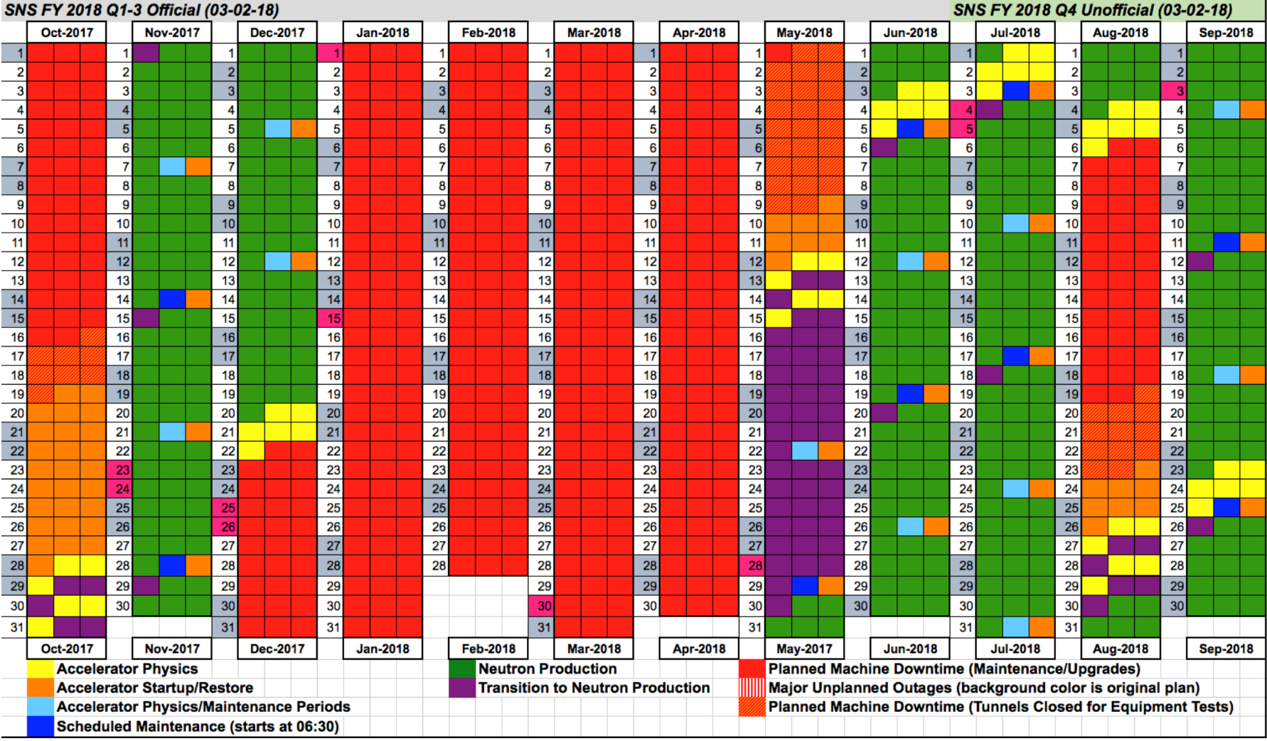
Long outage highlights
New RFQ installed, conditioned, characterized: >90% transmission 40mA, margin to 50 mA
IRP-2 installed, heavy water filled
Plasma processing of 3 cryomodules: linac energy from 990.5 MeV to 1010 MeV
More than 1400 system upgrades and maintenance activities
Beam on target on May 14

Slide 13
Research Accelerator Division (RAD) priorities and challenges
Priority 1: Achieve and sustain reliable (>90% availability) operations at 1.4 MW by the end of FY18
Steps/plan to achieve this priority
Risks and mitigation
Priority 2: Support of PPU and continued reliable facility operations
Steps/plan to achieve this priority
Risks and mitigation
Priority 3: Strengthen the accelerator R&D portfolio
Steps/plan to achieve this priority
Risks and mitigation

Slide 14
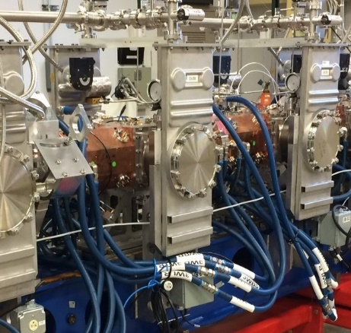
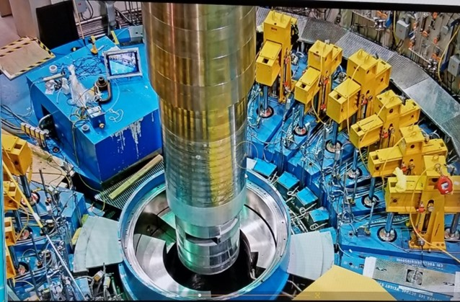
Priority 1 – Reliable (>90% availability) operations at 1.4 MW by the end of FY18
Reliable (>90% availability) operations at 1.4 MW by the end of FY18
Long outage December 2017 - May 2018 to install critical elements to increase beam power (beam current AND beam energy) and improve reliability
New RFQ moved from Test Stand to accelerator front-end; measured transmission increased from ~60% to >90% → increase beam power
Plasma processing of 3 cryomodules → increase beam energy to 1.01 GeV
Installed new IRP (Inner Reflector Plug) → improve neutron production
Installed heavy water → increase neutron yield by ~20%
Managed (schedule and resources) and executed more than 400 maintenance tasks during the long outage → increase reliability
3 targets/year operational cycle, execution of target management plan → overall facility operation reliability (goal is 2 targets/year or less)
Risk
Spare inventory, accelerator obsolescence, target performance
Mitigation
Spares: Comprehensive risk analysis → identified high-priority system spares
Obsolescence: Comprehensive system analysis → phased AIP plan
Target: see target management and development plans

Slide 15
Looking towards 2024-25 (PPU-CD4)
PPU: ”infant mortality” phase
SNS: mature operations phase (>15 years of operations)

Slide 16
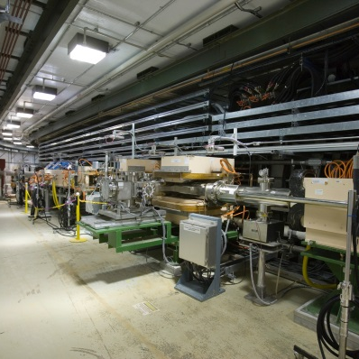
Priority 2 – Support of PPU and continued reliable facility operations
Support of PPU and reliable facility operations
Manage the rapid ramp-up for PPU execution in FY18 and FY19 without adversely affecting facility operations
Risk
competition for resources
Mitigation
Regular communication between operations and project, to communicate goals and matrixed personnel expectations
Project-like resource management in operations (leveraging the outage management experience)
Filling of key positions bridging project and operations
Use of subcontractors

Slide 17
Priority 3 – Strengthen the accelerator R&D portfolio
Strengthen the accelerator R&D portfolio
Improvements to the SNS facility
Attraction and retention of talented staff in operations
Improved collaboration with other institutions and national laboratories
Potential for proposal funding
Leverage of facility investments
Risk
Competition for resources
Lack of funding
Mitigation
Establish clear priorities: R&D lower than operations and PPU
Leverage external collaborators
Compete for external funding (FOAs, SBIRs)
Compete for internal LDRD

Slide 18
Response to 2017 AAC/TAC Committee Recommendations
We received 19 recommendations from the AAC/TAC Committee last year
Each recommendation was assigned an owner and was tracked in ACTS (Assessment & Commitment Tracking System)
18 recommendations have been closed
Recommendation 1 “Proceed with fabrication of the spare medium-beta cryomodule, if possible, ensure the funding profile is adequate to complete this task in a timely manner” has a closing date of 9/19, because the fabrication of the cryomodule is in progress
The speakers will address in their talks responses to the respective recommendations

Slide 19
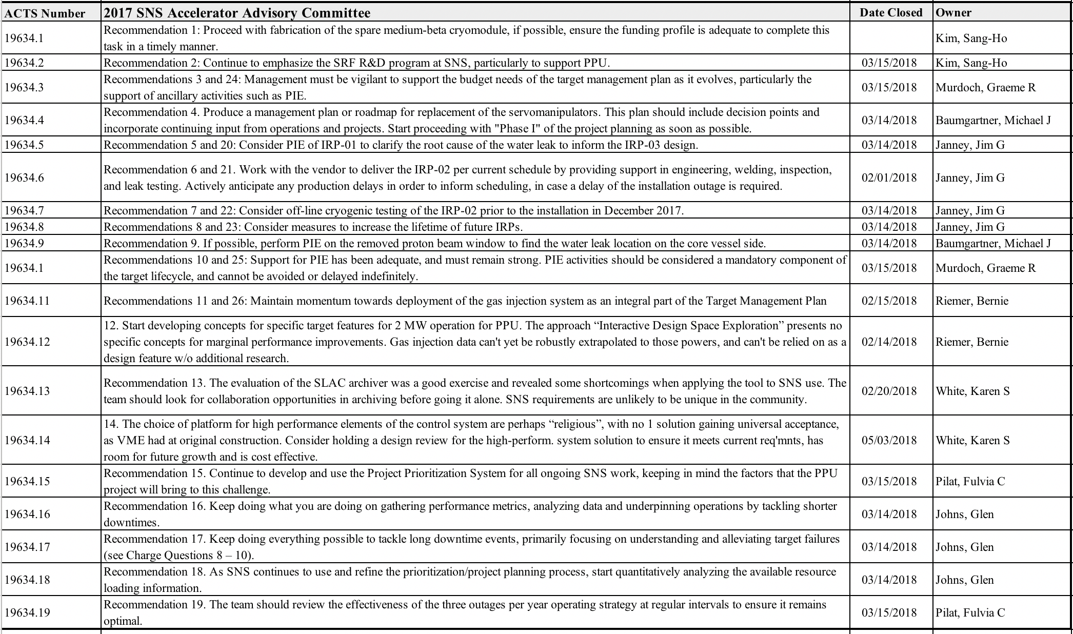
Tracked Recommendations

Slide 20
Response to charges
Charge for Accelerator Systems:
Do the capability and performance of the accelerator complex and neutron source support achieving Objective A? (Cousineau P5, Kim A7, White A8, Moss A9, Aleksandrov A10, Anderson A11, Norris and Eason A12)
Is the Prioritization process and Project Planning strategy that has been developed and is in use for outage planning reasonable? (Johns P9)
Is the scope of work identified for ongoing and future Accelerator Improvement Projects (AIP) appropriate and balanced between the competing interests of maintaining necessary margin for routine operation at 1.4 MW while addressing system obsolescence? (Dodson P8)
Is the Accelerator R&D plan presented appropriately positioned to widen collaborations and to leverage external resource support? (Cousineau A1, Shishlo A3, Liu and Abudureyimu A4, Evans A5, Kim A7)
Are the PPU pre-CD-2 activities properly focused? (Galambos P4)
Charge for Target Systems:
Is the SNS Target Management Plan a reasonable approach to improving both performance and understanding of SNS mercury targets? (Pilat P2, Wendel T1)
Have lessons learned from the IRP-01 and IRP-02 experiences been adequately considered in the design and fabrication plan of the next- generation IRP (IRP-03)? (Murdoch P7, Janney T5)
Is the major procurement planning sufficient for controlling long term cost and improving component manufacturing reliability? (Rosenblad T6)
Is the proposal for early use of the 2 MW PPU target in operations reasonable? (Riemer T7)
Do the benefits proposed from the PPU 2 MW target design changes outweigh additional potential complexities? (Wendel T1, Winder T3, Riemer T7)

Slide 21
Conclusions – from Kevin Jones’ talk last year….still valid with a few edits
SNS and RAD have had a very productive year since your last visit
Your recommendations stimulated considerable activity and resulted in substantial progress
We will have completed all work necessary for operation at 1.4 MW with margin by April 2018 May 2018
We have established a sound plan for the path to 1.4 MW operation by September 2018
We are managing a 10-year look-ahead operations schedule that accommodates the PPU performance plan, ties work on achieving reliable operation at 1.4 MW to the PPU schedule and develops a robust R&D program

