Slide 1
PPU and STS Overview
Presented at the
SNS Accelerator & Target
Advisory Committee Meeting
John Galambos, Director Proton Power Upgrade project
May 15, 2018

Slide 2
PPU charges
Charge | Description | Presentations
 | Are the PPU pre-CD-2 activities properly focused?
 | Is the proposal for early use of the 2 MW PPU target in operations reasonable?
 | Do the benefits proposed from the PPU 2 MW target design changes outweigh additional potential complexities?
P4 - Galambos
A7-Kim
A9-Moss
A11-Anderson
Charge 10
T7 - Riemer
Charge 11
T1 - Wendel
T3 - Winder
T7 - Riemer

Slide 3
SNS Upgrade Plans
24 instrument positions
19 instruments built
24 instrument positions
19 instruments built
22 instrument slots, 8 initial instruments
FTS
FTS
STS
1.4 MW
0.8 MW
2 MW
After STS Upgrade
Accelerator
Accelerator
Now
After PPU Upgrade
Proton Power Upgrade project doubles accelerator power capability
  Near term, ~$240M
  Increases FTS capability+ capacity and provides accelerator basis for STS
Second Target Station provides new instrument hall with world class cold neutron brightness
  Delayed from PPU start, ~$1.5B

Slide 4
Second Target Station: world class cold neutron performance
5 Å – long wavelength comparison
(0.8 MW)
(1 MW)
(5 MW)
STS will be the highest peak brightness long wavelength neutron source

Slide 5
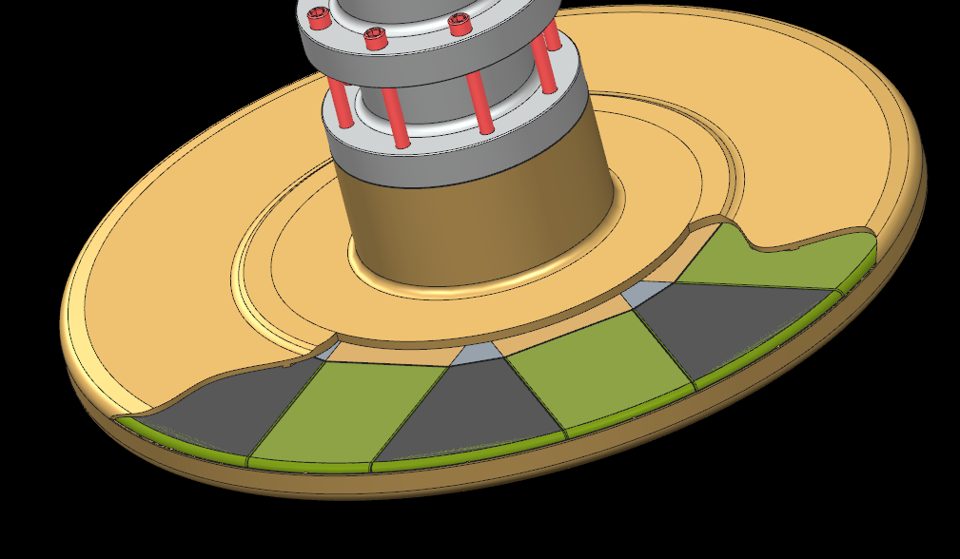
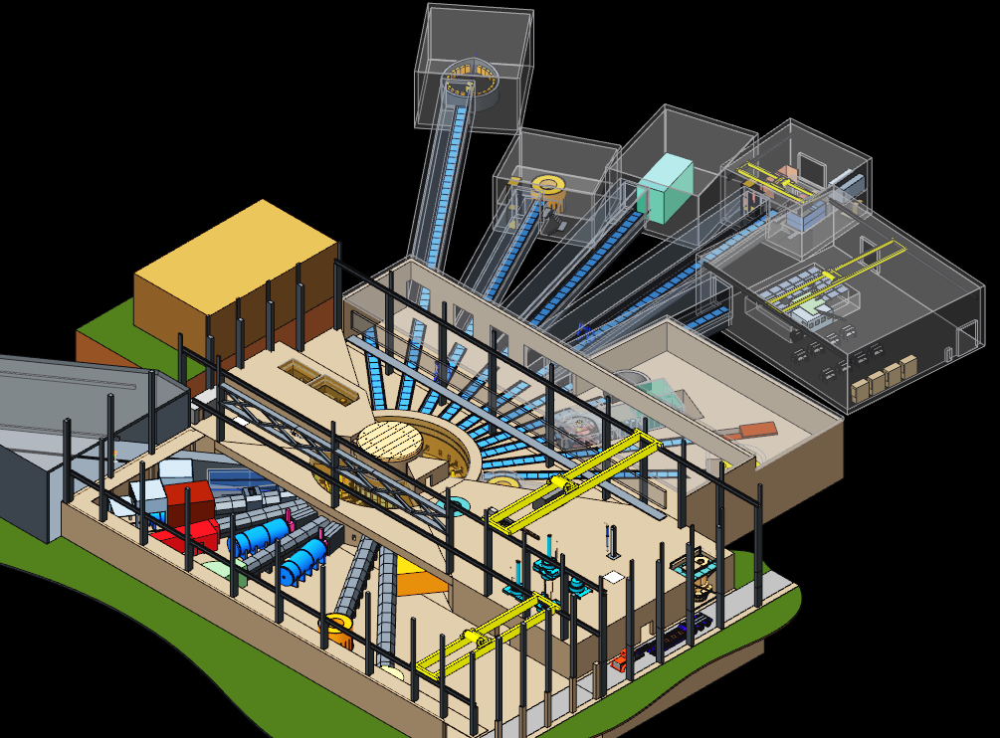
STS project activities
Review on the initial instruments and general target/instrument hall choices in April 2017
  Rotating water cooled tungsten target concept chosen
  Instrument hall general layout
Technical parameter changes:
  15 Hz, 2 cold moderators
STS project activities suspended June 2017
  Focus resources on PPU

Slide 6
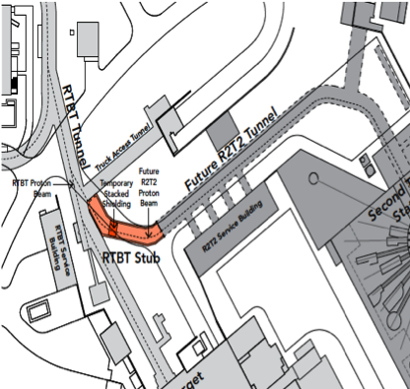
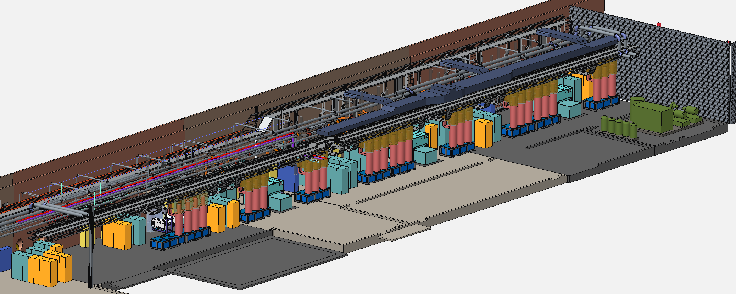
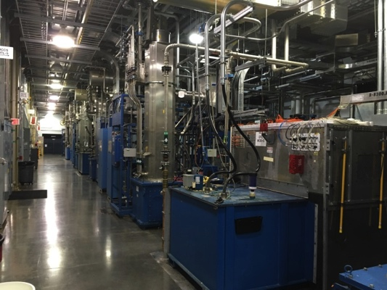
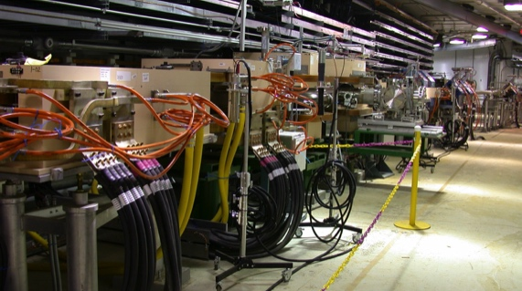
PPU Technical Scope
Conventional Facilities:
Klystron gallery
SRF:
7 new cryomodules
Tunnel stub
Basis for WBS Structure
Target systems:
2 MW target vessel
Support system upgrades
RF:
Upgrade existing linac RF
RF for new cryomodules
Ring:
Injection / extraction regions

Slide 7
PPU Guiding Principles
Minimize SNS operational impact
Target
  Leverage ongoing operations target improvements
Optimize built-in facility upgrade provisions and build on operational lessons
Accelerator
  Use existing technology where possible
  Utilize partnerships, sub-contract
  No equipment rework for STS following PPU

Slide 8
PPU Parameters: power increase with energy and current
PPU delivers 2.8 MW capable accelerator
Prior to STS, accelerator will run at 2 MW to FTS
 | SNS 1.4 MW | PPU full upgrade capability | PPU FTS 60 Hz operation
Proton beam power capability (MW) | 1.4 | 2.8 | 2.0
Beam energy (GeV) | 0.97 | 1.3 | 1.3
RFQ output peak beam current (mA) | 33 | 46 | 46
Average linac chopping fraction (%) | 22 | 18 | 41
Average macropulse beam current (mA) | 25 | 38 | 27
Energy per pulse (kJ) | 23 | 47 | 33
Pulse repetition rate (Hz) | 60 | 60 | 60
Macro-pulse length (ms) | 1 | 1 | 1
FTS decoupled moderator brightness/pulse (AU) | 1 | 2.04 | 1.43
FTS coupled moderator brightness/pulse (AU) | 1 | 2.16 | 1.51
33% energy increase
50% current increase
No change

Slide 9
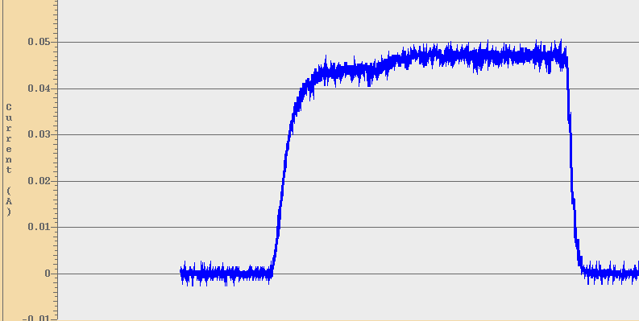
Accelerator front-end is “STS ready”
Ion source output
RFQ output
  Operation production source has demonstrated required output
  Measured beam at RFQ output, 4/30/2018
STS requirement
46 mA
STS Requirement
Beam current (A)
Notes:
STS – new facility

Slide 10
PPU Activities: 2017 – 2018
PM Cost Review
CD-1 Approved
OPA recommendations closed
OPA CD-1 Review
SRF partner selected (Jlab)
$36M line item FY18
PPU addressing target recommendations
Target gas injection
April 2017
May
June
July
Aug
Sept
Oct
Nov
Dec
Jan 2018
Feb
Mar
April
CD-1 DOE reviews spring 2017
Target response summer fall 2017
CD-1 approval and funding spring 2018
Now we are preparing for CD-2

Slide 11
PPU anticipated schedule: 2018 – 2019
Aim for a CD-2/3b review in ~ 1 year
  Baseline + preliminary design for entire project (CD-2)
  Final design for equipment already in use (CD-3b)
Director’s review
CD-2/3b review
OPA 3a/status review
System reviews
AAC/TAC
ICE review
(Cost)
Establish EVMS system
DOE reviews
Complete baseline and preliminary design
Complete documentation
April 2018
May
June
July
Aug
Sept
Oct
Nov
Dec
Jan 2019
Feb
Mar
April
May
June

Slide 12
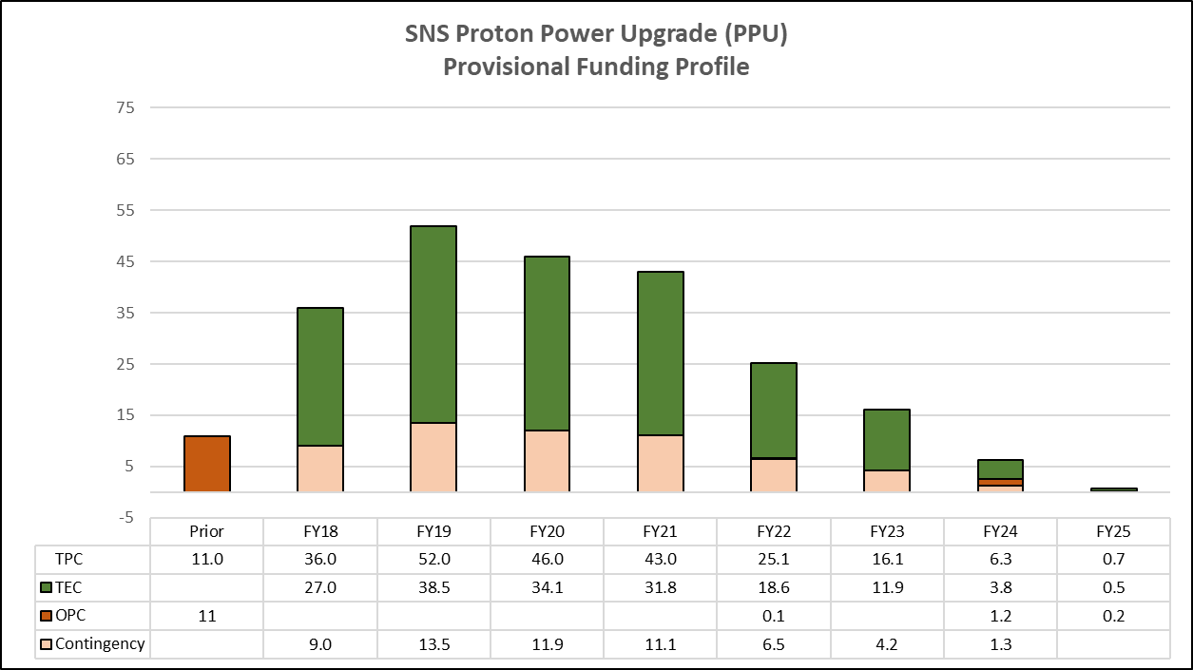
PPU Notional Funding Profile, Point Estimate
WBS # | WBS Title | Total ($M)
Total Estimated Cost (TEC) |  | 158.5
P.01 | Project Management | 14.1
P.02 | Superconducting Linac Systems | 38.9
P.03 | RF Systems | 60.7
P.04 | Ring Systems | 10.5
P.05 | FTS Systems | 25.7
P.06 | Conventional Facilities | 8.6
Other Project Cost (OPC) |  | 14.6
P.07 | R&D | 4.6
P.08 | Pre-Ops | 2.7
P.09 | Pre-CD1 Activities | 7.3
Contingency (33%) |  | 57.1
Total Project Cost (TPC) |  | 230.2
Cost range is $184M to $320M
The April 2017 “ICR team drilled down on >50% of direct costs; “there is a good basis of estimate.”
  Use of existing designs from SNS project and upgrades during operations.

Slide 13
PPU Notional schedule
Prior
FY2018
FY2019
FY2020
FY2021
FY2022
FY2023
FY2024
FY2025
FY2026
FY2027
Clear Gallery, procure & install chase inserts
(SNS operations)
PPU target demo
6 month outage
AE design of Klystron gallery
Civil construction Klystron gallery
Install RF equipment in gallery
Receive and install cryomodules
Procure and receive RF equipment
Ring and target install
Assemble cryomodules
RTBT stub
Procure cavities and cryomodule hardware
ARR and commis-sioning
KPP – 1250 hr Target ops time
Final target design
Fabricate early PPU target
Target development
30 mos. contingency
Early finish
(E)
CD4
(L)
CD1
CD3A
(TBD)
CD2/3B
CD3
Holding 6-month outage/early finish firm
Include a pre-6 month outage PPU target demo, possibly at > 1.4 MW

Slide 14
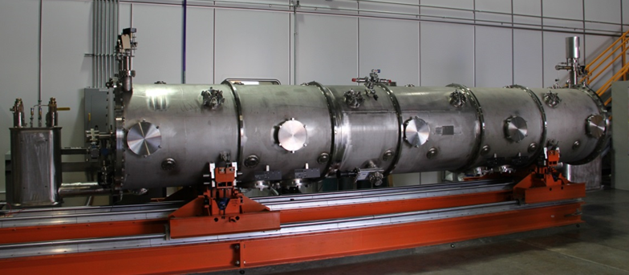
FY18 priorities
Charge 6
SRF / M. Howell
  Initiate cavity long lead procurements (Nb, cavity qualification equipment, cavities)
  With J-Lab, initiate cryo-module engineering baseline activities
A7-Kim
Spare cryomodule in production since 2012 demonstrates PPU gradient

Slide 15
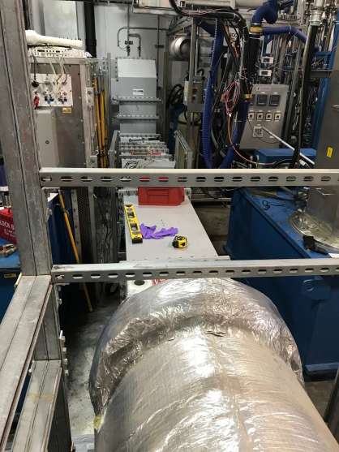
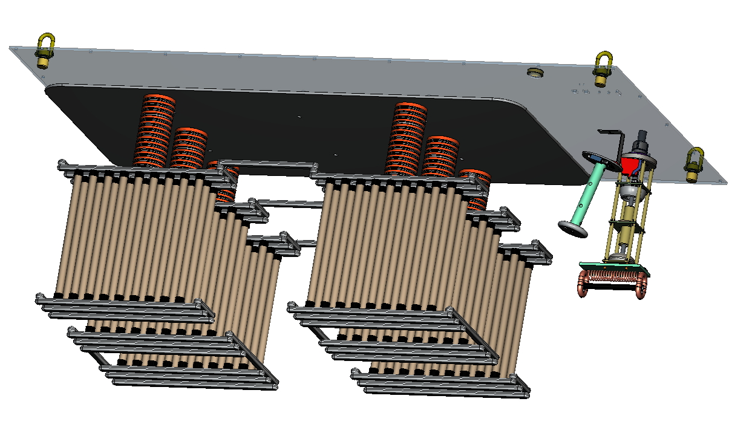
FY18 priorities
Charge A6
RF
  Finalize warm linac RF upgrade requirements (measurements driving RF into temporary loads for calibration)
  Test new HVCM at full power, initiate upgraded DTL klystron design and testing capability
Temporary load setup for CCL testing
A9-Moss
3 MW resistive load
A11-Anderson

Slide 16
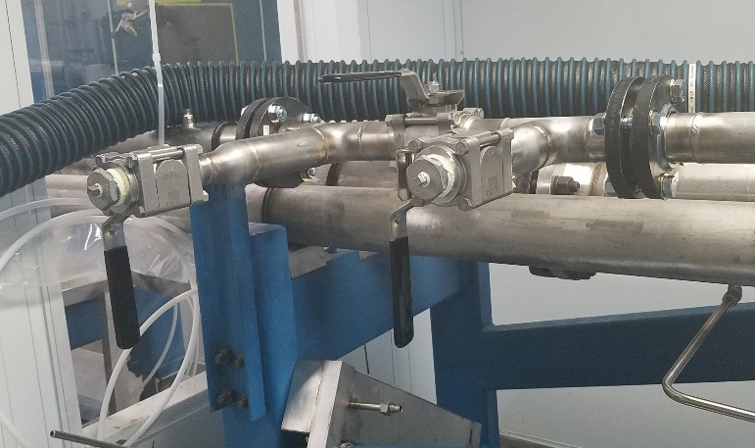
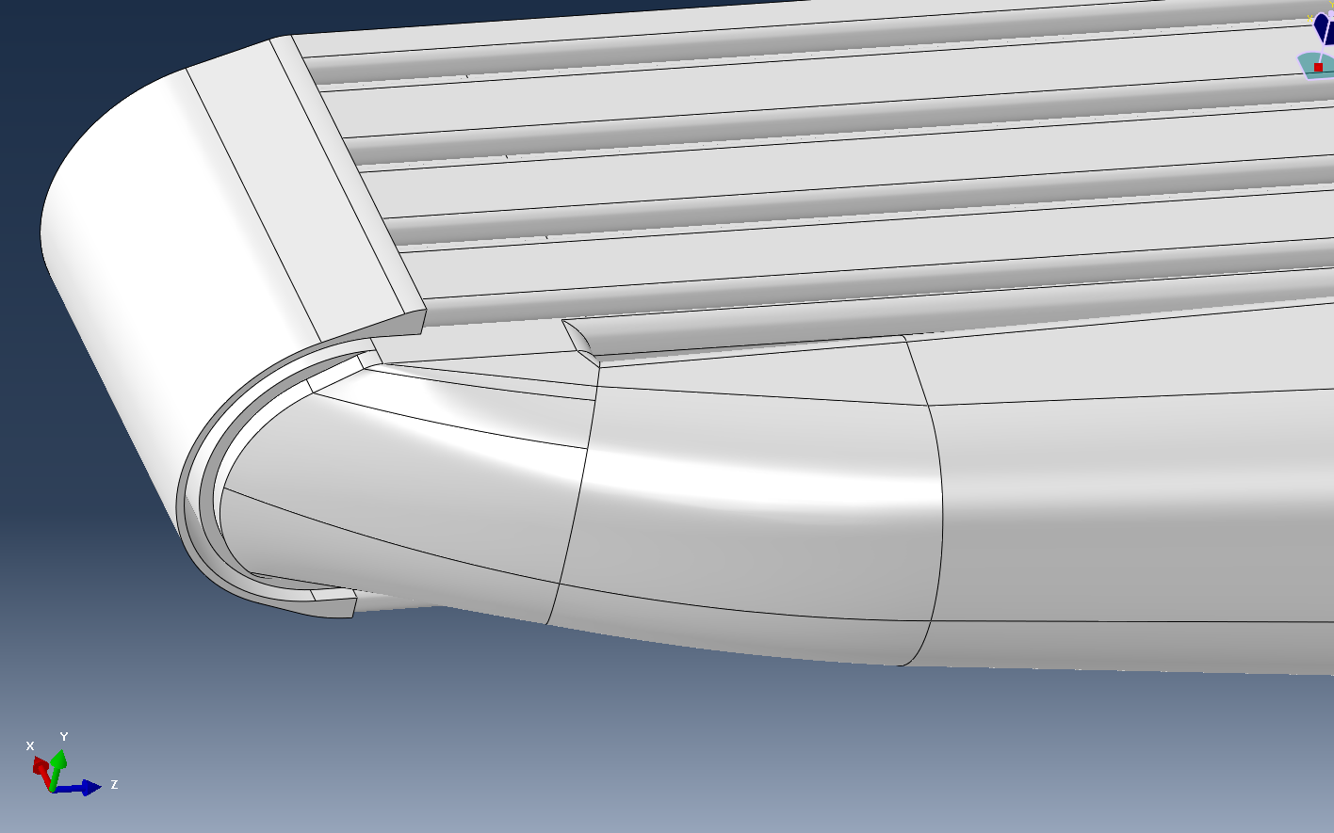
FY18 priorities
Charge A6
Target
  Target Test Facility gas wall injection testing
  PPU target conceptual design optimization
  Gas injection in operational targets
T7 – Riemer
T8 – Barbier
T3 – Winder
T1 – Wendel
T7 – Riemer
T8 – Barbier

Slide 17
Target gas injection ramp-up: operations and PPU
T7 – Riemer
Operational experience will feed into PPU target design up to mid 2020
Early PPU target demonstration is on critical path

Slide 18
FY18 priorities
Charge A6
Ring
  Extraction kicker approach
  Foil testing (Evans A5)
  Injection region magnet requirements
Conventional Facilities
  Award and initiate A/E firm design of klystron gallery work
  “BIM” design approach with RF and electrical equipment layouts incorporated
All
  Baseline scope
  Scrub schedule and cost estimates
  Draft Preliminary Design Report

Slide 19
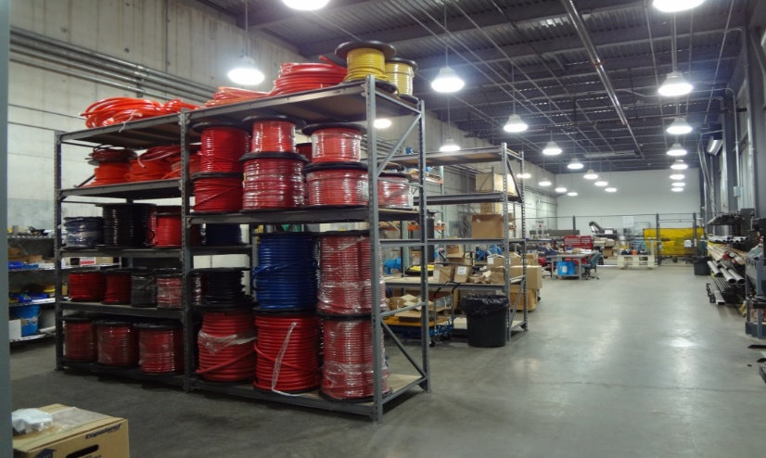
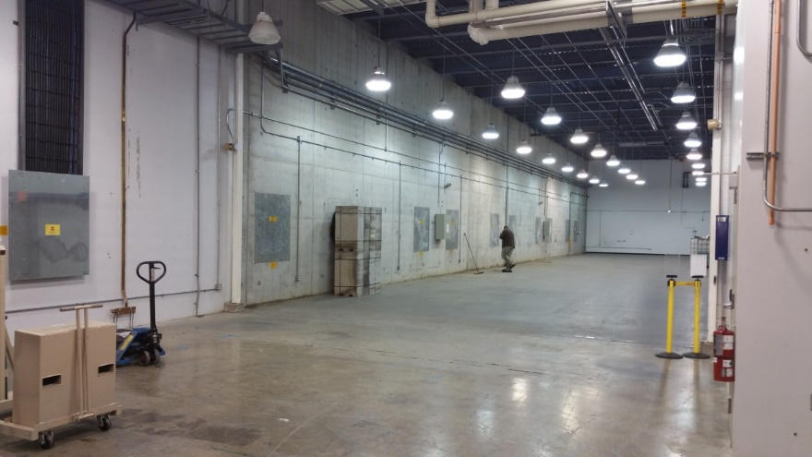
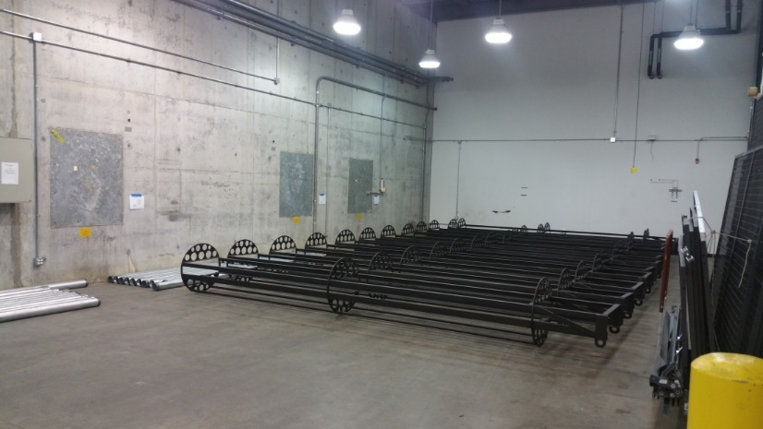
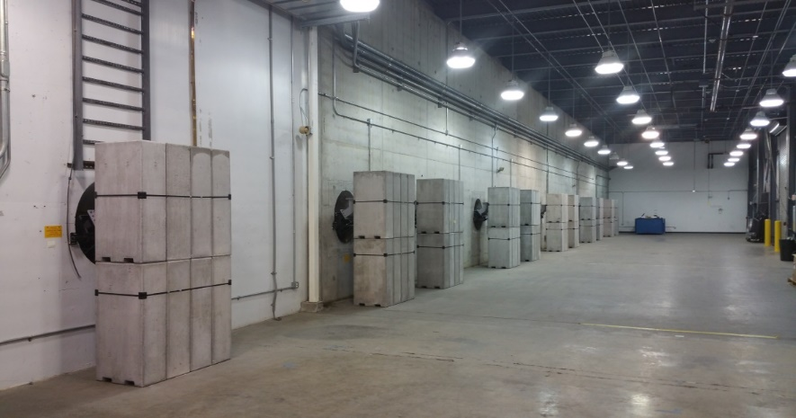
CF: Klystron gallery chase work complete
Charge A6
Stored equipment, water shop cleared out
Chases with incorrect cabling cleared
Inserts with RF waveguide / cable conduit installed
Cables re-routed
Ready for AE supported activities
July 2017
Nov 2017
Jan 2018
Mar 2018

Slide 20
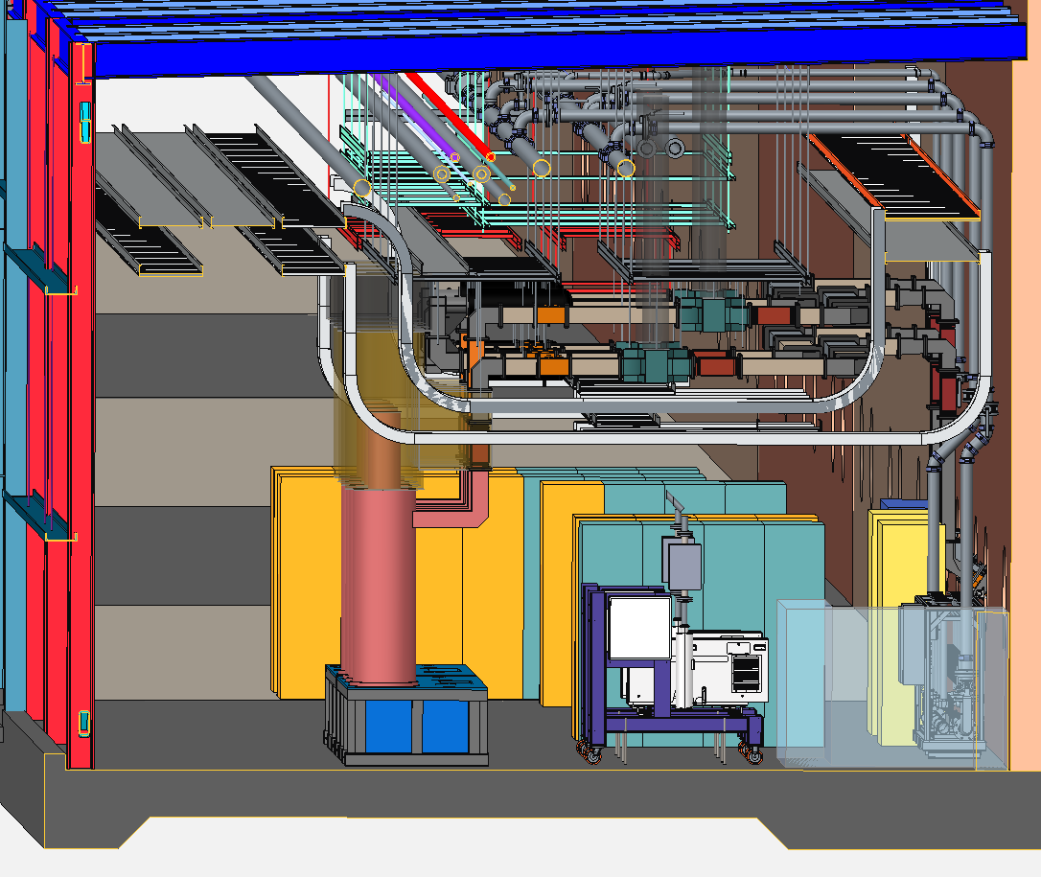
CF Activities: Klystron gallery near term
Charge A6
Layout of technical and conventional equipment will be combined into a single CAD model (“BIM” approach)
  Increased design scope for CF
  Will facilitate installation activities
  CF: cable trays, utilities, HVAC, …
  Include technical systems: HVCMs, RF, technical cooling skids
SOW is written, bidders oral presentations reviewed
  Aim to award this summer

Slide 21
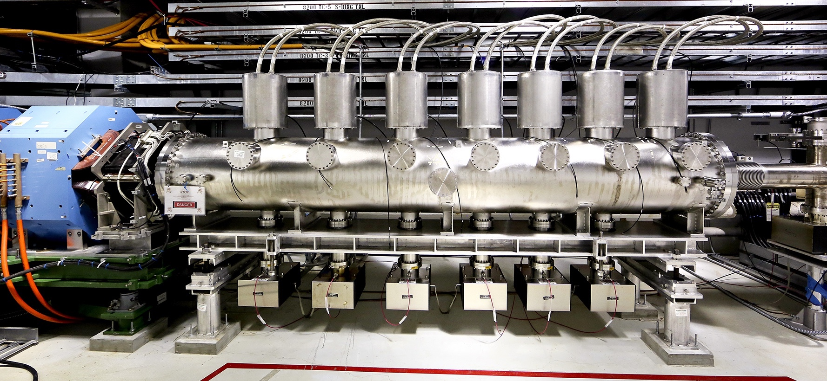
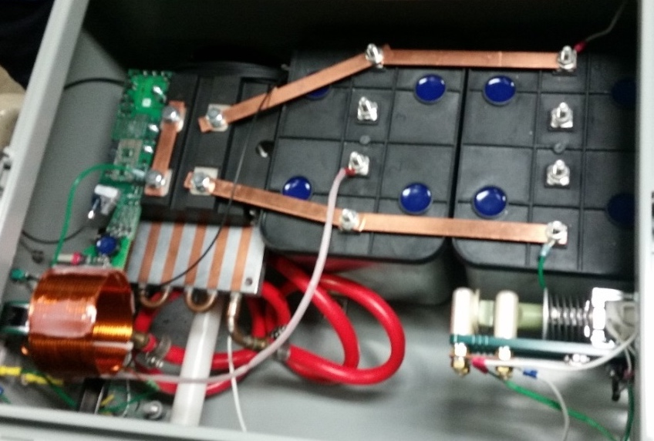
PPU-Ring extraction kicker system
Charge A6
One of the two sets of existing kicker magnets
Baseline: add 2 additional kickers
  Upgrade the existing 14 power supplies is preferred
Prototype extraction kicker resonant charging supply testing in progress
  Max voltage obtained to date is 39.8 kV with single pulse testing. Goal is 44 kV
Next steps: full voltage and full duty factor testing
Prototype resonant charging supply

Slide 22
Ring injection dump septum and beam optics
Charge A6
Scope includes new injection dump septum magnet, quadrupole magnet and new beam instrumentation
  We need accurate beam optics model to achieve the best possible design
  Model benchmark with historical data:
  marginal agreement
Next steps:
  Acquire new, more complete benchmark
  data
  Improve the beam optics model
  Create physics specs for the new
  septum magnet
Comparison of measured and model I-dump beam sizes
Beam size
IDmp quad current

Slide 23
PPU Key Performance Parameters
Key Performance Parameter | Thresholds (Performance Deliverable) | Objectives
Beam power on target | 1.7 MW at 1.25 GeV | 2.0 MW at 1.3GeV
Beam energy | 1.25 GeV | 1.3 GeV
Target operational time without failure | 1,250 hours at 1.7MW | 1,250 hours at 2.0MW
Stored beam intensity in ring | > 1.6x10¹⁴ protons at 1.25 GeV | > 2.24x10¹⁴ protons at 1.3 GeV *
Number of PPU installed cryomodules | 6 | 7
* corresponds to 2.8 MW at 60 Hz
“1250 hr operation” KPP is part of the transition to operations

Slide 24
PPU Organization
FY2018 Changes
  Wayne Steffey: project controls lead
  John Moss: RF WBS level 2 lead
  Gary Bloom: CF WBS level 2 lead
Multiple positions are now open

Slide 25
Risks / Concerns
Target performance at high power
  Timely operational experience and development activities will influence the design
Project ramp-up
  Matrix, subcontract, hire
Project mentality
  Last year’s reviews helped

Slide 26
Summary
PPU is launched
Moving towards a baseline – fine tuning
Fleshing out the team

