Slide 1
Outage Planning
Presented at the
SNS Accelerator & Target
Advisory Committee Meeting
Glen Johns
SNS Outage Manager
May 15-17, 2018

Slide 2
Outline
Prioritization Process
Outage Planning
  Summer (2017B)
  October (2017C)
  Winter (2018A)
Summary

Slide 3
RAD management has continued to utilize the project prioritization process established in 2016
Projects result in a defined product and recognize the full life cycle of work needed (design, prototyping, testing, manufacturing, installation, commissioning, documentation, and readiness for operation) but do not include routine/periodic maintenance activities (target changes)
Maintain 5 categories of projects (based primarily on funding source)
  Accelerator Improvement Project (AIP)
  General Plant Project (GPP)
  Institutional General Plant Project (IGPP)
  Line Item Construction (LI/MIE)
  Operational Improvement Project (OIP)
Discrete scoring and weighting of the 5 mission imperative criteria assess overall importance
  Deliver predictable and reliable operation against the published operating schedule (4)
  Maximize operating power consistent with target longevity (3)
  Improve facility capability (2)
  Respond to external drivers (2)
  Support priorities established for scientific instrument upgrades, LDRD projects, and other externally funded projects (8)

Slide 4
Risk management also plays an important role in assessing the overall impact of a project
Risk is assessed in terms of the probability of failure leading to down time and the consequence of that failure
The risk score is the product of the probability (integers 1-5) and consequence (integers 1-5) scores
Safety is incorporated by scoring a safety-related project impact on a discrete scale of 1 (no consequence), 10 (likelihood of a recordable injury if project not done), 50 (likelihood of a disabling injury if project not done) or 100 (likelihood of a fatality if project not done)
The overall impact score for a project is then obtained by multiplying together the criterion (sum of weighted scores from previous page) and risk scores, dividing by 10, and adding the safety score
Max score example: (((9*(4+3+2+2+8))*(5*5))/10)+100 = 527.5
Current prioritization matrix is on the wall

Slide 5
Memo from Division Director established original high priority projects for 2017B and 2017C along with an initial list for 2018A (March 10, 2017)
Original priority list for 2017B
Accelerator and Target Systems:
SCLS-10: CM09/CM19 insulating vacuum backflow preventer improvements
MSO-14: AIP-35 Warm Linac Vacuum Upgrade (remaining scope of work)
EERF-01B: AIP-34 HVCM Controller Upgrade (remaining scope of work)
CON-08: Isolate Front End PPS Cabinets
CON-03: Install high power RF shutters for the DTL1/2 waveguide
SCLS-05A: Plasma processing of high-beta cryomodules in the linac tunnel
CON-10: Timing Master Installation
EERF-33: Install new circulator on DTL2 RF Station
Instrument Data Acquisition and Controls:
IDAC-05: CNCS DAQ/Controls Upgrade
IDAC-06: EQ-SANS DAQ/Controls Upgrade
IDAC-07: VULCAN DAQ Upgrade
Instrument Upgrades:
INS-01A: NOMAD background reduction Phase 1
INS-03: Magnetism Reflectometer Improvement Project
INS-04A: EQ-SANS Detector Vessel/Sample Area Modifications Phase 1
INS-10A: SNAP Detector Rebuild Phase 1
INS-13: CORELLI Thimble
Notes:
Original memo had 16 activities for 2017B, 1 for 2017C, and 2018 had 21.

Slide 6
2017B planning was similar to previous outage
Developed high level block schedule
Created MS Project schedule based on 16 priority projects from memo
  4 projects deferred during planning phase (SCLS-10, INS-13, CON-8, CON-3)
  1 added (gas injection preps – MSO-07)
  Included routine/planned maintenance, PPS/IPPS certifications, instrument maintenance, and target change
Reviewed resource allocations and adjusted activities
Schedule baselined on 5/26

Slide 7
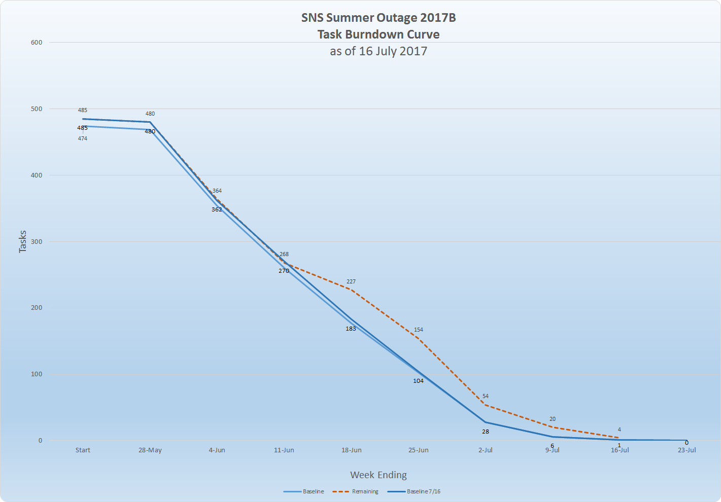
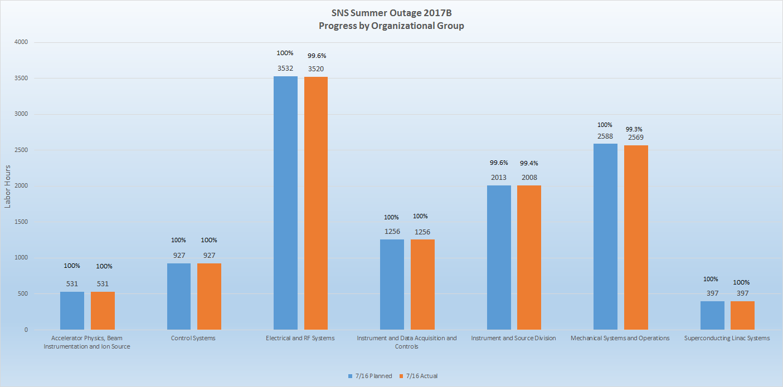
We actively managed the schedule during the 2017B outage
Tracked ~500 activities
  Added 41 activities / deferred 30 activities
Used 3 day look ahead slides at POD
Weekly updates on Monday
Neutron production began on July 13 as scheduled

Slide 8
Initial high priority project list for 2017C distributed on August 10, 2017
Accelerator and Target Systems:
MSO-07: He gas injection
MSO-04A: IRP replacement preparatory activities
MSO-15: AIP-36 Electrical work for HVCM cooling upgrade
MSO-43: LEBT turbo pump lifting fixture
EERF-35: HVCM fiber optic replacement
MSO-05A: HWS #4 heavy water conversion activities
EERF-40: Deploy 1st new Ring LLRF system
EERF-38: DTL/CCL RF power margin measurements
Instrument Upgrades:
INS-17B: ARCS Detector Modernization Phase 2
INS-01B: NOMAD background reduction Phase 2
INS-05B: POWGEN Phase 1 detectors
INS-13: CORELLI thimble
INS-06A: TOPAZ goniometer vacuum work

Slide 9
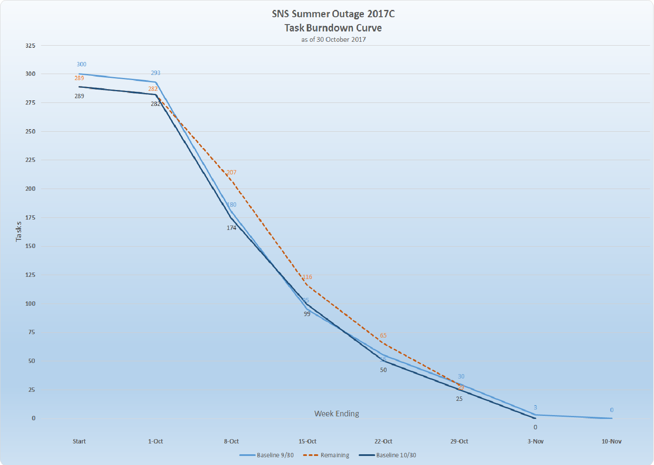
2017C was a short but challenging outage – GI3 was major focus
Developed high level block schedule
Created MS Project schedule based on 13 priority projects
  2 projects deferred during planning phase (INS-17B, INS-13)
  Included routine/planned maintenance, instrument maintenance, and target change
Hired permanent project controls specialist to overlap with contractor
Schedule baselined on 9/30
Tracked ~300 activities
  Added 33 activities / deferred 44 activities
  Included administrative actions needed to obtain approval for GI3 (ARR)
Neutron production began on November 1 as scheduled

Slide 10
Initial high priority project (55) list for 2018A distributed on October 30, 2017
6 deferred during initial planning (2 combined with existing task)
Accelerator and Target Systems
APBIIS-06 AIP-37 Beam Instrumentation Infrastructure Improvements
APBIIS-10 Electron scanner high voltage power supply replacement
CON-03 Install high power shutters DTL1/2 waveguide
CON-08 Isolate FE PPS Cabinets
CON-11 Isolate Ring/RTBT PPS Cabinets
CON-16 Install MPS Master Trigger Control Function
CON-17 Transition to new Timing Master
CON-18 New Injection Kicker Waveform Monitor
CON-19 Upgrade CTANS Controls
CON-20 Upgrade CUB Controls
CON-21 Upgrade Controls for SBDPS
EERF-12 Installation of new RFQ at Front-End building
EERF-32 Installation of old RFQ at BTF
EERF-36 Install new circuit boards in all HVCM PPIC chassis
EERF-37 Reinstall repaired klystron on production RFQ station
EERF-39 Perform RF Power Margin measurements on DTL and CCL RF stations - 2018A
EERF-40 Complete upgrade of extraction kicker pulse shape monitoring
EERF-41 Replace oil in DTL HVCM's
MSO-04B IRP Replacement
MSO-05B HWS #4 Heavy Water Conversion
MSO-15 AIP-36 HVCM Cooling Upgrade
MSO-17 LINAC Plug Door Replacement
MSO-30 Replace Obsolete MKS Gauge Controllers
MSO-48 Front End Building Vacuum Roughing Upgrade
MSO-49 Ring Injection Magnet Realignment Campaign
MSO-50 Ring Patch Cable Upgrade
MSO-52 Cryogenic Moderator system oil recovery skid
PPU-02 Address chase inserts in Klystron Gallery
SCLS-05B Plasma processing in the tunnel
SCLS-11 Swap cryomodule 17 with the spare cryomodule
SCLS-12 Spare Carbon Bed tie-in to CHL
SSG-06 Tie-in and Valving for Second Elevated Water Storage Tank
Instrument Data Acquisition and Controls
IDAC-04 ARCS DAQ/Controls Upgrade
IDAC-08 MagRef DAQ/Controls Upgrade
IDAC-09 SNAP DAQ/Controls Upgrade
IDAC-10 WAND DAQ/Controls Upgrade
Instrument Upgrades
INS-17C ARCS Detector Modernization Phase III
INS-06B TOPAZ Cryogoniometer
INS-13B CORELLI Thimble Phase II
INS-19 Liquids Reflectometer Improvement Project
INS-07 SEQUOIA Vacuum Upgrade
MSO-10 BL17 Turbo Integration--SCHW Cooling
INS-18 POWGEN T0 Chopper Baseplate
INS-10B SNAP detector rebuild Phase 2
INS-01C NOMAD Background Reduction
INS-04B EQ-SANS Detector Vessel/Sample Area Modifications Phase 2
INS-05C POWGEN Phase I Detectors

Slide 11
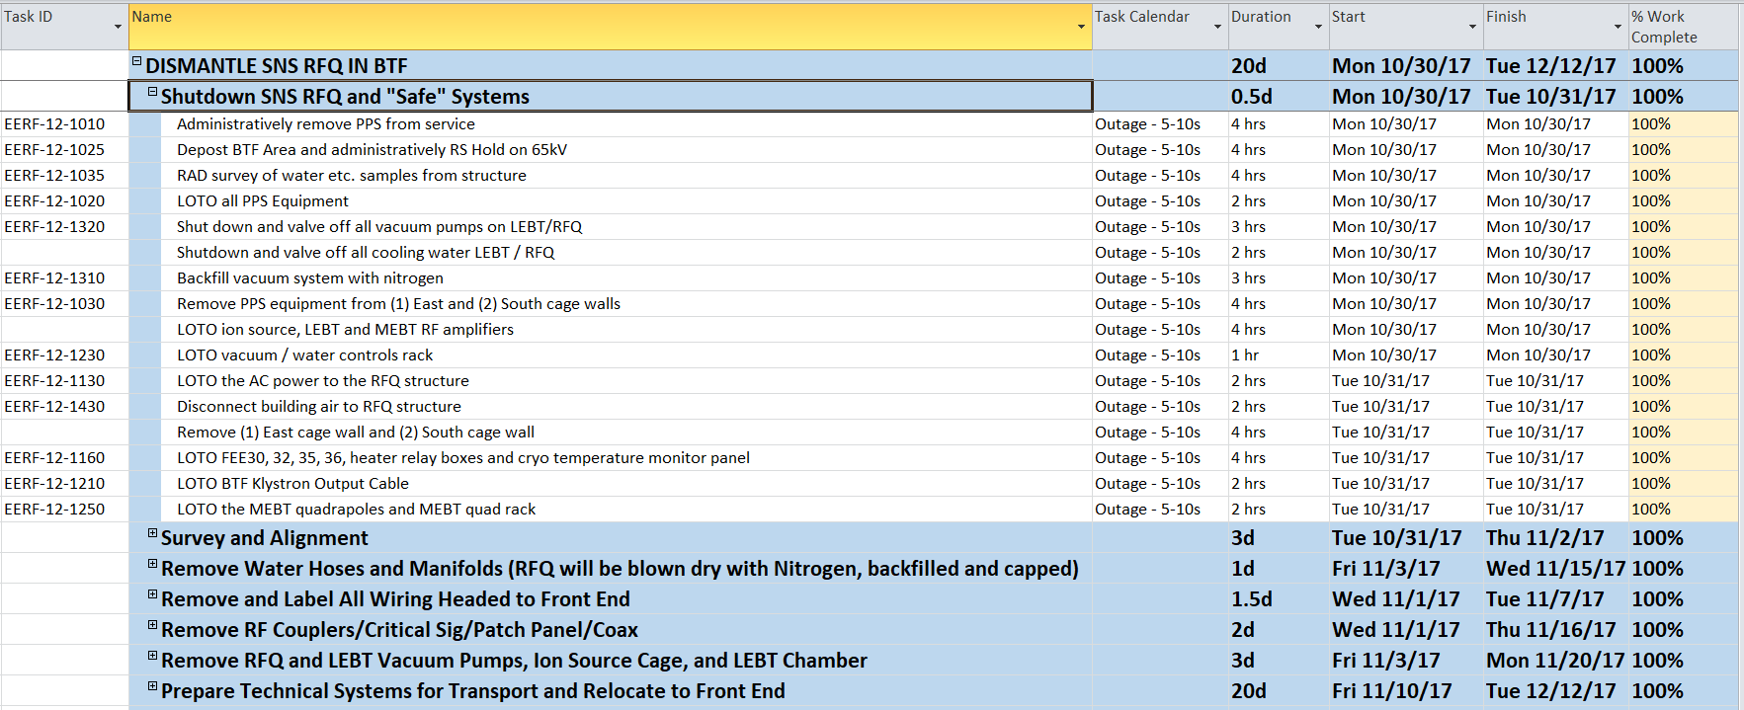
In preparation for 2018A, a detailed resource-loaded schedule was developed to move the new RFQ from the BTF to the Front End – work began on Oct. 30 – this effort took place while planning for the 2018A outage

Slide 12
We actively managed the schedule during the 2018A outage
High level block schedule
Utilized Primavera (P6) scheduling tool
Schedule was baselined December 22
Tracked 1465 activities (as of 4/30)
  Deferred 5 projects (CON-16, CON-17, CON-18, CON-21, and MSO-48)
  Added 123 / deferred 162 activities
  Completed 81% of priority projects
Used 3 day look ahead slides at POD
Weekly progress updates on Monday - reviewed progress with Division Director weekly
Spent considerable time validating and adding logic ties
Resource leveled activities during the last month

Slide 13
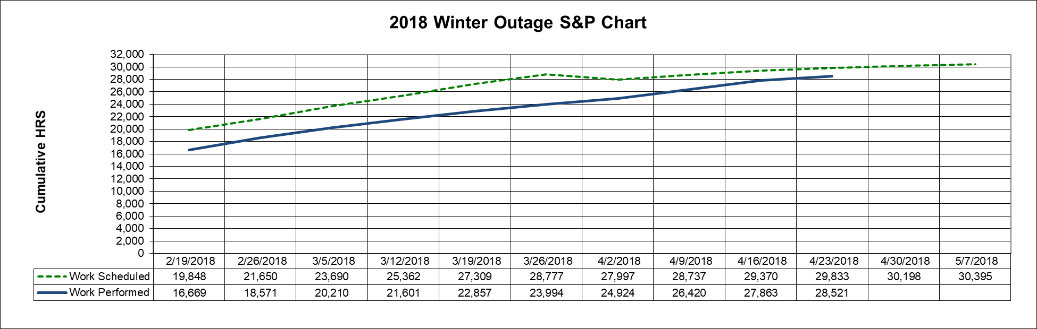
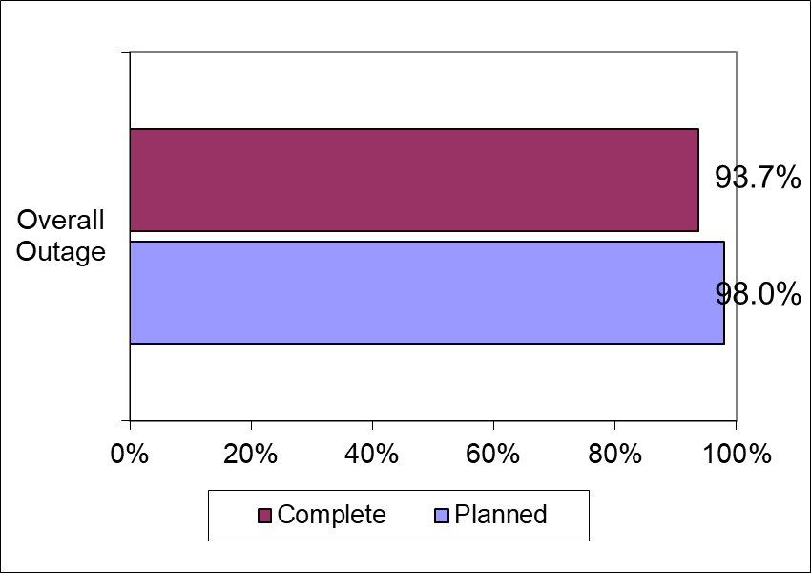
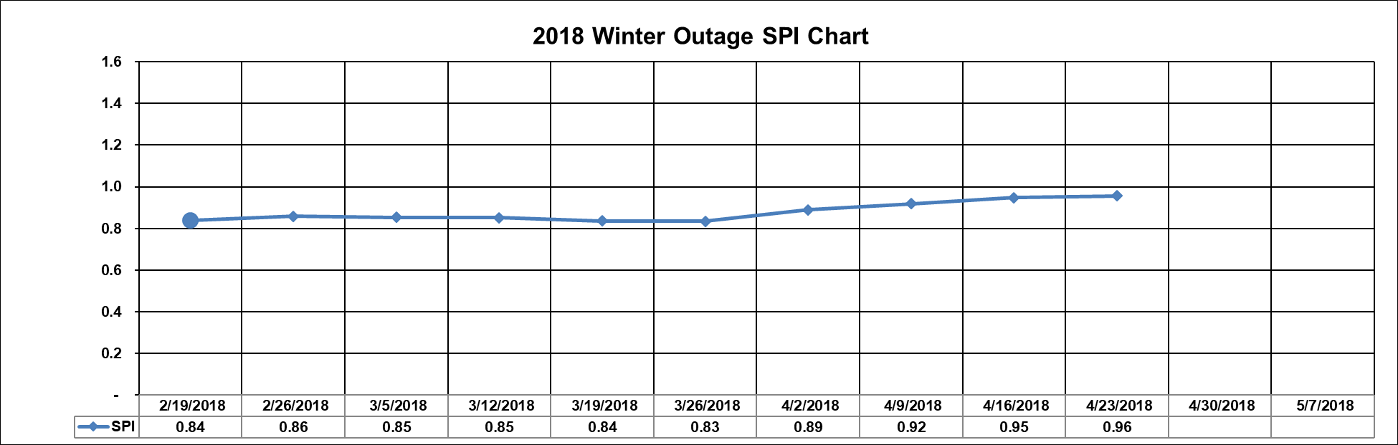
Updated metrics were used to evaluate progress
Added/deleted/changed tasks were tracked
Similar metric used for Priority tasks (both overall and individual)
0 new activities added
9 activities deleted

Slide 14
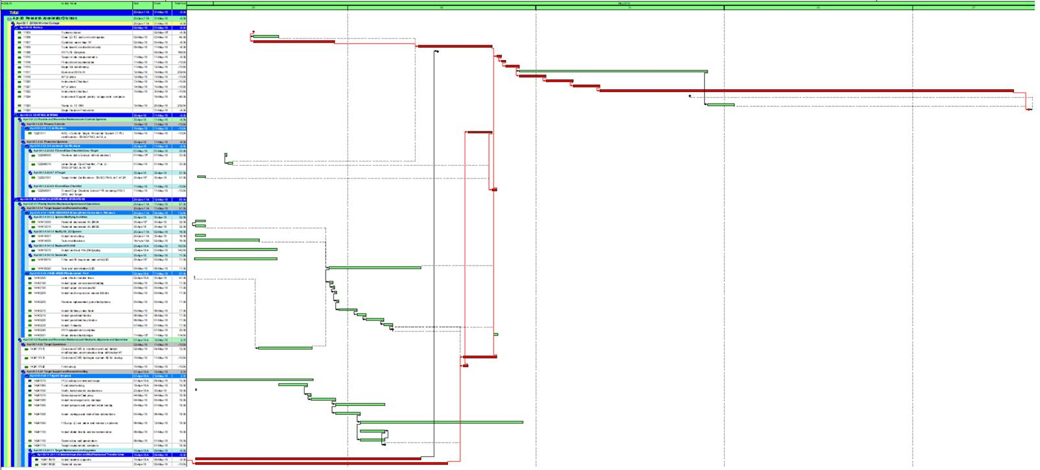
Tracked critical path for beam on target during final month – discussed daily progress along with ion source startup progress

Slide 15
Summary
Successfully executed 2017B, 2017C, and 2018A outages
Hired a permanent project controls specialist
Lessons learned
  Distribute priority projects early to allow for proper identification of all needed resources
  Put in start-up tasks at the beginning for logic linking
  Evaluate logic as it is entered
  Attempt some amount of resource leveling at the beginning
  Continue to educate planners/task leaders/team leaders on scheduling techniques
We will continue to utilize and improve our scheduling process to maximize outage effectiveness and ensure smooth integration with the upcoming PPU project

