Slide 1
Linac Beam Dynamics: Measurement and Simulation
Presented at the
SNS Accelerator & Target
Advisory Committee Meeting
Andrei Shishlo
Warm Linac Physicist
May 17, 2018

Slide 2
Outline
History of Linac Simulation Software at SNS
OpenXAL Online Model
  Bunch Centroid Motion
  RMS Bunch Sizes
PIC Codes
  PARMILA, IMPACT, Track, TraceWin
  PyORBIT (Linac Package)
Plans and Conclusions

Slide 3
Linac Simulation Software at SNS
SNS Project Stage | Linac Software
Design | Parmila, Trace3D
Commissioning | Parmila: Transverse Matching (Warm Linac) XAL Online: RF Setup, Transverse Matching (Warm Linac)
Power Ramp Up | Parmila: MEBT Round Beam Optics Impact: CCL, SCL Matching XAL Online: MEBT Optics for Proton Experiment Track: test
1.0 – 1.4 MW Operation | OpenXAL Online: Automated RF Setup, Longitudinal Twiss measurements in SCL, MEBT, Transverse Twiss in SCL PyORBIT: MEBT Optics
Sporadically used PARMTEQ for RFQ modeling.

Slide 4
OpenXAL Online Model
Features:
  Open Source
  Part of the OpenXAL framework
  Implemented in Java – fast
  Bunch Envelop & Center Tracking – significantly improved analog of Trace3D
  Improved RF Cavities models (rel. to Trace3D): can be used for realistic RF phase scans
  Includes 3D Space charge
Areas for improvement identified:
  RF gap model (ongoing activity)
  Realistic overlapping and fringe fields for magnets and distributed RF fields in RF gaps

Slide 5
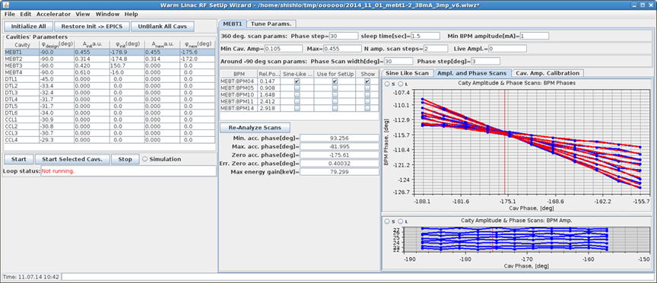
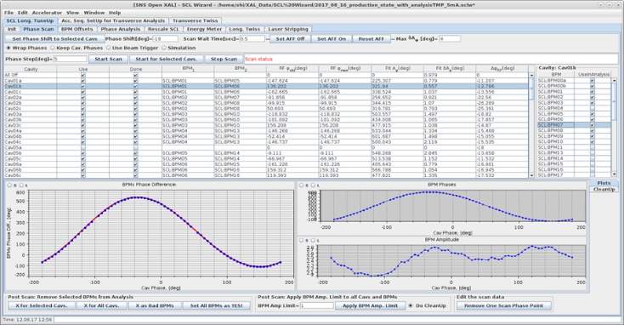
Bunch Center Motion: RF Setup
Online Model: simulates synchronous particle arrival time
BPMs signal: bunch center phase
φ = ωt
2 Apps: Warm Linac Wizard + SCL Wizard: OpenXAL Online Model engine inside
Overall: Success
22 min for Warm
Linac
40 min for SCL
MEBT | DTL-CCL | Superconducting Linac
Different BPMs give slightly different RF phase setpoints Probable cause: bunch length is big ~20⁰, Point-like model is an approximation PIC code could be used | RF structures are long Internal and external BPMs give slightly different RF phase setpoints Probably, fields inside cavities are different from design | Some accumulated differences between measured and simulated beam energies along SCL, usually it is about 2 MeV More precise model for acceleration inside RF cavities could improve this

Slide 6
Bunch Center Motion: RF Setup (Cont.)
Overall OpenXAL model is a great success for SNS
Warm Linac Wizard
  It can record the results of the empirical tuning, and it can restore it from the saved file
  RF setup is automated – it takes about 22 min for 14 cavities
SCL Wizard
  It is precise enough to restore production setup
  RF setup is automated – it takes about 40 min for 81 cavities
  SCL can be retuned in the case of one cavity failure or change of the amplitude without rescan based only on the model

Slide 7
Bunch Center Motion: Orbit Control
Online Model: simulates bunch center positions X and Y
BPMs signal: beam center X and Y
Quad and Correctors: fields
RF Cavities: amplitudes and phases
2 Apps: Orbit Correction and CCL Orbit Corr. : OpenXAL Online Model engine inside
MEBT | DTL | SCL
We have to apply orbit correction iteratively Probable cause: overlapping quadrupole fields Modification of OpenXAL online model is desirable | Orbit correction does not work: only few BPMs per DTL tank | If all files for model initialization are correct, the model works very well Otherwise, the iterative procedure is needed
 | CCL
 | Only few BPMs – Quad offsets were needed – the specialized app was developed Today we correct orbit empirically

Slide 8
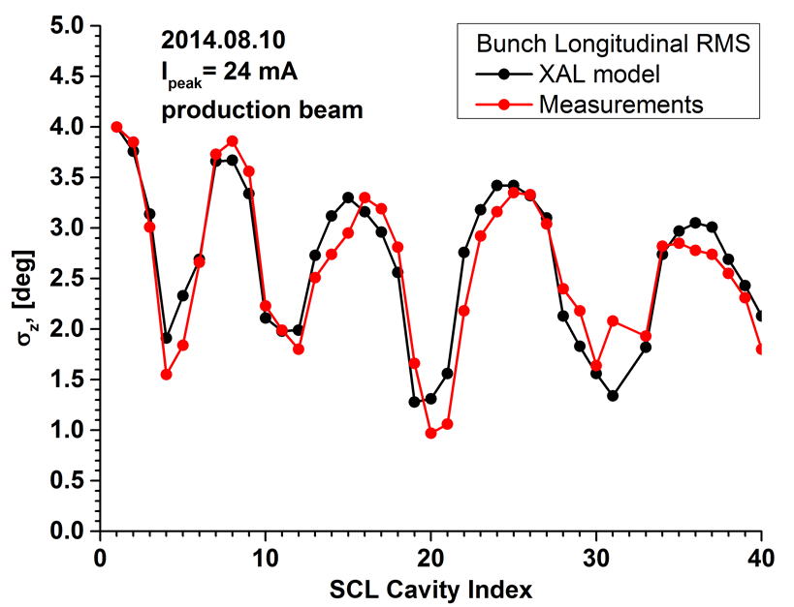
Bunch Length RMS: OpenXAL Online Model
In SCL no intercepting diagnostics are allowed
The procedure for longitudinal Twiss measurements based on a RF cavity manipulations and Fourier analysis of the BPM sum of all strip-lines signal is developed
  For SCL few years ago | for MEBT this year
Measured longitudinal RMS emittance is 80% and 100% more than design value in MEBT and SCL respectively
SCL Long - RMS Bunch Size Model/Measurements

Slide 9
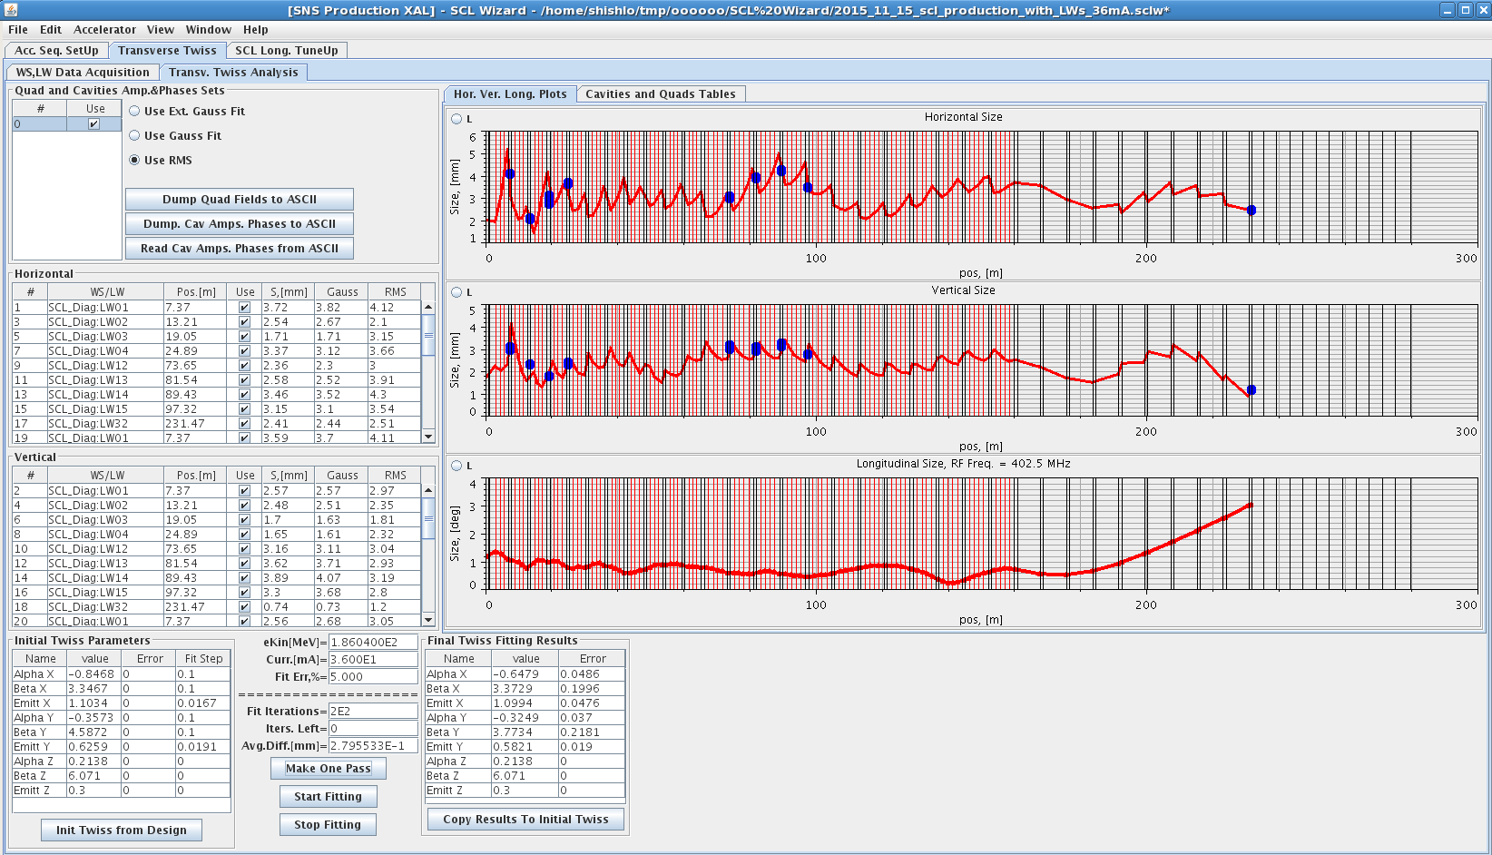
Transverse RMS Sizes, Matching
The model-based (Parmila, Impact, OpenXAL Model) matching was used as a first step – the final tuning (low beam loss) is always empirical
In the SCL we can reconstruct RMS beam sizes, but we cannot predict beam loss
Hor.
Ver.
Long.
SCL RMS Sizes: 2015.11.15
Points are Laser Wires Stations

Slide 10
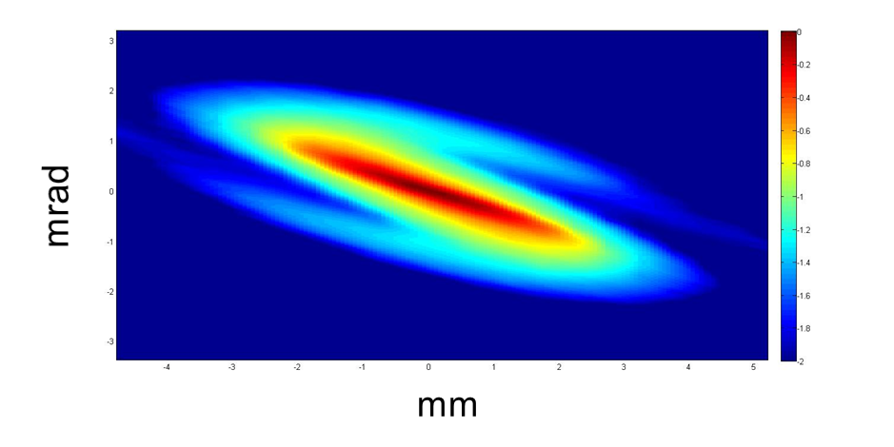
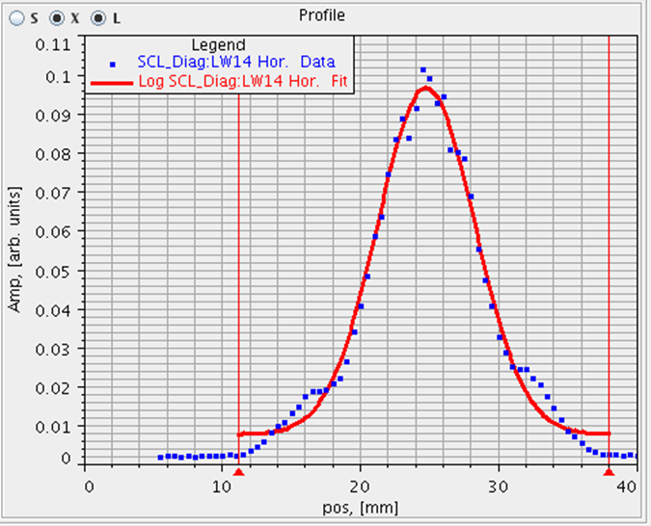
Envelop Codes Limitations
The Envelope codes are very useful, but they have limitations:
  For linear optics only – our RF models have non-linearities
  They cannot describe beam halo
  They cannot predict losses (some type of them)
We have to have combination of Envelop and PIC codes
Non-Gaussian beam component in SCL
X-X’ Phases Space Density, 2014
End of SCL
(courtesy of A. Aleksandrov)

Slide 11
Why Another PIC Linac Code?
There are a lot of PIC linac codes available: Parmila, Impact, Track, TraceWin etc.
They all have one fundamental drawback – SNS project does not have control over any of these codes:
  We cannot take a look at the source code
  We cannot make small reversible changes for computational experiments
  We cannot add new physics if we need it
  We cannot add new diagnostics
It is not universal – some people do not want to have this type of control
We started a linac code inside PyORBIT

Slide 12
PyORBIT : Scripting Shell Approach
Main Executable: CONST
Old style:
MAD-like structure
Old languages
Text Input File
Structure
and
Tracking commands
Output Files
“Accelerator Simulation Language”
PyORBIT is an extended Python interpreter: you can use numpy, matplotlib etc.
MODIFIABLE User Script
Dynamic Loading
Module 1
Module 2
Input File
With
Structure
Module 3
Output Files or Graphics
Module 4
.
.
.
Unfortunately, we have to use two language approach: Python + C++

Slide 13
Linac Model in PyORBIT
Linac part of PyORBIT has its own lattice structure
XML description of the linac lattice
5 different RF gap models
Two 3D Space Charge calculators: envelop like and 3D FFT
Overlapping quadrupole fields
Overlapping RF fields
Bunch Backtracking feature
Bunch generation from transverse emittance data
Apertures for quads, RF gaps, and beam pipe
Performed benchmark with Parmila, TraceWin, Impact

Slide 14
PyORBIT – Parmila Benchmark – MEBT
SNS MEBT 38 mA. PARMILA vs. pyORBIT
20,000 macro-particles
Water Bag 3D
Bunchers RF is on, 90⁰ phases
Timing:
Parmila SHEFF – about 4 sec
PARMILA 3D PICNIC – 8 sec
pyORBIT 1 Ellipsoid – 1.6 sec

Slide 15
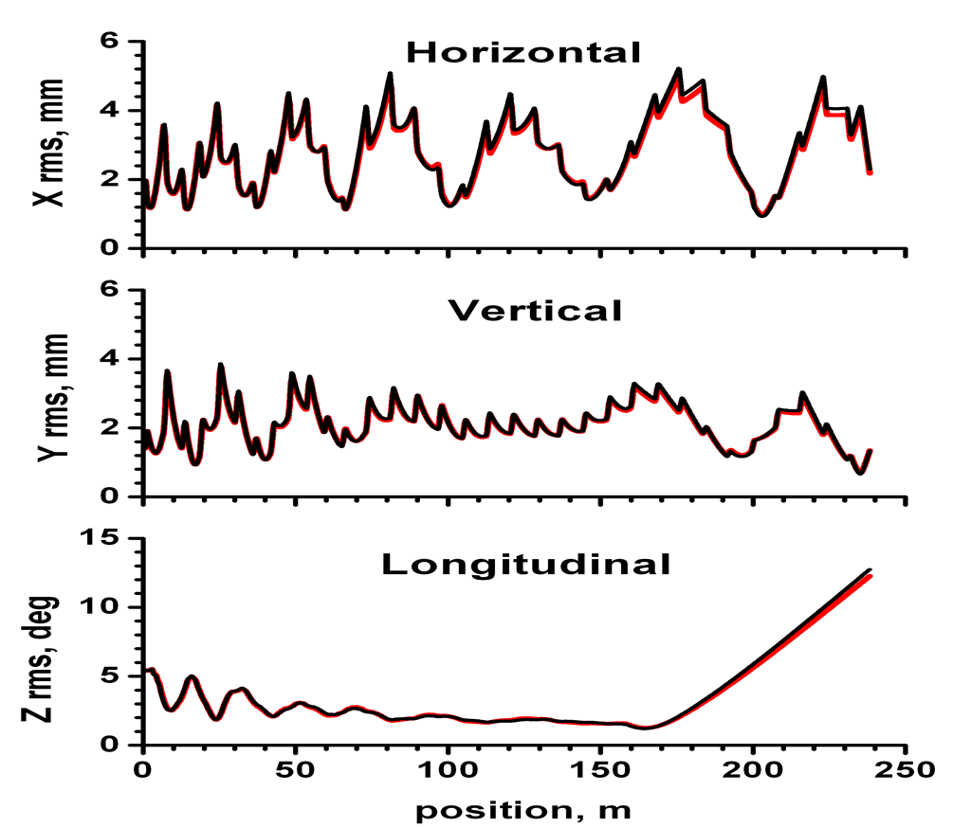
SCL: PyORBIT – OpenXAL Online Model
OpenXAL Online Model is an envelop tracking code

Slide 16
Plans for OpenXAL and PyORBIT
Ultimate goal for Control Room Apps: universal plugin mechanism for online models in control room applications – possibility to switch between models during live data analysis
OpenXAL: Structure and Online Model improvements
Right now: use PyORBIT as online model for our Beam Test Facility: the first variant with GUI is ready
Perform more benchmarks between PyORBIT and real data for SNS
Use PyORBIT for SNS SCL data analysis and a new optics generation to reduce losses

Slide 17
Conclusions
At this moment, SNS actively uses two simulation codes for the linac part of accelerator: OpenXAL Online Model and PyORBIT
OpenXAL is a community code – most active developers are at ESS, CSNS, and SNS
PyORBIT linac part is used only at SNS
There are plenty of tasks for PyORBIT here at SNS
Control room applications with accelerator models as plugins could be useful for community

Slide 18


Slide 19
PyORBIT at a Glance
PyORBIT is descendant of ORBIT code (rings + transport lines)
PyORBIT & ORBIT have the two language structure: driving scripting shell and C++ underneath
ORBIT’s Super Code shell was replaced by Python
Open source: means everybody can do anything, and it is open for future collaborators
Architecture allows independent development of external modules without any permission
At this moment owners of the PyORBIT Collaboration at GitHub are from: CERN, GSI, SNS

