Slide 1
Self-Consistent Beam Distribution
Presented at the
SNS Accelerator & Target
Advisory Committee Meeting
Jeff Holmes
Accelerator Physics
May 16, 2018

Slide 2
Goal and Motivation
Paint a self-consistent beam into the SNS ring
Self-consistent beam properties:
  Elliptical or ellipsoidal shape
  Uniform charge density
  These properties preserved in all linear transport
Self-consistent beam advantages:
  Low peak charge density (good for fixed target applications)
  Smaller tune shift and tune spread
  Less halo growth
  Potential to make flat beams
Funded by DOE BES Accelerator and Detector Research (ADR) Program

Slide 3
Rotating Beam: SNS Self-Consistent Candidate
Rotating beam properties:
  Ideally 2-D coasting beam distribution (uniform longitudinal density)
  Equal transverse tunes: Q_{x} = Q_{y}
  Emittances increase linearly in time from zero to maximum values
  Horizontal and vertical particle motion 90º out of phase
Issues for painting into SNS:
  Real world physics: nonlinearities, collective effects, RF bunching, scattering and losses, finite injected beam size
  Hardware limitations and necessary modifications:
    Addition of solenoids
    Injection kicker capabilities

Slide 4
Status a Year Ago (2017 AAC Meeting)
Theoretical studies complete
Incomplete computational results mostly positive, with caveats:
  Hardware modifications required:
    Addition of two 1.4 T half meter long solenoid magnets
    Introduction of bipolar power supplies on up to three of the eight injection kickers
  Quadrupole fringe fields a potential issue due to off-axis beam in injection straight section
    Move the injected beam closer to the closed orbit -> waste beam issues
Several questions remained:
  Resolution of fringe field issue
  Optimal painting scheme and ability of injection kickers
  Sensitivity of self-consistency (robustness)
  Experimental verification of self-consistency

Slide 5
Fringe Field Developments – Issue Resolved
Created a distributed fringe field model
Found a bug in the complex math library used in ORBIT
Modification of injection point unnecessary

Slide 6
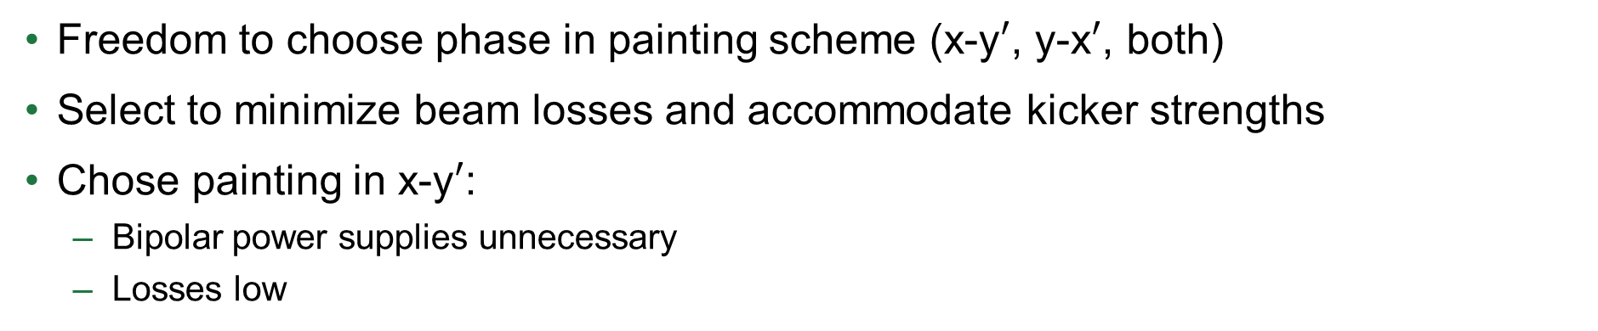
Painting and Injection Kickers – Choice of Scheme
Freedom to choose phase in painting scheme (x-y$′$, y-x$′$, both)
Select to minimize beam losses and accommodate kicker strengths
Chose painting in x-y$′$:
  Bipolar power supplies unnecessary
  Losses low

Slide 7
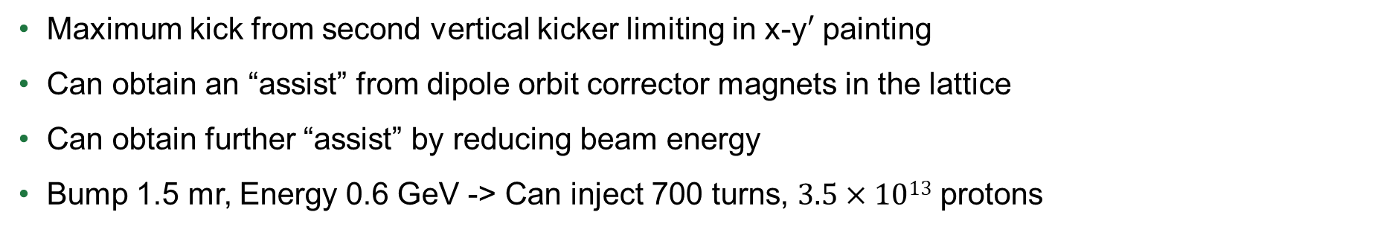
Painting and Injection Kickers – Limitations
Maximum kick from second vertical kicker limiting in x-y$′$ painting
Can obtain an “assist” from dipole orbit corrector magnets in the lattice
Can obtain further “assist” by reducing beam energy
Bump 1.5 mr, Energy 0.6 GeV -> Can inject 700 turns, $3.5×1013$ protons
V2

Slide 8
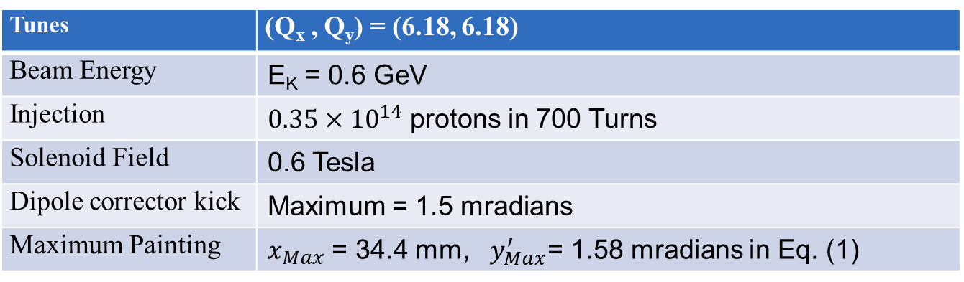
Self-Consistent Case – Parameters
This table shows the parameters for a case that we can actually paint once the solenoid magnets are installed
The simulation results shown on the next two slides use these parameters
Tunes | (Q_{x} , Q_{y}) = (6.18, 6.18)
Beam Energy | E_{K} = 0.6 GeV
Injection | $0.35×{10}^{14}$ protons in 700 Turns
Solenoid Field | 0.6 Tesla
Dipole corrector kick | Maximum = 1.5 mradians
Maximum Painting | $x_{Max}$ = 34.4 mm, $y_{Max}^{′}$= 1.58 mradians in Eq. (1)

Slide 9
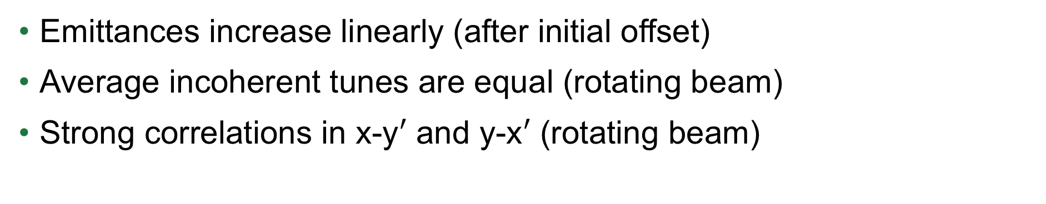
Self-Consistent Case – Verification (Time-Dependence)
Emittances increase linearly (after initial offset)
Average incoherent tunes are equal (rotating beam)
Strong correlations in x-y$′$ and y-x$′$ (rotating beam)

Slide 10
Self-Consistent Case – Verification (Beam Profiles)
Beam profiles have well-defined shape (constant density)
“Wings” at edges due to non-ideal effects
140 Turns
700 Turns

Slide 11
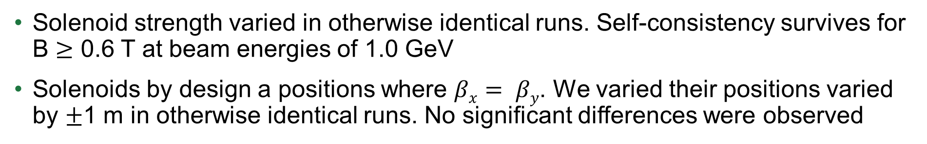
Sensitivity Studies – Solenoid
Solenoid strength varied in otherwise identical runs. Self-consistency survives for B $≥$ 0.6 T at beam energies of 1.0 GeV
Solenoids by design a positions where $βx= βy$. We varied their positions varied by $±$1 m in otherwise identical runs. No significant differences were observed
0.25 m⁻¹ = 1.4 T

Slide 12
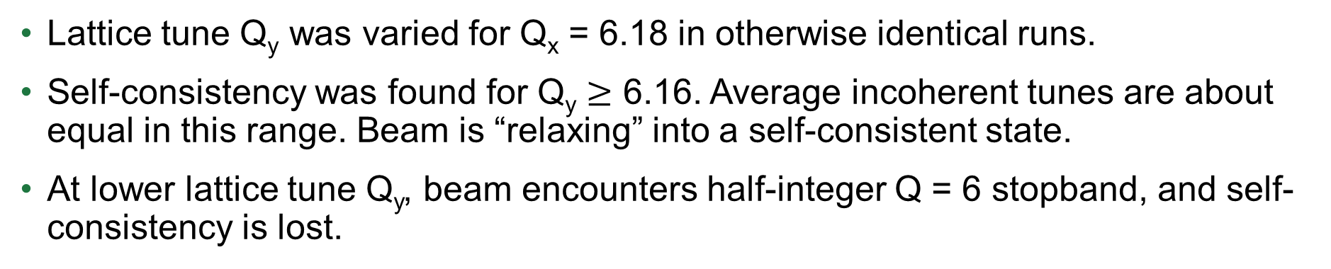
Sensitivity Studies – Lattice Tunes
Lattice tune Q_{y} was varied for Q_{x} = 6.18 in otherwise identical runs.
Self-consistency was found for Q_{y} $≥$ 6.16. Average incoherent tunes are about equal in this range. Beam is “relaxing” into a self-consistent state.
At lower lattice tune Q_{y}, beam encounters half-integer Q = 6 stopband, and self-consistency is lost.

Slide 13
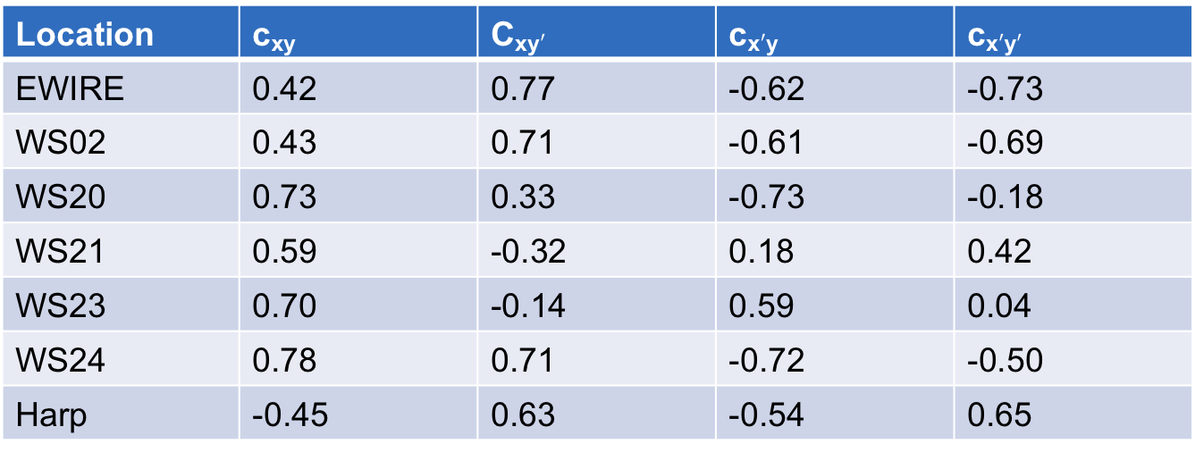
Experimental Confirmation - Profiles and Correlation Coefficients
EWIRE
WS20
Location | c_{xy} | C_{xy}$′$ | c_{x}$′$_{y} | c_{x}$′$_{y}$′$
EWIRE | 0.42 | 0.77 | -0.62 | -0.73
WS02 | 0.43 | 0.71 | -0.61 | -0.69
WS20 | 0.73 | 0.33 | -0.73 | -0.18
WS21 | 0.59 | -0.32 | 0.18 | 0.42
WS23 | 0.70 | -0.14 | 0.59 | 0.04
WS24 | 0.78 | 0.71 | -0.72 | -0.50
Harp | -0.45 | 0.63 | -0.54 | 0.65

Slide 14
Conclusions
Computational studies for injecting a self-consistent beam into the SNS ring are complete
The only hardware change required is the addition of two 0.5 m solenoids capable of at least 0.6 T
It will be necessary to run at reduced energy (ideally 0.6 GeV) to accommodate the limitations in injection kicker strength
The solutions appear to be quite robust, demonstrating low sensitivity to solenoid strength and placement and to the exact lattice tune setting
Next steps will involve:
  design, fabrication, and installation of the solenoids
  confirmation of the required lattice settings and painting waveforms, and
  detailed study on the measurement of the correlation coefficients between phase space variables

