Slide 1
Beam Diagnostics Systems, Status and Upgrade
Presented at the
SNS Accelerator & Target
Advisory Committee Meeting
Alexander Aleksandrov
Beam Instrumentation and Experimental Technology Team Leader, BeST
May 16, 2018

Slide 2

SNS Beam Instrumentation Systems are numerous and diverse
BCM, BLM, BPM, BSM, WS….
IDump
3 Position
1 Wire
6 Loss
2 Current
2 Video
1 Foil Temperature
RING
44 Position
54+ Loss
1 Current
12 Fast Loss
2 Electron Profile Scanner
2 Transverse feedback damper
15+ systems, 400+ IOCs
MEBT
6 Position and Phase
2 Current
5 Wire Scanners
1 CHUMPS
2 Emittance
1 Laser Wire (long)
1 Aperture
2 Scrapers
1 DD CHUMPS
HEBT
29 Position and Phase
26+ Loss,
3 Fast Loss
10 Wire
4 Current
2 Bunch Shape
6 Scrapers Charge
1 Laser emittance
4 HG BPM
CCL
10 Position and Phase
9 Wires
48 Loss
1Faraday Cup
4 Bunch Shape
10 Neutron Detectors
EDump
1 Current
4 Loss
1 Wire
MDump
4 Loss
2 Current
1 Wire
LDump
6 Loss
6 Position
2 Wire
RTBT
17 Position
26 Loss
5 Wires
4 Current
1 Harp
3 Fast Loss
1 Target Imaging
Not operational
DTL
10 Position and Phase
5 Wire Scanner
4 Loss Monitor
5 Faraday Cup
6 Current
18 Neutron Detectors
SCL
34 Position and Phase
33+ Loss
9 Laser Wire
24 Neutron Detectors
1 Fast DBCM
In development
Recently upgraded

Slide 3
Changes in Beam Instrumentation and Experimental Technology (BIET) Team
Changes in staffing
V. Tzoganis new hire
A. Reheman hired as staff
NSF grant
NSF grant
M. Santana VSP
engineers and
physicists
PhD
students
technicians
postdocs
Changes in scope
  Took responsibility for the magnetic measurement stand (shared with electrical group)

Slide 4
Many diagnostics systems electronics require replacement due to obsolescence
Hardware is 15-20 years old
  Critical for digital electronics
Software is outdated
  Often poorly documented
  Often impossible to update due to hardware compatibility
  Hard to find people for programming outdated systems
Outdated and complex designs
  Some systems easier to replace than maintain
“Big three” – multichannel distributed systems
  Linac Beam Position and Phase Monitors
  Ring Beam Position Monitors
  Beam Loss Monitors
“Stand alone” systems
  BCMs, WSs, etc.
Upgrade
covered by AIP-37
Upgrade covered by operations,
on case-by-case basis

Slide 5
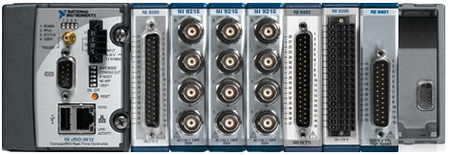
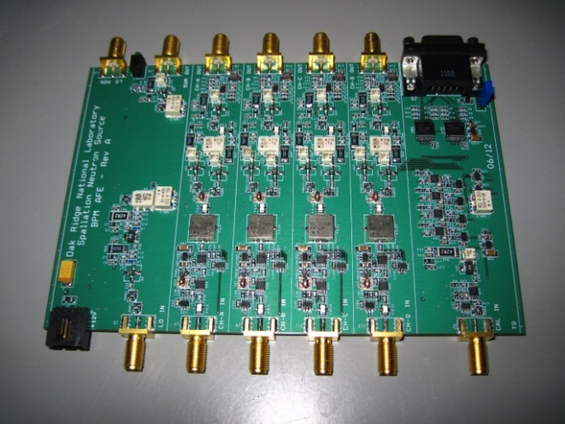
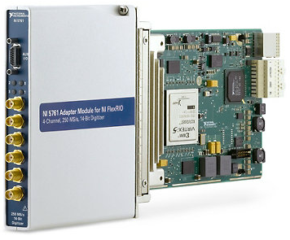
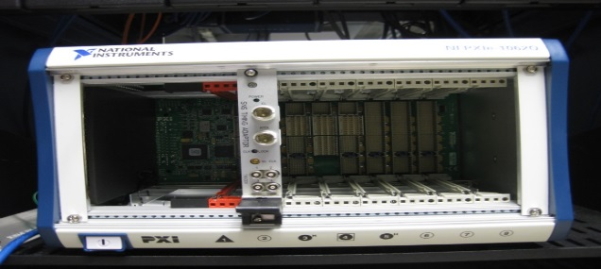
Our approach to all new electronics designs is to minimize custom design efforts
SNS design
Commercial Off-the-Shelf
NI cRIO for BW<1MHz
NI PXIe for wide BW
Custom built
Analog Front-End
COTS
Analog-To-Digital
Conversion
COTS
General Purpose FPGA
COTS
Crate and controller
Analog Front End boards are custom designed using help
from Electrical, RF,
and Controls engineers.
High Level Language Programming
Strive to minimize variety of NI cards among BI systems to maximum extent possible: controllers, FPGAs, ADC, etc.

Slide 6
AIP-37 Diagnostics Infrastructure Upgrade
Scope
  Replace Linac style BPM electronics (99 systems)
  Replace Ring style BPM electronics (64 systems)
  Replace BLM electronics (~400 channels of ICs, PMTs, NDs mix)
Duration and Cost
  $4.2M over 5 years
  Cost includes M&S, labor and contingency
  Schedule is driven by funds availability and operations schedule
Status
  Prototypes extensively tested and accepted for BPMs and BLMs
  Deployment is in progress for Linac and Ring BPMs
  BLM deployment is contingent upon deployment of new MPS
    Tentatively, begins in second half of 2019
New functionality
  New BPM acquisition rate 60Hz vs. 1Hz for old BPM
    Knowledge of beam position and phase for every pulse in multiple points along beam line
  Ready for variable pulse-to-pulse pattern of STS operation

Slide 7
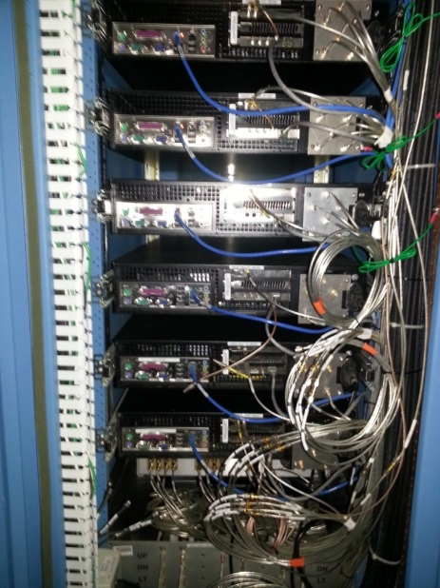
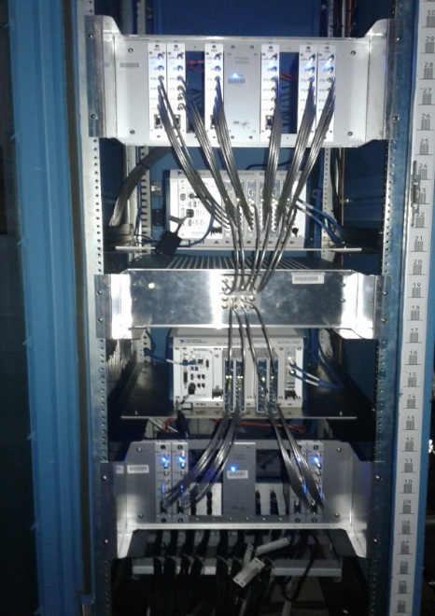
Linac BPMs installation progress
MEBT, 805MHz
DTL, 805MHz
CCL, 402.5MHz
SCL, 402.5MHz
HEBT, 402.5MHz
L_Dump, 402.5MHz
I_Dump, 402.5MHz
Old Linac BPM electronics
New Linac BPM electronics

Slide 8
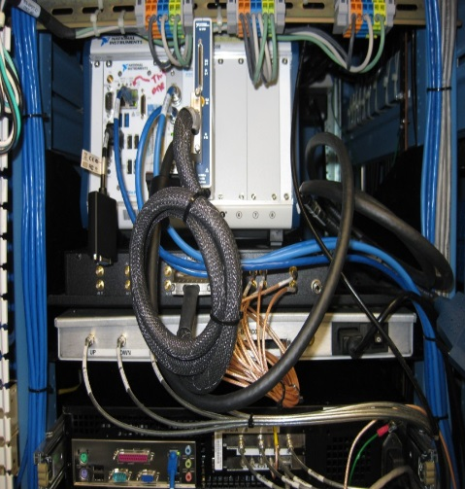
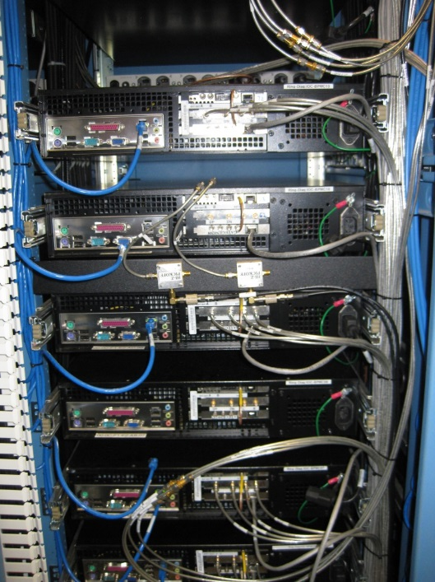
Ring style BPMs installation progress
Ring
RTBT, E_Dump
New Ring BPM electronics
Old Ring BPM electronics

Slide 9
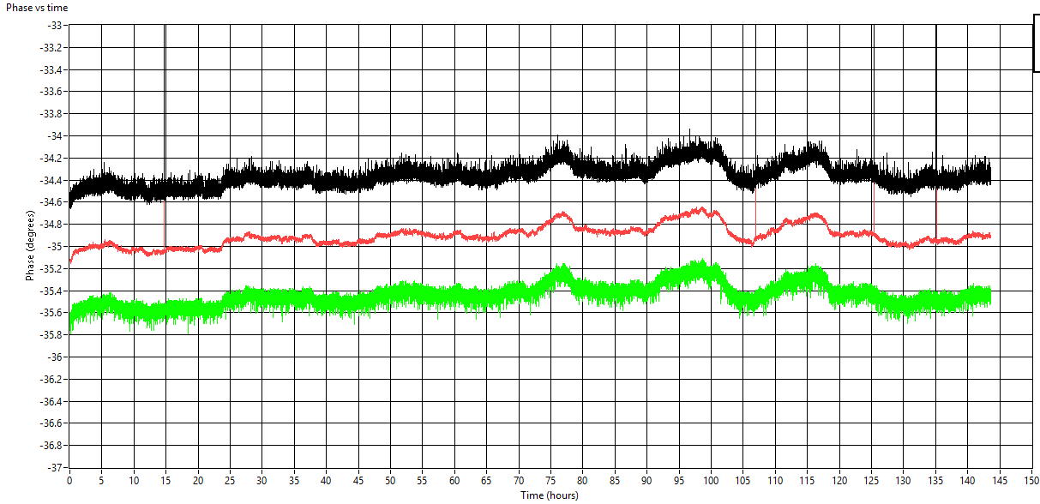
New NI ADC card reduces cost of linac BPM
NI FPGA card
NI PXIe crate
Original configuration
  6 NI-7971 FPGA
  6 NI-5761 4-ch ADC
    14-Bit, 500MHz BW
NI ADC card
New configuration
  2 NI-7971 FPGA
  2 NI-5753 16-ch ADC
    16-Bit, 100 MHz BW
Save up to 4 FPGA cards per crate
Save some on ADC cards
New system show identical performance in lab tests
Deploy one 4-BPM system for field test
Courtesy of C. Long

Slide 10
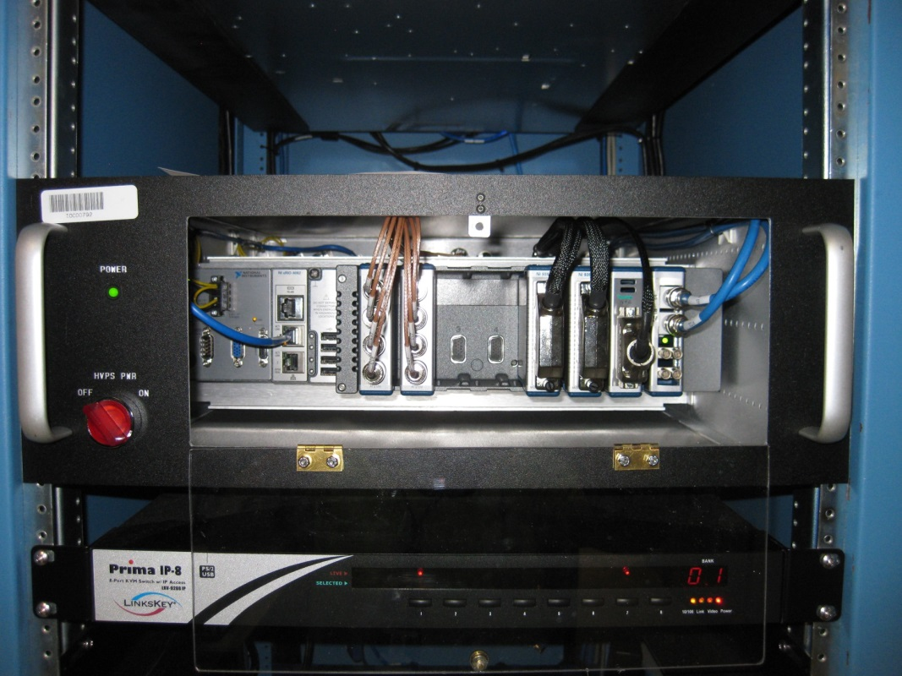
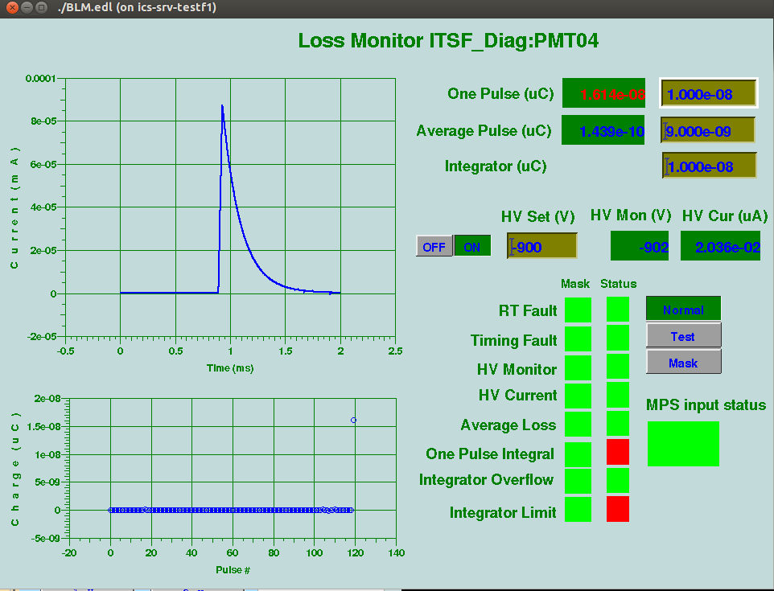
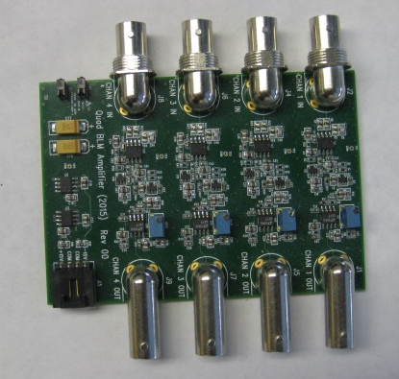
Test of new BLM electronics in BTF beam line
cRIO crate
AFE board
Operated continuously for ~ 1 year at BTF without any issues
Courtesy of S. Zhukov

Slide 11
Replacing obsolete standalone systems
RTBT harp electronics
  90 channels of low current measurements
  A new replacement system ready to deploy if the old one fails
Chopper operation monitoring system (CHUMPS)
  Done
  Same system can function as NCDs in Injection and Momentum Dump lines
DTL Faraday Cups charge readout AFE and DAQ
  Done
HEBT Scrapers charge readout DAQ
  Done
Beam Current Monitor BCM25i
  Measures integrated charge on target
  A prototype of fully digital new system installed for testing
Beam Shape Monitors
  Longitudinal bunch profile measurements in CCL, HEBT, BTF
  New electronics being developed

Slide 12
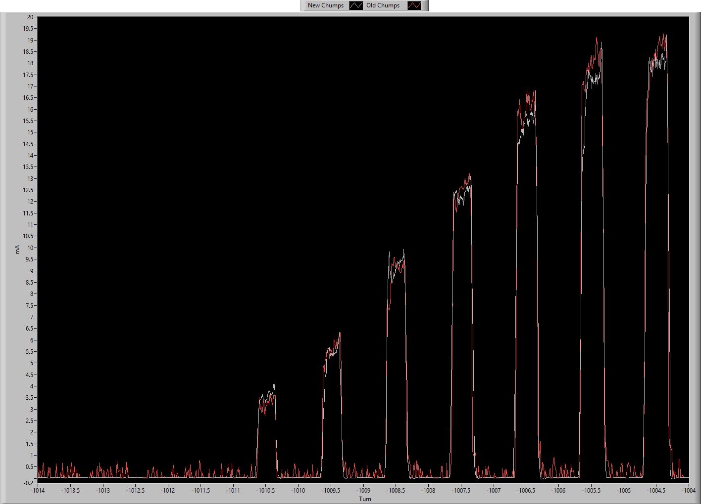
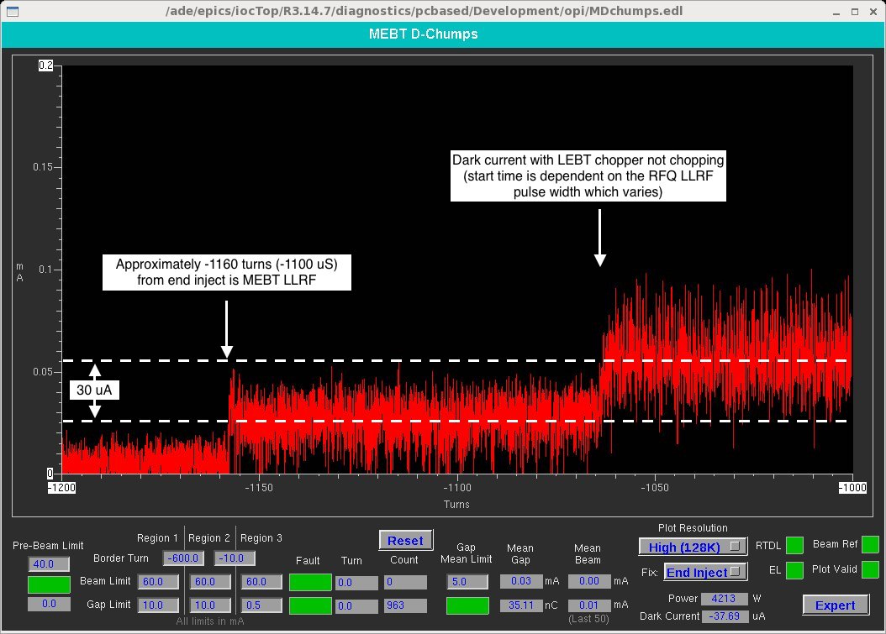
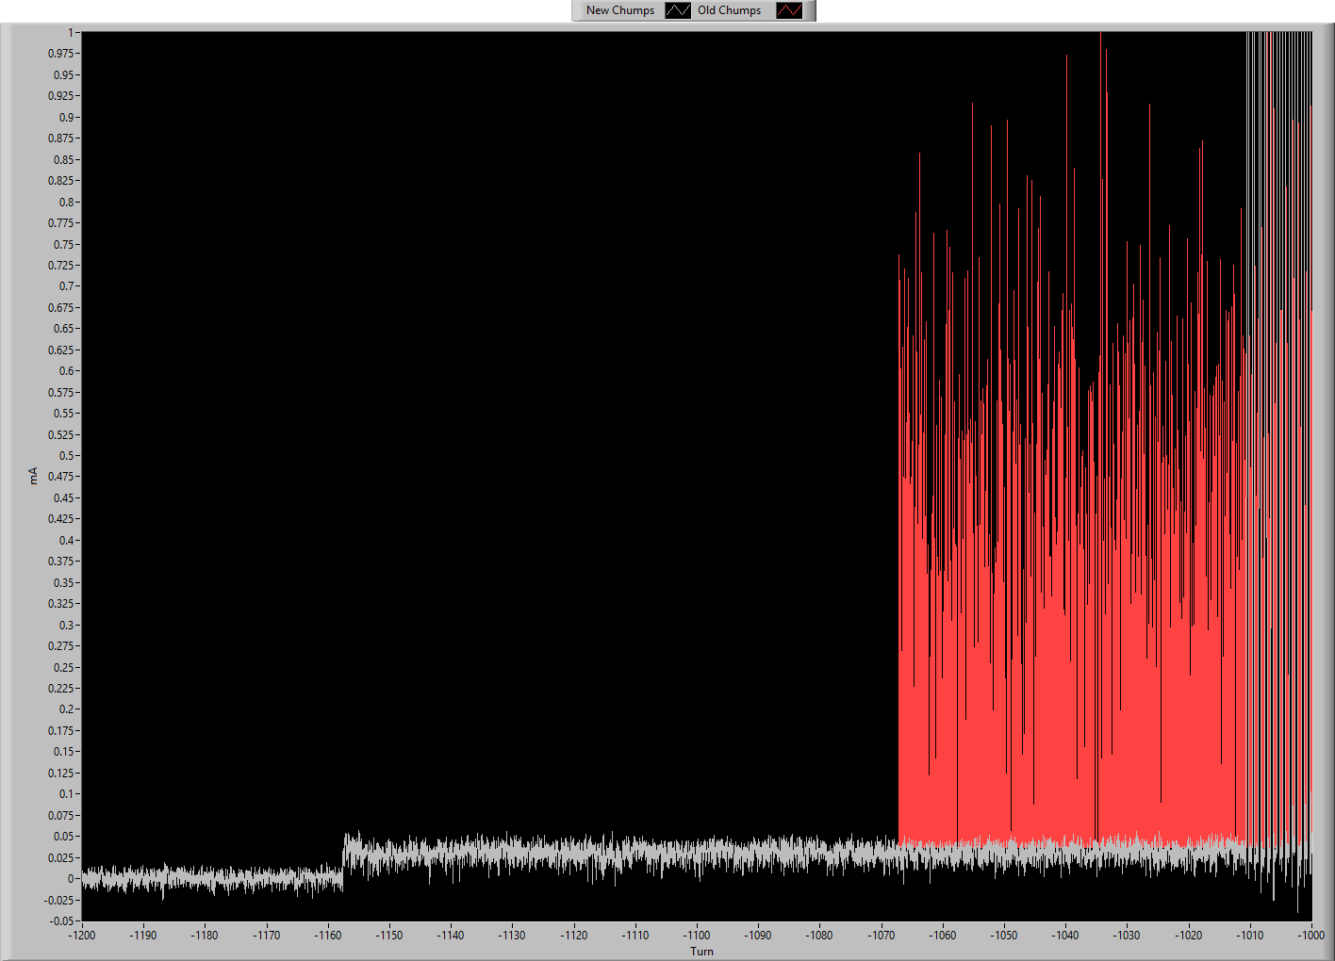
New direct digital CHUMPS demonstrates excellent performance
Same digital components as
in new BPM electronics
~ 10,000 dynamic range;
~ 20ns rise/fall time;
Linear response in full range -> 1 point beam-based calibration using BCM
Old CHUMPS
noise floor
New CHUMPS
noise floor
~10uA

Slide 13
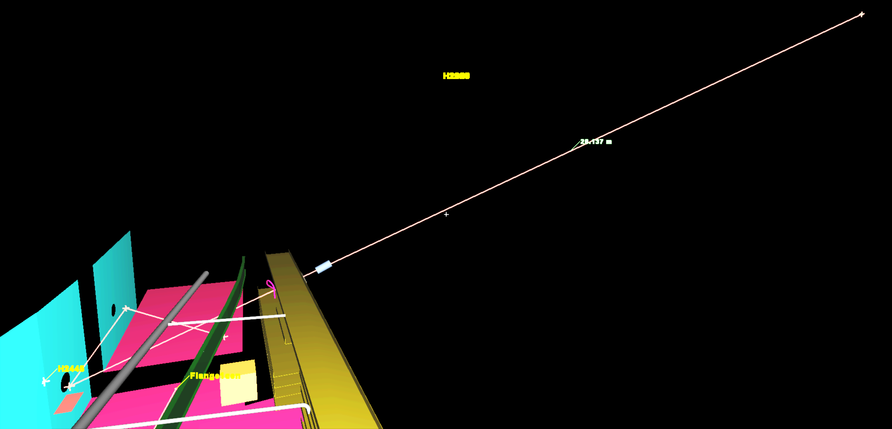
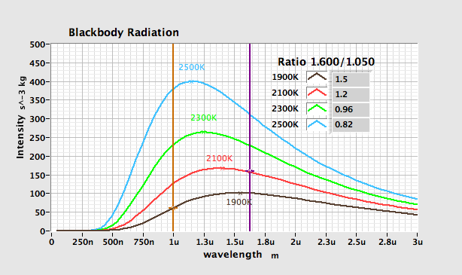
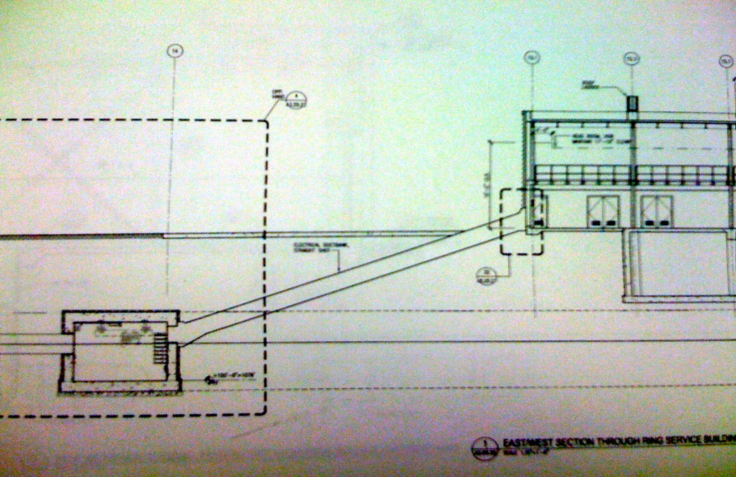
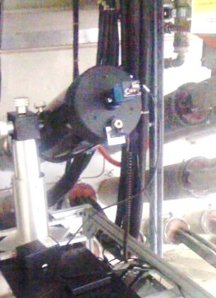

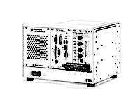
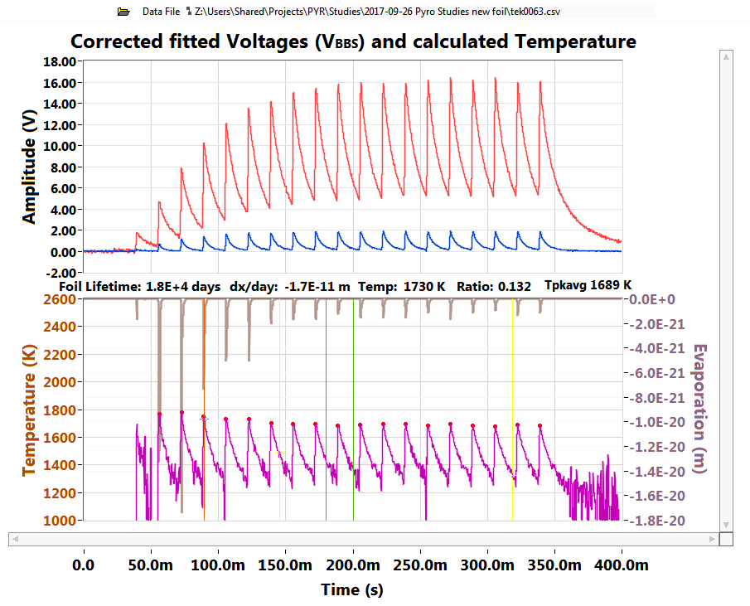
Foil temperature measurement system
Total Optical Path Length ~ 40 m
Telescope
Chase from Ring tunnel to service building
Window
DAQ
Mirror
Foil
T=1650 ± 150 K @1.2MW
Mirror
Courtesy of W. Blokland, A. Reheman

Slide 14
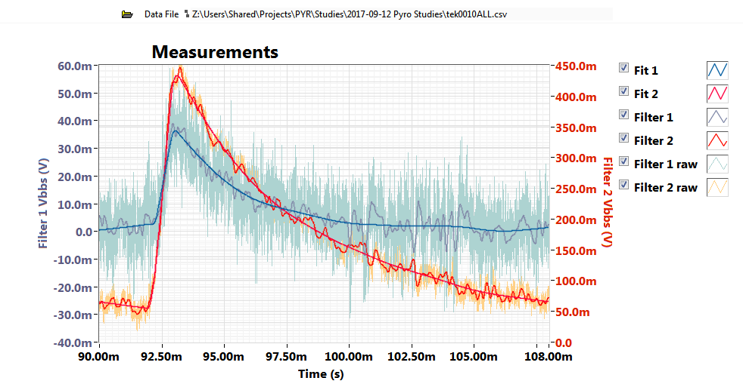
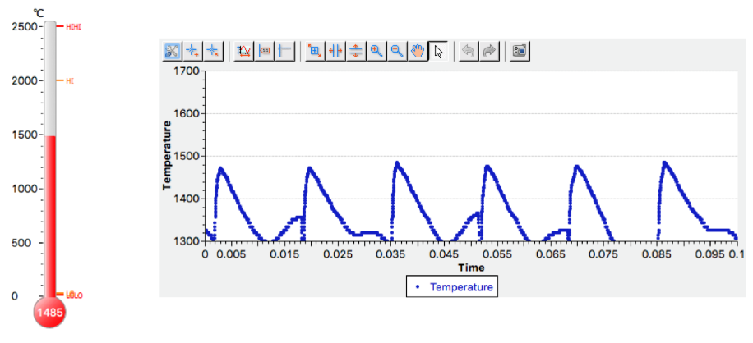
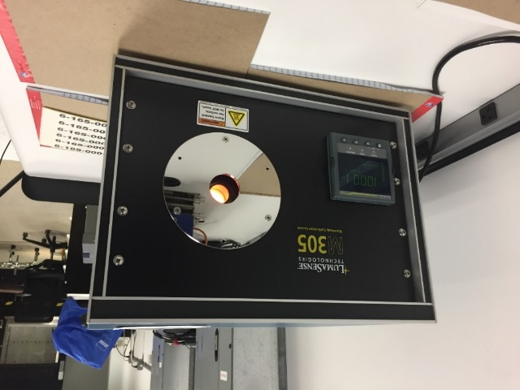
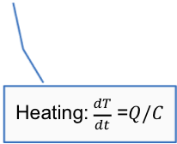
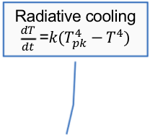
Short term development efforts
Radiative cooling $\frac{dT}{dt}$ =$k(T_{pk}^{4}−T_{ }^{4})$
Signal-to-noise improvement
  Signal processing
  Optics in tunnel options study
  Low noise detectors
Calibration improvement
  Optical components characterization
  Direct calibration vs. “black body” source
Control Room application
  Continuous temperature data archiving
Heating:$\frac{dT}{dt}$ =$Q/C$
New Spectrometer for free space calibration of the components
Control room CS Studio application
“Black body” source
Courtesy of W. Blokland, A. Reheman

Slide 15
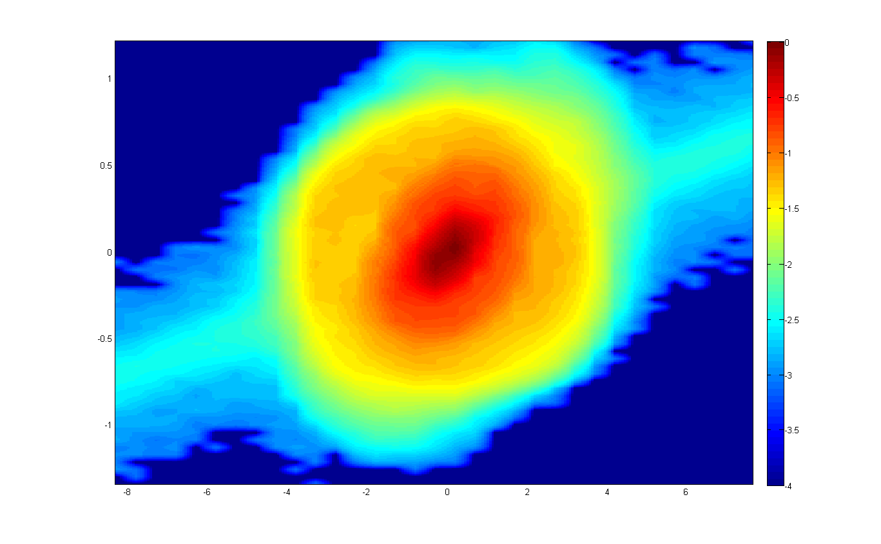
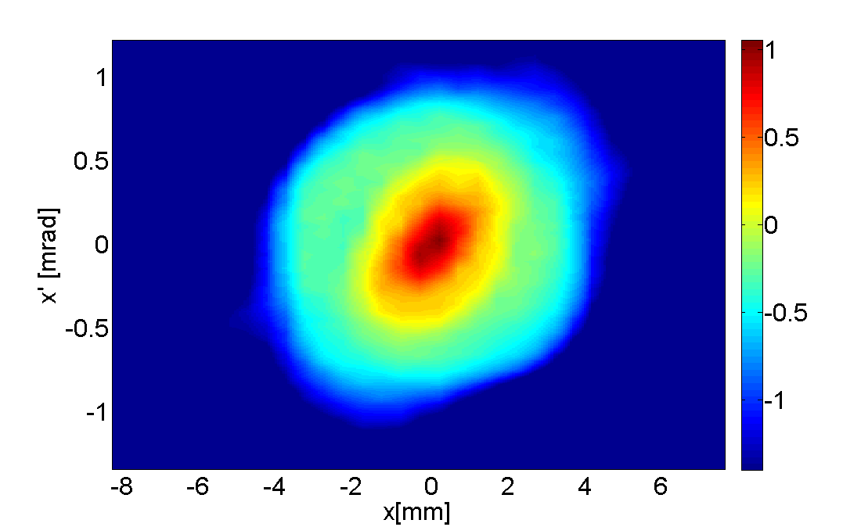
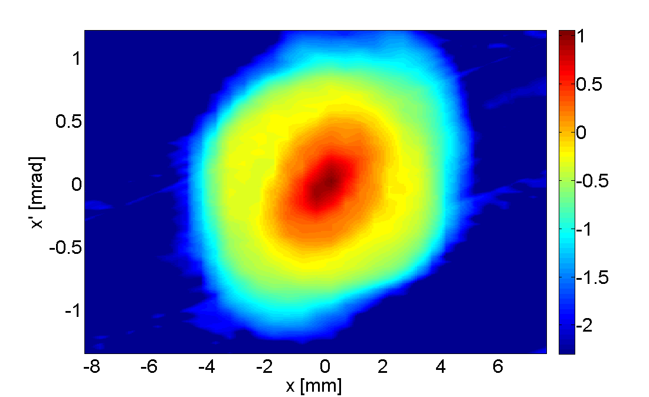
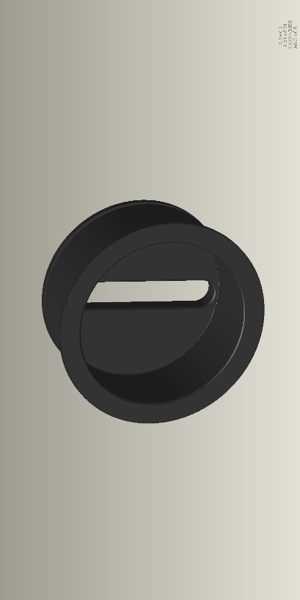
Continue efforts to increase dynamic range of beam distribution measurements
HEBT laser emittance scanner
wire
laser
2016
Will try installing simple baffle to absorb reflections
thresholding
filtering
DR = 250
DR = 2000
2017
2018

Slide 16
BIET team responsibilities include projects not directly related to SNS beam diagnostics
Beam Test Facility
  6D measurements system improvement
  New magnets magnetic measurements
  FODO experiment beam line assembling and commissioning
Laser Stripping
  Enhancement Cavity development
  2nd round of 10us Laser Stripping Experiment preparation
Target Strain and Vibration measurement

Slide 17
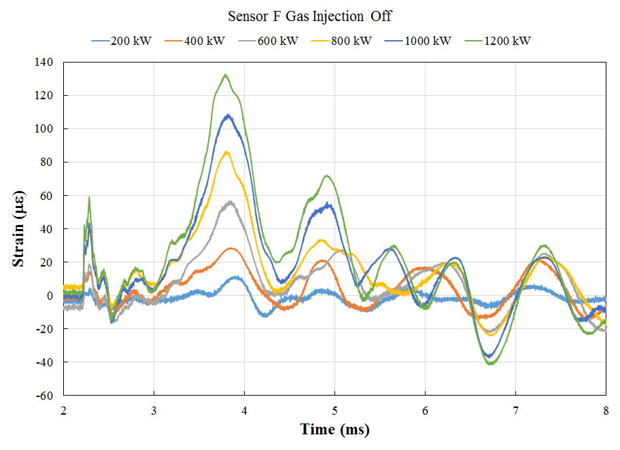
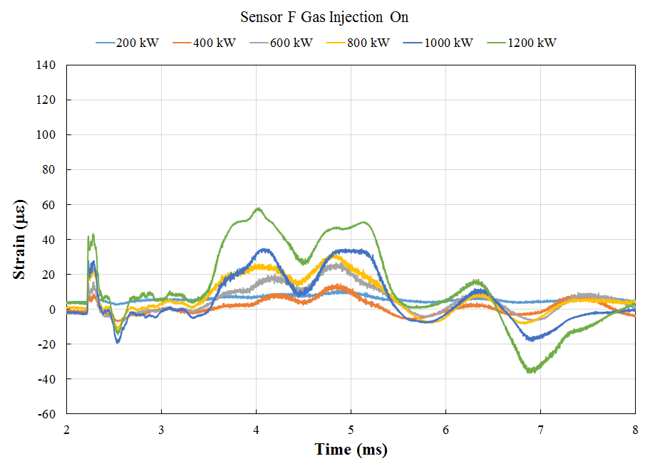
Target strain and gas injection
The Target Strain Monitor has been used to determine the strain reduction due to gas injection
use both a multi-mode based strain sensors and in-house developed super rad-hard single-mode sensors
saw a reduction in strain response for the different beam powers with gas on
Gas On
Low-coherence light source
Fiber circulator
Fiber sensor
Developed sensors using radiation-resistant fluorine-doped single-mode fibers
Implemented digital signal demodulation unit
Sensors have order of magnitude higher radiation resistance (~ 10⁹ Gy) than commercial products
Signal demodulation unit
Fiber collimator
Beam-splitter
Mirror
Gas Off
PZT
FPGA-based data processing
Phase-shifted detection
Single-mode strain measurements at different beam powers and with gas on or off.
Radiation-Resistant Fiber-Optic Strain Sensor Developed in house
Courtesy of Y. Liu, W. Blokland, C. Long

Slide 18
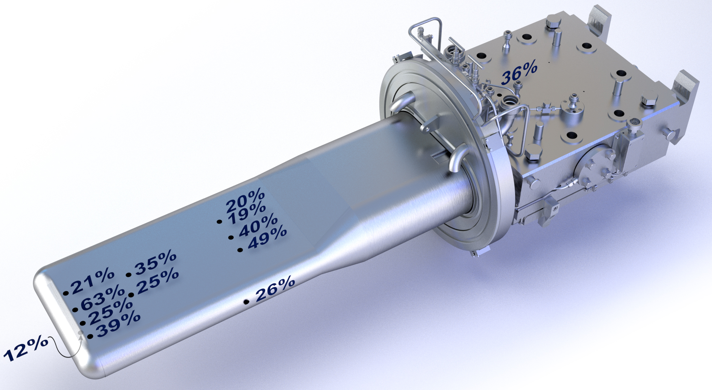
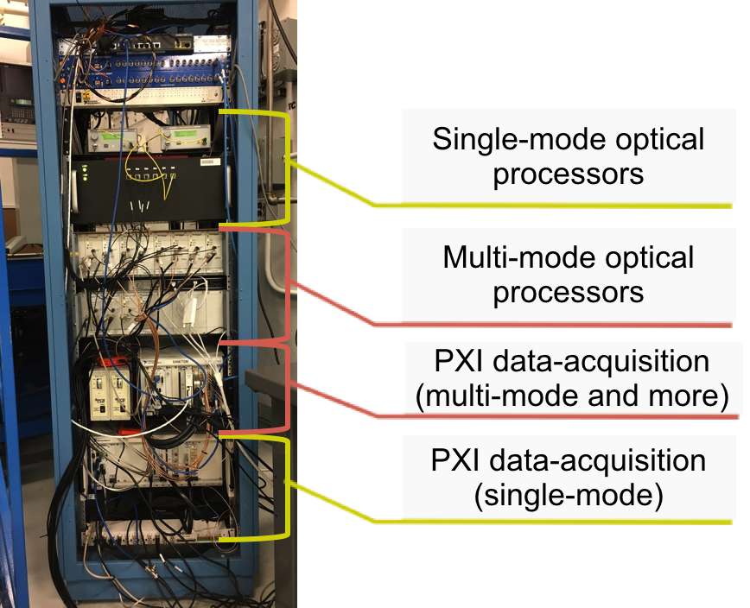
Target Strain Near Term Development Efforts
Data Acquisition System
Tests next targets with gas injection
Integrate single-mode and multi-mode sensor acquisition systems
Further develop single-mode optical processors
  Collaboration with ORNL Optics Group to develop new compact optical processors
Analyze data (ugly data contest) for target changes during neutron production, e.g. cracks in target nose or baffle
Courtesy of Y. Liu, W. Blokland, C. Long

Slide 19
Summary
Beam Instrumentation provides tools for reliable operation and fast machine tuning
Addressing obsolescence issues for BI systems
  AIP-37 is ongoing to replace BPM and BLM electronics
  Other diagnostics are upgraded as resources permit
Support other RAD activities
  Beam Test Facility
  Target Stress and Vibration measurement system
  Laser Stripping project

