Slide 1
Remote Handling in Target Systems
Presented at the
SNS Accelerator & Target
Advisory Committee Meeting
Michael Dayton
Target Systems Team Lead
May 16, 2018

Slide 2
Overview
Remote handling has played an important role in SNS operations during this review period
  Target T16 replacement
  Target T17 replacement
  Target T18 replacement
  IRP-1 replacement
  In-cell component installation to support GI3
  Service Bay component/infrastructure maintenance
  PIE Support
  Waste disposal support
The above items will be covered in more detail highlighting the philosophy of continuous improvement and planning for future operations

Slide 3
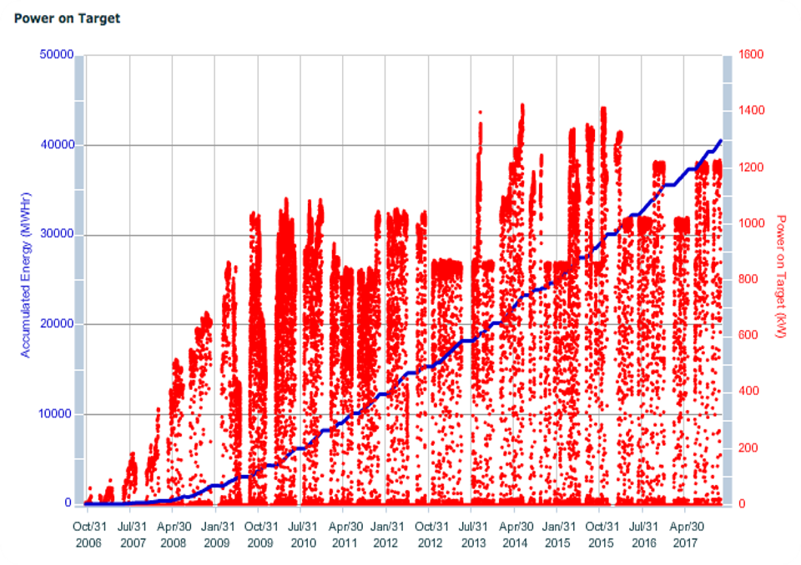
Major component replacements in SNS history
- Target (18)
- PBW (5)
- Shutter (5)
- CVI (2)
- IRP (1)

Slide 4
Three targets were replaced during this review period
Target T16 (MTX-011JF): June 2017, 1784 MW-hrs, 93 RH hours*
Target T17 (MTX-012): Oct 2017, 1934 MW-hrs, 51 RH hours*
Target T18 (MTX-008): Jan 2018, 1262 MW-hrs, 48 RH hours*
A philosophy of continuous improvement, lessons learned and technician engagement have led to:
  A reduction in the amount of time needed to replace targets
  Mitigation of the risks associated with target replacement
  Successful increases in the scope of work during target replacements for target instrumentation, implementation of gas injection, etc.
Target replacements are never routine, however…
*Approximate hands-on remote handling hours required to complete all
target replacement operations – metric used for process improvement

Slide 5
Delays were incurred during the installation of T17
After several “routine” target replacements, a problem with bolt installation during the installation of target T17 caused delays
  Two iterations of lowering the target onto the Carriage Seal Plate were required to achieve an alignment enabling installation of the eight bolts that secure the target to the Carriage incurring a two day delay
  Previous issues with bolt installation led to enhancements in the process that had eliminated these issues, so the T17 installation was disappointing
Additionally, once installed, the quality of the seal between the target and the Carriage was not acceptable
  This seal is tested by pressurizing with N2, isolating and then measuring the pressure decay in the seal volume
  The test revealed that the soft iron seal was leaking at a rate of 36 psi/hr (nominal requirement is <.1 psi/hr)
    Increasing the torque to 950 ft-lbs only marginally improved the leak rate

Slide 6
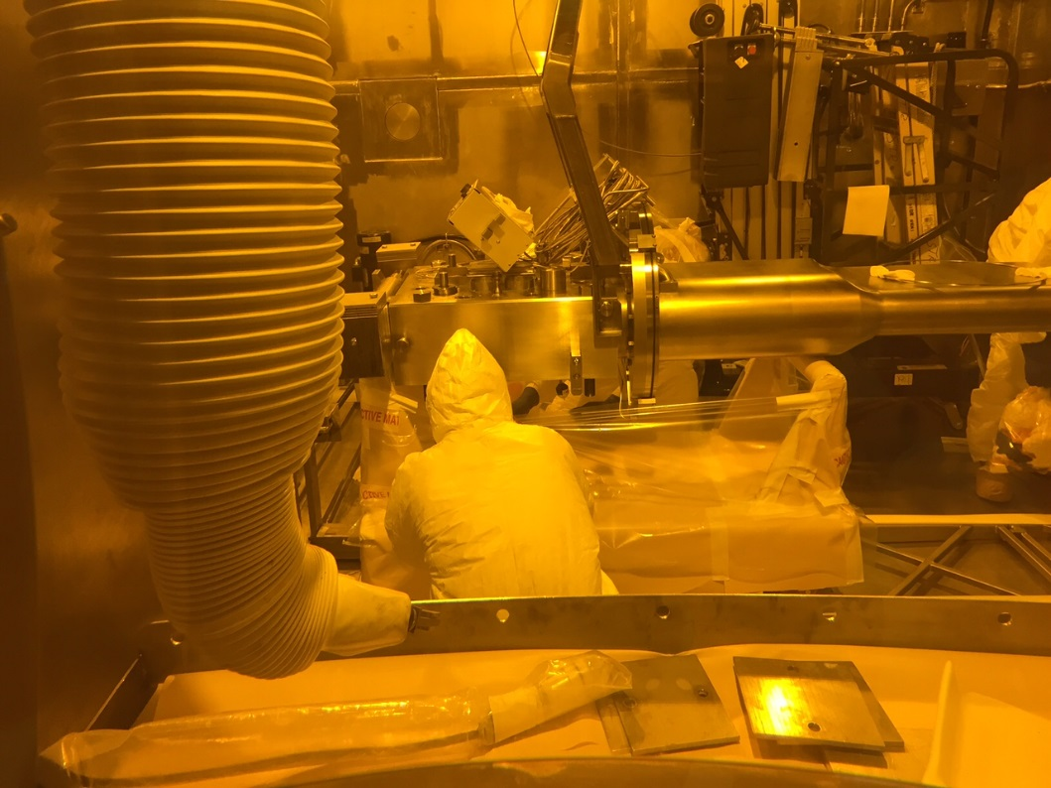
Seal Plate issues experienced during installation of T17
T17 was moved back into the Transfer Bay for the installation of a new soft iron seal
  The assumption was that the repeated attempts at alignment damaged the iron seal
Following installation of a new seal, T17 was re-installed and the seal test repeated with the same result – 36 psi/hr leak rate
  This indicated that the problem was not the seal itself and that improved alignment/new gaskets were not going to improve the leak rate
  Following consultations between NTD and RAD, the decision was made to increase the target bolt torque from the nominal 900 ft-lbs to understand if increased preload affects leak rate
Installation of a new seal onto Target T17

Slide 7
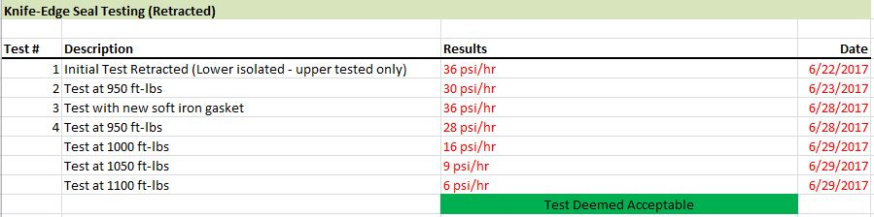
Seal Plate issues experienced during installation of T17
The following from the target replacement log shows the change in leak rate as a function of the target bolt torque:
Torqueing above 1100 ft-lbs incurred unacceptable hardware risk resulting in the decision to accept the 6 psi/hr leak rate and to move forward with the target replacement and beam operations
The small reduction in leak
rate led to the conclusion that
the seal was damaged and
additional preload would not
be the solution

Slide 8
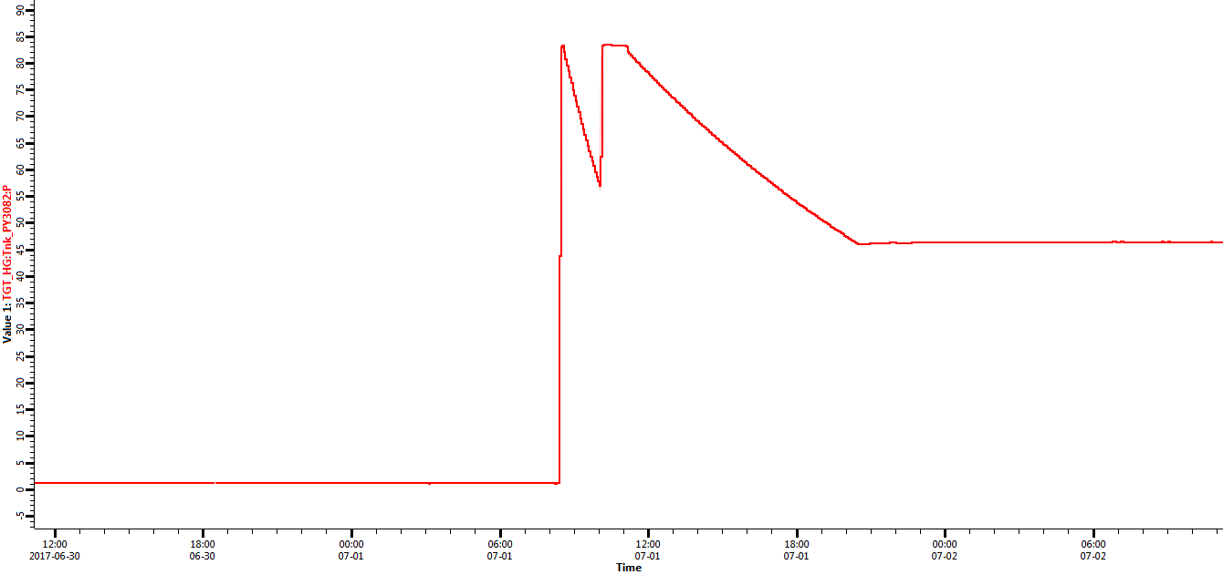
Seal Plate issues experienced during installation of T17
The previous testing was performed with the target in the retracted position
An additional test was performed with the target in the inserted (operational) position on 7-1-2017
  This test revealed the following:
At this point, the testing was
stopped and a pressure
of ~46 psi was constantly
applied to the seal
Initial testing showing
approximately 19.5 psi/hr
leak rate
Seal was pressed back
up and an additional decay
performed. This test resulted
in a leak rate of ~4.2 psi/hr.

Slide 9
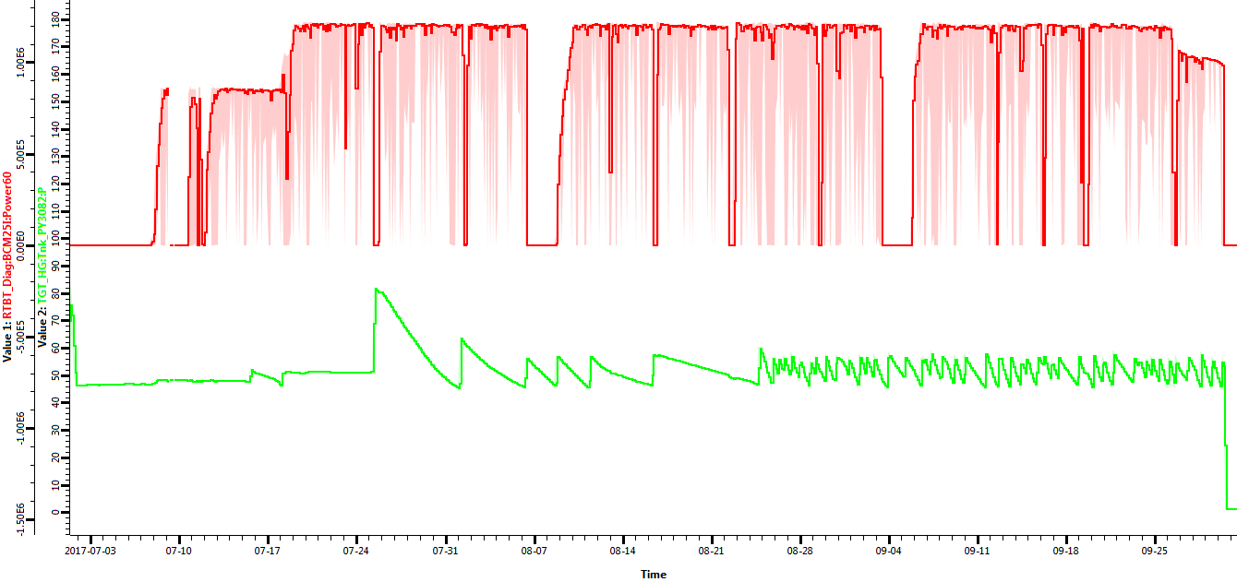
T17 seal performance improved with production beam
Seal performance was monitored during the run cycle:
Duration of T17 run
1200 kW
850 kW
Beam Power
<.25 psi/hr
Seal quality improves to this point
And then degrades thru the
remainder of the cycle
Constant 46 psi
operation
<.5 psi/hr
Upper knife edge
seal pressure
Post-installation
testing
Seal pressure was
increased and isolated
for nominal operation

Slide 10
Target T17 Replacement
T17 replacement was accomplished in approximately 51 hours despite manipulator/remote handling equipment issues
  One of the master-slave manipulators at WWS#1 failed on 4-Oct but was repaired quickly
  Issues with the rotation of the servomanipulator mast impacted testing
Carriage contact with the Mercury Drip Pan initiated a redesign of this component that was installed during target T18 replacement
Seal testing upon installation of T18 revealed a 22 psi/hr leak rate that improved to 8.5 psi/hr at 1000 ft-lbs of bolt torque
  Degradation of the ability of the Seal Plate to achieve the desired seal/leak rate was confirmed
    A spare Seal Plate is on hand, but a new Seal Plate design has been completed to improve the target alignment process – replacement planning is in work

Slide 11
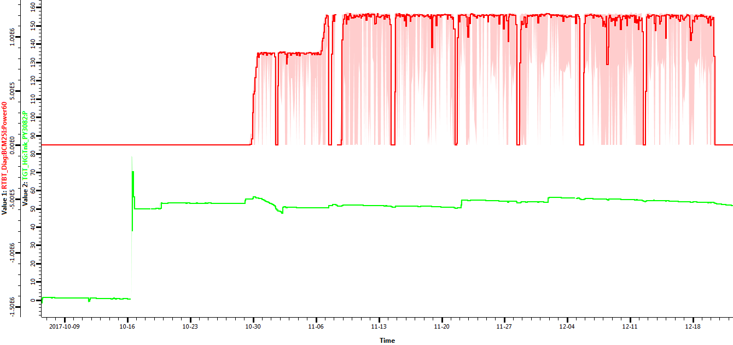
Target T18 seal issues also resolved during beam operations
Duration of T18 run
1200 kW
850 kW
Beam Power
Upper knife edge
seal pressure
Very low leak rate
High leak rates
during target
installation
Pressure fluctuations
during initial beam
operations
1 week

Slide 12
Target T18 Replacement/T19 Installation
Installation of target T19 was recently completed
  T18 was removed in January
  T19 installed in May
Initial alignment and target bolt installation was nominal
Upper knife edge seal test was performed after nominal 900 ft-lbs torque cycle
  Pressure decay of ~3.6 psi/hr was observed and deemed acceptable
    This result was an order of magnitude better than T17/T18 at this torque and better than what was previously achieved at higher torques
    The decision was made to move forward in the replacement operation without additional torque cycles to mitigate risk

Slide 13
Target Replacement Summary
Three targets were successfully replaced during this review period
The target replacement tooling and process, along with engaged technician involvement, has evolved to ensure successful replacements while mitigating the typical unexpected challenges associated with remote handling
Issues associated with this complex operation (e.g. seal performance, remote handling infrastructure, in-cell component damage) continue to be addressed in an expedient manner

Slide 14
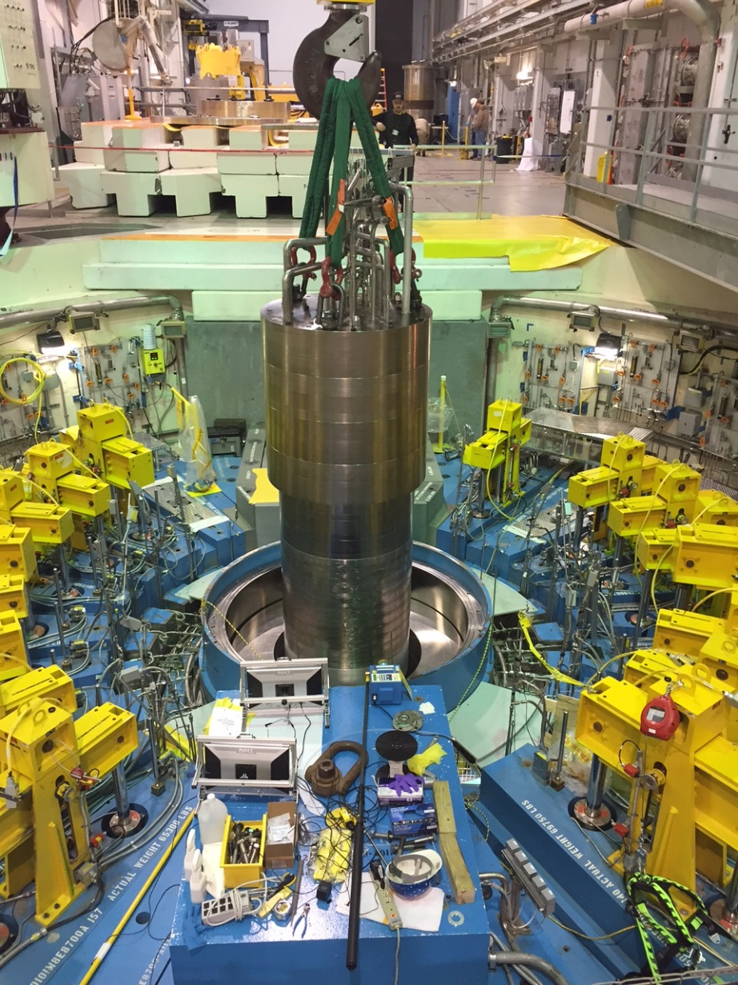
Replacement of IRP-1
The initial replacement of an Inner Reflector Plug represented a critical operation demanding significant planning
  Mockup testing to evaluate tooling and processes
  Functional and fit testing of tooling and casks for first time use
  Receipt of IRP-2 and installation into the Mock Up Test Stand
  Radiological planning to ensure ALARA principles were achieved
  Remote removal of IRP-1
  Installation of IRP-2
IRP-2 Being Lowered into
Core Vessel

Slide 15
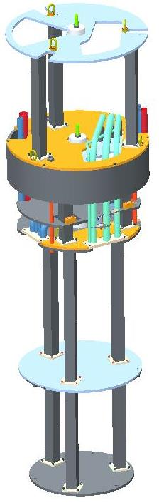
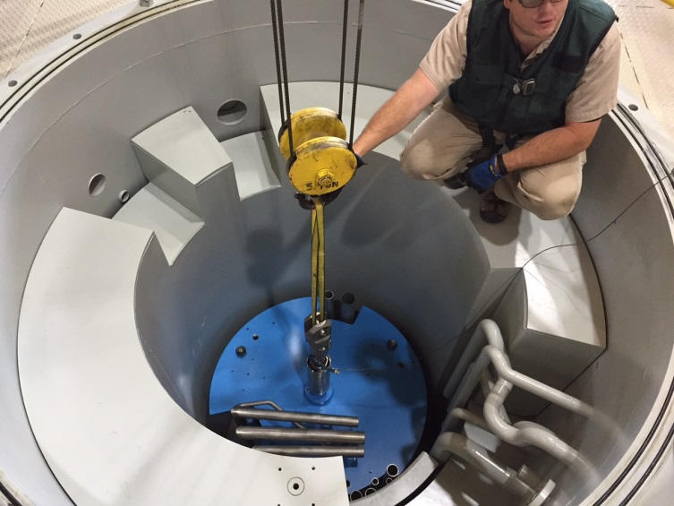
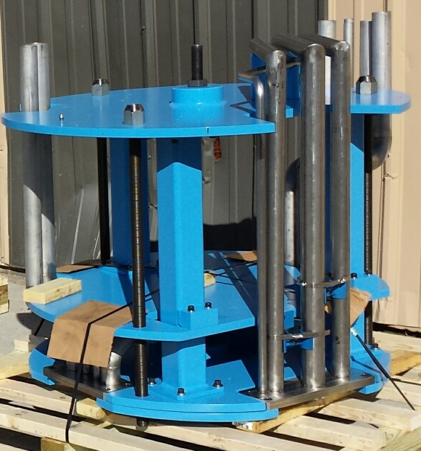
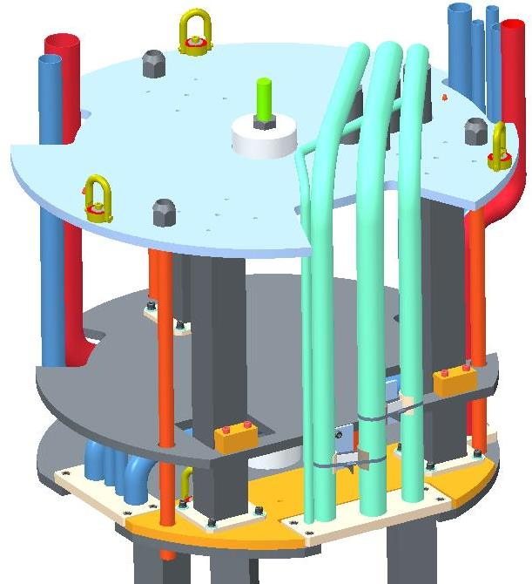
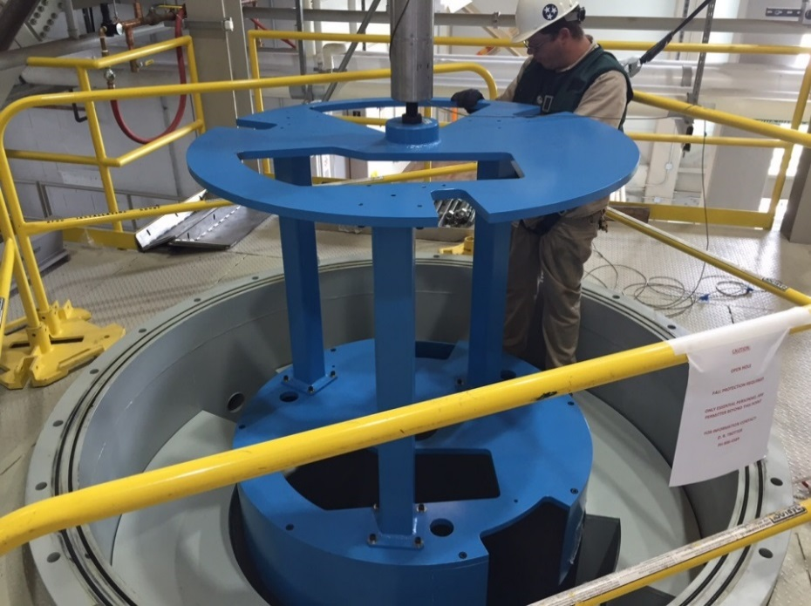
Mockup testing and pipe cutting used extensively to understand all aspects of the removal process
Full-scale mockup segments designed to
replicate segment dimensional envelops,
tie rod connections, piping and V-block
alignment interface to the Core Vessel
Mockup segments installed into a full-scale
Core Vessel mockup to check alignment
interfaces and provide high-fidelity technician training

Slide 16
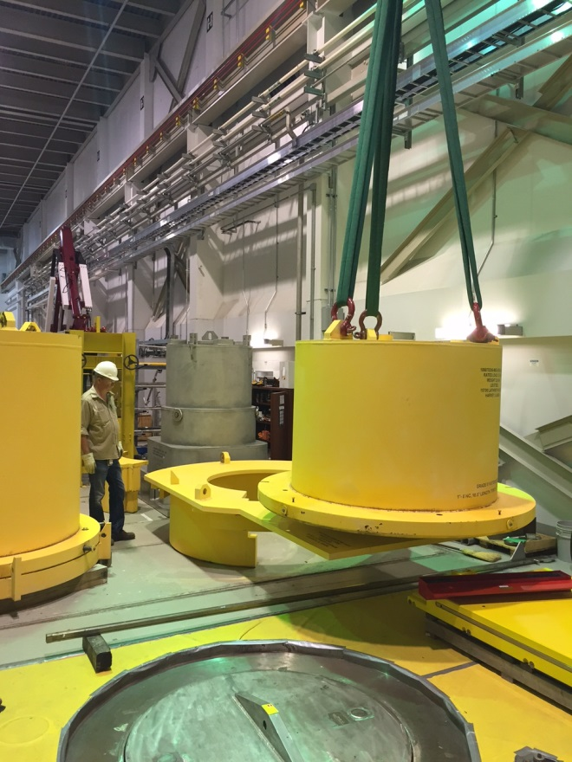
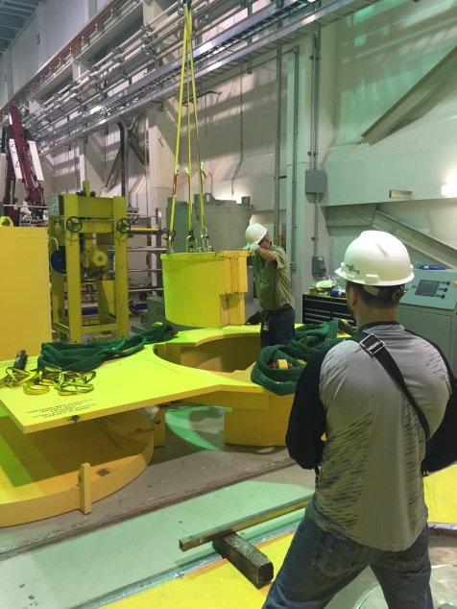
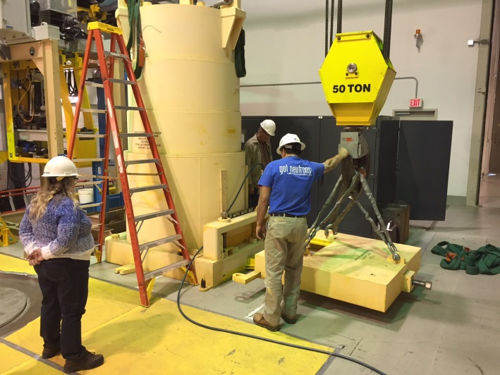
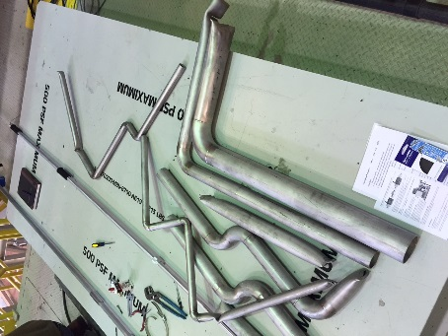
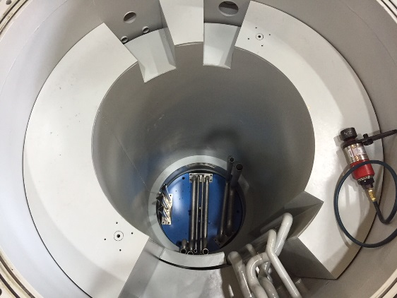
Tooling test and checkout in preparation for removal of IRP-1
Remote handling cask (3) fit checks, functional testing and interfaces were verified
Long-handled cutting tools were operationally tested on representative piping cross-sections
Actual full-scale mockup pipe cutting operations were completed to validate cutter positioning and access along with pipe segment removal options
Procedure development and refinement informed by mockup testing detailed operational step planning
High Bay replacement area evaluated and staged for remote camera/monitors and cask/equipment logistics

Slide 17
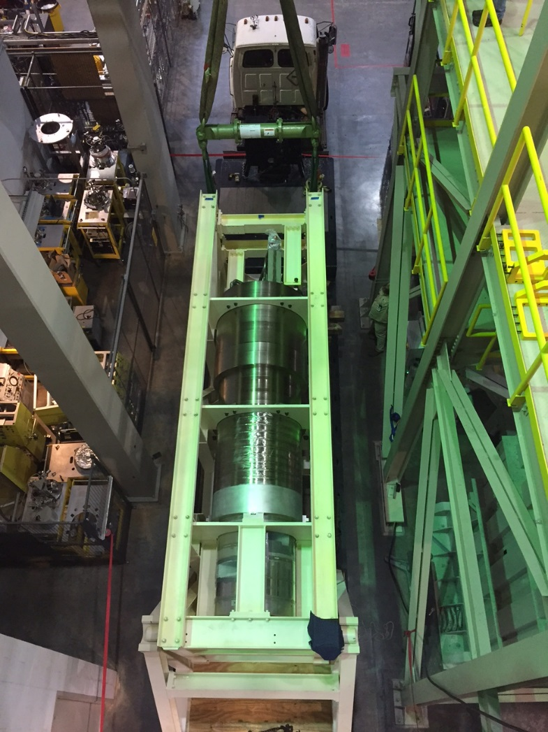
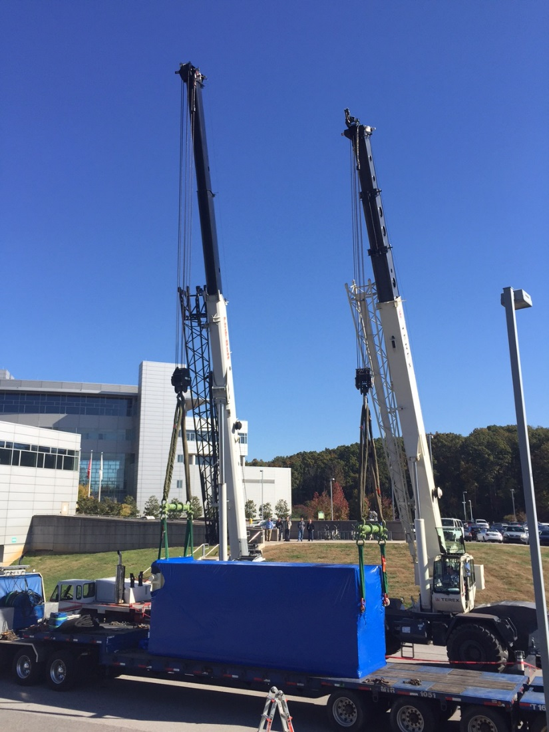
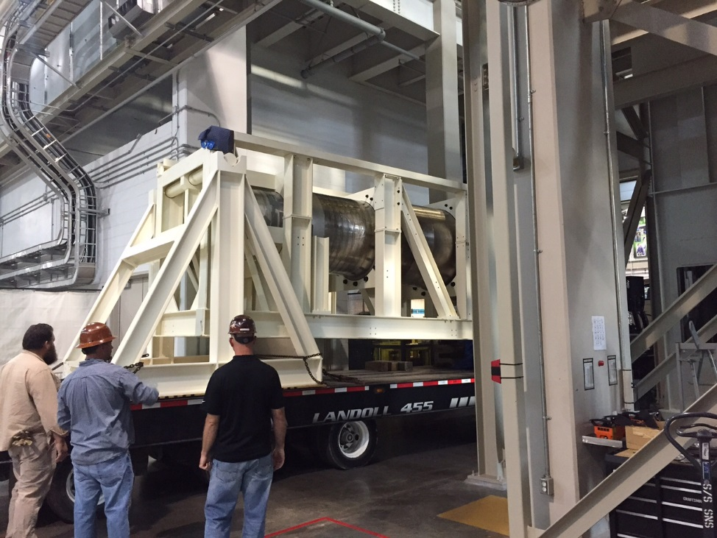
IRP-2 receipt required significant planning
Worked with IRP-2 vendor and F&O riggers to ensure a safe and controlled unloading and handling of IRP-2
IRP-2 moved into position
Under 50T crane
Offloading the 90,000 lbs
shipping package required
a complex, two-crane operation
IRP-2 rotated to vertical orientation
using a rotation frame

Slide 18
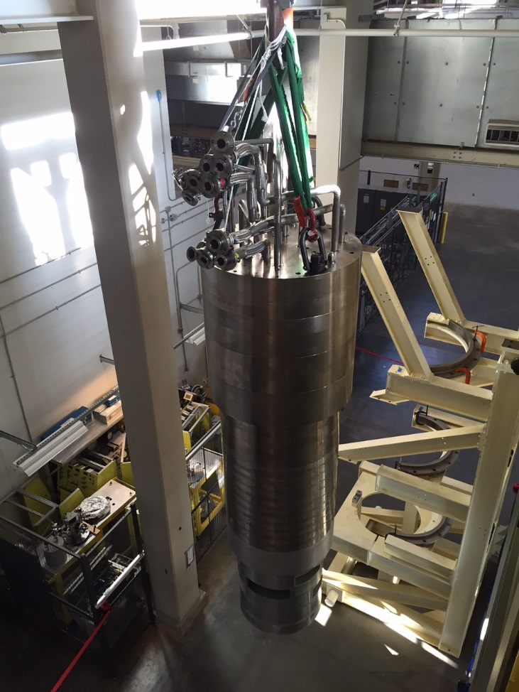
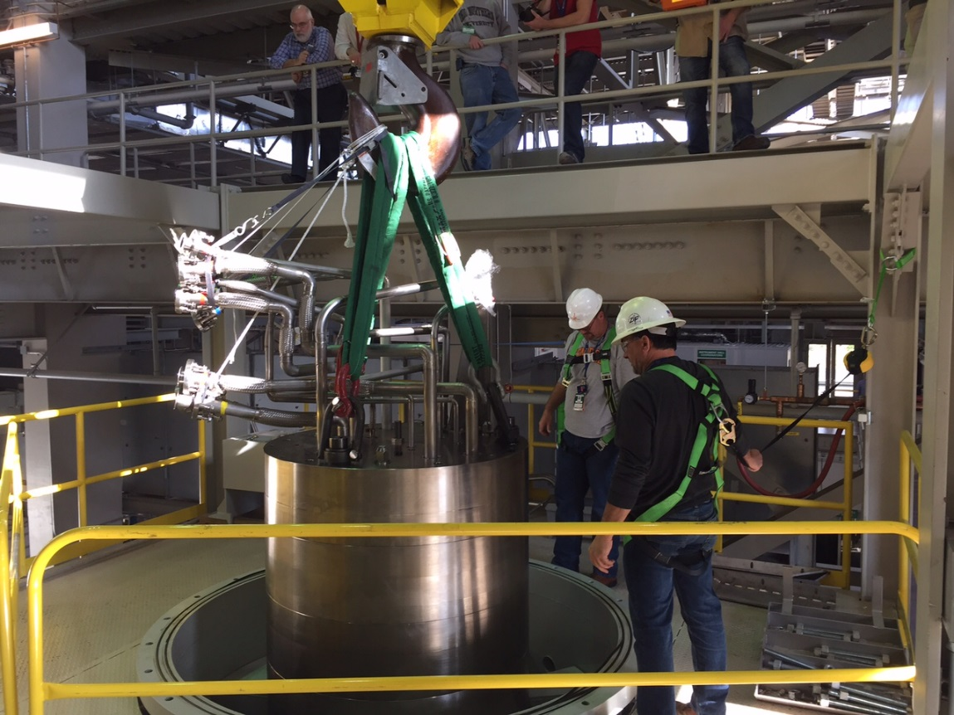
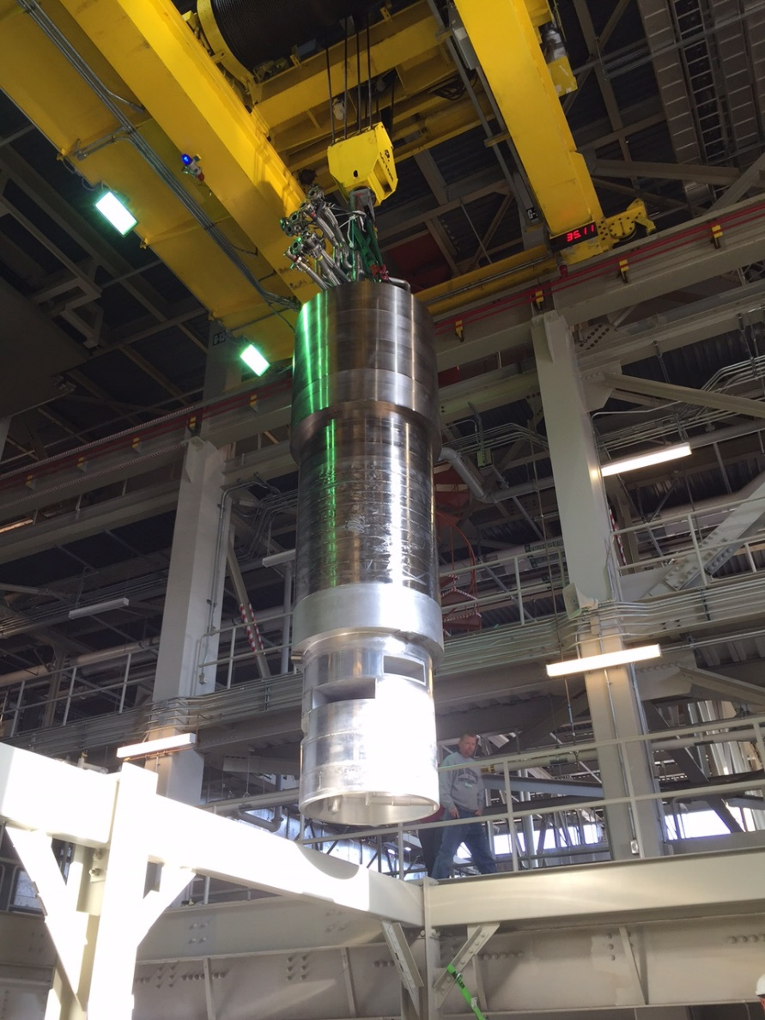
Installation into Mock Up Test Stand
IRP-2 installed into MUTS
Shipping Frame was disassembled
to remove IRP-2
IRP-2 hoisted over and
into MUTS

Slide 19
A comprehensive ALARA Plan was developed to address worker dose control, contamination control, and area monitoring
The ALARA plan used the work plan task breakdown to assess dose rates and worker dose for each task involving potential exposure (using modeled data)
Key tasks with exposure potential were identified and reviewed extensively for ALARA considerations
Projected collective dose was approximately 3,000 mrem for 18 workers (estimated based on model data)
Most of the dose was projected for the remote handling and RCT staff directly supporting the final IRP segment pull
Detailed ALARA dose projection spreadsheet helped to identify highest hazard tasks which received additional review to reduce doses

Slide 20
ALARA Planning Included Building Access Restrictions
Projected radiation areas during critical operations led to a plan to restrict building access to essential personnel only
  Critical operations were conducted on weekends to mitigate the impact to ongoing outage work
  Badge readers were disabled and building sweeps completed
Remote Handling Area
Predicted Controlled Area
Boundary
Predicted High Radiation Area Boundary
(General area >100 mR/hr)
Target Building Perimeter
Predicted Radiation Area Boundary
(General area >5 mR/hr)

Slide 21
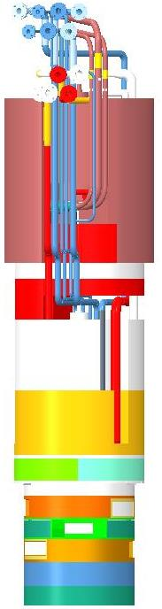
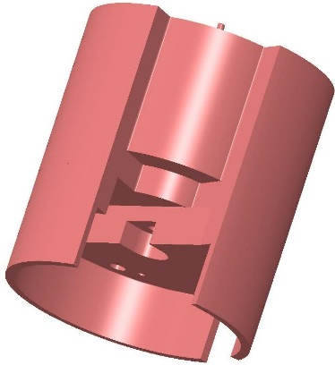
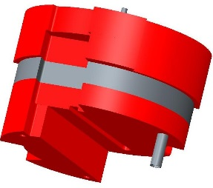
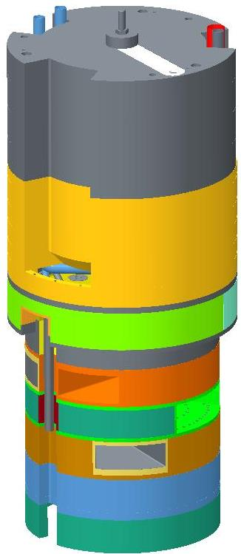
IRP removal can be summarized into a few basic steps
The IRP was removed as three separate segments
Pipe cutting and removal operations were required prior to the removal of each segment
Tie rods that structurally connect the three segments were loosened to allow separation of each segment from the one below
A basic list of steps are as follows:
  Upper Segment pipe cutting and removal
  Upper Segment tie rod loosening and removal
  Upper Segment removal
  Middle Segment pipe cutting and removal
  Middle Segment tie rod loosening and removal
  Middle Segment removal
  Lower Segment pipe cutting and removal
  Lower Segment removal
Upper
Passive
Shielding
Middle
Passive
Shielding
186” (15.5’)
63,000 lbs
Lower
Shielding
Reflectors
Moderators
Beam Ports
IRP-1 Assembly

Slide 22
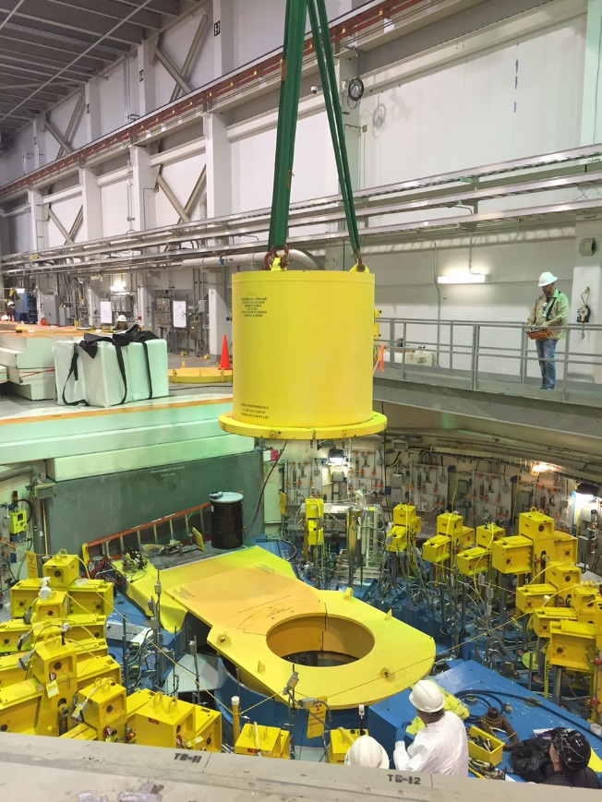
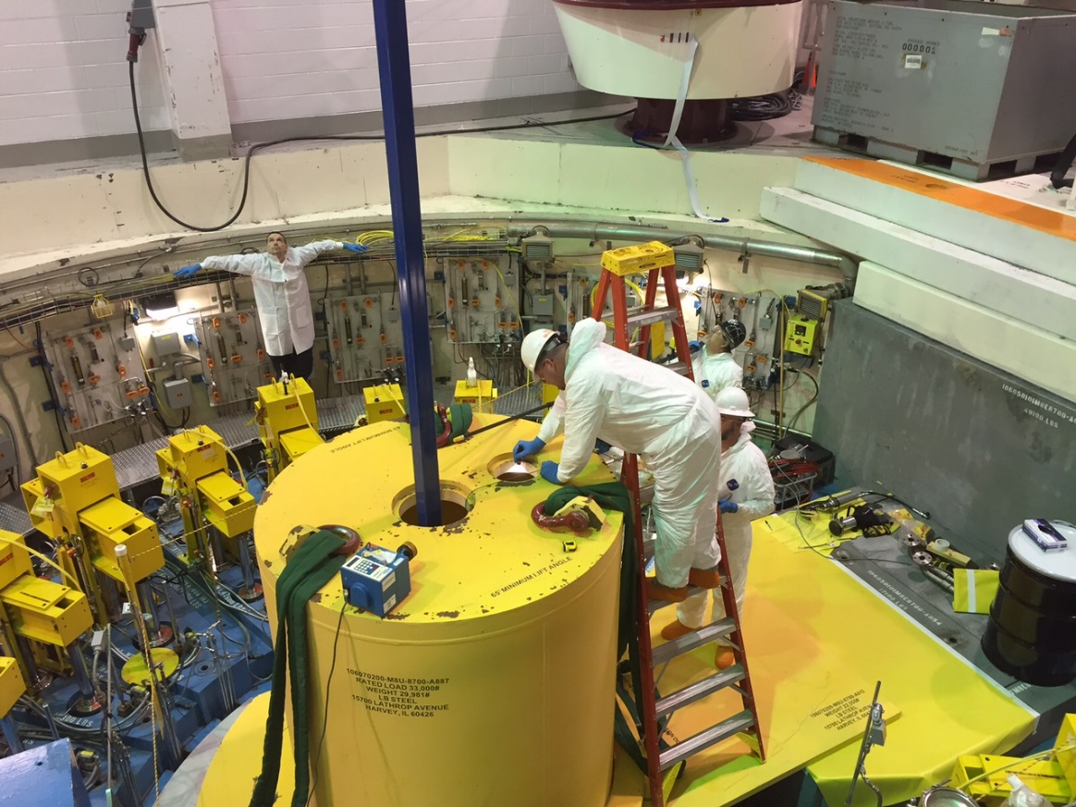
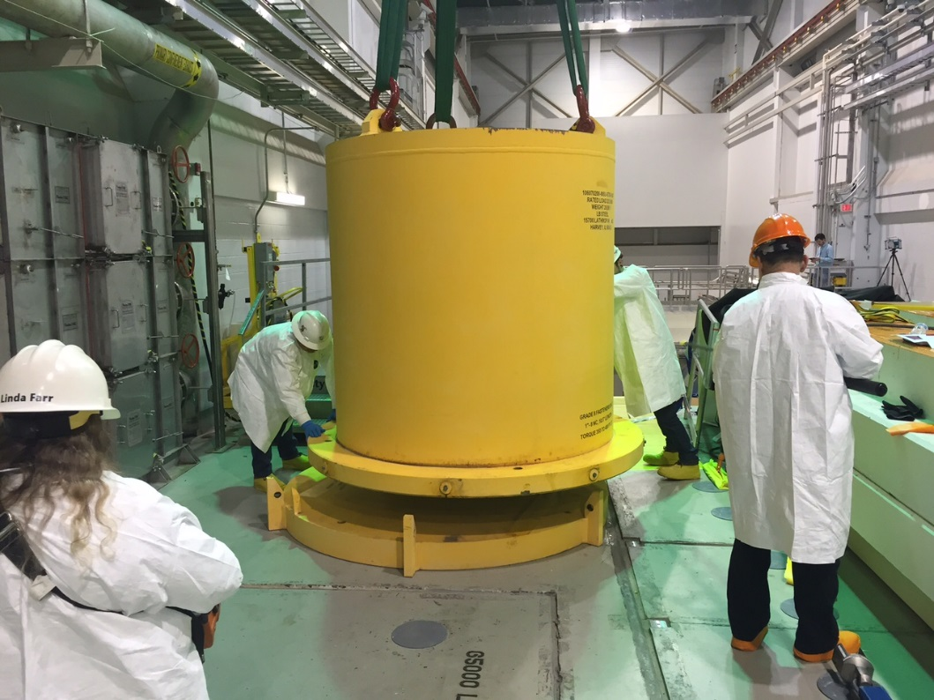
Upper Segment Removal Details
Upper Segment
Extraction into Cask
Removing Upper Segment Cask
From Core Vessel
Installation of Upper Segment Cask
Radiological Conditions
No loose radioactive contamination detected (<background/smear)
300 mR/hr at the open upper segment cask base (upper segment inside) before cask was set on its base plate
0.2 mR/hr on contact with the loaded cask
800 mR/hr at the core vessel opening
4.5 R/hr (highest reading) 1 foot from the top of the middle segment
Highest personnel exposure: 0.5 mR
Collective dose (16 people): 2.1 mR

Slide 23
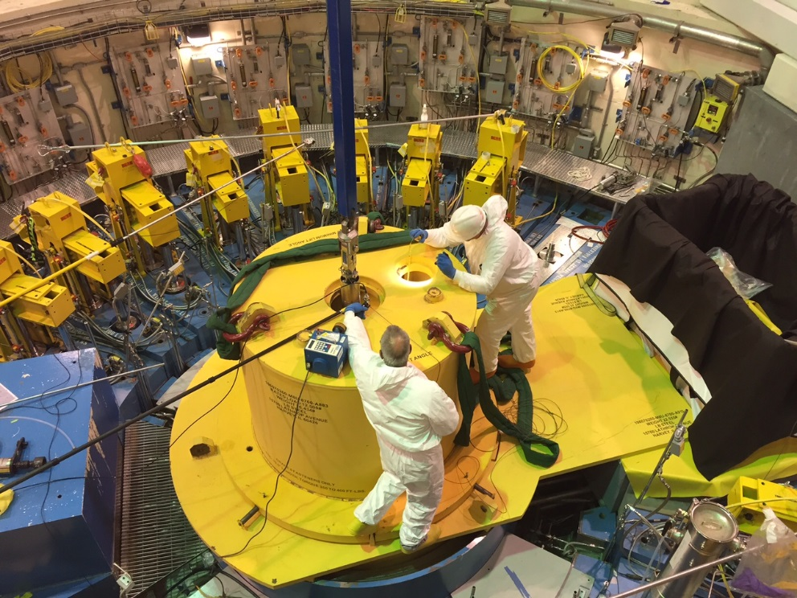
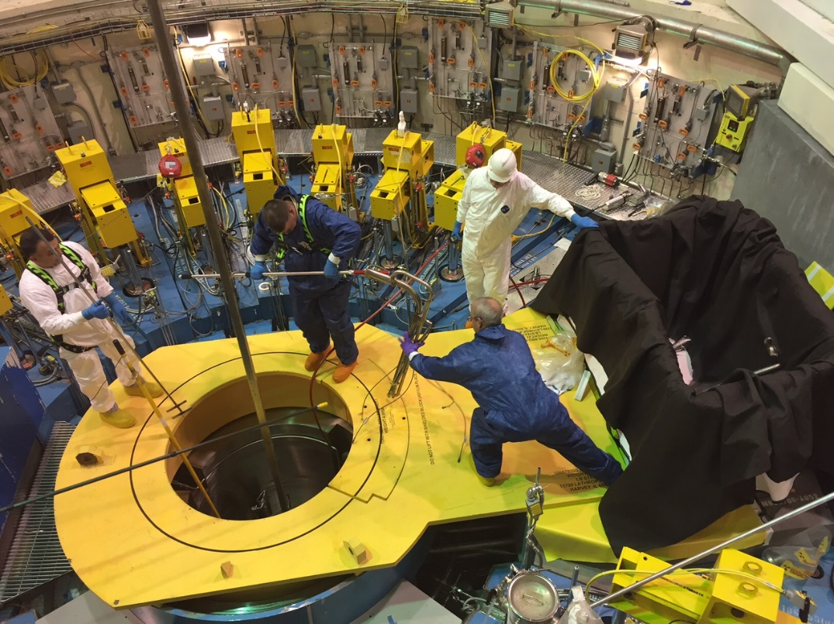
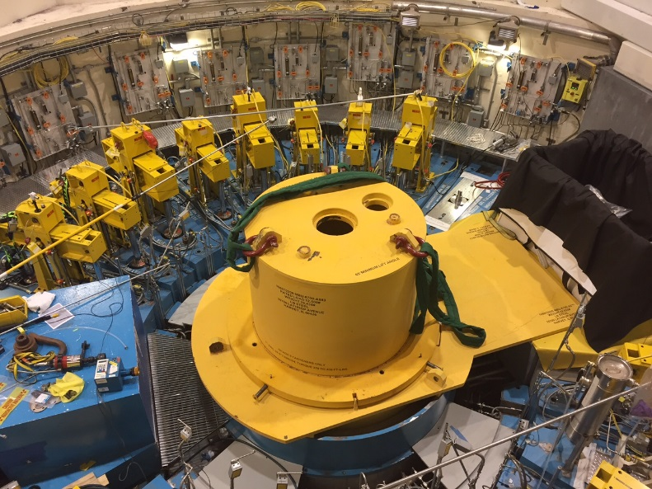
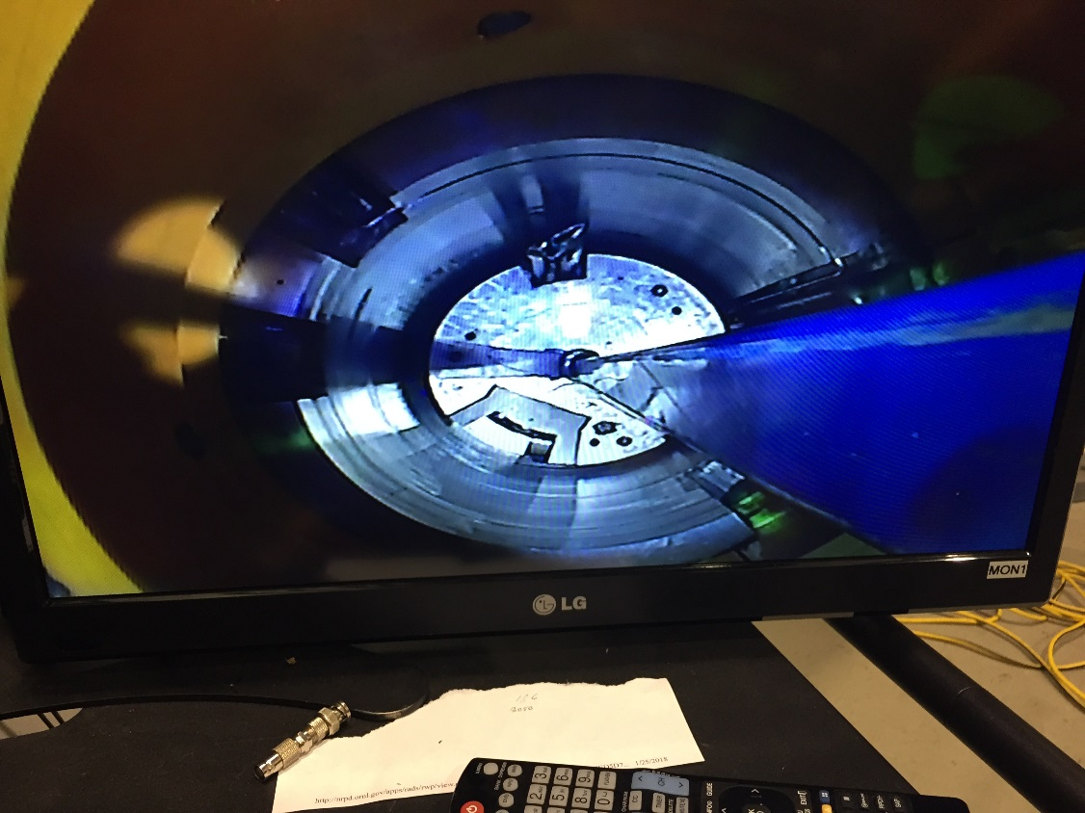
Middle Segment Removal Details
Middle Segment
Extraction into Cask
Middle Segment Pipe
Cutting and Removal
Radiological Conditions:
500 – 1,000 mR/h @ the plane of the Core Vessel
3.1 mR/h on contact and >0.2 mR/h @ 30 cm from
the side of the cask with the middle segment inside
Highest smear results: SDER work area was 9,400 dpm/100cm²
Remote Camera View

Slide 24
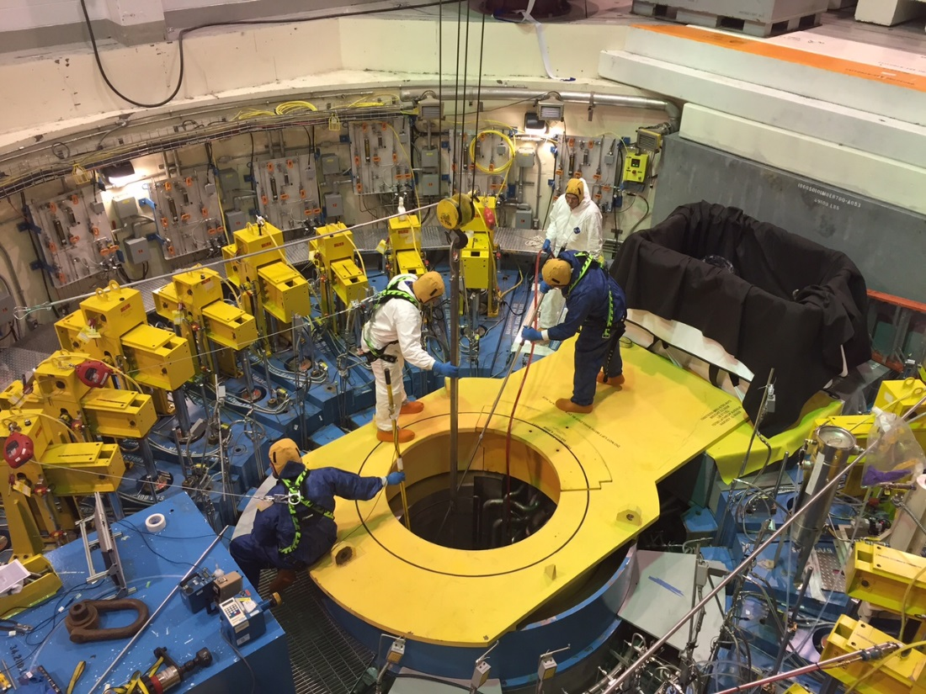
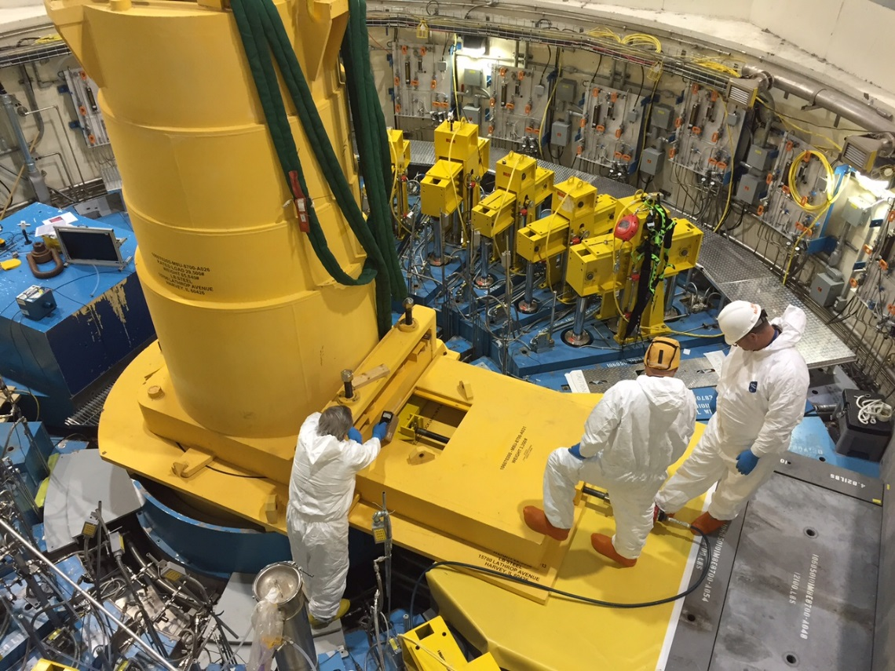
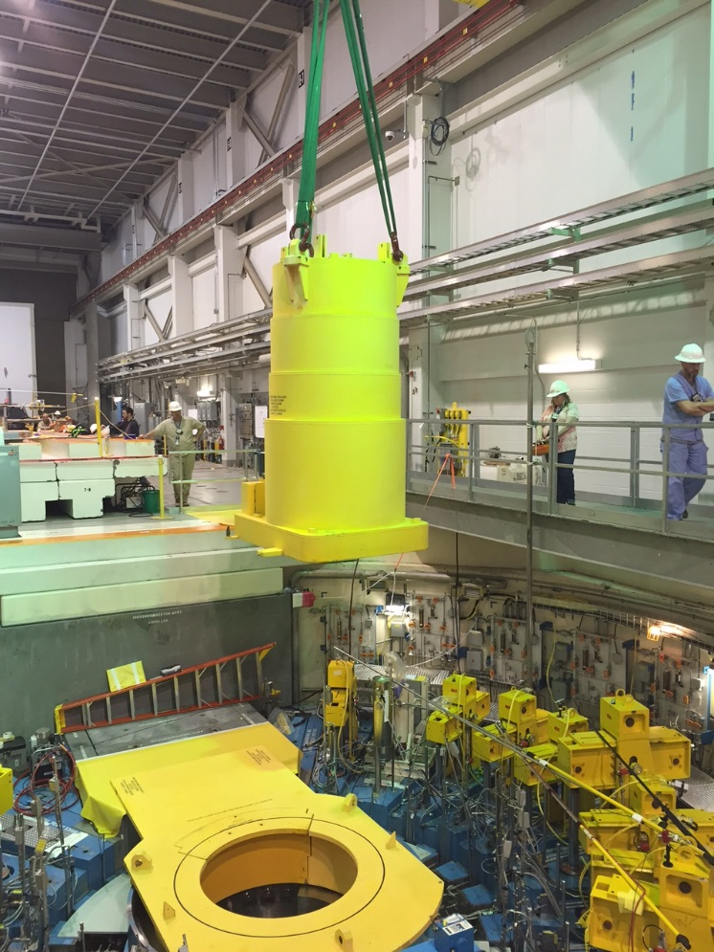
Lower Segment Removal Preparation
Lower Segment Pipe
Cutting and Removal
Installation and Testing
of Shielded Door Assembly
Lower segment pipe cutting and removal
involved the highest radiological hazards
Installation of Lower Segment
Cask over the Core Vessel

Slide 25
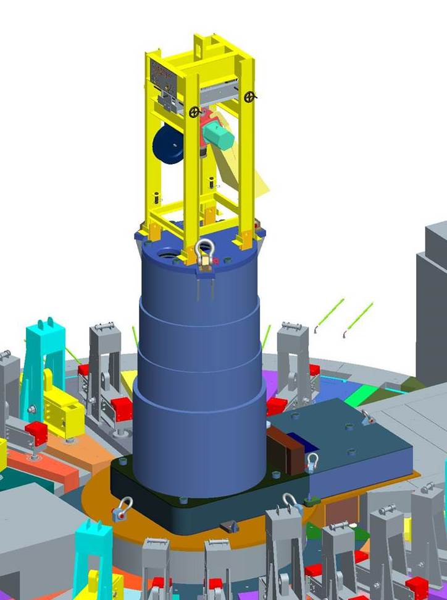
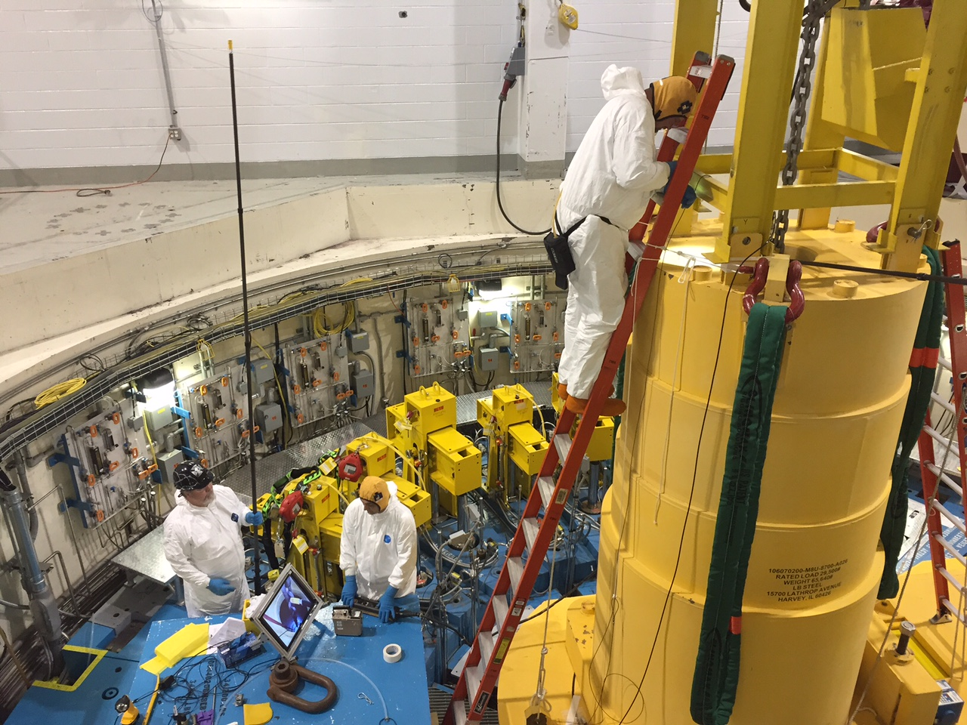
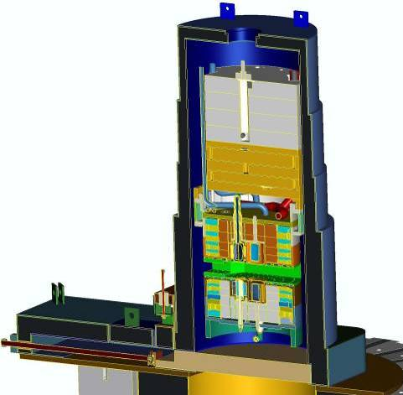
Lower Segment Removal
Technicians wore head-mounted
dosimetry to accurately capture
operational doses
Pneumatic Hoist
Shielded Door
Shielded Cask
Lower segment is engaged by
a remotely-operated grapple
and pulled up and into cask,
followed by closure of the
Shielded Door
Continuous RCT coverage
Remote camera monitor

Slide 26
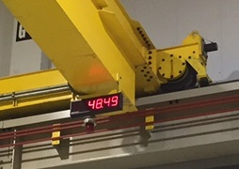
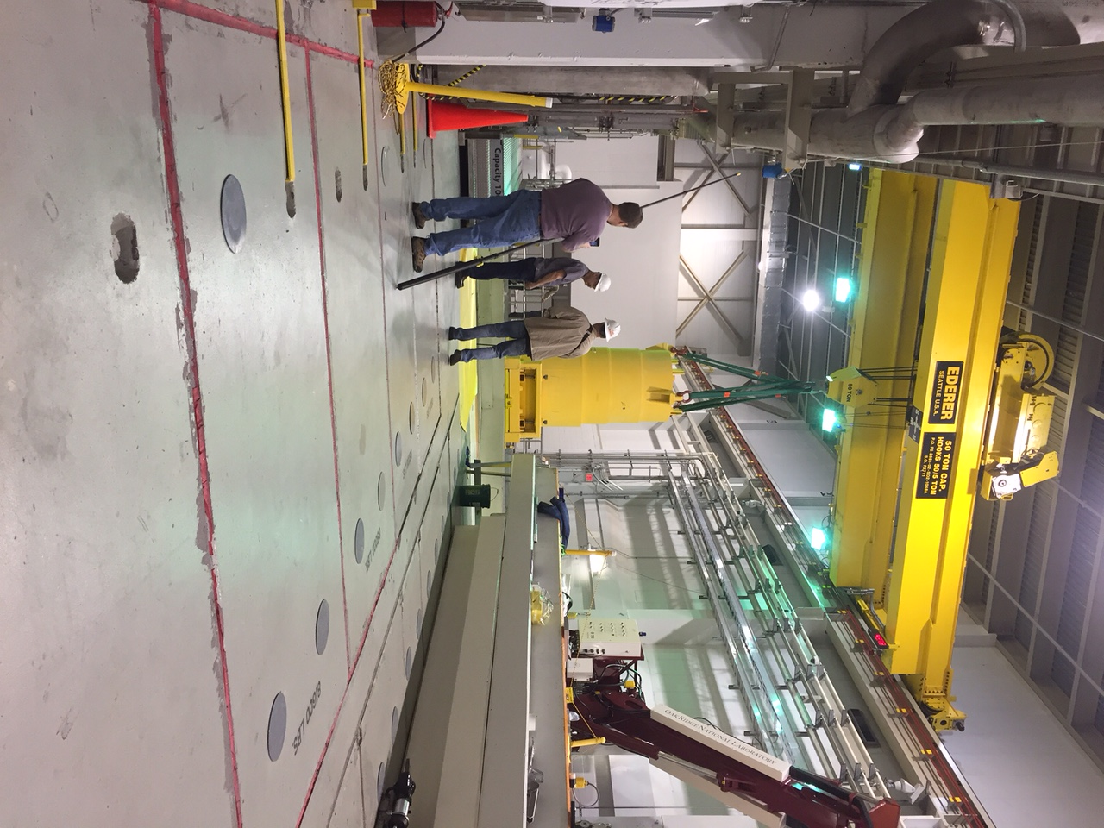
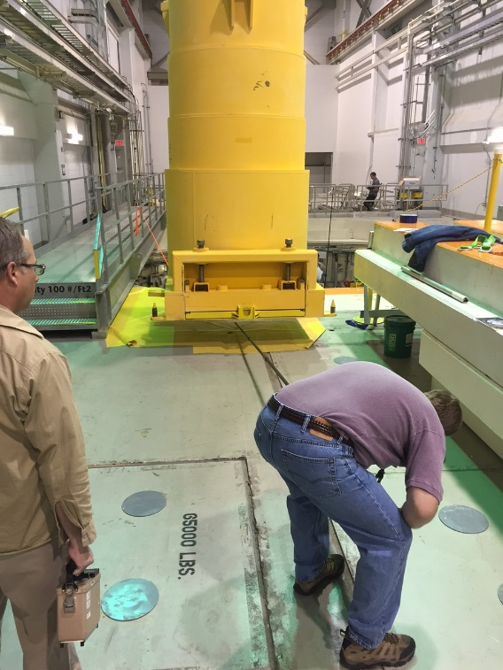
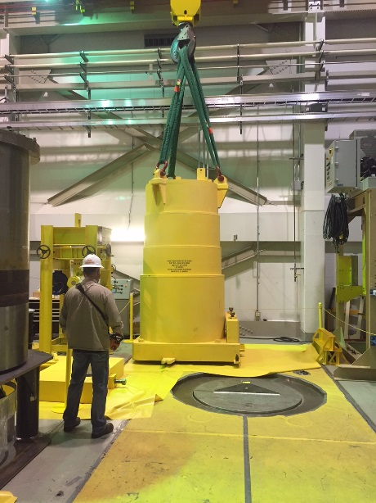
Lower Segment Cask Removal
Critical Lift moving the IRP
Lower Segment in its cask
from the Core Vessel
- Specific pre-job briefing held
- Building access controlled
- Extensive RCT coverage
- Essential personnel only
50T Crane Scale Read in Excess
of 48 Tons During the Lift
Lower Segment Cask
Stored in High Bay

Slide 27
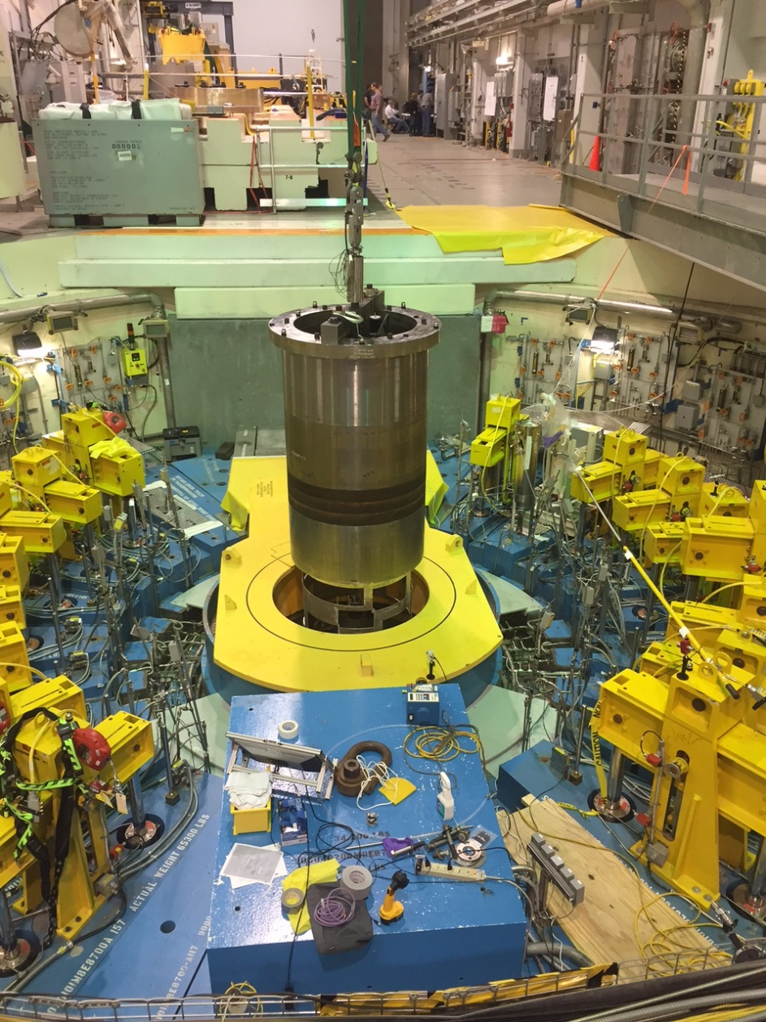
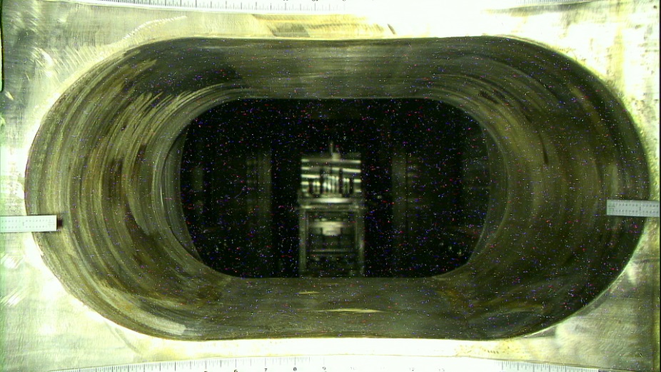
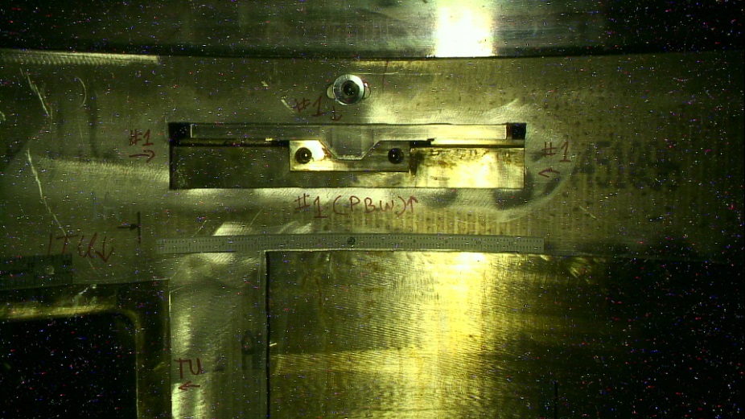
IRP replacement activities enabled Core Vessel inspection
The replacement of IRP-1 provided the unique opportunity to visually inspect interior portions of the Core Vessel following ~15 months (~6500 MW-hrs) of operation with the presence of water in the vessel
Camera View of Target Port
Camera View of IRP V-Block
Lowering Inspection Tool
Into Core Vessel

Slide 28
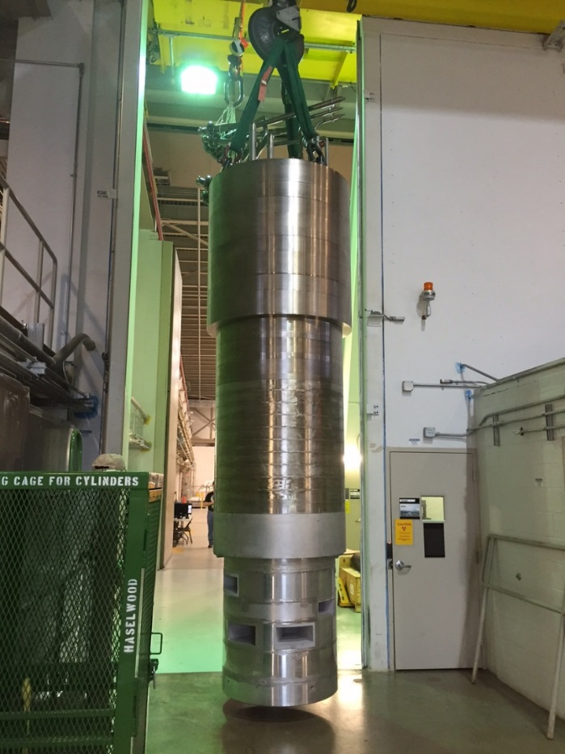
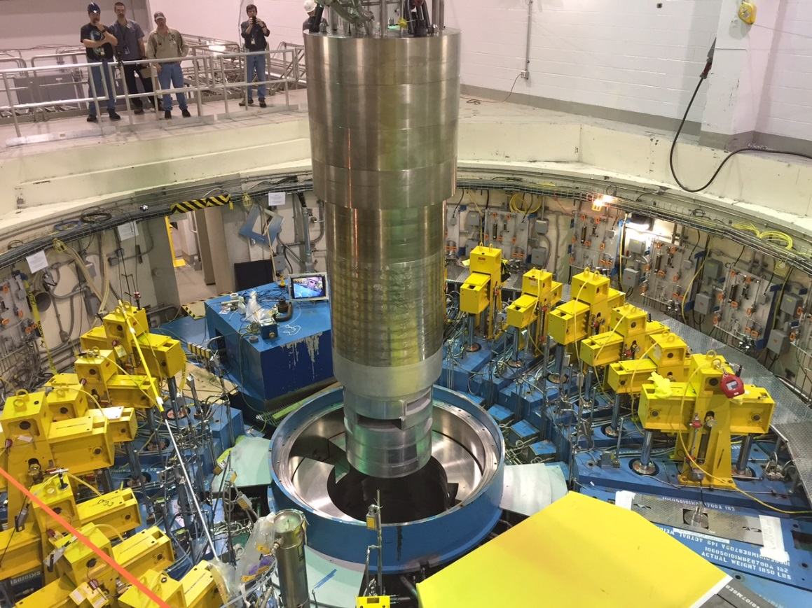
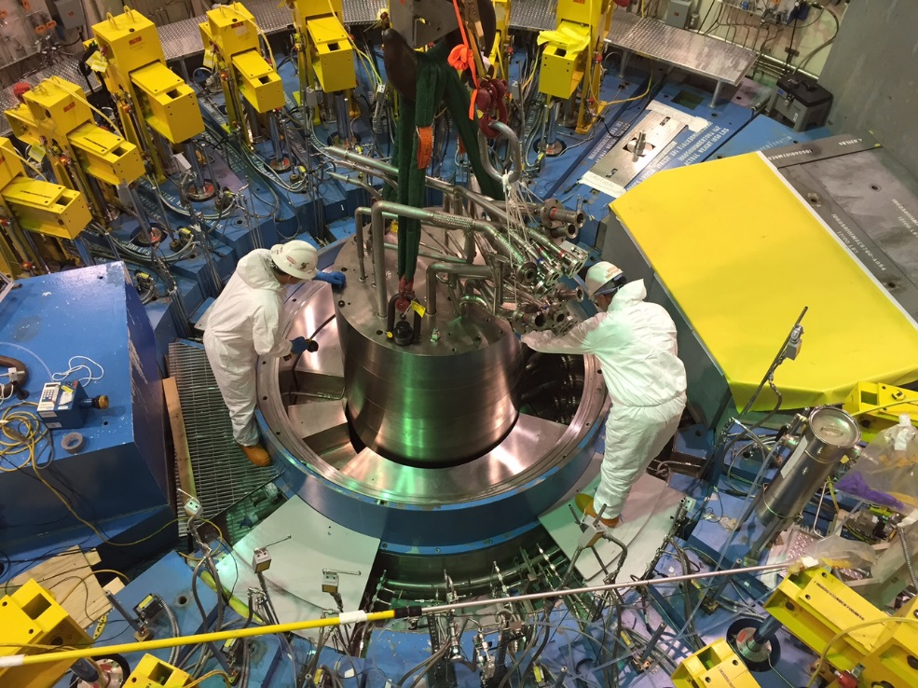
IRP-2 Installation
Positioning IRP-2 over
Core Vessel
Final Positioning
Moving IRP-2 Through Airlock
Dose rates in this area
were ~ 50 R/hr
Radiological Conditions:
Up to 80 mrem/h on the bridge
50 R/h over the core vessel opening
17 mR/hr on the ECO gamma on north side wall location
15 mR/hr on the ECO gamma on the south wall location
428 mR/hr on the ECO gamma on the roof above the core vessel
Self-shielding by the IRP
itself allowed technician
access for final positioning

Slide 29


Initial installation of IRP-2 revealed a slight misalignment
The IRP was remotely accessed from the Service Bay to assess the installed position
Exact misalignment was verified by a Carriage-mounted, instrumented tool that confirmed the visual observation
High-Rad Camera Mounted to Target Carriage
Observed Misalignment

Slide 30


IRP-2 was removed and an adjustment made to the alignment
Following extensive efforts to
understand the root cause of
the misalignment, the IRP-2
was removed and adjustments
made to the alignment v-blocks
Upon re-installation into the
Core Vessel, the location was
verified using the same
instrumented tool and found to
be within .010” of the planned
position
Re-installation of IRP-2
Survey and Alignment Setup
to perform adjustment to V-Block
positions

Slide 31


Unexpected Neutron Dose from Lower IRP
Following removal of the lower IRP segment, significant neutron dose was measured on the outer surface of the shielded cask
  Highly-energetic photons (1.8-2.4 MeV) produced neutrons in a reaction with the beryllium reflector creating a photoneutron source
  Neutron doses of ~ 60 mR/hr were measured on cask contact
Increased neutron background can adversely affect BL-14 (HYSPEC) requiring supplemental shielding
Cask position was
adjusted to enable
placement of large
bags of poly beads

Slide 32
IRP Replacement Summary
The first replacement of an IRP required extensive planning and preparation
  Mockup testing was instrumental in preparing for critical pipe cutting and tie rod loosening operations
  All remote handling operations went according to plan
Detailed ALARA planning and real-time management of the operation mitigated radiation dose to workers
  Less than 450 mR cumulative dose compared to 3000 mR estimated
Installation alignment is now well understood and documented for future replacements

Slide 33


Initial Implementation of Gas Injection
The initial implementation of gas injection (GI3) required significant remote handling work in the Service Bay
  Gas Liquid Separator (GLS) installation
  Helium gas supply (pipe cutting and hose routing)
These activities represented work never envisioned in the cell
GLS Installed in Position
on existing shield block east
of the Mercury Pump
- GLS connected to existing
MOTS lines
Moving new GLS into
Transfer Bay

Slide 34
Helium Supply to the Service Bay
The initial implementation of gas injection for the target required a new source for helium gas in the Service Bay
Several options for routing this helium into the Service Bay were considered but were unable to address safety concerns surrounding the containment of mercury in the cell
  In the end, the most robust route involved bring the helium in from the High Bay through an existing spare Light Water System (LWS) #2 pipe that enters the cell from the Gas Liquid Separator cavity
  Flex hoses used the spare pipe as a “conduit” between the GLS cavity in the High Bay and the cell to supply the gas
This spare LWS#2 pipe was capped in the Service Bay, so a means to “open” the end of the pipe was required to route the hoses
  The decision was made to remotely cut the spare pipe

Slide 35



Helium Supply
Spare LWS#2 Pipe
View looking west in the Cell
In-Cell Cooler
Entry point in the cell from the GLS cavity above
Servo access was better
in this area due to interference with
in-cell cooler, but this was at the
maximum working height for the servo
arms
Clamps securing LWS#2
pipes to wall of the cell
- Cuts had to be made above this point
Spare Water Pipe
(access in this area
is difficult)
In-cell camera view of pipe/Grayloc
fitting on the west wall

Slide 36


Pipe cutting tooling design
The tooling design needed to balance the access constraints, the piping proximity to the wall and other critical items, the pipe restraints in the cell and the contingencies associated with trying to make a cut remotely
LWS#2 Pipe
(2” SCH 40 316 SS)
Clamp assembly capable
of being remotely installed
Onto pipe
Modified, off-the-shelf
grinder with 8” cutting wheel
Grinder mounting structure
interfaces with clamp and controls
cutter movement into and out of pipe

Slide 37


Pipe cutting successfully completed
Due to the configuration of pipe supports on the spare LWS#2 pipe, two cuts were required to remove a center section of pipe to enable flex hose routing
  One cut was initially made low on the pipe
  The clamp and cutter assembly was then moved up the pipe ~20 inches and another cut completed
Due to the location in the Service Bay, only camera views were available for installation and operation
Both cuts were successfully completed on 8-31-2017
Cut in Progress
Pipe Removed

Slide 38
Service Bay Support Activities
Several important activities were completed in the Service Bay
  Installation of a new Mercury Pump tank rupture disc
    Includes flex hose to route potential mercury
  Installation of a new Mercury Drip Pan
    New design to replace the damaged item and mitigate/eliminate future incidents
  Replacement of the credited DP sensors on the Mercury Pump Tank
  Ongoing target PIE support
    Operations ranging from nose sampling to laser scanning to support Target Management Plan
  Continuing waste disposal support
    Planning for the first use of the new TN-RAM cask in June
    Working with Orano (formerly Areva) to utilize new “dry” lift beam

Slide 39


Mercury Drip Pan Replacement
Drip Pan
Drip Pan
Remote Camera Image of Previous
Mercury Drip Pan Damaged by
Contact with Target Carriage
Installation of New Mercury Drip
Pan with Carriage Retracted for Target T18 Replacement

Slide 40


PIE Support
Technician
performing
laser scanning
on activated
Nose sample
in Transfer Bay
Due to the activation of target modules, remote handling remains a critical part of target PIE
Laser scanning of nose samples continues to provide invaluable data quantifying cavitation erosion damage
  Efforts are underway to begin robotic scanning of nose samples to:
    Reduce the technician dose associated with the scanning operation
    Enable the scanning of more highly-activated samples than what is currently possible
Testing of a
robotic system
to eliminate the
need for a tech
no be present for
the scanning

Slide 41

Waste Disposal Support
The following TN-RAM shipments were completed:
  Target T15: September 2017
  Target T16: October 2017
    21 successful TN-RAM shipments have been made
Target T17 shipment in June will be the first utilization of the new, second, TN-RAM cask
  In conjunction with this shipment, a new “dry” lift beam will be used
  SNS reviewed the design of this lift beam to ensure compatibility with 50T crane hook height constraints
Functional Testing of Dry Lift Beam
at Orano Facilities

Slide 42
Summary
Remote handling continues to be an integral part of continued operations at SNS
In addition to “routine” component replacements, the scope of remote handling work has increased over the years beyond what was originally envisioned
Rigorous planning, incorporation of lessons learned and continuous improvement has enabled successful outcomes of these varied activities

