Slide 1
Inner Reflector Plug Performance and IRP-3 Design
Presented at the
SNS Accelerator & Target
Advisory Committee Meeting
Jim Janney
Mechanical Engineer
May 16, 2018

Slide 2
Introduction
Overview
2017 AAC Recommendations
IRP-1 Performance
IRP-3 Design Changes
IRP-3 Procurement Strategy
Summary

Slide 3
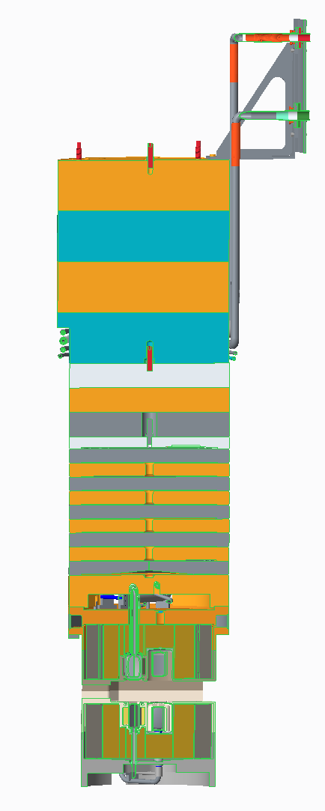
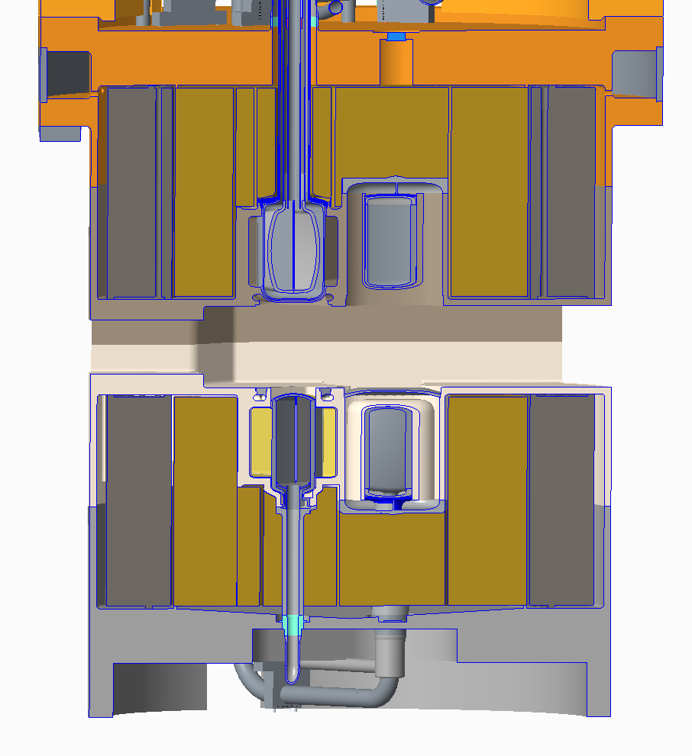
Inner Reflector Plug Overview
The IRP is a 70,000lb plug divided into 3 main segments
Upper IRP – Plated carbon steel shielding
Middle IRP – Water cooled stainless steel shielding
Lower IRP – Water cooled aluminum vessel filled with steel and beryllium surrounding aluminum ambient and cryogenic moderator vessels
Water piping and cryogenic transfer lines transverse all three assemblies

Slide 4
2017 AAC Recommendations
Provide engineering, welding, inspection, and leak checking support to IRP-2 vendor to maintain schedule
Support was supplied and IRP-2 schedule was maintained
Consider Post Irradiation Examination (PIE) of IRP-1 to clarify the root cause of the water leak to inform the IRP-3 design
Not possible due to leak location
Development activities planned to make helium lid welds more robust
Consider off-line cryogenic testing of the IRP-2 prior to installation
Not possible due to IRP-2 transfer line design but IRP-3 transfer line design has been modified to allow testing
Consider measures to increase the lifetime of future IRPs
IRP-3 ambient moderator poison plate has been thickened to increase lifetime

Slide 5
IRP-1 Operational Overview
Leak in transfer lines discovered after installation required disassembly of middle and upper IRP to repair (2005)
Insufficient hydrogen supply tube length required installation of spring to provide adequate hydrogen flow to the bottom downstream moderator (2009)
Nonlinear performance of top upstream moderator discovered (2012)
Targets 8 & 9 scrape IRP target port but cause no performance issues (2012)
Loop 3 water leak causes major operational challenges including stopping the operation of BL-4B (2016)
Expected lifetime of 32 GWh but operated for 40.5 GWh with loss of instrument resolution on decoupled moderators (2017)

Slide 6
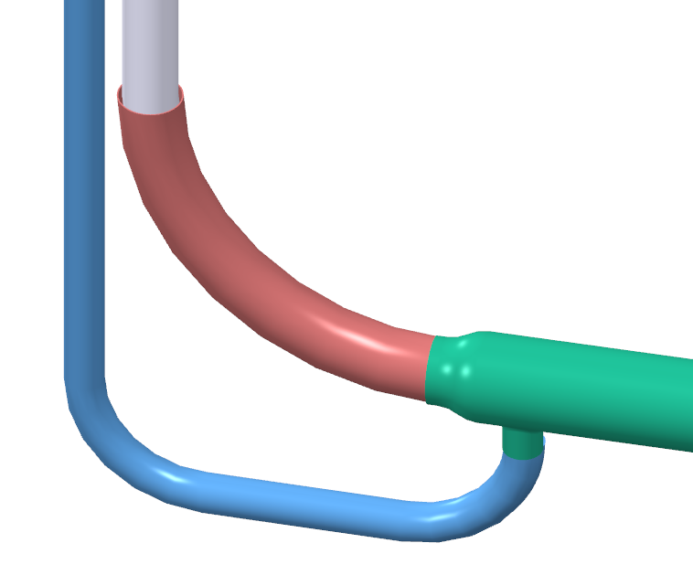
IRP-1 Premoderator Water Leak
Helium annulus termination, water flowing from this location
Leak is from water annulus that surrounds the Top Downstream Moderator transfer line between the indicated elevations
Water break off from transfer line
Top Downstream Moderator
Water annulus termination weld to helium line
Top Downstream transfer and water lines
Neutrons to 4, 5, and 6

Slide 7
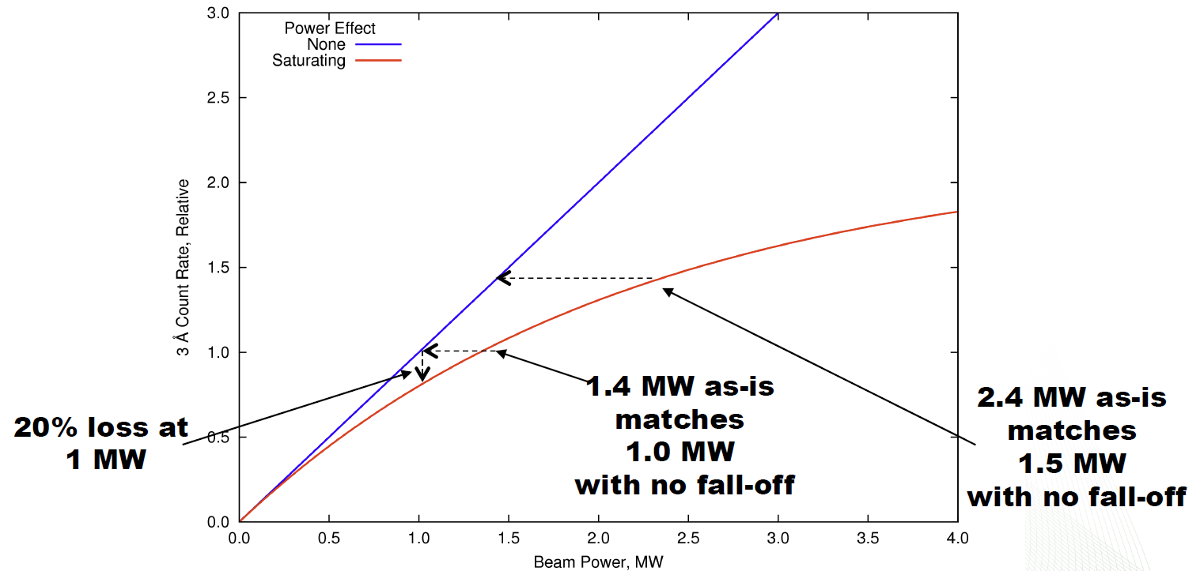
Top Upstream Moderator Performance Non-linear with Power

Slide 8
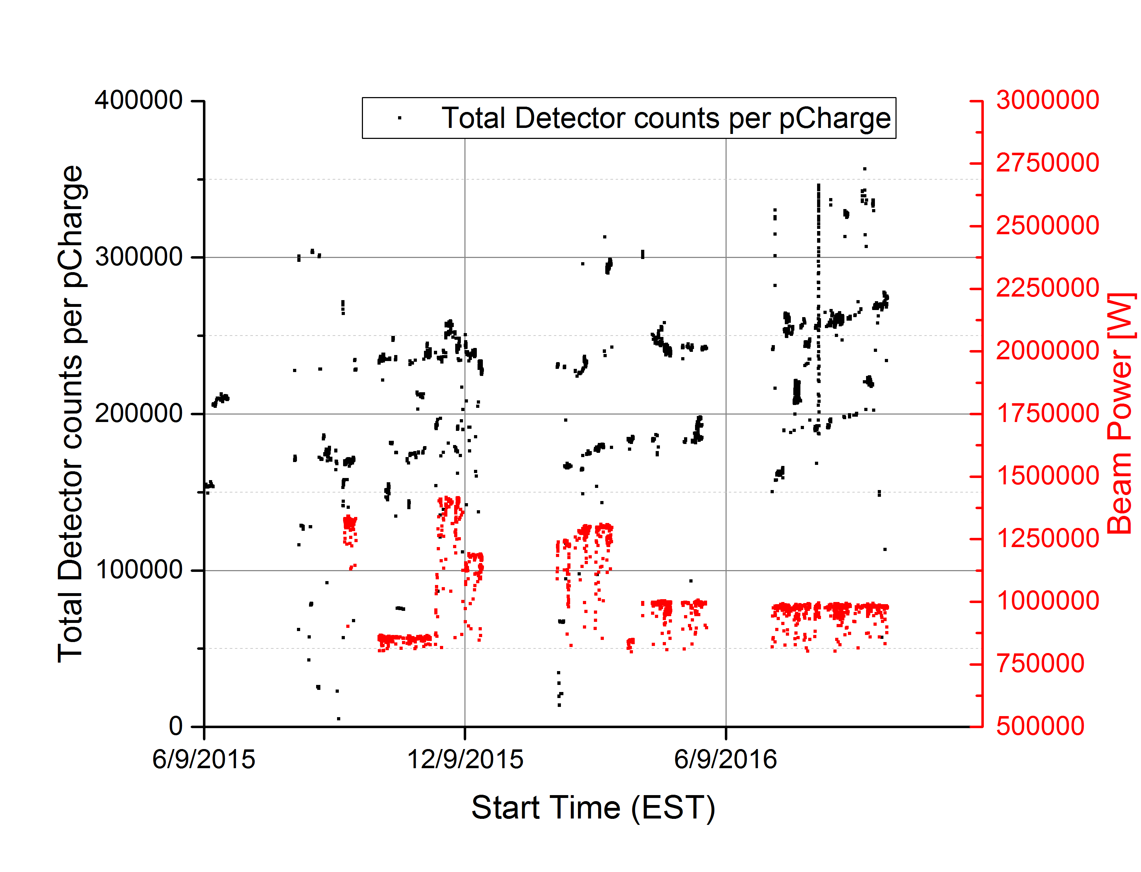
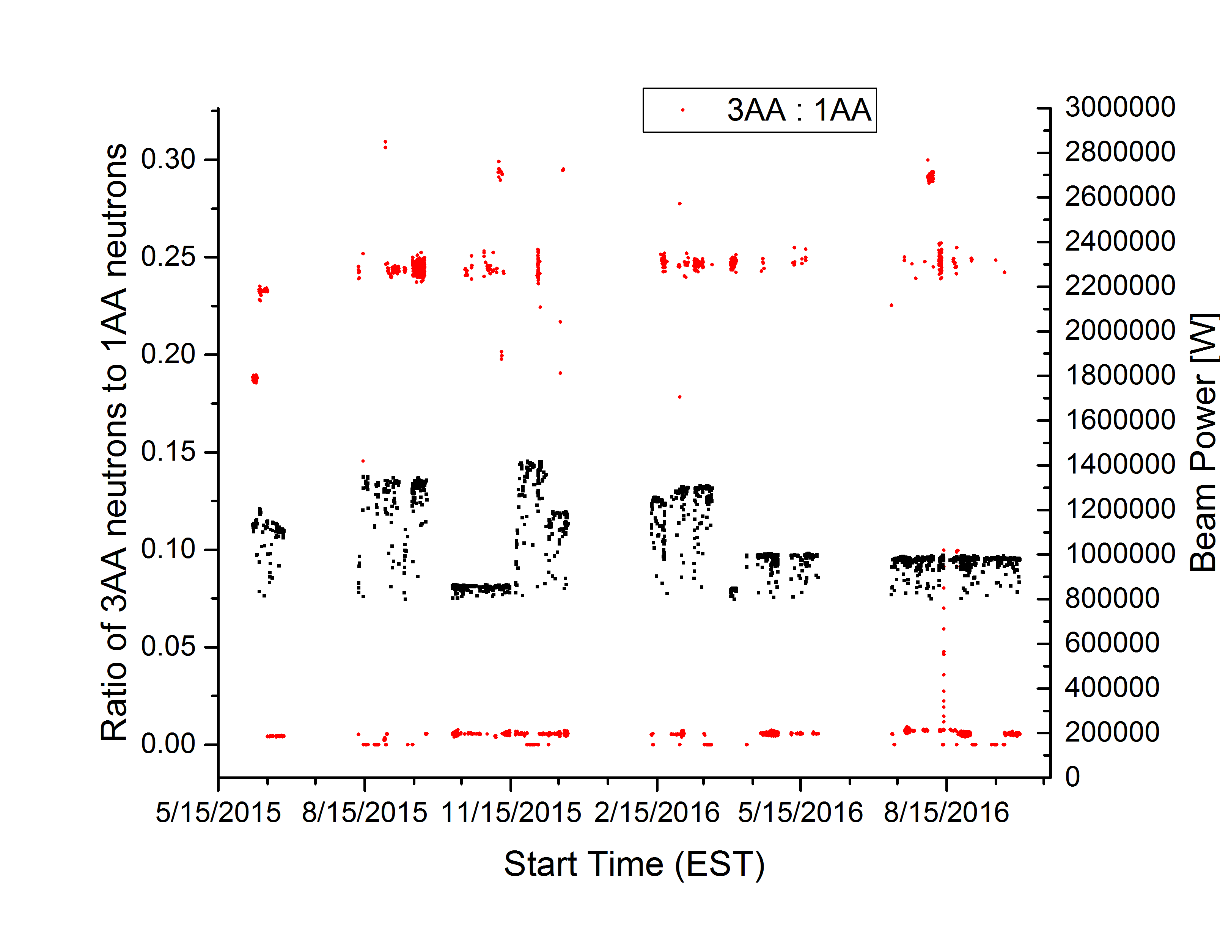
IRP-1 End of Life Performance Degraded on Ambient Moderator
VULCAN after 35 GWh:
Uptick in neutron production at steady beam power
No spectral changes

Slide 9
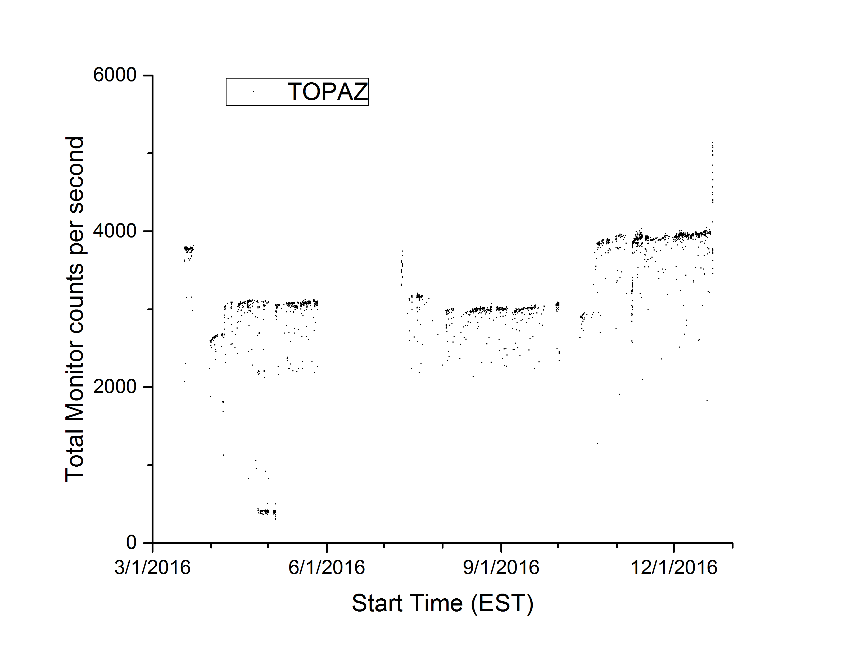
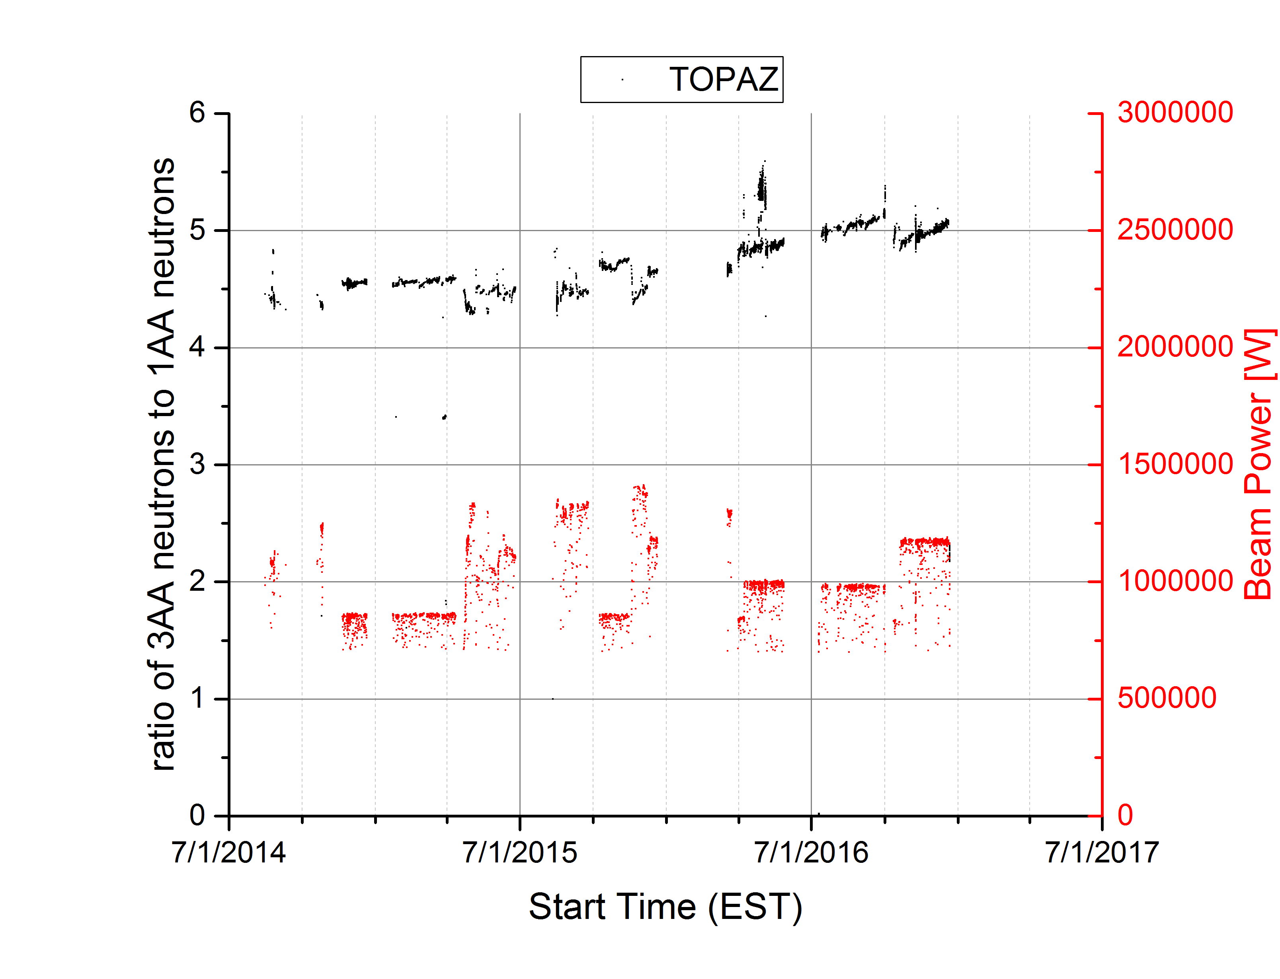
IRP-1 Decoupled Hydrogen Moderator starting to show signs of degradation
TOPAZ:
Uptick in neutron production at steady beam power
Spectral changes

Slide 10
IRP-3 Change Request
Provide moderator and pre-moderator in same states and locations
Provide decoupler material in similar locations
Provide as much neutron reflector as possible in moderator region
Surround neutron reflector in shielding to reduce dose rates
Increase IRP lifetime by thickening poisons without sacrificing significant performance
Simplify IRP manufacturing as much as possible without sacrificing neutronic performance
Modify design to mitigate problems encountered during IRP-1 operation and IRP-1 and 2 fabrication and installation

Slide 11
Moderator Vessel Locations and Geometries Unchanged
Top Downstream Coupled H₂
Top Upstream Decoupled H₂
Bottom Upstream Decoupled H₂O
Bottom Downstream Coupled H₂

Slide 12
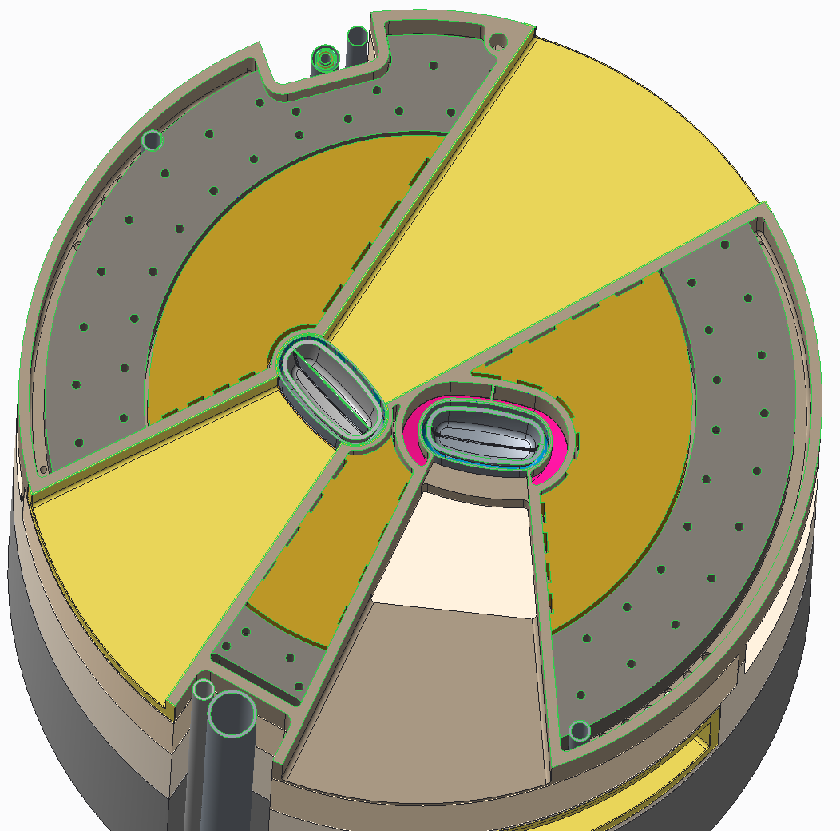
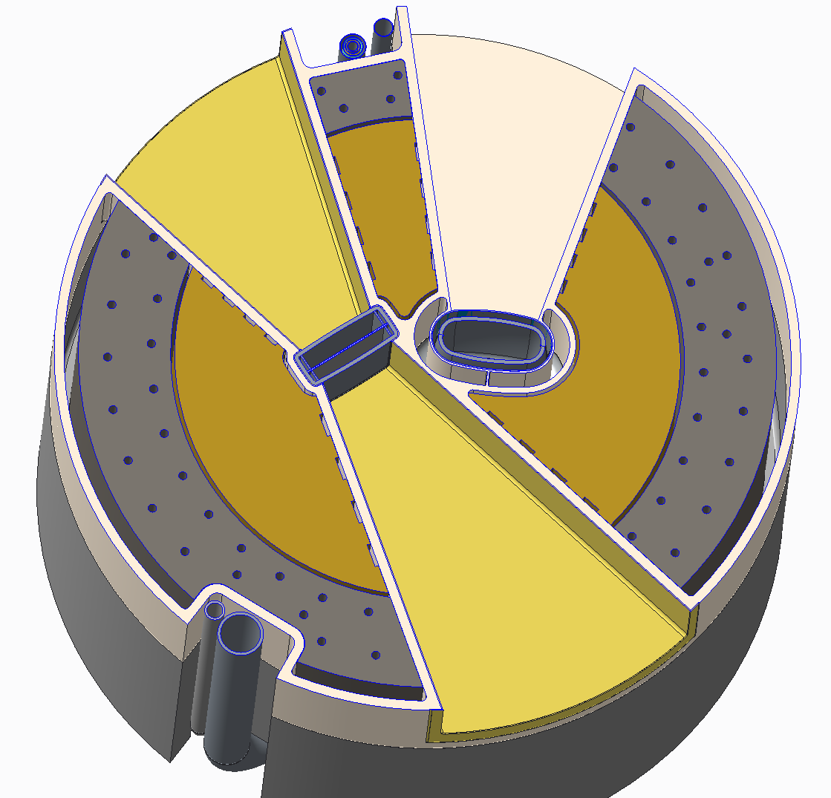
Decoupler and Poison Material in Similar Configurations
Top Moderators
Bottom Moderators

Slide 13
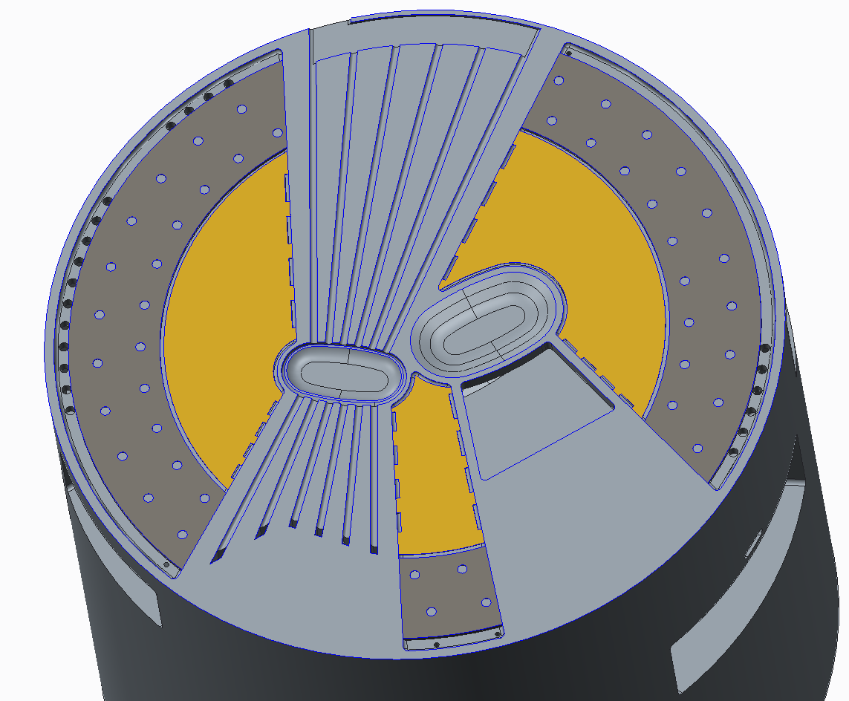
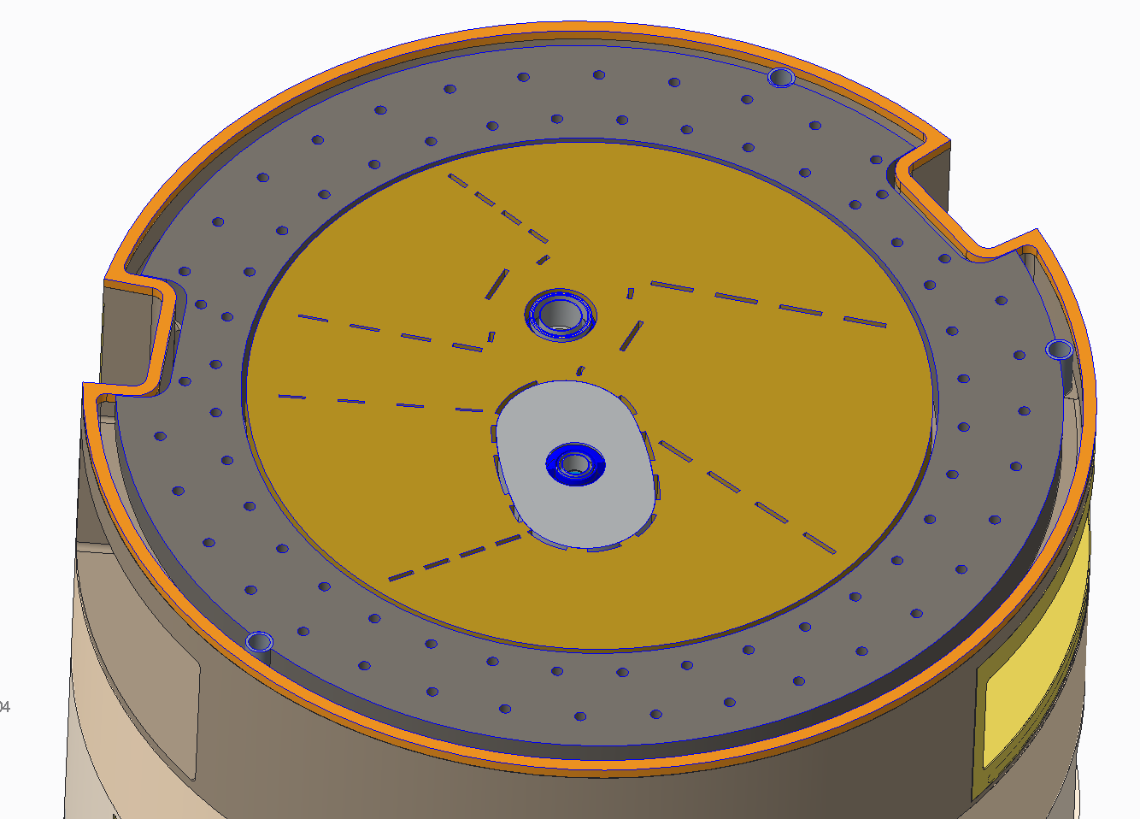
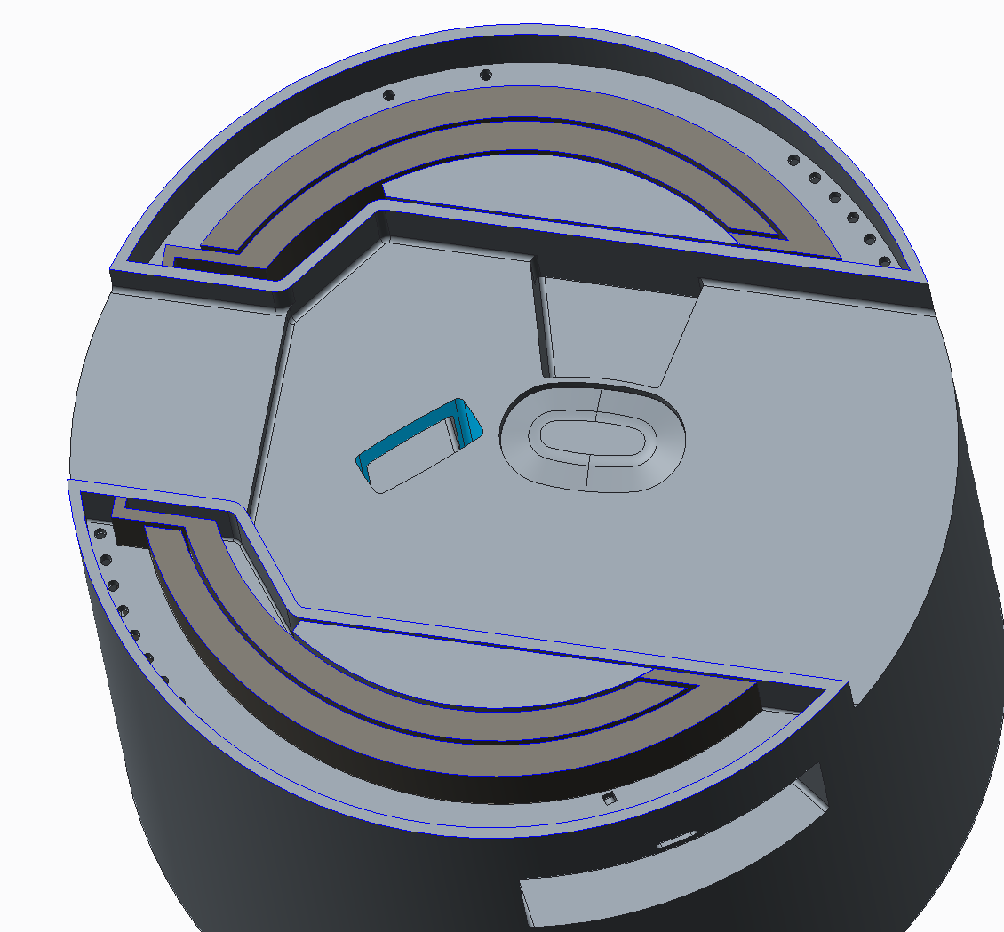
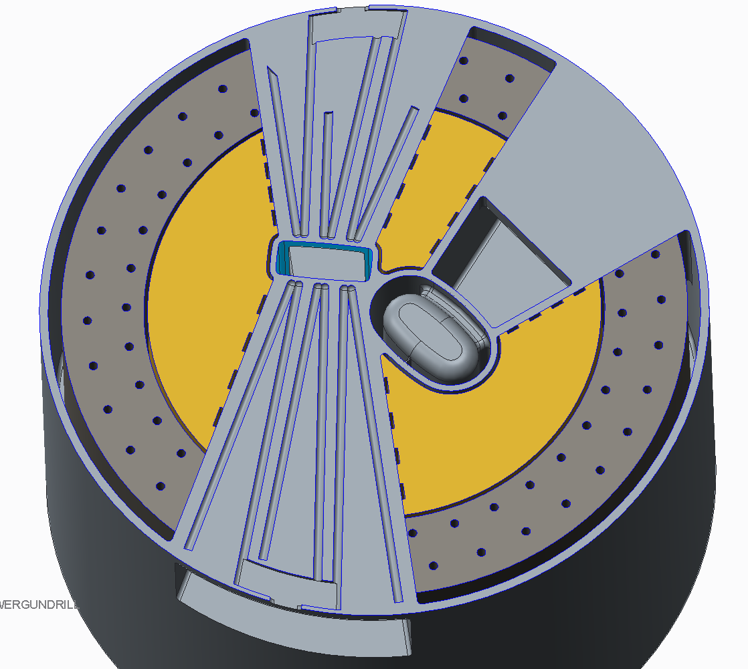
Lower Inner Reflector Plug Heavy Water Cooling

Slide 14
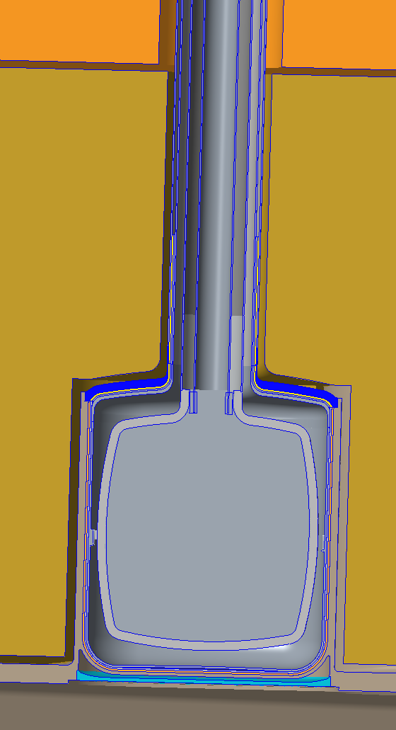
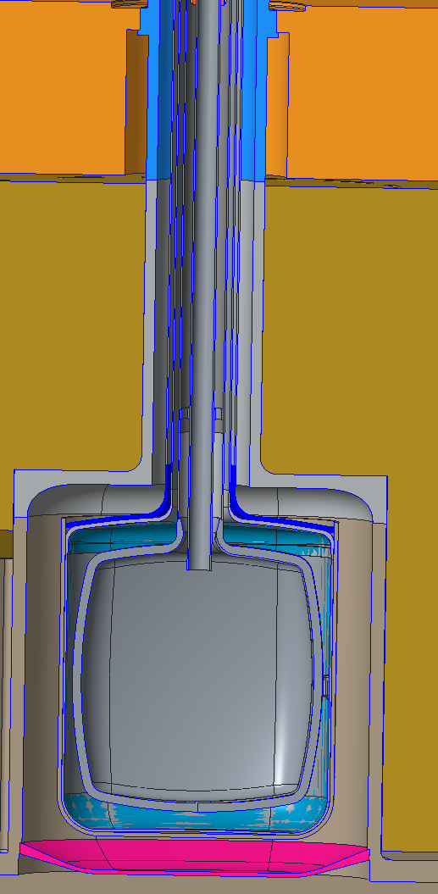
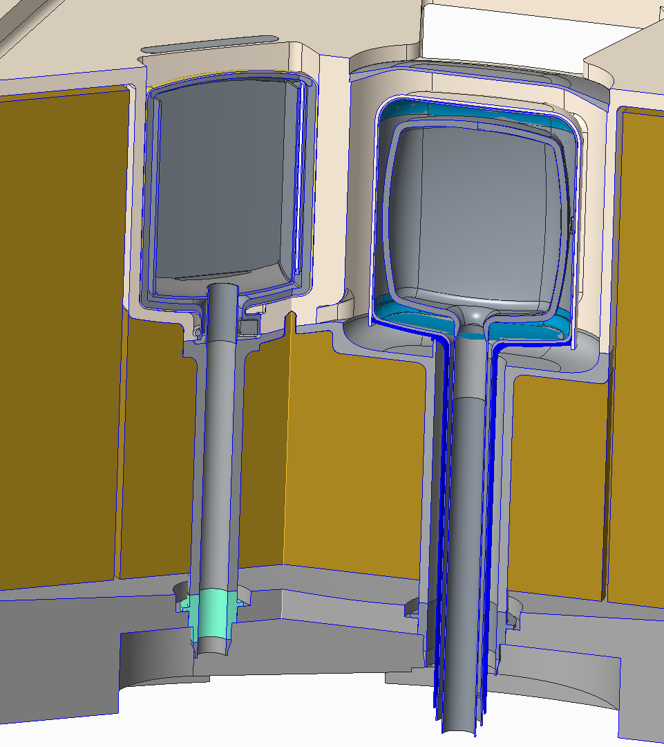
Moderator Water Cooling
Top Upstream (Heavy Water)
Top Downstream (Light Water)
Bottom Moderators (Light Water)

Slide 15
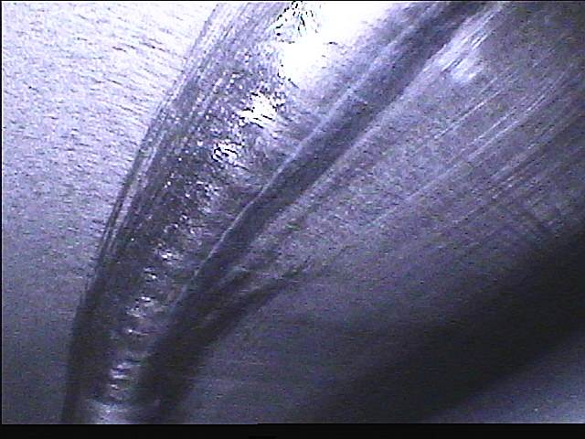
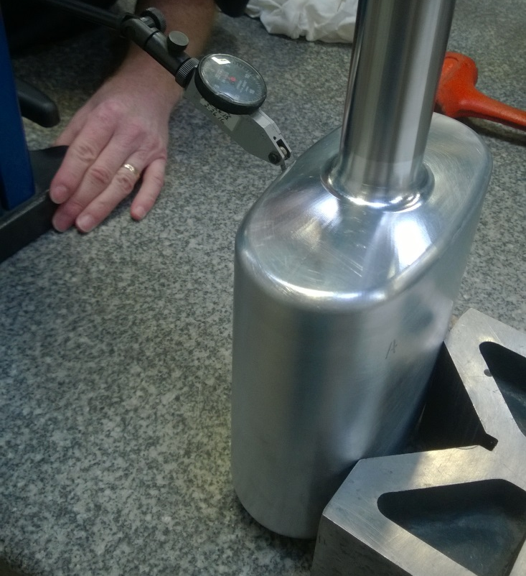
Moderator Welding Issues
Charge 8
Hydrogen Vessel EB welds feature difficult geometry but were consistently successful after development
Vacuum Vessel welds feature difficult geometry and extremely thin welds
Scrapped 2/3 fully inspected vessels
No success in EB redevelopment
GTAW VV were successful
Plan to EB H₂ vessels and GTAW Vacuum vessels as in IRP-2

Slide 16
Cadmium Application and Machining Issues
Charge 8
Only one known source for Cd spraying
Many issues with adhesion and thickness consistency
Adhesion improved if only one layer is sprayed
Limited sources for machining of cadmium
Allows one heavy layer to be sprayed with no subsequent touch up
Makes necessary moderator fit up and thickness tolerances possible

Slide 17
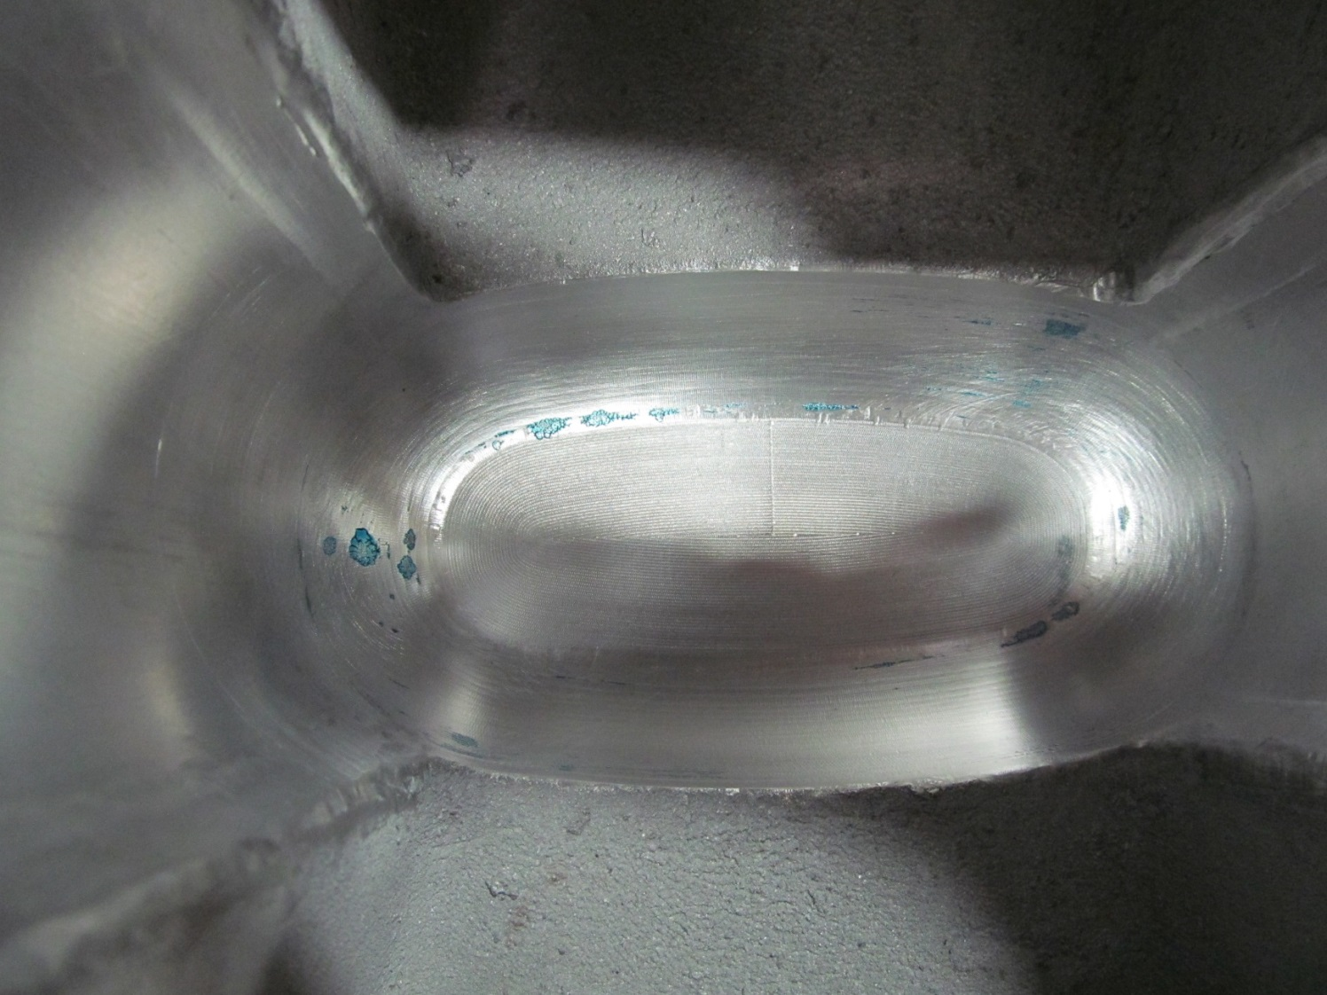
Moderator Fit Up Issues
Charge 8
Minimal issues fitting up ambient and downstream cryogenic moderators
Fit requirement for heat removal from Top Upstream Moderator very problematic
GTAW Vacuum Vessel marginal in straightness for required fit
Lots of time intensive match machining
Spraying Cd into moderator pocket loosens fit requirement
Prefer to develop He lid Cd coating and subsequent welding

Slide 18
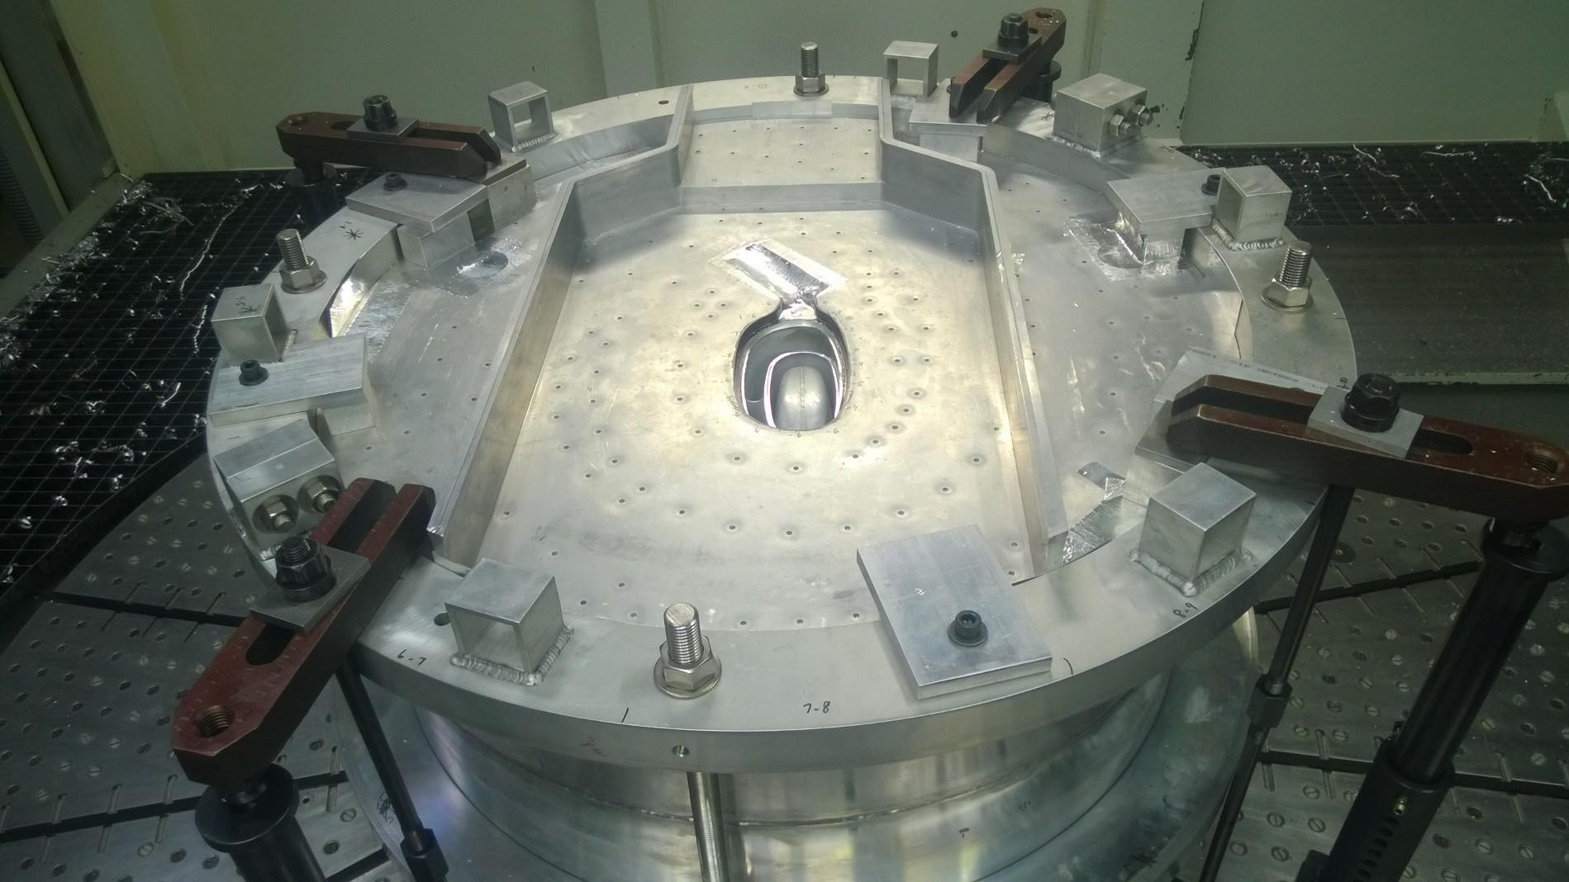
Serpentine Plate Issues
Charge 8
Flatness requirement for weld fit up was problematic for IRP-2
Some subsequent tolerances were missed due to material movement from machining and welding
No major issues
Difficult to inspect EB welding
Serpentine channels will be removed and replaced with gun drilled beamtube cooling channels

Slide 19
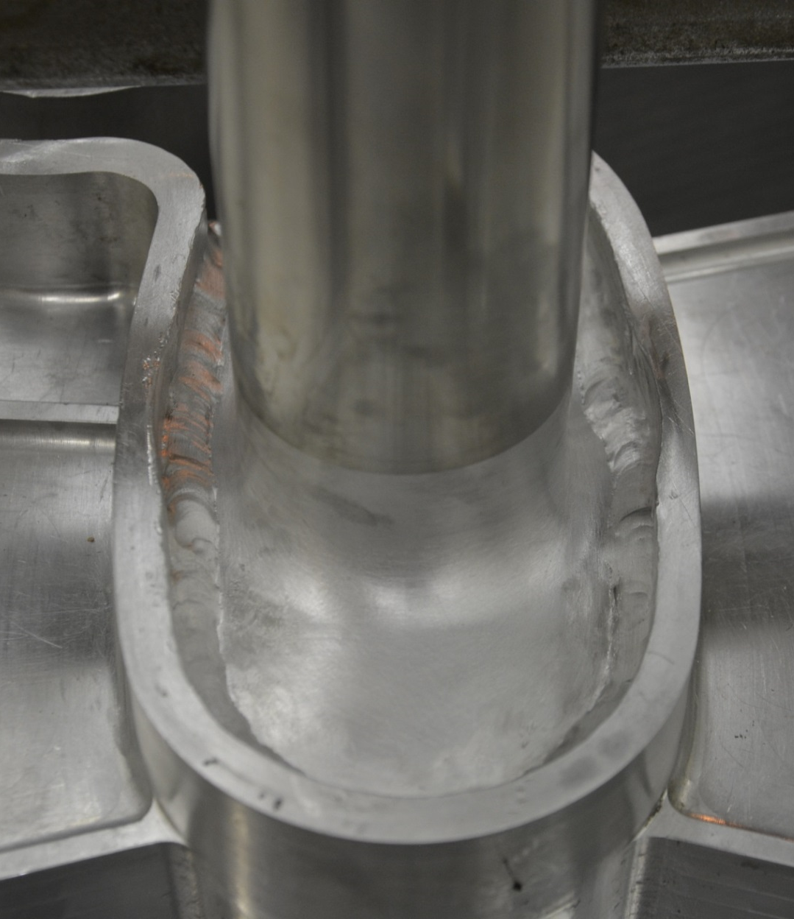
Helium Lid Welds likely leak sites in IRP-1 and 2
Charge 8
Top Upstream Helium Lid had problematic weld access
Access improved by removing water lid from top upstream
Plan to EB weld Top Upstream Helium lid to reduce Cd inclusion risk
Development activity to access robustness of current downstream helium lid welds planned
May EB weld or change joint design if necessary
Access improved with new premoderator design

Slide 20
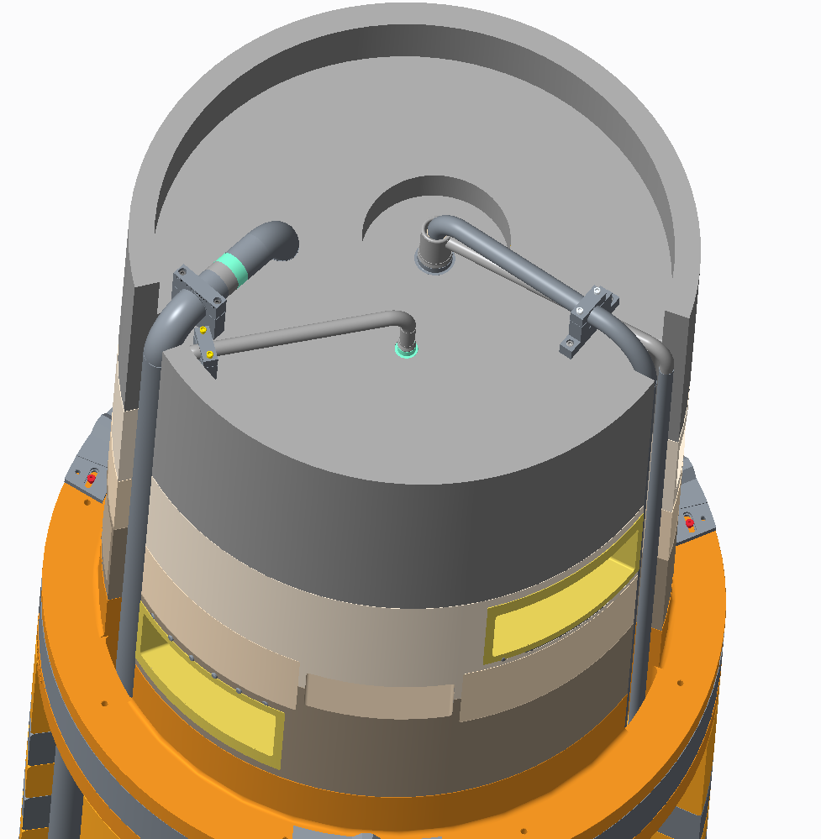
Pipe chases added back to reflector vessel
Charge 8
In IRP-2, bottom reflector utilities were run within reflector vessel
Lots of additional aluminum welding
In order to transition utilities to SS as soon as possible, bottom reflector utilities will be run in pipe chases on the outer diameter
This method was used in IRP-1
Creates some additional complexity in circumferential reflector welds
Eases requirement for precision of piping fabrication

Slide 21
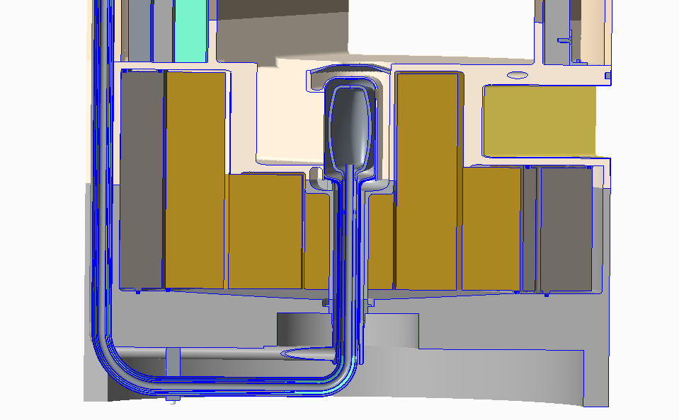
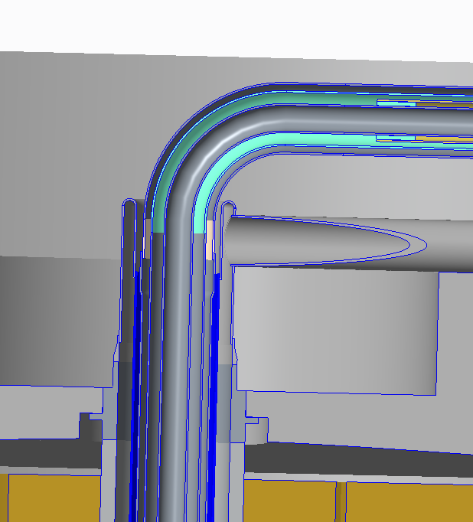
Water layer broken off transfer lines immediately
Charge 8
Simplify transfer lines by breaking off water leaving only 4 concentric lines
Reduces risk of pulling on moderator structures
Allows for transfer line functional tests
Potential for increased heat load to hydrogen system by not having water near vacuum layer
In close proximity to reflector vessel, wrap aluminum wire between vacuum layer and water pipe to cool vacuum layer and reduce radiation heat transfer
No mitre bends in transfer lines
Improves venting and structural robustness

Slide 22
Transfer line routing allows testing before stacking shielding
New transfer line routing allows for transfer lines to be fabricated and tested in parallel with reflector vessel fabrication
Greatly improves schedule and reduces fabrication risk
Transfer line routing more complicated
Transfer lines installed and functionally tested prior to any shielding stacking
If issues are found later in fabrication, shielding can be easily removed
Charge 8

Slide 23
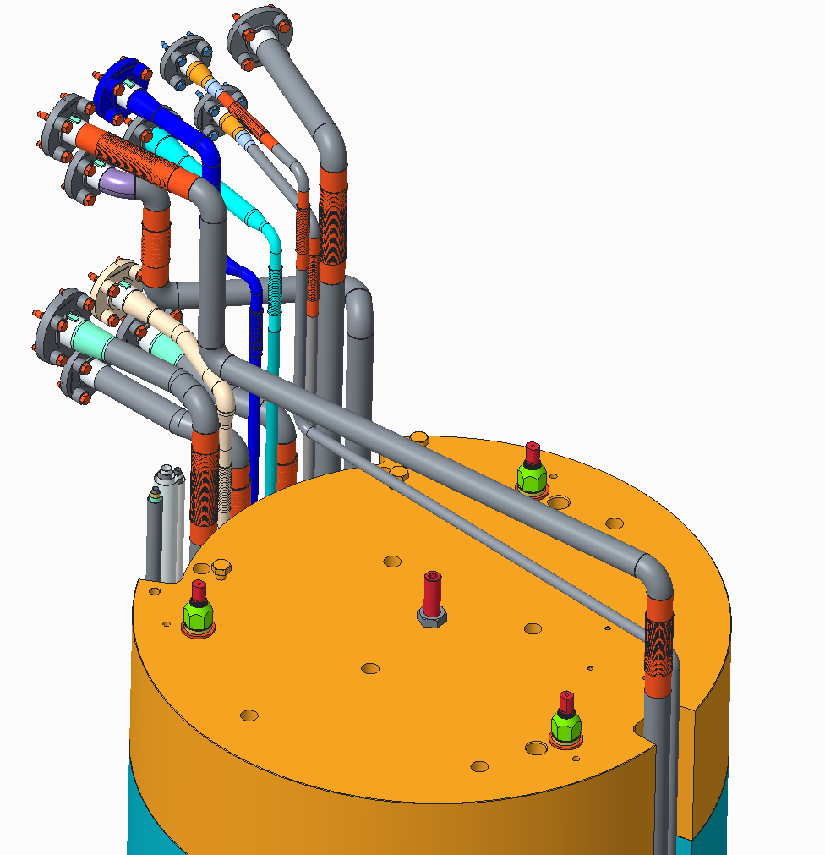
Almost all water piping installed prior to stacking shielding
Water piping can be fabricated in parallel with reflector vessel if desired
Piping routing more complicated
All water piping can be brought to level above upper shielding prior to stacking shielding
2 lines must be crossed over upper shielding after stacking
Most testing can be performed prior to stacking of shielding
If issues are found after shipping, only 2 welds need to be cut to remove shielding to gain access
Charge 8

Slide 24
Transfer Line Terminations Incorporate As-Built Data
Charge 8
IRP-2 transfer lines were very close to not fitting core vessel penetrations
Survey and Alignment Team provided data on location of core vessel transfer line penetrations during IRP-2 installation
As-built data used to align nominal transfer line routing

Slide 25
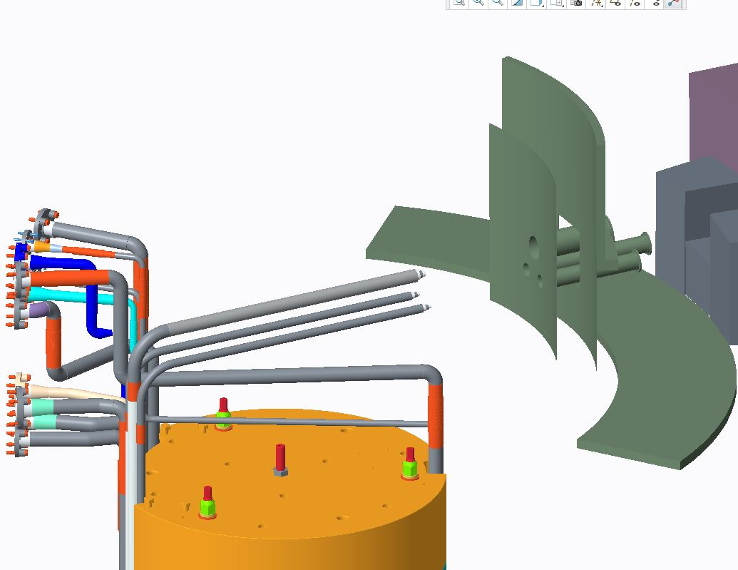
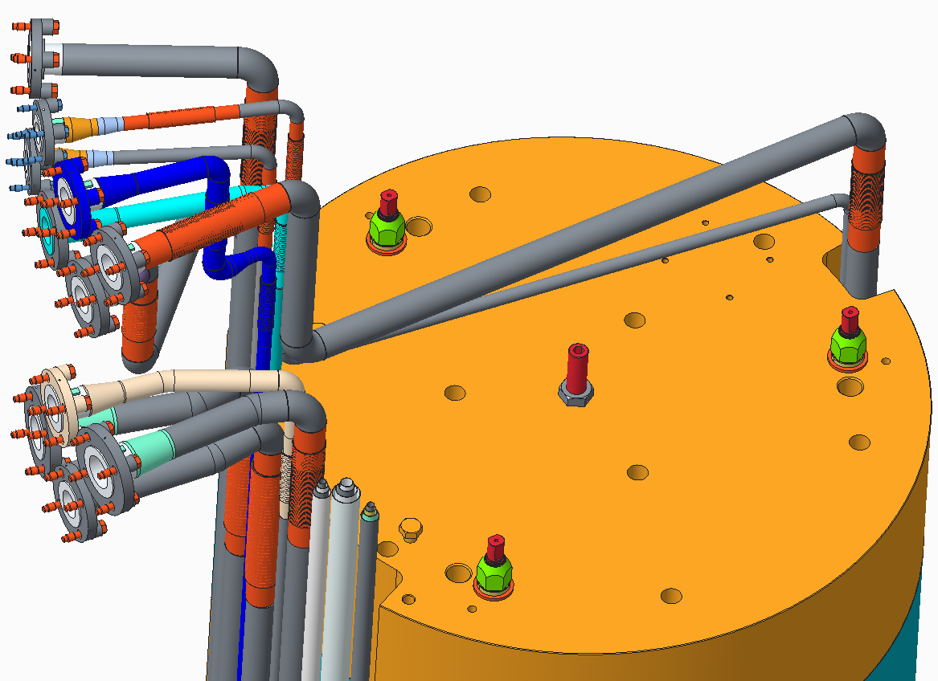
Transfer Line Installation Improved
Charge 8
L-shaped spools to be added atop the IRP during installation to allow for greater tolerance for transfer line fit up
Existing spools will be pulled out of the way from outside the SDER to allow for installation and fit up

Slide 26
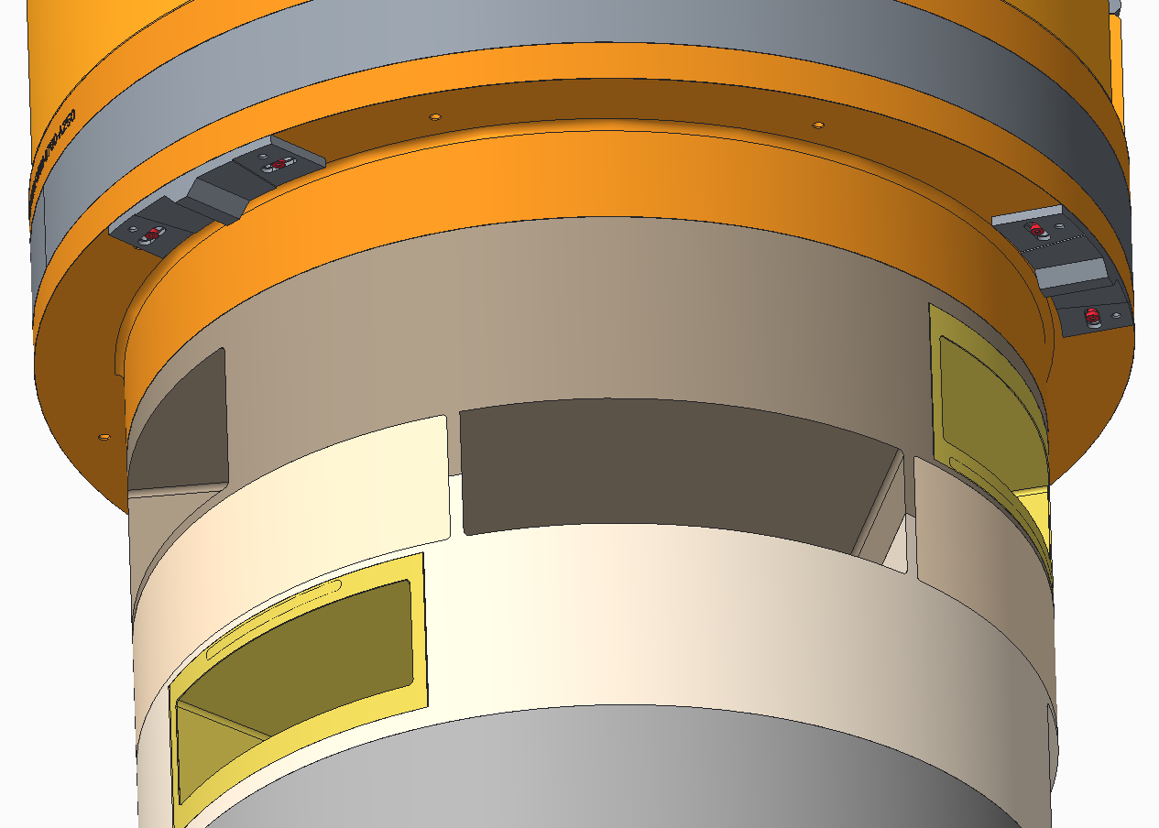
Alignment blocks will have recessed mounts to prevent movement during installation
Charge 8
Alignment blocks moved during initial IRP-2 installation because friction force was not enough to hold them in place
Machined recessed mounts will simplify alignment and prevent movement during installation

Slide 27
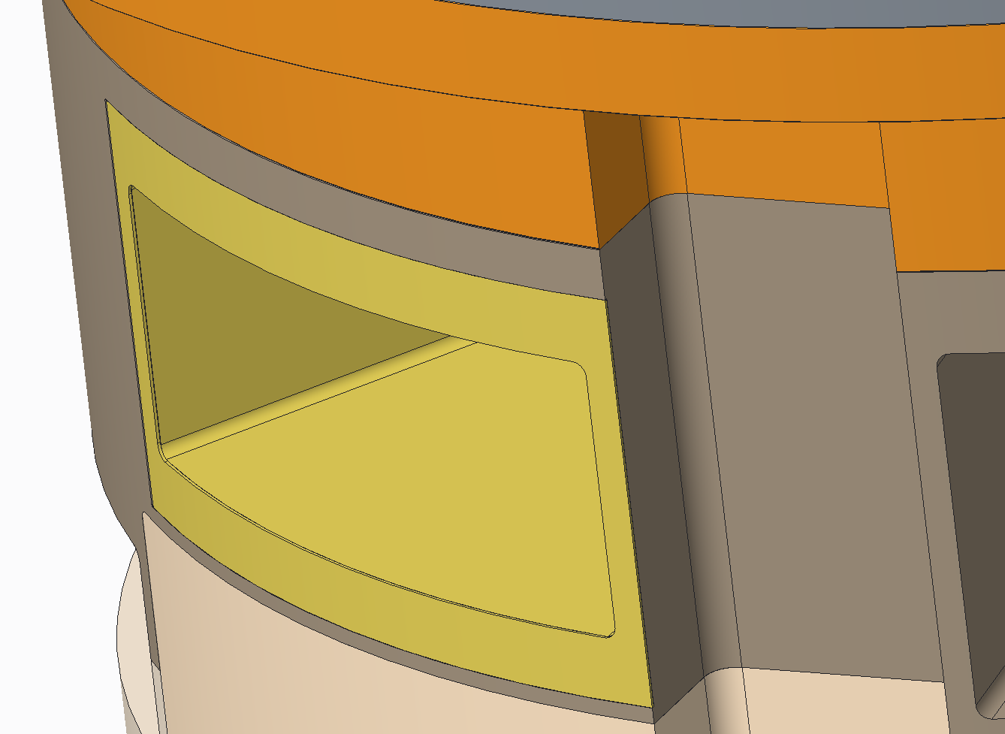
Cadmium Picture Frames Recessed to Prevent Damage
Charge 8
Damaged Cadmium from MUTS Insertion/Removal
Cadmium Recessed to Prevent Damage during Handling

Slide 28
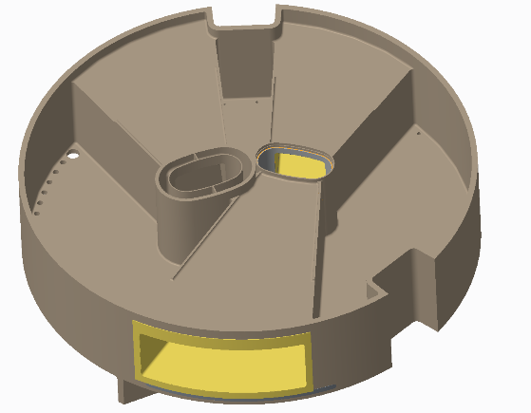
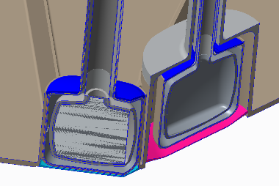
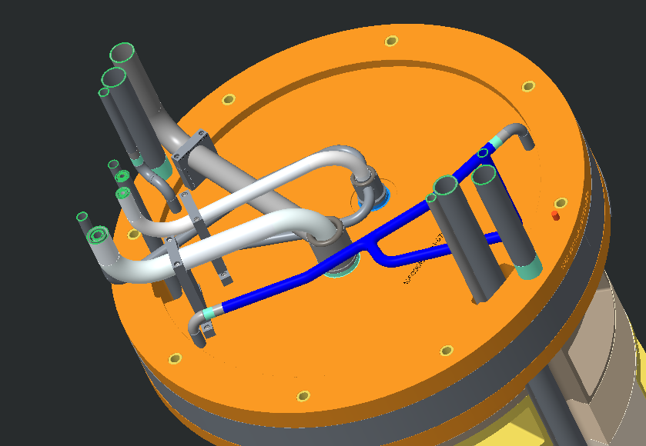
R & D will Alleviate Manufacturing Uncertainties
Charge 8
Cadmium coating with limited access and subsequent cadmium machining
Helium lid weld development for welding adjacent to cadmium coatings
Transfer line tube bending and welding

Slide 29
IRP-3 Lifetime Consideration
IRP lifetime limited to 50 GWHr by aluminum radiation damage
Not a firm limit, 50 GWHr=~35 dpa
Ambient moderator poison and decoupler could easily be thickened to accomplish this lifetime
3% loss of flux at beginning of life compared to nominal poison
Decoupled hydrogen moderator could have problems with thickened poison plate
Moderator non-linear performance with power not well understood
If problem is with Hydrogen density, adding heat load would make it worse
Extreme non-linearity of density change with temperature makes consequences to top upstream moderator potentially catastrophic
Increase ambient poison thickness but not cryogenic moderator
IRP-3 lifetime would be 37 GWHr, compared to 27 GWHr for IRP-2
Perform simulation and experiments to increase confidence and reduce risk for increasing lifetime of future IRPs

Slide 30
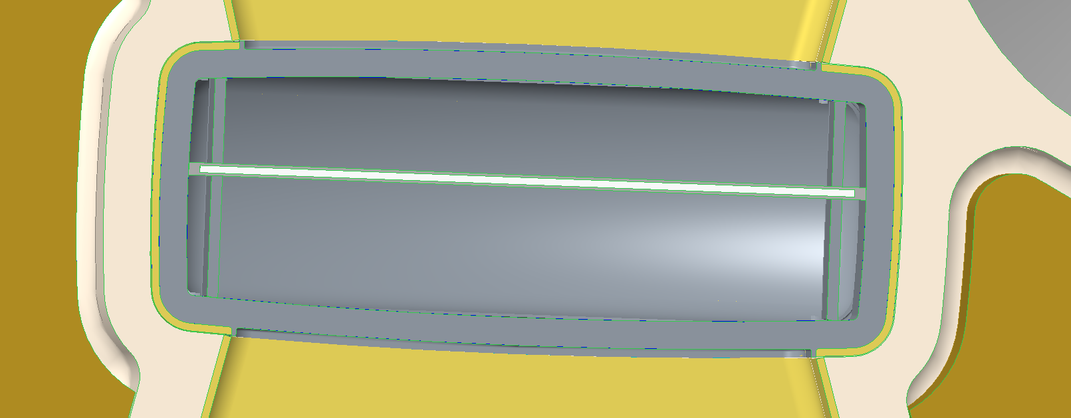
Bottom Upstream Internals and Coating Modified
Gd poison plate thickened from 1mm to 1.31mm
Increases lifetime to same as Top Upstream poison plate
Dummy Al plate removed – flow no longer symmetric
Beam line 15-16-17 side maintained at 25 mm water thickness
Beamline 7-8-9 side increased from 15 mm to 16.7 mm water thickness
Cadmium designed overlapped in corners to reduce gap

Slide 31
Bottom Upstream Moderator Performance Improved
By removing the aluminum plate on the BL-17 side and moving the poison plate 2 mm towards BL-17, the effective poison depth on BL-17 side remains the same and the one on BL-8 side increases by 2 mm
The moderator performance on BL-17 side remains nearly the same:
Up to ~5% increase in peak pulse intensity due to the removal of the 2 mm gap
Negligible change on the time-averaged intensity and FWHM
On BL-8 side:
15 – 20% increase in the time-averaged intensity
only ~ 7% increase in the peak pulse intensity
~ 10% increase in FWHM

Slide 32
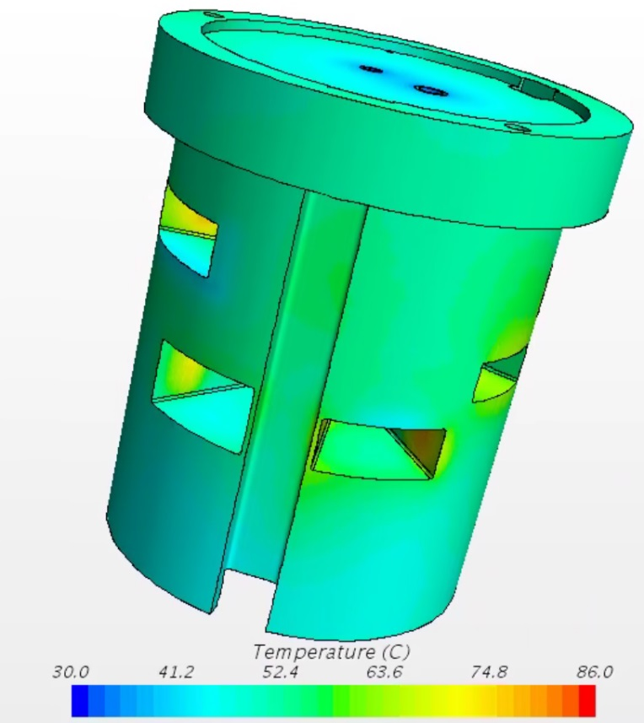
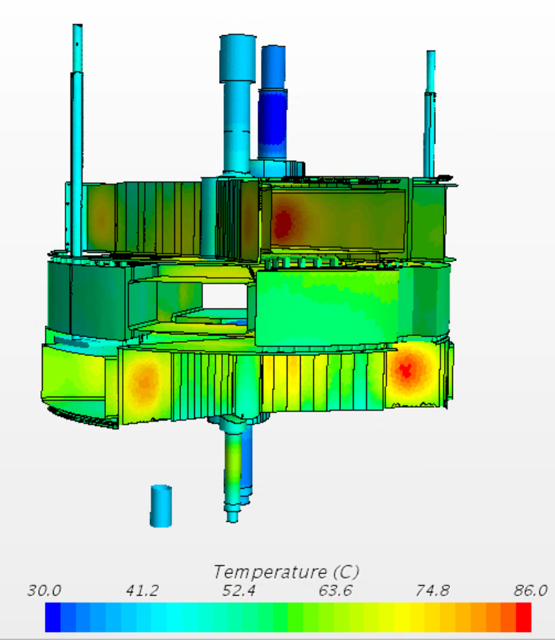
Thermal Analysis Meets Design Requirements
CFD analysis completed confirming IRP-3 design meets thermal design requirements at 2 MW power, 1 GeV
All surfaces in contact with water <100 C
All aluminum parts <120 C
Need to confirm design with 1.3 GeV
IRP-3 Aluminum Temperatures
Max temperature located on duct surface = 86 C

Slide 33
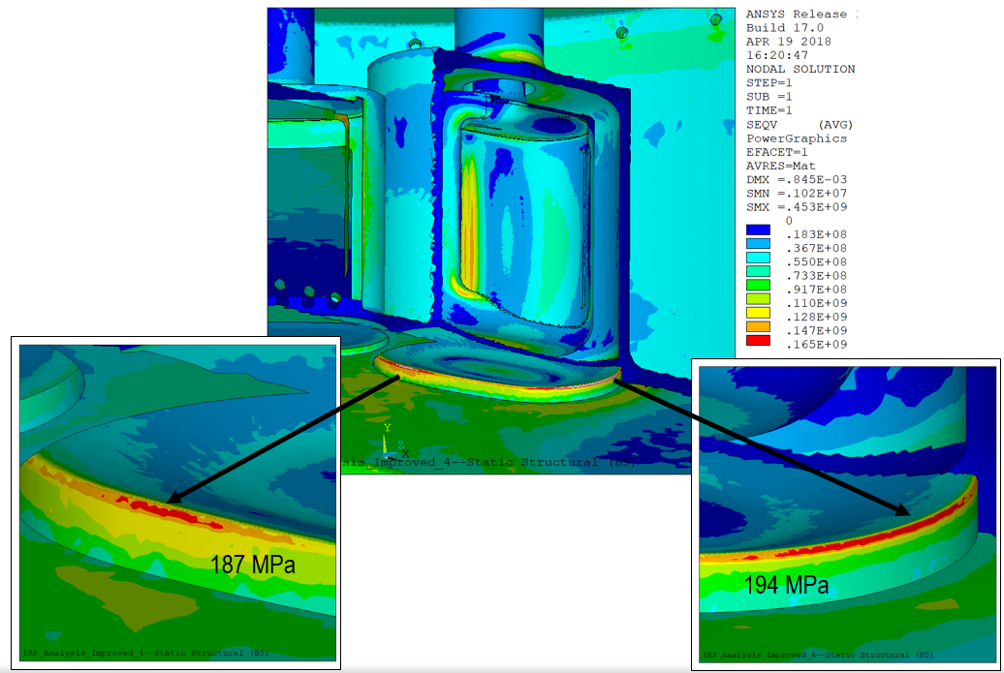
Structural Analysis Requires Minor Revision to Weld Details
IRP-3 Combined Von Mises Stresses
ASME Section VIII Div. 2 style structural analysis shows general design compliance based on deadweight, pressure, and thermal loadings
Some weld details to be modified in order to meet design requirements

Slide 34
Procurement Strategy Modified
Charge 8
T6 - Rosenblad
Rather than procuring IRP-3 through 1 large contract, IRP will be broken into many smaller contracts to help control schedule, risk and cost
FY18 – Moderators and R&D
FY19 – Beryllium, Lower IRP, and Piping (Including Transfer Lines)
FY20 – Middle IRP, Upper IRP, and Integration
Should allow for delivery before mid 2022

Slide 35
Summary
IRP-1 exceeded lifetime expectations despite operational issues
Lessons learned from IRP-1 operation and IRP-2 fabrication have been incorporated into IRP-3 design
Manufacturing development is planned to mitigate remaining fabrication uncertainties
IRP-3 design meets design requirements with the exception of a few weld details
IRP-3 procurement strategy modified to mitigate schedule risk

