Slide 1
Status of Linac High Voltage Converter Modulators Upgrades
Presented to the
SNS Accelerator Advisory Committee
David E. Anderson
Team Lead, High Voltage & Pulsed Power Systems
May 16, 2018

Slide 2
Acronyms
AT-HVCM – Alternate Topology High Voltage Converter Modulator
BTF – Beam Test Facility
DGA – Dissolved Gas Analysis
FPGA – Field Programmable Gate Array
HVCM – High Voltage Converter Modulator
IGBT – Insulated Gate Bipolar Transistor
NCL – Normal Conducting Linac
PM – Preventative Maintenance
PPU – Proton Power Upgrade
RFTF – Radio Frequency Test Facility
SCL – Superconducting Linac

Slide 3
Outline
System Introduction
Calendar year 2017 Performance Statistics
Preventative maintenance
Upgrades & development
Proton Power Upgrade (PPU) Activities and Plans
Conclusion

Slide 4
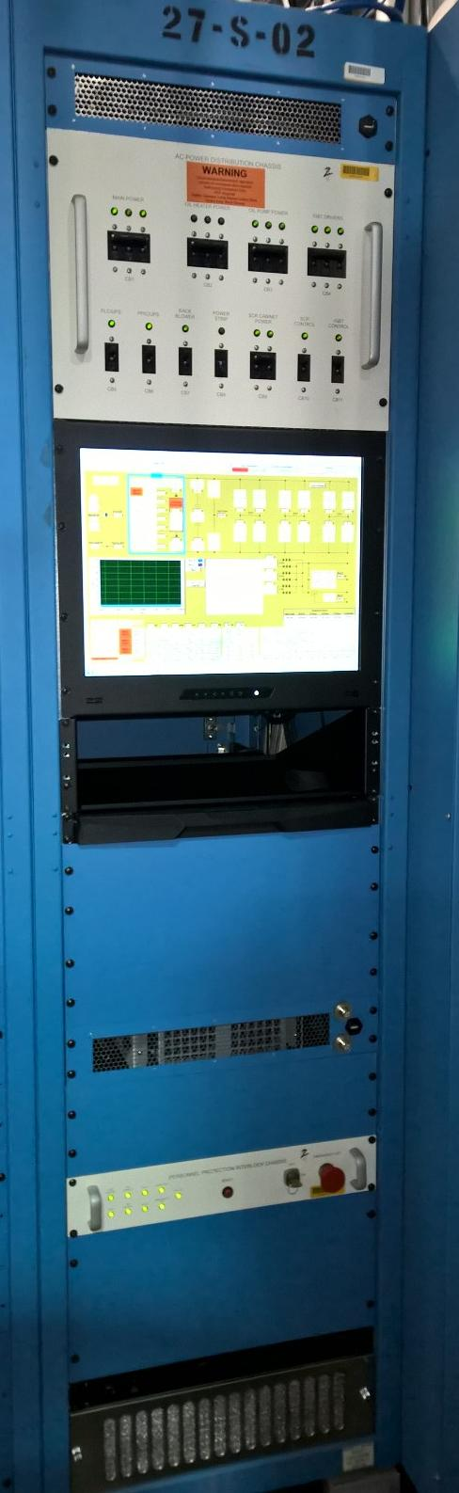
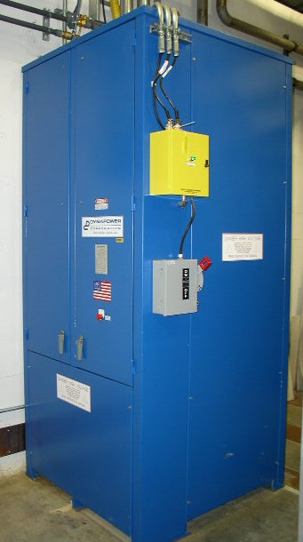
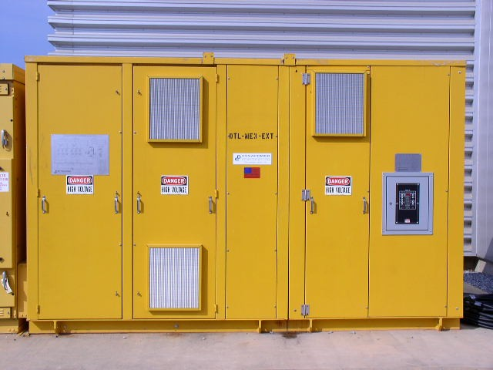
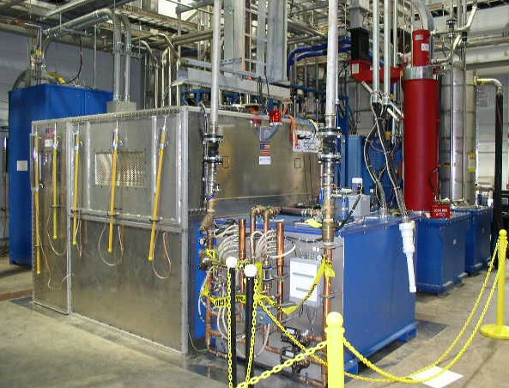
Modulators provide pulsed power to high power RF klystrons using 20 kHz switching with Insulated Gate Bipolar Transistors (IGBT)
Provides up to 135 kV, 1.35 ms pulses at 60 Hz to amplify RF up to 5 MW
  75 kV for SCL, 125 kV for DTL
3 phases switching at a nominal 20 kHz employed to increase output ripple frequency
Powers multiple klystrons up to 11 MW peak power
15 operational modulators, 2 test stand modulators
Approximately 1.15×10⁶ combined hours

Slide 5
HVCM Downtime Summary CY2017 – 22% (18%) of total
System | Total Hours | Major (>4 hrs.)
RFQ-Mod | 9.8 | -
DTL-Mod3 | 1.9 | -
DTL-Mod5 | 0.9 | -
CCL-Mod1 | 10.6 | 1
CCL-Mod2 | 5.6 | -
CCL-Mod3 | - | -
CCL-Mod4 | 13.3 | 1
SCL-Mod1 | 7.0 | 1
SCL-Mod5 | 1.1 | -
SCL-Mod9 | - | -
SCL-Mod12 | - | -
SCL-Mod14 | 9.6 | 1
SCL-Mod15 | 1.0 | -
SCL-Mod18 | 1.1 | -
SCL-Mod21 | 9.7 | -
Multiple | 3.4
TOTAL | 75 (119) | 4 (4)
PRIOR YEAR VALUES SHOWN IN PARENTHESIS
Total hours improved by 37% from previous year
Major failures account for 41% of total downtime
  NWL evaluation boost capacitors in CCL-Mod1
  Missing gate pulse in CCL-Mod4 and extensive troubleshooting
  Header cable failure in SCL-Mod1
  SCR cooling fan failure and electrical noise in SCL-Mod14
Oil pump failures lead non-major failures (10% overall)
  Usually due to bearing failure
  All replaced with units w/ thrust bearing or new oil cooling upgrade
New controller channel access / network / timing issues failures account for 9% of failures
  None since August 2017
IGBT drivers account for 5.4 hours or 7%
  Many modifications on existing drivers
  New design addresses modifications, obsolescence, noise mitigation and other issues

Slide 6
Recent Preventative Maintenance on HVCM systems focused on aging components
Replaced Envirotemp FR3 in DTL and CCL tanks after further analysis indicated oil reached end of life – SCL HVCMs pending but electric field stresses 45% lower
Boost capacitors replaced in warm linac
Boost capacitors, primary bus work and voltage dividers replaced on all SCL HVCMs during last 2 outages
Replaced Personnel Protection Interlock Chassis PCBs to address obsolete relay issue
Filtered AC signals from SCR cabinet to remove noise on new controller
All non-upgraded oil pumps replaced with motors that employ thrust bearing
Fiber optic cables replaced in warm linac, cold linac deferred
Partially replaced faulty SCR manifold flow switches
  Vulnerable to no indication of loss of flow
  Complete redesign of switch/manifold a future activity

Slide 7
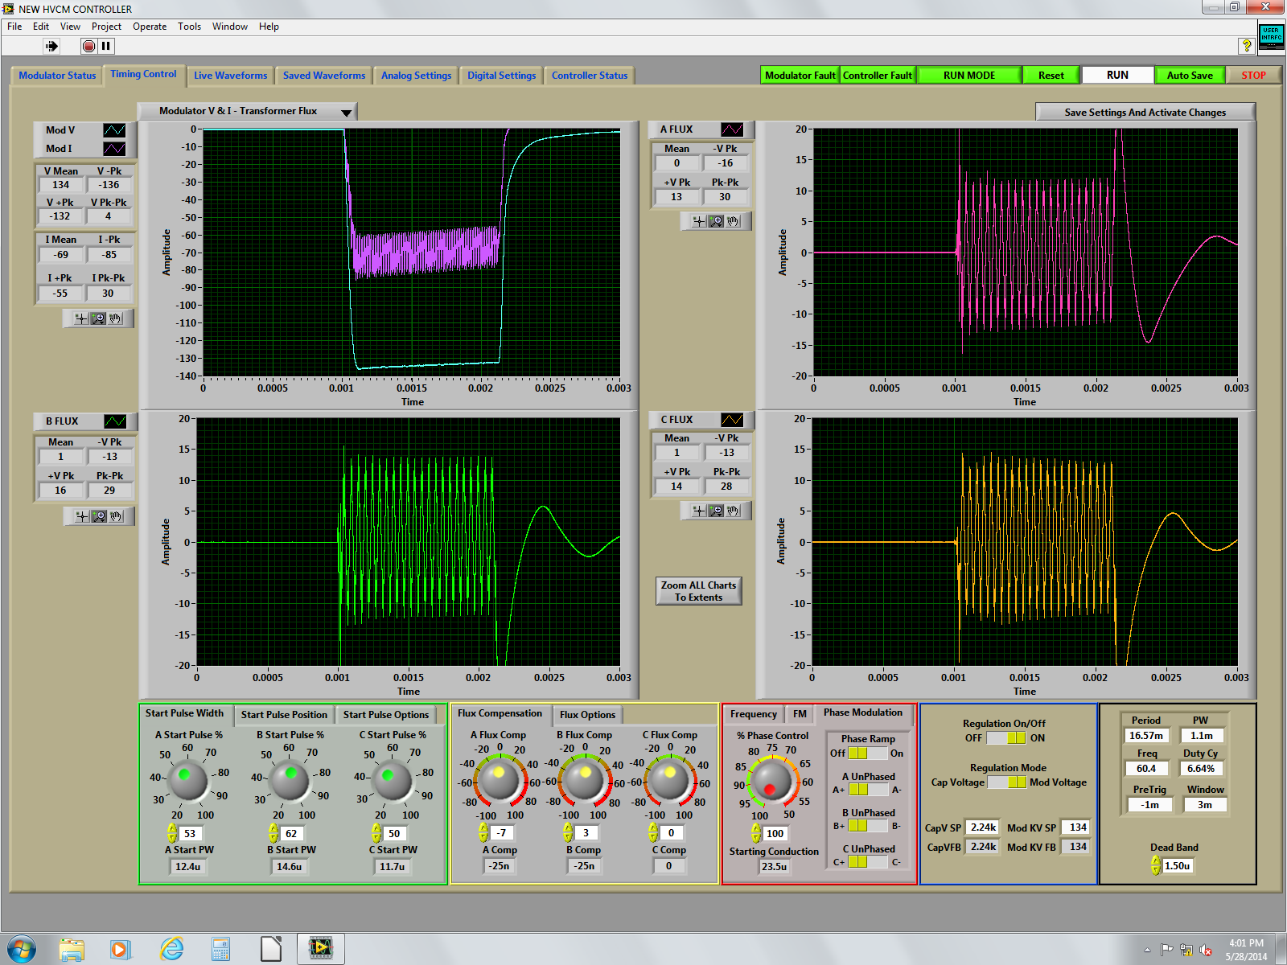
New controller installation (AIP-34) completed summer 2017
Final four SCL units installed during summer
Added new features:
  New oil cooling system AIP upgrade monitoring
  Improved Human Machine Interface based on feedback from users
  Enhanced interface to IGBT drivers to remotely monitor gate switching events
  Improved efficiency of Averna FPGA virtual instruments – frees up FPGA resources for enhanced timing features, etc.
  Expanded capabilities to support a future RF mobile test stand

Slide 8
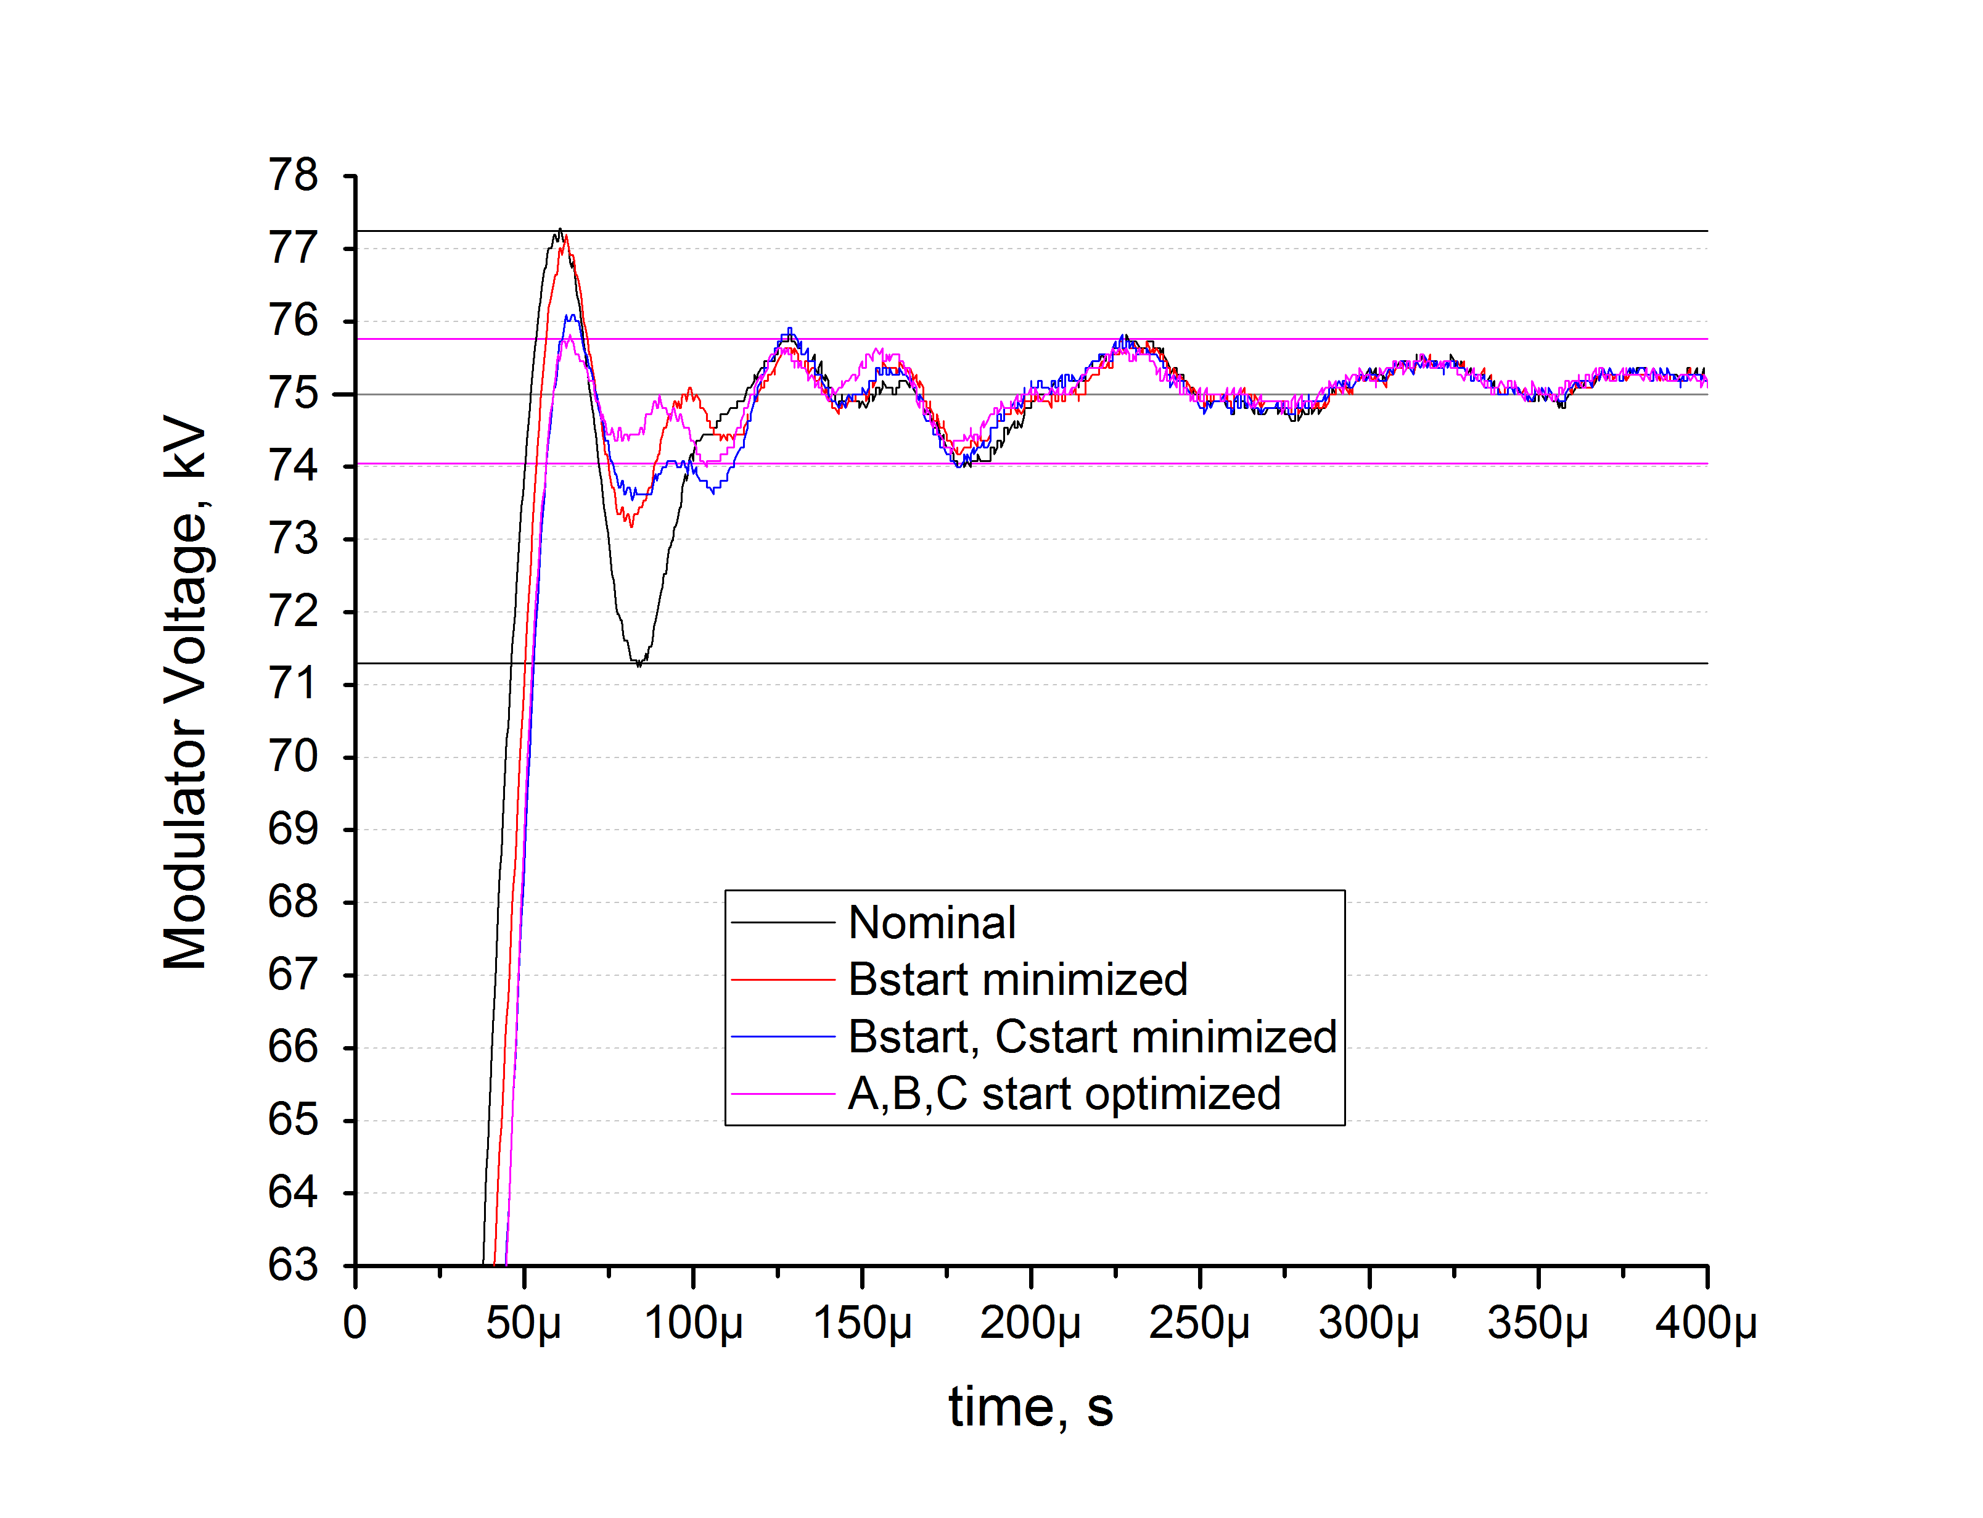
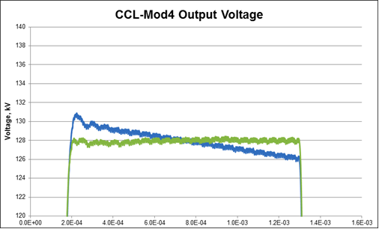
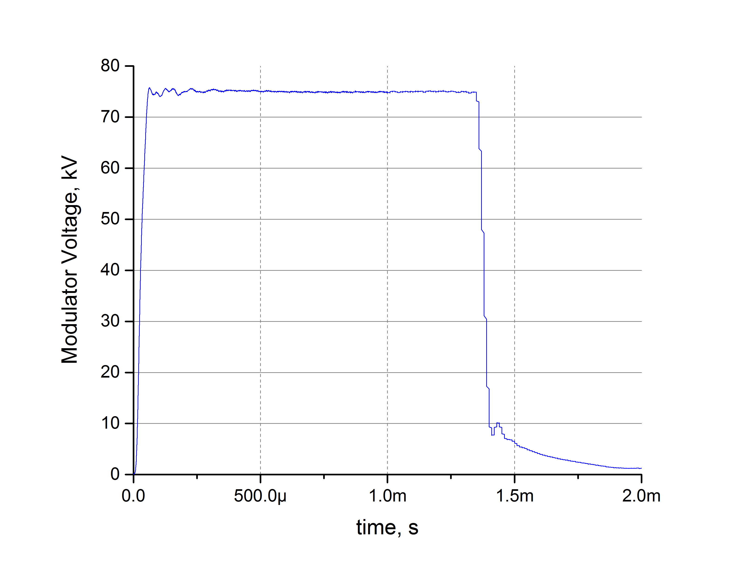
Pulse flattening and optimization on all HVCMs to improve LLRF control margins & minimize cavity trips
Pulse flattening enabled and leading edge optimized throughout Gallery
Further improvement possible after optimizing FPGA resources to control individual IGBT pulses – ongoing effort
Added 25 μs to all warm linac HVCMs to achieve 1 ms beam in linac
+0.7%
-1.5%
+2.7%
-5.2%
SCL-Mod14 Pulse Optimization

Slide 9
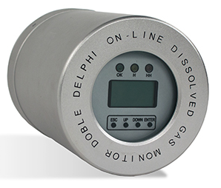
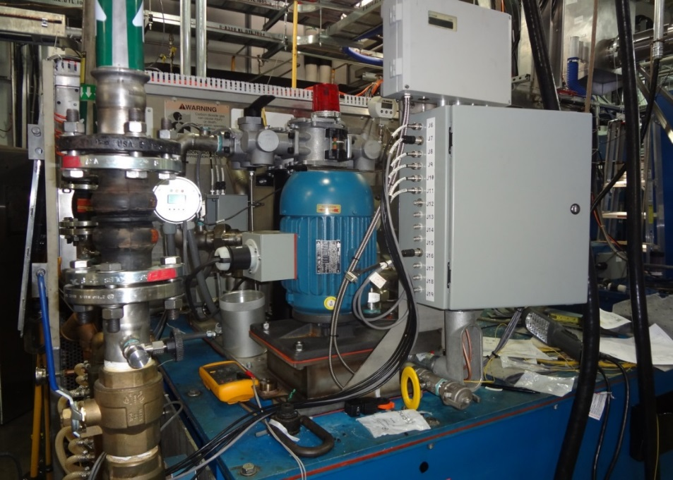
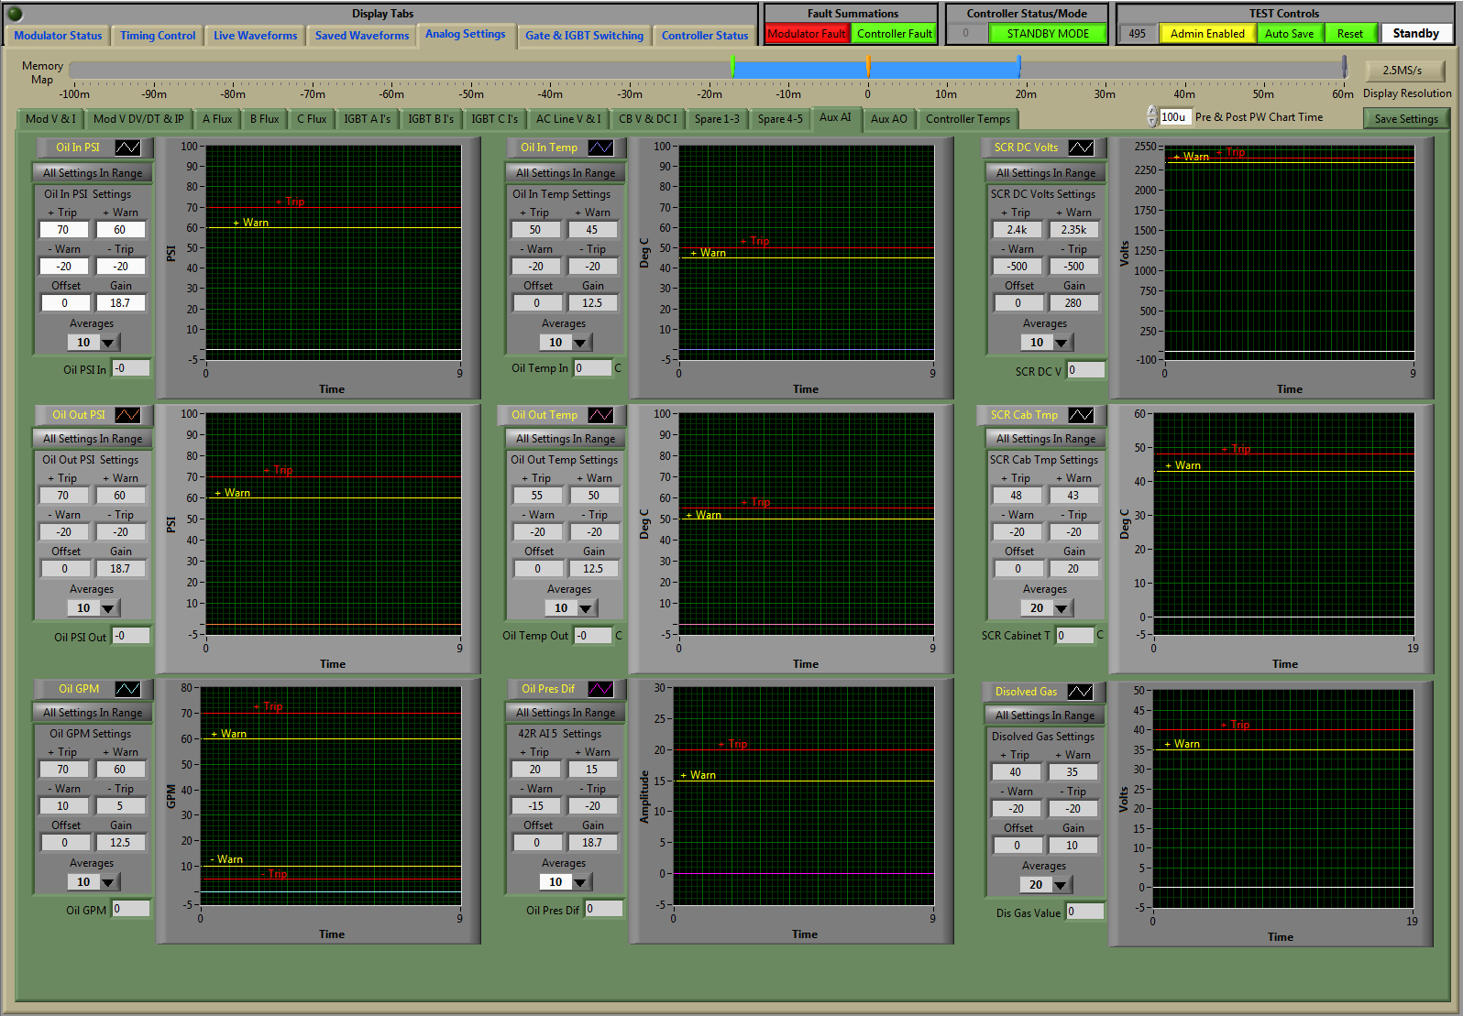
Enhanced reliability and reduced MTTR is improved by replacing the existing oil cooling system (AIP-36)
Installed in DTL HVCMs (3X) & on SCL-Mod21
The Barron’s Oil system can be used during operation
Added dissolved gas analyzer (H₂, CO, C₂H₂, & C₂H₄ (ethylene))
Pressure, temperature, flow and dissolved gas levels available on local and EPICS screens
Operators trained on new capabilities

Slide 10
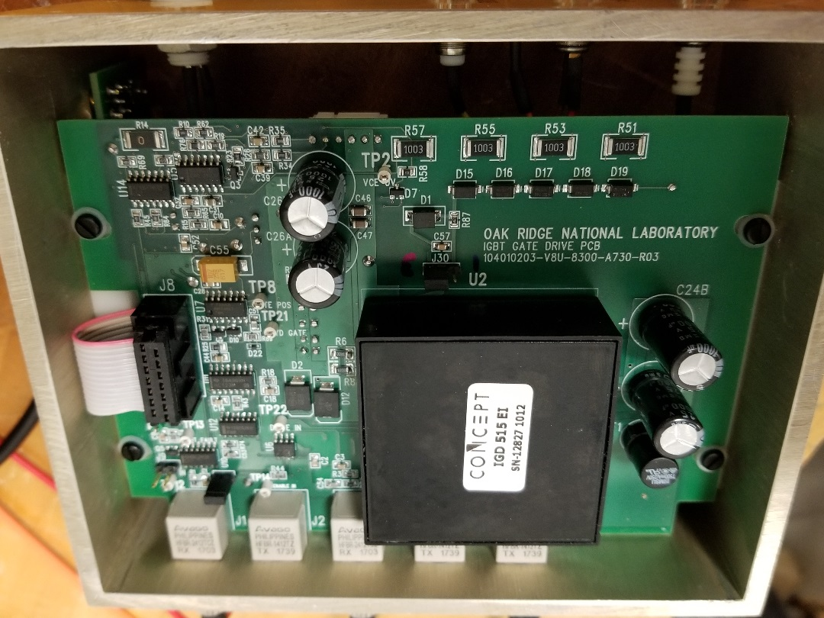
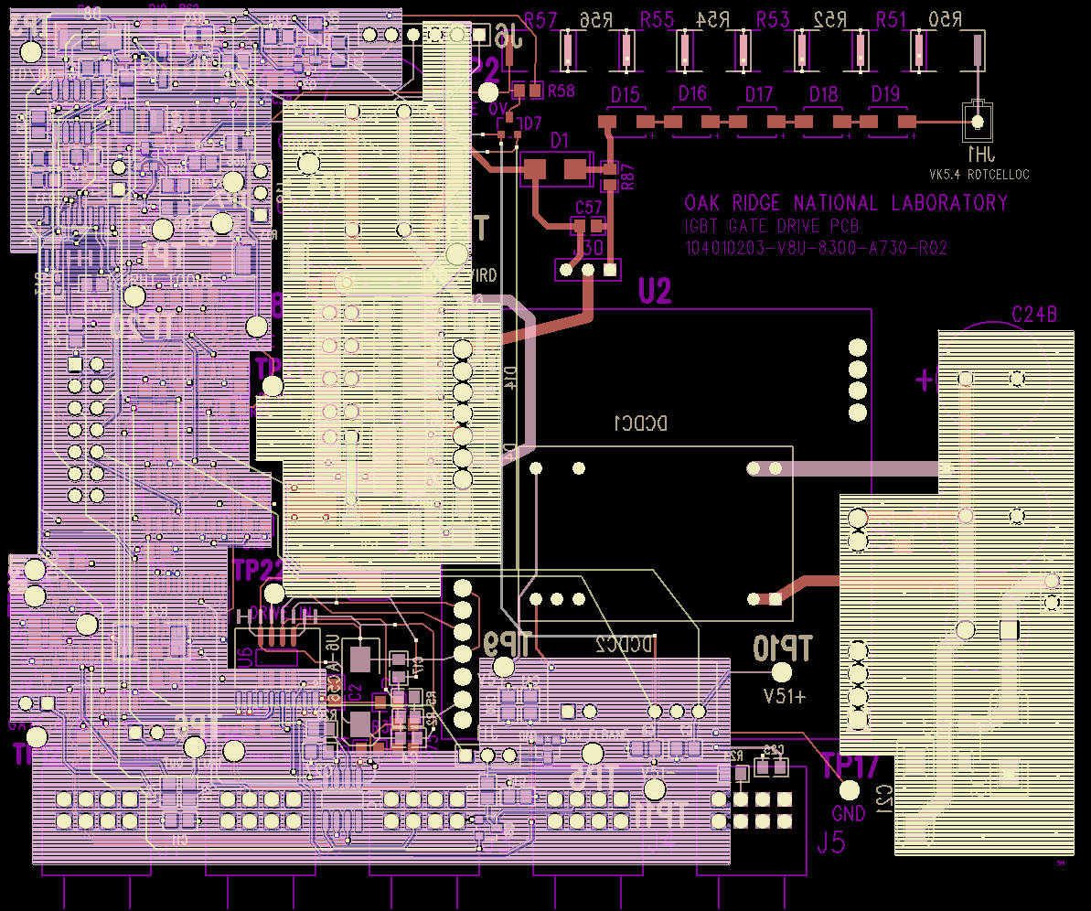
Completion of HVCM IGBT gate driver PCB addresses compatibility, noise and obsolescence issues
Incorporates additional protection features
Compatible with other IGBT power modules (current HVCM IGBT obsolete)
Improved noise immunity and high voltage isolation
Tested to 300+ hours in RFTF at full power (testing is ongoing)
Plan to install in operational modulators during upcoming outage

Slide 11
Obsolete IGBT Evaluation complete, -HE3 device compatible
FZ1200R33KL2C discontinued Nov. 2016
Sufficient spares on-hand for a few years
FZ1200R33HE3 is compatible with minor changes to gate resistors
Evaluated most manufacturers’ compatible modules
Device | V_{CES}, V | I_{C}, A | E_{on}, mJ* | E_{off}, J*
FZ1200R33KL2C | 3300 | 1200 | 144 | 2.5
FZ1200R33HE3 | 3300 | 1200 | 120 | 2.5
FZ1500R33HE3** | 3300 | 1500 | - | 2.3
obsolete
replacement
*measured at V_{CE}=2400 V, I_{C,comm}=1320 A
**1500 A version of the non-obsolete device considered for PPU upgrades

Slide 12
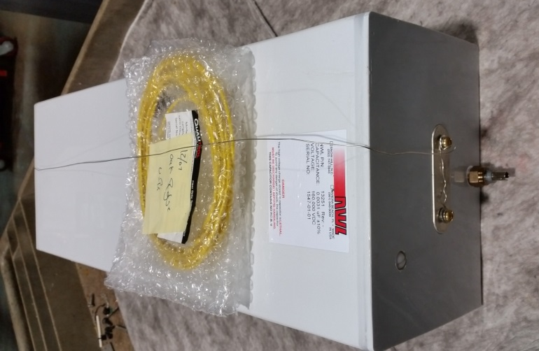
Progress continuing on HVCM boost capacitors
Condenser Products currently utilized in all systems but have exhibited some problems
  Caps installed in warm linac in 2015 required replacement in some HVCMs in 2017/2018
  Dissolved Gas Analysis samples from damaged capacitors reveal possible arcing and thermal decomposition of cellulose
NWL capacitors failed under evaluation in CCL-Mod1 (~10,000 hrs. operation)
Identical NWL delivered a thermally-instrumented unit, installed in RFTF
  T_{case} = 122 °F
  T_{internal} = 124 °F

Slide 13
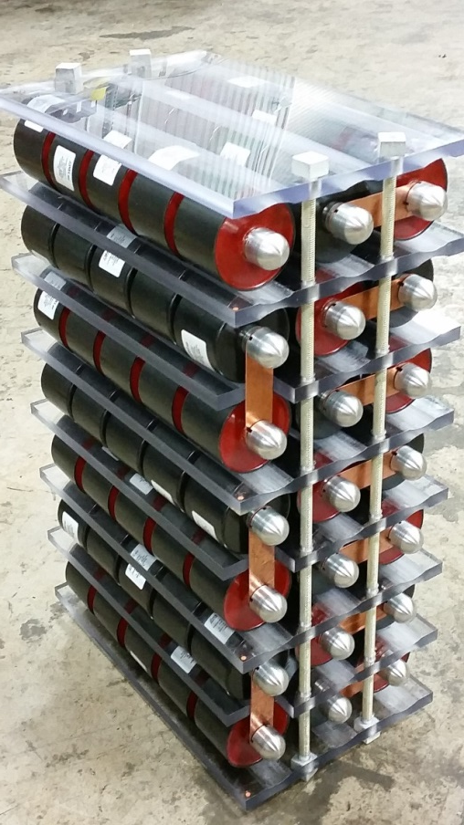
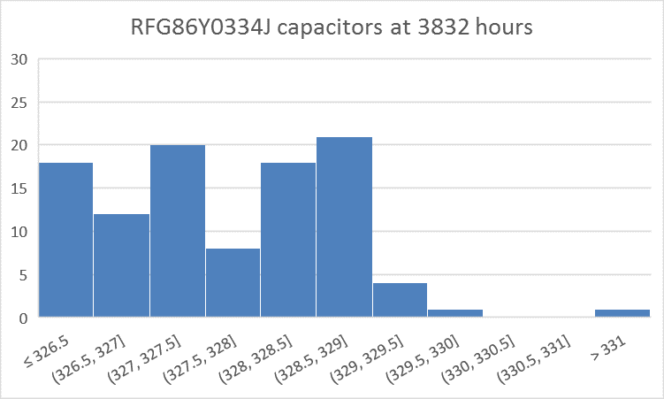
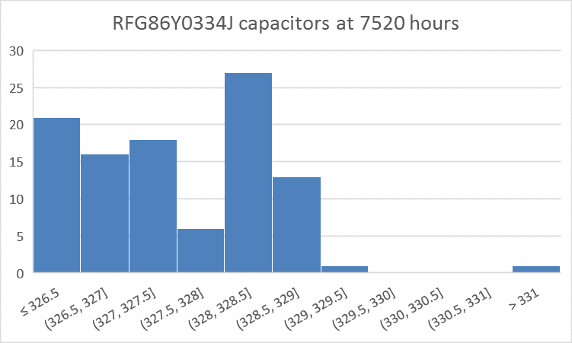
Boost capacitor array shows great promise, need to test additional assemblies
TPC solution shown is ~100 metallized poly film capacitors
  Tested in RFTF for ~20 months, 7500 hours (began 2/11/16, removed 10/23/17)
  Temperature <120°F (vs. 135-140 on prior film/foil caps)
  Average degradation of 0.04% over 3700 hours, expected end-of-life (ΔC=1%) 90,000 hours
    Component with largest ΔC (0.76%) would change 19% over 90,000 hours
  Plan to purchase a full set of arrays and continue testing
FPG86Y0334J capacitors at 3832 hours
FPG86Y0334J capacitors at 7520 hours
No. of units
Capacitance range (nF)
Capacitance range (nF)

Slide 14
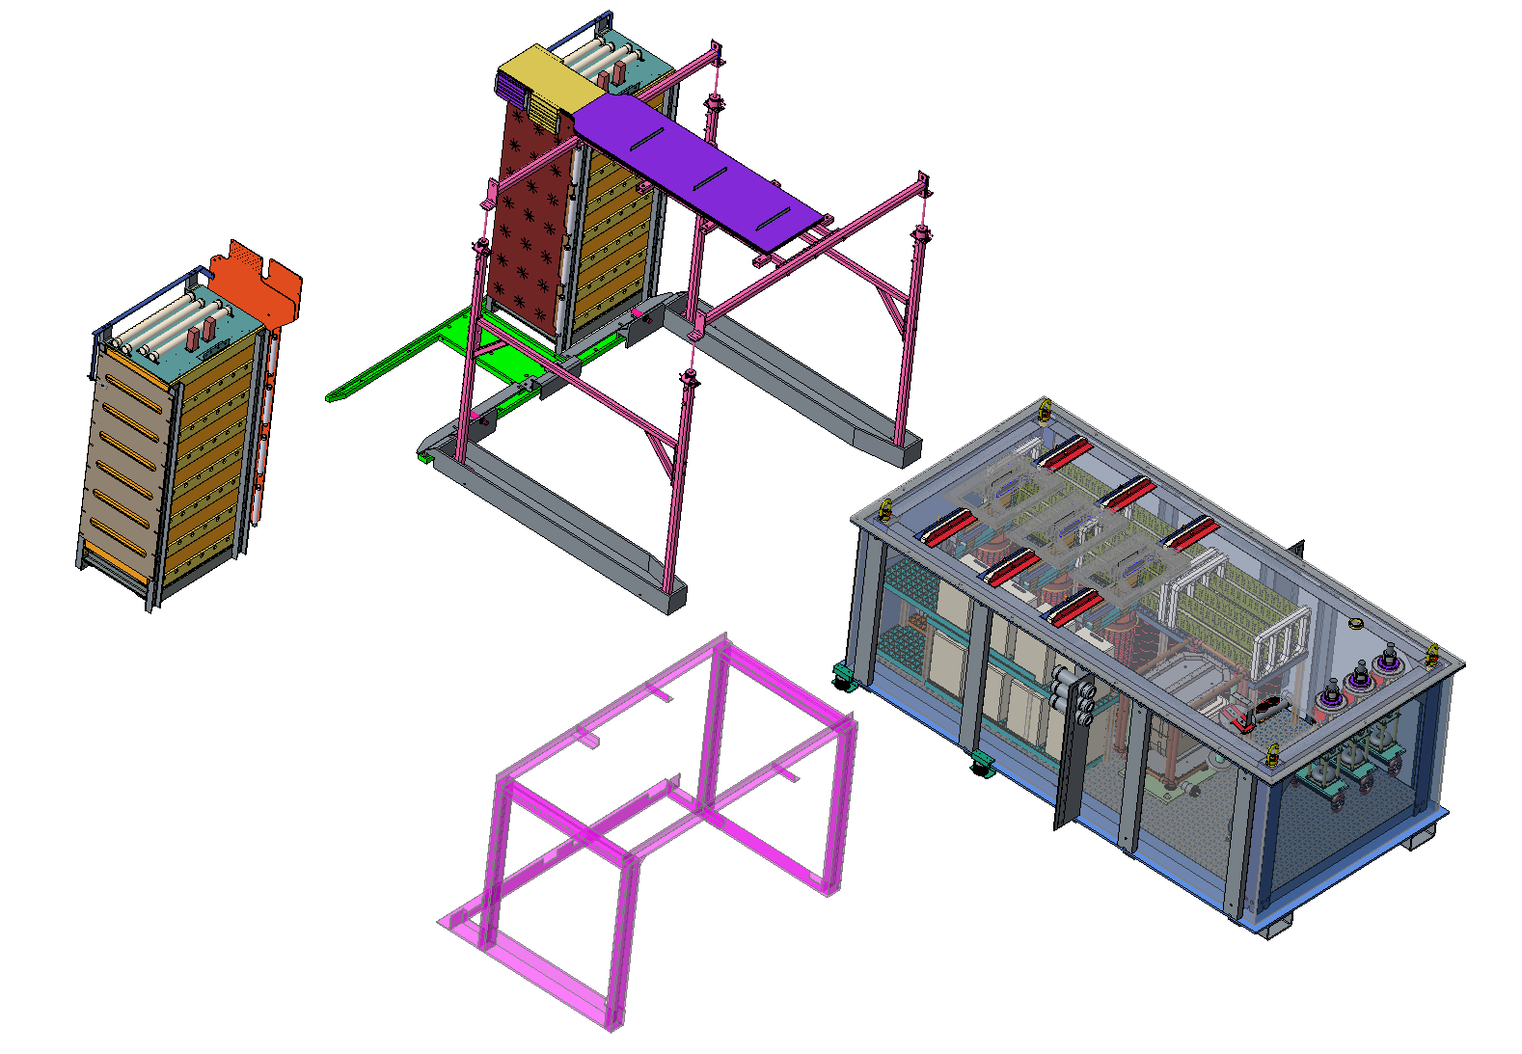
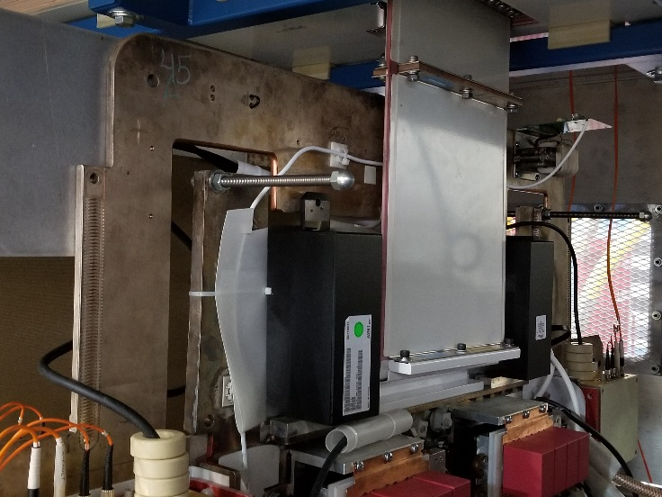
The laminated bus nearing finalization and proposed baseline for PPU
Dual bypass capacitors redesigned by TPC – reduces effects of parasitic inductance
Alignment system designed and bids received, order pending
Investigating alternative connections between laminated bus and switch plates
  Flexible parallel Eriflex commercial bus
  ORNL-designed flexible thin copper bus
Planned solution for PPU new modulator systems

Slide 15
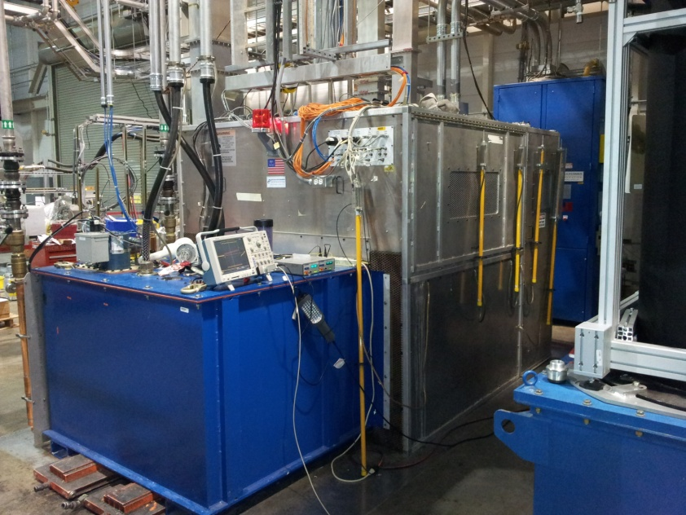
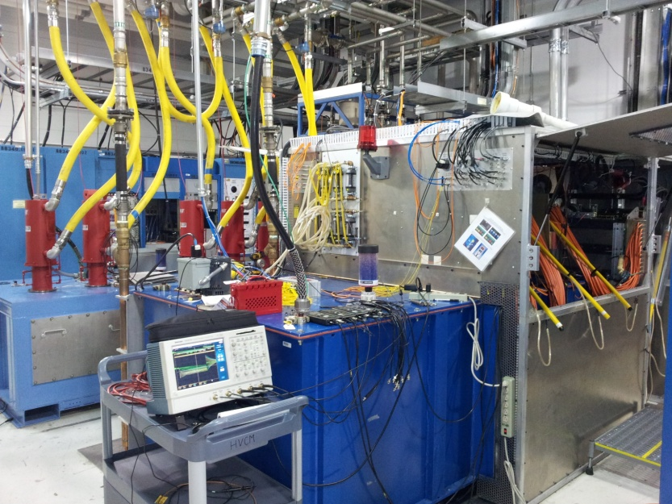
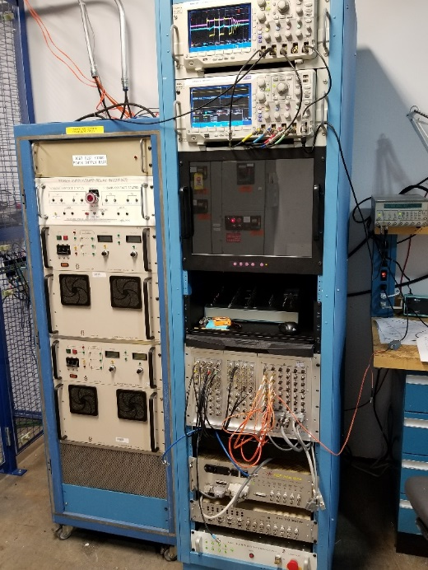
Modulator test stands expanding to support PPU modulator development and other testing activities
Planned
RFTF HVCM
NCL variant of HVCM
Primarily to support RF and SCL testing & BTF
Secondary mission is NCL HVCM work (long run reliability studies)
Dedicated BTF HVCM
Nominally RFQ HVCM configuration also serves as spare for RFQ
Used for dual 3.0 MW DTL upgrade studies w/ dummy load
Frees up RFTF HVCM to support PPU testing of cryomodules and RF couplers
HEBT HVCM
SCL variant of HVCM, PPU-rated beam stick load
Primary mission is to support PPU new modulator development (AT-HVCM)
Single Phase Test Stand
Test IGBT assemblies and pre-qualify spares
Quantify some PPU components
Test stand and new controller “plug & play” spare

Slide 16
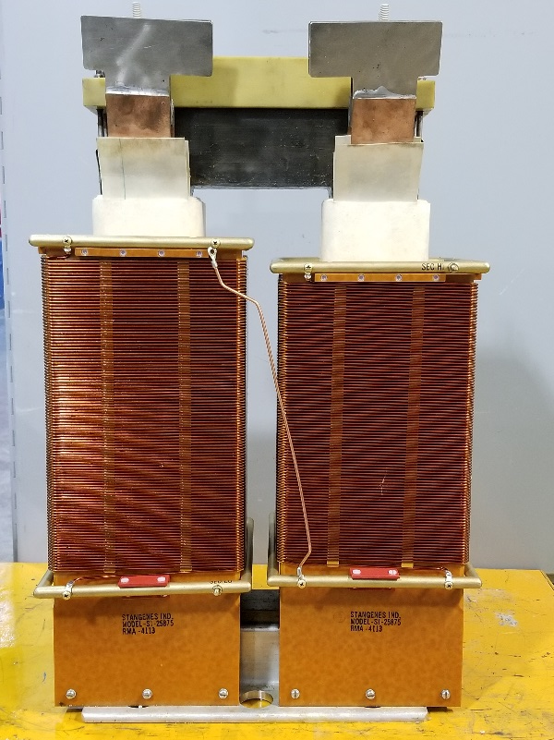
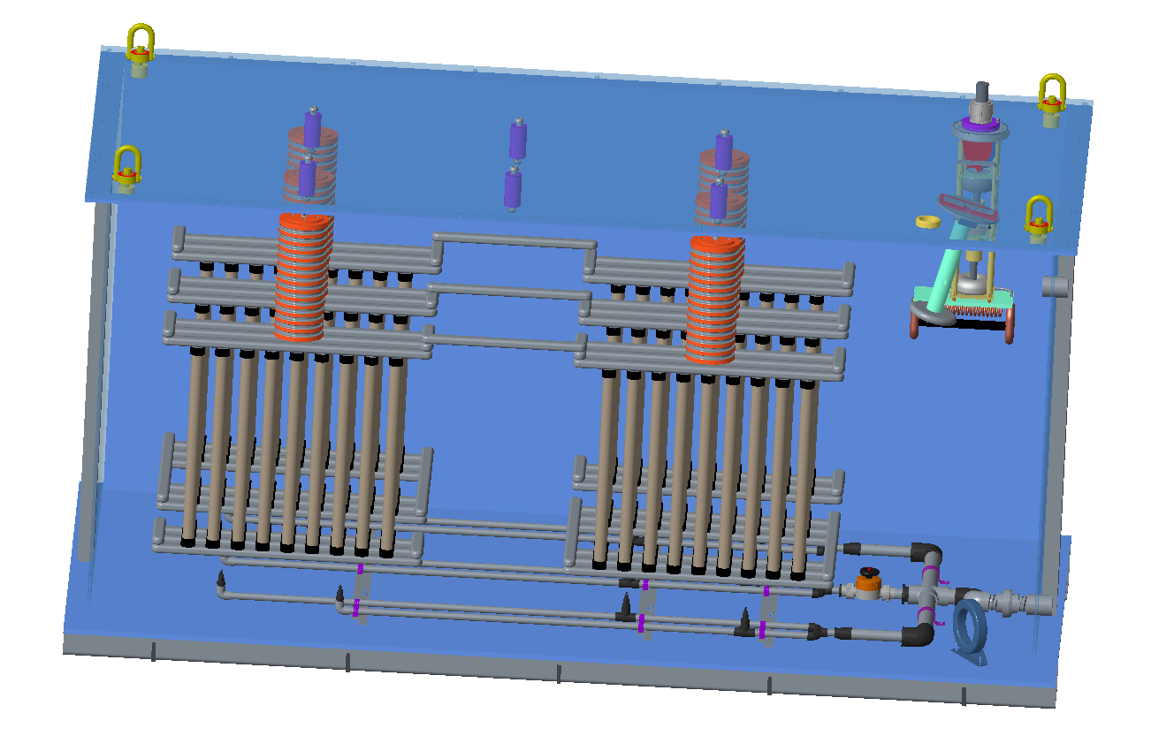
The Existing Linac Upgrade portion of the PPU Project requires some development but should achieve comparable reliability
Summary of PPU upgrades of existing HVCM systems
  DTL – replace 2× HVCM with new transformers and capacitors to power dual 3.0 MW klystrons
  CCL – operate at elevated voltages due to additional beam loading
  SCL – operate at elevated voltages due to additional beam loading
Testing / prototyping status to-date
  Initial testing in HEBT for SCL HVCMs at ±1220 V DC (78 kV 10 klystron load equivalent)
  Still need to perform increased voltage testing of CCL systems in RFTF
  Modified boost transformers (20:1) prototyped and capacitors specified to achieve required higher output voltages for dual 3.0 MW klystrons
  Test in RFTF with Kanthal/Sandvik load

Slide 17
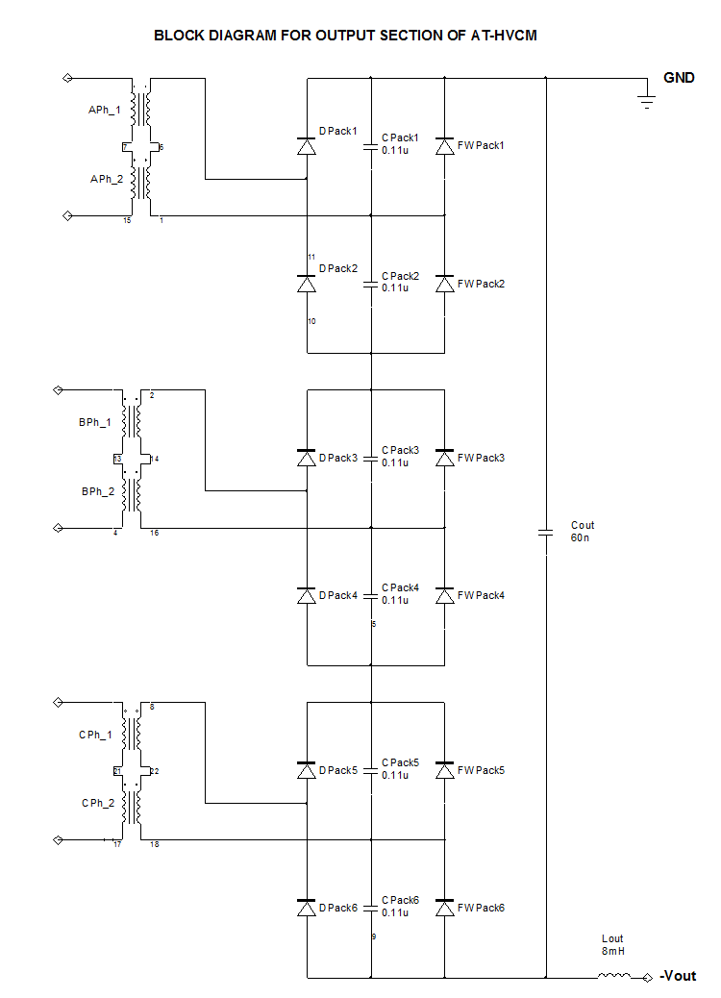
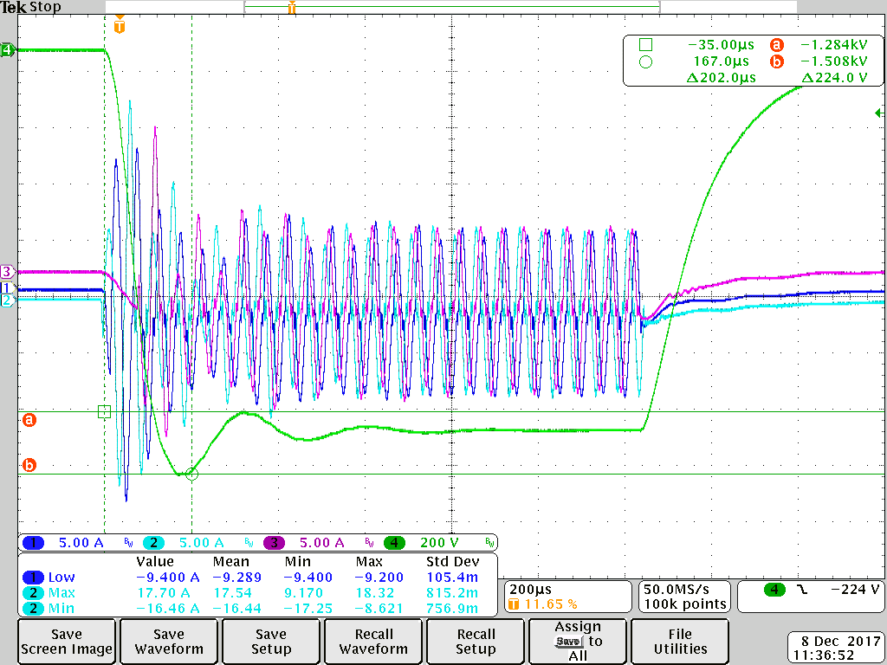
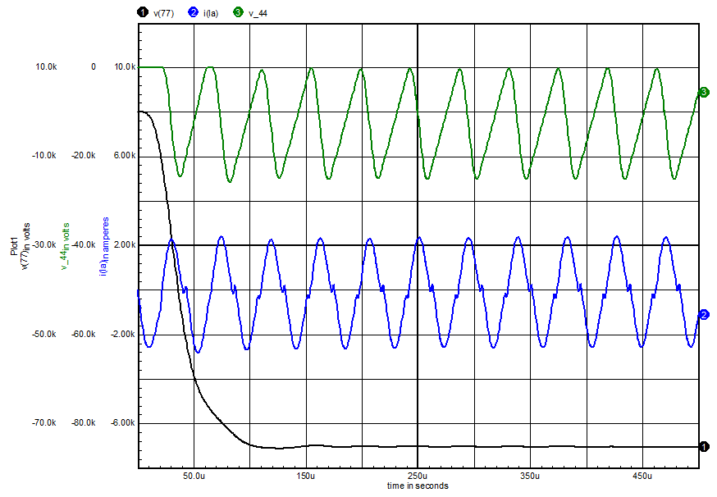
The Alternate Topology Modulator (AT-HVCM) baseline for 3 new PPU modulators
Compared to current HVCM
  Permits soft-switching of IGBTs to minimize losses
  Reduces ringing and voltage on capacitors across transformer secondaries = higher reliability
  More load-tolerant
Added filter capacitor across secondary to reduce ripple
  Created large initial IGBT currents and capacitor voltage transients
  Freewheeling diode resolves issues
Testing resumes late-May culminating in a down-select review at end of calendar year
Output cap, no freewheeling diodes
Output cap and freewheeling diodes

Slide 18
Summary
Over 1 million combined operational hours on all HVCM systems to-date
Downtime has improved in spite of equipment aging
  Emphasis on electromechanical component replacement and PM
  Plans in place to address other failure mechanisms
Controller installation complete throughout
  Pulse flattening, pulse length extension and pulse ripple optimization functioning
  Further ripple optimization possible with IGBT timing changes
HVCM cooling upgrade AIP installed in 4 locations with 2-3 per upcoming outage scheduled
PPU work has transitioned into development stages
  Alternate topology HVCM wrapping up late CY2018
  Test load and prototype components for dual 3.0 MW HVCM ordered

