Slide 1
Controls Status and Machine Protection Upgrade
Karen S. White
Control Systems Group Leader
5/16/2018

Slide 2
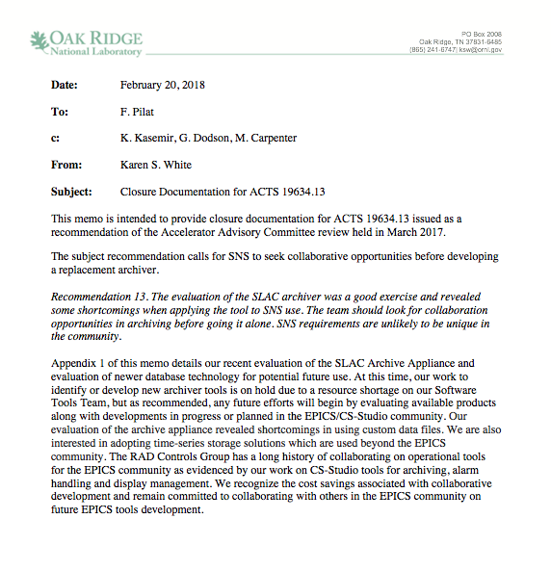
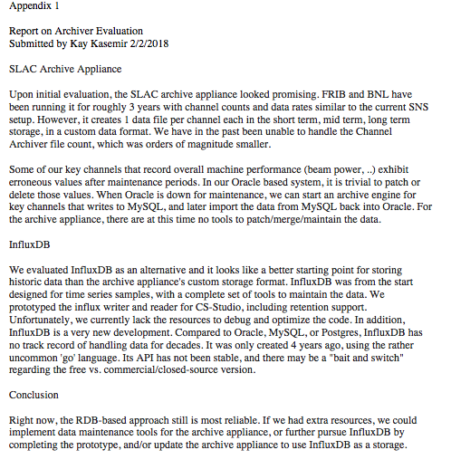
Response to recommendations from AAC 2017
Recommendation 13. “The evaluation of the SLAC archiver was a good exercise and revealed some shortcomings when applying the tool to SNS use. The team should look for collaboration opportunities in archiving before going it alone. SNS requirements are unlikely to be unique in the community.”
We are actively engaged with the CS-Studio Working Group on all tools development
Archiver evaluation on hold due to priority and resource availability
Summary report available

Slide 3
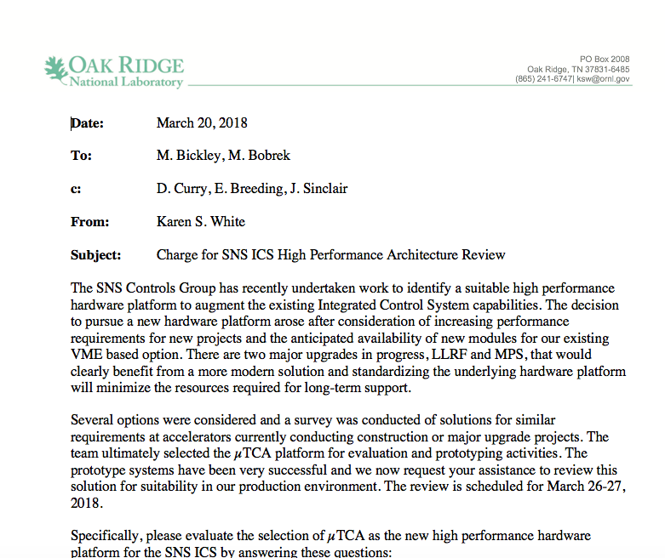
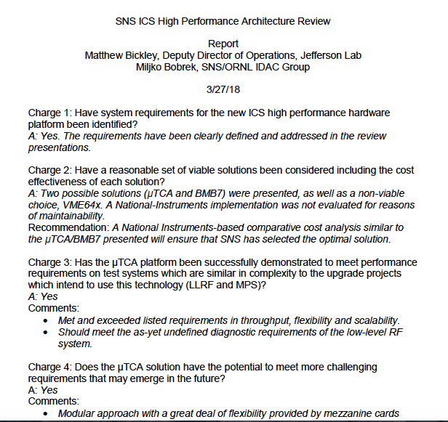
Response to recommendations from AAC 2017
Recommendation 14. “The choice of platform for high performance elements of the control system are perhaps “religious” issues, with no one solution gaining universal acceptance, in the way VME had at the time of the original SNS construction. Consider holding a design review for the high-performance system (currently µTCA) solution to ensure it meets current requirements, has room for future growth and is cost effective.”
Review held 3/26-27/2018
Committee supports the choice of µTCA

Slide 4
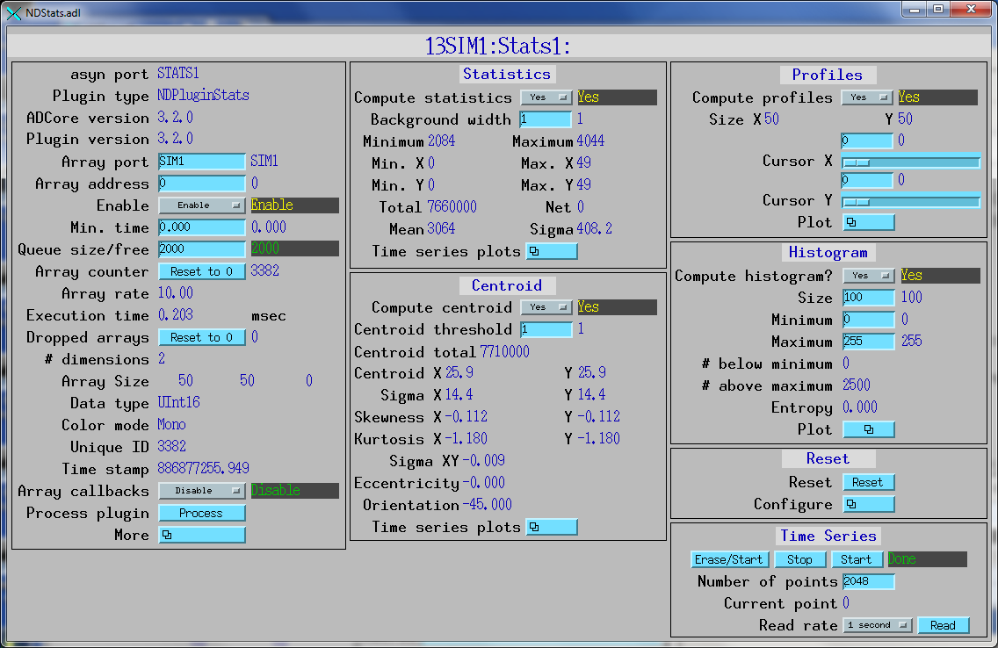
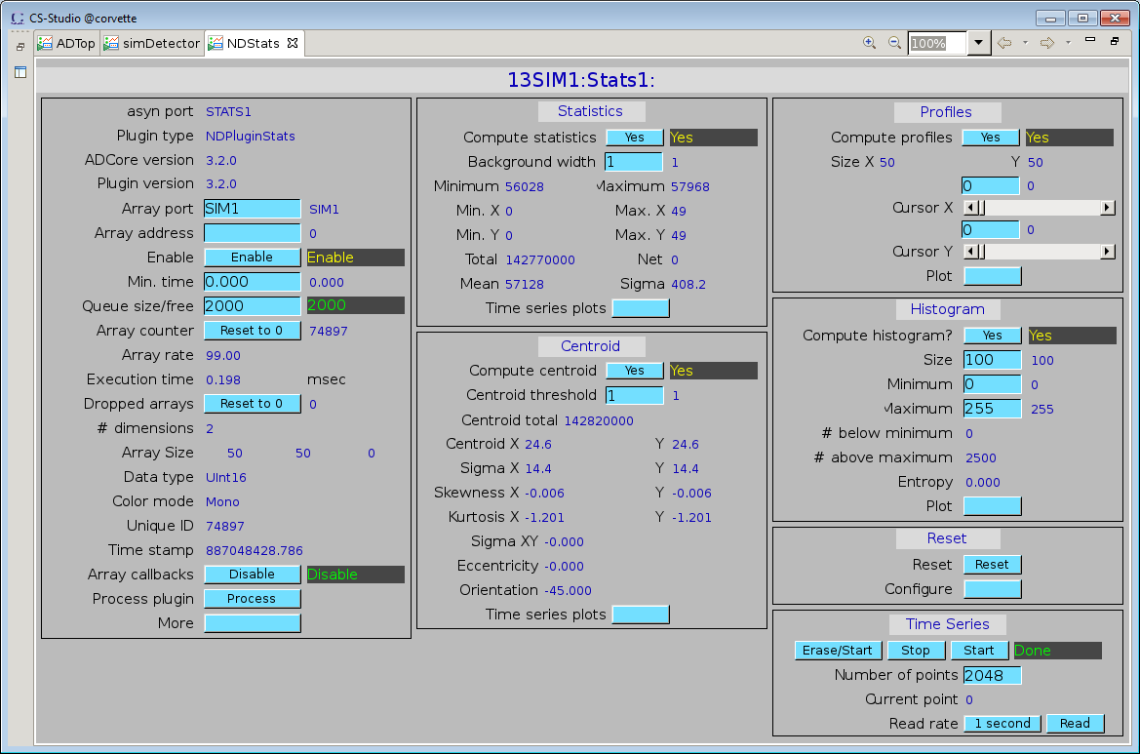
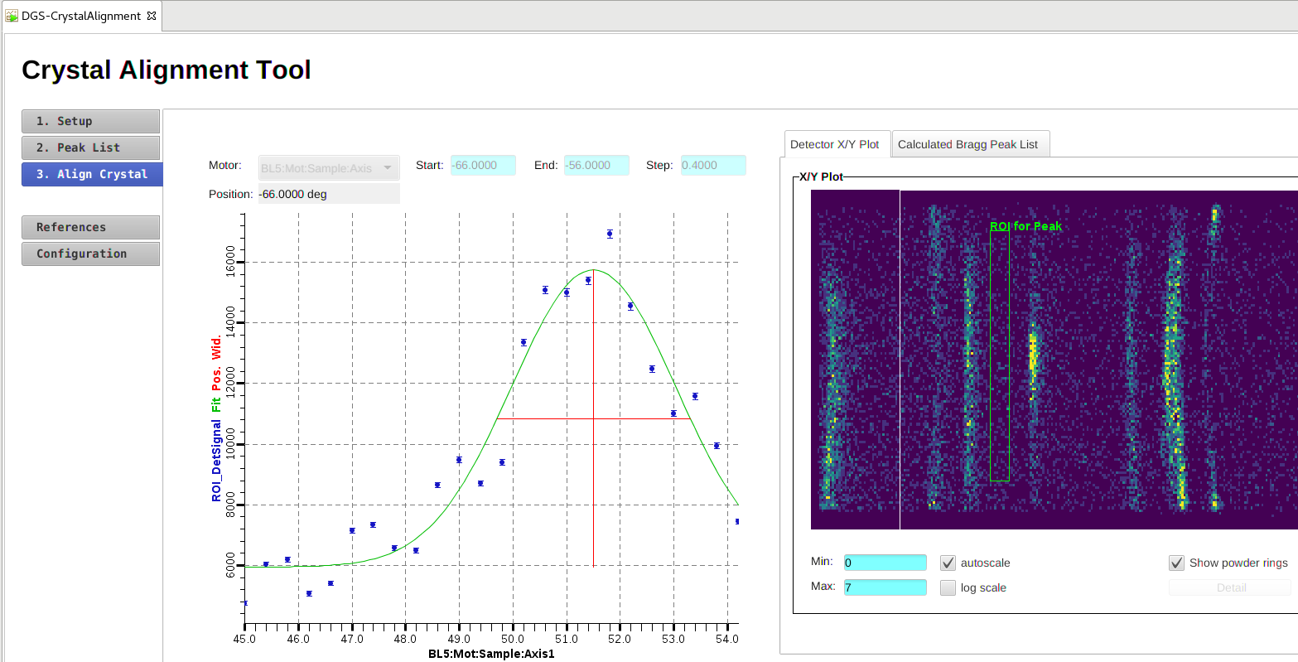
Software Tools – CS-Studio
MEDM
Converted into CS-Studio Display
Collaborating with CS-Studio Working Group to improve tools: functionality, performance, sustainability
  Maintain CS-Studio
    MEDM/EDM converter improvements, ‘batch’ support
  Display Builder
    Editor Improvements
    Widget bug fixes
    Now used on most SNS beam lines
  Phoebus
    “CS-Studio without Eclipse”

Slide 5
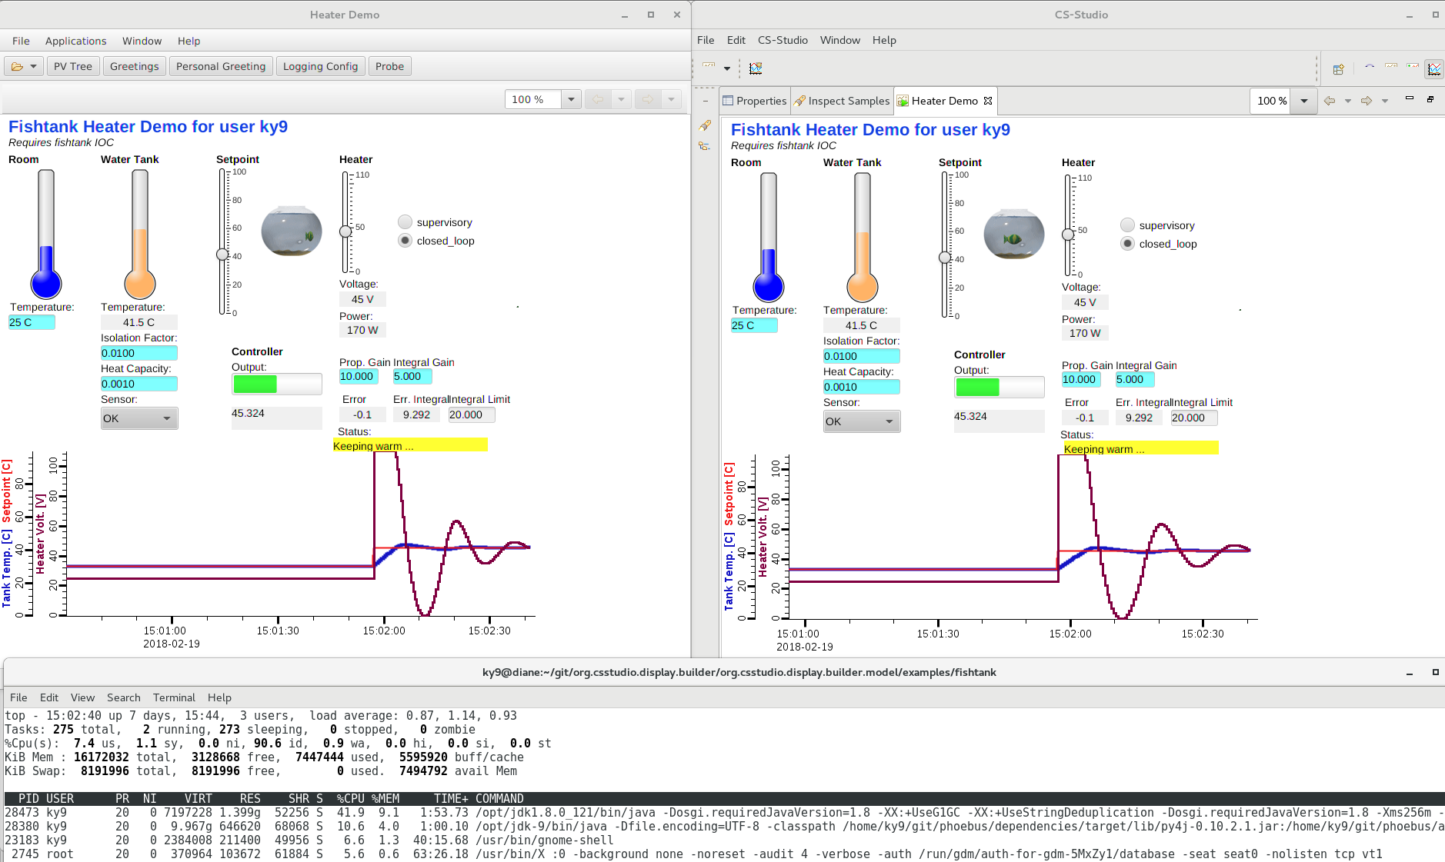
Phoebus:
¼ CPU,
½ Memory
CS-Studio with Eclipse

Slide 6
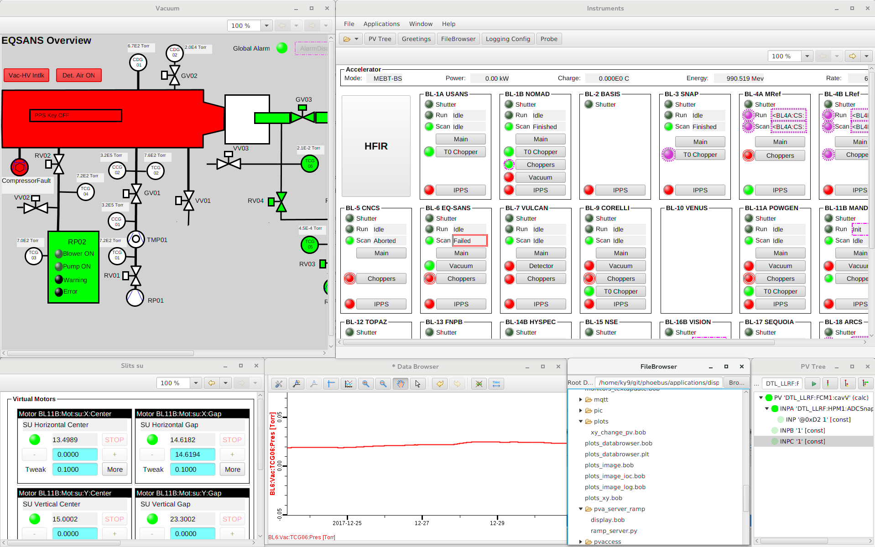
Phoebus Progress
Completed
Probe
PV Tree
PV Table
File Browser (basic)
Data Browser
Display Builder
Scan UI
Scan Server
100% compatible with existing
PV Table, Display Builder, Data Browser configuration files
Plan (end of FYY2018) to allow use on SNS beam lines
Alarm UI
Also planned, but not essential
File Browser (better)
Alarm Server
Archive Engine

Slide 7
Supporting Projects
Longest scheduled outage in SNS history resulted in a record number of projects requiring controls support
  New RFQ and extensive Front End improvements
  New Target with gas injection, first IRP replacement, conversion to heavy water
  Much more in between
Shortage of EPICS application developers prevented completing some projects

Slide 8
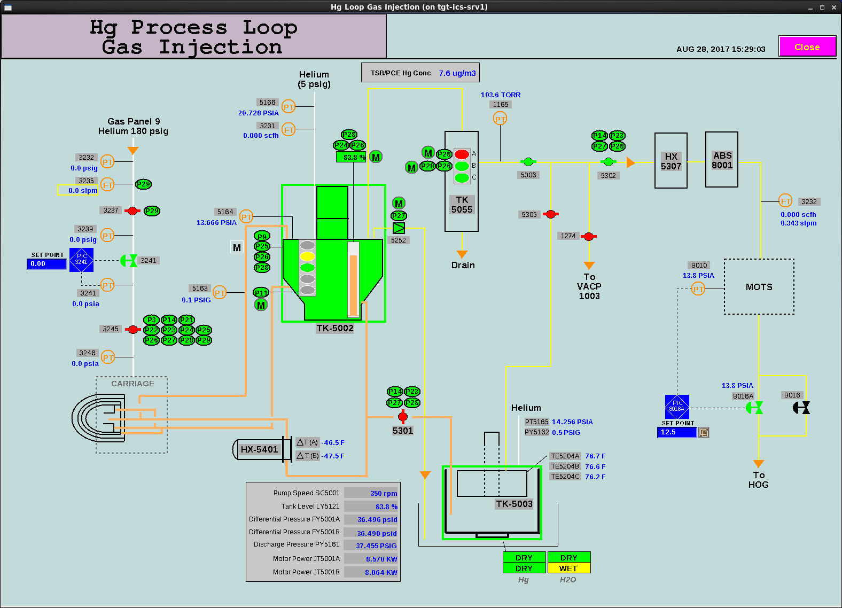
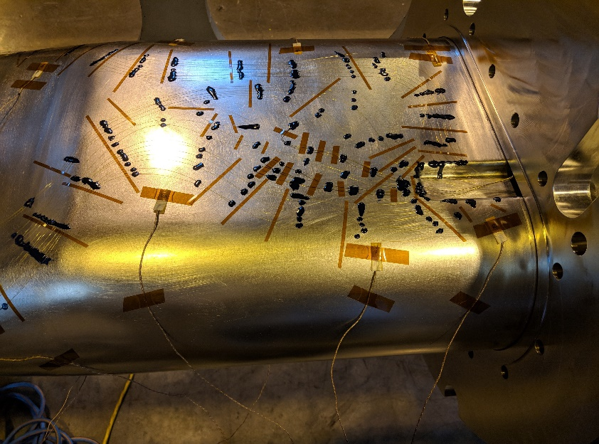
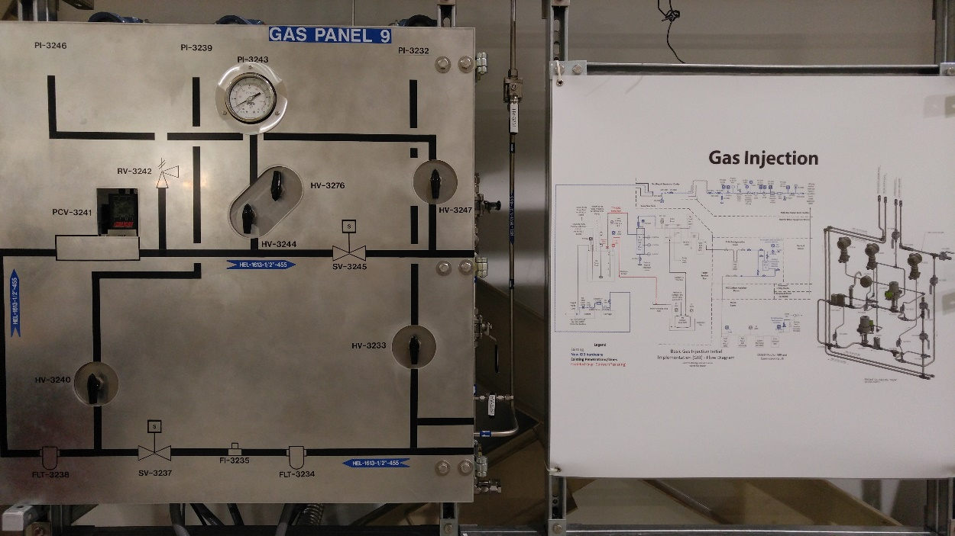
Support for Helium Gas Injection
Helium Gas Injection Screens
Strain Gauge Instrumentation used to measure GI3 performance
Helium supply panel for gas injection

Slide 9
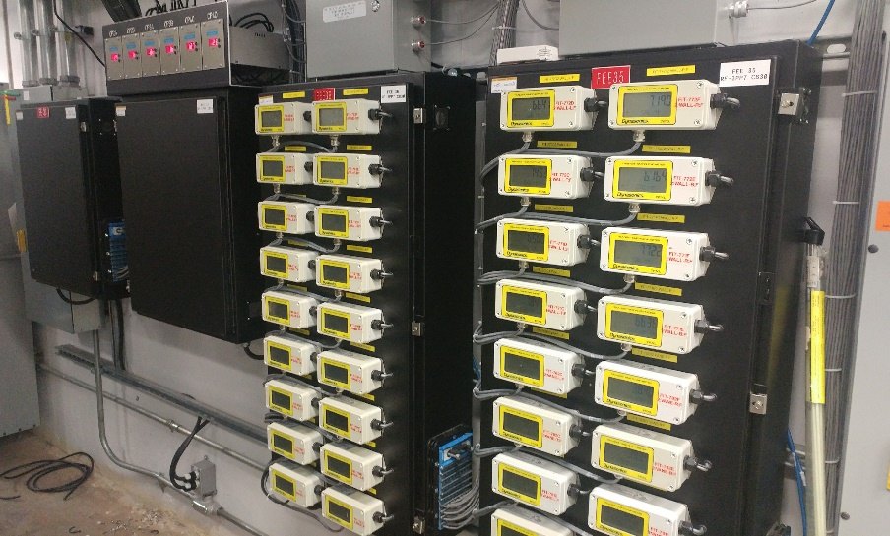
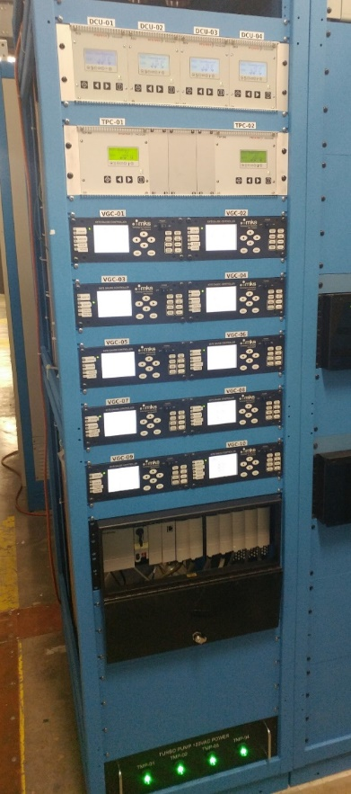
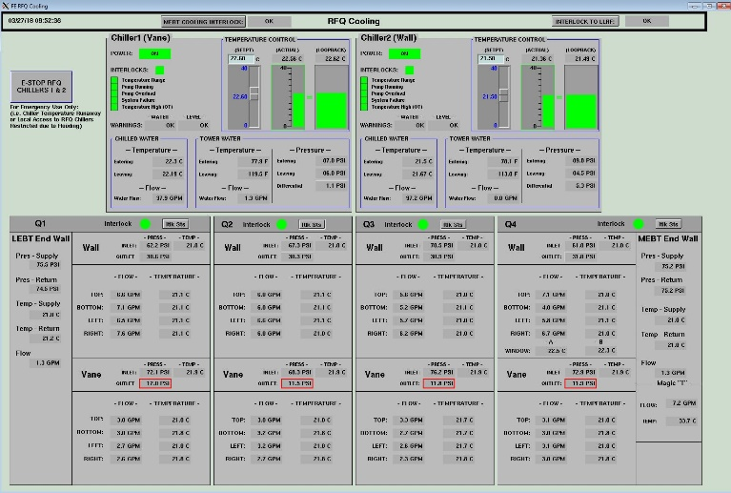
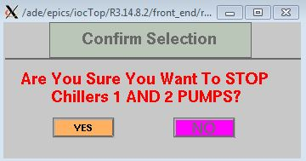
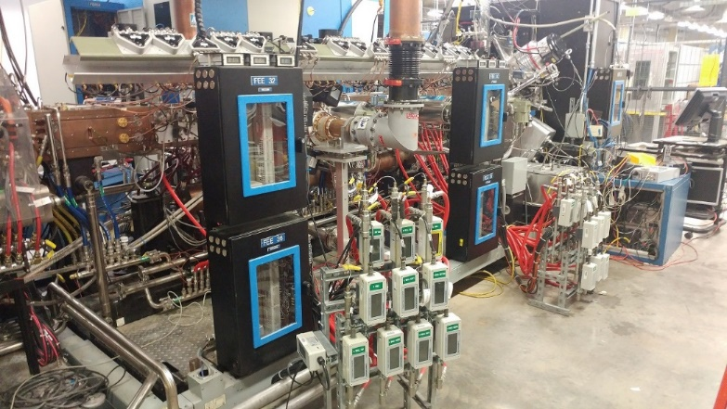
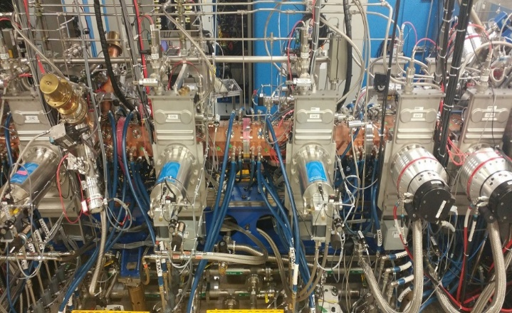

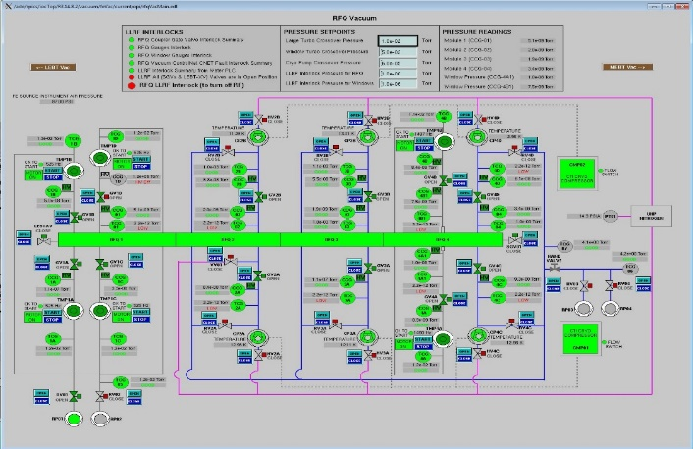
Support for RFQ swap
New Cooling screens
New Vacuum control racks
EPICS integration of new RFQ controls
Before: Berkeley RFQ with control enclosures and flow transmitters near the structure
After: New water and vacuum controls with enclosures and transmitters relocated

Slide 10
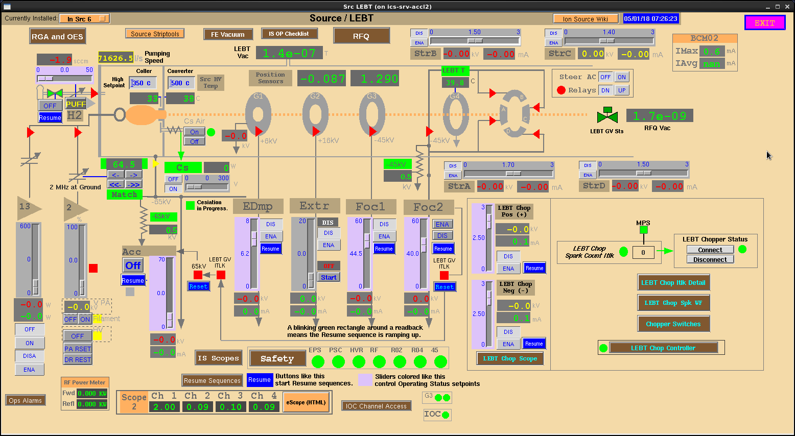
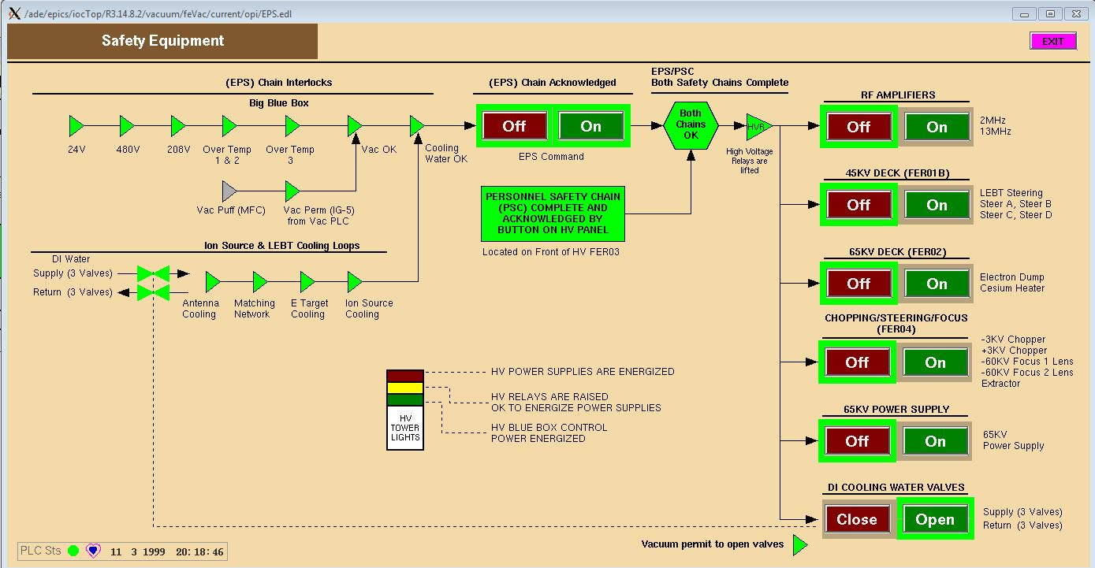
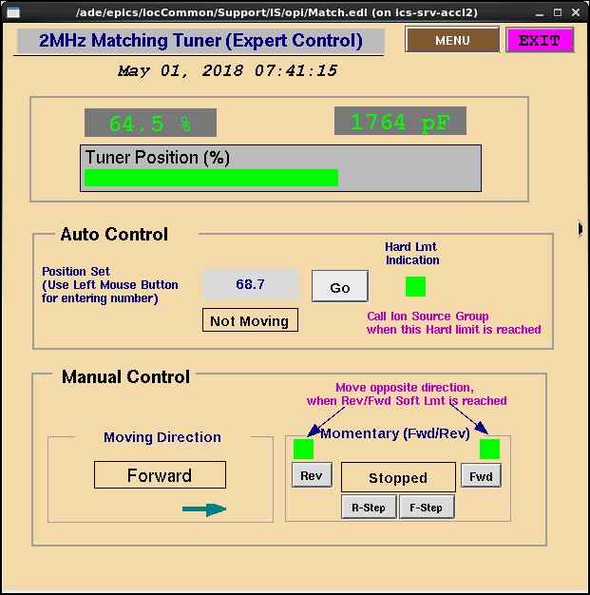
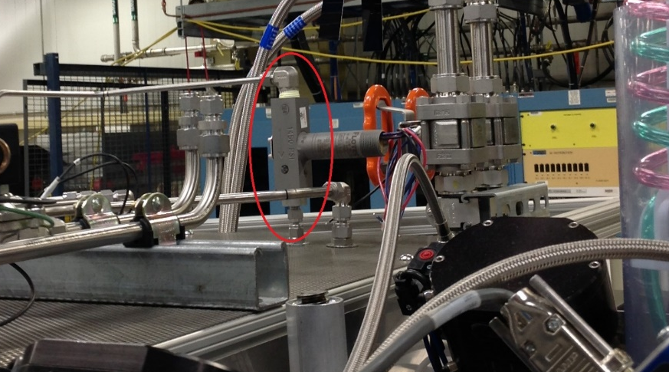
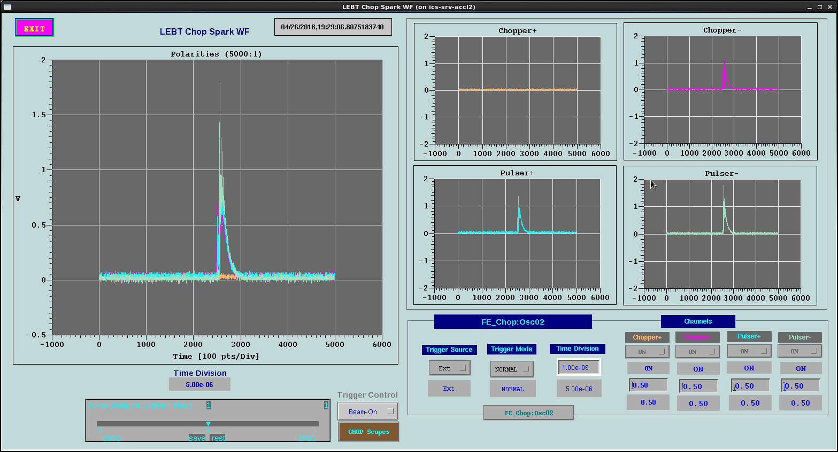
Support for Front End upgrades
EPS controls modified to add 65kV Interlock
LEBT Gate Valve Interlock protects new RFQ
LEBT Chopper Spark Detector

Slide 11
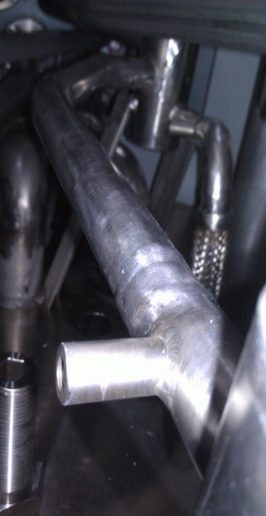
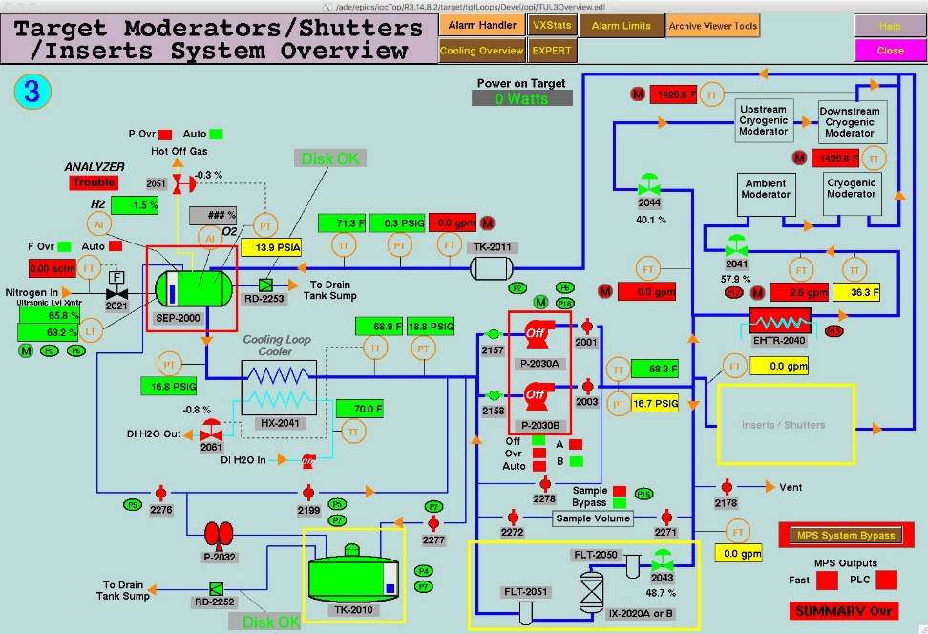
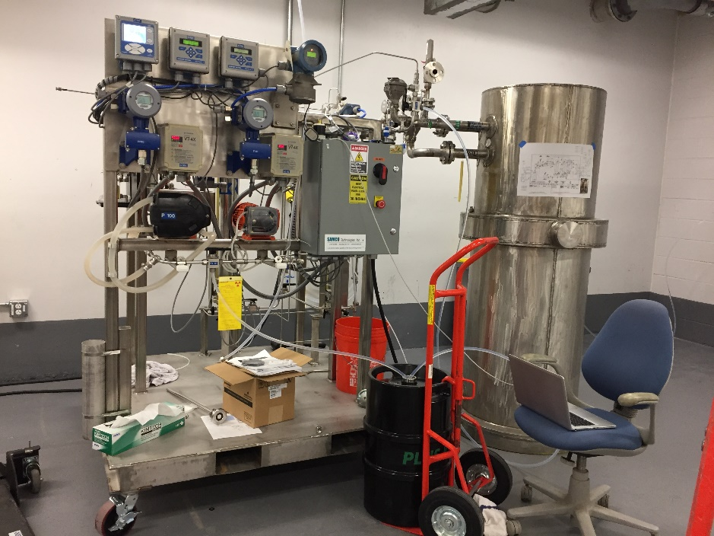
Support for Target system upgrades
TT-2221
TT-2222
New ATS’ for CMS controls
Thermocouples for new IRP
D2O clean up skid

Slide 12
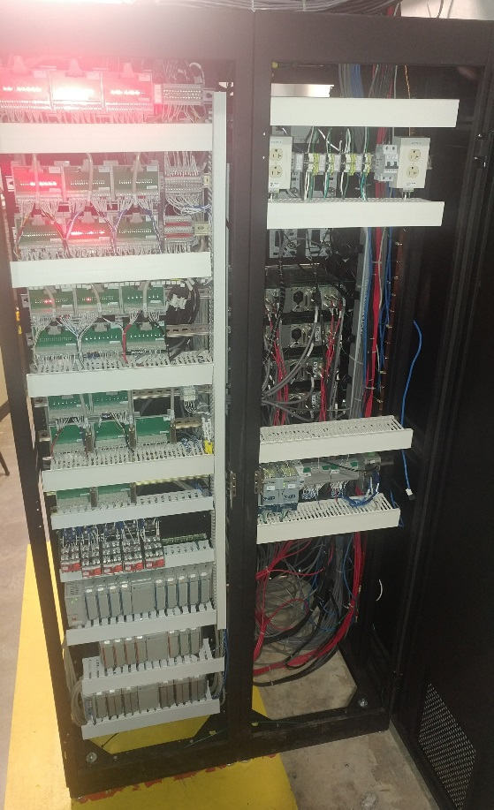
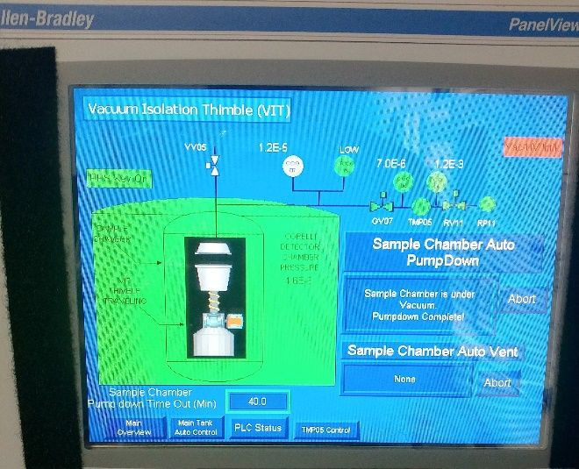
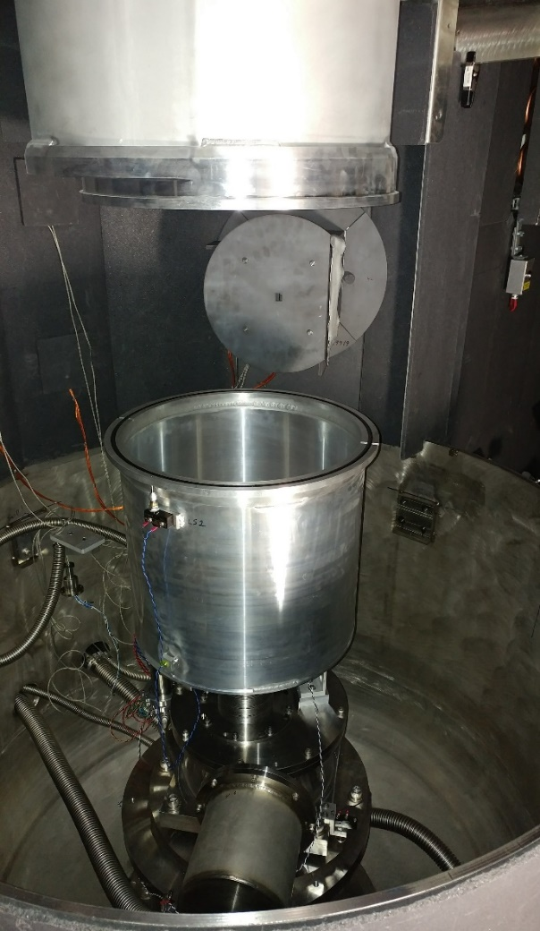
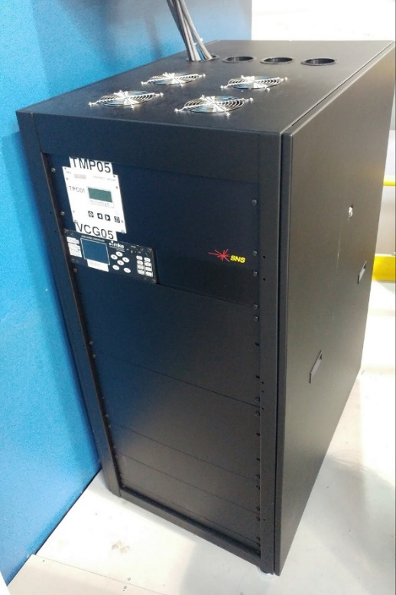
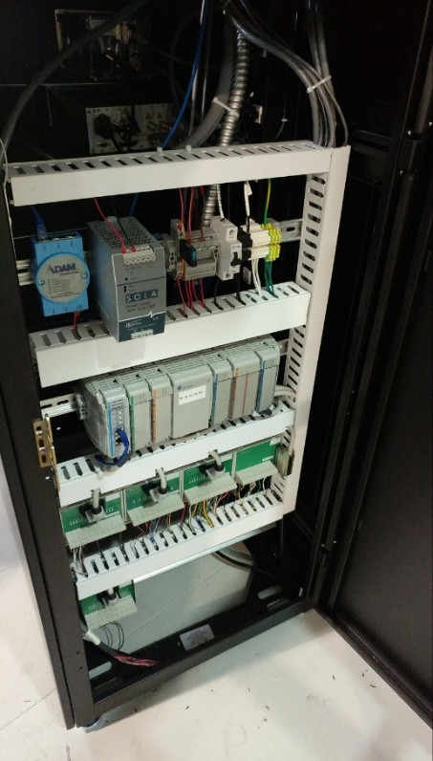
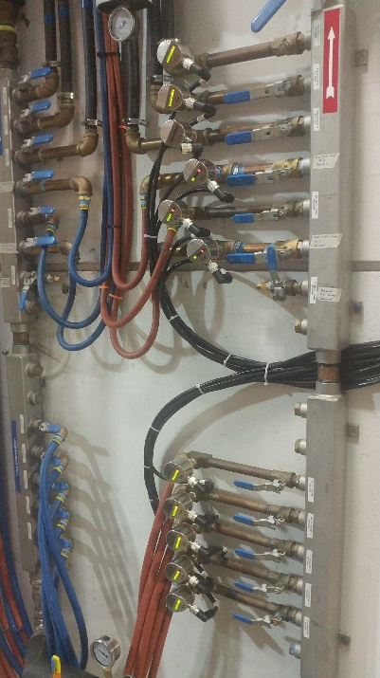
Support for beamline improvement projects
Vacuum Controls have been upgraded and standardized for 12 beamlines
BL-17 Vacuum controls upgrade
New vacuum controls rack for BL-9 VIT
Thimble installed in the detector vessel

Slide 13
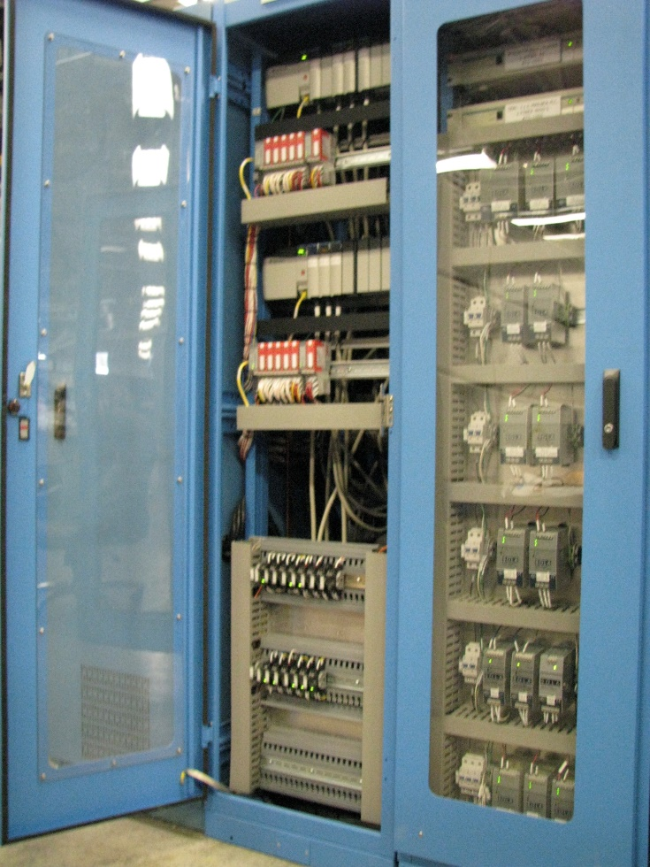
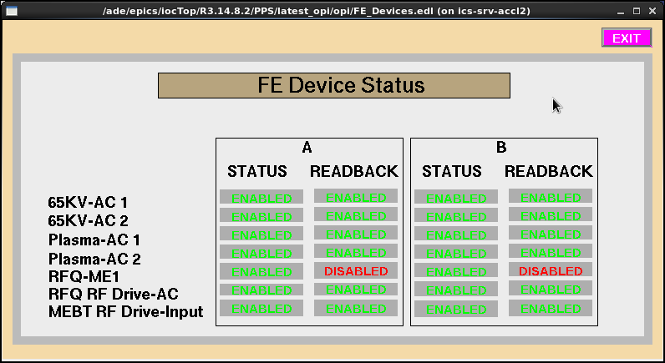
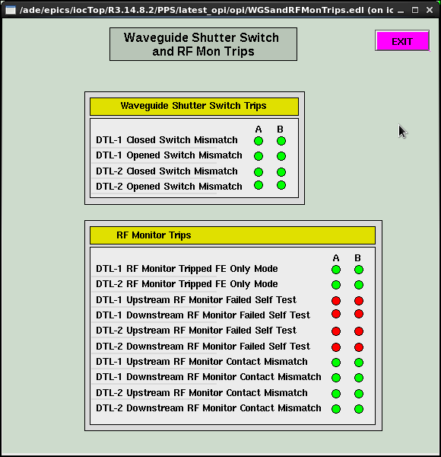
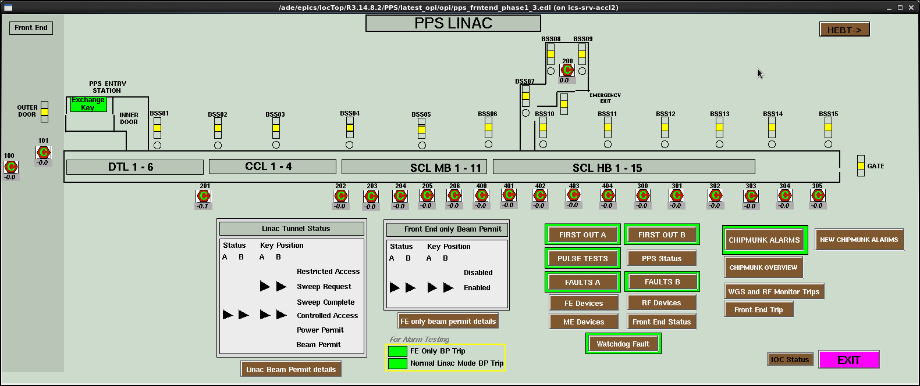
Personnel Protection System (PPS) – Front End (FE) racks replaced
Completely replaced two existing racks
Eliminated common grounding issue
Upgraded PLC CPU, I/O and common relays to Safety rated
Converted all communications to Ethernet
Added new safety remote I/O for Waveguide Shutters
Re-wrote difficult to support PLC ‘B’ Logic (state notation text -> ladder logic)
New I/O Rack with Safety PLC HW
AC Power consolidated to one side of one rack

Slide 14
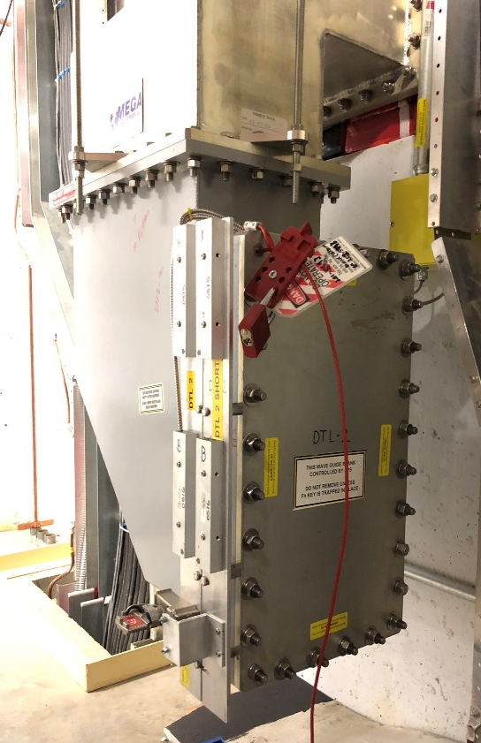
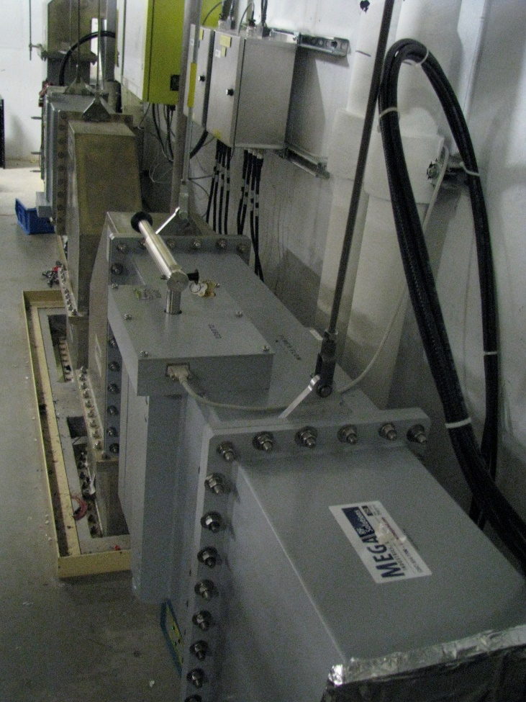
PPS - Waveguide shutters enable Ion Source operation on maintenance days
Old (blanking plate) method – remove a section of waveguide and install a blanking plate (several hours)
New method – insert/remove shutters by pulling a handle (a few minutes)
Blocks RF from reaching DTLs 1&2
No degradation to radiation safety or reliability
Allows beam studies on maintenance days
Increases Safety from exposure to HPRF
Old method using a blanking plate
New method with interlocked waveguide shutters

Slide 15
PPS power supply grounding ACTS complete
Grounding issue discovered July 2013 in PPS Central Controls Room (CCR) rack
Defect was corrected, grounding evaluated system-wide, improvement plan developed and implemented
PPS Grounding of Accelerator cabinets complete
  July 2015 – Isolated CCR, replaced racks
  January 2016 – Isolated klystron gallery PPS racks
  June 2016 – Isolated HEBT PPS rack
  February 2018 – Replaced front end PPS racks
  April 2018 – Isolated Ring and RTBT rack power
This completes all action items associated with the grounding issue
Next year, plan to start the same process in the Target PPS and Instrument PPS
Notes:
Last year had us finishing the TPPS in summer of 18. TPPS is not part of the action item. TPPS field wiring is much more complicated due to connections with so many beamlines plus the Target areas.

Slide 16
Obsolescence
Work to reduce technical debt and ensure high availability and maintainability by replacing obsolete software and hardware
Some high cost replacements have been funded by AIP – e.g. timing, Machine Protection System (MPS) – but many less expensive systems do not fit into annual Controls budget
Developing a package of lower cost upgrades to propose for future multi-year AIP
  Network switches
  Oregon Micro Systems (OMS) stepper motor drivers
  PLCs and Panelviews
  Input Output Controllers (IOCs)

Slide 17
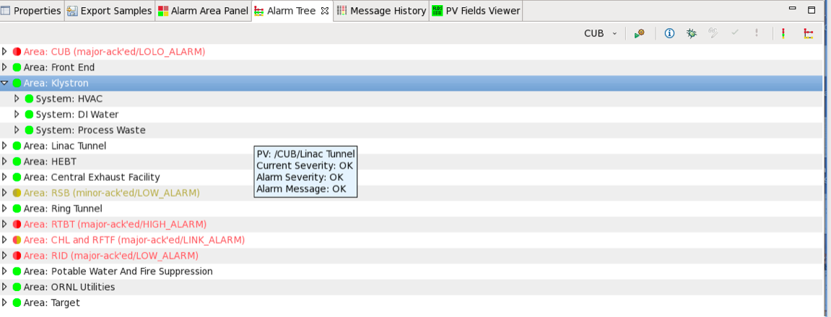
Software Obsolescence
BEAST alarm handler developed but difficult work remains to convert and remove far reaching tentacles of multiple old alarm handlers
  CUB, CF and Target CF Alarm Handler (ALH) based system converted during 2018 long outage
  Soft IOCs serving “PAMS” will be moved to a new server and phased out

Slide 18
Injection Kicker Waveform Monitor
LeCroy Scope
GT&FS
The Injection Kicker Waveform Monitor uses a wave masking function on LeCroy WaveRunner 64Xi oscilloscopes
These scopes are no longer available for purchase
System required by SNS Operating Envelope (OE)
  Beam operations is limited to < 100kW without a working waveform monitor
LeCroy Scope
Diagnostic
LeCroy Scope
WFM
LeCroy Scope
Diagnostic
LeCroy Scope
WFM
Replaces LeCroy
Oscilloscopes
IOC
MCH
AMC
FMC
8-Ch ADC
Timing
Interface
FMC
Integrated
MPS/Timing
Custom MPS
Interface
µTCA
External interface
hardware

Slide 19
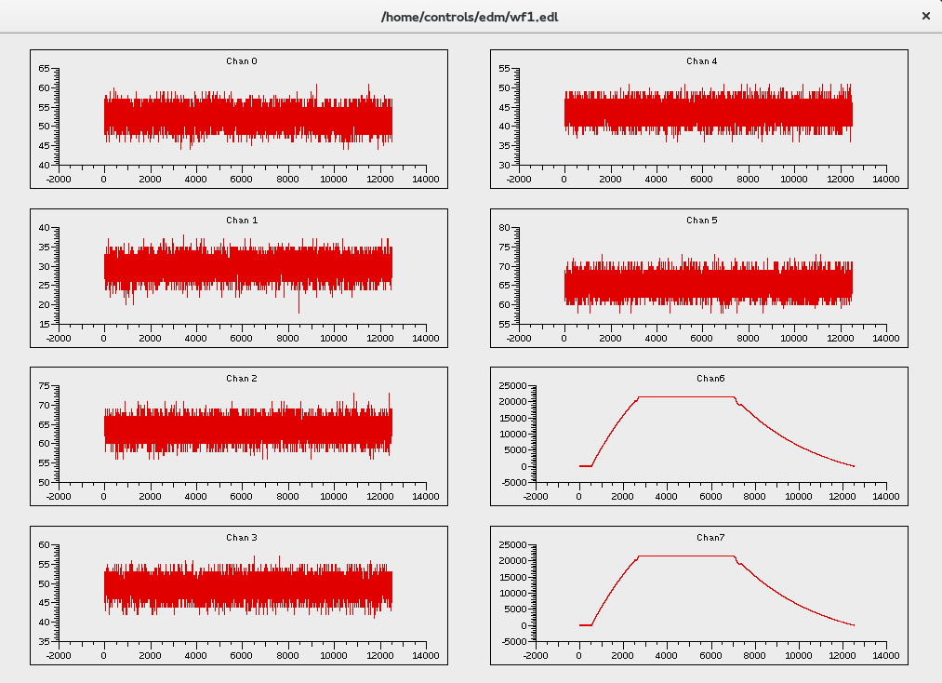
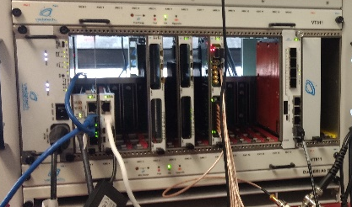
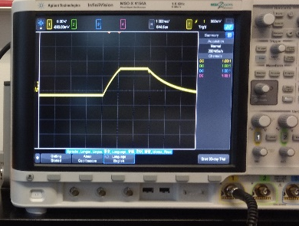
Injection Kicker Waveform Monitor
MicroTCA system
  Commercial carrier
  Custom FMC interface
EPICS waveform updates @ 1Hz
Diagnostic waveform capture @ 60Hz
Installed during extended outage
  Commissioning planned during machine restoration period
EPICS waveform display
Waveform image
Injection Kicker Waveform
Monitor µTCA Shelf

Slide 20
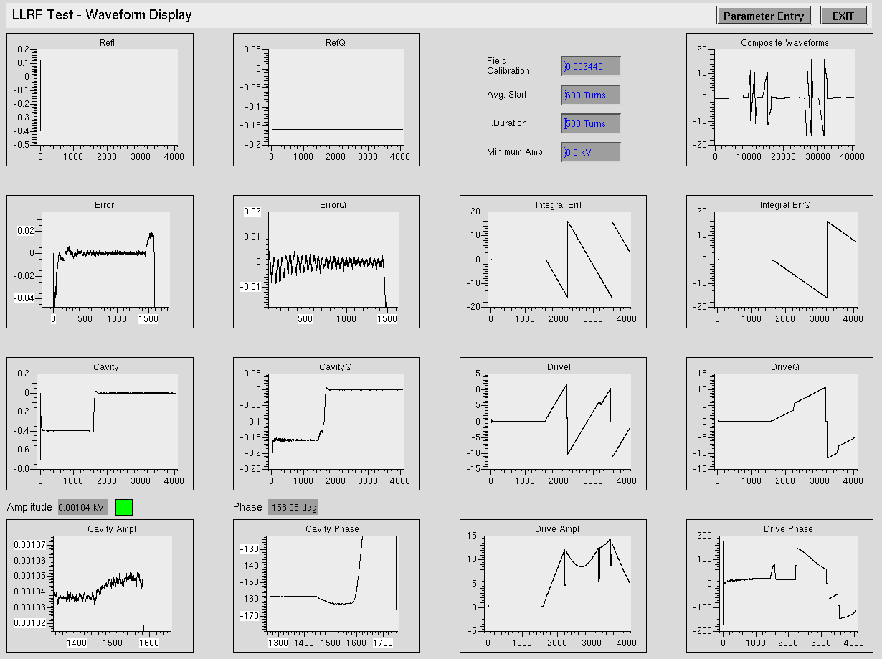
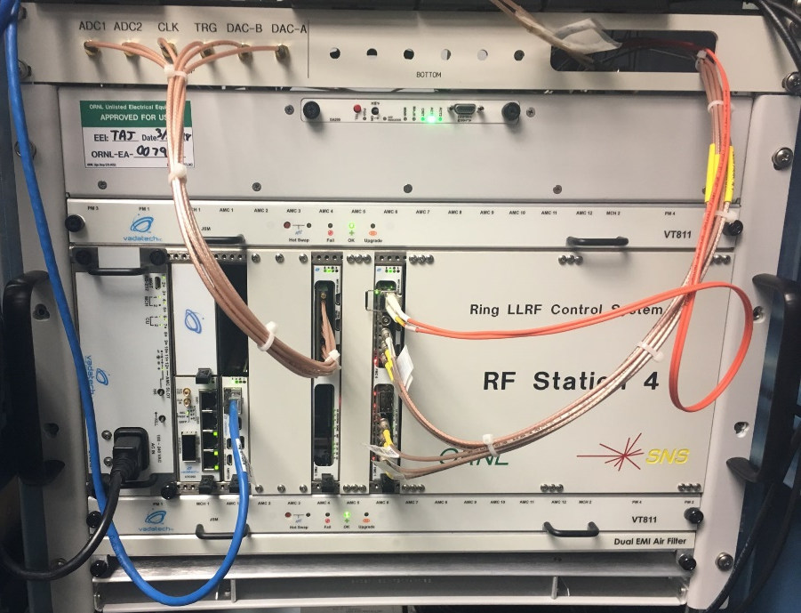
Ring LLRF Controls Upgrade
Partnered with LLRF team to replace obsolete hardware for LLRF in the Ring
There are 4 Ring LLRF stations
  1 & 2 are fundamental frequency stations
  3 & 4 are second harmonic stations
Replaced station 1 during the October 2017 outage
Replaced station 4 during the extended outage 2018
Expect to replace station 2 & 3 before end of CY18
Ring LLRF EPICS interface
Ring LLRF
µTCA Shelf

Slide 21
AIP-39 Machine Protection System (MPS) Upgrade
Legacy System
New System
Decreasing Reliability
  Aging hardware ⇒ increasing failure rates
  Lack of integration ⇒ more failure points
Declining Maintainability
  Increased failure rates reduce inventory of spare subsystems
  Component obsolescence prohibits obtaining “safe” supply of spares
Limited Scalability
  Current system lacks capacity to support facility upgrades (PPU, STS)
  No capacity for developing basic diagnostics and implementing simple improvements
Improved Reliability
  Simplified and efficient architecture
  Highly integrated ⇒ failure point reduction
  Uses modern subsystems and components
Improved Maintainable
  Commercial hardware with multiple vendors
  Compliant with PICMG open modular computing specifications
Scalable Architecture
  Viable path for major facility upgrades — PPU & STS
  Commercial software for diagnostics

Slide 22
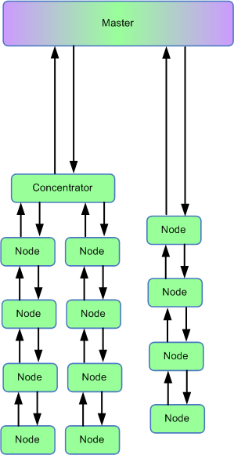
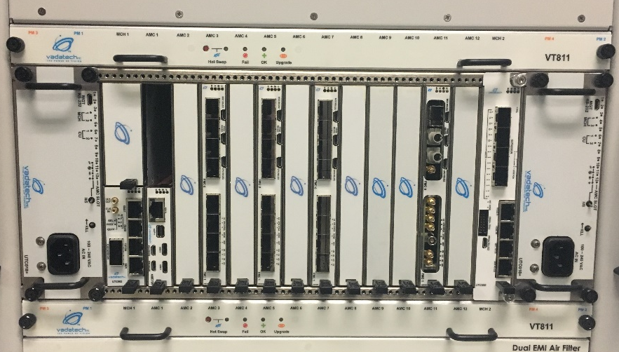
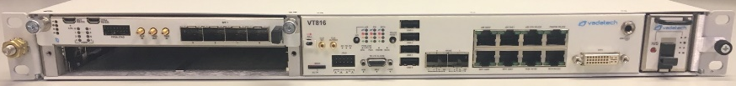
AIP-39 MPS Upgrade
New system goals
  Open architecture
    Follow applicable standards
    Commercial hardware
  Reduce complexity
    89% reduction interconnects
    41% reduction in field nodes
Initial funding received late FY17
  MPS Master is installed
  Trigger control function to be tested during machine studies
  Initial field nodes are on order
MPS Master Node
Field Node

Slide 23
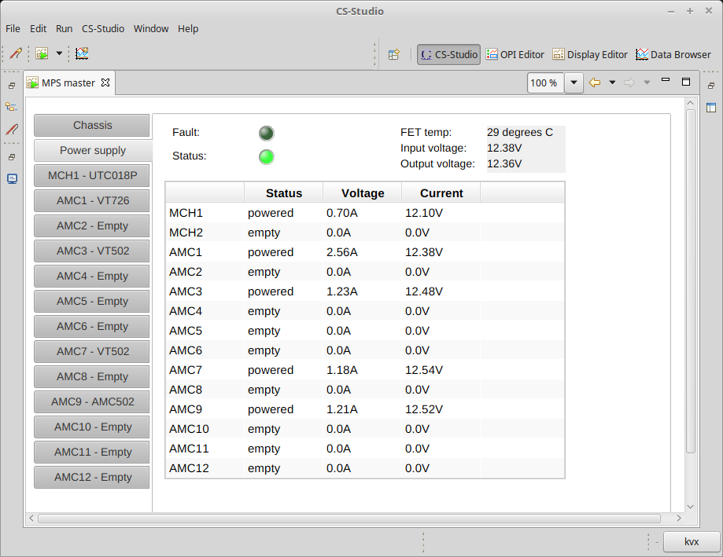
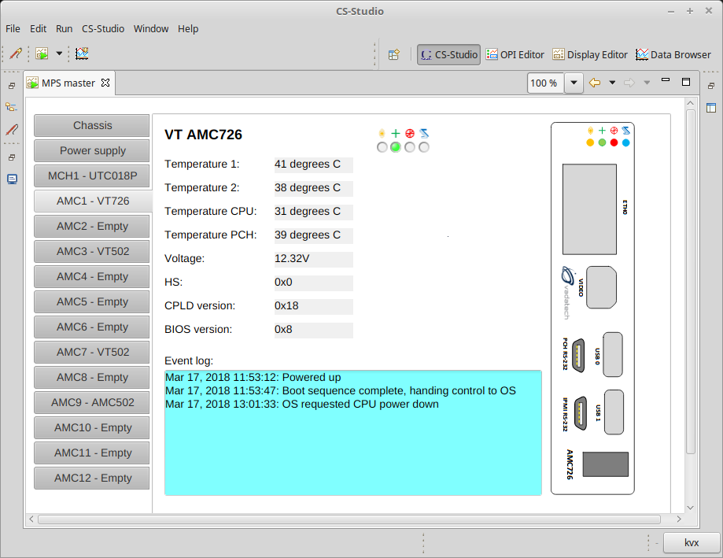

AIP-39 MPS Upgrade
IPMI – Intelligent Platform Management Interface
Driven by Intel, IBM, Dell, HP, Cisco, SuperMicro (over 200 vendors)
Hardware monitoring, system logging, recover control, list of hardware inventory
Available on MPS Master and all Field Node shelves
Power Supply
IOC
Field Node Interface

Slide 24

Support for PPU
Existing ICS architecture does not change; add more:
  Racks
  Devices
  Instrumentation
  PLCs
  IOCs
  Device control software
  Screens, Alarms
EPICS system proven to scale at larger installations

Slide 25
Summary
Controls is successfully
  Managing the performance of our large, distributed EPICS based control system
  Supporting accelerator improvement and development projects
  Simplifying systems to reduce support requirements and maintain availability
  Reducing technical debt due to obsolescence
  Planning for PPU

Slide 26
Backup

Slide 27
Other Protection System Team (PST) Work
Standardizing Beam Lines
Oxygen System Team (OST) Oxygen Deficiency Hazard (ODH) Monitoring Improvements
Re-writing PLC code
Upgrading PLC hardware
  Safety PLCs
  Ethernet Communications
Updating design basis documentation
R&D
  ODH Monitoring
  Reliability
  Radiation Monitoring
  PPS Architectures

Slide 28

AIP-39 MPS Upgrade - Standards
PCI Industrial Computing Manufactures Group (PICMG) Open Modular Computing Specifications
  Advanced Mezzanine Cards (AMC)
    AMC Base Specification: PICMG, AMC.0, R2.0, November 15, 2006
  Micro Telecommunications Computing Architecture (MicroTCA)
    MicroTCA Base Specification: PICMG, MTCA.0, R1.0, July 6, 2006
  MicroTCA Enhancements for Rear I/O and Precision Timing
    MicroTCA: PICMG, MTCA.4, R1.0, August 22, 2011

Slide 29

AIP-39 MPS Upgrade
Master node
Commercial Shelf
  Vendor Field Replaceable Units (FRUs)
    MicroTCA Carrier Hub (MCH)
    Carrier cards and Field Node Interface
    Crossbar Switch (CBS)
    Cooling fans (top and bottom)
    Power supply modules x2
      Redundant power supply
    Air filter
  Custom FRUs
    Legacy System Interface (LSI)
    Timing System Interface (TSI)
Field Node Interface
Legacy and
Timing Interface
MCH
MCH
IOC
Power Supplies

Slide 30
AIP-39 MPS Upgrade
Reduce complexity and failure points
650 connections reduces to 74
  206 SCSI ⇒ 0
  204 Fiber Links ⇒ 65
  226 Timing Links ⇒ 2
  636 total ⇒ 67 total
  89% improvement
Field nodes chassis count goes from 102 ⇒ 60
  41% improvement

Slide 31







AIP-39 MPS Upgrade
Commercial AMC Crate Front Side
Field node
Commercial Shelf
  Vendor FRUs
    Carrier card
    Cooling fans (front and rear)
    Power supply module
    Air filter
  Custom FRUs
    Rear Transition Module (RTM)
    Field interface components
AMC523
Removable Front Fan
and Filter
Commercial AMC Crate Rear Side
Custom RTM
Removable Rear Fan
and Power Supply
Custom Interface Components

