Slide 1
Superconducting Linac Systems Status and SRF Activities
Presented at the
SNS Accelerator & Target
Advisory Committee Meeting
Sang-ho Kim
Group Leader, Superconducting Linac Systems Group
May 16, 2018

Slide 2
Outline
SNS Superconducting Linear Accelerator (Linac) Systems scope
Recommendations and responses
SCL Systems status
SRF activities (PPU, R&Ds)
Summary

Slide 3
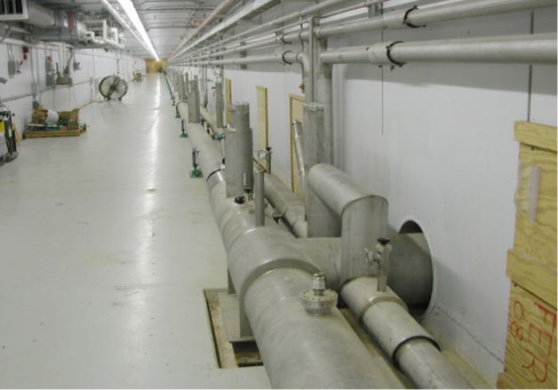
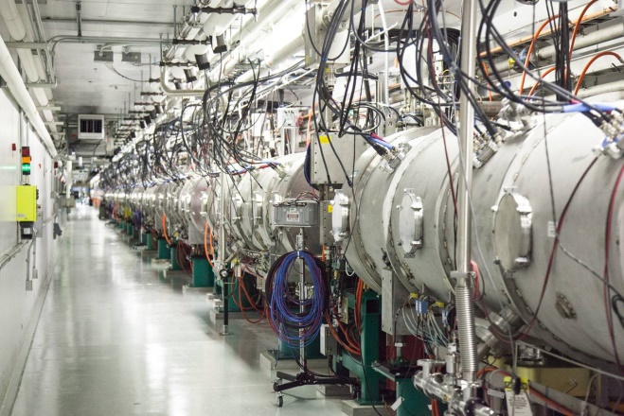
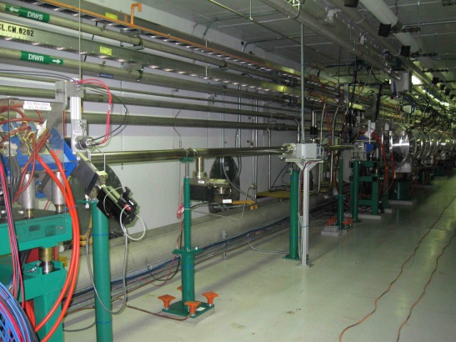
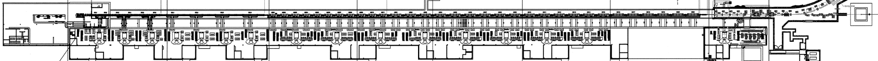
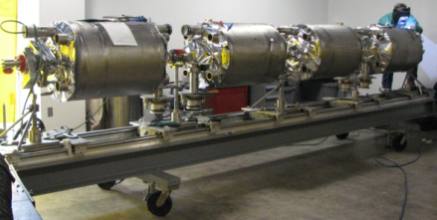
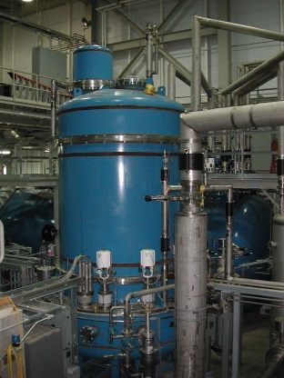
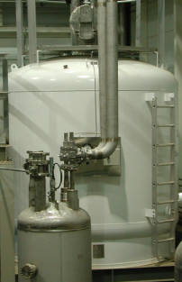
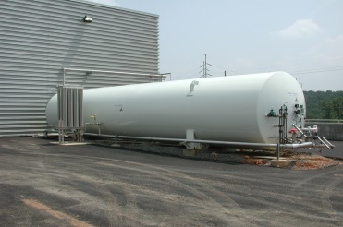
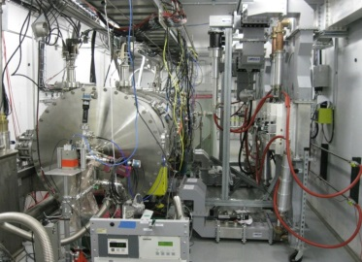
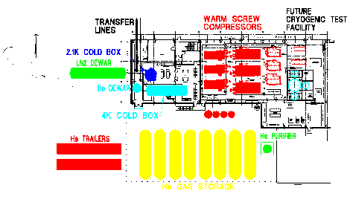
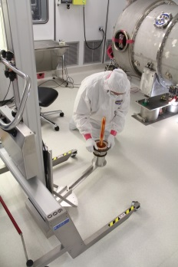
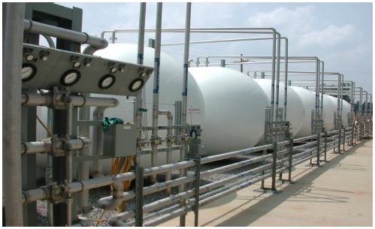
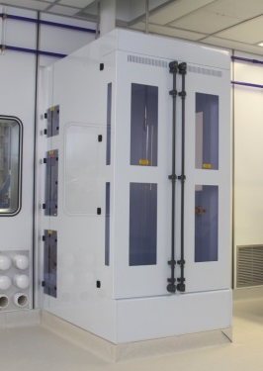
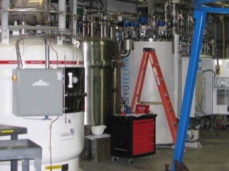
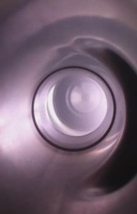
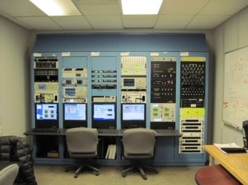
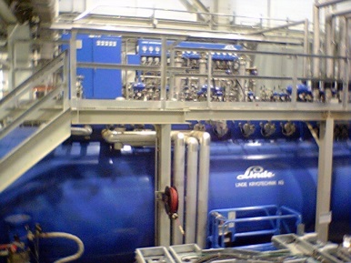
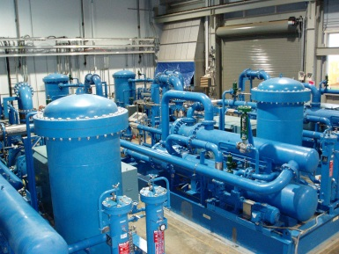
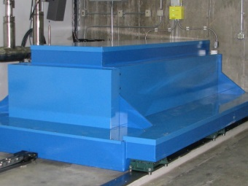
SNS SCL Systems scope
Empty slots
for upgrade
Transfer lines in the tunnel (during installation)
Cryomodules
in the tunnel
SNS Linac
LN2
LHe dewar
Test cave
2 K Cold Box
R&D
CM
rework
GHe storage
Control room
HPR
CTF
CTF
4 K
Cold Box
VTA
Warm Compressor

Slide 4
Response to recommendation
Recommendation 1: Proceed with fabrication of the spare medium-beta cryomodule, if possible, ensure the funding profile is adequate to complete this task in a timely manner
  Status: open (due date: September 2019)
  Management is working to ensure that the funding profile is adequate to complete this task in a timely manner
    Fabrication is in progress
    FY18 funding was on hold due to budget uncertainty
    In April 2018, FY18 funding is allocated
Recommendation 2: Continue to emphasize the SRF R&D program at SNS, particularly to support PPU
  Status: closed
  SRF R&D strategy and plan has been updated – R&D programs are selected and in progress including activities that support PPU

Slide 5
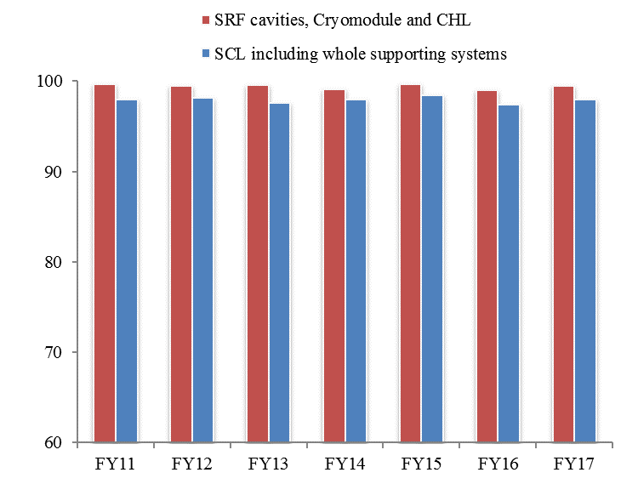
SCL operation has been stable and reliable
Availability last 7 years:
  Whole SCL including RF, HVCM, Control, Vacuum, etc.: ~98 %
  SRF cavities, cryomodules, and CHL: >99%
    Average trip or downtime: <1 trip/day corresponding to <5 min./day
Sustainability for the future
  Addressing two vulnerabilities
    Develop CHL spare carbon bed
    Develop spare medium beta cryomodule
Improving performance
  Deployment of in-situ plasma processing

Slide 6
CHL spare carbon bed background
The CHL carbon bed and final filter are part of the helium purification system
  CHL carbon bed is approaching its end of lifetime according to the original estimation
  Carbon bed oil contamination carryover to the 4K cold box represents a single point failure (4-6 months downtime)
Options for the final installation of spare carbon bed were reviewed and the minimum risk option was chosen
  The spare carbon bed is connected in series to the existing one to keep helium transfer lines and LINAC cold

Slide 7
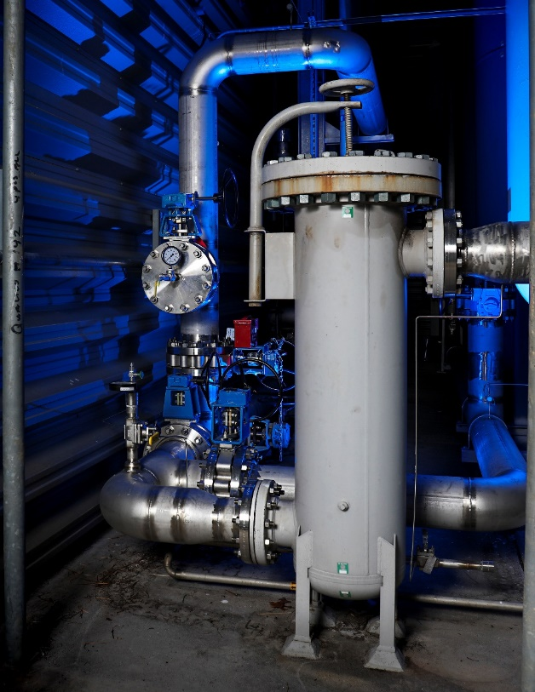
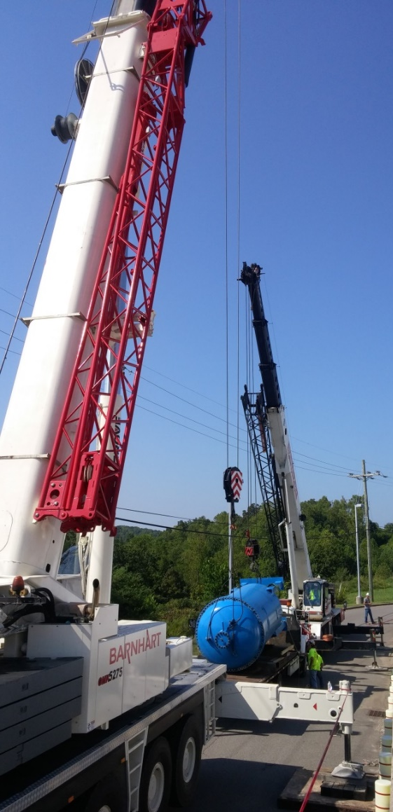
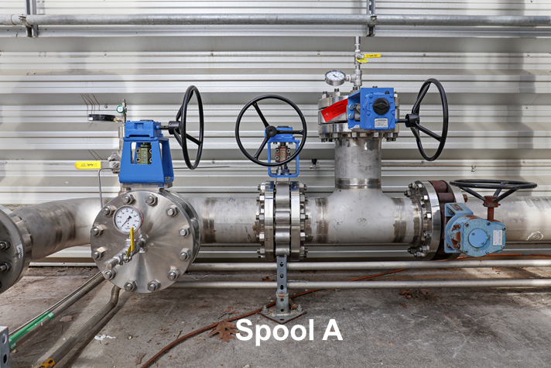
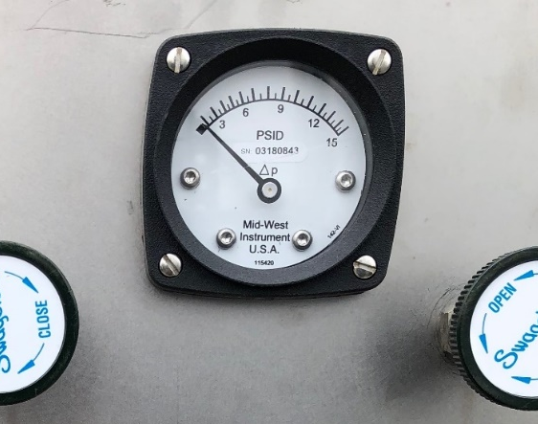
Spare carbon bed project
Project started in FY16 was successfully completed in April 2018
  This required meticulous planning and exercises including precise survey and alignment
    Critical installation activities were conducted during two 8-hrs CHL shutdowns – LINAC and helium transfer lines were kept cold
Successfully commissioned with new configuration and operating mode
  Pressure drop by new piping and vessels is <2 psi at flow rate of 1100g/s
  New vessel is currently online
    Additional benefit to cryogenic community: will provide real carbon/oil adsorption capacity

Slide 8
Benefiting from spare high beta cryomodule
Spare high beta cryomodule was developed in house and replaced low performer in the tunnel in 2012
  Offline cryomodule was plasma processed and serves as a spare
Vacuum leak identified at two fundamental power couplers in the slot 17 cryomodule (17b and 17d cavities)
  Leak rates were measured at 10⁻⁷ torr l/s during summer shut down 2017
  Cavities were operated at a reduced gradient (11.5 MV/m → 8 MV/m)
  The cryomodule was taken out for repair in January 2018

Slide 9
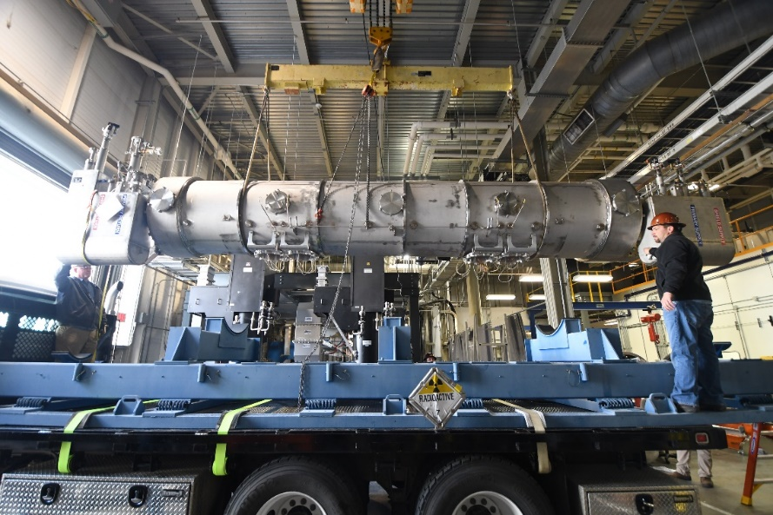
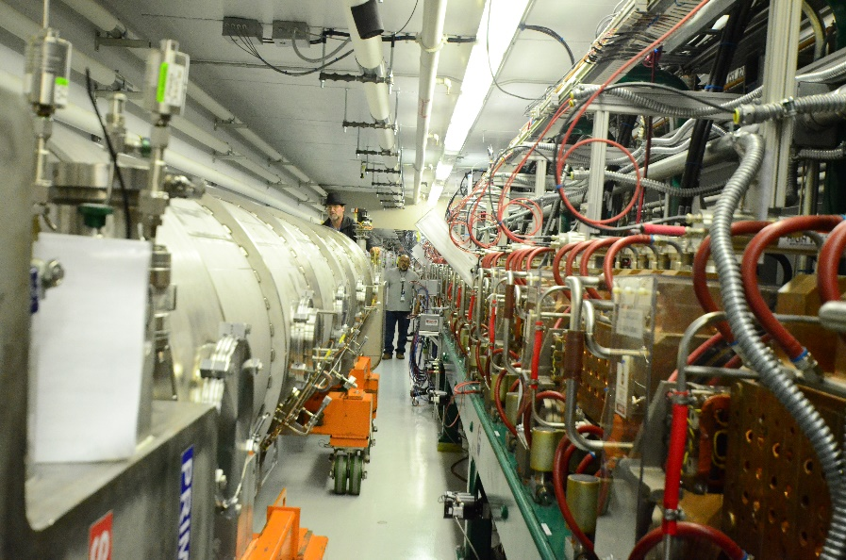
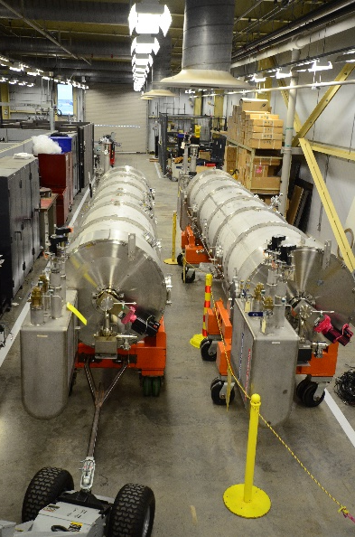
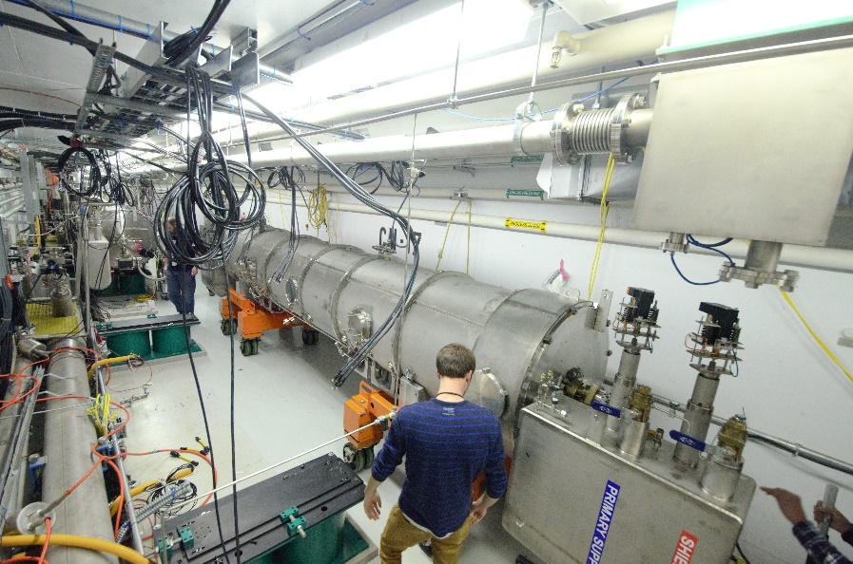
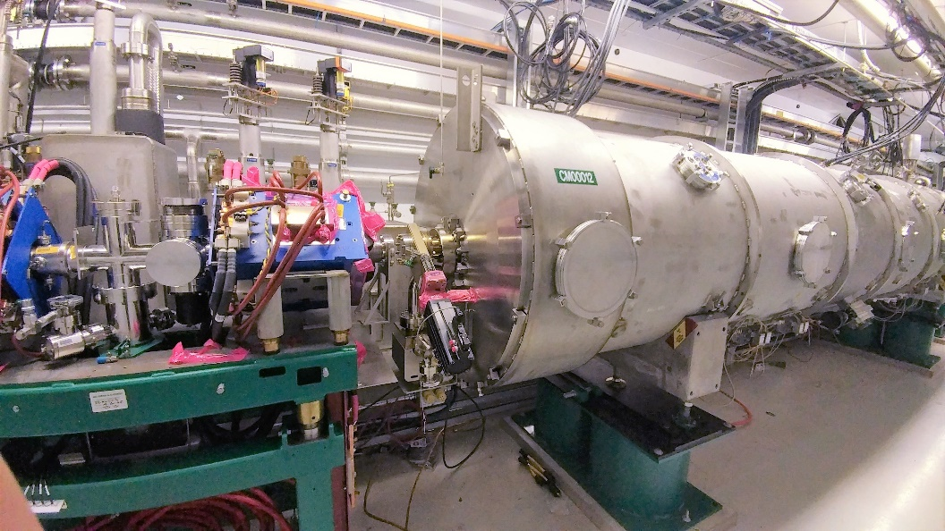
The cryomodule in slot 17 was successfully replaced with the high beta spare cryomodule

Slide 10
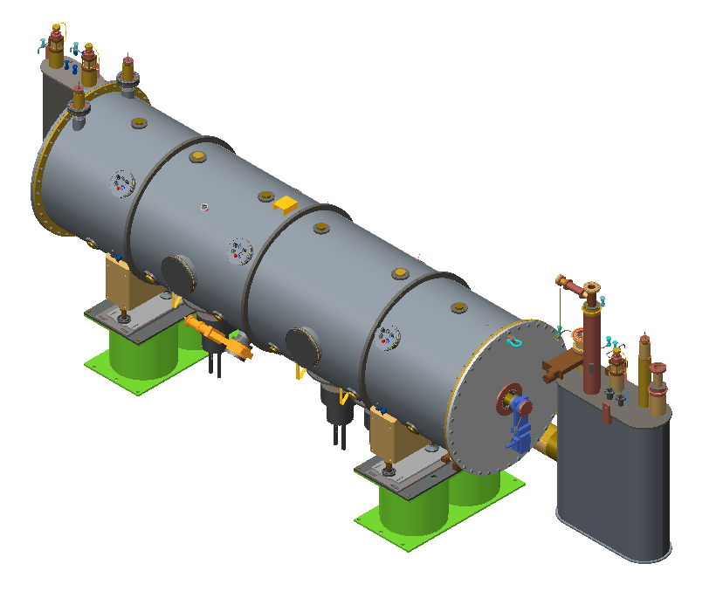
Spare medium beta cryomodule development
Will allow removal of any operating medium beta cryomodule for repair
  5a and 11b are currently off
  Necessary for long term sustainability of SNS operation
Same strategy for the spare high beta cryomodule
  Design changes to comply with 10CFR851
  In-house development
  Other minor changes to improve performance and reliability
    No HOM couplers, no piezo tuners, high Residual Resistivity Ratio
    (RRR) niobium for end groups
Started the project in FY17, funded by RAD operation

Slide 11
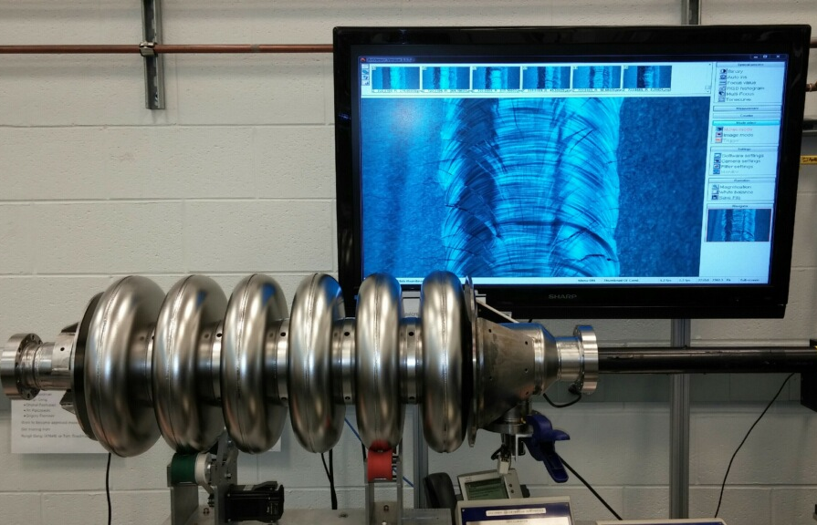
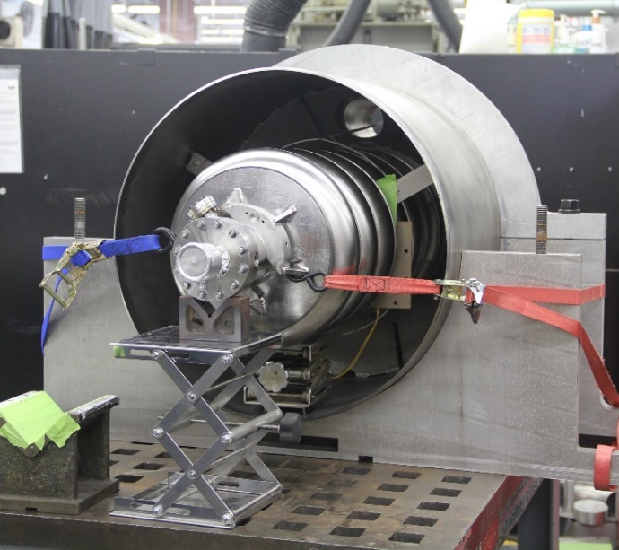
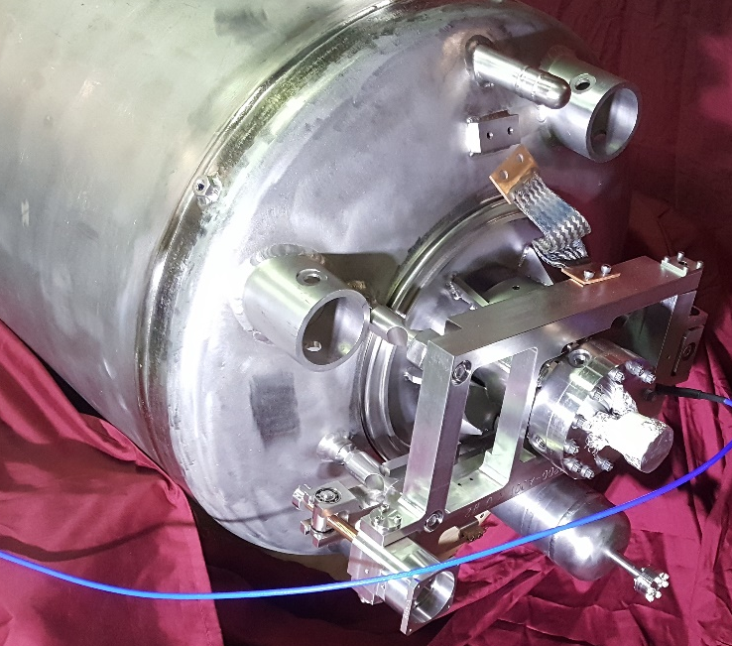
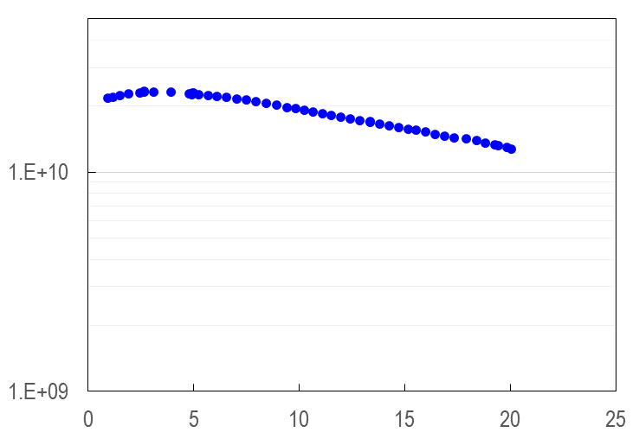
Spare medium beta cryomodule project is progressing
All three cavities are developed
  VTA test: limiting E_{acc} ranges 19-22 MV/m
Helium vessel welding is progressing
  Cavity 1 & 2 completed
  Cavity 3 in progress
All fundamental power couplers are baked and RF conditioned
Cavity 1 is fully dressed and qualified in HTA: no performance degradation
All other sub-components for string assembly are ready
  Cavity string assembly will start this summer
Resumed procurements for cold mass assembly
3e10
Q₀
1e10
SNS medium beta
cavity specification
1e9
E_{acc} (MV/m)

Slide 12
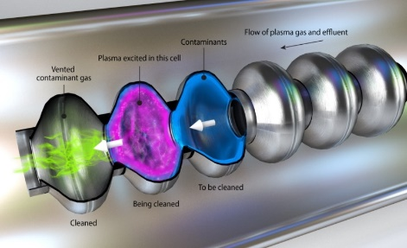
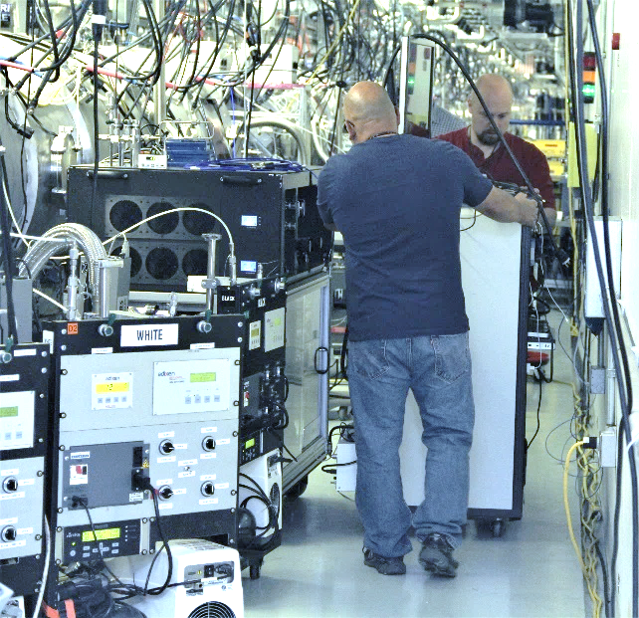
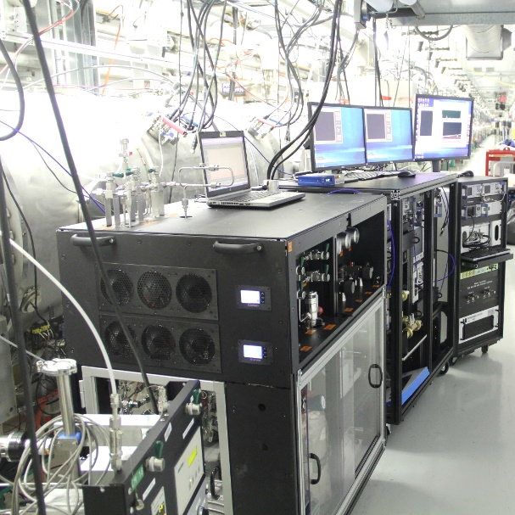
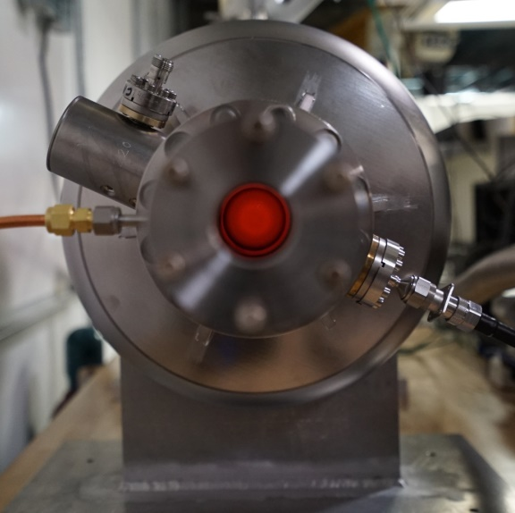
Successful deployment of in-situ plasma processing
Five additional cryomodules in the tunnel since last AAC review
  In summer 2017, deployed plasma processing technique to two additional cryomodules (CM16 and CM17)
  In winter 2018, deployed plasma processing technique to three additional cryomodules (CM21, CM22 and CM23)

Slide 13
In-situ plasma processing has been the driving force to bring SNS beam energy to 1 GeV
Total 8 high beta cryomodules have been successfully plasma processed
  7 cryomodules in the tunnel and 1 offline
  Accelerating gradient increased by 20% on average
    Improvement of E_{acc} ranges from 0.2 to 6.0 MV/m
    10 MV/m gain per cryomodule on average
    No performance degradation from plasma processing observed so far

Slide 14
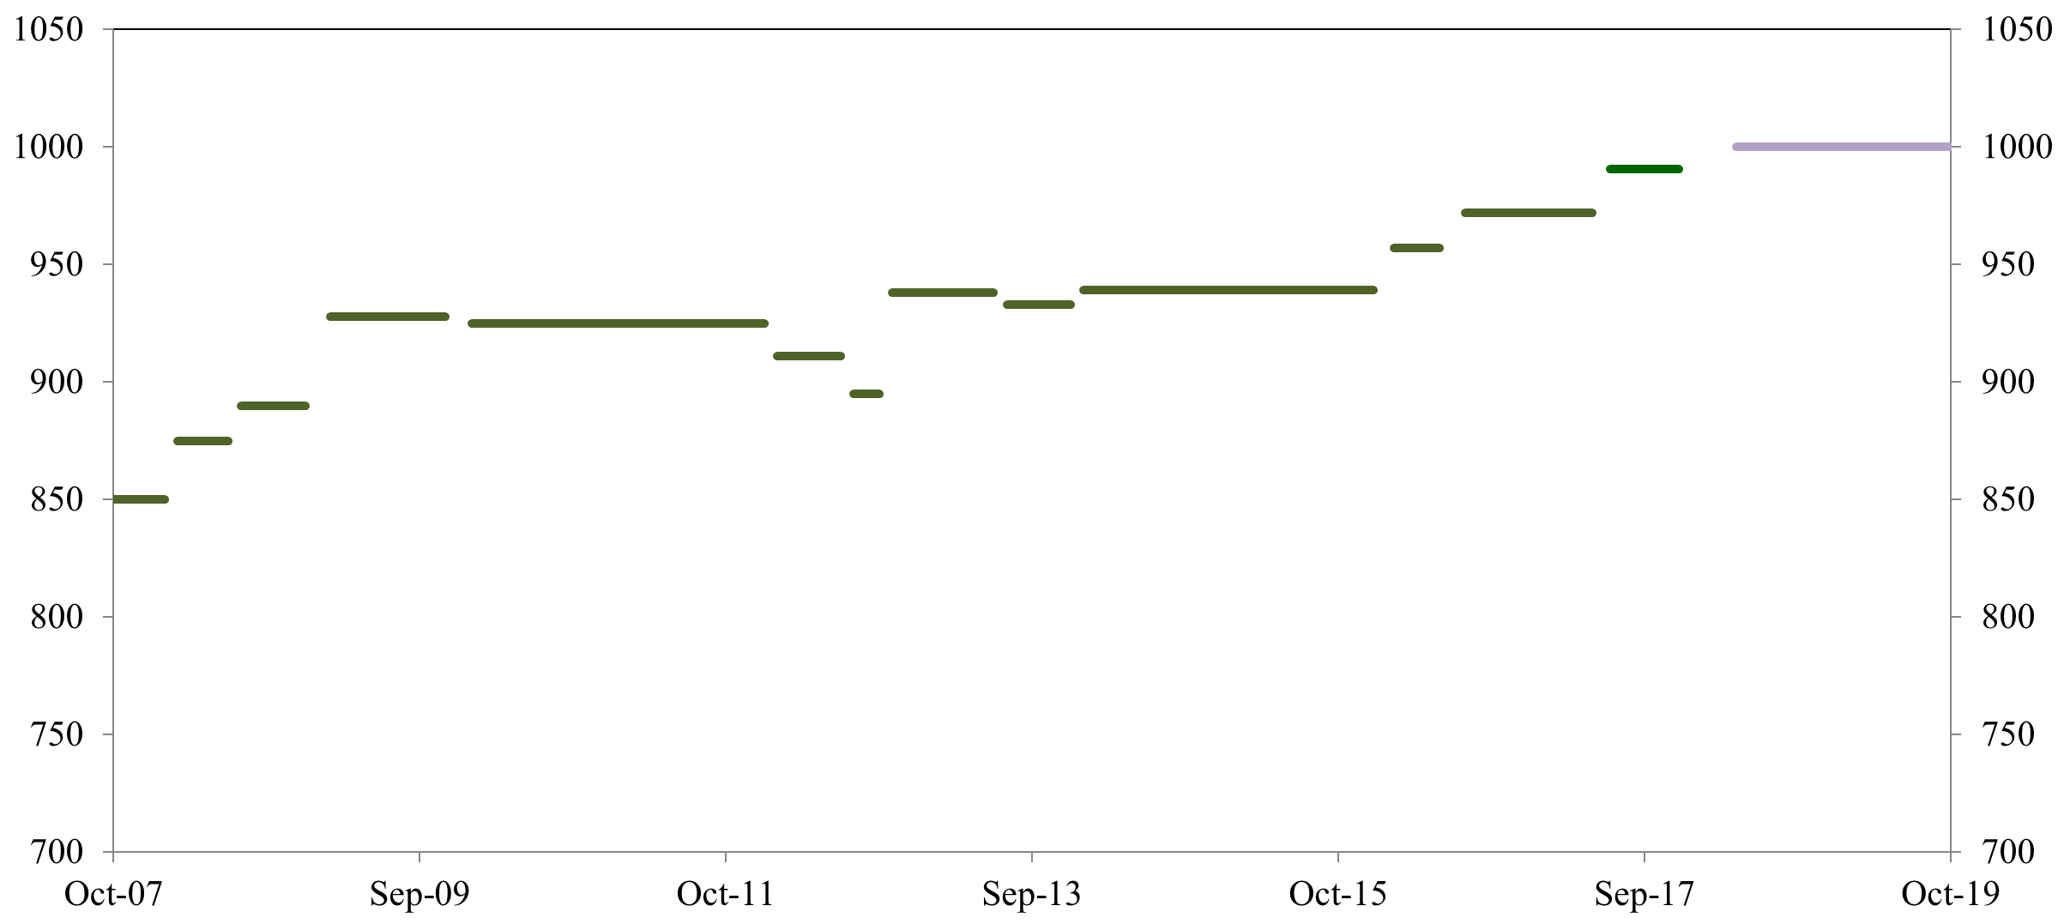
Linac output energy increased to > 1,000 MeV
1 GeV with
increased
energy margin
Second in-situ
plasma
processing
CM18
Recognized
Errant
Beam
990 MeV
3 cavities
Turned off
(errant beam)
MB CM in
(slot 6)
after repair
972 MeV
Fourth in-situ plasma processing CM21, 22 & 23
1
2
957 MeV
Additional
HVCM
939 MeV
Third in-situ
plasma
processing
CM16 & 17
First in-situ
plasma
Processing (CM19)
&
Performance recoveries of degraded cavities (thermal cycling, RF conditioning)
CMs out
from slot 6 and 20
for repair
Linac output energy (MeV)
High beta
spare CM in
for slot 20
RF/Control improvement
Two CM Repairs
Other misc.
1. Full pulse length
for 1.4 MW
2. Worst performing
HB CM out (slot 19),
HB CM from slot 20 in
after repair
May 2018

Slide 15
PPU SCL Scope: beyond 1 GeV and 1.4 MW
Road to 1.3 GeV and 38 mA beam loading (2.8 MW)
  7 additional cryomodules will be installed in empty slots
    Design E_{acc} for new PPU cavities is 16 MV/m
    Fundamental power couplers for 65 kW average power (700 kW peak)
  Utilize the spare high beta cryomodule developed in-house as design standard for PPU cryomodules with some improvements:
    No HOM couplers
    High RRR niobium for end groups
    Fundamental power couplers for higher power rating
  Improvement of existing cryomodules
    Plasma processing for medium beta cryomodules
    Use spare medium beta cryomodule to replace low performing cryomodule

Slide 16
PPU pre-CD2 activities for SCL (1)
Implementing resource strategy for PPU SCL maximizing efficiency
  Agreement complete for matrix employees from operations to project
  Hire 1 permanent engineer and 1 permanent technician
  Use contract resources where possible
  Use work force at partner laboratory
Preparation for CD-3a, Long Lead Procurements (LLPs), is in progress
  Cavity procurement (including material, material scanning, test and shipping hardware, vendor process qualification)
  Coupler procurement (inner and outer conductor)

Slide 17
PPU pre- CD-2 activities for SCL (2)
Preparation for CD-2 is on track
  Bring partner laboratory on board through Memorandum Purchase Order (MPO)
    Jefferson Laboratory (JLab) identified as strategic partner
    Senior team leader at JLab identified and working closely with SCL level 2 manager
  Prepare baseline cost and schedule estimate
    Review estimates from CD-1
    Update from budgetary estimates to vendor quotes
Responding in advance to previous review action items due by CD-2
  Validate cavity end group improvement – complete
  Test Fundamental power coupler – complete
  Finalize in-situ plasma processing recipe for medium beta cavities – ongoing

Slide 18
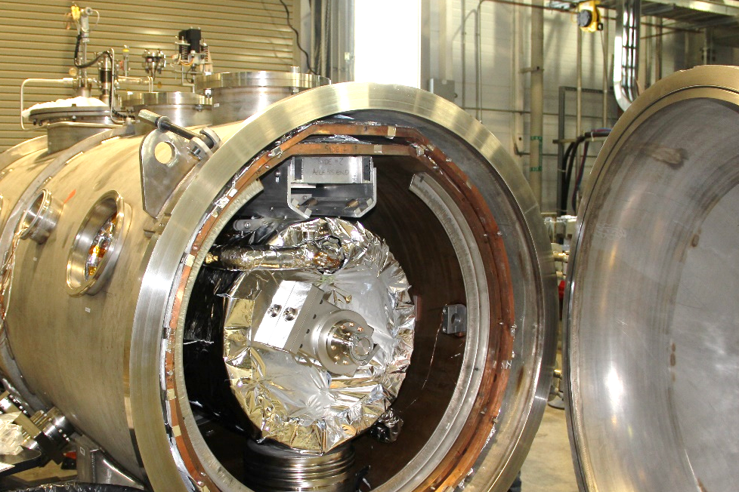
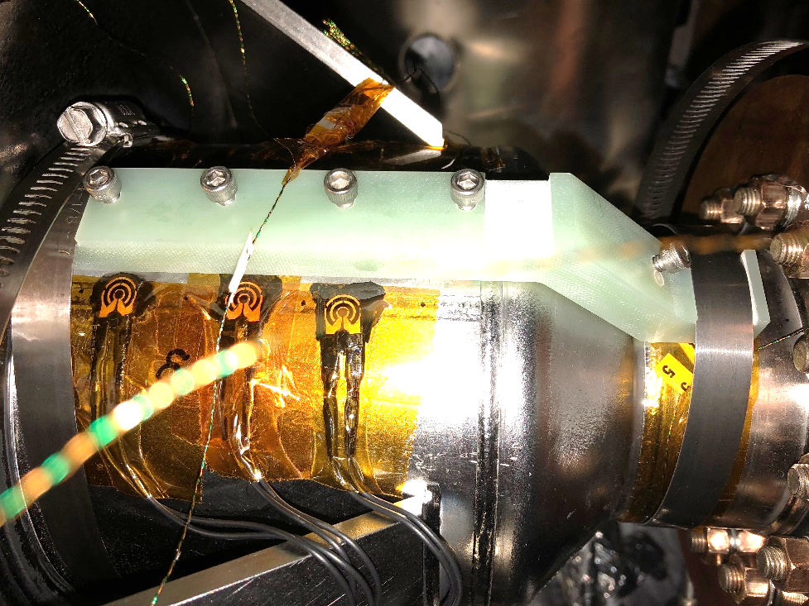
Improvements to achieve PPU E_{acc}
Electro polishing
  Vetted through fabrication and operation of the spare high beta cryomodule
Improve thermal stability of end group
  PPU cavity end groups will be made of high RRR niobium
    Similar as cavities fabricated for spare medium beta cryomodule
    Improved stability vetted with HTA test of a cavity
      Stable operation with spot thermal load (heater) in the end group of 4.5 W

Slide 19
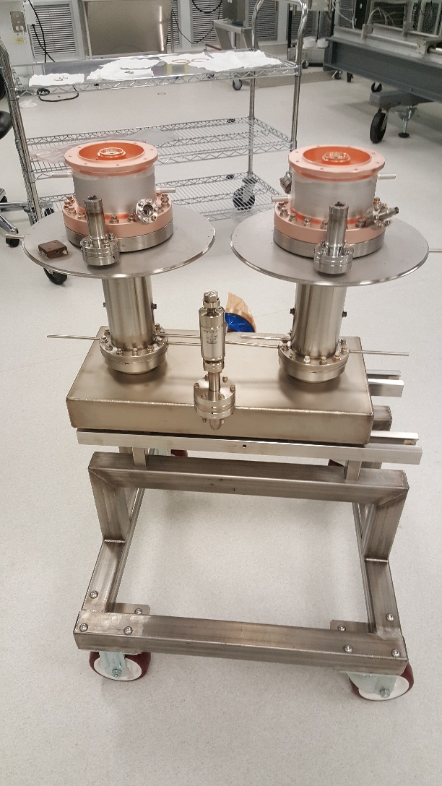
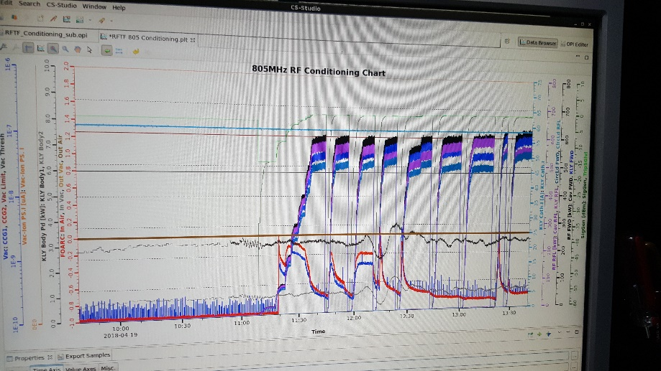
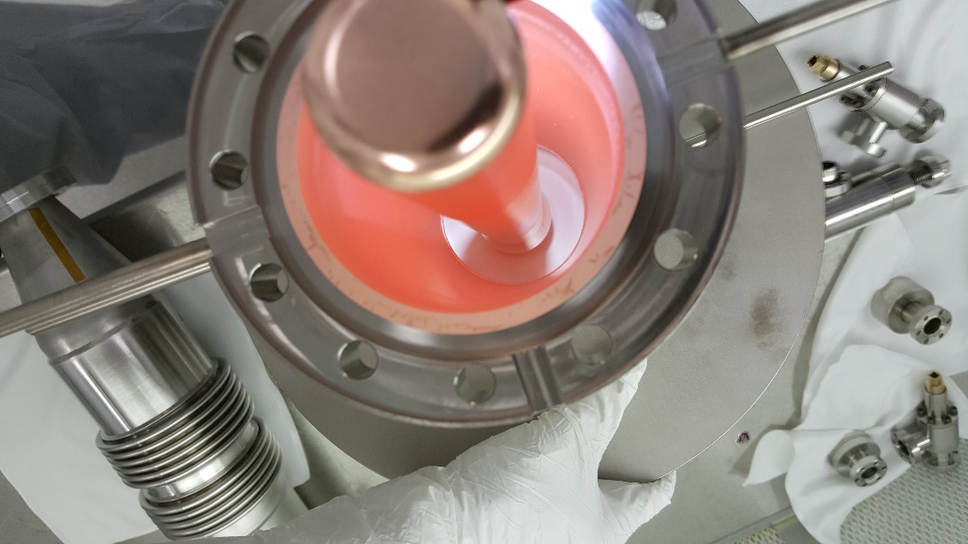
Development PPU fundamental power coupler
Design change for 65 kW average power (700 kW peak)
  Inner conductor thickness increased from 3 mm to 7 mm
Prototype fabricated and tested
  Increased RF conditioning power level from 600 kW to 750 kW at full duty factor

Slide 20
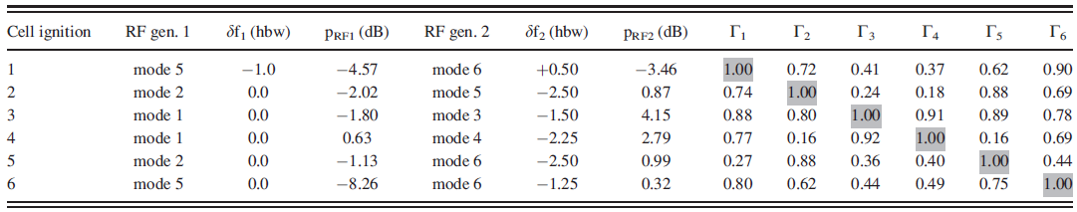
Plasma processing for medium beta cavities – R&D (1)
Leverage available RF power in medium beta cryomodules for PPU
  Aim at increasing medium-beta cavities E_{acc} by 1.7 MV/m on average
  Need to modify plasma processing recipe developed for high-beta cavities
    Existing hardware can be used (same frequency 805 MHz)
    Develop dual tone ignition parameters
Dual-tone ignition parameters for high-beta cavities*
* M. Doleans J. Appl. Phys., 120, 243301 (2016)

Slide 21
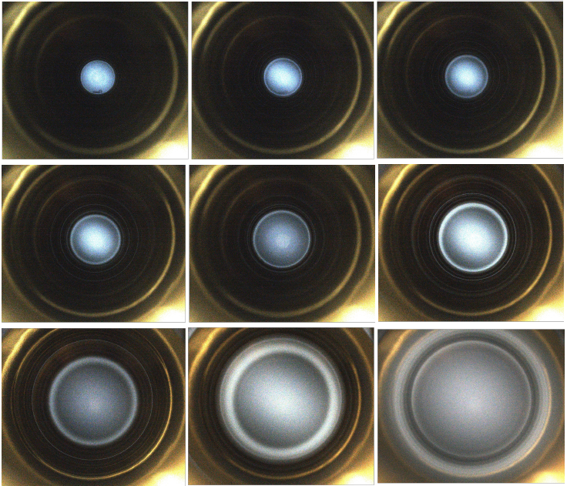

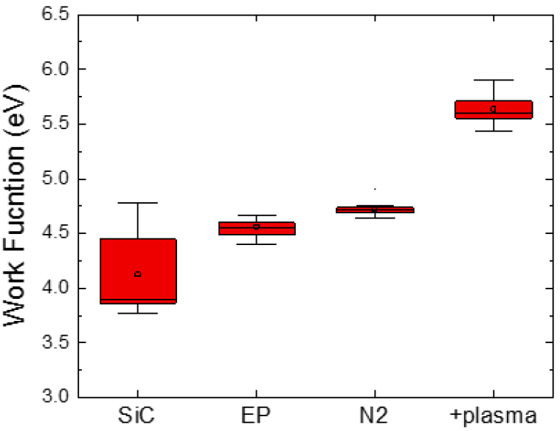
Plasma processing for LCLS-II – R&D (2)
On-going collaboration between three Laboratories funded by BES
Plasma processing for 9-cell 1.3 GHz LCLS-II cavities
  Plasma ignition methodology modified to use HOM couplers *
  Plasma processing increases work function for LCLS-II niobium surface **
(courtesy P. Berrutti, FNAL)
* P. Berrutti et al., “Update on plasma processing R&D for LCLS-II”, IPAC18
** K. Tippey et al., "Improving the work function of nitrogen doped surfaces…“, IPAC18

Slide 22
Ex-situ plasma processing – R&D (3)
In-situ plasma processing using neon/oxygen mixture for increasing E_{acc} of cryomodules in operation
  Reactive oxygen removes surface hydrocarbons
    Increases work function of surface and reduces field emission
  Being deployed to high-beta cryomodules
  Will be deployed to medium-beta cryomodules for PPU
Ex-situ plasma processing R&D aims at exploring other plasma processes for cavities during fabrication or repairs
  Not restricted to in-situ conditions (e.g. cavities with FPC)
  Different plasma generation methods and more aggressive plasmas can be explored (e.g. to attack particulate contamination)

Slide 23
Program Development for future R&D – R&D (4)
NScD Program Development (PD) fund
  Funds aiming at developing new business at the Laboratory, supporting sponsor liaison activities, and maintaining a network of client relationships and interfaces
    Support exploring new research topics in accelerator science and technology, and networking with other fields of research
  SCL Systems Group awarded PD fund in FY18
    Emphasis will be on exploring innovative techniques to probe SRF surfaces and networking with corresponding groups
    Seek potential funding sources aligning with new research topics

Slide 24
Summary
SCL and CHL are operating reliably
  Significant testing and operational experience has led to a better understanding of systems
SNS is conducting a multi-faceted approach to improve machine reliability and performance
  Critical spare developments
  In-situ plasma processing
SRF activities are actively in progress, in support of machine improvement, PPU project and R&D for future

Slide 25
Backup slides

Slide 26
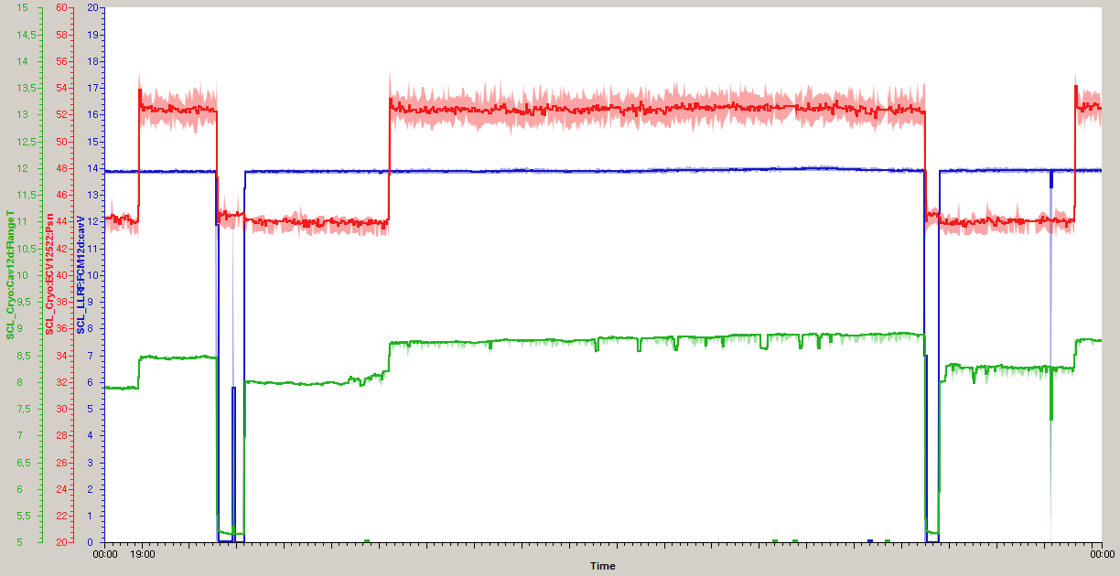
Hot spot example 1: meta-stable condition at the same gradient
JT valve position (10% more: 50-60 W)
Cavity gradient
Coupler flange temperature
(not hottest spot)
Some part in the end group (must be very low field region) must be normal conducting but still operable
Additional cryogenic load at 2K is about 50W more from one cavity (would be 800W in CW)

Slide 27
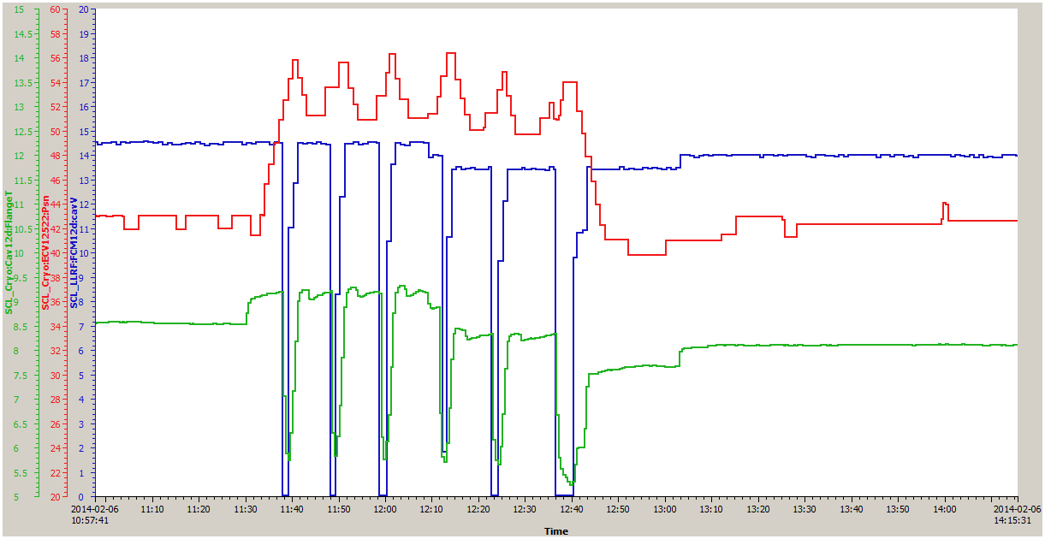
Hot spot example 2: unstable condition
JT valve position (10% more 50-60 W)
Cavity gradient
Coupler flange temperature
(not hottest spot)
Reduce gradient during operation by 0.5-1MV/m due to end group quench
Cavity still unstable → have to wait 10-15 min. for cool-down

Slide 28
Ex. Simulation of hot spot in the end group
With 1-W spot thermal load (reactor grade niobium)

