Slide 1
Overview of Inner Reflector Plug (IRP) Issues
Presented at the
SNS Accelerator & Target
Advisory Committee Meeting
Graeme Murdoch
Director, Neutron Technologies Division
May 15, 2018

Slide 2
Outline
Review of Core Vessel components
Previous IRP issues
Recent IRP replacement activities
Design and Manufacturing of IRP-3
IRP-3 planning for the future

Slide 3
The core vessel contains the inner and outer reflector plugs, neutron moderators, core vessel inserts (CVI), and interfaces with the target and proton beam window seals
T-Block Roof Shields
Shutter Drive Equipment Room
Service Bay
Outer Reflector Plug
Neutron Beam Line
Inner Reflector Plug
Target and Carriage Assembly
Core Vessel

Slide 4
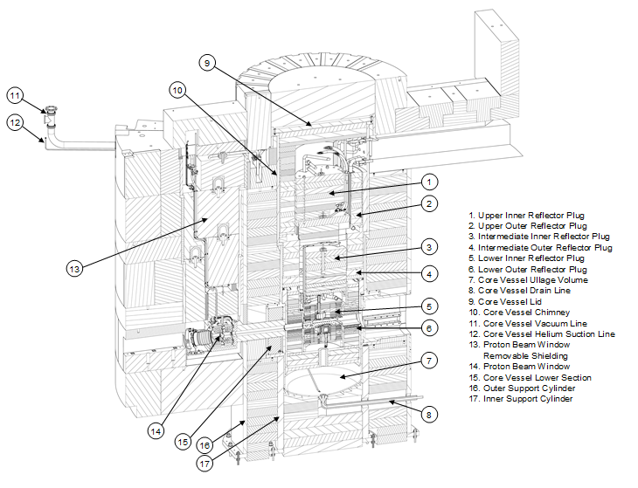
The core vessel contains a significant amount of equipment

Slide 5
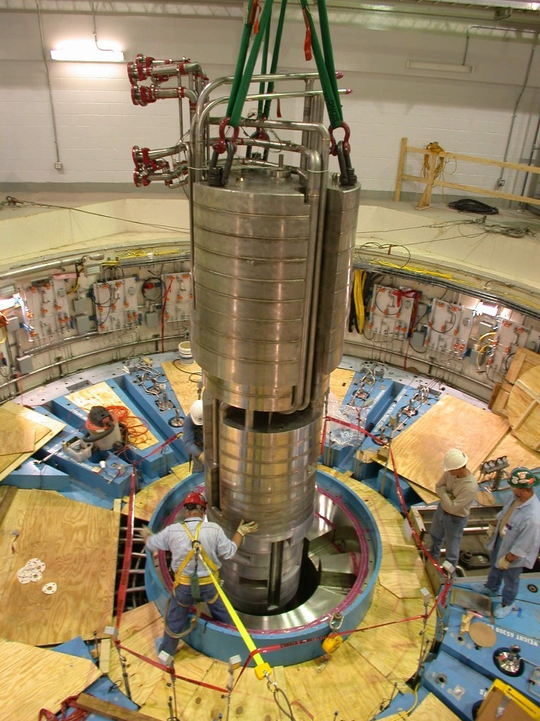
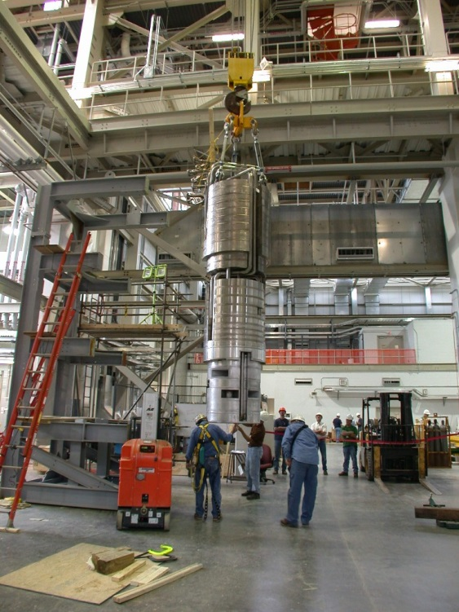
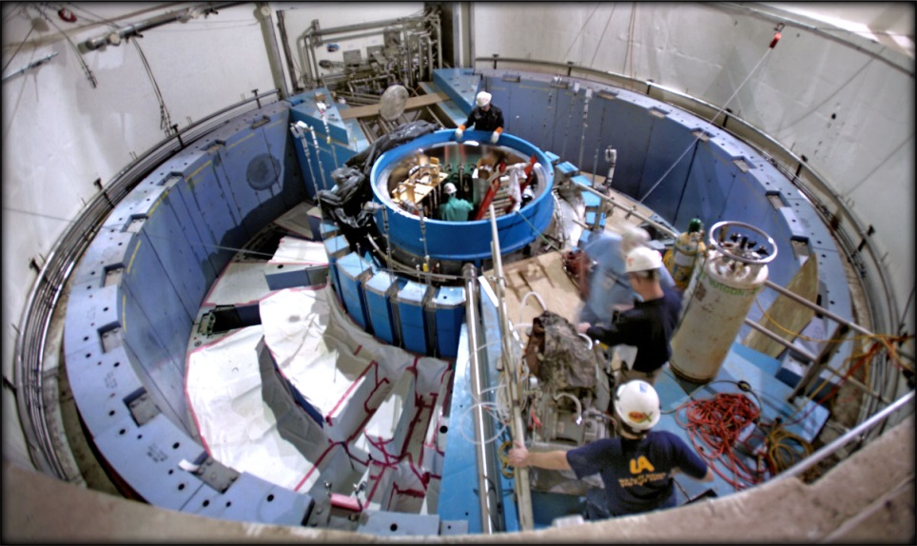
The IRP is a large, complex and limited-life component of the neutron source
Photos of the original IRP-1 installation

Slide 6
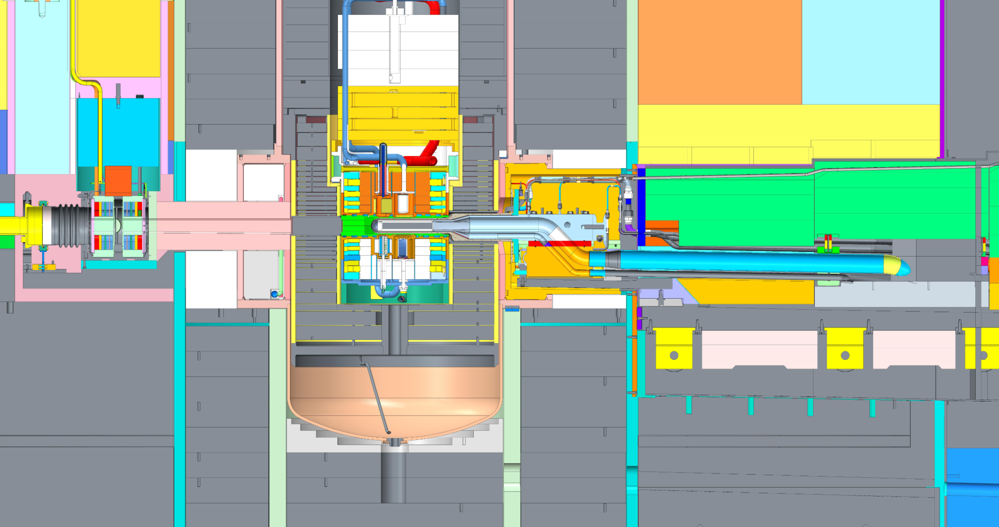
The lower segment of the IRP is inaccessible, and contains the neutron moderators, poisons and decouplers
Rolling Carriage
PROTONS 60 Hz

Slide 7
Review of status in March 2017: water leaks into the SNS target system core vessel developed in IRP-1
The first leak was identified in early Fall 2016
Remained small at approximately 0.5 gallons per day
Located in the proton beam window
Issue was resolved after Proton Beam Window (PBW) changeout
The second leak was identified November 14, 2016
The leak rate continued to increase and required engineering solution
After a major effort to design and install a leak collection system, the second leak was successfully managed
Loss of neutron science on BL4A due to collection of water in beam tube
Notes:
User Office

Slide 8
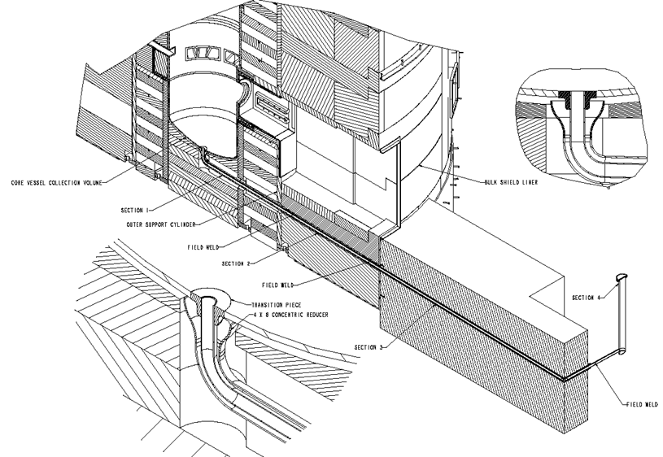
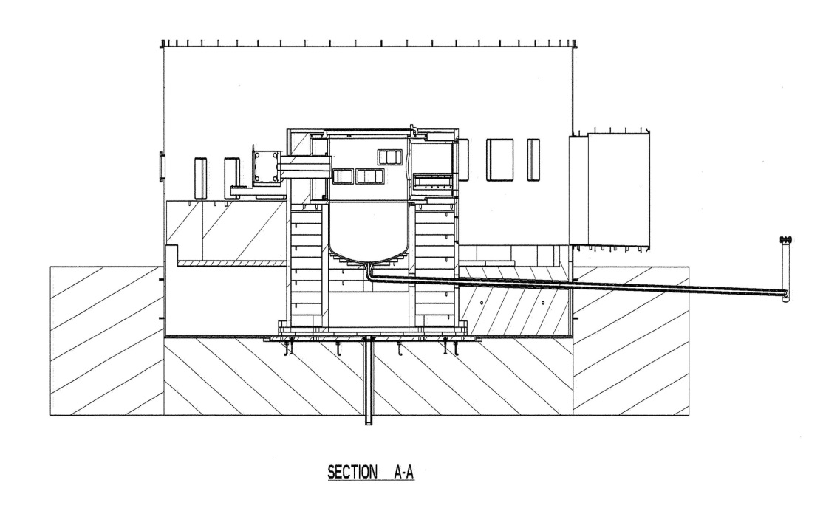
The Core Vessel drain system became an integral part of facility operation – regular pumping to the Low Level Liquid Waste tanks was required
The Core Vessel/Drain Line/Stand
Pipe was design such that the volume
capacity at the top of the Stand Pipe
is greater than the amount of mercury
that is postulated to drain into the
Core Vessel (182 gallons)
Stand Pipe in Service Bay
6” ID

Slide 9
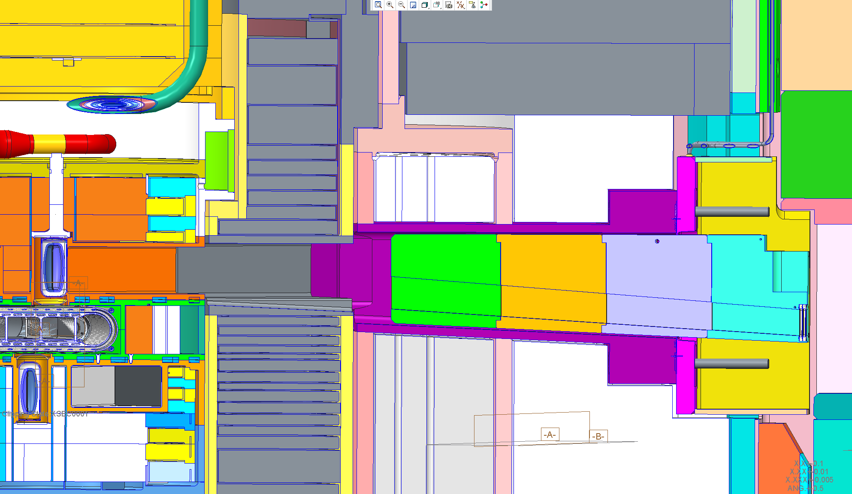
BL-4B CVI channel accumulated water, preventing neutron science activities
BL-4B has the only canted (-4º) CVI channel – has capacity to accumulate ~3.2 liters of water before equilibrium is reached – probably wicking between IRP and Outer Reflector Plug (ORP)

Slide 10
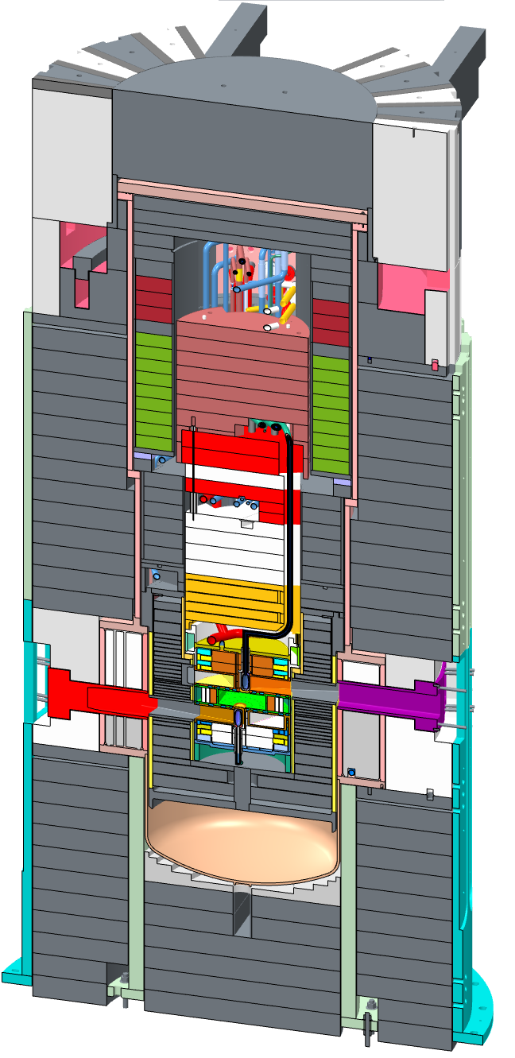
The actual leak was in an inaccessible location buried within the IRP stack up
Inner Reflector Plug
Top Downstream Moderator
Outer Reflector Plug
Core Vessel
Leak position
Bulk shielding
Neutrons to 4, 5, and 6

Slide 11
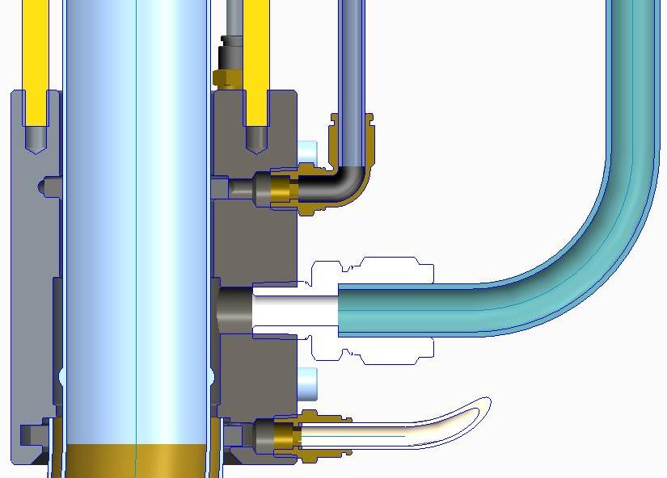
A coupling was designed to seal the emanation point and port the water away
Capacity was up to ~1 gpm – leak rate was ~ 1.8 gph
Vacuum tube
Upper Buna-N seal
Threaded rod
Upper RTV port
Water exit port; routed to Loop 3 drain tank
Internal lip to position clamp
helium tube interface
Lower RTV port
(primary)
Helium tube
Lower Buna-N seal
Notes:
RAD

Slide 12
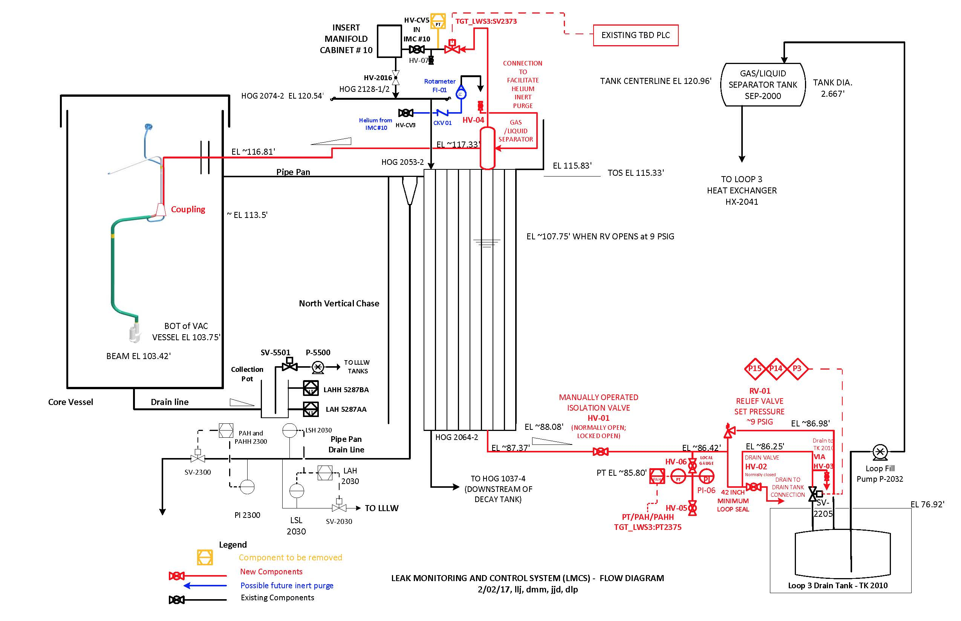
Operational and safety issues required the water to be routed outside the core vessel (vacuum jacket integrity, low level liquid waste, BL-4B)
Operational Process Flow Diagram (PFD)
Notes:
RAD

Slide 13
Since March 2017
At cessation of operation on December 22, 2017, IRP-1 had reached an integrated exposure of 40.5 GW-hr (initial estimates were 32 MW-hr), resulting in significant and undesirable changes to the instrument neutron spectra from the burn-up of poison/decoupler materials (Gd/Cd).
Receipt inspection of IRP-2 at SNS identified a small vacuum leak on the heavy water loop. Options to address this issue were evaluated and an action was implemented prior to installation.
The replacement of IRP-1 with IRP-2 was successfully completed.

Slide 14
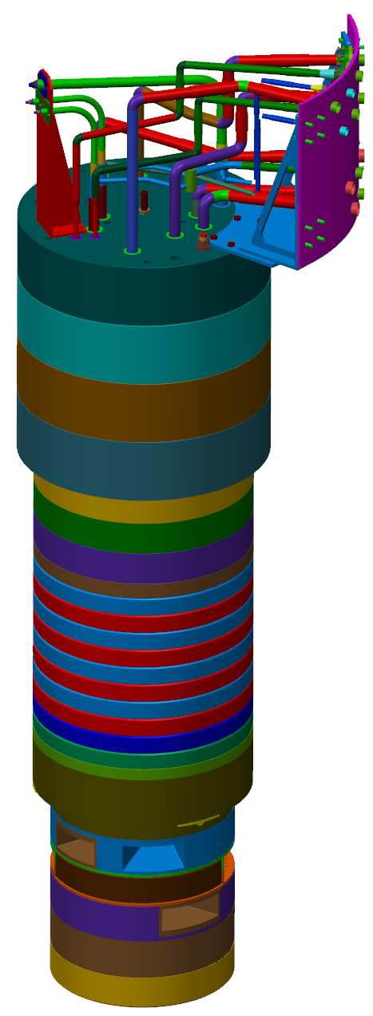
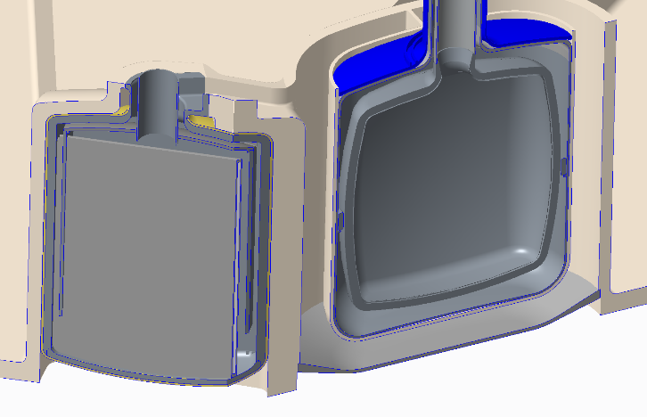
Fabrication challenges with IRP-2 included welding, assembly, and transportation
Welding within the complex and tight moderator geometries brought many challenges
Fabricated welds failed inspection many times during the fabrication period
Inspection techniques and acceptance criteria changed
Alignment concerns
During final assembly at the vendor, a leak was confirmed in IRP-2 on December 21, 2016
Required a major rebuild and delayed delivery to SNS by ~ 8 months
The delay and expected delivery and receipt inspection of IRP-2 required that the start of the long outage be delayed to the end of CY 2017
A new realization of the IRP fragility raised concerns about transportation of the fully assembled stack-up
Upper IRP
Intermediate IRP
Lower IRP
Complete IRP
Tight-fitting moderators
Notes:
User Office

Slide 15
Replacement of IRP-1 with IRP-2 had many challenges
T4 - Dayton
Never been done before operation
Potential for high doses to personnel
Extensive planning and mockup testing was required
Discovered vacuum leak in Loop 4 water line during receipt testing at SNS
Disposal and personnel ALARA issues required removal of IRP-1 (in segments) into storage casks
Specialized cutting tools required to shear piping
Specialized tooling required for inspection of core vessel surfaces and survey & alignment verification
Correct alignment of IRP-2 relative to ORP
Notes:
User Office

Slide 16
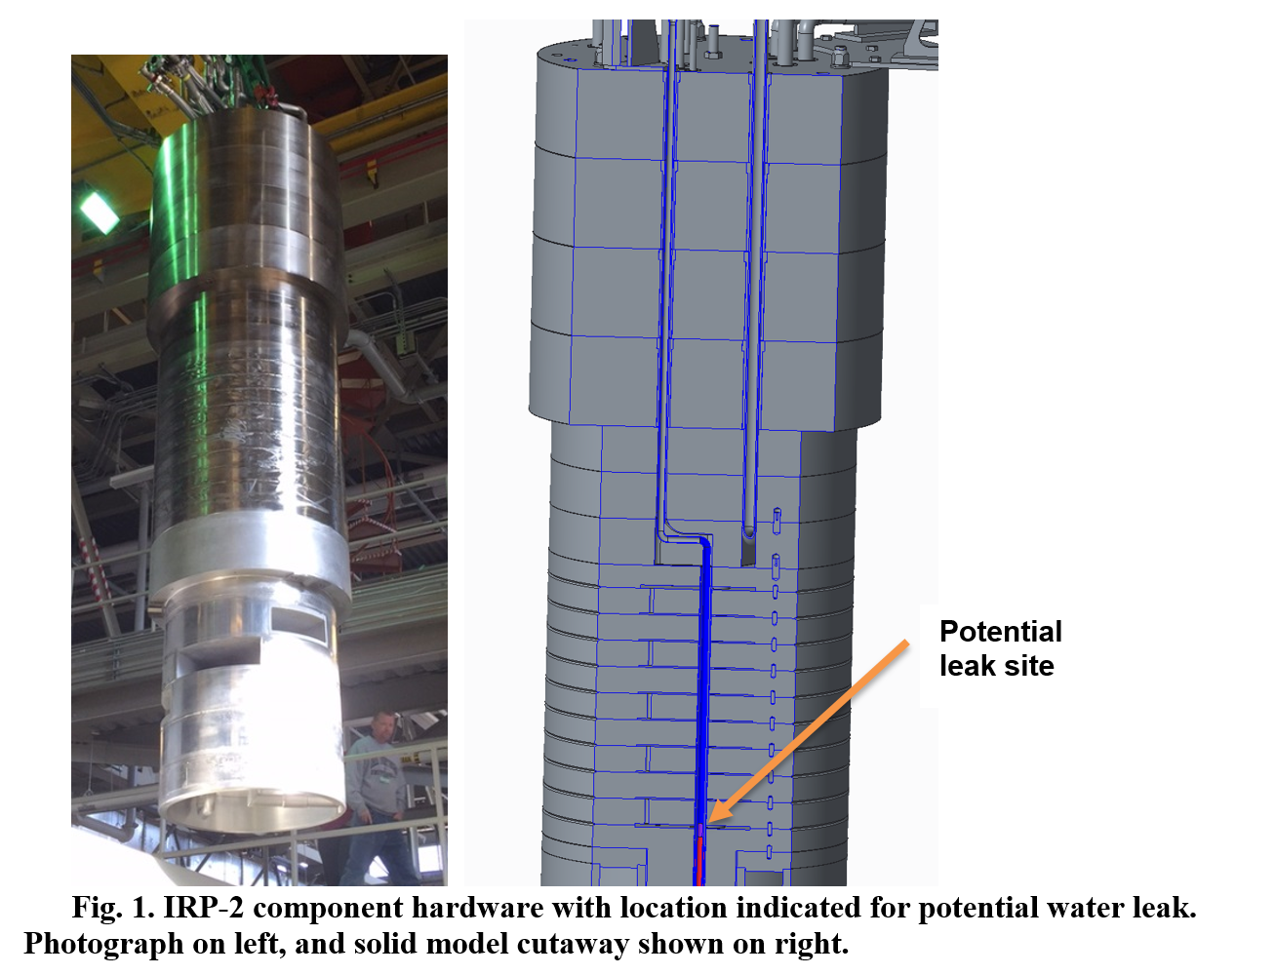
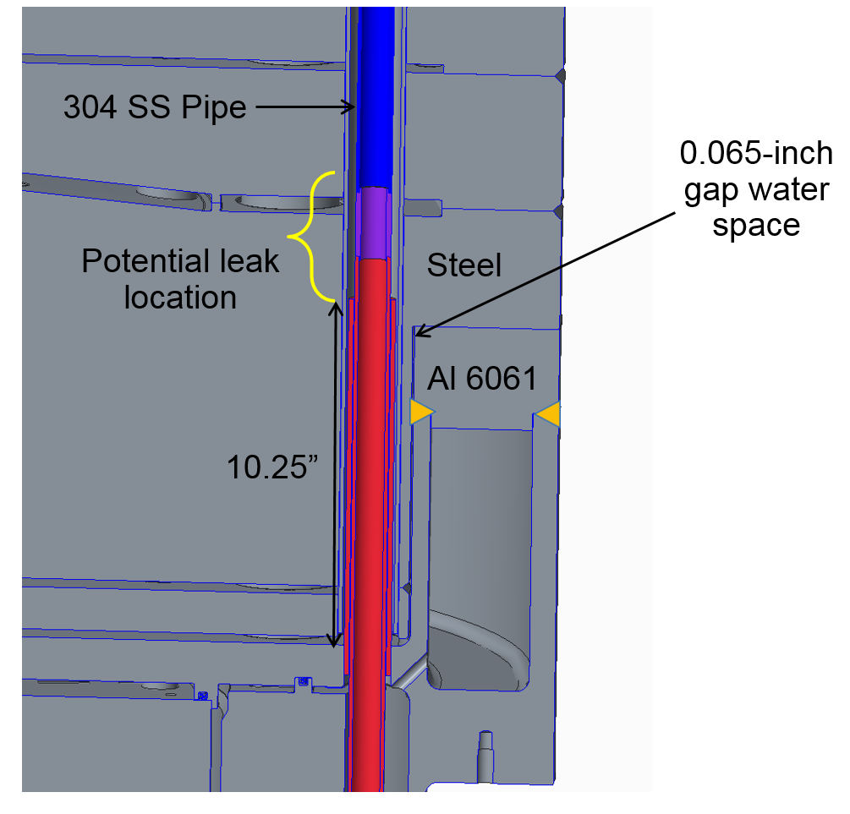
After delivery to SNS a vacuum leak was detected in the water piping for IRP-2 within the Intermediate IRP during onsite acceptance testing
IRP-2 component hardware with location indicated for potential water leak.

Slide 17
The leak was not big enough to leak water, but mitigation plans were considered to prevent future issues
Doing nothing
Filling the space around the water pipe with epoxy
Drilling a hole in the IRP to allow drainage of water in the future
After extensive mockup testing and engineering simulations, the decision was made to drill a drain hole, but not to use epoxy.

Slide 18
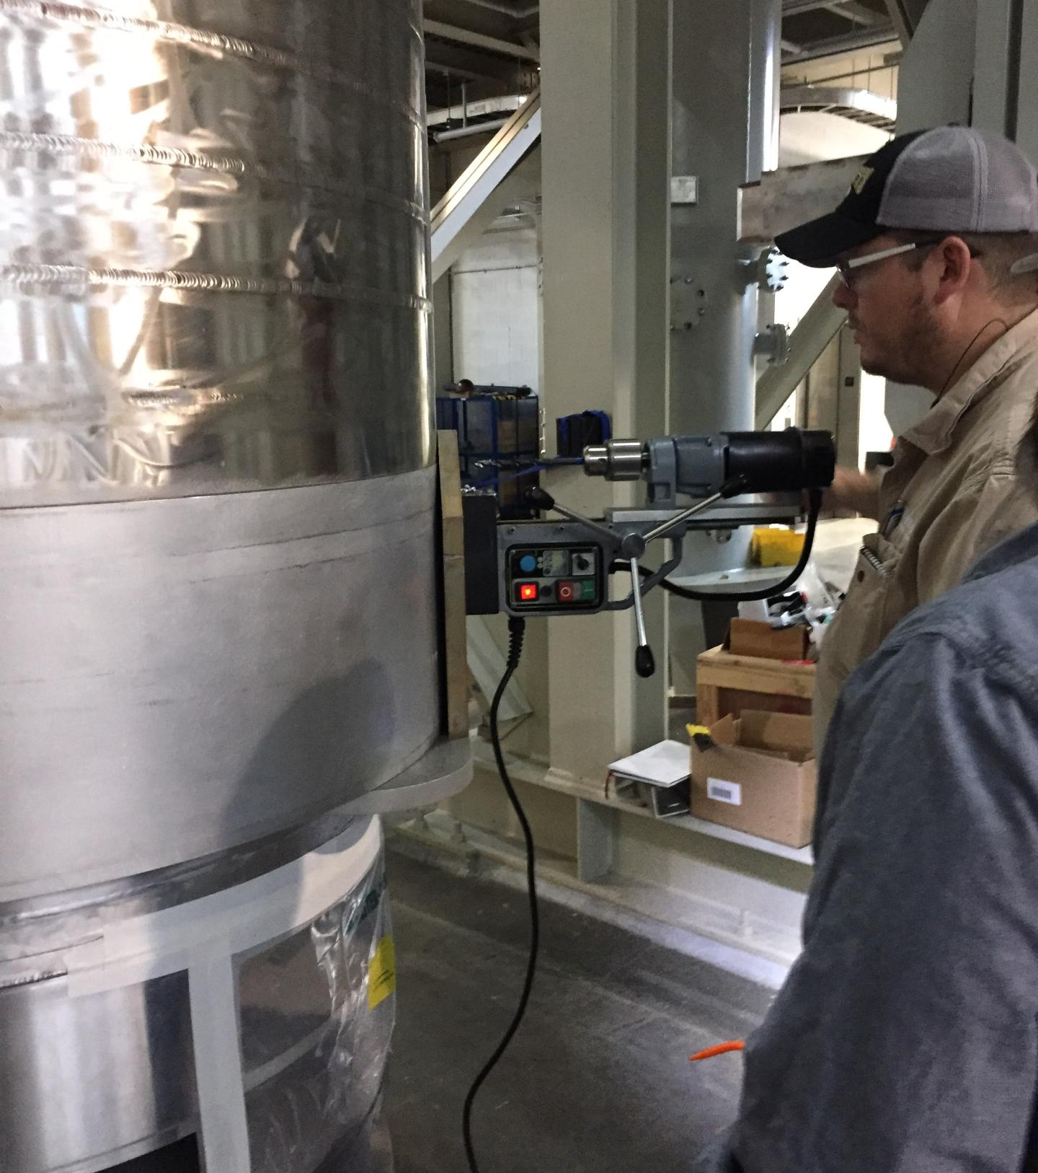
IRP-2 Drain Hole Activity
Drain hole position determined based on IRP 3-D model
Positioned 180º opposite to BL#4B
Ultrasonic Testing used to confirm drill location
Drain Hole Drilling

Slide 19
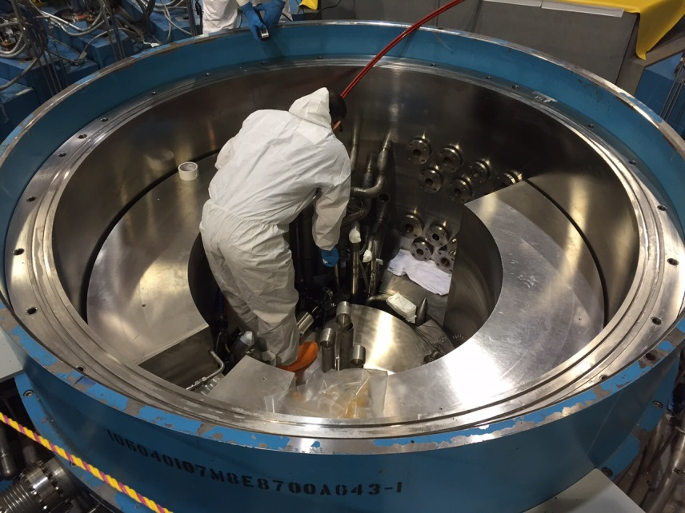
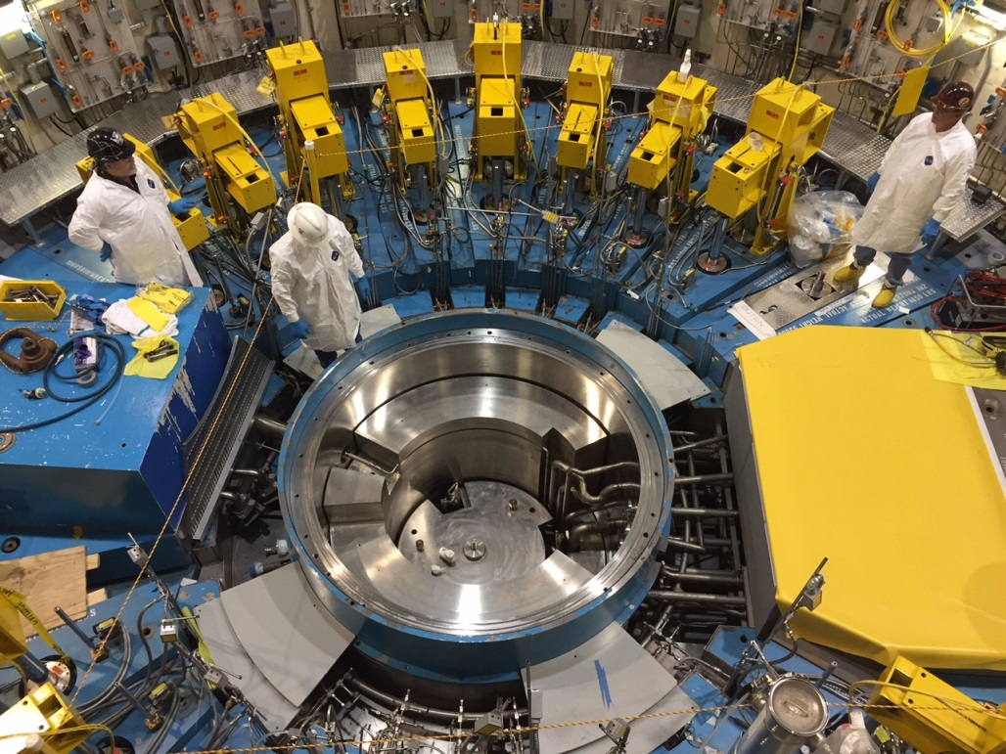
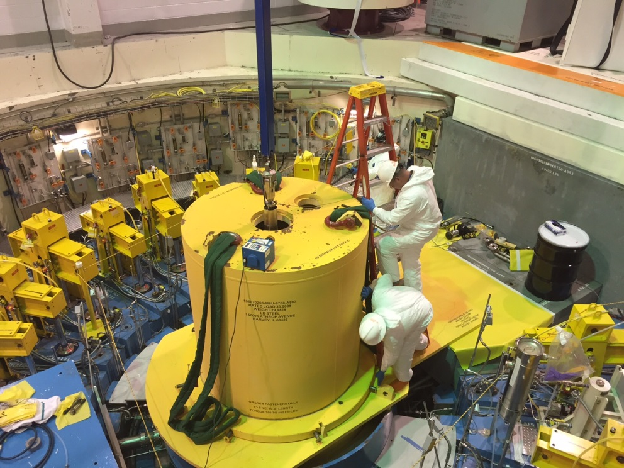
IRP-1 Removal Operations: Upper Segment
T4 - Dayton
Pipe Cutting
Upper Segment
Ready for Removal
Upper Segment pulled into
Shielded Cask

Slide 20
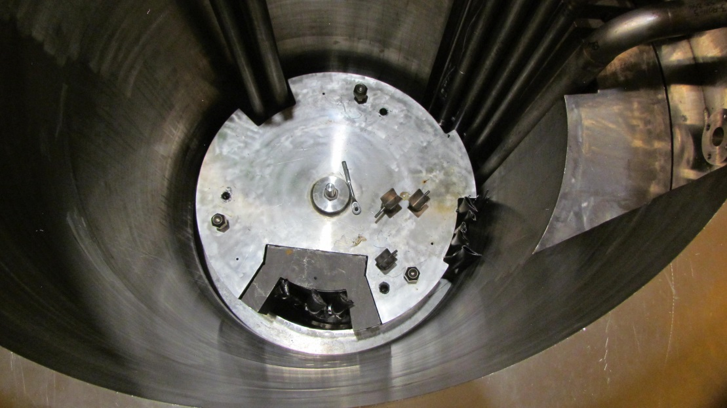
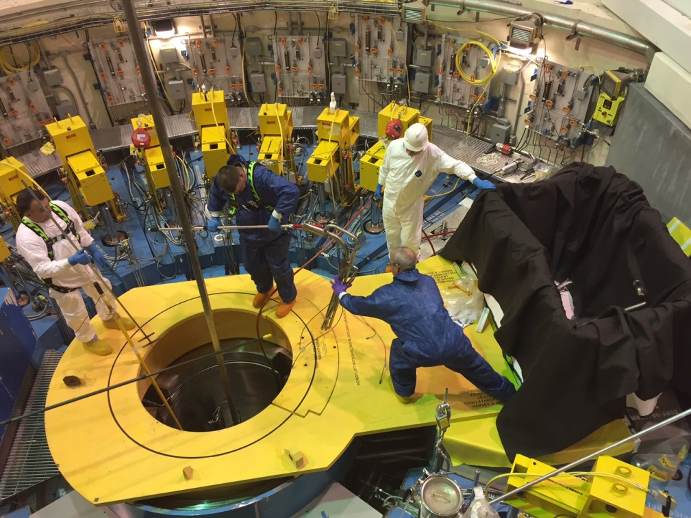
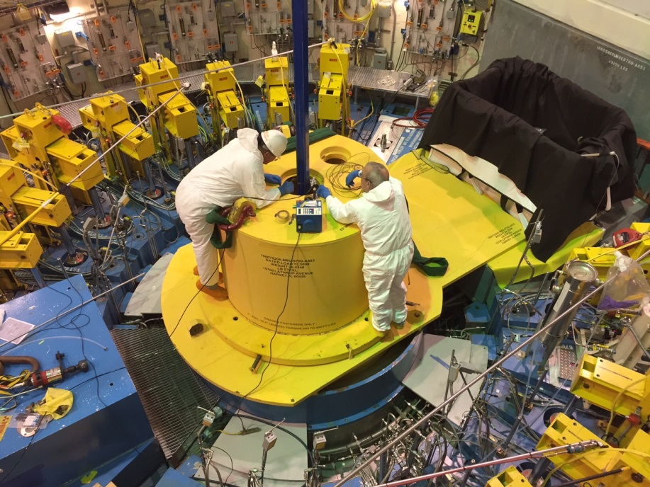
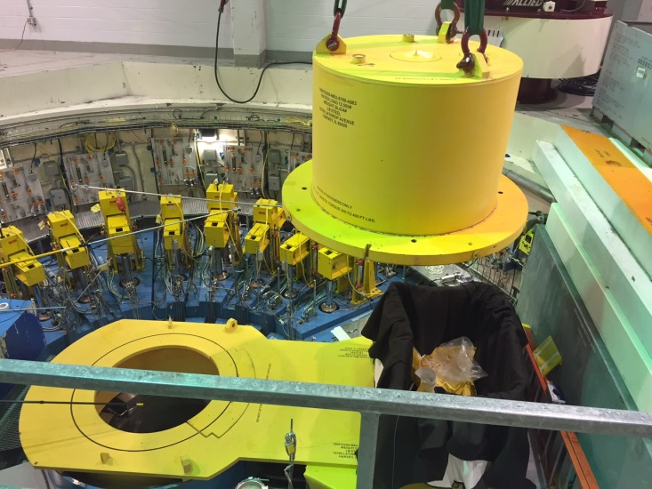
IRP-1 Removal Operations: Middle Segment
Middle Segment Ready for Removal
Pipe Cutting
Max Dose Rates:
~ 800 mrem/hr at opening to Core Vessel
Middle Segment
Cask Operations

Slide 21
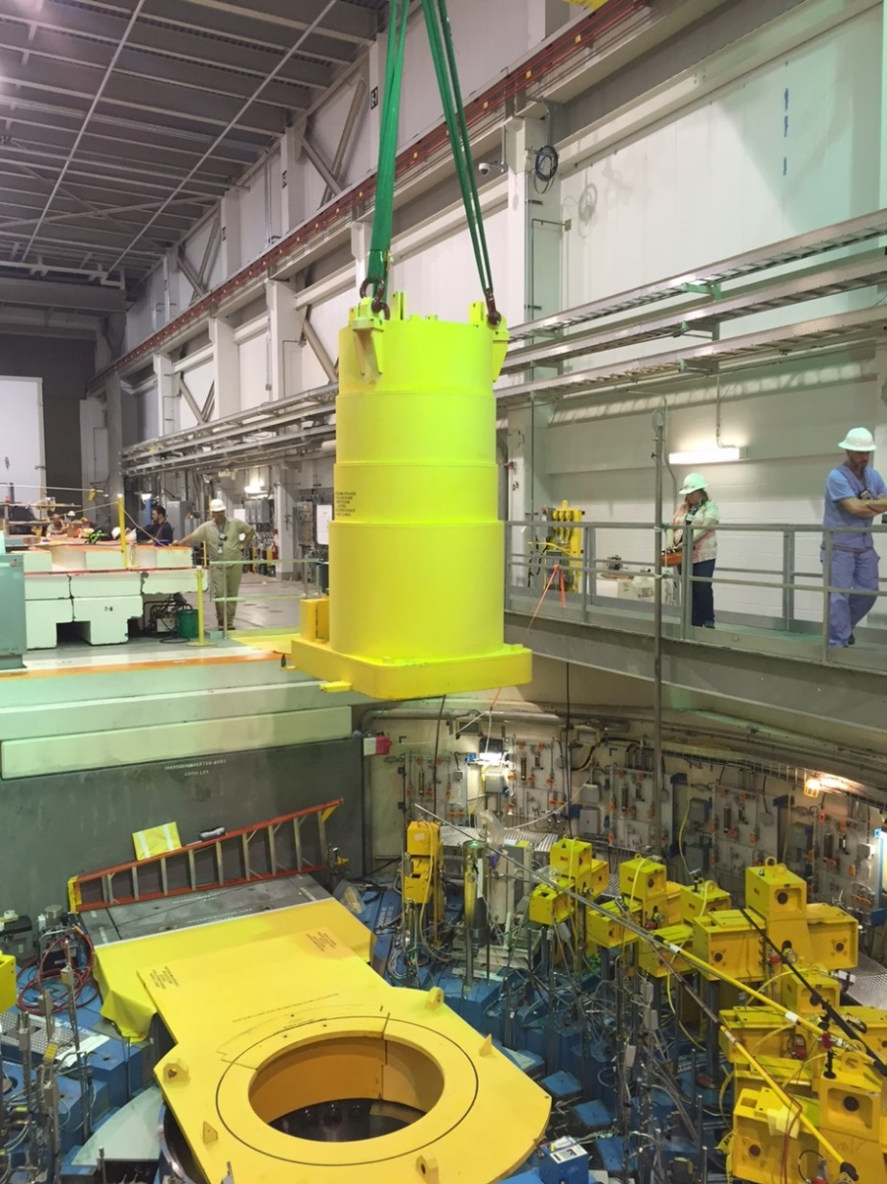
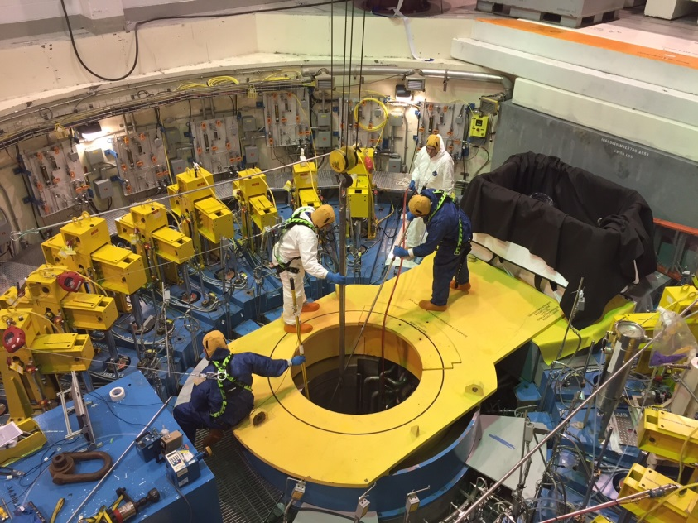
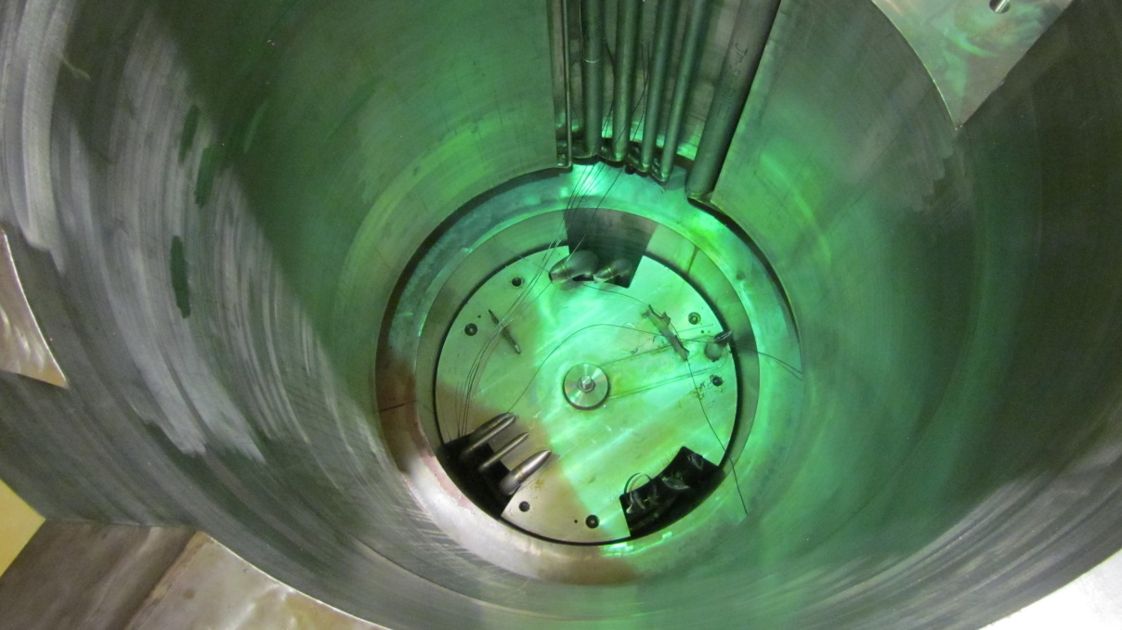
IRP-1 Removal Operations: Lower Segment
Pipe Cutting
Max Dose Rates:
~ 1000 mrem/hr at opening to Core Vessel
Lower Segment Cask
Lower Segment Ready for Removal

Slide 22
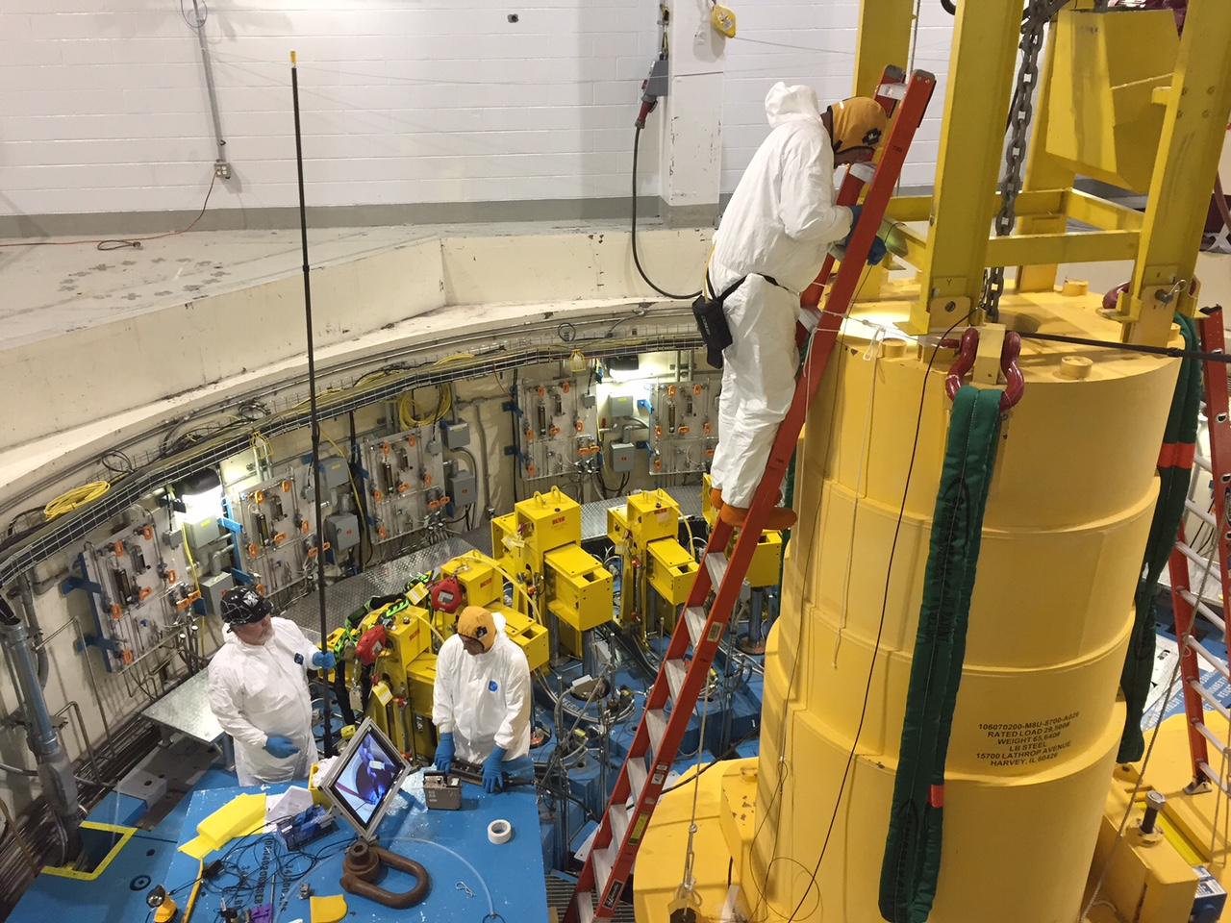
IRP-1 was successfully removed and stored in shielded casks
Technicians raise the lower IRP segment into its shielded cask.

Slide 23
IRP replacement activities enabled Core Vessel inspection
The recent replacement of IRP-1 provided the unique opportunity to visually inspect interior portions of the Core Vessel following ~15 months (~6500 MW-hrs) of operation with the presence of water in the vessel
Test Report 106070200-TR0001 documented the results of this inspection
Some observations of Core Vessel components (i.e. the Proton Beam Window and Core Vessel Inserts) necessitated an assessment of these components in light of their credited function under FSAD-NF Section 5.2.8

Slide 24
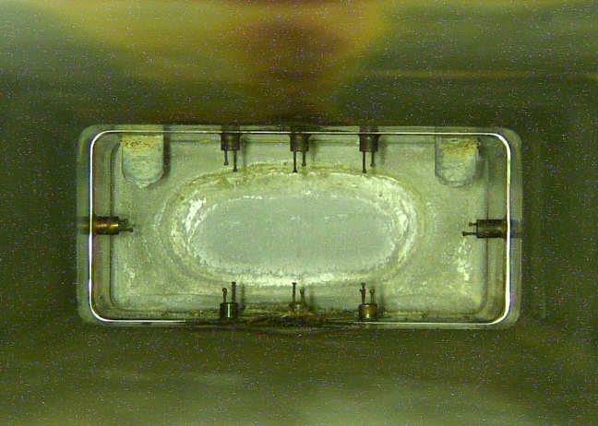
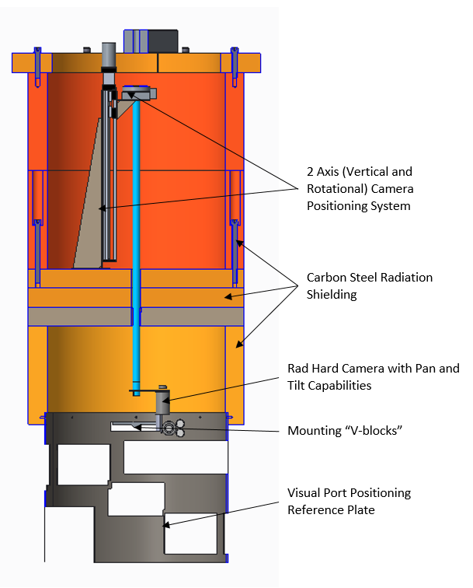
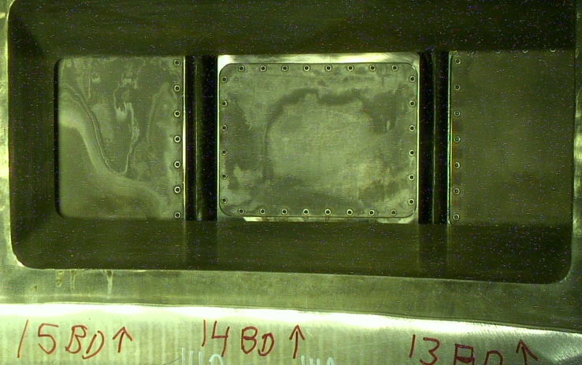
IRP inspection tool was used for examining the inside of the core vessel
T2 - McClintock
A view of the PBW. Corrosion or buildup can be seen on and around the PBW, the reflective mirrors, and the halo monitors.
Sectioned view of the IRP inspection tool.
Typical staining/discoloration of beamline windows (beamlines 15, 14B, 14A, and 13 are shown, from left to right, as examples). The discoloration appears to be superficial in nature.

Slide 25
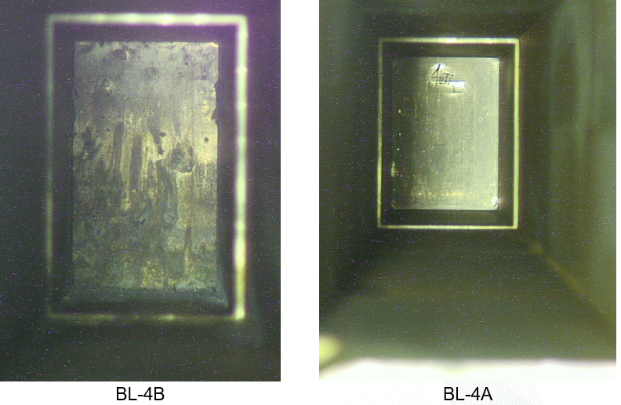
Inspection of Core Vessel Surfaces
A view of Beamlines 4B and 4A. Beamline 4A window appears to be in good condition. BL-4B window shows significant staining and/or pitting. It is likely that BL-4B window was affected by the IRP-1 water leak. The beam port for BL-4B is angled downwards, which enabled the port fill with water at the time of the leak.

Slide 26
Ability of the Core Vessel and components to perform credited function is not adversely impacted
FSAD-NF Section 5.2.8 defines the Core Vessel credited functions as:
“(1) retain liquid mercury in a confined location and (2) mitigate mercury vapor release inside the building”
The observed conditions do not adversely impact these functions as:
The PBW and CVIs are located above the height achievable by liquid mercury in a worst-case incident, therefore (1) is not affected
Mitigation of mercury vapor release inside the building (2) is not impacted due to:
Failure (leakage) of the window portion of the PBW would expose the Core Vessel atmosphere to the RTBT flight tube (accelerator) – not the inside of the Target Building
Failure (leakage) of the inner CVI windows does not expose the Core Vessel atmosphere to the building, but to an interstitial helium region that is isolated, pressurized and monitored
Each of these boundaries are actively monitored resulting in prompt discovery of a change in condition due to degradation. Any change would be further evaluated by engineering and operations personnel.

Slide 27
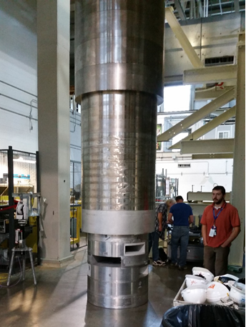
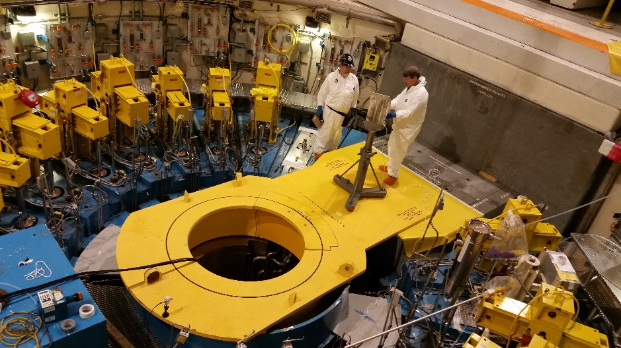
Challenges associated with IRP-2 alignment
Goal: Needed to align all corresponding ports between IRP and ORP, and wanted better clearance between target nose and edges of IRP target port.
Challenges: No “as-built” survey performed during initial installation in 2005, and radiation levels now preclude ordinary survey/alignment measurement methods. Had concerns that original installation might have involved some sort of “field-fit” modification.
Results: IRP-01 provided minimum target clearance of 0.097 inch. IRP-02 provides clearance of 0.224 inch.

Slide 28
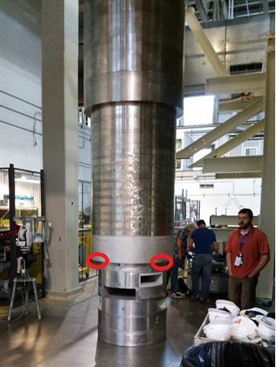
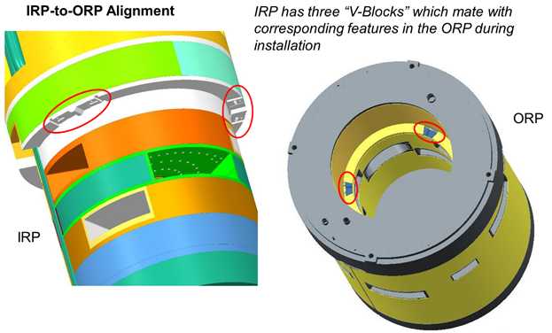
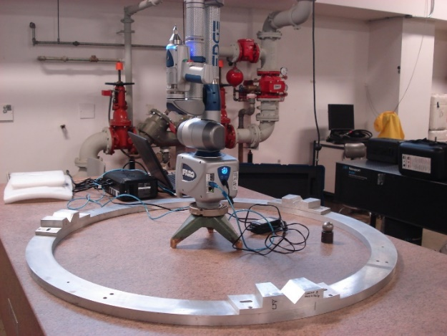
IRP - ORP alignment system
Positions and orientation of ORP V-block features were not documented during original installation by a regular “as-built” survey.
Instead, a fabricated “clocking ring” which was supposed to duplicate the geometry of the installed ORP.
Clocking ring showed unequal arc lengths, differing by up to 4 mm between arcs. (Turned out to be very wrong!)
However, this ring was used as the basis for setting the v-blocks on the IRP-2; no other information was available.
Clocking ring artifact showed large deviations from equiangular 120-degree design spacing of V-blocks.

Slide 29
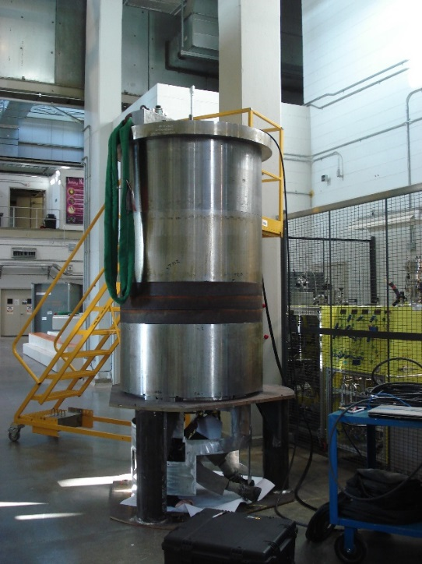
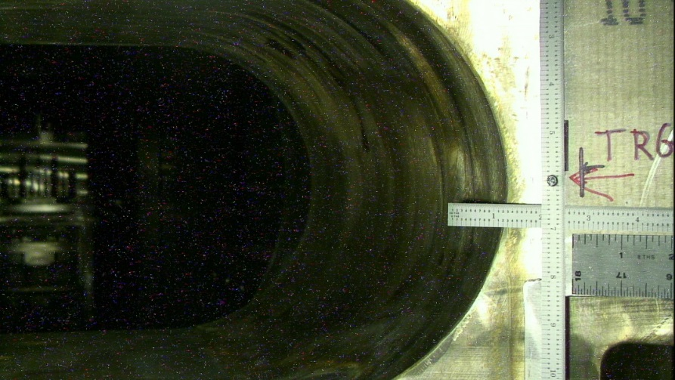
IRP Inspection Tool was used to gain confidence about the as-built configuration of the ORP/IRP configuration
Constructed a test fixture with v-block arrangement identical to that of the clocking ring.
Lowered into ORP and used a camera to read calibrated scales on the edges of the ORP ports.
This exercise indicated that a rotation of 0.3 degree would be needed to match the target port.
This rotation was applied to the v-blocks of the actual IRP, and it was installed.
Last half-inch of seating IRP-02 into the ORP was not smooth eventually engaging with a bang!
Measurements on top of IRP showed apparent slight rotation and lateral displacement from expected position.
Misalignment was clearly visible from cameras mounted on the target carriage.

Slide 30
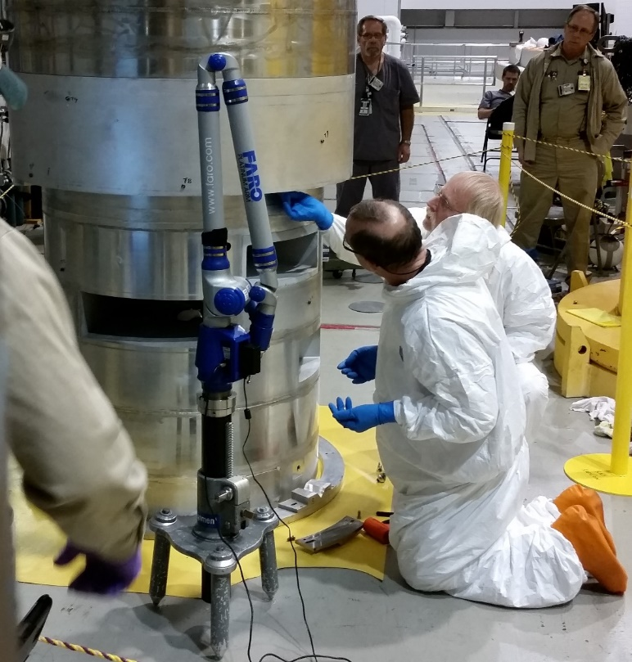
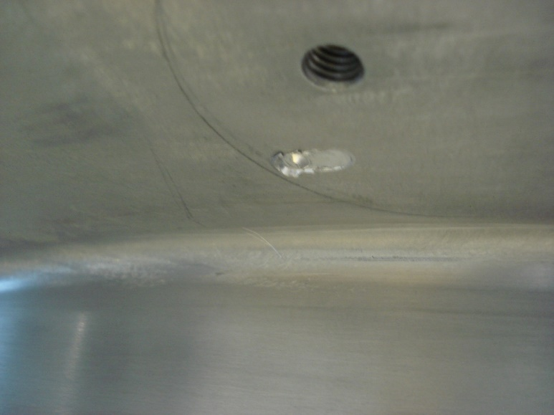
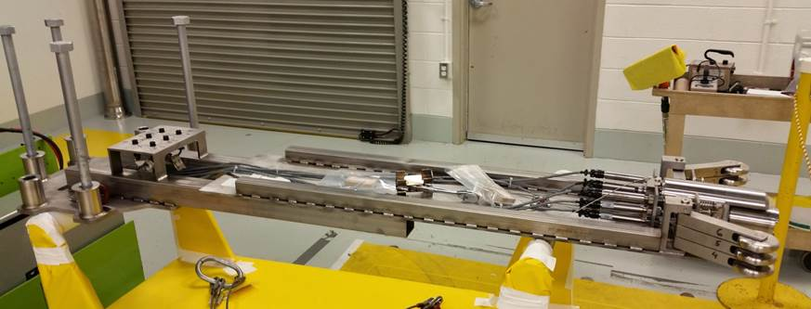
Verification of v-block slippage, and final alignment
Measurements by LVDT feelers on target carriage confirmed unexpected IRP clocking, which reduced target clearance to an unacceptable level.
Working with engineering, several lines of evidence indicated that the clocking ring was inaccurate.
Meeting held between NTD and RAD to present path forward agree that IRP-02 needed to be re-set.
IRP was removed and one v-block was found to have slipped by 0.25 inch during installation.
V-blocks were reset to their nominal 120-degree positions, biased with a small rotation about the PBW port to improve clearance at the Target port.
Reinstallation was smooth, and LVDT feelers confirmed that Target port clearance of IRP-02 is better than that of IRP-01.
Discovery of quarter-inch gouge left by sliding set-screw on IRP v-block.
LVDT inspection tool was mounted on target carriage to check target port clearance.

Slide 31
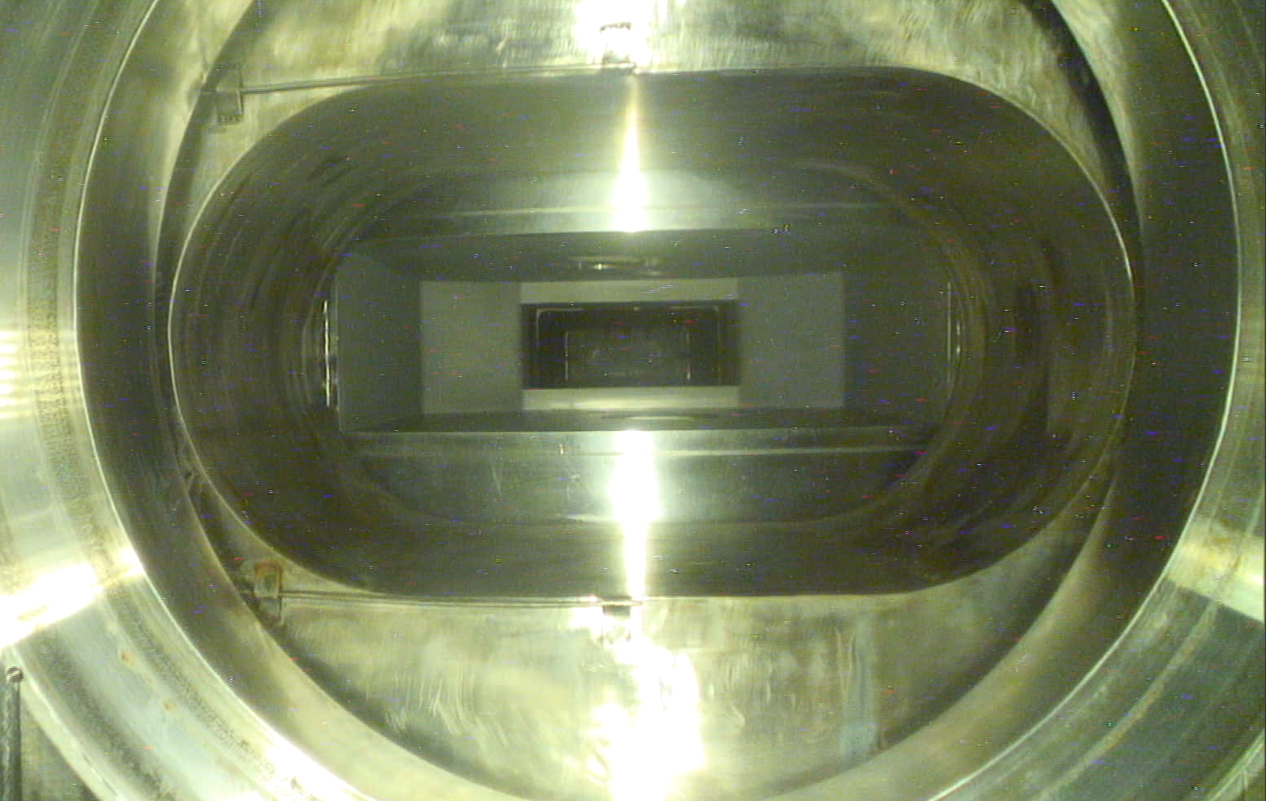
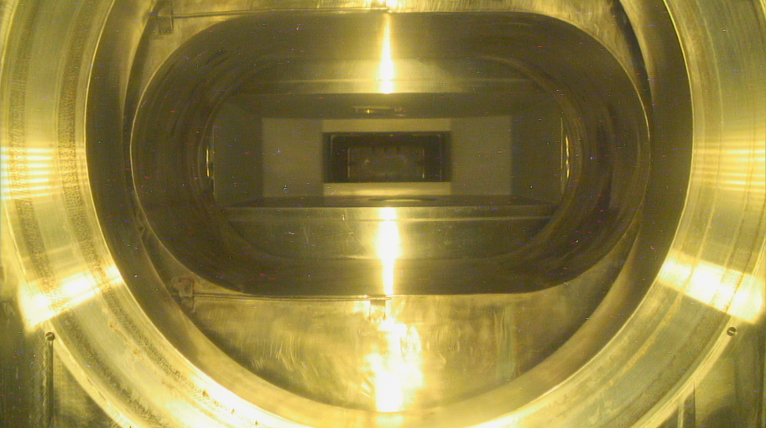
IRP-2 was successfully aligned
We now have a very good understanding of how to align future IRPs accurately.
ORP
Misalignment shown by exposed edges of IRP
IRP
Target flange
IRP-2 Image from target carriage after first installation.
IRP-2 Image from target carriage after correction.

Slide 32
Design of IRP-3: Lessons learned must translate into improved hardware and manufacturing processes
The goal is for a robust design for both manufacturing and operations, balanced by enhancements to neutronic performance
The new design and manufacturing plan must reduce likelihood and consequences of past problems
Water leaks
Ease of assembly and in-process testing
Welding
Survey & alignment issues
Concerns:
IRP fabrication is expensive and long lead
Operation of IRP-02 coincides with start of IRP-3 fabrication
SNS has no spare, nor any portion of a spare, so that a failure of this component could lead to a outage equal to the time for fabrication
T5 - Janney

Slide 33
The new IRP-3 design addresses past problems
Improvements to welding accessibility, preparations and processes
Change to cadmium application that will relieve tight tolerances impacting power limit
Piping layout within stack-up improved for access and assembly and mitigation of safety issues
Unnecessary metal is removed and geometries simplified
Minimize spaces for trapped water in the event of a future leak

Slide 34
IRP-3 procurement plan is tailored to address past risk and project management issues
T6 - Rosenblad
IRP-3 will be contracted as build to print rather than design and build
Work will be divided into 7 contracts rather than 2
This allows vendor choices to better match the type of work preformed and widens the pool of vendors
Reduces total risk and scope on a given vendor – problems in one area do not bleed across the entire project
Requires more SNS staff project management, which is planned and in place
Procurements begin with moderators and process development in FY18
Projected completion is 2022

Slide 35
Summary
IRP-1 completed a successful 12-year run with some inhibited performance over its extended life
IRP-2 arrived just in time and has been certified for operation
Design of IRP-3 is complete, and includes major changes to mitigate the operational and fabrication risks encountered with IRP-1 and IRP-2
IRP management and manufacturing plans are in final draft; manufacturing plan details procurement strategy with a view to controlling costs and improving assurance of on-time delivery

