Slide 1
The SNS Accelerator Improvement Program
Presented to the
SNS Accelerator Advisory Committee
George W. Dodson
RAD Deputy Director
May 15, 2018

Slide 2
Topics
Methodology to Evaluate RAD Projects and Priorities
Requirements for an Accelerator Improvement Project (AIP)
History of SNS AIP Projects
Current and Planned Project Funding and Funding History
Other Major Needs, not AIPs
Recent and Current AIPs
Approach to Spares
Summary

Slide 3
RAD Projects and Priorities
RAD Projects (AIPs, Upgrades, Major Spares, etc.) are evaluated against each other at regular intervals using the same methodology.
Criteria used to evaluate Projects include Performance Criteria and Risk Factors
  The Performance Criteria which are:
    Performance of Accelerator Facilities against the published schedule
    Operating Beam Power
    Capability
    External Drivers
    Obsolescence Mitigation
  The Risk Factors are the risks to achieving the sponsor’s goals if the AIP is not undertaken. This Total Risk is the product of these factors:
    A. Probability, the estimated frequency of downtime events if AIP is not undertaken
    B. Consequence, the estimated duration of downtime events if AIP is not undertaken

Slide 4
What are the DOE Requirements for an AIP Project and what do they address?
DOE provides AIP funds to SNS for additions, modifications, and improvements to the research accelerator and ancillary equipment facilities to maintain and improve the performance, reliability and efficiency of operations, and to provide new accelerator capabilities. This definition encompasses all systems involved with the production of neutrons for the individual SNS beamlines.
AIPs must result in a deliverable that can be identified and the deliverable must have an estimated cost greater than or equal to $500,000, less than $10,000,000 and a lifetime of at least 2 years. Fabrication of spares is not allowed in the AIP program (no spare Medium Beta Cryomodule).
Since ~2013, AIPs have begun shifting from addressing design problems with the original installed equipment to what the SNS needs for reliable, predictable operation at 1.4MW.
This includes a recent emphasis on Obsolescence Mitigation. This is important because we have been operating for 12 years.

Slide 5
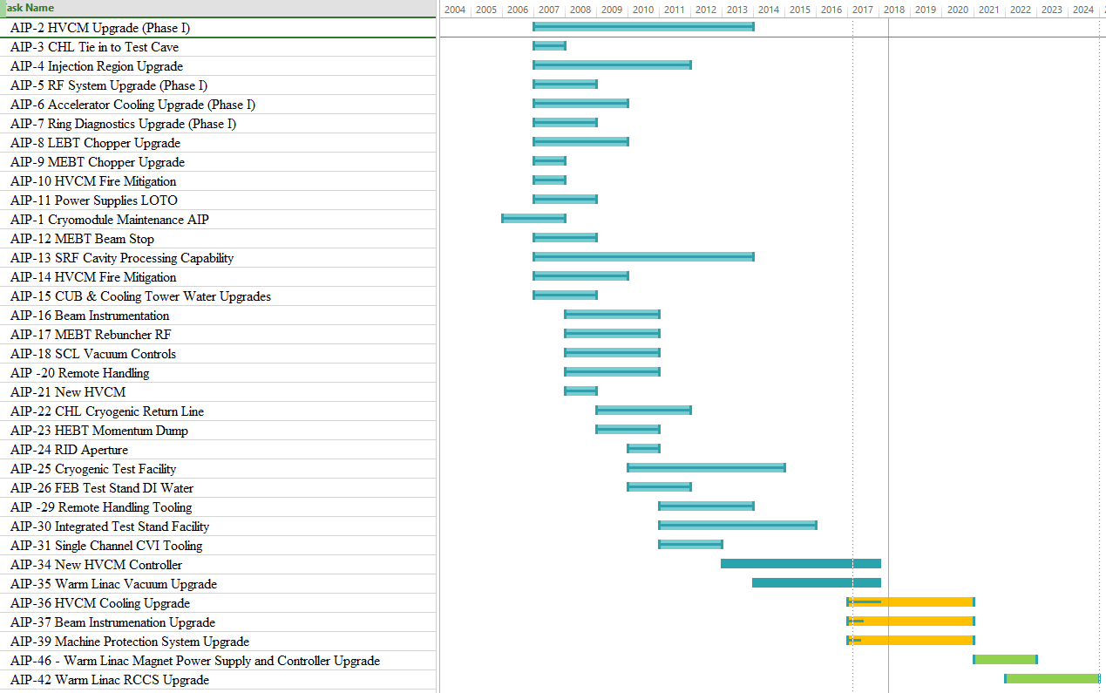
All Accelerator Improvement Projects Since 2006
Projects that are:
Completed
Underway
Future Projects

Slide 6
Current and Planned AIP Funding FY 2017 – 2018
AIP Number and Description | FY 17 $K |  |  |  | FY 2018 $K
 | FY 16 Carryover | FY 17 New BA | FY 17 Total Scheduled BA | FY 17 Costed and Committed | Rescheduled FY 17 Carryover | FY 18 New BA | FY 18 Total Scheduled BA | Projected Spending
AIP-34 New HVCM Controller | $ 77 | $ 143 | $ 220 | $ 104 | $ - | $ - | $ - | $ -
AIP-35 Warm Linac Vacuum | $ 719 | $ 700 | $ 1,419 | $ 1,041 | $ - | $ - | $ - | $ -
AIP-36 HVCM Cooling Upgrade | $ - | $ 663 | $ 663 | $ 330 | $ 499 | $ 790 | $ 1,289 | $ 1,142
AIP-37 Beam Instrumentation Improvements | $ - | $ 404 | $ 404 | $ 383 | $ 187 | $ 790 | $ 977 | $ 1,274
AIP 39 Machine Protection System Improvements | $ - | $ 233 | $ 233 | $ 134 | $ 265 | $ 420 | $ 685 | $ 435
AIP- 46 Linac Magnet Power Supply & Controller Upgrade | $ - | $ - | $ - | $ - | $ - | $ - | $ - | $ -
AIP-42 Warm Linac Resonance Control System (RCCCS) Upgrade | $ - | $ - | $ - | $ - | $ - | $ - | $ - | $ -
AIP-38 Warm Linac DTL and CCL RF Couplers | $ - | $ - | $ - | $ - | $ - | $ - | $ - | $ -
Subtotal Accelerator Improvement (AIP) | $ 795 | $ 2,143 | $ 2,938 | $ 1,993 | $ 951 | $ 2,000 | $ 2,951 | $ 2,852
New Funding
We received the new FY 2017 New Funds with 6 weeks left in the FY!
We costed/committed ~ $1.993 M in AIP funds in FY17, $848 K of that on New Starts. We had $951K in carryover.
Completed AIP 34, the Warm Linac Vacuum
Completed AIP-35, the New HVCM Controller
Started AIP 36, the New HVCM Cooling Upgrade
Started AIP 37, the Beam Instrumentation Improvement Upgrade
Started AIP 39, the Machine Protection System Upgrade

Slide 7
Planned AIP Funding FY 2019 - 2022
AIP Number and Description | FY 2019 $K |  |  | FY 20 $K | FY 21 $K | FY 22 $K
 | Projected Carryover | FY 19 New BA | FY 19 Total Scheduled BA | FY 20 Total Scheduled BA | FY 21 Total Scheduled BA | FY 21 Total Scheduled BA
AIP-34 New HVCM Controller | $ - | $ - | $ - | $ - | $ - | $ -
AIP-35 Warm Linac Vacuum | $ - | $ - | $ - | $ - | $ - | $ -
AIP-36 HVCM Cooling Upgrade | $ 311 | $ 634 | $ 945 | $ 718 | $ 41 | $ -
AIP-37 Beam Instrumentation Improvements | $ 80 | $ 634 | $ 554 | $ 718 | $ 953 | $ -
AIP 39 Machine Protection System Improvements | $ 217 | $ 733 | $ 950 | $ 564 | $ 206 | $ -
AIP- 46 Linac Magnet Power Supply & Controller Upgrade | $ - | $ 500 | $ 500 | $ 500 | $ 1,000 | $ 1,200
AIP-42 Warm Linac Resonance Control System (RCCCS) Upgrade | $ - | $ - | $ - | $ 500 | $ 800 | $ 1,200
AIP-38 Warm Linac DTL and CCL RF Couplers | $ - | $ - | $ - | $ - | $ 500 | $ 1,100
Subtotal Accelerator Improvement (AIP) | $ 448 | $ 2,500 | $ 2,948 | $ 3,000 | $ 3,500 | $ 3,500
The 3 new starts in 2017 will consume all AIP funds until 2021 at the current level of AIP funding, $2M per year; we are proposing growth in AIP funding from FY 2019 to FY 2021 by $.5M/Yr until we reach $3.5M/Yr in FY 2021.
In FY 2019 we plan to start: AIP 46, Warm Linac Magnet Power Supply and Controller Upgrade then add dedicated projects targeted at Obsolescence Mitigation using these funding increases.

Slide 8
AIP Funding and Spending History FY 2007-2017

Slide 9
Other Major Needs, Spares and Upgrades – Not AIPs
Spare Medium Beta Cryomodule $1,700K
CCL Klystron Second Vendor Startup $2,000K
Spare CCL Klystrons $4,000K
Replacement Remote Handling Robot $10,000K
Shutter Rods Replacements $1,200K
Projects |  | FY 18 | FY 19 | FY 20 | FY 21 | FY 22 | FY 23 | FY 24 | Project Identifier
Total |  | $ 3,588 | $ 4,770 | $ 4,044 | $ 4,106 | $ 4,020 | $ 2,045 | $ 790
Mechanical Systems |  | $ 923 | $ 2,170 | $ 2,224 | $ 2,286 | $ 2,200 | $ 225 | $ 790
 | Servo-Manipulator Replacement | $ 603 | $ 1,850 | $ 1,904 | $ 1,966 | $ 2,200 | $ 225 | $ 790 | MSO-13
 | Shutter Rods | $ 320 | $ 320 | $ 320 | $ 320 | $ - | $ - | $ - | MSO-28
Spare Medium Beta Cryomodule |  | $ 1,000 | $ 700 | $ - | $ - | $ - | $ -
Normal Conducting Linac Klystrons |  | $ 1,665 | $ 1,900 | $ 1,820 | $ 1,820 | $ 1,820 | $ 1,820 | $ -
 | DTL 402.5MHz | $ 765 | $ 1,000 | $ 920 | $ 920 | $ 920 | $ 920 | $ - | EERF-10
 | CCL 805 MHz | $ 900 | $ 900 | $ 900 | $ 900 | $ 900 | $ 900 | $ - | EERF-10

Slide 10
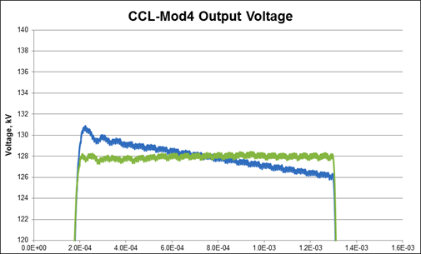

AIP-34 Added HVCM Pulse Feedback for Pulse Flattening and Droop Elimination for RF Control Margin
Completed in 2017
Originally, the HVCMs ran as “Open Loop” pulse forming networks with no feedback. High voltage pulse droop reduced RF control margin at the end of the pulse.
A new HVCM Controller, with pulse feedback control to reduce droop and produce consistent, flat pulses was developed, tested and deployed. The new controller has many new features including fault logs and high resolution waveform capture diagnostics. Spare channels, in the controller interface were used to integrate with the new HVCM cooling system (AIP-39) to permit monitoring and alarming of oil parameters, including dissolved gas.
In the 2017 summer outage the last 4 HVCM controllers were installed in production modulators and the test stands.
Overshoot / ringing at the beginning of the pulse was reduced to mitigate cavity and LLRF performance issues. This resulted in pulse flatness and ringing reduced to less than 1% over the entire pulse, a reduction of factor of 10 in droop, thus improving RF control margin.
New controller with feedback

Slide 11
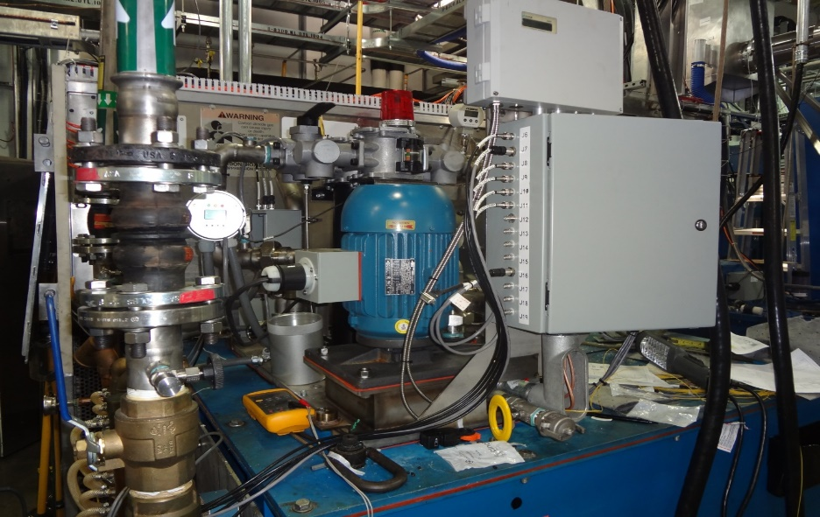
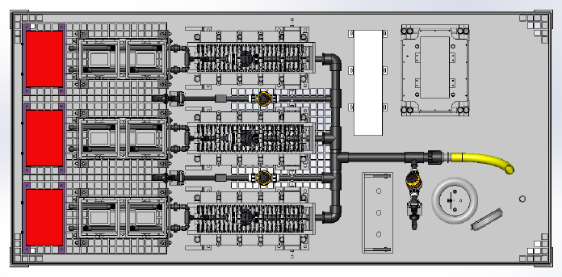
AIP-36 Addressed multiple HVCM Cooling System issues for Performance and Higher Reliability
New Start in FY2016, Underway
Dramatically improved cooling to reduce component overheating damage
Reduce oil degradation and downtime due to improved oil flow, external pump, heat exchanger and oil filter(s).
The first four HVCM cooling units were fabricated and were installed internal cooling piping during the FY18 Winter Outage as scheduled on modulators HVCM-RFQ, HVCM-DTL-3, HVCM-DTL-5 and HVCM-SCL-21.

Slide 12
AIP-36 HVCM Cooling System Upgrade addressed Performance and Reliability
  More reliable self priming vertical pump with higher capacity
  Pump/motor assembly can be changed without removing other components
  Filters can be swapped during operation without interruption
  Larger capacity heat exchanger
  Tank internal cooling piping has been redesigned to eliminate hot spots and direct oil to the critical areas for improved heat transfer.
  Oil Flow has improved by 300% to 46 GPM and does not decrease during operation due to clogging, causing thermal runaway
  Heat removal to the cooling water increased from 6KW to 61KW
  Internal surface temperatures have dropped to well below the design requirements

Slide 13
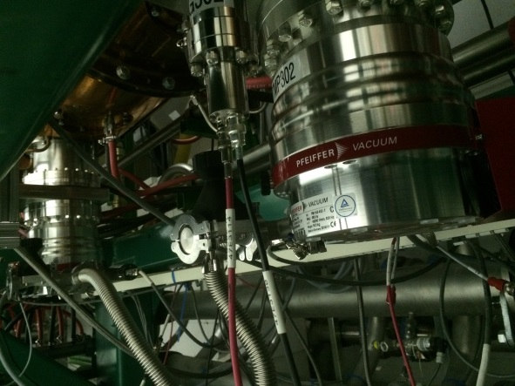
AIP-35 Warm Linac Vacuum Upgrade of the DTL, CCL and MEBT for Increased Reliability
Upgrades were completed in 2017
The large DTL and CCL are large accelerating structures, each with many “O” Rings. Ion Pumps were replaced with large Turbopumps more suited to the high gas load.
This reduced the number of RF Trips due to vacuum bursts which each took ~30 minutes to recover by almost a factor of 6. RF conditioning time was reduced by roughly a factor of 2, 4.5 days vs. 8.7 days for a RF window.
 | 2013 to 2015 Before Upgrade | 2015 to 2018 After Upgrade
Downtime Hours | 106 | 18
% of total downtime | 3.90% | 1.24%
Number of events | 246 | 40
Total beam hours | 16,447.7 | 15,679.9

Slide 14
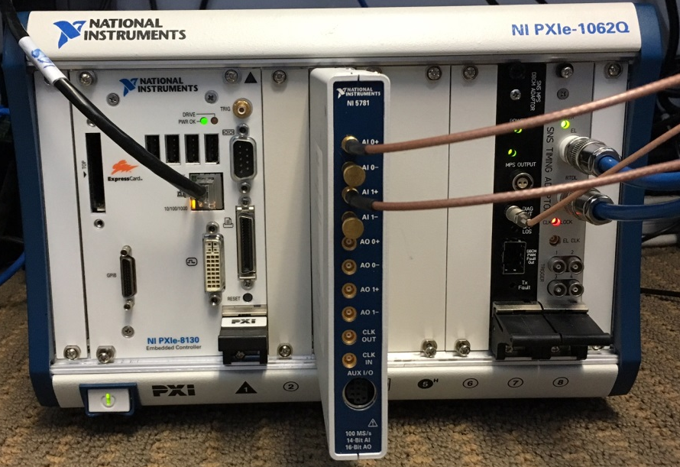
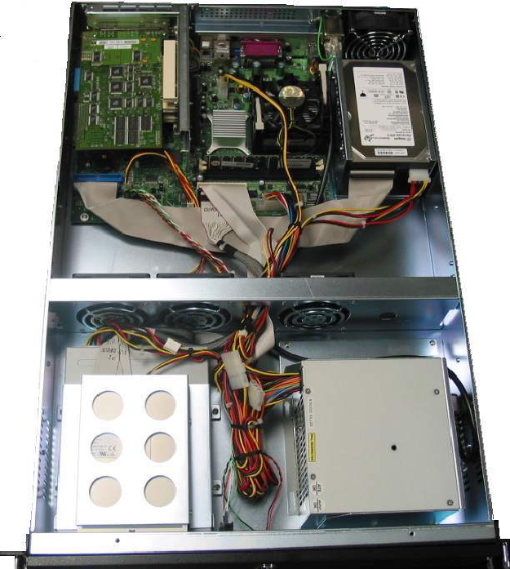
AIP-37 Beam Instrumentation Infrastructure Upgrade for Obsolescence Mitigation, Performance and Reliability
AIP 37 - New Start in FY2017, Underway
Replace obsolescent custom components for all SNS beamlines Beam Position Monitors and Beam Loss Monitors with a COTS solution. In FY 2027 we:
Procured, assembled, installed, tested and calibrated 26 sets of the Linac style BPM electronics (10 in DTL, 10 in CCL, 6 in SCL)
Procured, assembled, installed, tested and calibrated 16 sets of the Ring style BPM electronics
Procured 6 sets of Linac style (SCL) and 8 sets of Ring style BPM electronics to be installed during summer 2018 shutdown.
Obsolete Custom IBM-PC XP-OS Motherboard dead-end system
replaced by
NI COTS PXIe and FlexRIO with a
RT-OS and an upgrade path

Slide 15
AIP-39 Machine Protection System (MPS) for Reliability, Sustainability and Obsolescence Mitigation
New Start in FY2017, Underway
Legacy System
Decreasing Reliability due to aging hardware, increasing failure rates and lack of integration
Declining Maintainability due to increased failure rates and reduced spares inventory where component obsolescence prohibits obtaining adequate supply of spares
Limited Scalability where the current system lacks capacity to be extended for PPU/STS and has limited diagnostics and capacity for developing improvements
New System
Reliable and Maintainable with simplified and efficient architecture that is Highly integrated with Improved Performance, Lower latency communication links and a Scalable Architecture
  MicroTCA-based platform, a viable path for major facility upgrades — PPU & STS

Slide 16
AIP-39 Machine Protection System (MPS) for Reliability, Sustainability and Obsolescence Mitigation (cont.)
Within the first few weeks, placed for the commercial components that make up the MPS Master, including the crate, power supplies, MicroTCA Controller Hardware (MCH), Processor Controller (PC), Crossbar Switch (CBS), Field Node interface modules (x3), and Trigger Control components (x1). The custom electronics for the Master build out where also ordered. These include the modules required to interface the SNS timing interface, pulse width and repetition rate controls.
All of the MPS hardware components are compliant with the PICMG open architecture.
Installation of the MPS Master components was carried out during the week of April 9th 2018. The commissioning of the MPS Master will occur during the initial accelerator physics studies when they become available.

Slide 17
Future Improvements Planned Using AIP Funding
AIP-46 - Warm Linac Magnet Power Supply and Controller Upgrade – Future
    Replace obsolescent components, standardize power supplies and controllers for MEBT, DTL and CCL
    Power Supplies and Controllers are specified
AIP-42 Warm Linac RCCS Upgrade– Future
    Will add redundant pumps, increased capacity, flexibility, instruments and controls for full current beam operation and the capacity to increase for the future PPU needs

Slide 18
Spares
For spares, we are working to develop a calculational basis for the number of spares needed for each asset class (Manufacturer and Model Number) by examining the failure rate data over the past 11 years. These data will be used:
  Assist the hardware teams in determining if engineering changes would be enhance reliability.
  As inputs to a Reliability Modeling code to calculate the number of spares on-hand to prevent an “Out of Stock” condition that would interrupt operation.
  To determine the actual MTBF and primary failure modes of each asset class to predict the onset of Terminal Mortality

Slide 19
Summary
We control an active AIP Process.
AIPs have shifted over the years from addressing strictly design problems with the original equipment base to what we need for sustainable operation, including an increasing emphasis on Obsolescence Mitigation.
With an installed equipment base of ~$700M, an AIP budget of $2.0 M/Year is not sustainable. We are proposing growth in AIP funding beginning in FY 2019 by $.5M/Yr until we reach $3.5M/Yr in FY 2021.

Slide 20
AIP-34 Additional Information
AIP-34 Status Summary
AIP-34, the New HVCM Controller, was completed during the Summer outage of 2017. The final four controllers were installed in SCL-Mod9, SCL-Mod12, SCL-Mod15 and SCL-Mod21. The entire Klystron Gallery has been fully operational with the new controllers since resumption of operations.
EPICS screens have been created to mimic the local HMI. Operators have been trained on the use of the new capabilities associated with the new HVCM controllers. Additionally, a server site was established to provide fault log and fault waveform data outside of the accelerator network whenever a fault occurs or on demand by the operators. This has proved invaluable to troubleshoot problems with HVCM systems either after the event (for random non-reproducible events) or from a remote location during emergency repairs.
Technicians have been trained on the new features of the new controller. With all diagnostics now available as high-resolution waveforms, the ability to troubleshoot and pinpoint problems is significantly improved. This, combined with true first fault indication, minimizes repair time during unplanned maintenance events.
Several software upgrades have taken place since the initial installation. The local HMI has been improved based on feedback from users and operators. New features have been added consistent with modifications and/or upgrades to other hardware, mainly the IGBT drivers, to permit enhanced functionality. Patches and fixes have been added to address networking and channel access issues. The code continues to be optimized to improve Windows and FPGA resource usage. The original FPGA virtual instruments, supplied by Averna, have also been modified to improve overall efficiency of the program. Utilizing spare channels, the new HVCM cooling system instrumentation has been integrated into the controller (and through EPICS screens) to permit monitoring and alarming of oil parameters, including dissolved gas.

Slide 21
AIP-34 Additional Information - Continued
Pulse flattening efforts have been underway since the capabilities have been available during the new controller prototyping effort, but all production HVCMs were pulse flattened in the fall of 2017. These efforts focused on minimizing pulse droop but did not address overshoot and ringing that occurred after the risetime of the pulse. Late in CY2017 a campaign was implemented to optimize the overshoot / ringing at the beginning of the pulse to mitigate cavity and LLRF performance issues. At the conclusion of the 2nd optimization effort, pulse flatness and ringing were each reduced to less than 1% over the entire pulse.
An effort has been initiated to expand the capabilities of the new controller for other applications. Currently, use of the controller as a mobile test stand for acquiring a variety of cavity, LLRF and HPRF signals is under evaluation. The system was evaluated during a recent event to acquire signals from multiple RF systems and the results were encouraging.
Additional ongoing activities are focused on expanding the capability of the system to address test stand needs and find alternatives for obsolescent hardware. While none of the original hardware is currently obsolete, National Instruments has warned that this could take place in the next year or two for the PXI-78XX family. The SNS currently possesses sufficient spares to keep the controllers operational for several years, giving us sufficient time to address any future obsolescence issues.

Slide 22
AIP-34 Additional Information
In 2017, we completed the last installation phase of AIP35. This effort consisted of completing the installation for CCL 1 and CCL 2. Previously, the systems for CCL 3, CCL 4, and all the DTL tanks were upgraded. The heart of the new pumping system design for the DTL and CCL structures consists of 3 turbo pumps on each DTL tank, 6 on each CCL tank, and 1 turbo pump on each RF window, which replace the ion and NEG pumps respectively. Each turbo pump is a hybrid bearing design with a drag stage and a nominal pumping speed for air of 700 L/s. This pump size and configuration was selected because it most closely matches the respective conductances of the RF shields on the pumping ports as well as matches the existing port flange type and size. The turbo pumps have remote mounted controllers in cabinets in the klystron gallery, which also houses the vacuum gauge controllers and PLC for the entire system.
Each turbo pump is isolated from its respective tank as well as the common foreline manifold by appropriately sized electro-pneumatic vacuum valves. These valves can be automatically closed in the event of a turbo pump fault or if the pressure in either the tank or foreline fall outside of normal operational parameters. Pressure transducers in the foreline and on the turbo inlet monitor the local pressures and are interlocked to the operation of the turbo pump as well as the isolation valves. A partial schematic representation of this configuration is shown in Figure 1
The new vacuum system for the DTL and CCL tanks is monitored and controlled through the existing three-layer control system architecture. New dedicated PLC controllers for the vacuum components on each tank replace the original PLC control systems and communicate with an EPICS Input Output Controller (IOC) that oversees multiple systems. In turn, a machine operator interface is provided through LINUX consoles.
In summary, the operation of the warm l
Linac vacuum system has improved since the completion of AIP 35. Downtime related to vacuum issues throughout the warm Linac has been greatly reduced. Below is a table summarizing downtime before and after the upgrade to the DTL systems:

Slide 23
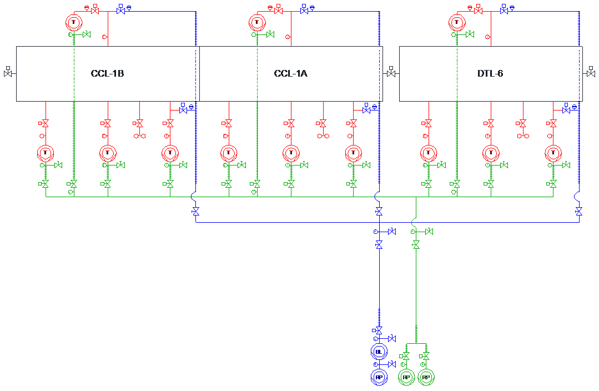
Additional Information

