Slide 1
2 MW Target Development
& PPU Upgrade Plans
Presented at the
SNS Accelerator & Target
Advisory Committee Meeting
Bernie Riemer
PPU FTS Systems Manager, R&D Manager
May 16, 2018
Notes:
2018.05.11

Slide 2
Outline
Charges 10, 11
Review of PPU First Target Station (FTS) Systems and Gas Injection R&D scope
PPU 2MW Target Development Plan goals
Building upon GI3 success, increasing target gas rate
Early use of a PPU target
Jet-flow damage mitigation
Gas wall: efficacy vs. design complexity
PPU 2 MW Design concepts
Progress on DES development
Moderator system upgrades – ortho → para LH2 catalysts and diagnostics

Slide 3
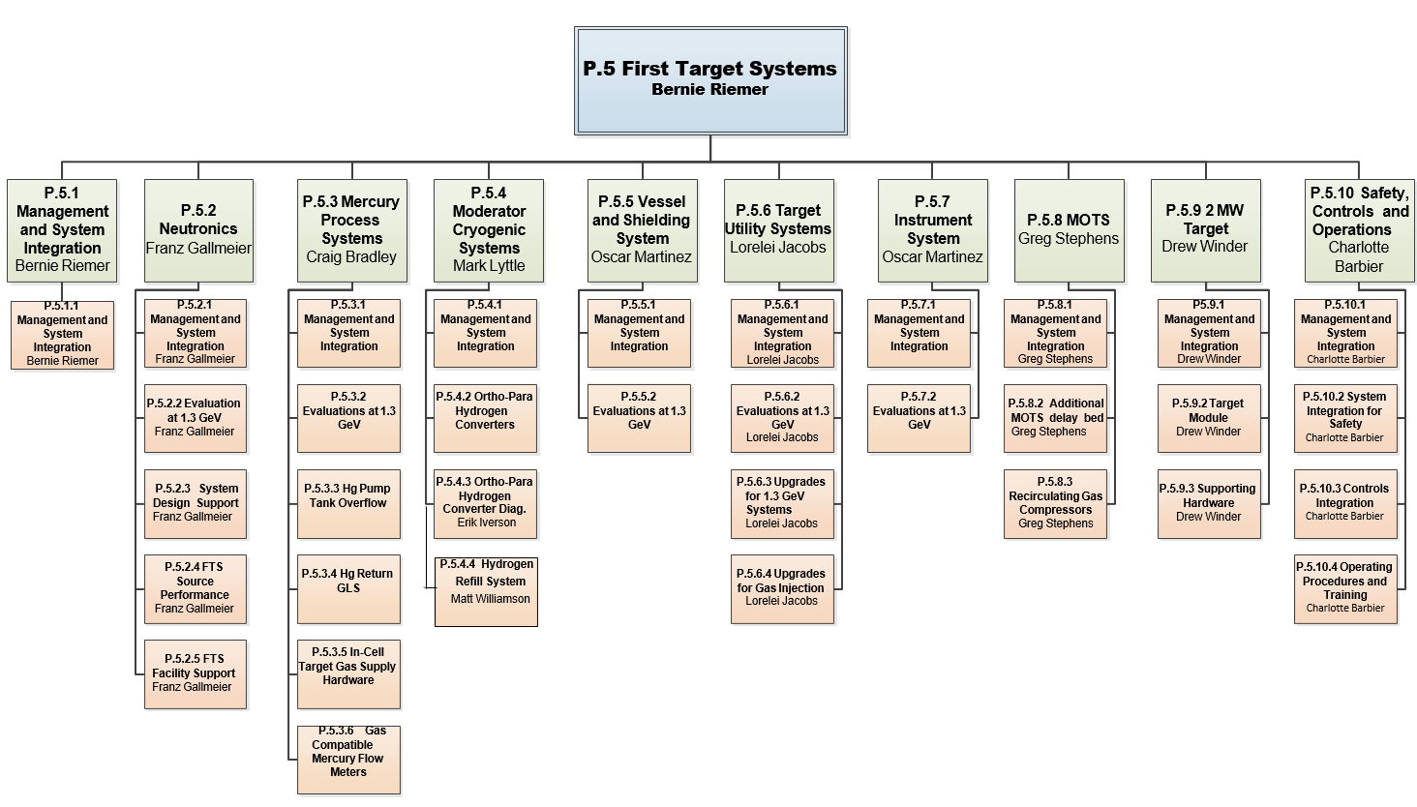
PPU P.5 – FTS Systems scope is more than the target
Requirement is to assure reliable operation of the First Target Station at 1.3 GeV, for at least 2.0 MW, at 60 Hz
Target consumption rate of no more than 4 per year
  1,250 hours per target

Slide 4
PPU P.7.1 – R&D for target gas injection
PPU gas injection R&D is addressing:
  Swirl bubbler design & performance
  Bubbler gas rate
  Gas wall design & gas rate
  Gas hold-up characterization in mercury process loop
  Gas gas-liquid separator design
A combination of experiments and simulations is being employed
Maximum envisioned PPU total gas flow is 20 standard liters per minute – small bubbles & gas wall
  Likely will be less
Gas injection R&D talk by Charlotte Barbier
T8 - Barbier

Slide 5
PPU 2 MW Target Development Plan goals
Small gas bubble injection
  Establish a population of small gas bubbles in the spallation zone of the target with volume fraction of > 10⁻⁴ with bubble sizes < R=0.15 mm
Protective gas wall
  Feature not used in 1.4 MW targets
  Robust design for the gas wall and its supply needed with acceptable fabrication risk
Mercury vessel design improvements before gas injection benefits
Prevent liquid mercury from escaping service bay
T8 - Barbier
Charge 10
Notes:
Small Gas Bubble Injection:
Establish a population of small gas bubbles in the spallation zone of the target with volume fraction of > 10⁻⁴ with bubble sizes < R=0.15 mm
Add pulse fatigue life margin and reduce cavitation damage
Bubble production goal has already been demonstrated in TTF with swirl bubblers!
Larger bubbles are also beneficial, particularly for strain reduction away from front of target
Protective Gas Wall:
Create a protective gas wall with > 60% time-averaged gas coverage over the center ~half of the inner window surface facing the bulk mercury volume
Robust design for the gas wall and its supply needed with acceptable fabrication risk
Mercury Vessel Design Improvements:
Minimize pulse fatigue stress through vessel design changes before consideration of gas injection
Minimize thermal fatigue by mercury flow improvement and design changes that further reduce thermal stress
Mitigate cavitation erosion by establishing shear flow at the vessel wall where damage potential is high
Safety:
Effective mitigation of hazards associated with high-flow gas injection and timely authorization for PPU target operation

Slide 6
Gas flow rates for PPU bubblers and gas wall will be guided by R&D and operational outcomes
Outcomes from current operations are vital for PPU 2 MW target success
With 1.4 MW operations and increasing gas rates, we will
  evaluate improvements in erosion and strain
  evaluate effects on process loop behavior
    risk of pump tank overflow
    pressure losses vs. required pump head
  evaluate off-gas emissions and radiological hazards
Notes:
Thin out – take out sub-bullets – speak to those points
Timeline of final design – initiates before R&D and operational goals are complete

Slide 7
PPU will build upon GI3 success and future gas injection outcomes with 1.4 MW / 1.0 GeV
Successful commissioning of GI3 demonstrated significant strain reductions with an injected gas rate below 0.5 SLPM
  Strain reductions were greater with higher gas rates
GI3 target cavitation erosion is under assessment
  Inner window was not cracked, but a few through-holes in center of inner window
We intend to maximize fatigue life margin for the PPU target with more gas
T3+ - Winder
T2 - McClintock
Notes:
GI3 showed more gas = more strain reduction;

Slide 8
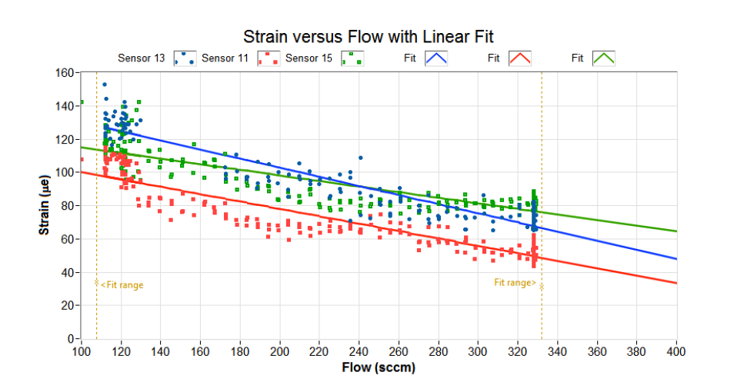
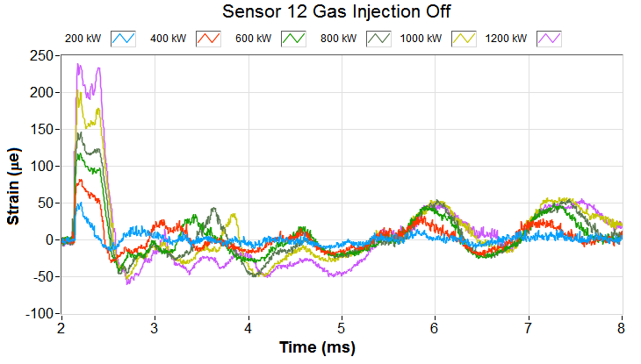
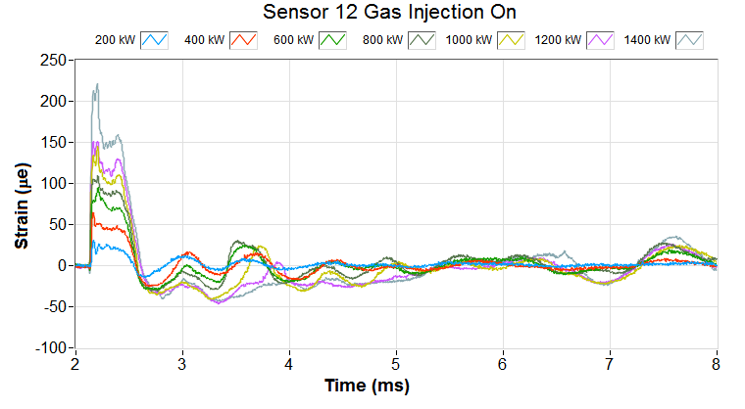
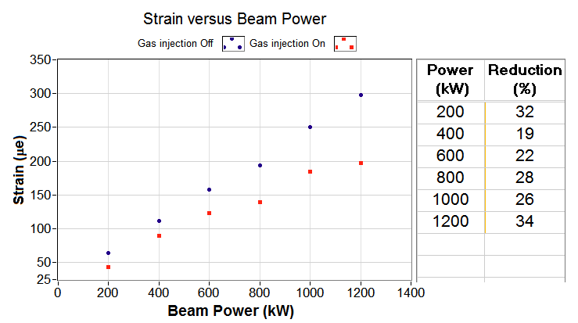
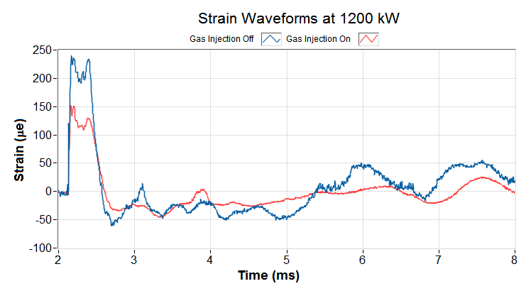
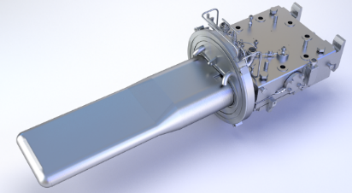
GI3 gas injection demonstrated from ~ 10% to 60% strain reduction with T-18
Injected gas rate 0.45 – 0.23 SLPM
More gas = strain reduced more
T3+ - Winder
Gas off
Gas on
Reductions are very encouraging
Further & more uniform reductions around the target are possible
PPU goal is to maximize margin
Sensor 12
Notes:
It is too early to judge whether this is enough / close to enough strain mitigation.
The ‘how much strain mitigation is enough’ question is not easily answered.

Slide 9
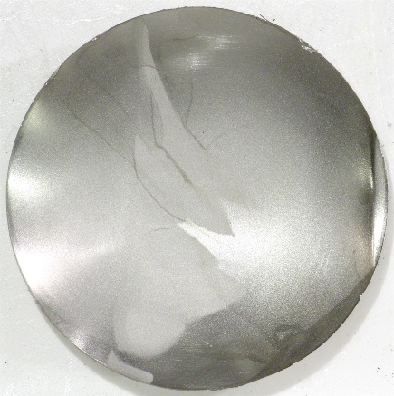
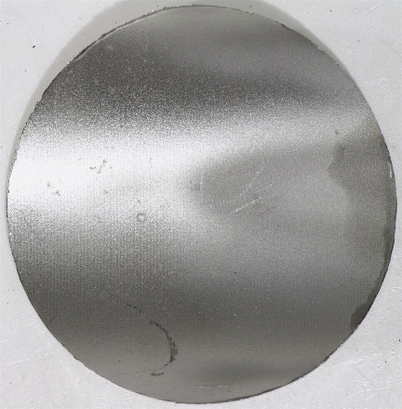
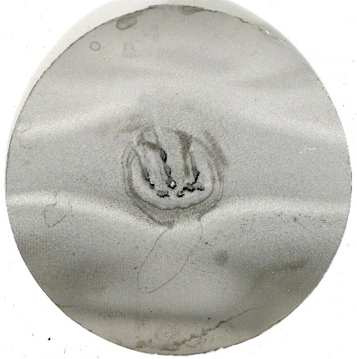
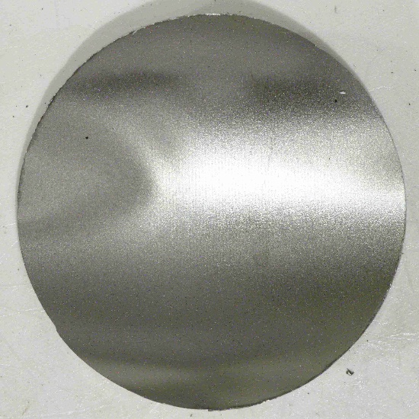
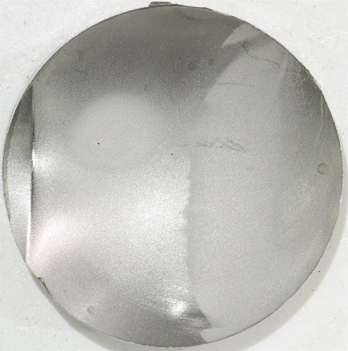
Target 18 inner wall samples were not fractured
T2 - McClintock
T-18: jet-flow design & first target with gas injection
A few through-wall holes in center disk
  These may have disturbed channel flow
Light erosion elsewhere, including on side samples
Precision measurement of erosion with laser scanning is planned in May
P_{average} = 1,128 kW ; E_{total} = 1,261 MWh
Inner wall – surface facing bulk mercury

Slide 10
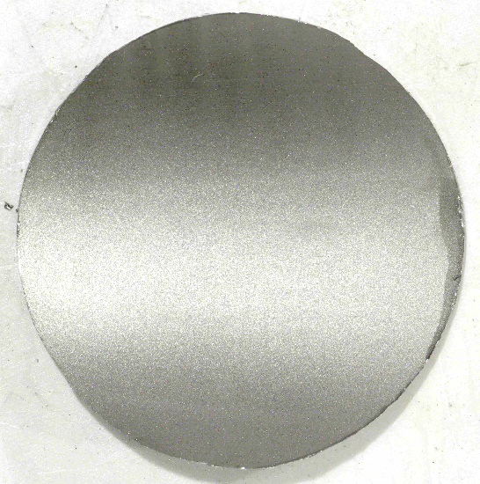
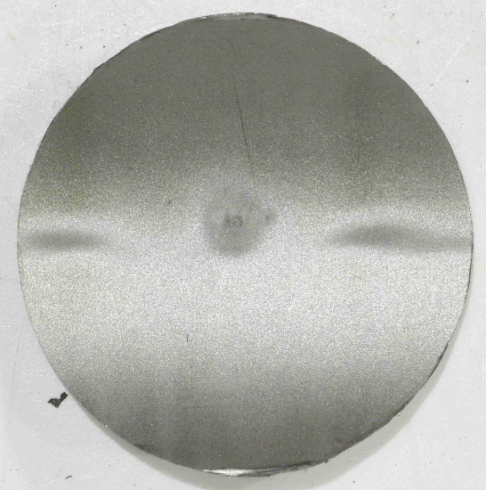
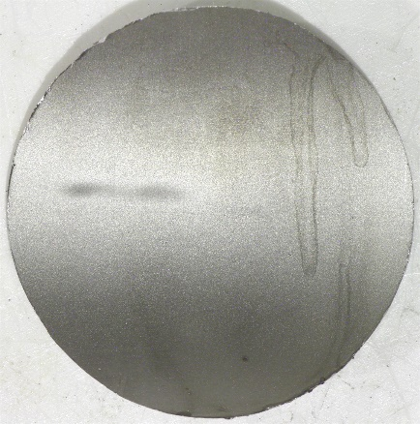
Target 18 outer wall samples had some light erosion
T2 - McClintock
Desire to understand extent of damage in center sample due to disturbed flow from inner wall holes
P_{average} = 1,128 kW; E_{total} = 1,261 MWh
Outer wall – window cooling channel surface

Slide 11
Planned target deployments and proposed gas rates support development for both PPU and 1.4 MW operations
Assessment of vessel pulse strain and cavitation damage with increasing gas rates in the future will influence PPU target operation
Higher gas rates will also inform about mercury system behavior and needed mitigations for hazard of mercury escaping the service bay
Transition to swirl bubblers comes with T25 in 2020 (Chinstrap design)
Successors to Chinstrap targets will incorporate more features of PPU target concept
  Tapered front body, no center baffle are likely
Deployment of a PPU target is planned before the long 2023 outage
  Early validation of design; improvement of fabrication procedures
  This will not have an operating gas wall
Charge 11

Slide 12
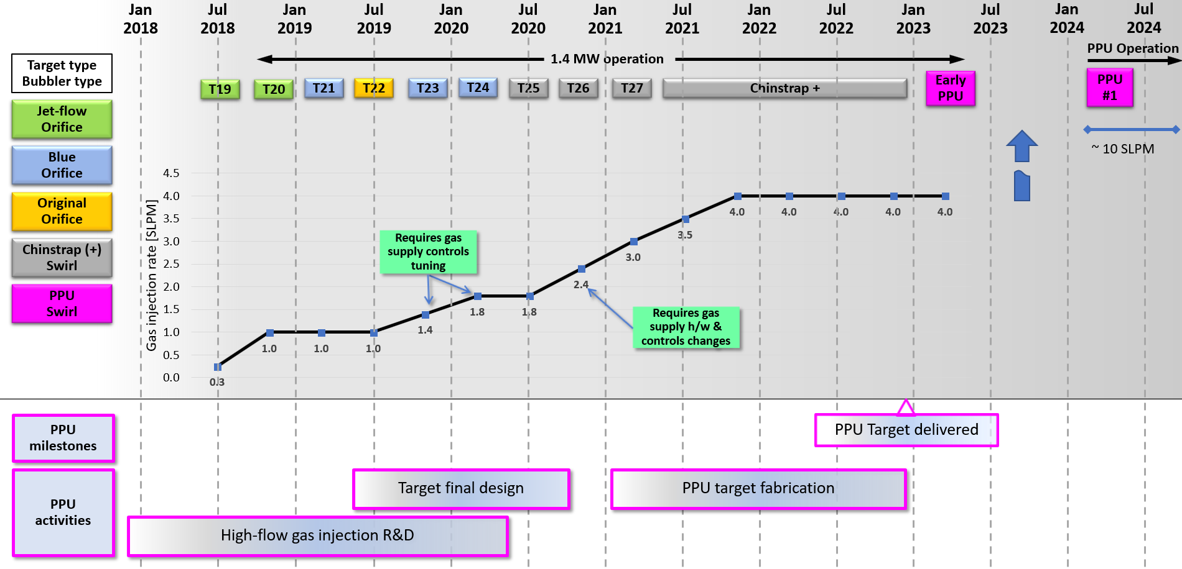
Planned target deployments and proposed gas rates support development for both PPU and 1.4 MW operations
0.7
Notes:
Gas rates above 1.8 SLPM come too late to influence target design. But they can impact how much we actually operate the gas rate at.
Chinstrap + designs will be commencing along with PPU design – convergence of features.

Slide 13
Authorization for routine operation of gas injection has been granted by DOE site office
Authorization allows moving forward with gas injection
  New section of the Operations Envelope (OE) has been added that defines ‘normal operating’ (based on demonstrated experience) and OE (safety) bounds for gas rate and mercury pump speed parameters
  New test procedure for qualifying changes to the ‘normal operating’ bounds
  Unreviewed Safety Issue Evaluations (USIE) process will be used to increase OE limit or for changes in gas injection system technology
  Operating procedure for target gas injection updated to be consistent with revised OE and new test procedure
  SNS Internal Note was issued by safety staff issued that reviewed consistency of proposed path forward with Safety Assessment Supplement for GI3
  These and GI3 Commissioning Report were reviewed by DOE Site Office staff

Slide 14
Early deployment of PPU target design with 1.4 MW beam
Charge 10
This would be without an operating gas wall – protections for mercury process loop overflow with high gas flow will not be in place yet
Pros
Cons
Opportunity to identify unforeseen design issues sooner and more time to implement corrective action
Opportunity to identify fabrication issues sooner and optimize procedures
Reduced risk to PPU success
Potential to operate at > 1.4 MW before long outage
  Accelerator will be capable of > 1.4 MW
Unforeseen design / fabrication problem with new design interrupts 1.4 MW neutron production
Additional cost to project for extra target
  Potentially one less target for operations to fund
Forego some target development / design time on initial PPU target
Delivery schedule critical
Notes:
10. Is the proposal for early use of the 2 MW PPU target in operations reasonable? (Reimer T7)

Slide 15
Target operations metrics
Target leaks have not interrupted neutron production since 2016
Three targets per year is providing reliable operations and more design & operation opportunities to learn from
Operational Number | Target Type | Removal Date | Reason For Removal | Total Energy (MWh) | Average Power (kW) | Bubbler type | Gas rate (slpm) | Pump Speed (RPM)
T06 | Nom | Sep-12 | Trap CP Leak | 617 | 916 |  |  | 278
T08 | Nom | Oct-13 | Admin | 3750 | 851 |  |  | 278
T09 | Nom | Jul-14 | Admin | 4197 | 1033 |  |  | 278
T10 | Jet | Sep-14 | Front Body to XTN Leak | 601 | 1052 |  |  | 278
T11 | Nom | Nov-14 | Trap CP Leak | 166 | 1116 |  |  | 278
T12 | Nom | Oct-15 | Erosion - Nose Leak | 4460 | 964 |  |  | 278
T13 | A321 | Mar-16 | Erosion - Nose Leak | 2588 | 1075 |  |  | 278/350
T14 | A321 | Oct-16 | Admin | 2762 | 968 |  |  | 350
T15 | A321 | Jan-17 | Admin | 1682 | 1110 |  |  | 350
T16 | Jet | Jun-17 | Admin | 1783 | 950 | IOB | 0 | 350
T17 | Jet | Oct-17 | Admin | 1936 | 1127 | IOB | 0 | 350
T18 | Jet | Jan-18 | Admin | 1261 | 1120 | IOB | ~0.35 | 350
T19 | Jet | Aug-18* |  | 2100** | 1300 | IOB | ~0.25* | 350
T20 | Jet | Jan-19* |  | 2350** | 1400 | IOB | 1.0* | 350
*expected
leak
**estimated

Slide 16
Mitigation of erosion at inner wall did not meet expectations with recent jet-flow targets w/o gas
Comparison between T-10 (jet-flow) and T-6 (original) showed benefit from shear flow for reducing pitting damage at center of inner wall
  Experimental evidence is also strong
However, expected damage mitigation with T-16 and T-17 was not achieved
While jet may be extending the damage incubation period, it appears to worsen the erosion rate once pits develop
  Jet velocity may be too high in these recent targets
Changes to reduce jet velocity are coming

Slide 17
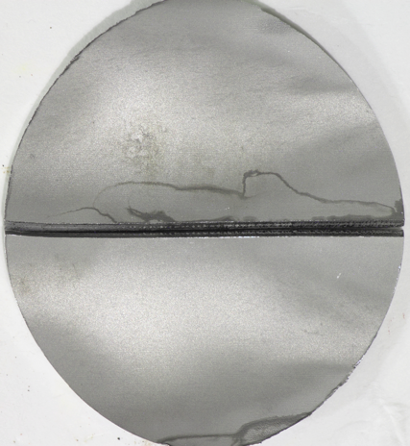
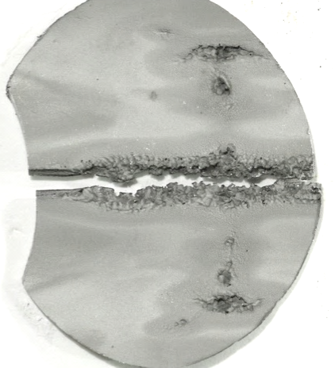
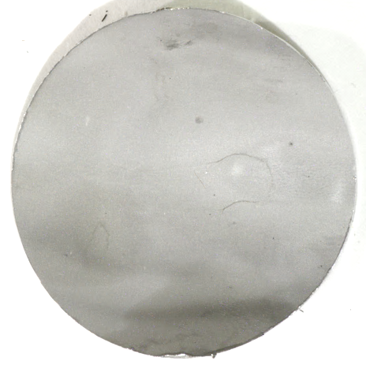
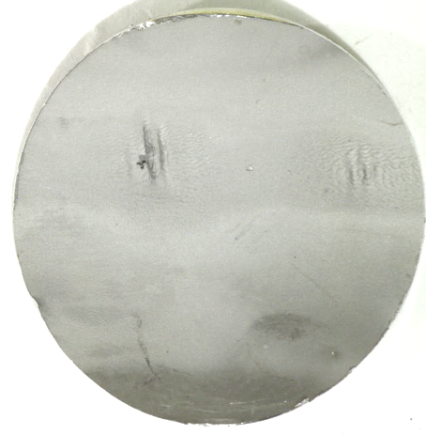
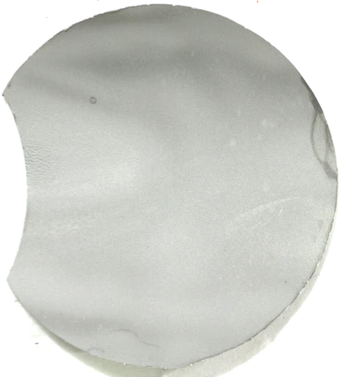
Comparison between T-6 (original) and T-10 (jet-flow) showed the jet-flow reduced erosion to the inner wall and delayed its fracture
Targets 6 and 10 experienced almost the same average power and total beam energy – permitting direct comparison between the designs
  Total energy to these targets was modest due to weld related leaks
Target experimental data had similarly shown that shear flow at the wall can reduce cavitation pitting damage
T2 - McClintock
sample n/a
Target 6
(original)
P_{avg} = 916 kW, 617 MWh
Samples of inner wall of beam-entrance region, bulk facing surface
Target 10
(jet-flow)
P_{avg} = 1052 kW, 601 MWh
Mercury pump speed was lower than current practice

Slide 18
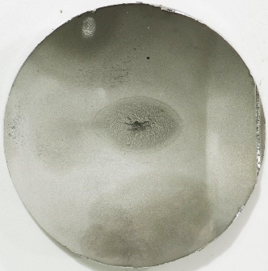
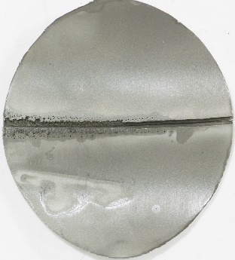
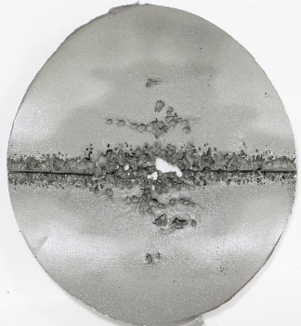
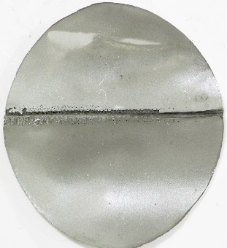
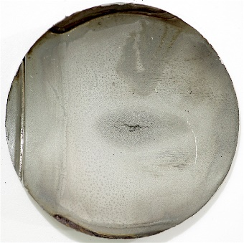
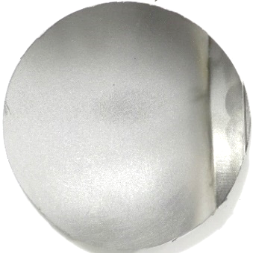
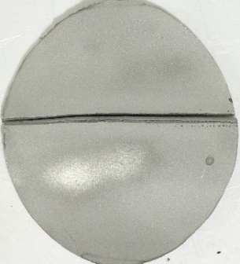
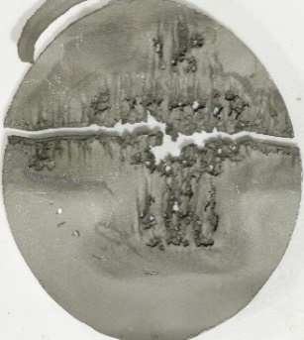
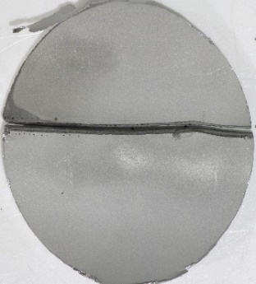
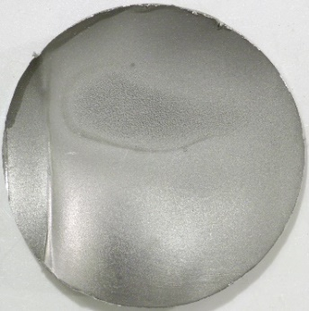
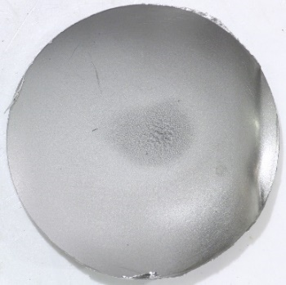
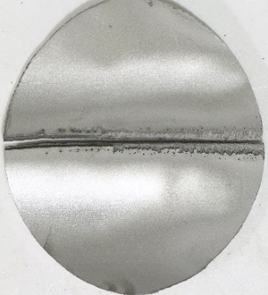
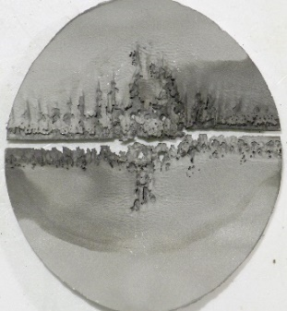
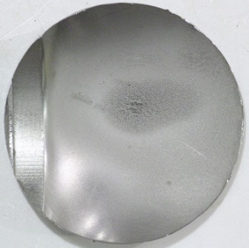
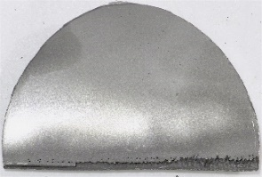
Recent jet-flow targets’ inner wall damage was found comparable to original design targets
T2 - McClintock
Left supply
Inner wall
Right supply
Total energy on these targets was higher than T6 & T10
Mercury pump speed was higher than during T10 operation
Elongated canyons of erosion on T16 and T17 at the center suggest jet velocity could be too high (3~4 m/s) and worsening the erosion rate after any initial improvement in incubation period
Design changes to slow jet velocity down to 2.0~2.5 m/s are coming
Target 15
(original)
P_{avg} = 1133 kW
E_{total} = 1667 MWh
Target 16
(jet-flow)
P_{avg} = 968 kW
E_{total} = 1780 MWh
Target 17
(jet-flow)
P_{avg} = 1127 kW
E_{total} = 1936 MWh
Notes:
Show T18 samples again …

Slide 19
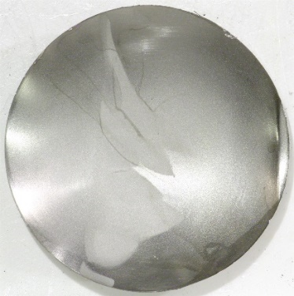
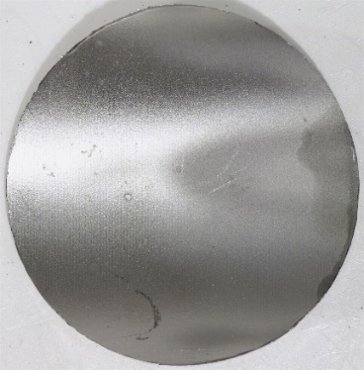
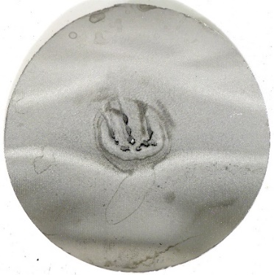
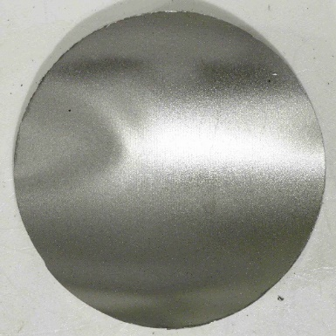
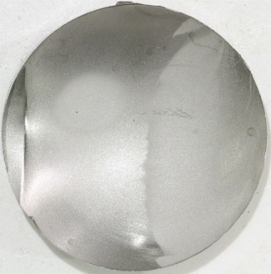
Target 15
(original)
P_{avg} = 1133 kW
E_{total} = 1667 MWh
Target 16
(jet-flow)
P_{avg} = 968 kW
E_{total} = 1780 MWh
Target 17
(jet-flow)
P_{avg} = 1127 kW
E_{total} = 1936 MWh
Target 18
(jet-flow, GI3)
P_{avg} = 1128 kW
E_{total} = 1261 MWh
Notes:
Show T18 samples again …
P_{average} = 1,128 kW ; E_{total} = 1,261 MWh

Slide 20
Why protect the inner beam window?
It’s not a containment boundary …
Central portion of outer beam window may be the next vulnerable region for leaks from cavitation damage – after sides of outer window
Fracture of the inner beam window changes the response stiffness of the target, further complicating engineering analyses
Protecting the inner window integrity should help outer window survive longer
  Leakage of mercury from bulk to window channel disturbs shear flow that helps reduce damage on outer window surface, and changes cooling conditions
  Added movement of inner wall risks loss of narrow channel mitigation of damage on outer wall
Notes:
PPU target lifetime goal of 1,250 hours is tolerable, not preferable
Protection of inner beam window – the most severely damaged region – will extend life of the outer beam window – which has seen some erosion

Slide 21
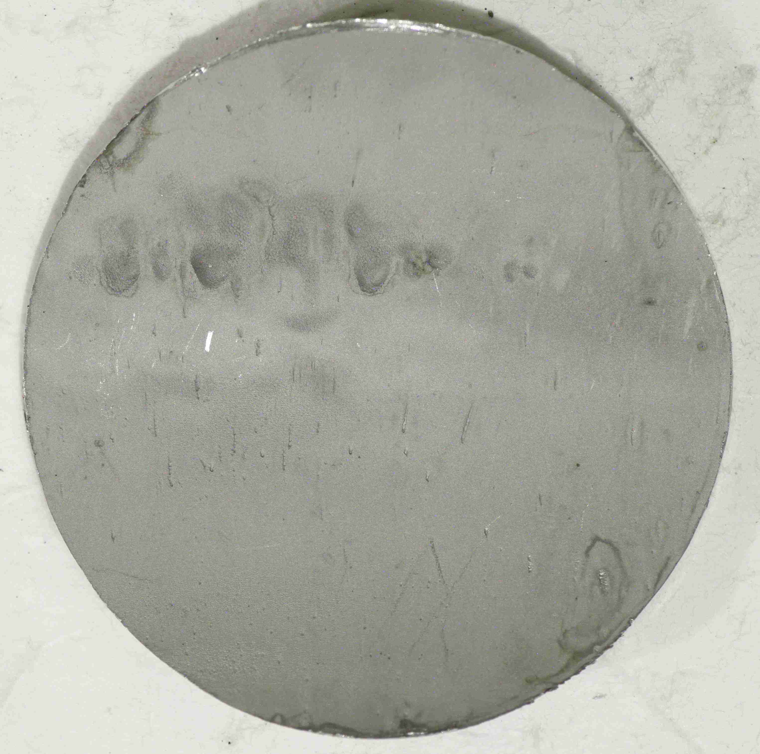
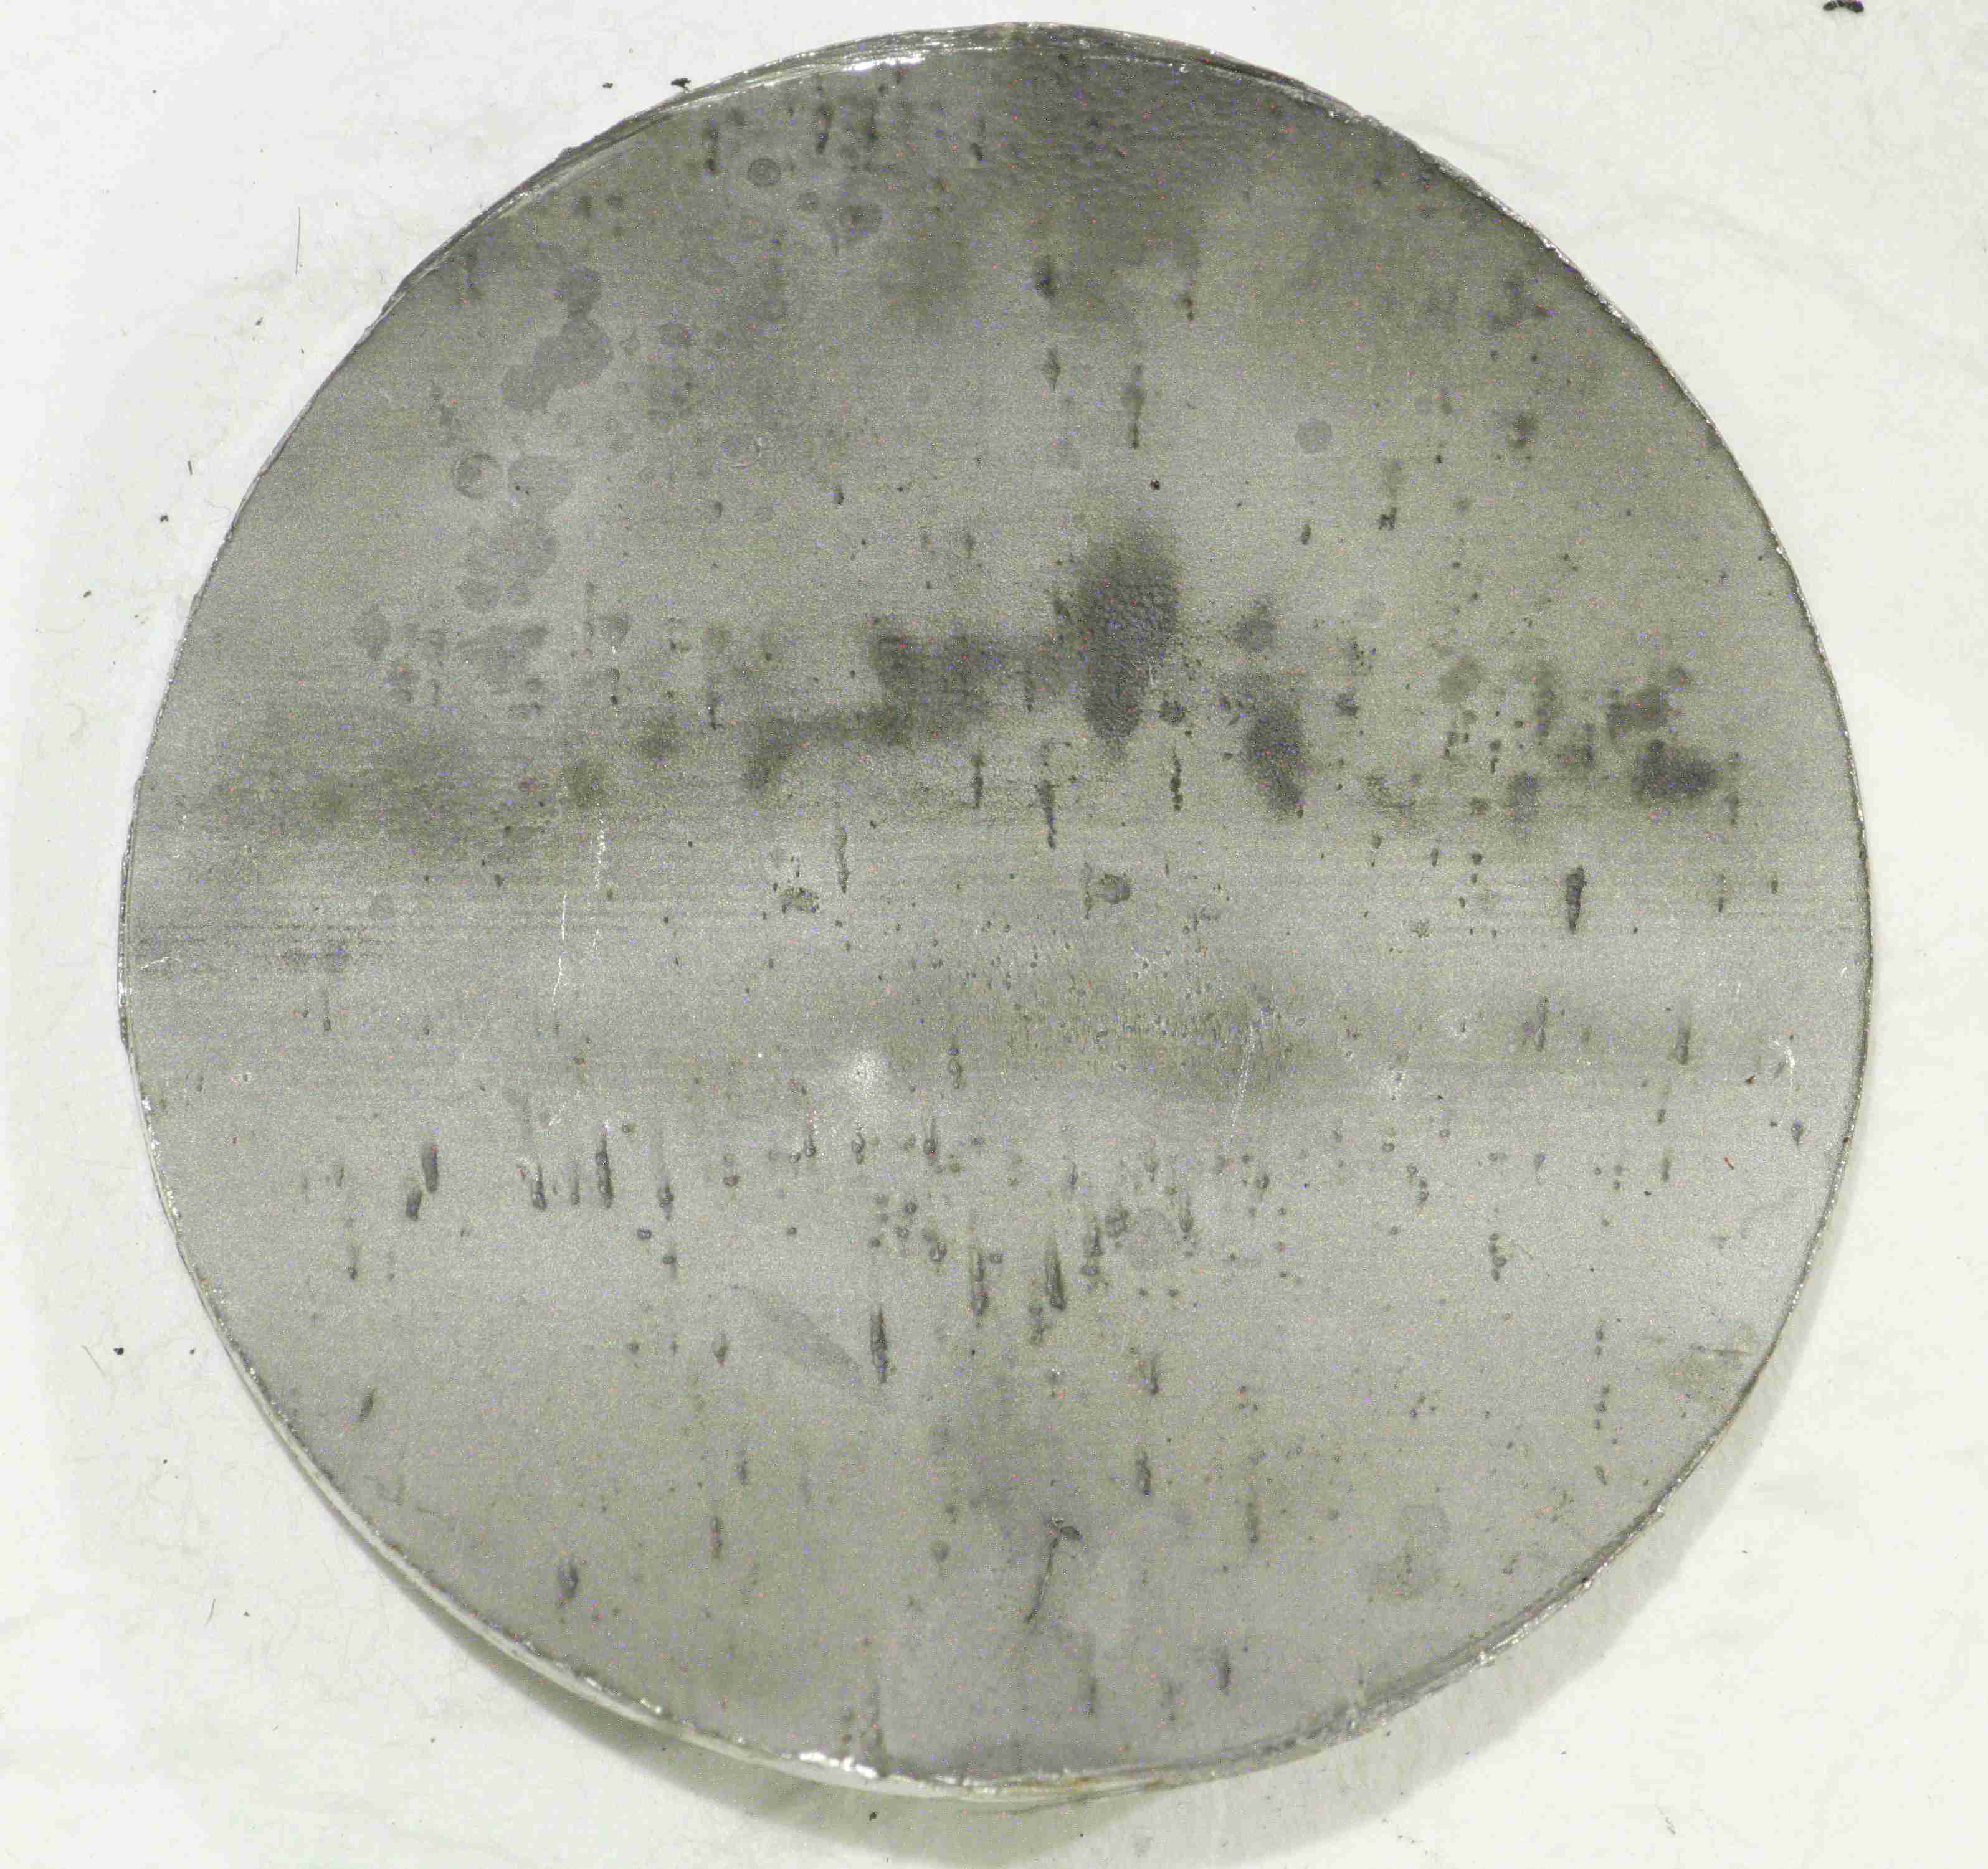
Significant outer wall erosion on high total energy targets
T-9 lost about 0.035 inch due to erosion
  Outer window thickness is 0.090 inch – must be thin to limit thermal stress
Target 9
(original)
P_{avg} = 1033 kW
E_{total} = 4197 MWh
Did not leak
Target 12
(original)
P_{avg} = 964 kW
E_{total} = 4677 MWh
Leaked – erosion of side outer window
Center disk samples of outer wall
Notes:
Protection of inner beam window – the most severely damaged region – will extend life of the outer beam window – which has seen some erosion

Slide 22
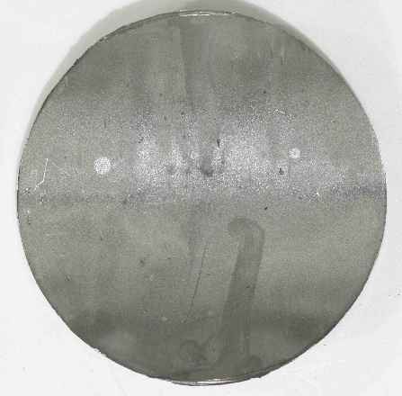
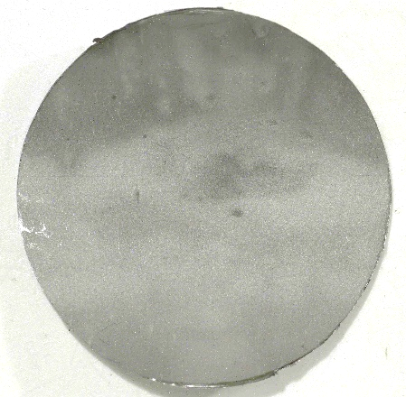
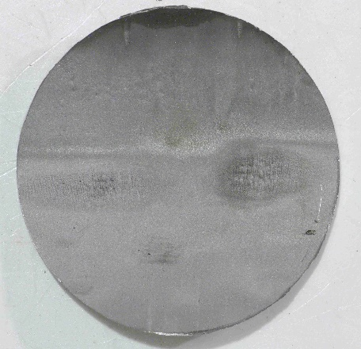
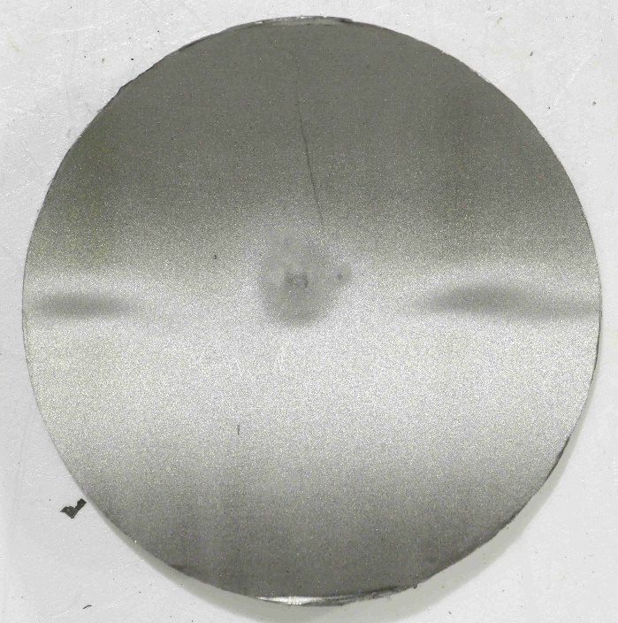
Laser scanning will quantify erosion on target samples
Target 15 - original
P_{avg} = 1,133 kW; E_{total} = 1,667 MWh
Target 16 - jet-flow
P_{avg} = 968 kW; E_{total} = 1,780 MWh
Target 17 - jet-flow
P_{avg} = 1,127 kW; E_{total} = 1,936 MWh
Target 18 - jet-flow - GI3
P_{avg} = 1120 kW; E_{total} = 1,261 MWh
Center disk samples of outer wall
Notes:
T15, T17 and T18 have similar average power. T17 the most total energy.
T15 and T16 have similar total energies.
Jet-flows w/o gas seem slightly rougher.
And, there remain regions we have yet to get observations of – in channels for example

Slide 23
PPU gas wall development
Charge 11
Gas wall damage mitigation potential is high, based upon in-beam mercury target experiments, testing done in water with research lithotripter (Boston University), US Navy development work …
Gas wall need not be a continuous sheet of gas covering the surface to provide significant protection from erosion
  A bubbly curtain near the wall surface can be effective
  PPU goal of time-averaged gas coverage 60% over middle portion of inner wall
Planned experiments on new Target Test Facility (TTF) bypass loop will assess gas wall coverage of several injection concepts
Trade-off between achieved gas time-average coverage over central region of inner beam window vs. robustness of the gas wall design (including gas supply routing) will be made in the future based upon R&D outcomes and design complexity
T8 - Barbier
Notes:
11. Do the benefits proposed from the PPU 2 MW target design changes outweigh additional potential complexities? (Wendel T1, Winder T3, Reimer T7)

Slide 24
PPU 2 MW Target mercury vessel design development is progressing along parallel paths
General goals
  Maximize the pulse fatigue life before crediting gas injection
  Robust weld designs with inspection friendly configurations
  Shear flow in side corners of beam window
  Jet-flow (shear) across middle of inner window
  Gas wall (bubbly curtain) across middle of inner window
  Swirl bubblers for efficient production of small bubbles for pressure wave mitigation
  Stiffness sufficient against pulse dilatational modes ( ≤ 75 Hz ) – w/o a center baffle
Target design development has parallel paths:
  Conventional design and evaluate
  Automated design exploration studies (DES)
    Outcomes will influence conventional design approach

Slide 25
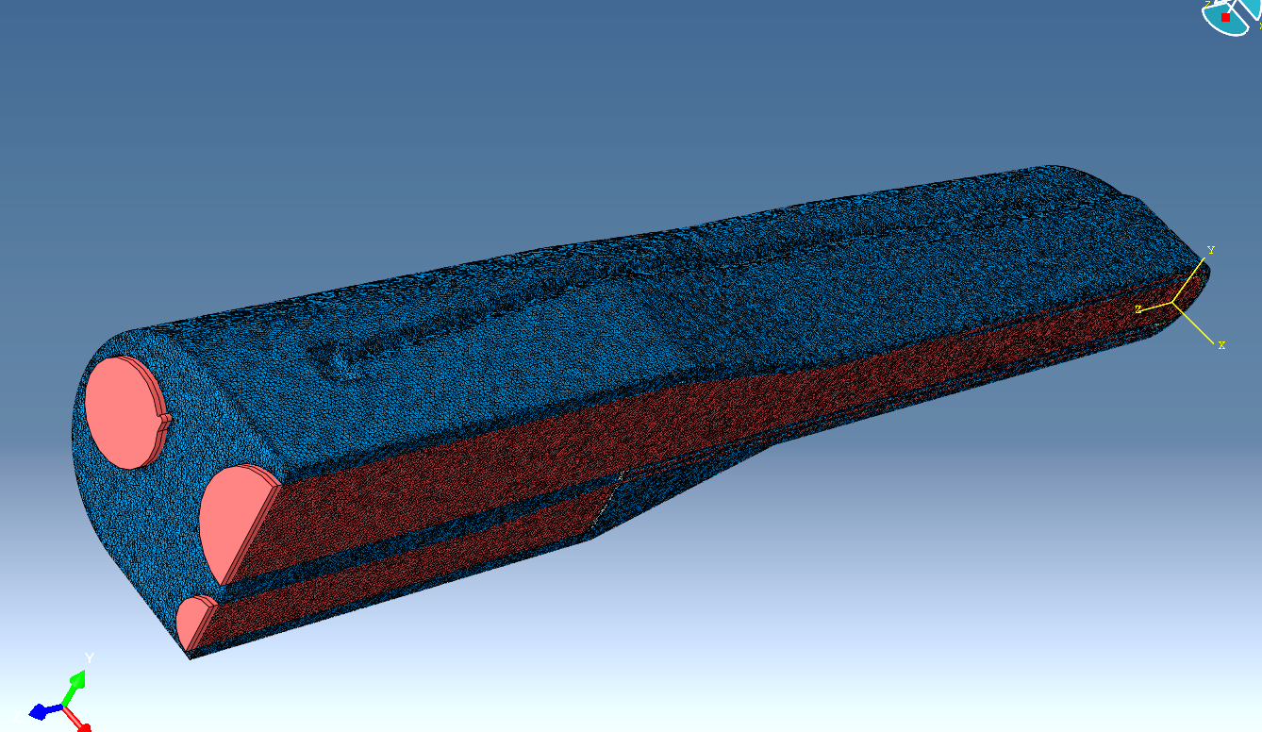
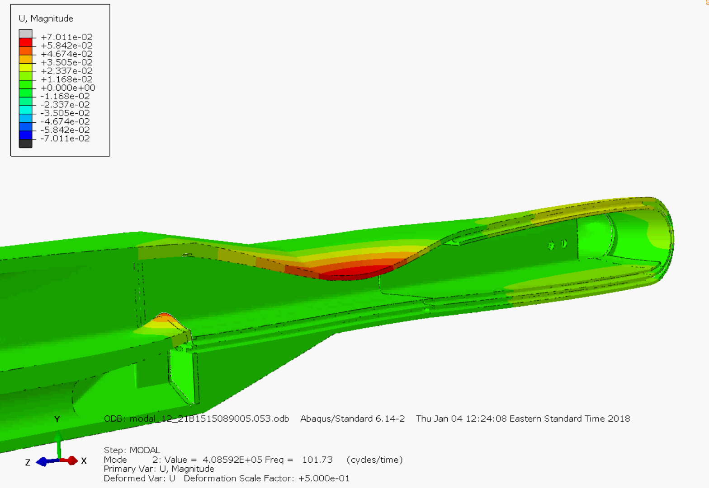
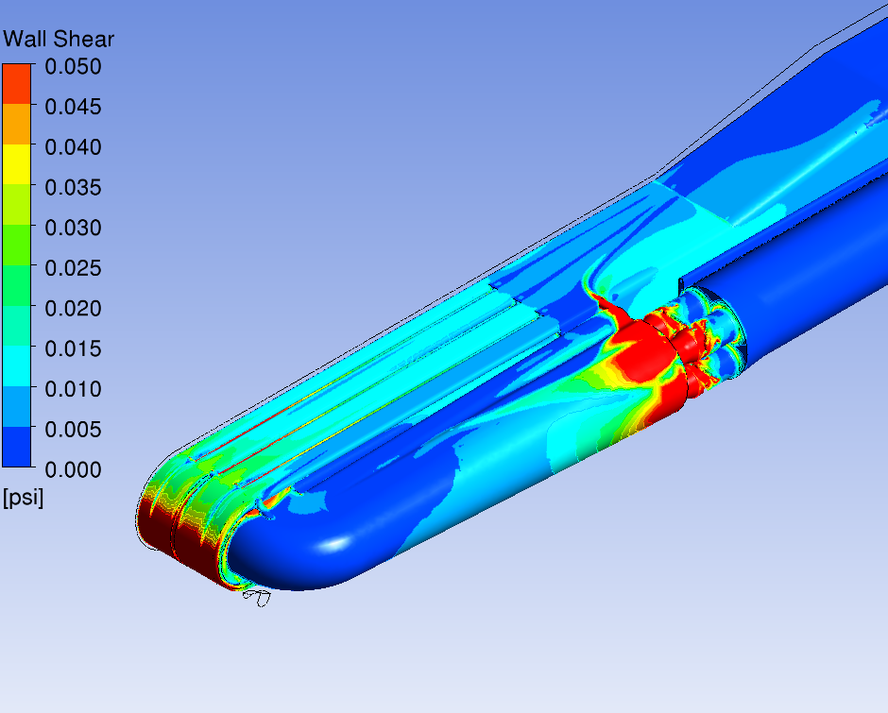



PPU Target Design Progress – conventional approach status
12-21 model
A number of design concepts have been modeled and evaluated
  Pulse response, CFD, thermal, modal
  Moderately coarse mesh models used for fast turnaround
Key points from recent analyses (December model):
  Modal behavior without center baffle is achievable with stiffened upper front body – breathing mode at ~100 Hz (75 Hz goal)
  Swirl bubbler design with acceptable pressure drop and good bubble production is in hand
  Thermal stresses look acceptable
  Side baffle flow bypass holes help with overall pressure drop and temperatures near side baffle
  Pulse stress levels appear generally acceptable except for localized areas
  Detailed neutronic energy deposition model compared with simplified model with little differences found (< 10%)
  Issue - Low shear flow in supply channel nose corners
12-21 model
102 Hz
12-21 model
4-4-18 model
Next PPU model (4-4-18)
  Increased corner taper to improve shear flow
  Features to reduce fabrication difficulty
  Welded inner window
  Looking at option for simplified gas injection into jet flow channels by tube with holes instead of inner window gas wall design
4-4-18 model
4-4-18 model

Slide 26


PPU Target Progress –
Automated Design Exploration (ADE) Studies
Design exploration features
Capability that automates pulse simulation over multiple design variables has been sufficiently developed to ‘production’ status
Results point to promising feature combinations for reducing pulse response stress, hence improving fatigue life margin
Outcome is not a final design – rather – results of DES influence design choices to pursue in detail with conventional approach
Recently: simulations up to 600 μs (December 2017 concept) with 48 design points evaluated
Features examined:
  Baffle length
  Baffle lateral distance
  Baffle radius
Meshing, pulse loading, boundary conditions: all automated

Slide 27





Recent design exploration outcome is encouraging that technique will improve PPU target pulse fatigue life
Minimum of maximum stresses found by DES was 30% less than maximum stress found in baseline version of December 2017 model
σ_{max} = 233 MPa
Baseline geometry
σ_{max} = 169 MPa
Optimized geometry
Example result surface
Next iteration will use more current concept for model baseline and feed outcomes back into conventional design effort
Will continue DES for PPU for another 6 months as preliminary design matures

Slide 28
PPU includes upgrades to the LH₂ moderator loops for ortho-to-para catalysis and monitoring
Will provide stable neutron pulse shapes at all times during run cycle with PPU high-power operation
All three LH₂ loops will have catalyst added
  1 decoupled moderator; 2 coupled moderators
  Will add to hydrogen inventory, which requires safety assessment
Online ortho/para diagnostics will confirm state
  Some development is required
Formal concurrence from scientific staff is in process
Committee comments on this welcome

Slide 29


Motivation for LH₂ ortho-to-para catalysis:
Stable beam characteristics vs. time
TOPAZ Beam Monitor
Moderator characteristics change with age of LH₂ and with operating power
Some instruments see temporal changes in moderator performance
Implementing a catalyst into the hydrogen loop will enforce fast conversion and stabilize the ortho/para ratio
CMS LH₂ vented
Notes:
Thin out. Emphasize the stability point
High para fraction hydrogen would further allow intensity gains of 40-60% for a coupled moderator by increasing its volume, an improvement that could be implemented in a future IRP
TOPAZ data: On 8/17/2015 power outage led to venting of CMS hydrogen. Restart on 8/12/2015 shows difference in neutron counts at different wavelengths vs. data taken prior to venting – all at about the same power. Over time, changes in counts continue.
Simulation data: higher ortho content lowers peak brightness, broadens pulse width / extends tail – worsening pulse resolution.

Slide 30
Summary
2 MW Target development is supported by PPU R&D activities and outcomes from 1.4 MW operations over the next several years
Success with GI3 with strain reduction is encouraging that significant pulse fatigue margin can be added to the PPU target design
  Higher gas flows were observed to reduce strain more
Cavitation erosion mitigation with GI3 was positive, but further work is needed for longer target life and higher power
Early deployment of a PPU target is an opportunity to resolve fabrication issues and validate the design, and is the project preference
Gas wall development is progressing – tests will begin soon
  Design complexity and fabrication risks will be considered in making the design choice for a gas wall in the PPU target

