Slide 1
SNS Operations Performance Metrics FY17 & FY18-Q1
Presented at the
SNS Accelerator & Target
Advisory Committee Meeting
Glen D. Johns
Accelerator Operations Manager
May 15-17, 2018

Slide 2
Outline
FY17/18 Run Schedules
Review of SNS Commitments
Beam Power
FY17 and FY18-Q1 Performance
Downtime Overview
Summary

Slide 3
FY17 schedule after adjustment due to IRP delivery delay
Basically unchanged from last AAC

Slide 4
FY18 schedule after extending 2017C outage due to gas injection implementation and extending 2018A by one month for IRP inspection results in a commitment of 2565 hours delivered of NP

Slide 5
SNS Commitments
Year | Neutron Production Availability |  | Integrated Beam Power (MW-hrs)
 | Commitment | Actual | Commitment | Actual
FY2007 | 68.0% | 65.7% | 117 | 159
FY2008 | 74.0% | 72.0% | 877 | 945
FY2009 | 80.0% | 80.7% | 2031 | 2166
FY2010 | 85.0% | 85.6% | 3253 | 3455
FY2011 | 88.0% | 92.0% | NA | 4132
FY2012 | 90.0% | 90.0% | NA | 4368
FY2013 | 90.0% | 72.4% | NA | 3848
FY2014 | 90.0% | 83.7% | NA | 4798
FY2015 | 90.0% | 74.6% | NA | 4612
FY2016 | 90.0% | 86.4% | NA | 5348
FY2017 | 90.0% | 87.5% | NA | 5406
FY2018 (Q1) | 90.0% | 93.5% | NA | 1260
Year | Neutron Production Hours Delivered |  | Total Operating Hours Delivered
 | Commitment | Actual | Commitment | Actual
FY2007 | 1500 | 2078 | 3500 | 3779
FY2008 | 2700 | 2807 | 4000 | 4032
FY2009 | 3500 | 3553 | 4500 | 4916
FY2010 | 3900 | 4250 | 4800 | 5310
FY2011 | 4300 | 5002 | 5000 | 5941
FY2012 | 4500 | 4725 | 5000 | 5746
FY2013 | 4000 | 4202 | 5000 | 5120
FY2014 | 4230 | 4424 | 5000 | 5294
FY2015 | 4230 | 4441 | 5000 | 5278
FY2016 | 4230 | 4972 | 5000 | 5832
FY2017 | 4230 | 4807 | 5000 | 6079
FY2018 (Q1) | 2565 | 1040 | 5000 | 1421

Slide 6
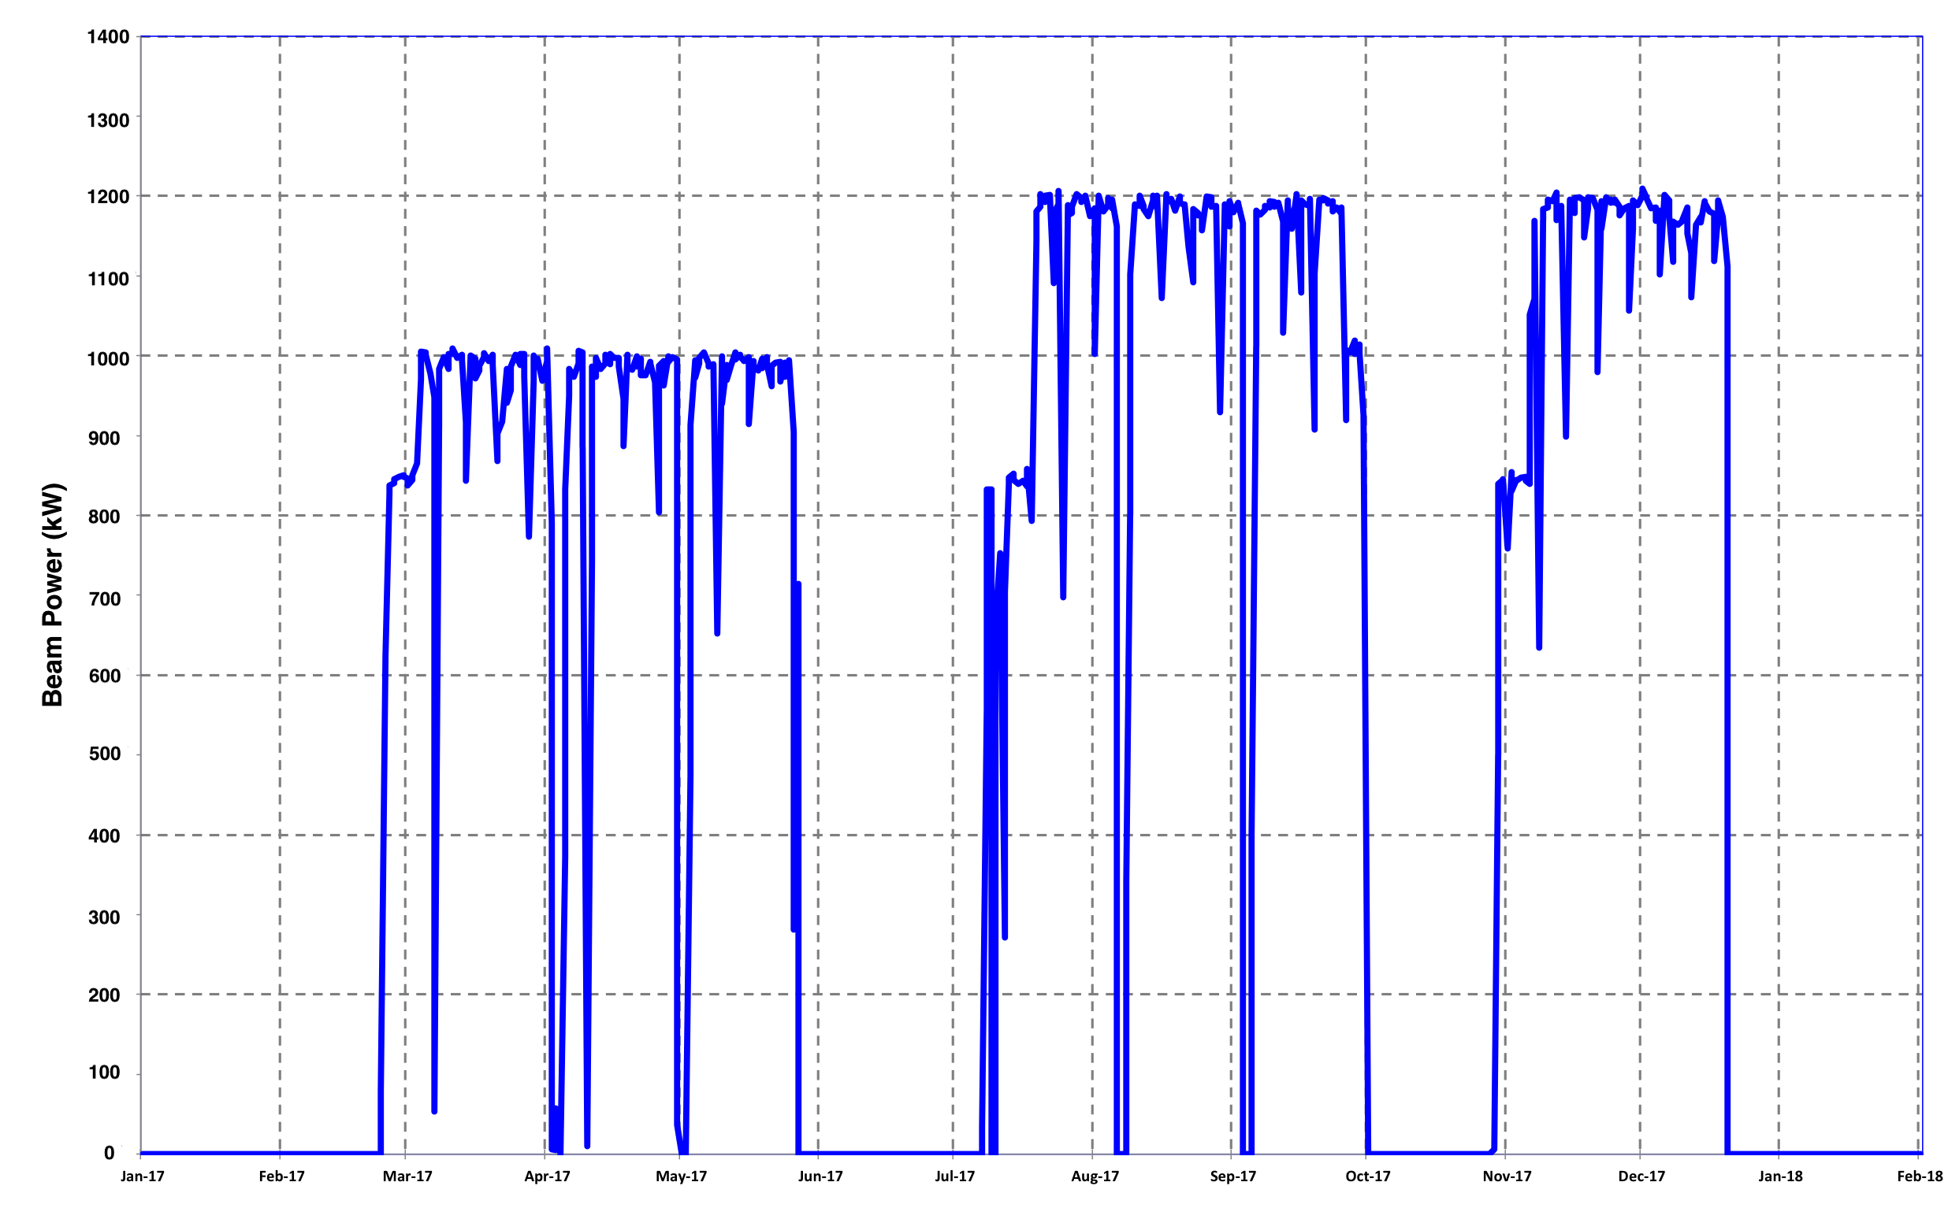
Beam power on target (60 sec average) – per Target Management Plan
1.2 MW for ~73 days
(T17)
1.2 MW for ~43 days
(T18)
1.0 MW for ~84 days
(T16)
2017A
Winter
Outage
2017B Summer
Outage
2017C October
Outage
2018A Winter Outage
IRP Leak

Slide 7
IRP leak led to availability of 87.5% against schedule (94% excluding leak)
Ion source 13MHz breaker trips & source failure
2017A Winter
Outage
2017B Summer Outage
IRP Leak
1.2 MW (T15)
1.0 MW (T16)
1.2 MW (T17)

Slide 8
FY18 continued with excellent performance (93.5%)
Feeder 2074 trip
2017C Fall Outage
2018A Winter Outage
1.2 MW (T18)

Slide 9
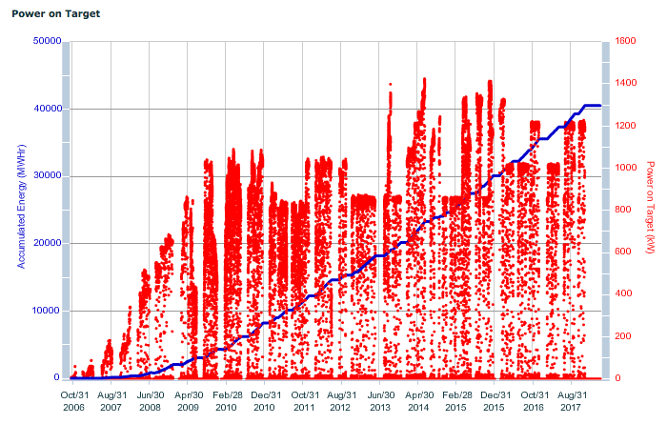
Energy and power on target from October 2006
IRP Changeout
Delivered ~40.5 GW-hrs to IRP-01
FY13 – 3848 MW-hrs
FY14 – 4798 MW-hrs
FY15 – 4612 MW-hrs
FY16 – 5348 MW-hrs
FY17 – 5406 MW-hrs
FY18 – 1260 MW-hrs

Slide 10
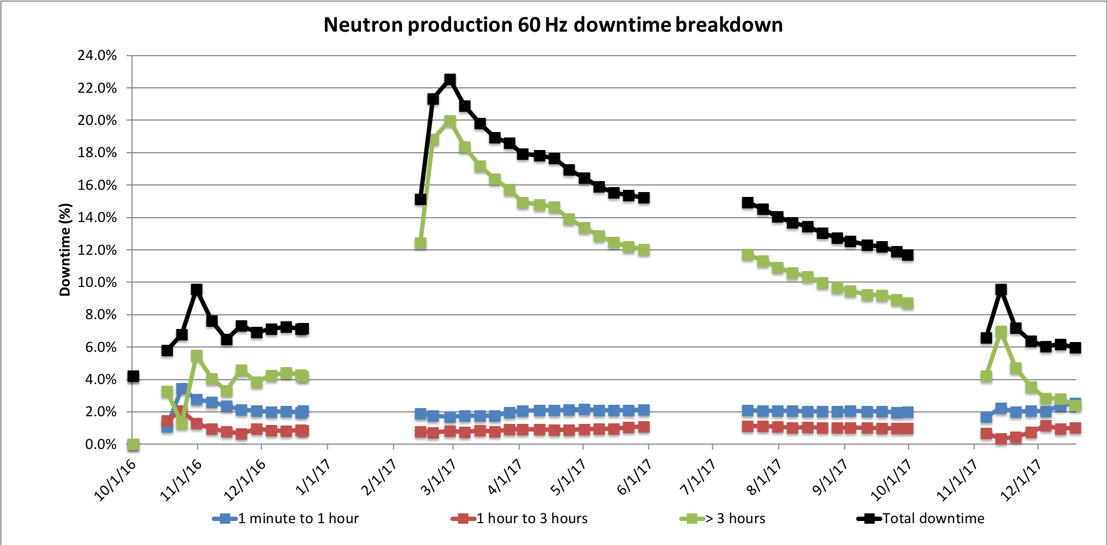
Long duration events dominate overall downtime numbers
Less than 3 hour trips are ~3% of downtime
SCHEDULED TARGET CHANGE
2017A Outage
IRP water leak
FY17
Run 2
2017B Outage
FY17
Run 3
2017C Outage & GIS COMMISSIONING
FY17
Run 1
FY18
Run 1
Ion source
SCL CM17
HVCM
failure
Switchgear failure

Slide 11
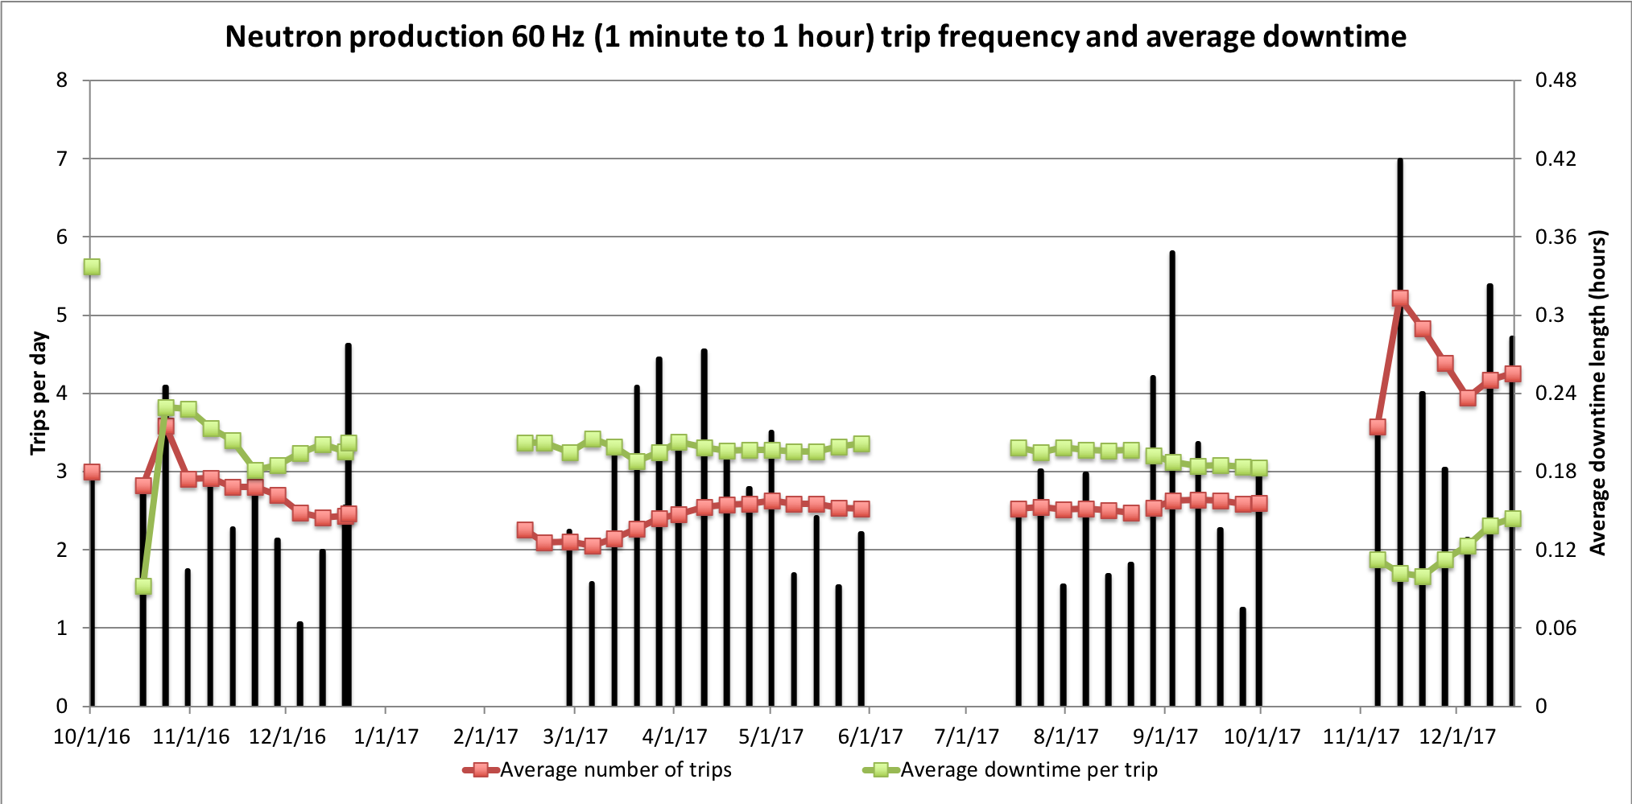
Short duration trip rate of ~2.5 trips/day in FY17
Individual cavity faults affect FY18-1 rate
SCHEDULED TARGET CHANGE
2017A Outage
IRP water leak
FY17
Run 2
2017B Outage
FY17
Run 3
2017C Outage & GIS COMMISSIONING
FY17
Run 1
FY18
Run 1
RFQ cavity instability
HVCM instabilities
HVCM instabilities

Slide 12
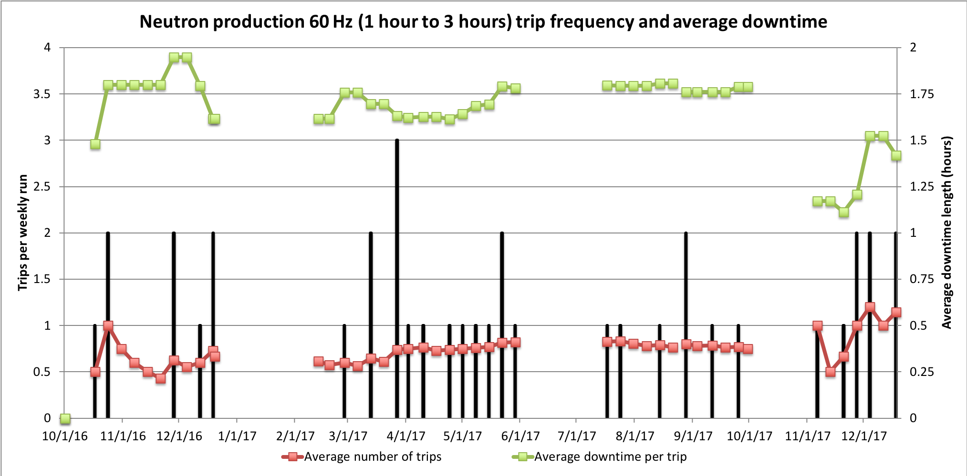
Medium duration rates are fairly constant
SCHEDULED TARGET CHANGE
2017A Outage
IRP water leak
FY17
Run 2
2017B Outage
FY17
Run 3
2017C Outage & GIS COMMISSIONING
FY17
Run 1
FY18
Run 1
HVCM
Ion source

Slide 13
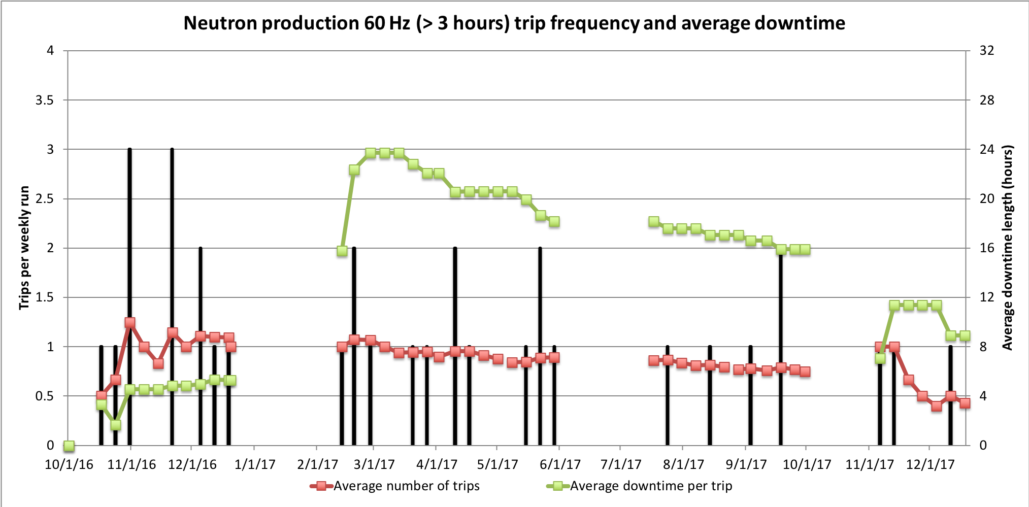
Long duration trips for FY18 are excellent (so far)
Strive for 1 trip every 2 weeks
SCHEDULED TARGET CHANGE
2017A Outage
IRP water leak
FY17
Run 2
2017B Outage
FY17
Run 3
2017C Outage & GIS COMMISSIONING
FY17
Run 1
FY18
Run 1
Multiple HVCM
failures
Ion source
SCL CM17

Slide 14
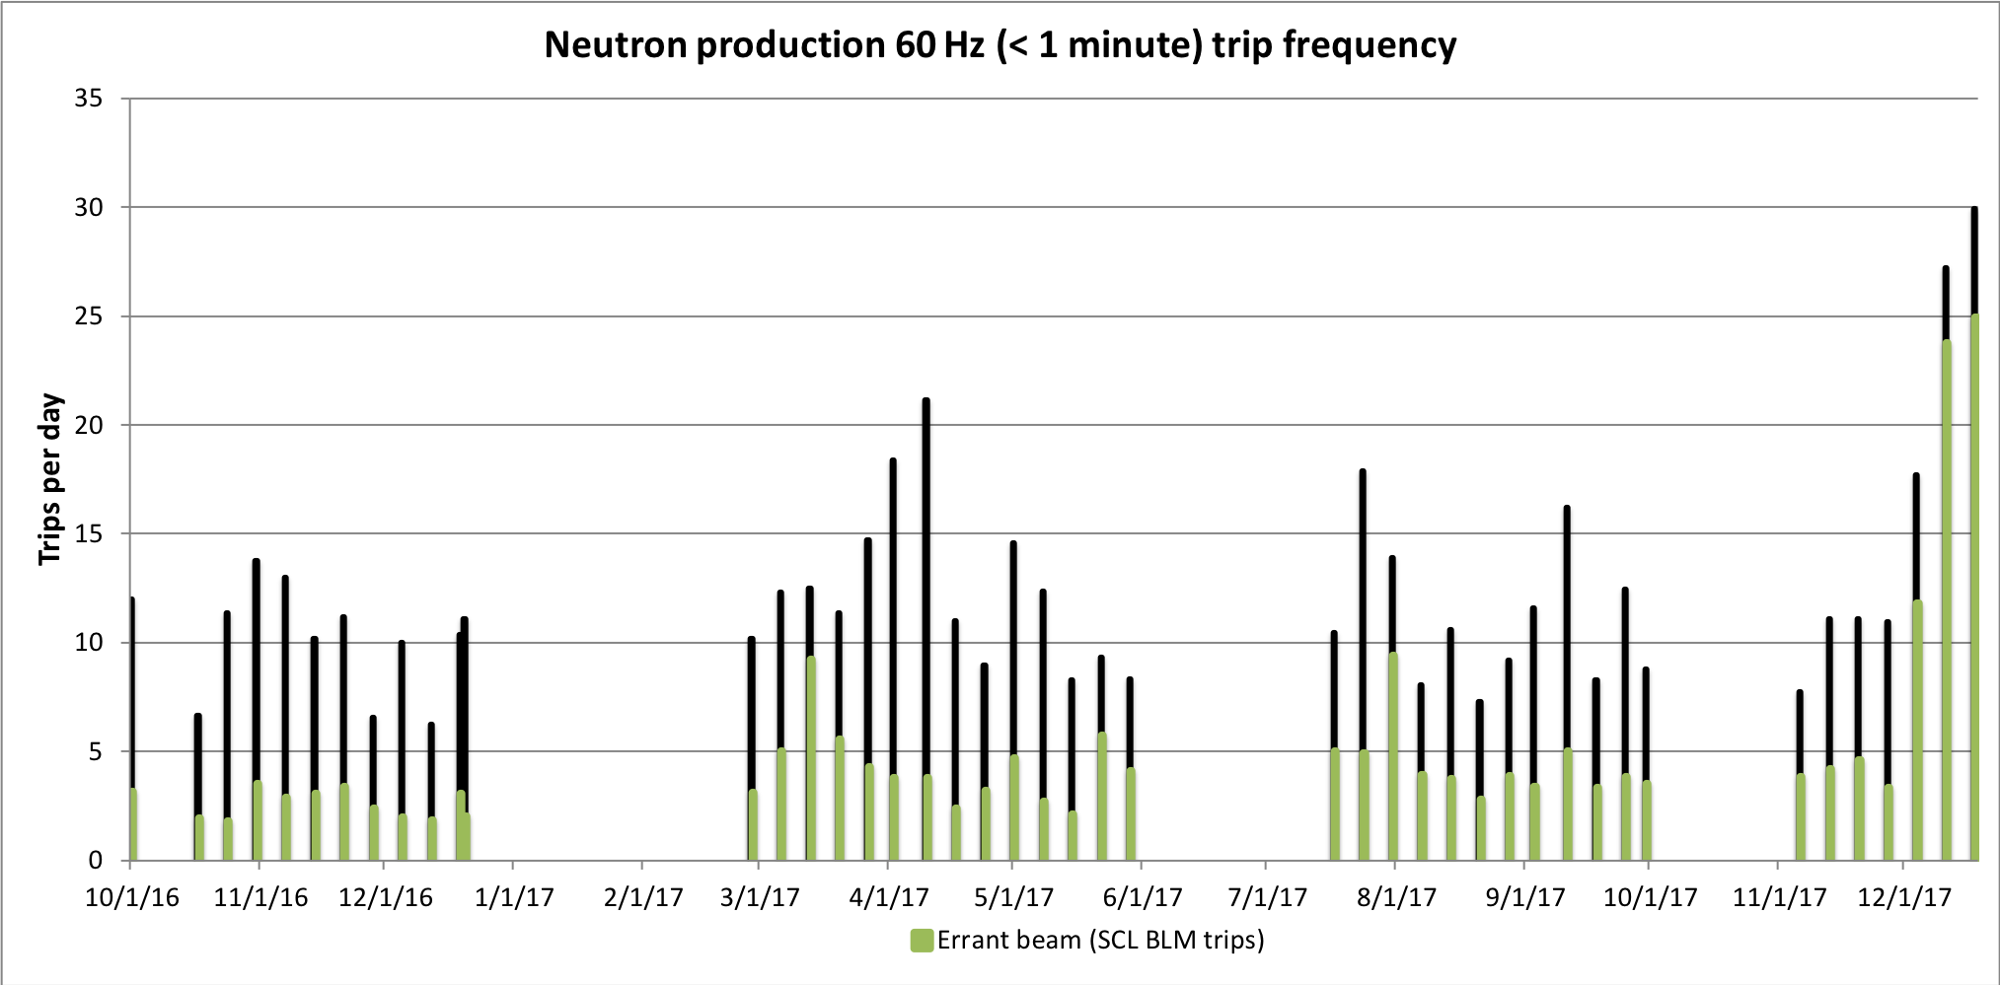
Continue to monitor errant beam trips
Individual equipment issues significantly affect trip rate
SCHEDULED TARGET CHANGE
2017A Outage
IRP water leak
FY17
Run 2
2017B Outage
FY17
Run 3
2017C Outage & GIS COMMISSIONING
FY17
Run 1
FY18
Run 1
Lightning induced MPS trips
Beam tuning
DTL5 RF window arcing

Slide 15
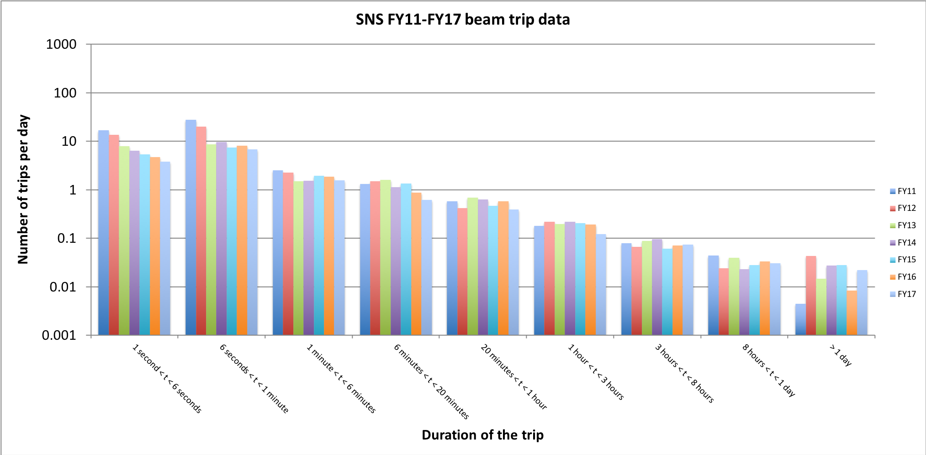
Continue to make good progress on reducing number of short trips
Also beginning to see a marked reduction in resettable RF cavity trips
Errant beam, magnet ps
SCL cavity trips
Warm linac cavity trips
Requires tech expert or repair (call-in)

Slide 16
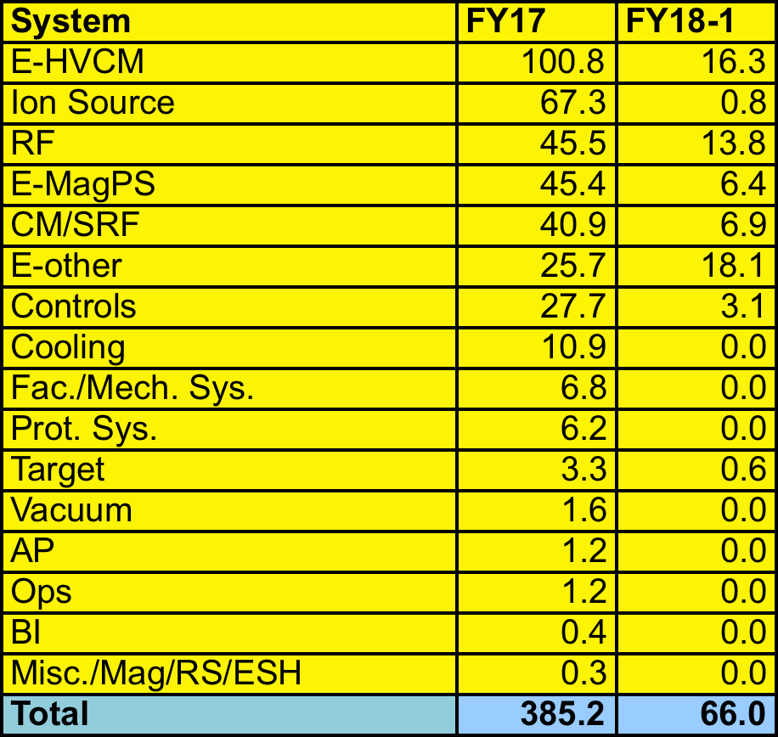
Excellent downtimes excluding IRP leak (353.6 hours)

Slide 17
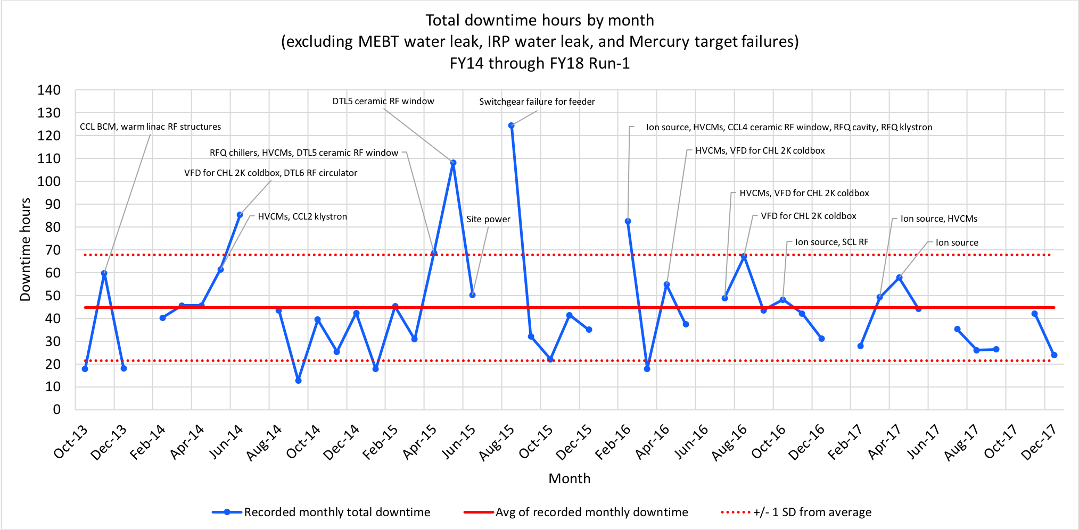
Dreaming of how good it could be…..
Minimum runtime 16 days
Average runtime 27 days
Downtime hour level for
90% availability
Downtime hour level for
95% availability

Slide 18
Summary
Execution of the target management plan has resulted in predictable operations
Excellent availability in FY17 (excluding IRP leak) and FY18-Q1
Long downtime events continue to be impactful
We continue to measure our performance and make system improvements as you will hear over the next two days

