Slide 1
The R&D Plan
Presented at the
SNS Accelerator & Target
Advisory Committee Meeting
Sarah Cousineau
Group Leader, Beam Science and Technology
May 16, 2018

Slide 2
R&D Plan Focuses Unique Technological Strengths
High Power Technology
Super-conducting Cavities
High Intensity Beams

Slide 3
High Power, High Intensity R&D is Multi-Faceted
Superconducting Cavities
Operational
Techniques
Injection Technologies
High Power Technology
Space Charge Beam Dynamics
High Intensity
Beams
Electrical and RF
H- Ion Sources
Measurement, Control and Simulation
High Power Targets
Surface Processes

Slide 4
R&D for High Intensity Beams

Slide 5
The SNS Beam Test Facility (BTF)
BTF Parameters
Species: H⁻ or p
Energy: 2.5 MeV
Beam current: < 50 mA
R&D duty factor: 10 Hz at 50 µS
Built to commission RFQ and other hardware
Now a primary station for equipment development and beam dynamics R&D
6D Phase Space Measurement Station

Slide 6

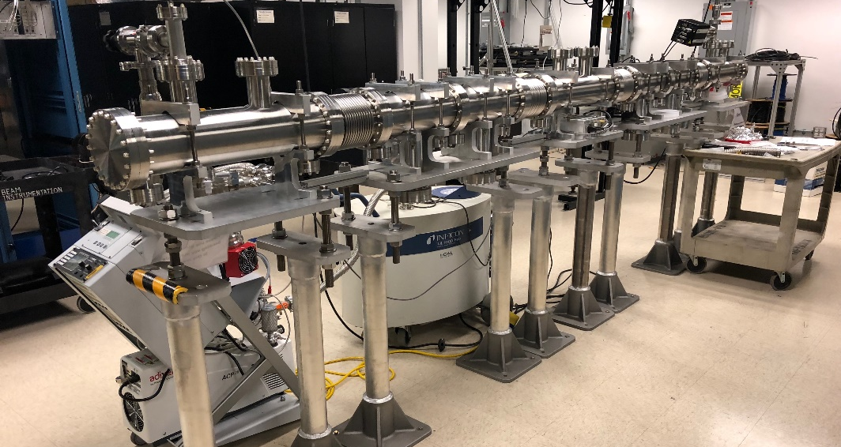
High Dimensionality Beam Dynamics Research Initiated
Focus is on developing new field of high dimensionality beam dynamics research
First ever 6D phase space measurement accomplished
Measurement showed complex phase space structure only visible in 5D or above
FODO beam line ready and waiting for installation
Talk by A. Aleksandrov
Future Plan
Commission new FODO lattice
Decrease measurement times
6D experiments and benchmark simulations
Acquire external support and SBIR collaborations
New FODO Line

Slide 7
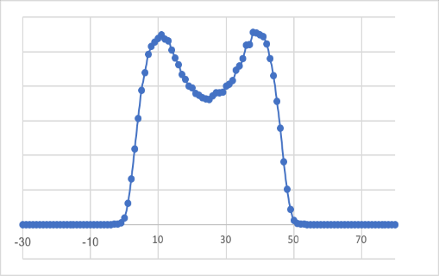
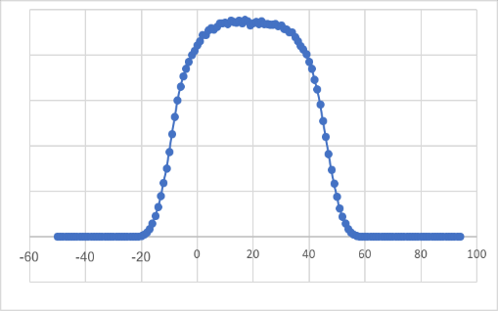
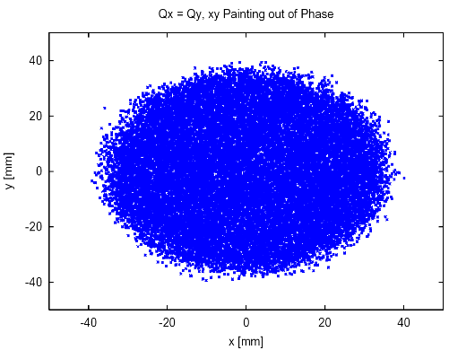
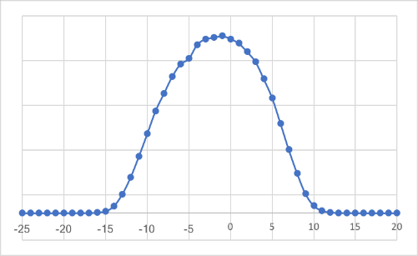
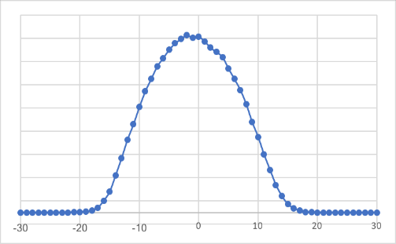
Self-Consistent Beams for Controlling Space Charge Effects
Focus is on first experimental demonstration of self-consistent beams in a ring
Self-consistent beam distributions have many attractive features
Never before experimentally realized
Feasibility study shows it can accomplished in the SNS ring
Nominal SNS beam profile evolution
Turn 200
Turn 1000
Shape is altered by space charge
‘Rotating beam’ self-consistent distribution
Talk by J. Holmes
Future Plan
Install and commission hardware in ring
Demonstrate a self-consistent beam in the SNS ring
Self consistent beam profile evolution
Turn 240
Turn 600
Shape is not altered by space charge

Slide 8
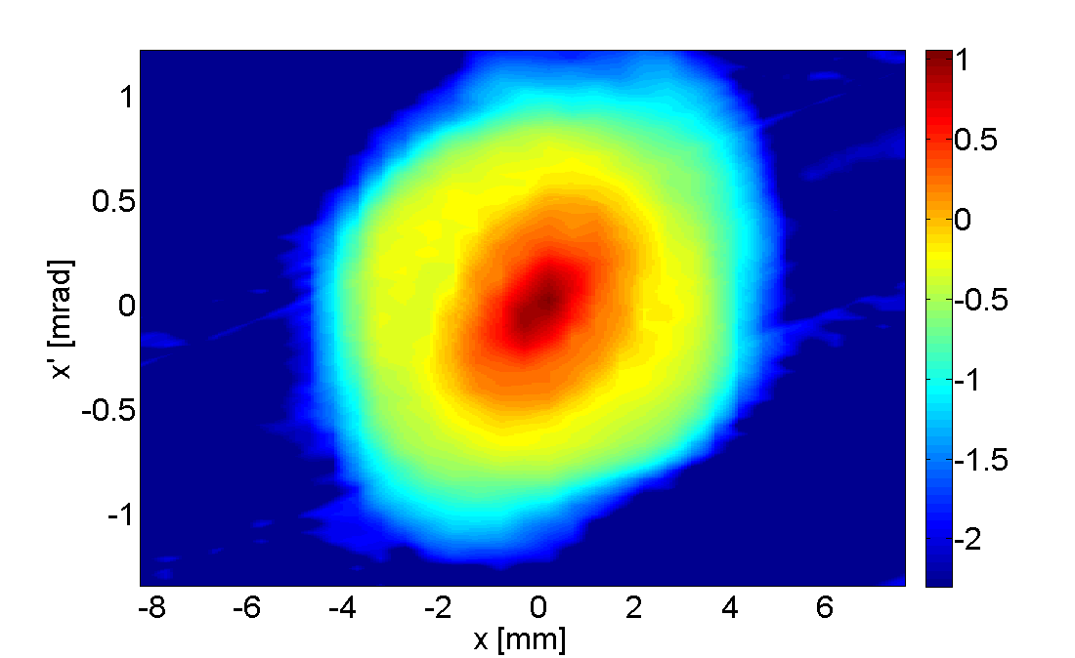
Non-Destructive and High Dynamics Range Beam Diagnostics
Focus is on high dynamics range and non-interceptive techniques
Lasers used extensively for emittance and profile measurements
Efforts aimed at achieving high dynamic range measurements to 10⁻⁶
  Wire scanners presently at 10⁻⁵
  Laser emittance and MEBT slit emittance presently 10⁻⁴
HEBT Laser Emittance Station Measurement
DR = 2000
Future Plan
Achieve 10⁻⁵ for laser emittance station
Achieve 10⁻⁶ for Beam Test Facility slit and collector systems
Dynamic Range 10⁻⁴ after recent improvement

Slide 9
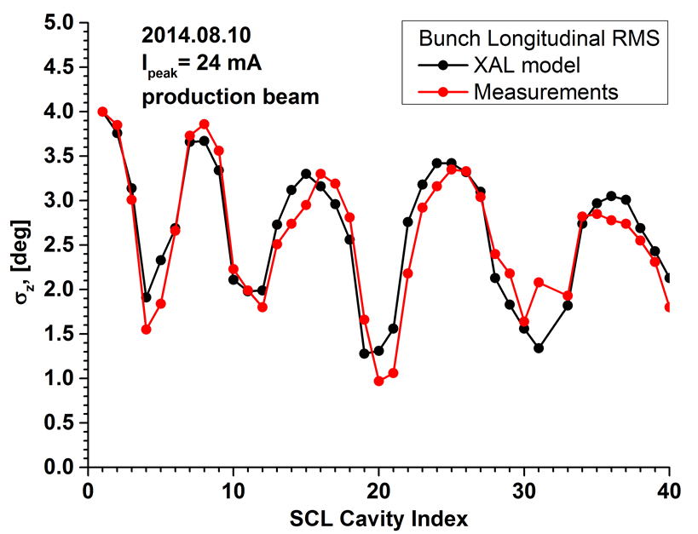
New Tools for Understanding Beams in the Linac
MEBT benchmark between codes
Focus is on developing tools for measuring and modeling high intensity beams
pyORBIT code extended to include linac capability
pyORBIT incorporated as online control room model for Beam Test Facility
pyORBIT benchmark of SNS linac ongoing
Talk by A. Shishlo
Long. bunch size measurement using BPM
Future Plan
Achieve accurate benchmark of beam in linac
Design new optics for lower beam loss
Develop universal plugin mechanism for online models in control room applications

Slide 10
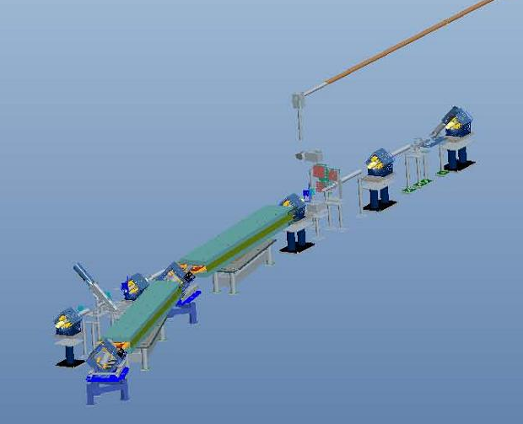
Lasers for Pulse muSR Beam Pulse Shaping
Focuses on pulse shaping demonstration of viable path for future muSR facility
Laser stripping of H⁻ to H⁰ for demonstration of muon spin resonance (muSR) beam line time structure
Utilizes existing infrastructure
SNS HEBT
Laser Transport Line
from SCL
Laser Slit
H⁻
~11.6 m
Dipole
Talk by A. Rakhman
Laser Stripping Station
Future Plan
Demonstrate muSR 30 ns pulses at 50 kHz
Measure stripping efficiency
H⁰
to Linac dump
H⁻
to Ring

Slide 11
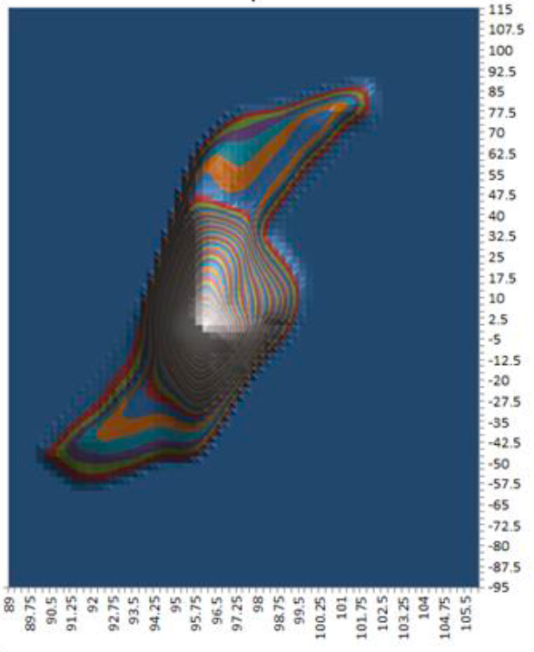
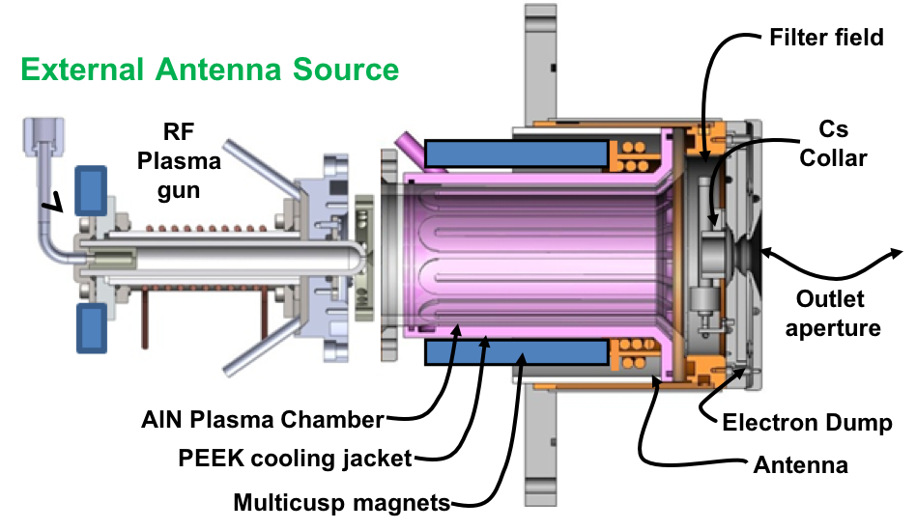
Ion Source Development and Research
Focuses on improving reliability and understanding beam emittance
External antenna source developed and tested on BTF: ~2500 hours, produced 40-45 mA
New 60 Hz-capable emittance device under design
Ion source previous emittance measurements methods developed
Future Plan
Test external antenna source on production machine
Study beam emittance versus other parameters using upgraded emittance device
External antenna design

Slide 12
High Power Technology

Slide 13
The SNS Injection Technology Effort
H⁻ charge exchange is a limiting technology for high power accelerators due to radiation and foil survivability at high power density
SNS R&D program has a three-prong approach
Measure foil Temperature
Develop Better Foils
Study nanoscale properties of foils
Create and test new foils
Predict foil failure beam power limit
Develop Alternative Technologies
Progress technologies to support full scale laser stripping
Gain deep understanding of physics
Understand Foil Performance at 1.4 MW

Slide 14
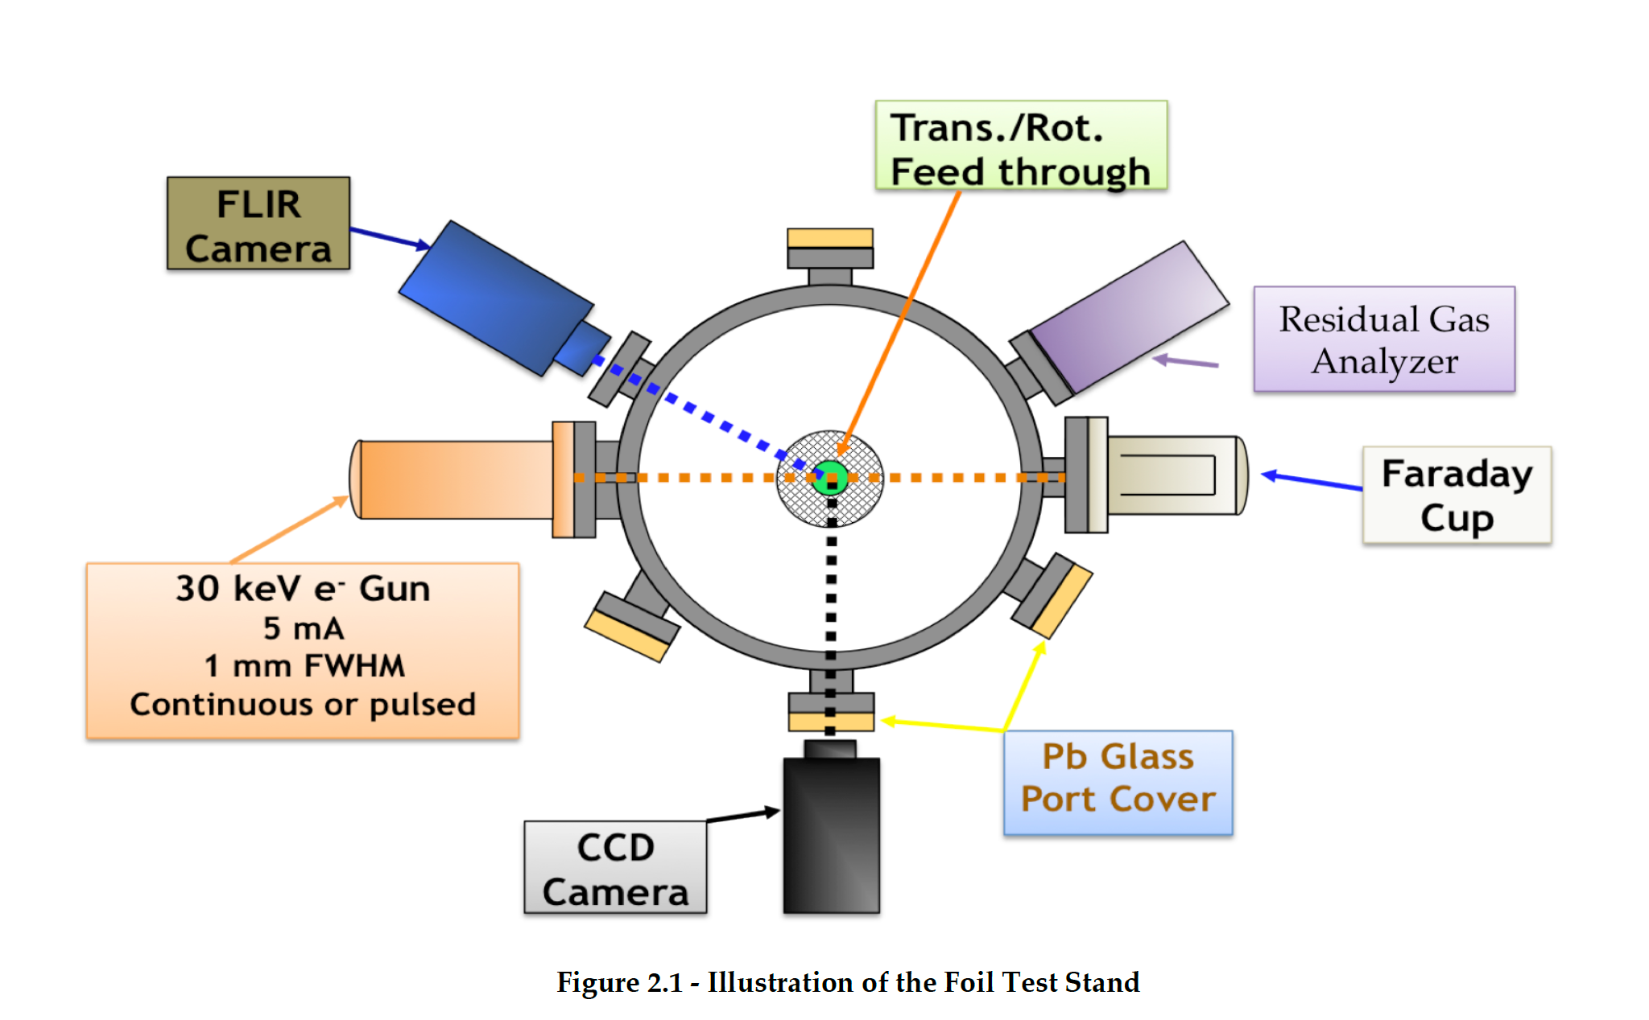
Injection Foil R&D: Foil Development
Foil test stand configuration
Foil effort focused on improving uniformity, lifetime, and reliability to ensure foils will survive at 2.8 MW
Investigating nano-scale properties of foils
Collaborating with Center for Nanophase Material Science (CNMS)
Utilizing in-house foil production and foil testing facilities
Talk by N. Evans
Future Plan
Establish links between nano-properties of foils and their performance in SNS-relevant measures
Establish 1.4 MW and 2.8 MW equivalent test procedures on foil test stand
Different techniques for nano-crystalline nucleation

Slide 15
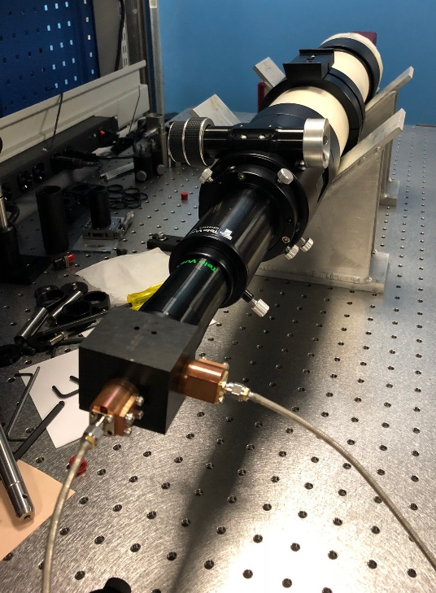
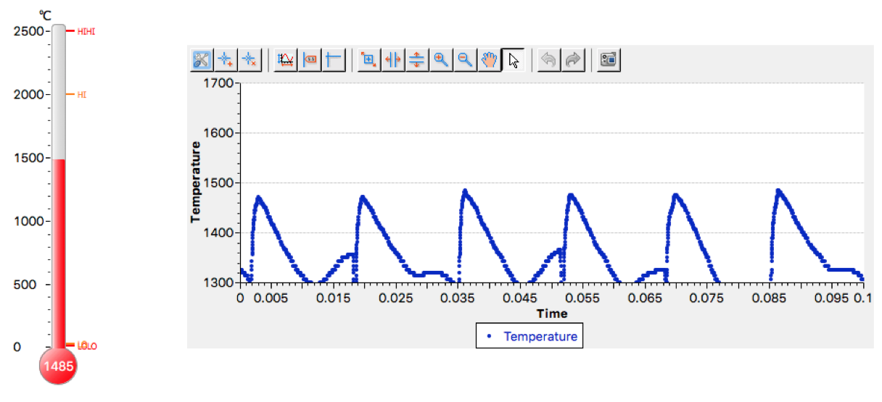
Injection Foil R&D: Foil Temperature Measurement
Telescope with two photodiodes
Focus on measuring foil temperature during production to understand performance and limitations
Remote measurement, dual pyrometer technique
First version of measurement system online
Talk by A. Aleksandrov
Future Plan
Establish SNS peak foil temp within ±50 K
Determine “failure” temperature of existing foils
Provide analysis and feedback for foil production R&D
Control room screen

Slide 16
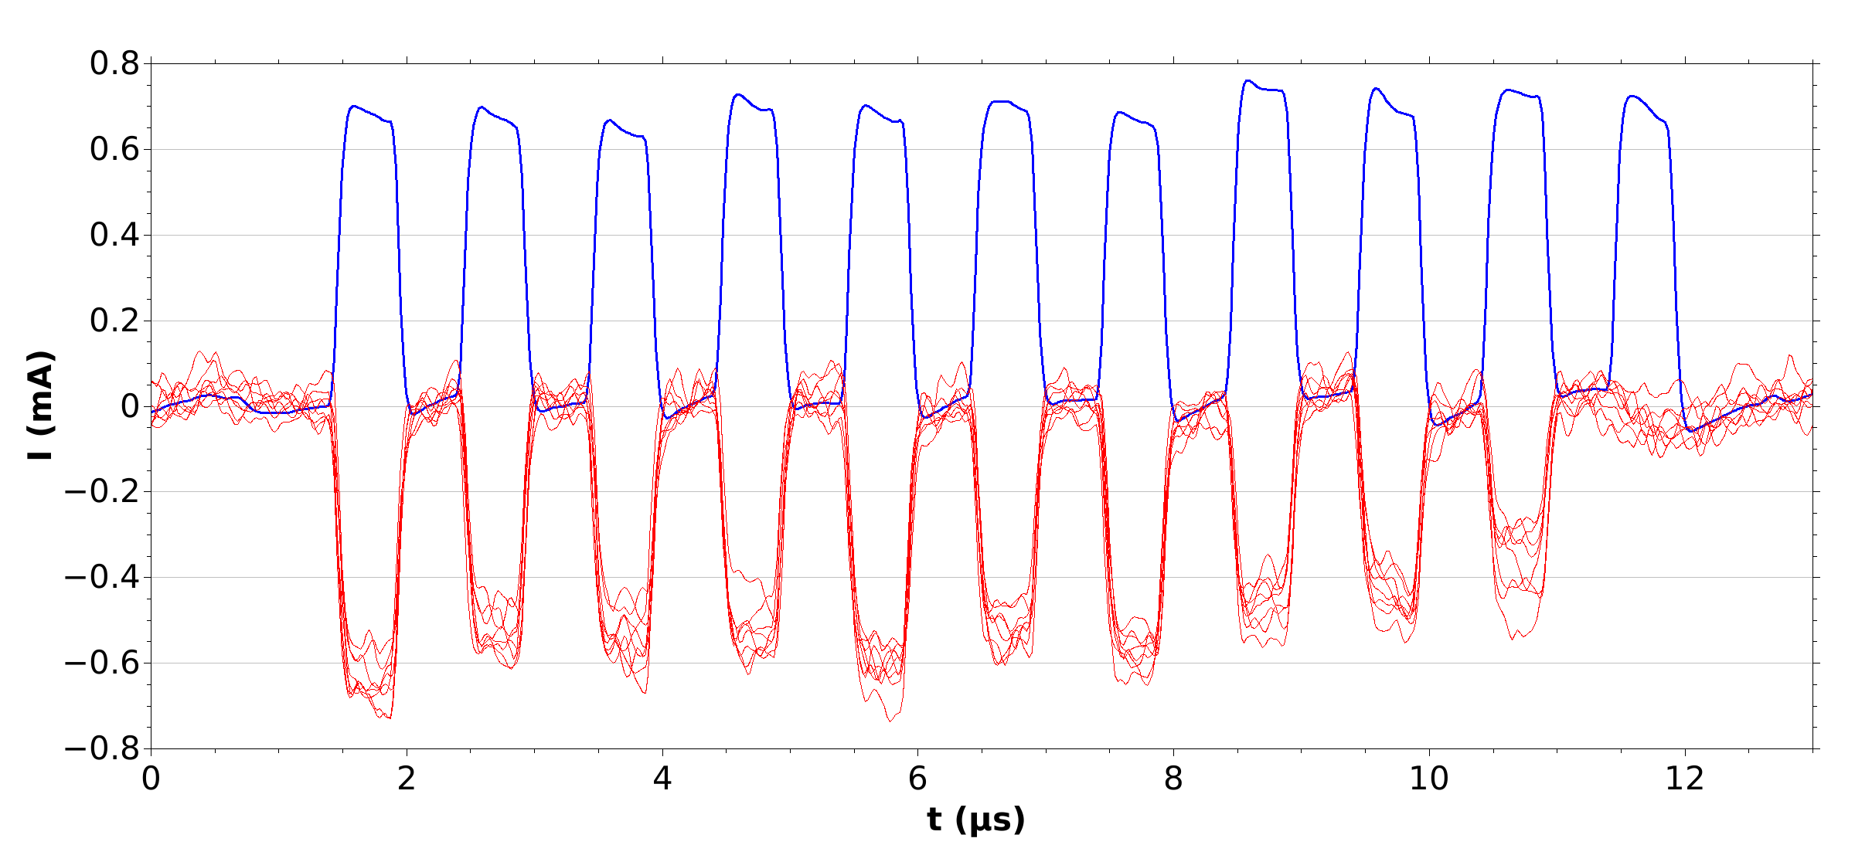


Laser-Assisted Charge Exchange (“Laser Stripping”)
Focus is on developing a foil-free charge exchange technology:
Achieved 95% stripping for 10 µs H- beam*
Jitter in laser did not allow for deep physics study
New power amplification scheme achieved 1 MW peak UV in recycling cavity
Results of 10µs Experiment
H⁻ reference pulse
Proton pulses
Talk by A. Rakhman
Recycling Cavity Concept
Future Plan
Address laser jitter issue
Perform deep physics study of 10 µs stripping
Go Green with recycling cavity for 1.3 GeV
Proton
Beam
H⁻ Beam
*Funded in part by DOE HEP grant

Slide 17
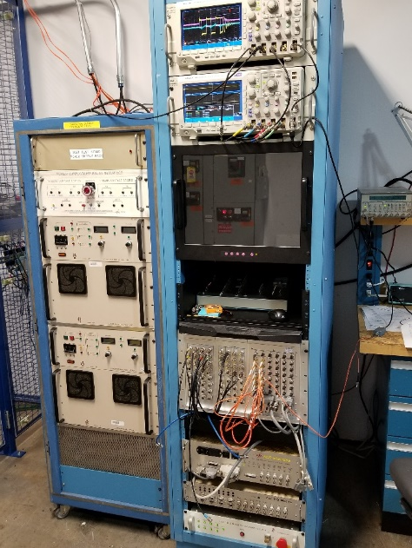
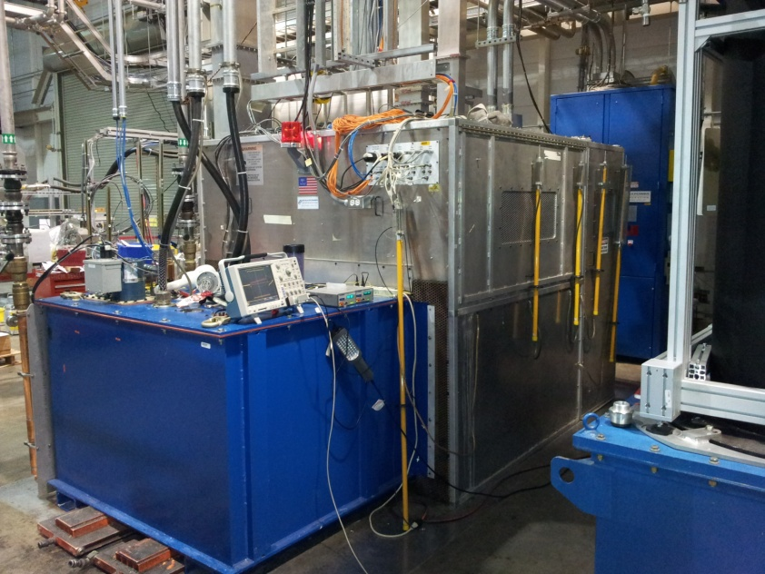
Electrical and RF Development
HVCM controller test stand
Focus is on improving reliability of systems and preparing for PPU
Improved HVCM and HVCM controls system to increase performance and reliability
Developing alternative technologies that improve performance and/or support PPU
Upgraded Ring LLRF controls
HVCM test stand (one of three)
Talks by D. Anderson, J. Moss
Future Plan
Refine HVCM controls to reduce initial ripple and optimize FPGA resources for other applications
Test and complete design for alternative technology HVCM
Complete all PPU baseline and procurement

Slide 18
Superconducting Cavities

Slide 19
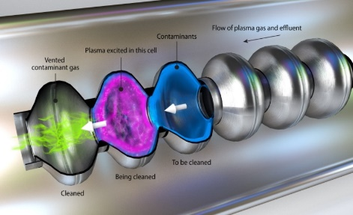
Superconducting Cavity Research and Development
Focus is on understanding and improving field emission in superconducting cavities
In-situ high beta plasma processing complete - average of 20% gradient increase
Recently modified in-situ plasma processing recipe for LCLS-II cavities (collaboration with Fermilab, SLAC)
Talk by S. Kim
Future Plan
Investigate in-situ plasma processing for medium beta cavities
Investigate ex-situ plasma processing techniques
Explore innovative techniques to probe SRF surfaces (PD funds)

Slide 20
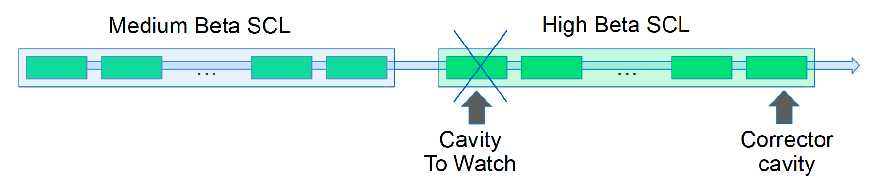
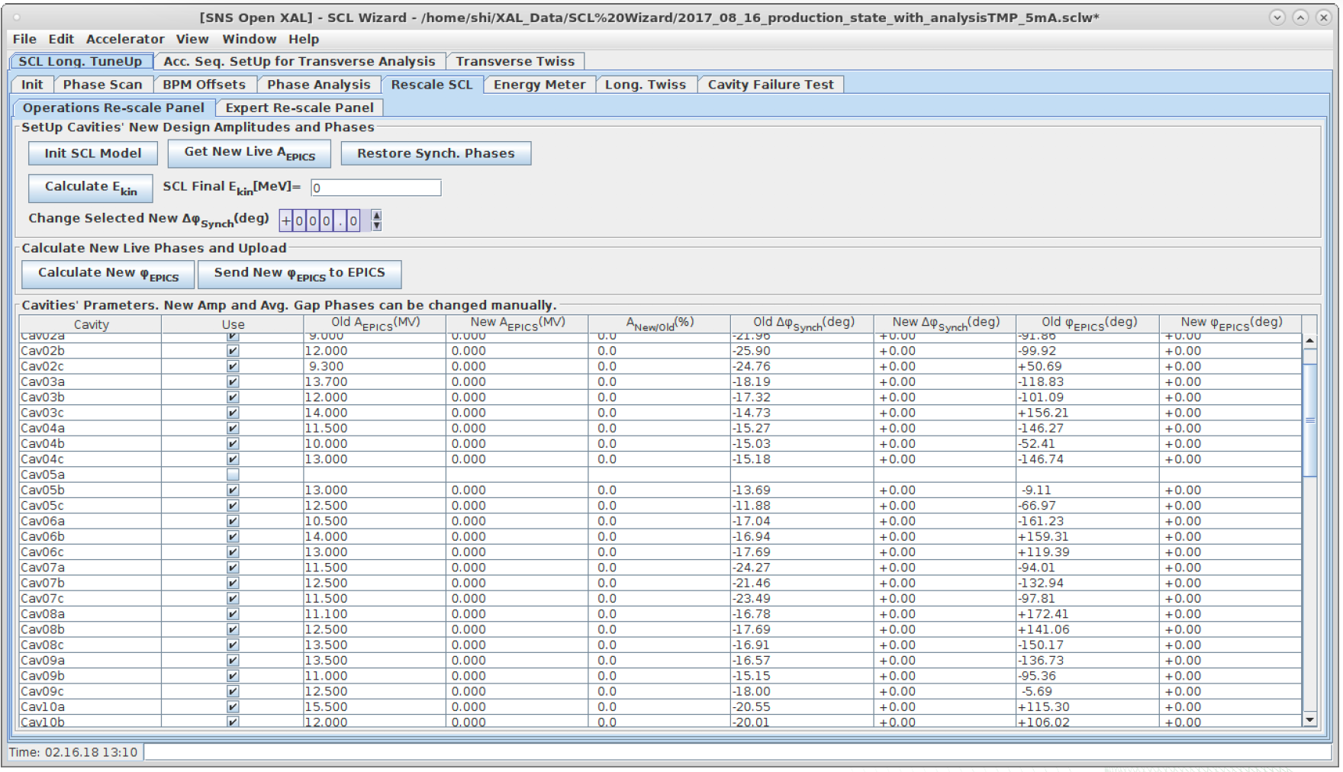
SCL Operational Techniques and Machine Learning
Focus is on more efficient and reliable operation of the SCL
Close to fully automated tuning of SCL already achieved
Proof-of-concepts for machine learning for beam fault prediction and reliability improvement
Software for cavity failure compensation experiment
Future Plan
Demonstrate fully automated “no-human-hands” recovery of SCL after loss of cavity
Demonstrate proof of concept for machine learning fault prediction

Slide 21
Summary
Thrust areas are high intensity beam dynamics, high power technologies, and superconducting cavity research
SNS is leveraging unique technological strengths to engage in high impact R&D:
  Highest power beam in world, highest intensity proton ring
  Only hadron SCL
  Only 6D measurement system
Success in R&D will depend on support of the division, directorate, and lab to support accelerator R&D, and to recruit and retain most talented staff
Historically Research Accelerator Division (RAD) has been very supportive

