Slide 1
AC Power Distribution
Presented at the
SNS Accelerator & Target
Advisory Committee Meeting
Kevin P. Norris
Manager – Electrical Power Systems
Robert H. Eason
Engineering – Site Operations Support
May 16, 2018

Slide 2
Outline
System One-Line Diagrams; 161kV/13.8kV & Conventional Substation
System Components
Metering System
Power Usage/Cost; PPU Estimate
Challenges/Associated Beam Downtime
Maintenance
Spares Inventory
Upgrades/Improvements
Recommendation Summary

Slide 3
161kV/13.8kV System One-Line Diagram

Slide 4
Conventional Substation One-Line Diagram

Slide 5
System Components
Two 161kV/13.8kV 70 MVA transformers
Switch house; Twenty 13.8kV Feeder Breakers, 5 Spares
28 Conventional Substations; 13.8kV manual switches (34 total), Transformers (25 oil filled,3 dry type), and distribution switchgears (480v or 4160v)
17 Modulator Substations; 13.8kV Motor-operated switches (17 total), Transformers (all dry type) (13.8kV/2100v)
Main Ring Dipole Substation; 13.8kV Motor-operated switch, Two 13.8kV Breakers, Two oil-filled 13.8kV/185v transformers
13 Generators (40kW – 400kW)
18 Automatic Transfer Switches (ATS)
14 Uninterruptible Power Supply Systems (UPS)(15kW- 100kW)

Slide 6
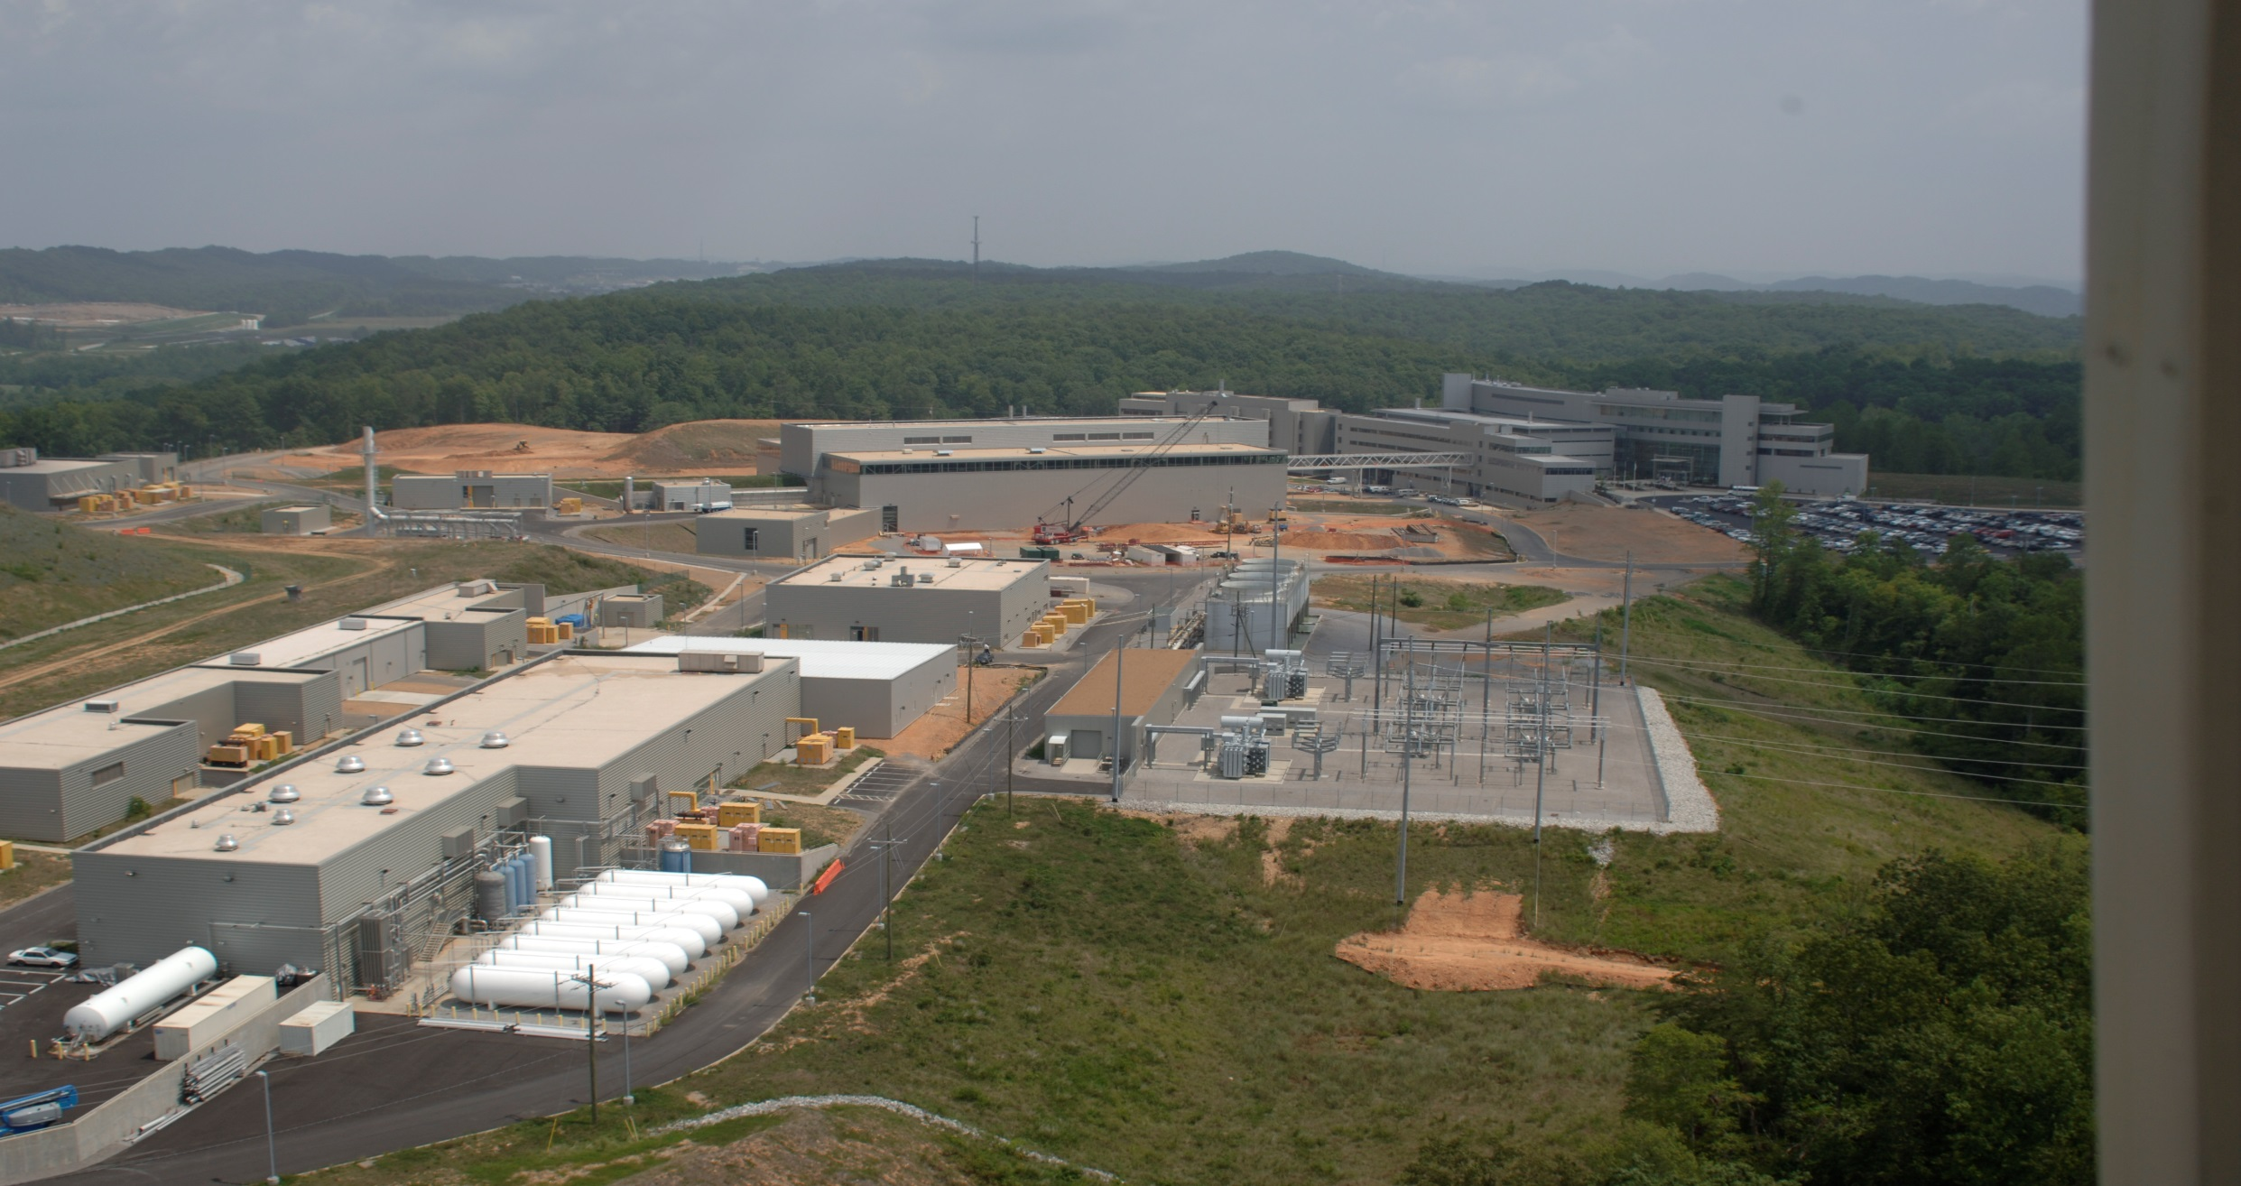
System Components – Aerial View
161kV/13.8kV
Transformer 1
161kV Lines –ELZA,
Ft. Loudon
Switch house
Switchyard
161kV/13.8kV
Transformer 2

Slide 7
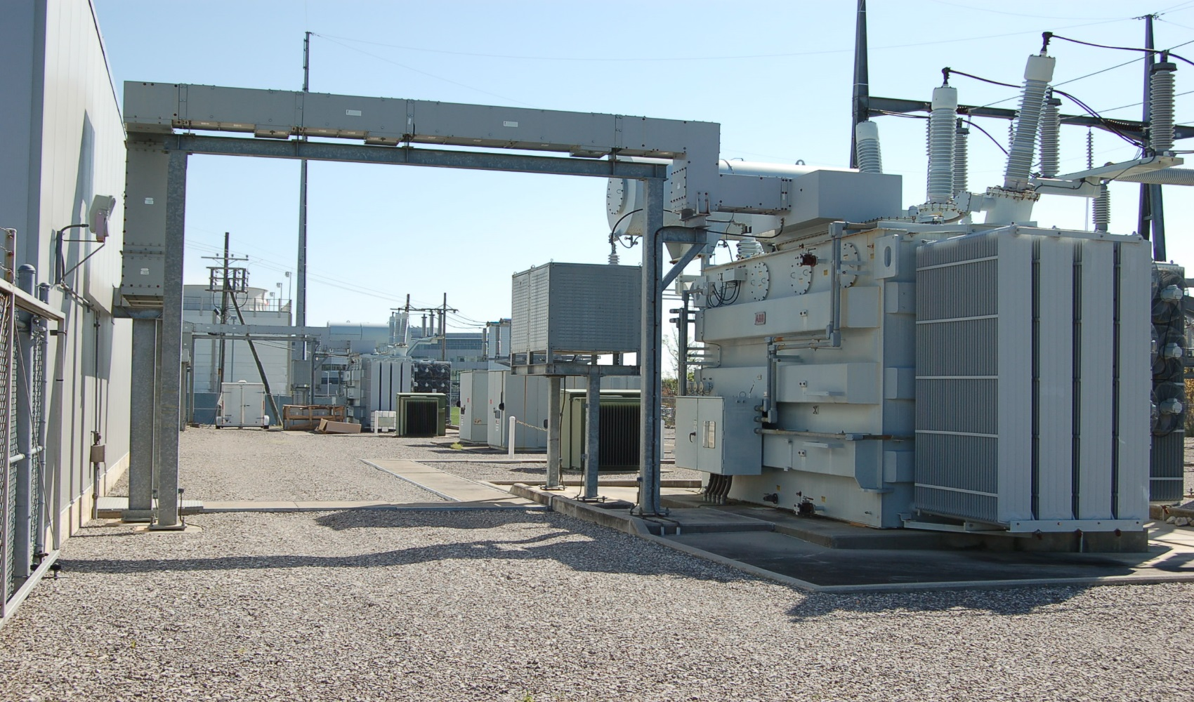
System Components
Two 161kV/13.8kV 70MVA Transformers
13.8kV Bus B
161kV line
13.8kV Bus A
Failures
161kV/13.8kV Transformer 1
161kV/13.8kV Transformer 2

Slide 8
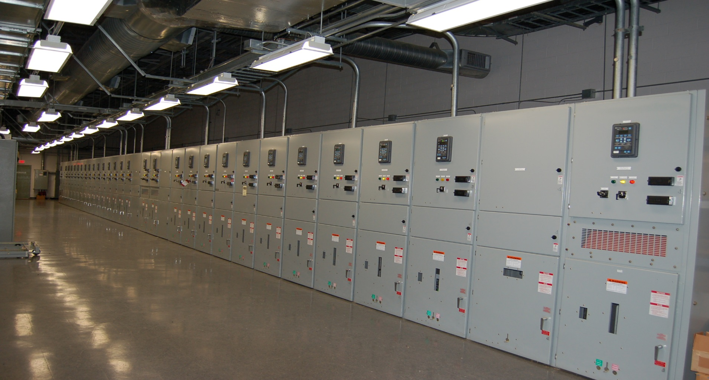
System Components
13.8kV Switch house; Bus A; 15 breakers (3 are for future use); Bus B; 10 breakers (2 are for future use)
Bus A
FP 5000
Protective
Relays
Metering Upgrade
2 Bus Tie Breakers-Normally Open
Bus B Feeder Breakers
Main Breaker Bus B

Slide 9
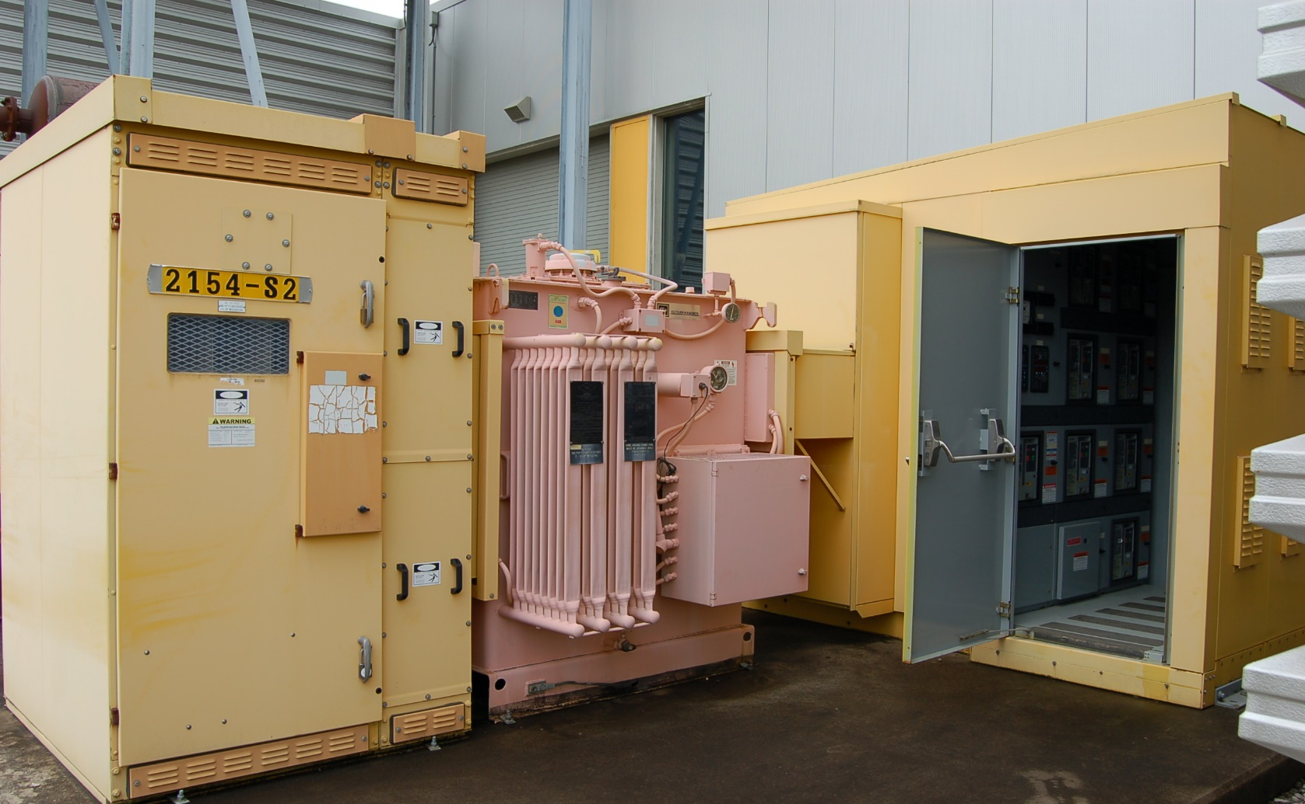
System Components
28 Conventional Substations; 13.8kV manual switches(34 total), Transformers (25 oil-filled, 3 dry type); Switchgears (480v or 4160v)
13.8kV/480v
Transformer
480 v
Distribution Switchgear
KL-SS2 Substation
Failures
13.8kV manual switch

Slide 10
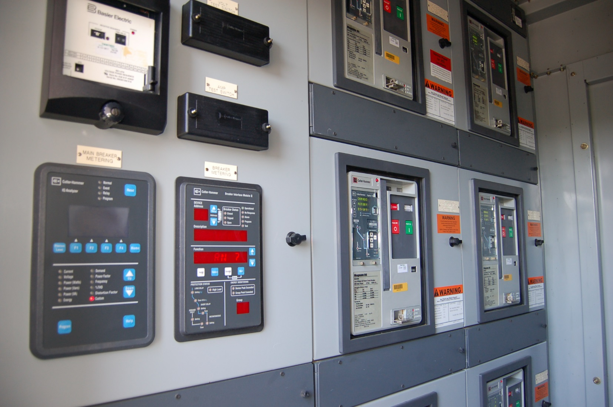
System Components
Conventional Substation – 480 Volt Distribution Switchgear
480v Swgr Breakers with DT1150 Trip Units
IQ6610 Analyzer
(monitors main breaker)
Metering Upgrade

Slide 11
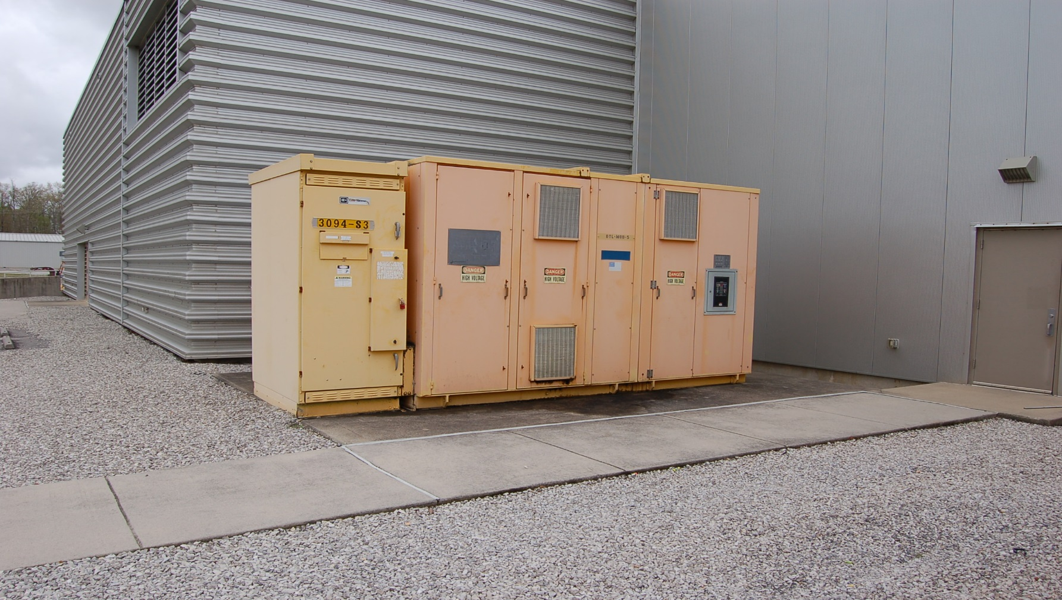
System Components
17 Modulator Substations; 13.8kV motor-operated switches (17 total), Transformers (17 total)
13.8kV/2100v
Modulator Transformer
(Dry-Type)
DTL-MOD-5
Substation
Failures
13.8kV motor-operated switch

Slide 12
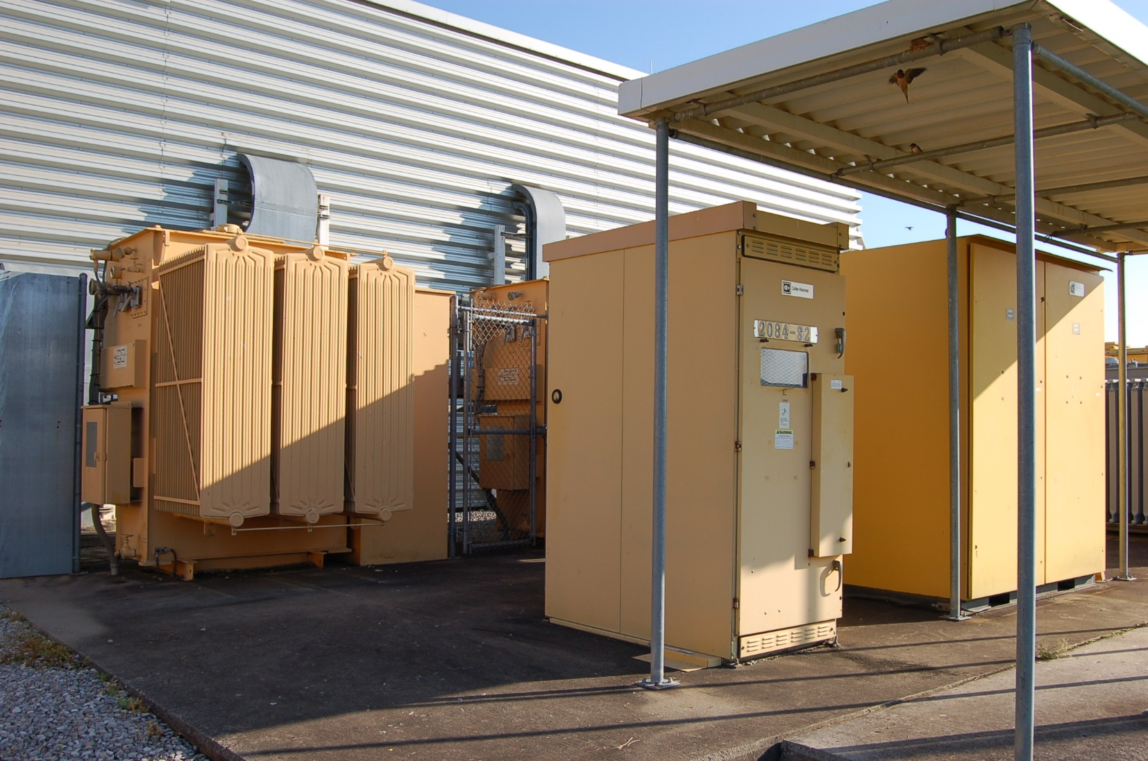
System Components
Main Ring Dipole (MRD) Substation; 13.8kV motor-operated switch, Two 13.8kV Breakers, Two 13.8kV/185v Transformers
MRD Transformers
13.8kV/185v, Oil-Filled
Failures
13.8kV Breakers
13.8kV motor-operated switch

Slide 13
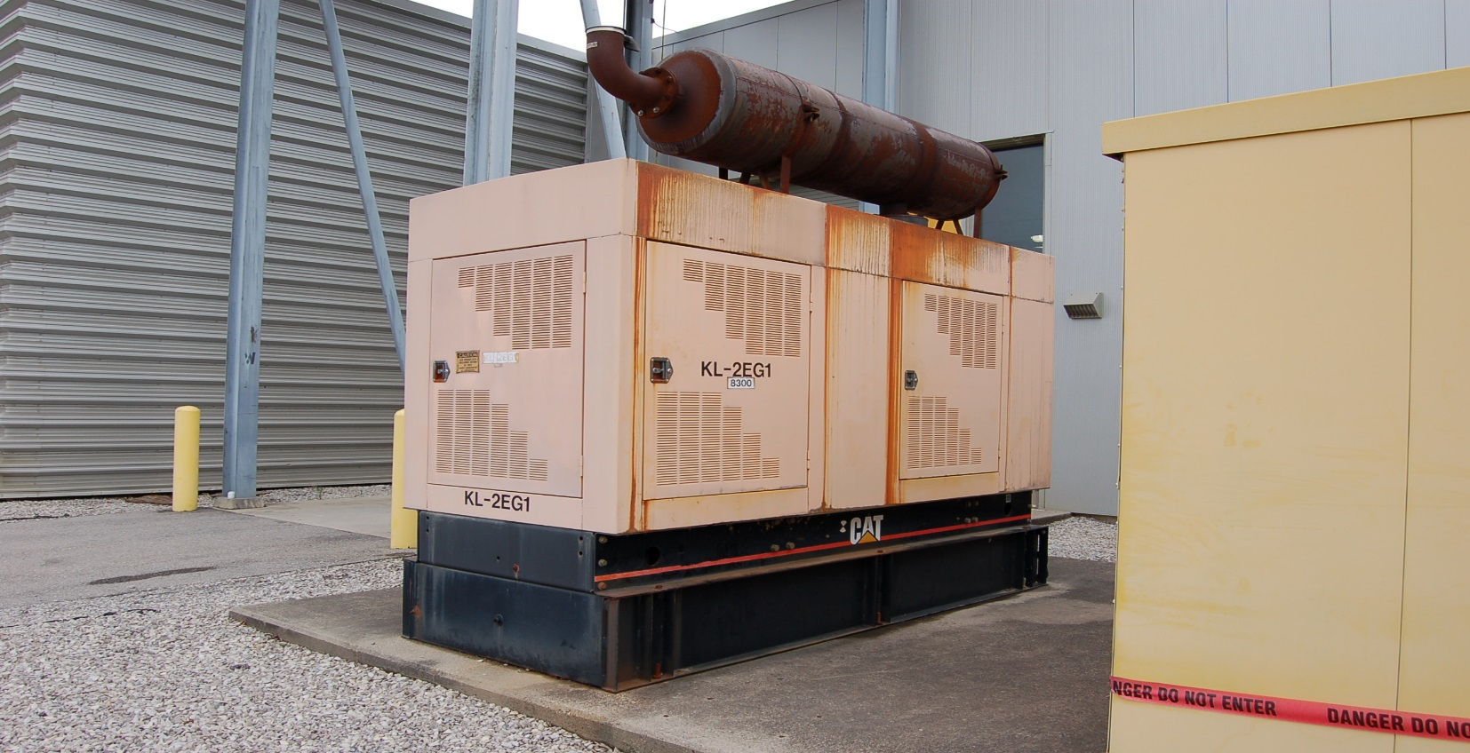
System Components
13 Emergency Generators (40kW – 400kW); ~3MW Total Capacity, 800kW connected load

Slide 14
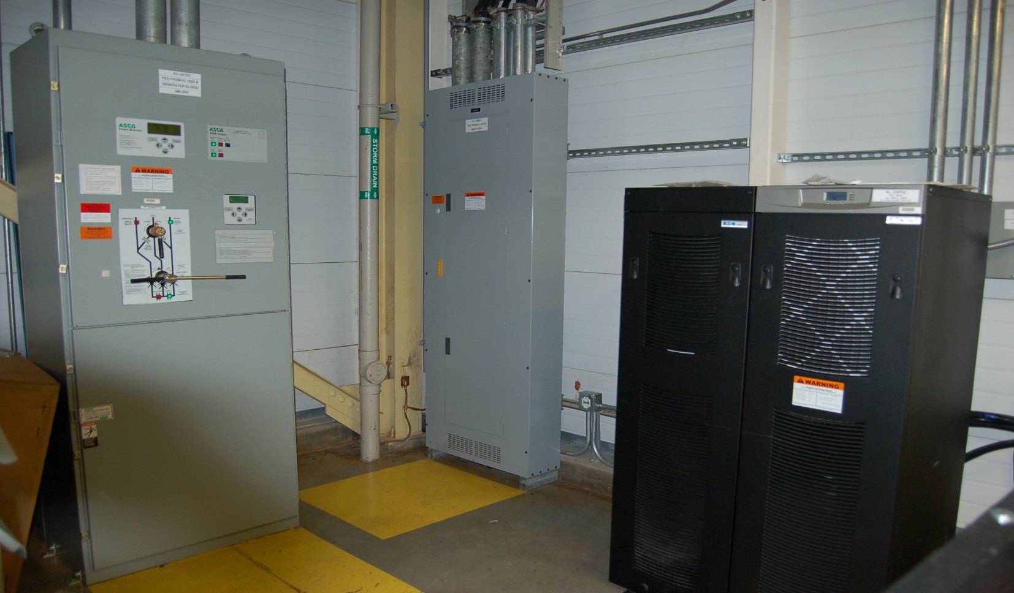
System Components
18 Automatic Transfer Switches (ATS) Units
14 Uninterruptible Power Supplies (UPS) Units
Emergency Distribution Panel
ATS Unit
UPS Unit
Failures

Slide 15
Metering System
The existing Metering System is based on Eaton Electrical’s PowerNet Architecture installed in 2000-2004, which utilizes inputs from Eaton electrical switchgear (IQ6610 Analyzer), protective relays (FP-5000) and low voltage power circuit breaker (LVPCB) trip units (DT-1150).
PowerNet Architecture has become obsolete and will need replacement in the future as Eaton support and replacement parts for this platform are no longer available.
PowerNet provides electrical metering information to the Experimental Physics information and Control System (EPICS)

Slide 16
Metering System-EPICS Screenshot

Slide 17
Power Usage/Cost; PPU Estimate
For 2017, Average Demand ~25MW, Peak of ~28MW
Breakdown of Usage (data taken Sep. 18th, 2017)
17 Modulators; 11MW
Central Helium Liquefier Facility (CHL); 3.8MW
Central Utilities; 3.0MW
Ring Service Bldg.; 3.4MW
Klystron Gallery; 1.8MW
Target Facility; 1.8MW
Central Lab Office Bldg. (CLO); 1.0MW (Total 25.8MW)
Calendar Year 2017 Cost: $12.1 Million
PPU Estimated additional power ~6MW

Slide 18
Challenges and Associated Beam Downtime
13.8kV Switch Failures–9 Total; 4 motor-operated,5 manual
Mar 2005; DTL-MOD3; motor-operated, fuse failure; Before beam production
Oct 2007; RN-SS1; manual, moisture; No downtime; during shutdown
Jan 2010; RT-SS1; manual, moisture; No downtime; during shutdown
May 2013;SCL-MOD15; motor-operated, fuse failure; 12.9 hours
Nov 2014; SCL-MOD18, RF-PS1;motor-operated,fuse failures; No downtime (during Target failure)
August 2015; BP-SS1;manual, moisture; 67.4 hours
October 2017; BP-SS1;manual, rodent; 14.4 hours
November 2017; BP-SS1; manual, rodent; 15.9 hours (Total 110.6 hours)

Slide 19
Challenges and Associated Beam Downtime
Transformer Failures
Dec 2009; RTBT Substation transformer; mechanical failure of winding core; No downtime, during shutdown
Jan 2015; RN-SS2 Substation transformer; moisture intrusion through tap changer; No downtime, during shutdown
13.8kV Bus Failures
Jan 2012; 13.8kV Bus B fault; Moisture; No downtime, during shutdown
Jan 2018; 13.8kV Bus A fault; Moisture; No downtime, during shutdown
UPS Failures
Oct 2006; KL-2UPS1 (9330 type); Control board; no downtime
Jan 2012; KL-2UPS2 (9330 type); Control board; no downtime

Slide 20
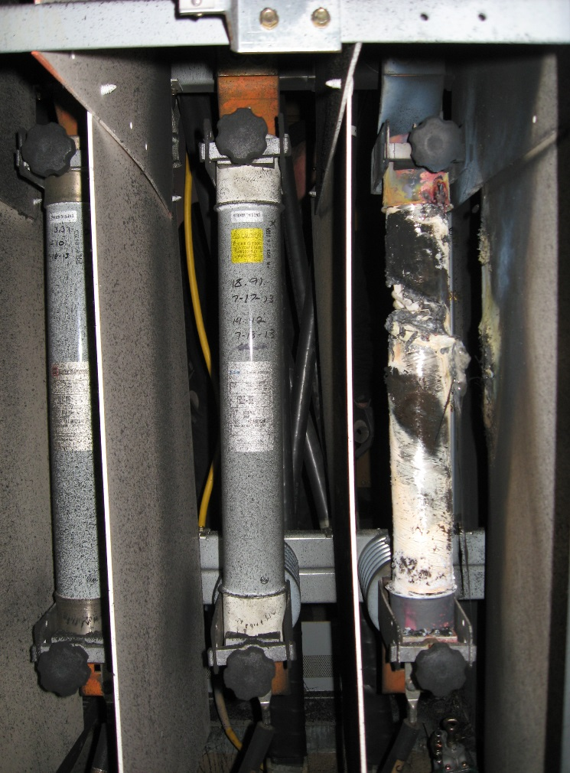
13.8kV Motor-Operated Switch failures- 4 total, all fuse related

Slide 21
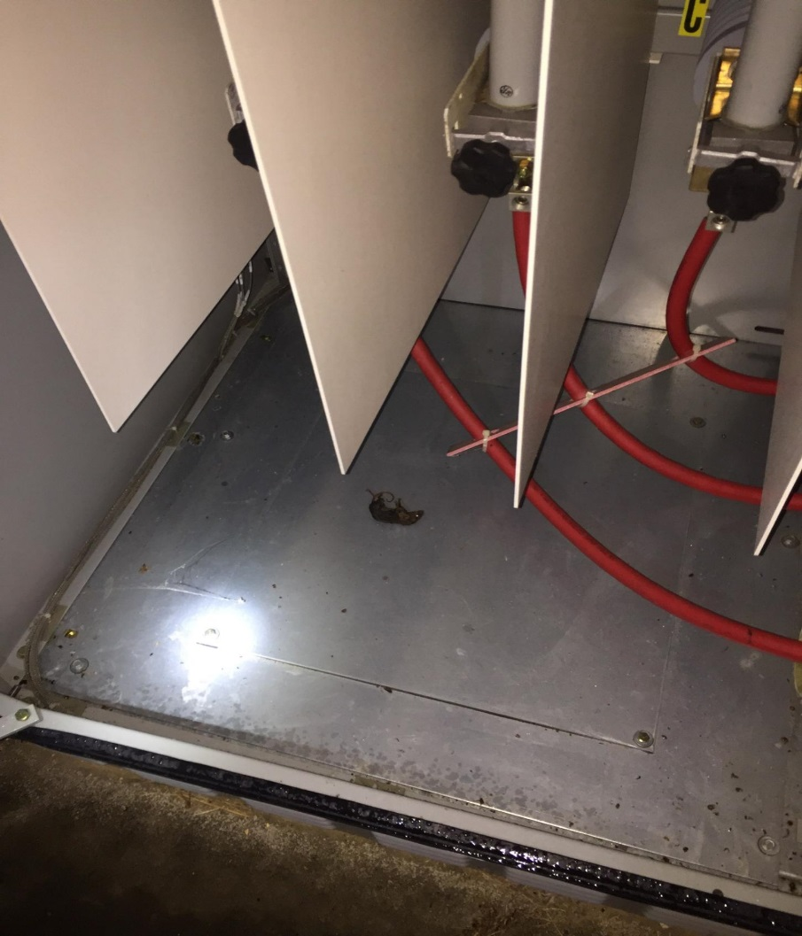
13.8kV Manual Switch failures- 5 total; 2 by rodent, 3 by moisture

Slide 22
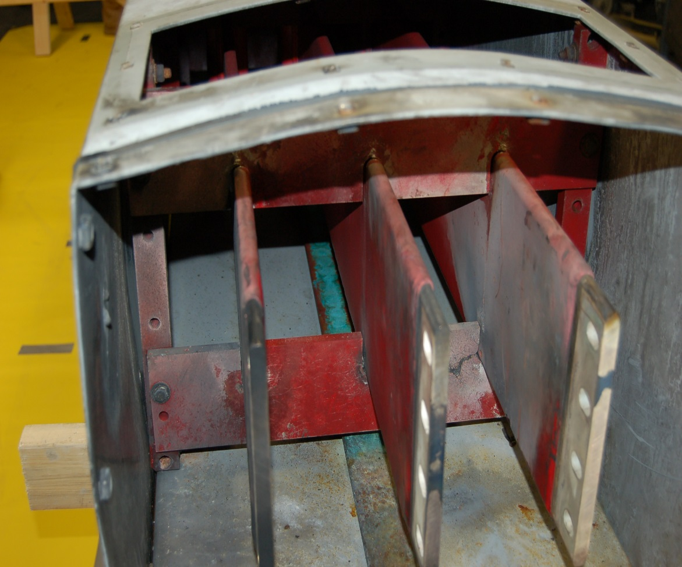
13.8kV Bus Failures- 2 total- One each Bus A and Bus B, both moisture related
Bus B- Fault location
End View

Slide 23
Maintenance
13.8kV/4160v/480v Distribution Switchgear; 4 year cycle
13.8kV Manual switches – Every 4 years but some operational areas are problematic- Heater circuits verified quarterly by ammeter or thermal imaging
13.8kV Motor-operated switches – Annual pm- Heater circuits verified quarterly by ammeter or thermal imaging
Transformers ; Annual Dissolved Gas Analysis (DGA)
Generators; Monthly, Annual, Tri-Annual
ATS units; Annually
UPS units; Annually

Slide 24
Spares
13.8kV motor-operated switches; 2 original styles;
13.8kV manual switches; 2 original styles;
Two S&C switches ($90K each) are on order, may be used in any of the above configurations
Transformers; Have two 13.8kV/4160 transformers and one 13.8kV/480 transformer on site; one 13.8kV/185v transformer for the main ring dipole (MRD)
Recommend providing funding for 3 more spare transformers; Two 13.8kV/480, 2500KVA and One 13.8kV/4160, 5000KVA, $300K

Slide 25
Upgrades and Improvements
13.8kV Switches; Evaluating different switch options for replacement of original vendor supplied switches
Costs ($25K to 90K); 52 total switches (34 manually operated, 18 motor-operated)
Physical construction- Conduit stub-ups; transformer transition; size of concrete pad
Operational considerations (motor-operated (remote)/ manual)
Recommend funding for a phased approach to replace all 18 motor-operated switches and evaluate critical manual switches for replacement (i.e., Central Utilities)

Slide 26
Upgrades and Improvements
S&C Switch ($90K) – 1 installed at BP-SS1 Conventional Substation (3 of 9 switch failures at this location)
13.8kV switch enclosed in SF6 Tank
BP-SS1 Substation

Slide 27
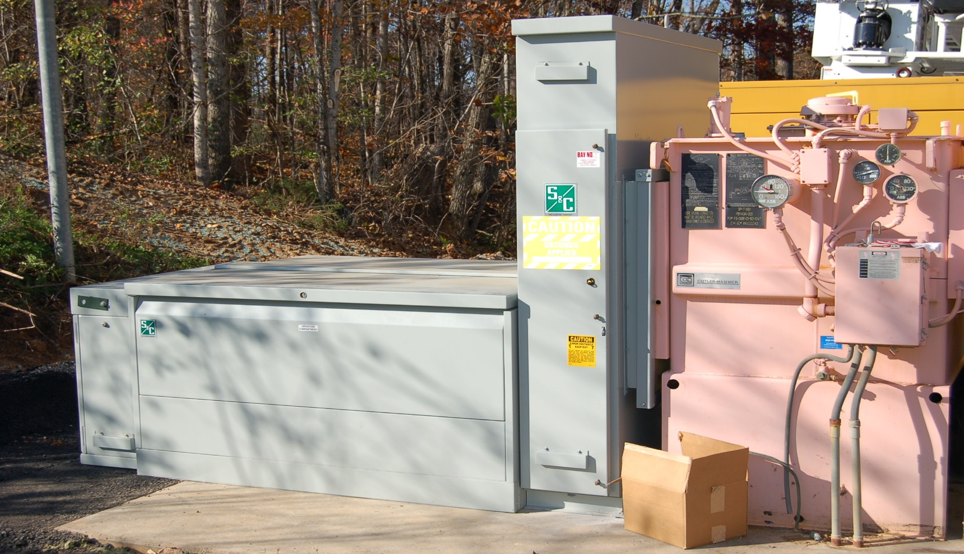
Upgrades and Improvements
BP-SS1 Substation
Concrete Pad Extension

Slide 28
Upgrades and Improvements
13.8kV Bus Faults: Evaluated a Partial Discharge Monitoring System to be installed on both outdoor 161kV/13.8kV transformer bus secondaries
The system analyzes RF signals emitted by partial discharge pulses; the pulse quantity and magnitude are analyzed over time to determine insulation problems, poor electrical connections, and surface tracking
Recommend full funding for this project; $122K

Slide 29
Upgrades and Improvements
UPS replacement – 7 remaining model 9330 UPS units are reaching the end of service life- 1 on order to replace the Front End 9330 UPS; 2 have failed and been replaced with newer model
Recommend a phased approach to replace 6 outdated UPS units, approximately $35K each
Metering Upgrade – Based on technical direction set by ORNL Electrical Utilities organization- Based on Schneider Electric’s ION architecture (vs. Eaton Electrical’s PowerNet)
Install new metering in 13.8kV Switchgear, all conventional substations (including main and distribution breakers), connect all UPS units and generator units, and in the 17 modulator substation secondaries
Recommend a phased approach to funding this approximately $1.8 Million project

Slide 30
Summary of Recommendations
Funding for 3 more spare transformers; Two 13.8kV/480, 2500KVA and One 13.8kV/4160, 5000KVA, $300K total
Funding for a phased approach to replace all 18 motor-operated switches and evaluate critical manual switches for replacement (i.e., Central Utilities); $150K initially
Funding for the Partial Discharge Monitoring System; $122K total
Funding for a phased approach to replace 6 outdated UPS units, approximately $35K each; $70K initially
Funding for a phased approach to upgrade the PowerNet metering $1.8 Million project; $225K initially

