Slide 1
EPICS Meeting 2016

Slide 2
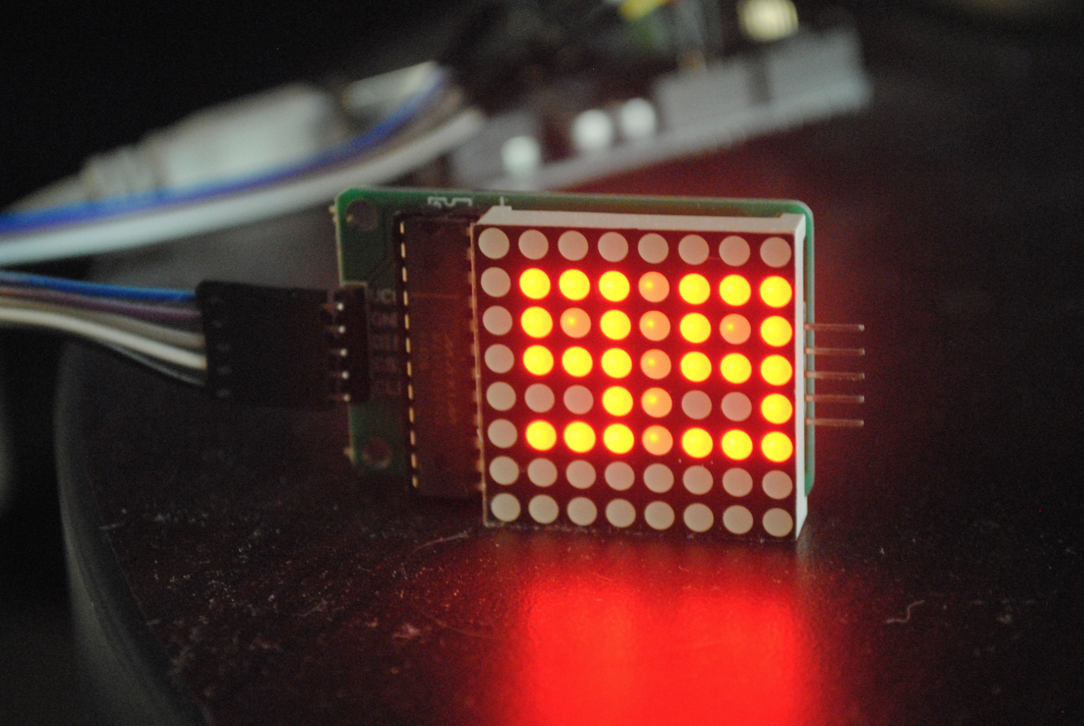
?
Thanks for
attending
presenting
sharing

Slide 3
EPICS Collaboration Meeting Spring, 2017 will be in ..
?

Slide 4
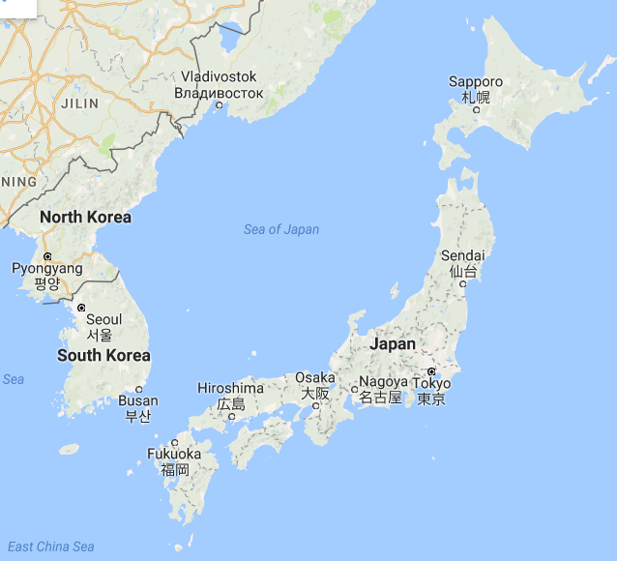
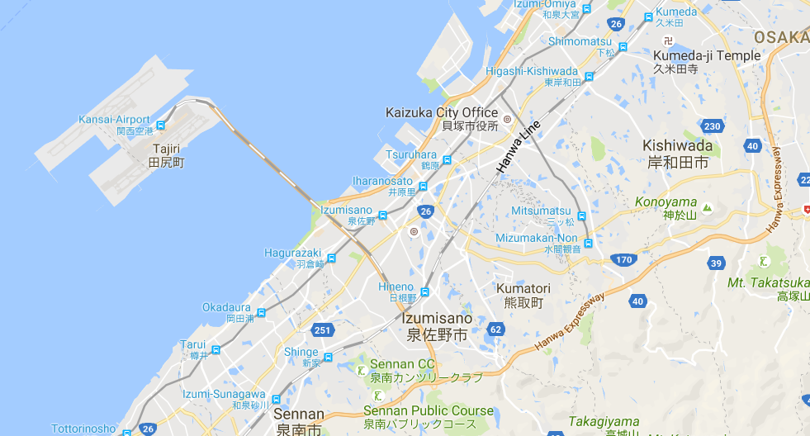
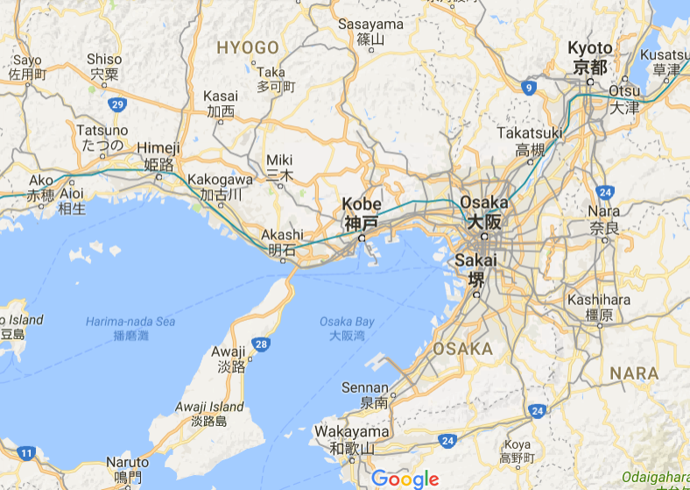
EPICS Collaboration Meeting
Spring, 2017
KURRI
(Kyoto University
Research Reactor Institute)
Kansai International Airport
5km
Location
Japan
-> Osaka
-> Kumatori
Kyoto
IPAC2010
Kobe
ICALEPCS2009
Date
15-19, May, 2017

Slide 5
EPICS Collaboration Meeting Spring, 2017
Host and Venue
KURRI (Kyoto University Research Reactor Institute)
with helps from KEK and J-PARC
KURRI is in Kumatori, Osaka, Japan
http://www.rri.kyoto-u.ac.jp/en
Date
15-19, May, 2017
More …
More information will be given later on the web
Very close to Kansai International Airport (KIX)
Not ! located in Kyoto

Slide 6
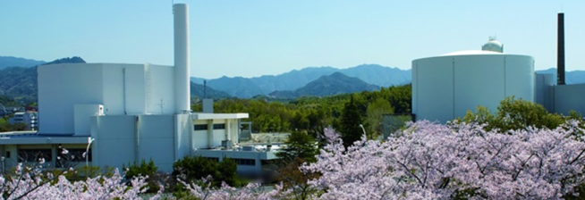
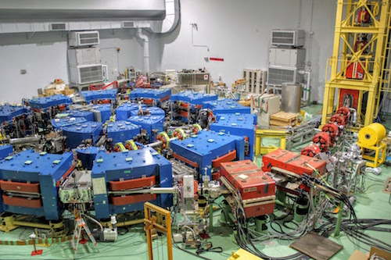
About
KURRI research reactors in spring
FFAG Accelerator Complex
- KURRI FFAG Complex had been constructed for the feasibility study of the accelerator driven system (ADS).
- The first ADS experiment had been performed in March, 2009.
- EPICS had been introduced from 2010.
By
Y.Kuriyama (KURRI)
n.kami (J-PARC/KEK)
See you next in Japan !

