Slide 1
ESS Experience with Ion Source and LEBT Control System Development and Commissioning
Nick Levchenko
Control Systems Engineer
www.europeanspallationsource.se
2016-09-xx

Slide 2
Scope

Slide 3
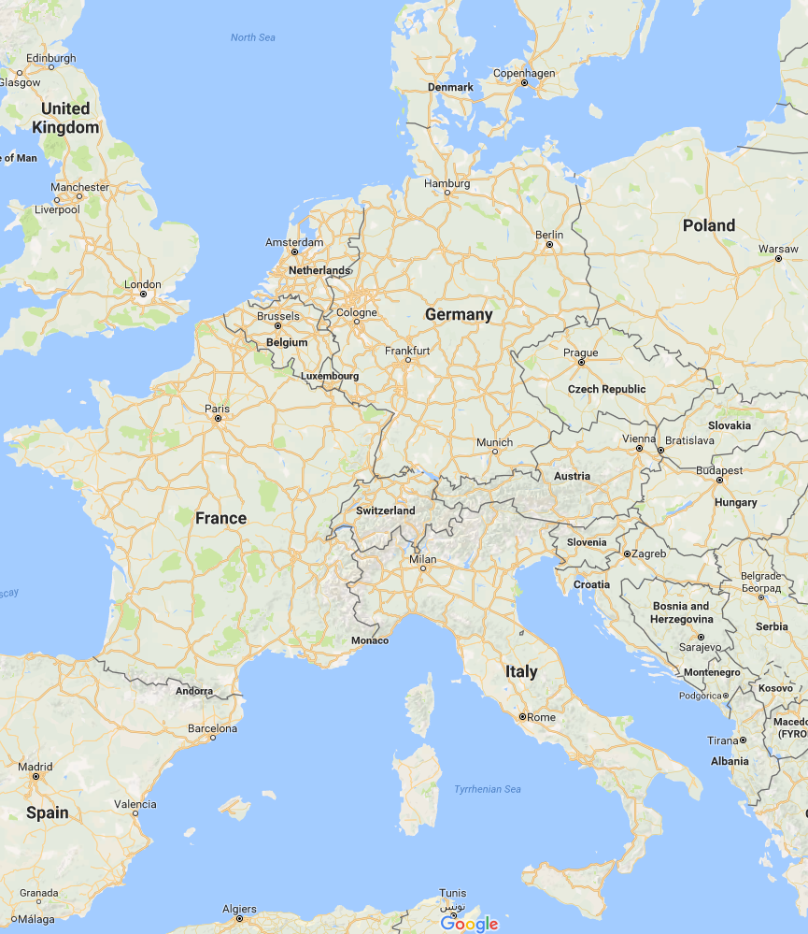
Stakeholders
ESS ICS Division
ESS Accelerator Division
CEA (Saclay)
INFN LNS (Catania)

Slide 4
Control System Technical Solutions
VME-based very fast data acquisition and control (Faraday Cup, Magnetron, etc.), later transitioning to uTCA
EtherCAT-based fast data acquisition and control (power supplies, cooling and vacuum systems)
PLC-based local interlocking and control
PC-based IOC’s
MRF-based timing system (VME, PCIe)

Slide 5
EPICS @ ESS
ESS EPICS Environment (EEE), collection of scripts to:
Compile and install EPICS resources
Create/run IOC’s without compilation (dynamic loading, introduced by Dirk Zimoch, PSI)
All machines are network-booted
All IOC’s run using centrally located EPICS modules
IOC’s are managed with IOC Factory

Slide 6
Example IOC (Architecture)
IOC
require
require
require
m-epics-mks945
m-epics-plc
m-epics-pstdk
Vacuum Controller
PLC
Power Supply

Slide 7
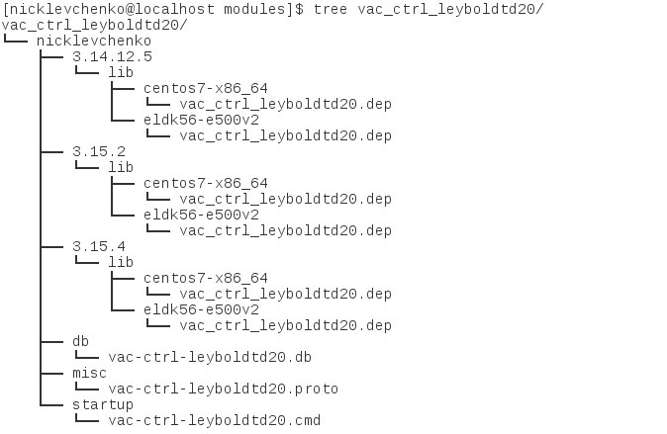
Module
Module version
EPICS versions
Architectures
7

Slide 8
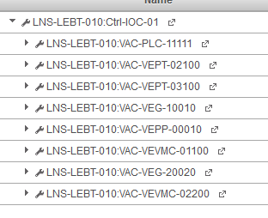
Controls Configuration Database (CCDB)
Defines which devices an IOC controls

Slide 9
Controls Configuration Database (CCDB)
Defines which EPICS modules does IOC need for every controlled device

Slide 10
IOC Factory
Configures the IOC (EPICS versions, module versions, etc.)

Slide 11
IOC Factory
Configures the IOC (EPICS versions, module versions, macros)

Slide 12
Example IOC (Generated by IOC Factory)
Vacuum Controller
PLC

Slide 13
Advantages of module architecture
Support multiple EPICS versions
Automatic management of dependencies
Easy to manage multi-user work on the same IOC
Can test individual modules in parallel with iocsh
Easy to reuse modules developed by other people for other IOC’s
Easy to switch between different module versions
Easy to work with remote users

Slide 14
Modules distribution (m-epics-s7plc)
ESS EEE Server
CEA EEE Server
rsync
make
make install
Lund, Sweden
Saclay, France

Slide 15
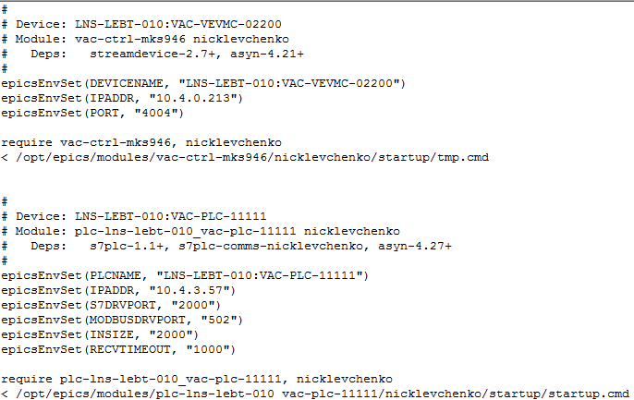
IOC configuration distribution (st.cmd)
ESS EEE Server
CEA EEE Server
rsync
www
CCDB, IOC Factory
Lund, Sweden
Saclay, France

Slide 16
Current issues (work in progress)
Need for manual import of modules developed in remote locations
ESS EEE Server
CEA EEE Server
rsync
CCDB, IOC Factory
make
make install
16

Slide 17
Current issues (work in progress)
Need for manual recompile of modules when adding new EPICS version
Module version
EPICS versions
17

