Slide 1
BLUESKY & OPHYD
A lightweight framework for Interactive and automated data collection
Arman Arkilic — NSLS2

Slide 2
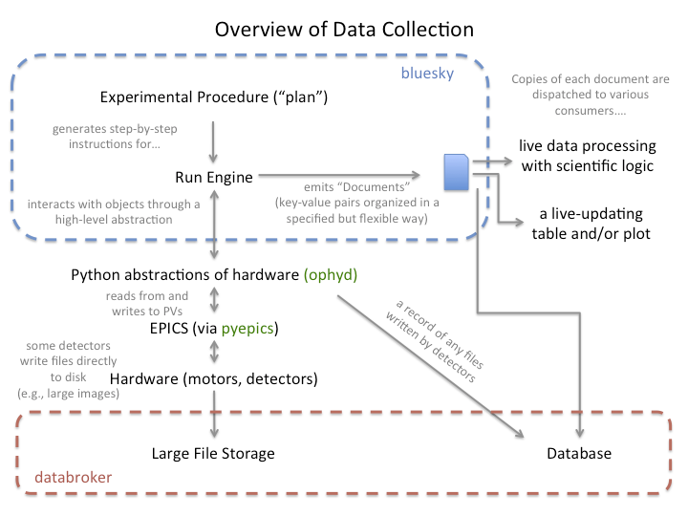
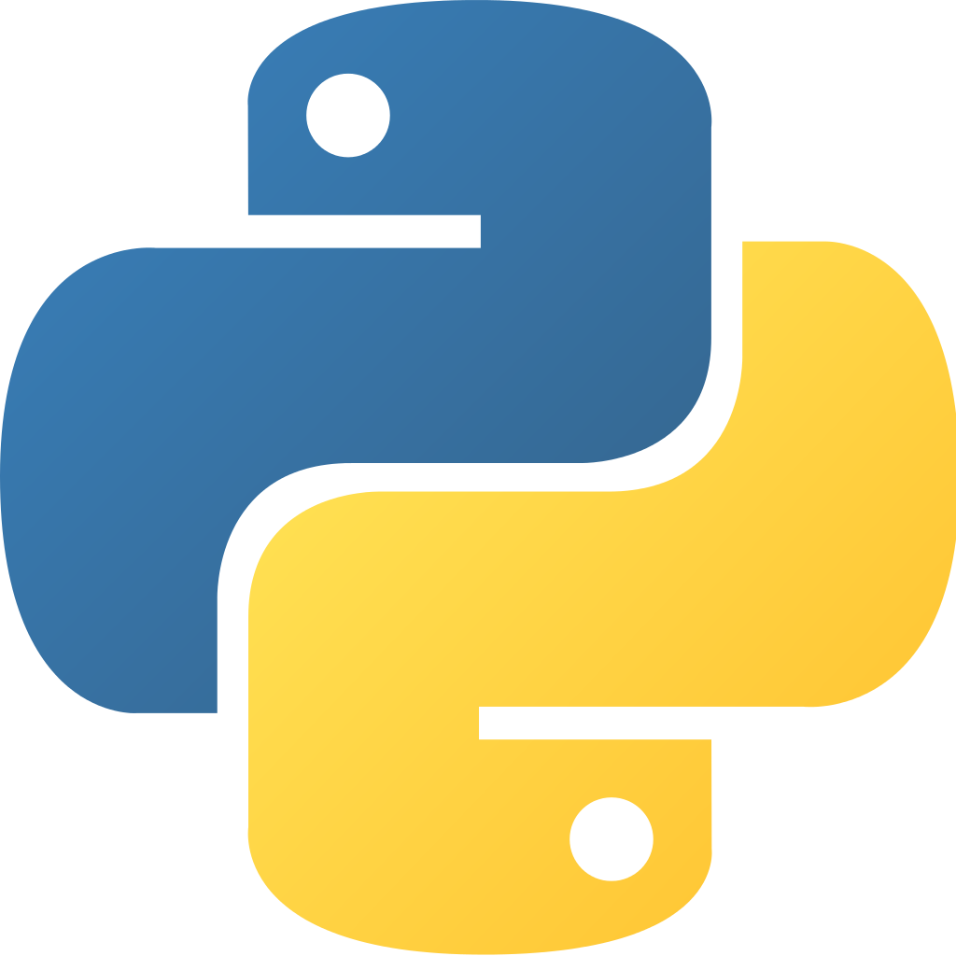
Data collection overview and FRAMEWORK COMPOnents
BLUESKY: Specify and execute experiments
OPHYD: Hardware abstraction layer
MIDDLE-LAYER SERVICES: Asynchronous and semi-structured services + archiver appliance
DATABROKER: Simplified interface to obtain data from middle layer
SUITCASE: Library that provides means to export experimental data from database to file
ARCHIVERAPPLIANCE: For PVs that were not captured by daq
http://nsls-ii.github.io/

Slide 3
BLUESKY

Slide 4
Captured and organized to facilitate reproducibility and searchability
RICH Metadata

Slide 5
Seamlessly reuse a procedure on completely different hardware
Experiment generality
Same experimental procedure (“scan”)…
scan([point_detector], motor, 1, 5, 5)
…different hardware:
scan([area_detector], temp, 273, 283, 10)
There are many other procedures…
relative_scan([area_detector], temp, 273, 283, 10)

Slide 6
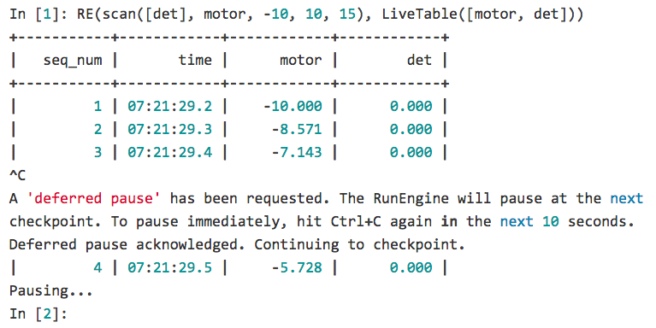
Experiments are “rewindable,” recovering cleanly from interruptions
INTERRUPTION RECOVERY

Slide 7
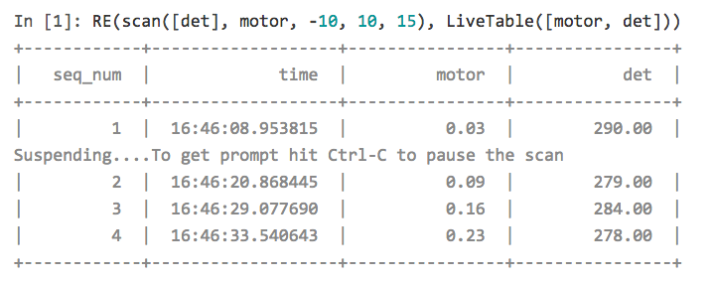
Experiments can be run unattended, automatically suspending and resuming if needed
Automated SUSPEND/RESUME

Slide 8
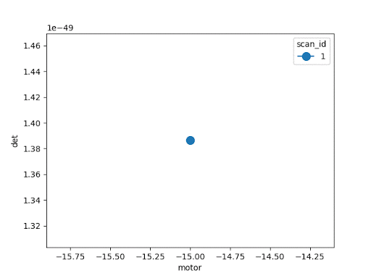
Export data (live) into any desired format or database*
PLUGGABLE I/O

Slide 9
CUSTOM EXPERIMENTAL PROCEDURES (“PLANS”) GET FEATURES FOR FREE
INTERRUPTION RECOVERY
Bluesky’s design separates specification from execution. The RunEngine (the executor) handles all of the following:
handling interruptions (Ctrl+C or automatic suspension)
I/O
“cleaning up”, e.g., putting hardware in a safe state at exit
User-defined procedures do not have to do any of this; they get it all “for free”.

Slide 10
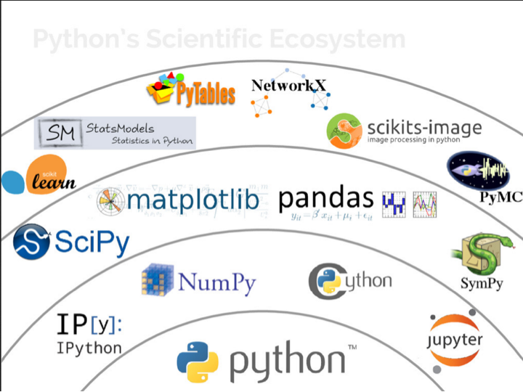
Interface naturally with numpy and Python scientific stack
INTEGRATION WITH SCIENTIFIC PYTHON
[“State of the Stack” by Jake VanderPlas, SciPy Conference 2015]

Slide 11
Some niceties about bluesky
Key Bluesky Features
Ability to compose and combine complex plans in addition to built-in simple ones
Customizable callbacks: any function that accepts a Python dictionary as its argument can be used as a callback.
Interruptions: all plans can be interrupted
Suspenders: Signal can be monitored and execution suspended for appropriate condition
Asynchronous acquisition: flying and monitoring

Slide 12
OPHYD

Slide 13
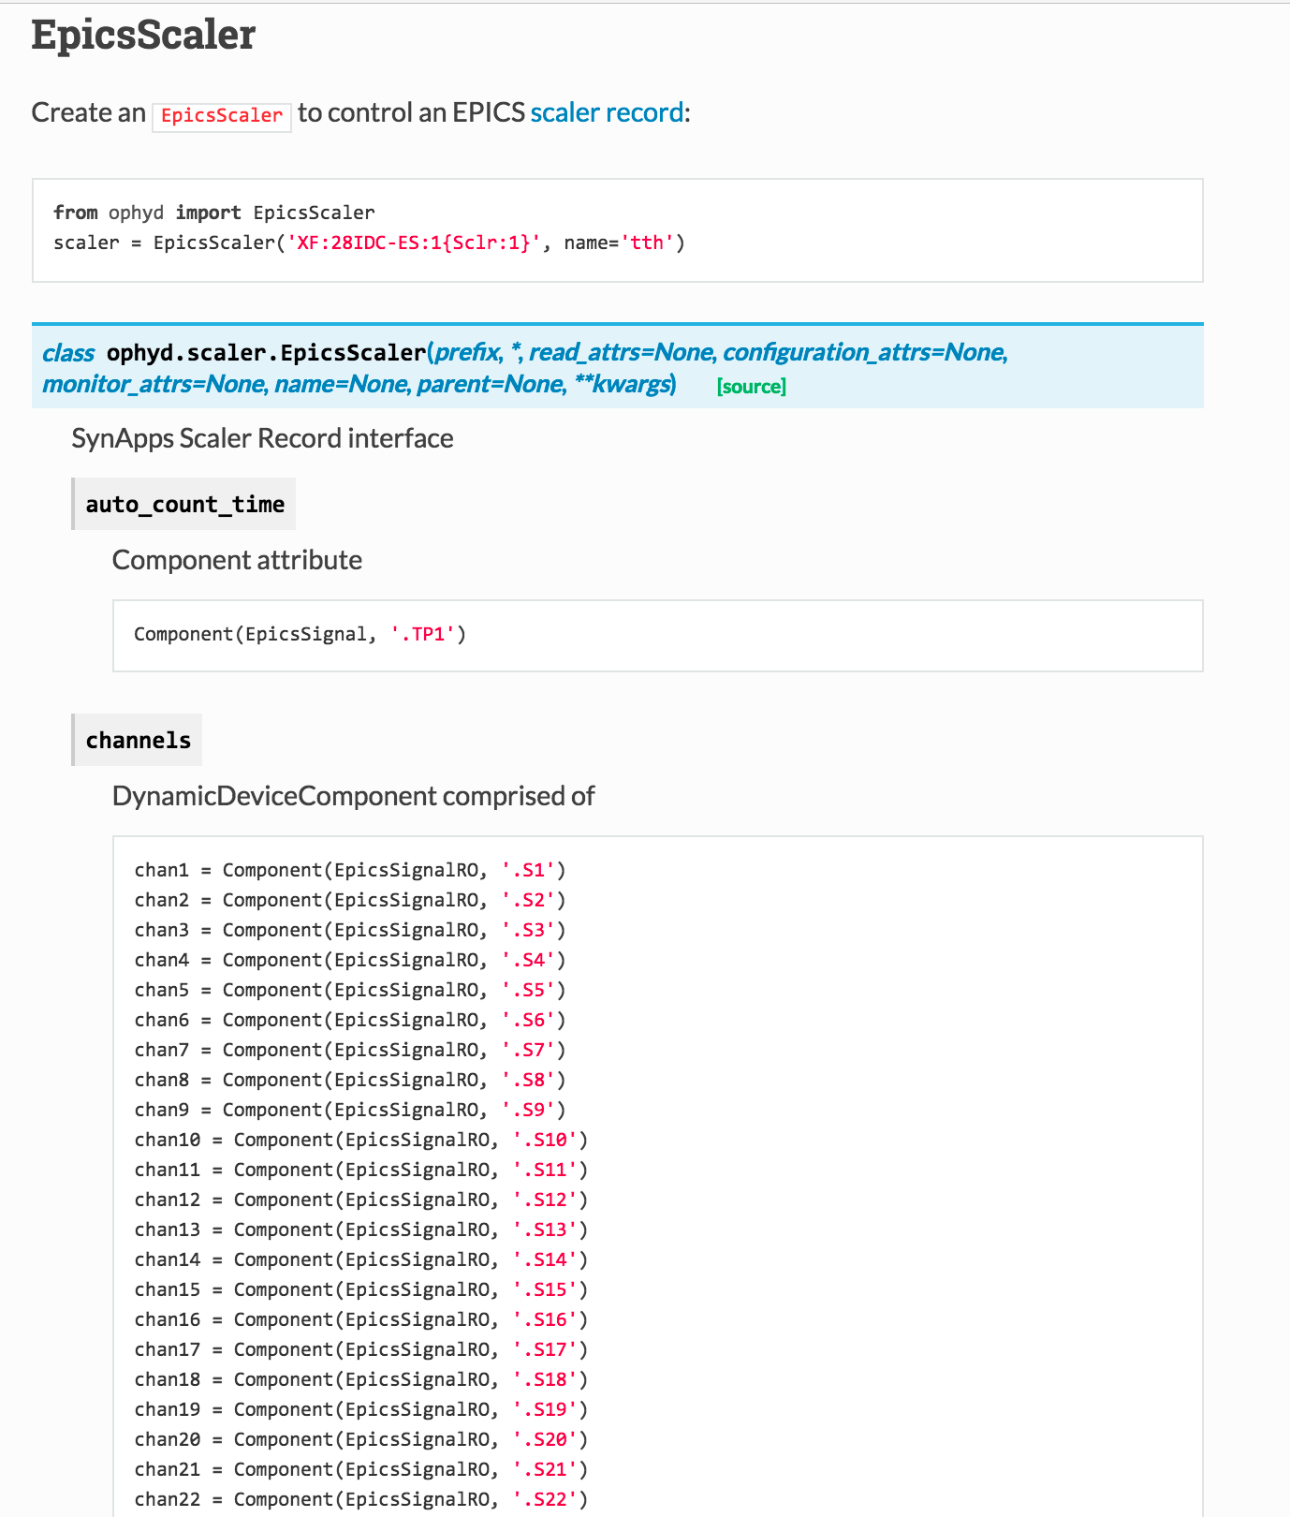
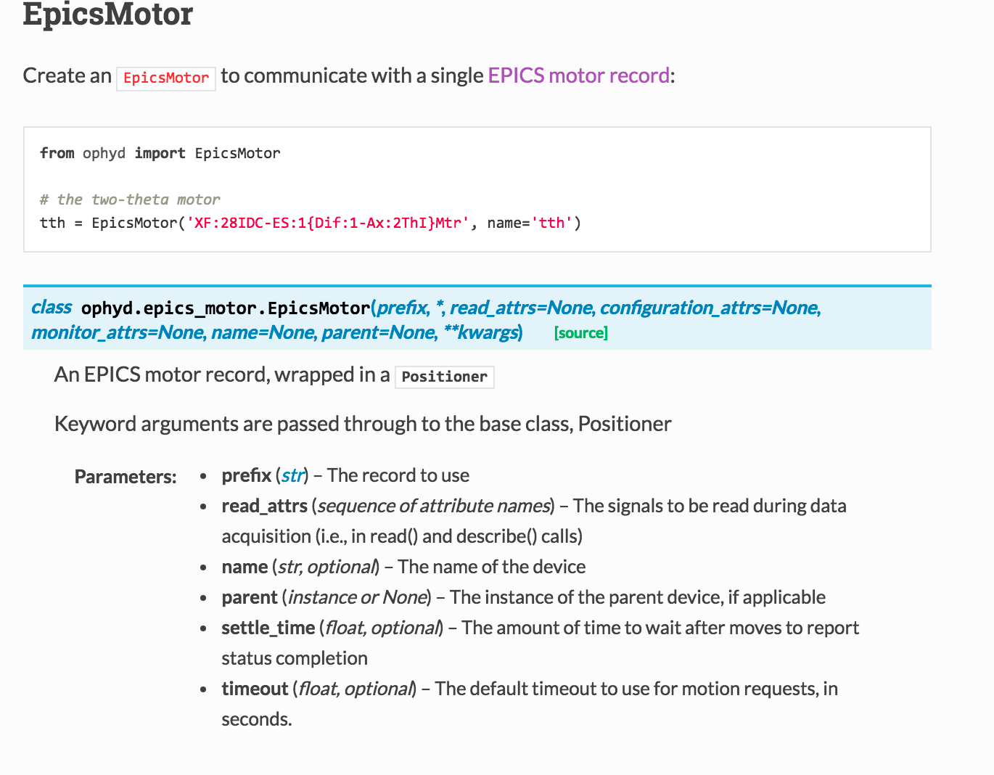
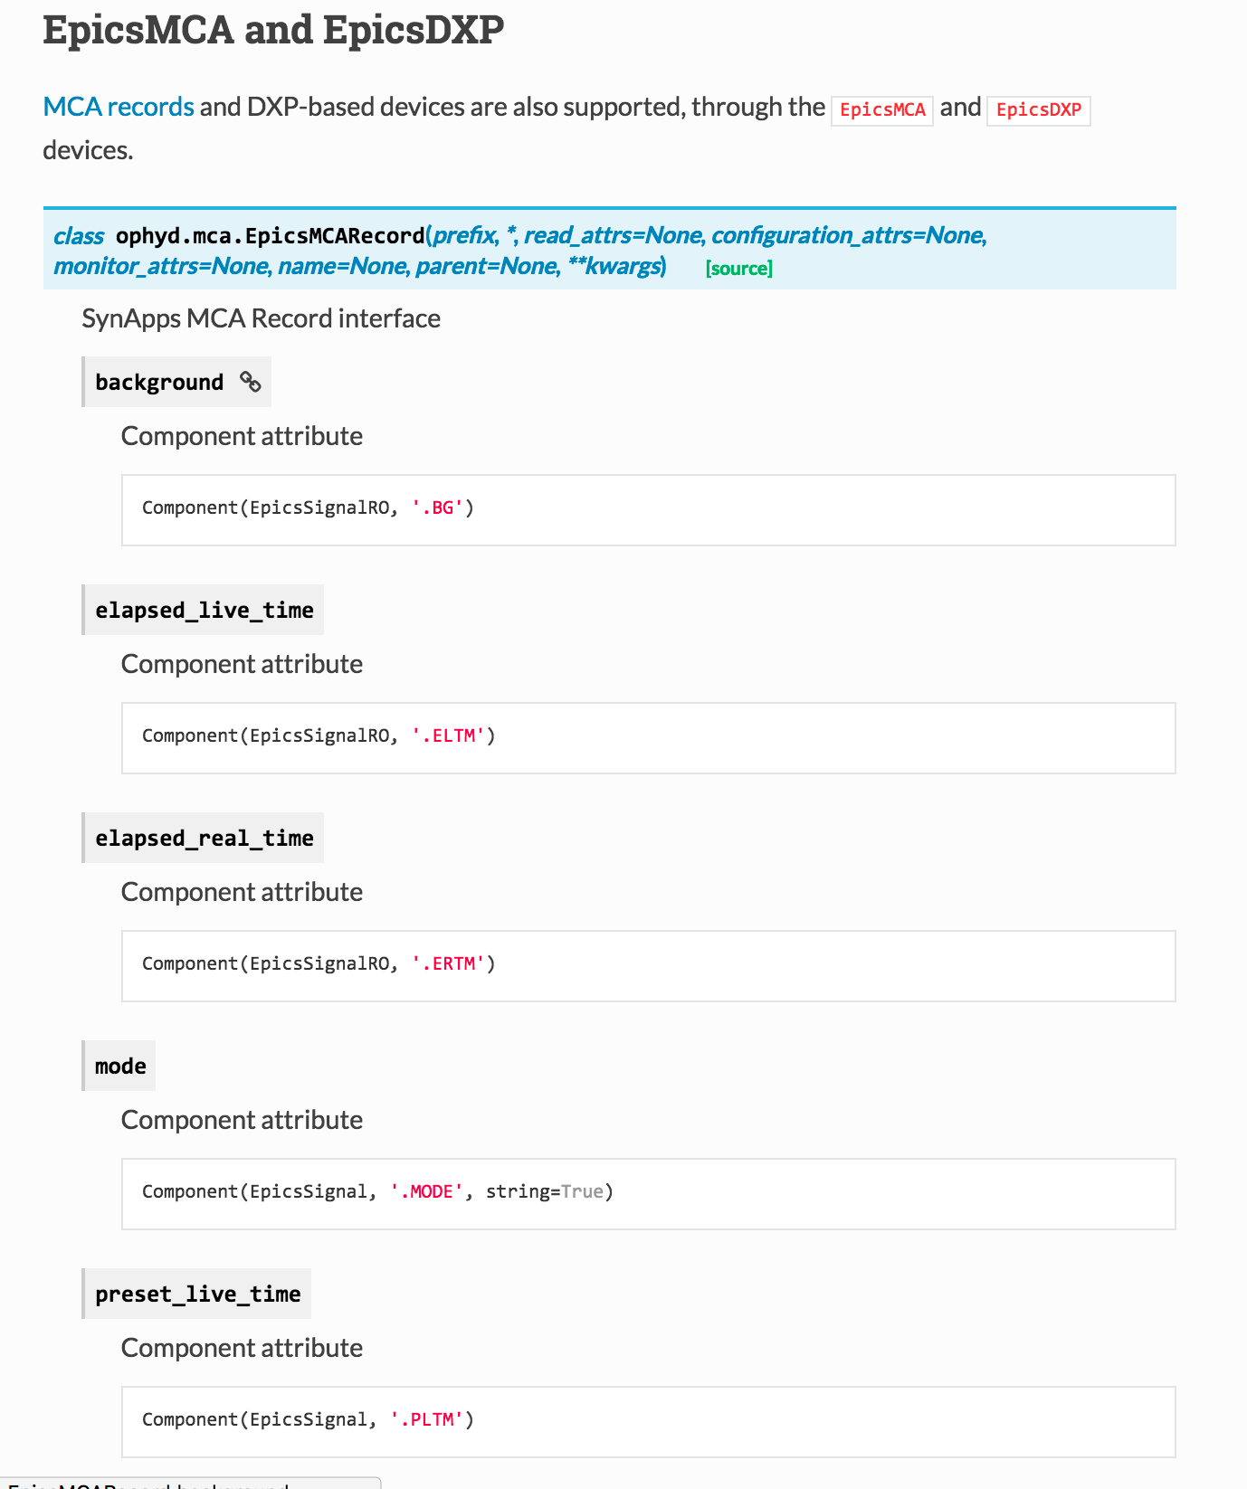
Allows users to work with devices w/o epics expertise
ABSTRACTION LAYER ON TOP OF EPICS

Slide 14
DEVICES HAVE Common attributes and methods
UNIFIES HARDWARE BEHIND SET/STOP
All Devices Have:
name -> human-friendly string identifying device
read() -> dict of human-readable names and values
describe() -> dict of metadata about each value
trigger()
stage() and unstage() -> a “context manager,” like arming
subscribe() -> asynchronously monitor
(…and a couple more optional ones)
“Movable / Settable” Devices Have:
set(…)
stop()

Slide 15
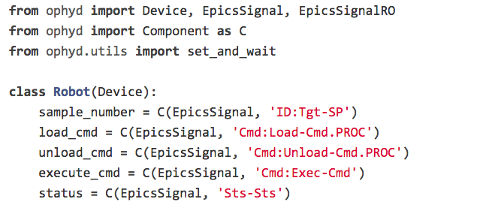
What beamline/accelerator Staff thinks of a device
CLEAR SCOPING

Slide 16
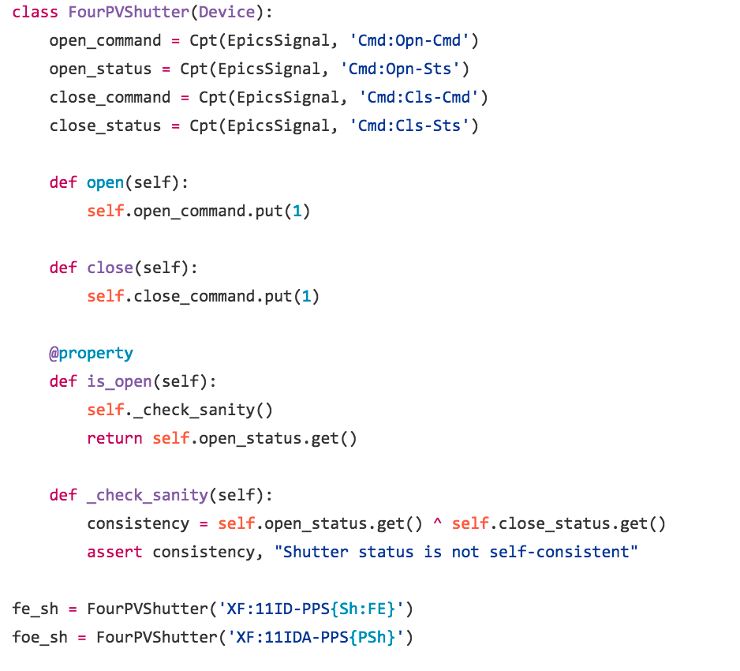
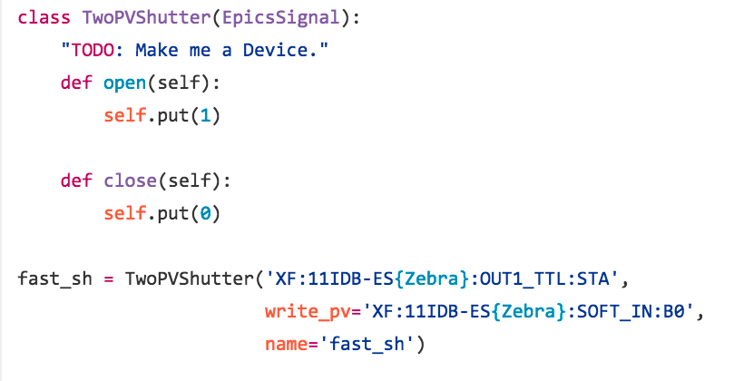
DECLARATIVE SYNTAX IN PYTHON

Slide 17
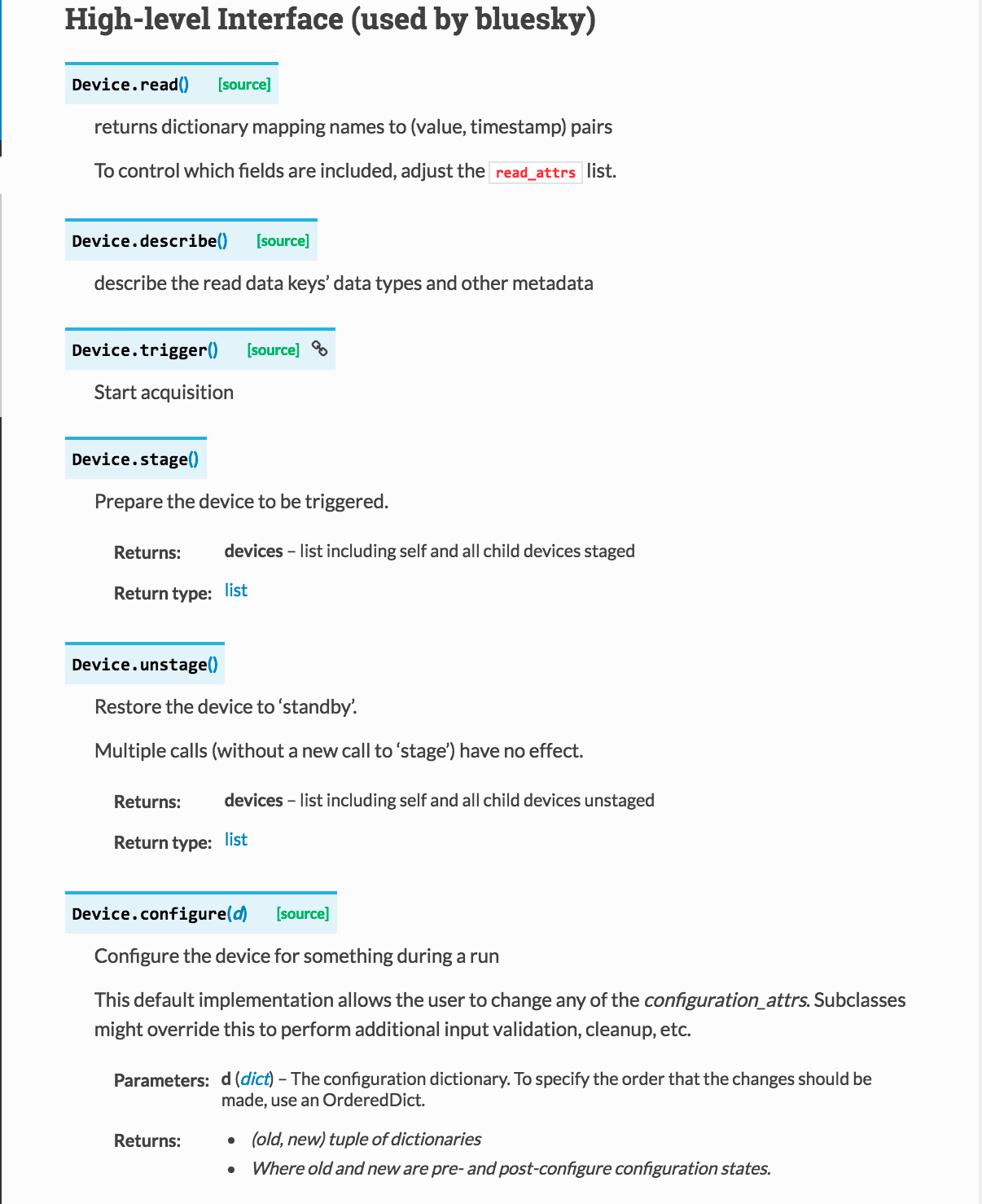
PROVIDES AN INTERFACE FOR BLUESKY and ALIASES FOR PV(S)

Slide 18
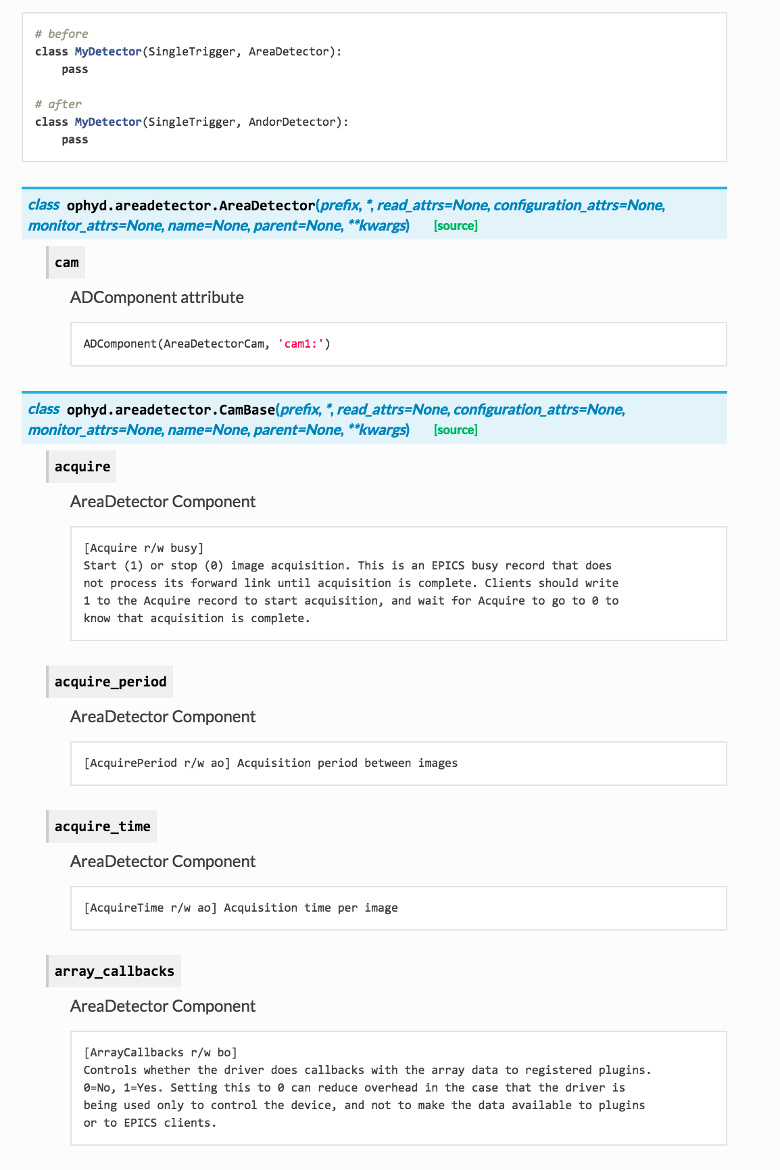
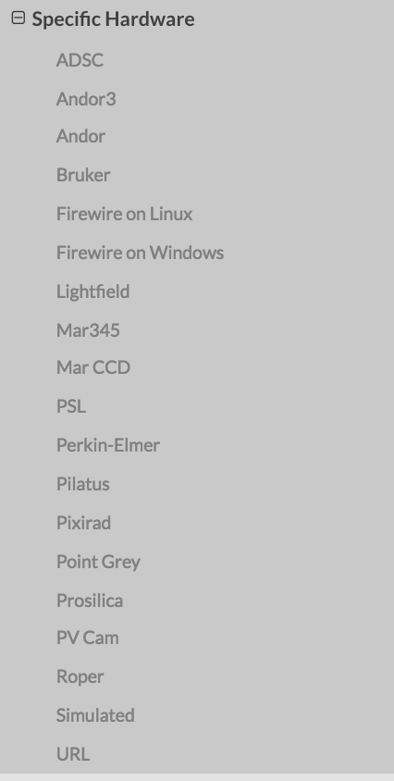
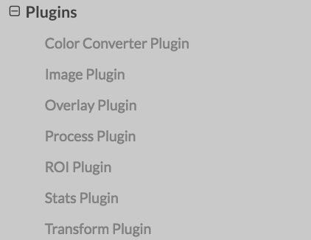
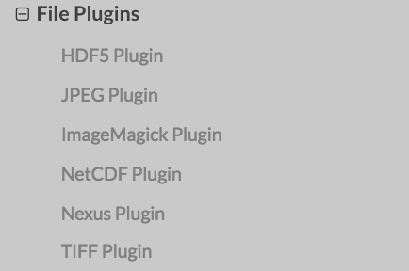
provides specialized classes for specific detectors supported by EPICS Area Detector

Slide 19
ACKNOwledgements
Thomas Caswell
Dan Allan
Ken Lauer

Slide 20
SOME NICETIES of ophyd
OPHYD
A Device is composed of Signals or of other Devices. Devices can contain other devices. Some devices map to single pieces of hardware (like a motor). Others group together many different pieces of hardware (like a diffractometer).
In one process, the same PVs might appear in multiple different Devices, so organized for different uses.
The staging process is a “hook” for preparing a device for use. To add custom staging logic to a Device, subclass it and override stage and/or unstage like so.
ophyd provides a high level interface that is used by bluesky: read, describe, trigger, stage, unstage, configure, read_configuration, describe_configuration
ophyd also provides a low level interface for exploration and debugging
ophyd comes with a set of “ready to use” devices: EpicsMotor, EpicsScaler, EpicsMCA/DXP, ‘AreaDetectors’
PVPositioner (explain what position is according to ophyd (we had an example about this somewhere)), Pseudopositioner(aliasing), SoftPositioner(debug)
ophyd provides means to compose custom devices (maybe a simple Cpt example, most likely not)
Difference between signal and device: sig no sub component
AreaDetector and specific hardware (most likely not but we have a list)
Reciprocal space

