Slide 1
Diirt and V4

Slide 2
Diirt Architecture

Slide 3
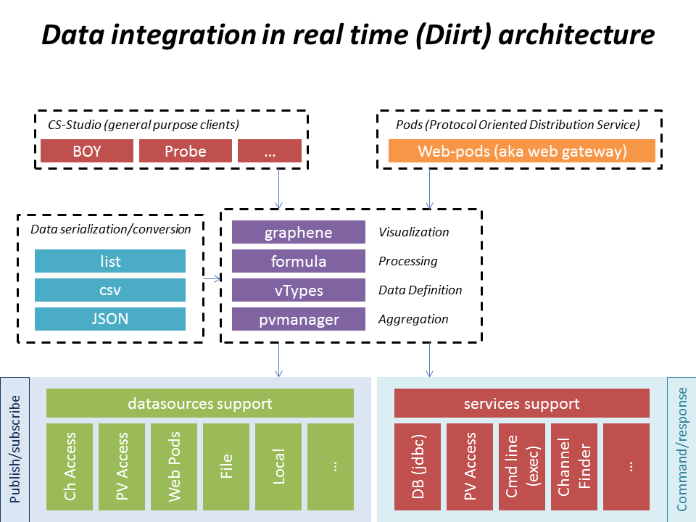

Slide 4
Diirt and V4 channels

Slide 5
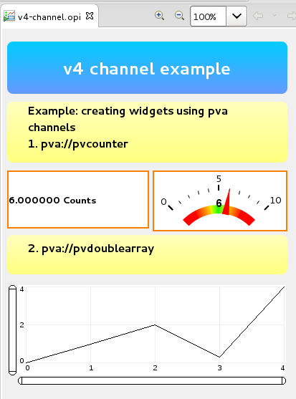
Creating V4 channels
Use the pvacess datasource prefix when creating the channel pva://<name>
Notes:
Publish susbscribe

Slide 6
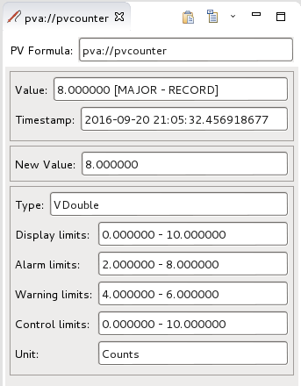
Creating V4 channels
Use the pvacess datasource prefix when creating the channel pva://pvcounter epics:nt/NTScalar:1.0 -> Vdouble
Notes:
Publish susbscribe
Alarm_t, display_t, time_t, control_t
o.diirt.support.pva.adapters
PVFieldto Vtypes

Slide 7
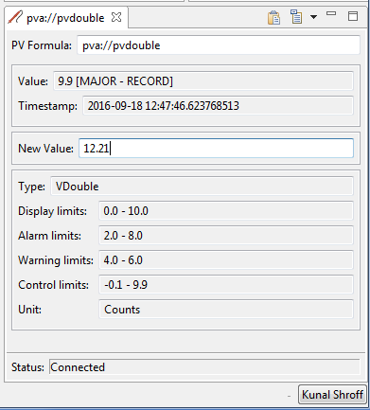
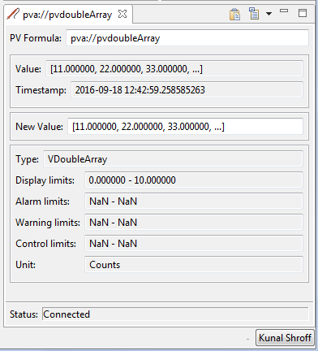
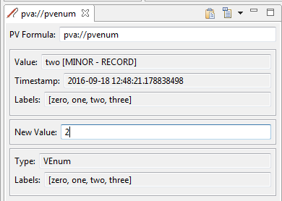
Creating V4 channels
diirt-pva module
Support for adapting NTTypes to VTypes
Notes:
General Normative Types
NTScalar
NTScalarArray
NTEnum
NTMatrix
NTURI
NTNameValue
NTTable
NTAttribute
Specific Normative Types
NTMultiChannel
NTNDArray
NTContinuum
NTHistogram
NTAggregate

Slide 8
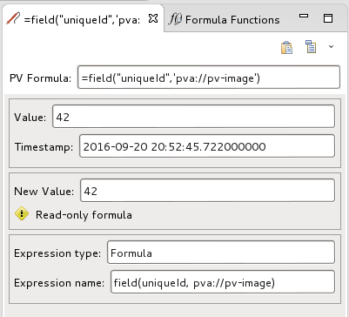
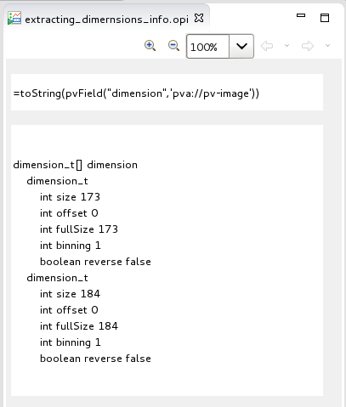
Accessing V4 structured data
Formula Functions Allow parsing of any V4 data structure into a Type that can be used by cs-studio applications

Slide 9
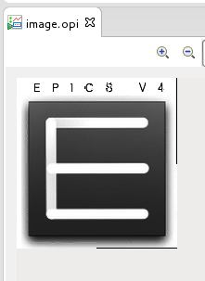
Accessing V4 structured data
NTNDArray formula set
image
Creates an VImage from the NTNDArray using all the appropriate fields (value, dimensions, …)
ndArray
Extracts the raw values as a VNumberArray
attributes
Creates a VTable from the attributes structure of this NTNDArray

Slide 10
Diirt and V4 services

Slide 11
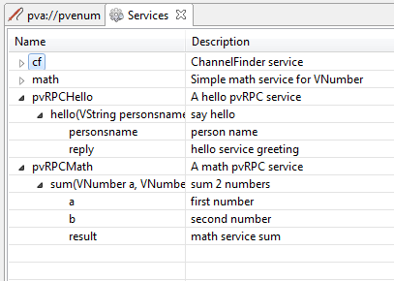
Describing V4 services for Diirt
Services provide a means to execute and retrieve the result V4 RPC call
Preparing the arguments
Mapping Vtype <-> NTTypes
Handle asyn/synchronous calls (todo)
New diirt services can be contributed via java SPI
Notes:
A service is defined as a collection of service methods. Each service method represents a function call: it has one or more named parameters and it has on or more named result. Something like:

Slide 12
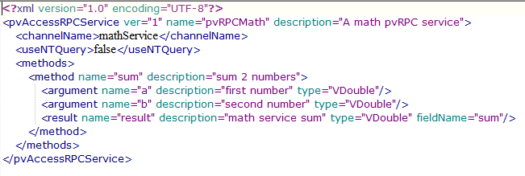
Describing V4 services for Diirt
Simple services can be described via xml files which
Service name to be connected
List of arguments
List of results, along with the fields the result maps to and the Type
Configuration file location
/configuration/diirt/pvarpc/
helloService.xml
mathService.xml

Slide 13
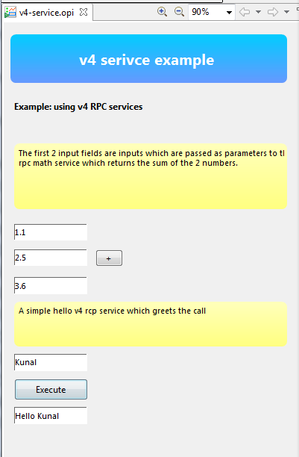
Using V4 RPC services with Diirt
The services button
Defines the V4 service to be use RPCMath/Sum
The channels from which to create the argument list loc://pv_a (VDouble) -> argument a loc://pv_b (VDouble) -> argument b
Provide a local channel from which to read the result loc://pv_sum (VDouble)

Slide 14
Future plans
Use diirt V4 services to integrate MASAR, ChannelFinder, and other V4 services in cs-studio
Add more widgets/application capable of accepting V4 data.
More support for NTType – Vtype mapping
Expand support V4 xml service definition
….

Slide 15
Questions?

