Slide 1
areaDetector use and developments at Diamond
Ronaldo Mercado
Epics Collaboration Meeting
Oak Ridge
Sep 2016

Slide 2
Outline
History
IOC count
Pilatus detectors with PPU
EPICS v4 plugin
Area Detector for ADCs
Computer vision – loop centring - at MX beamlines
Mapping project and SWMR
Conclusions
20 September 2016
Area Detector use and developments at Diamond

Slide 3
History
Before 2010 All Diamond area detector data was to be handled by our upper level acquisition software (GDA).
However, speed wasn’t great (Java) and there was no consistent framework.
Consequently, GDA team selected EPICS area detector as their detector framework.
2010 onwards EPICS team takes over detector interfaces. Many areaDetector drivers and plugins used and developed.
December 2013 at NSLS-II Area detector working group formed.
20 September 2016
Area Detector use and developments at Diamond
3

Slide 4
IOC count
About 170 IOCs using areaDetector 1-9
About 40 IOCs using ADCore 2-4
Aravis GigE Camera IOCs ~ 80
Pilatus driver IOCs – 17
Medipix IOCs - 9
Pco camera IOCs – 8
Xspress3 IOCs – 7
Perkin Elmer IOCs - 4
Dxp IOCs (XIA) – 4
Pixium IOCs – 2
quadEM – 3
dtacq - 3
20 September 2016
Area Detector use and developments at Diamond

Slide 5
Pilatus detectors with PPU
Unmerged changes to Pilatus detector driver, both related to use of PPU “Pilatus Processing Unit”
“Soft trigger” option (Giles Knap)
Restores step scan performance without additional hardware – 20 Hz step scan vs 5 Hz when PPU is introduced.
Overcomes extra latency in invoking the area detector pipeline.
CBF template copy (Ronaldo Mercado) Works around detector server and camserver not able to access template from central storage.
scp from ppu to detector server
Scientific Computing
Detector
Furka
/ramdisk to /ramdisk
(modified rsync)
Grimsel (modified rsync)
20 September 2016
Area Detector use and developments at Diamond

Slide 6
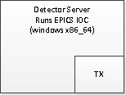
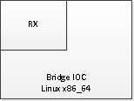
EPICS v4 plugin
DLS purpose: mainly move data from Windows to Linux
Future intent: distribute processing to multiple hosts
NDPvaPlugin
pvaDetector plugin
20 September 2016
Area Detector use and developments at Diamond

Slide 7
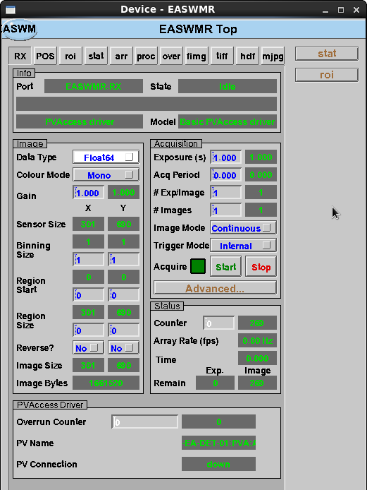
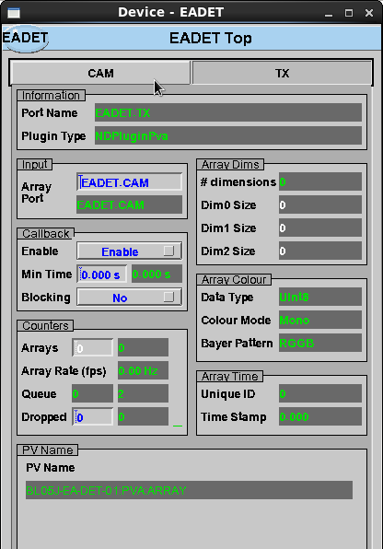
EDM screens for epics v4 plugin
20 September 2016
Area Detector use and developments at Diamond

Slide 8
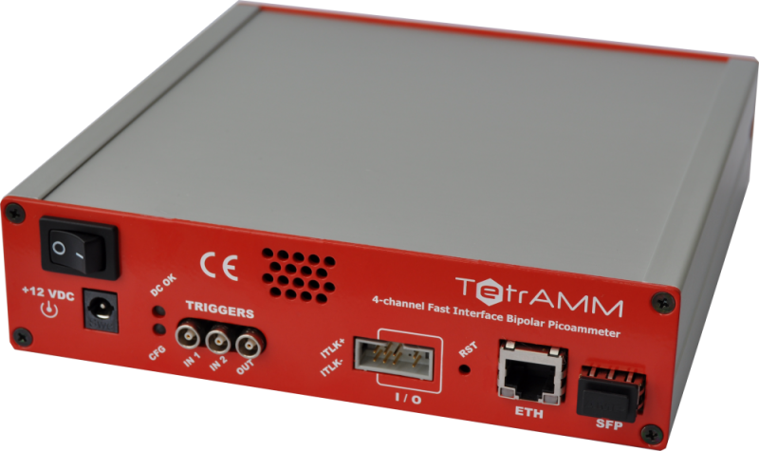
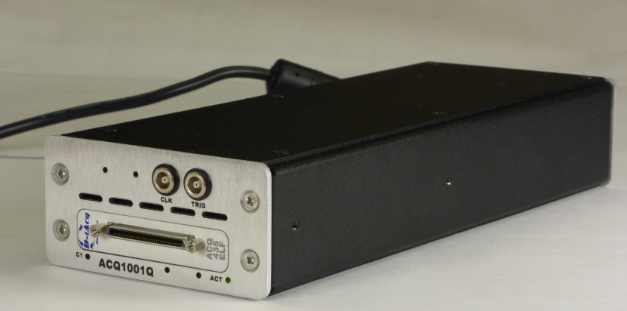
Area Detector for ADCs
quadEM (Mark Rivers)
CAENels TetrAMM
D-TACQ ADCs (Adam Bark)
NDReframePlugin (Ed Warrick)
Provides triggering by using an ADC channel.
ADEthercat (Ronaldo Mercado)
NDArrays from Ethercat ADCs
ADIvium (Jon Thompson)
NDArrays from Ivium multi channel potentiostat.
Area detector driver for Panda (Chris Turner)
NDArrays from Panda ADC channels
In development
20 September 2016
Area Detector use and developments at Diamond

Slide 9
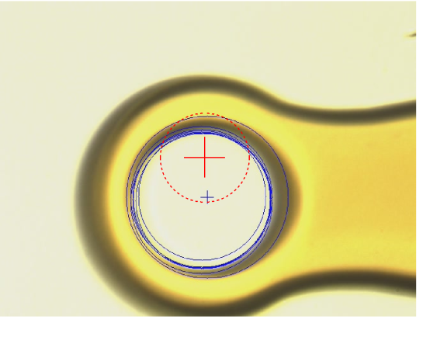
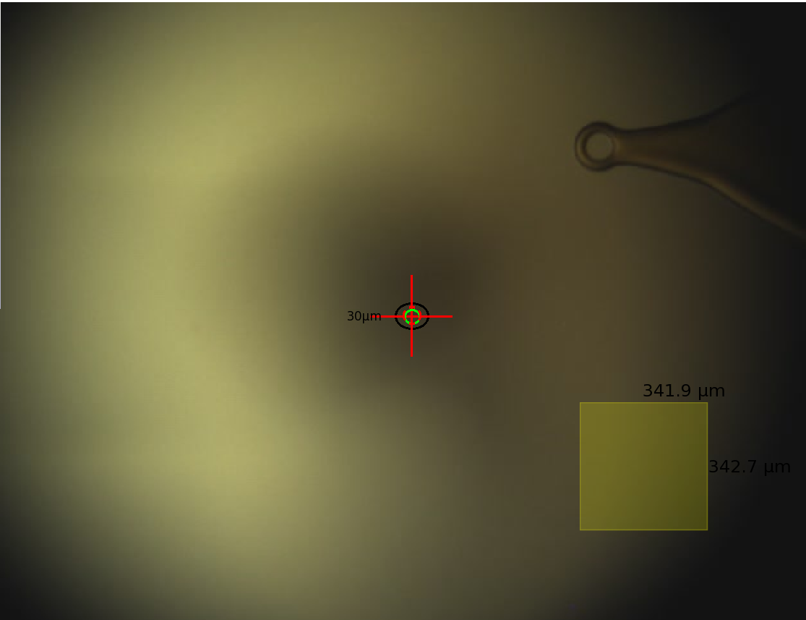
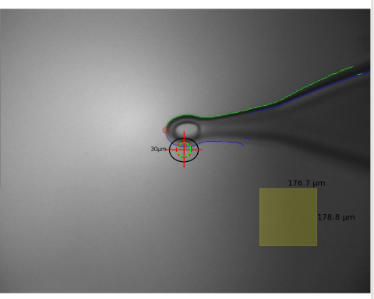
Auto-centring using adPython
Robot loads 75um Mitegen loop
Autocentring brings loop face-on
Zoom 2: Alignment at omega and omega +180 using findCircle and 1st round of rotation axis alignment
Zoom 10: Optimisation of the alignment until it converges to less than 4 pixels (1um)
FindCircle (through area detector)
Focussing through STAT plugin
Python script plugin (Hough circle finding): Tom Cobb and James O’Hea
Results
Tested with rotation axis off by 40um, it brings it back to within 3-4um
Repeatable (within 1um)
Takes few minutes
20 September 2016
Area Detector use and developments at Diamond

Slide 10
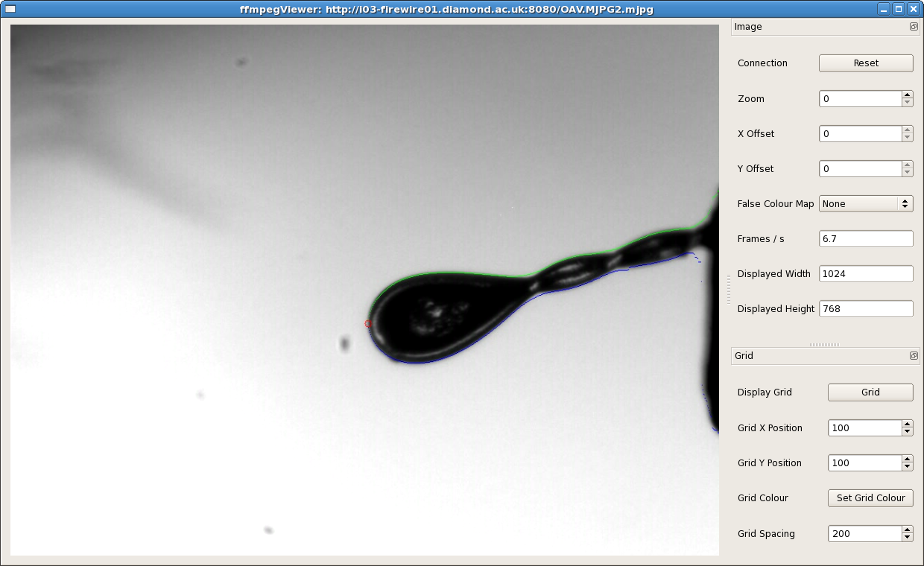
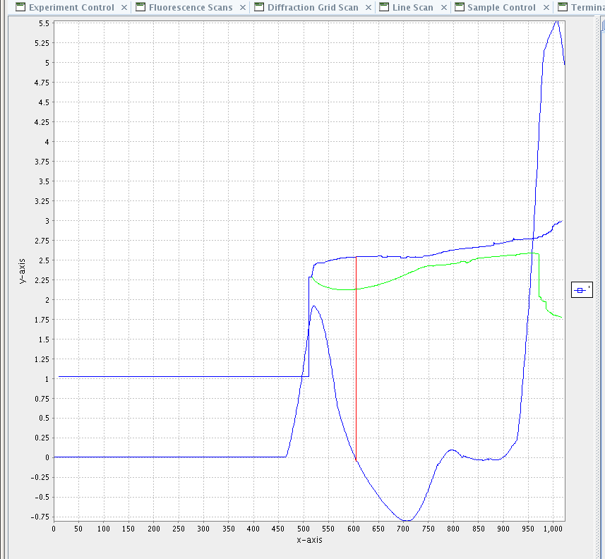
Auto centring using adOpenCv
20 September 2016
Area Detector use and developments at Diamond

Slide 11
adOpenCv pipeline and results
Camera
Blur (Gaussian)
Edge detect (canny)
Close
Sample locate
Values to GDA
Derivatives to detect sample loop widest point
Centre by moving motors
Results
Hough circle finding with moves, etc., takes minutes – too slow for unattended operation
“Sample locate” processing at 7 to 8 frames/sec
Turnaround time of 10 seconds
Can be used unattended when loop size matches crystal size
“sample locate” could be moved to adPython with no loss of performance
adPython is recommended for new projects.
20 September 2016
Area Detector use and developments at Diamond

Slide 12
Mapping project and SWMR
Mapping
Work packages
WP1 SWMR
Single Write Multiple Read
Pronounced “swimmer”
20 September 2016
Area Detector use and developments at Diamond

Slide 13
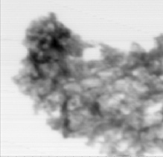
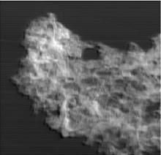
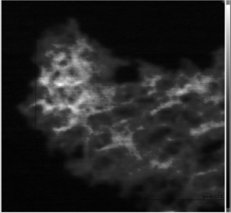
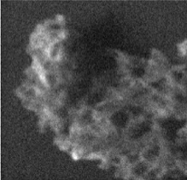
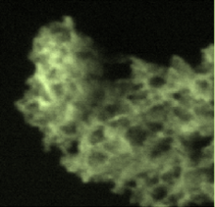
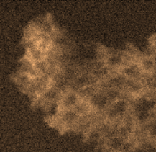
Mapping
Move sample under focused x-rays
Continuous or trajectory motion (a.k.a. fly scan)
Interactions with the sample are recorded
Process
Reduce data to create a map (image)
Visualization
Show map of reduced data
Click to see raw or detailed data
Abs
DPC
DF
1 μm
C
O
C
O
Fe
Slide Thanks to Mark Basham
20 September 2016
Area Detector use and developments at Diamond

Slide 14
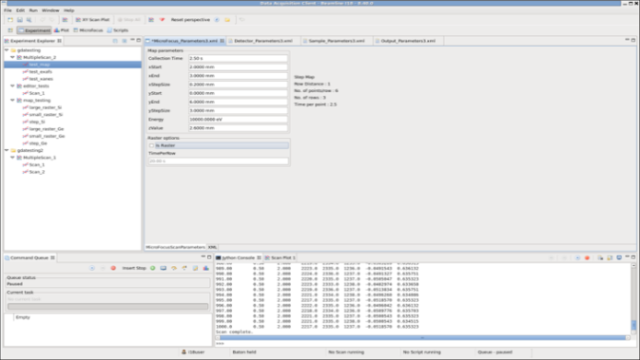
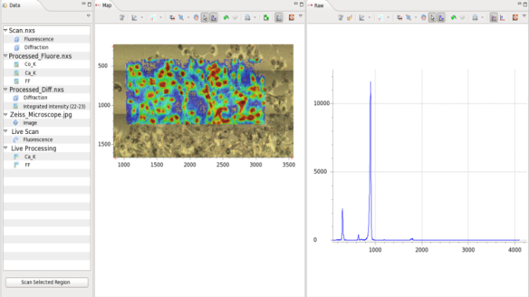
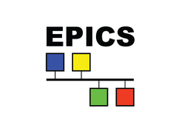
Mapping project work packages
WP3 – Experimental Parameters
WP2 - Visualisation
WP2.1 – NXScan
WP1 - SWMR
Messaging
Data
WP2.2 - Processing
WP4 – EPICS/GDA Middleware
20 September 2016
Area Detector use and developments at Diamond

Slide 15
Conclusions
The architecture works well Big advantage is that it has three data streams: Compressed video via ffmpeg for interactive visualisation Uncompressed frame data via channel access High speed data streaming to disk
Consistent set of plugins
Many detector types, few of each
SWMR developments and NDPos plugin are a cornerstone of the Mapping Project
Gradually migrating to ADCore, still many IOCs using release 1-9
20 September 2016
Area Detector use and developments at Diamond

Slide 16
Thank you for your attention
Acknowledgements
Slides/feedback
James O’Hea
Mark Williams
Alice Douangamath
Mark Basham
Giles Knap
Jon Thompson
Ulrik Pedersen
Chris Turner
James Mudd
Nick Rees
Tom Cobb
Mapping project
Analysis
Mark Basham
Alun Ashton
Peter Chang
Baha El Kassaby
Jacob Filik
Science
Andy Dent
Paul Quinn
Controls
Tom Cobb
Alan Greer
Ulrik Pedersen
Gary Yendell
Acquisition
Matthew Dickie
Matt Gerring
Rob Walton
James Mudd
Charles Mita
Keith Ralphs
Matthew Webber
Project Planning
Kathryn Poulter
Steven Launchbury
20 September 2016
Area Detector use and developments at Diamond

