Slide 1
Current uses of CS-Studio at Diamond Light Source
Matthew Furseman
10:00, Thursday 22nd September, 2016
Notes:
Diamond Light Source has been adopting CS-Studio for its control interface and eventually intends to replace EDM entirely. At the moment an automated framework for generating Synoptic GUIs for beamlines has been created and has been used to commission Diamond's two newest beamlines, I14 and I21. A description of this framework combined with examples of the GUI layout used with it will be given. A large part of moving from EDM has been the automated conversion process which is designed to produce CS-Studio screens that are visually and functionally identical to our existing EDM screens. As we have around 7000 of these screens the automated conversion is necessary for making the transition, and the familiarity of converted screens will allow the machine operators to continue as usual during the transitional period. The difficulties and our achievements in this process will also be described.

Slide 2
Contents
Motivation
EDM conversion process at DLS
Conversion Screenshots
GUI Builder
I14/I21 Screenshots and descriptions

Slide 3
Motivation for moving from EDM to CS-Studio
EDM is nearing end of life (or is it!? ‘Future of edm’, 14:00 today).
EDM’s libraries are being phased out.
EDM is supported by one person, CS-Studio has community support due to use at many sites.
We could benefit from the rest of the infrastructure that CS-Studio provides, such as BEAST on beamlines and V4 compatibility.
Potential to integrate into DAWN and GDA; Diamond’s data analysis and data acquisition software is also built on Eclipse RCP.

Slide 4
Overview of conversion process
Checkout module to be converted.
Script checks configure/* for dependencies and also checks out dependent module tree.
Dependency
Python Script
Dependency
Find EDL Files
converter.jar
Post Process
Dependency
Part of CS-Studio, built by Jenkins.
Dependency
Module to be converted
Relative paths are used with linked resources to take care of versioning and editing out of the read only production file system.
https://github.com/dls-controls/css-converter-python
Notes:
Python script sounds simple but is ~6000 lines

Slide 5
Post processing: Click ordering
Widgets must be on the top of the stack to be clickable in CS-Studio but not in EDM. Recreate clicks on the top attached to an invisible rectangle.
EDM
CLICK
CS-Studio
LED
LED
CLICK
LED
LED
LED
LED
LED
LED
Invisible
Rectangle

Slide 6
Post processing: Grouping containers
Extend grouping container boundaries to include all widgets.
EDM
CS-Studio
Fixed!
GROUPING CONTAINER
GROUPING CONTAINER
LED
LED
LED
LED
LED
LED
LED
LED
LED
LED
LED
LED
Cropped

Slide 7
Post processing
Convert EDL symbol files for DLS symbol widget.
Swap some fonts and sizes to improve legibility.
Tweak colours to keep antialiased fonts legible.
Must ‘infer’ what the designer wants,
ends up with some manual corrections.

Slide 8
Many small issues we have overcome
Can’t create local Enum PVs
Escaping quotes in external command line calls
Unsigned data in intensity graph
Missing grid lines in XY-Graph
Keeping specific OPI files bound to a view when changing perspective and restarting
Many many more...

Slide 9
Some more small issues yet to be overcome
Char arrays are shown as integers in text updates, not ASCII text.
Small (~1px) sized details can be lost by slight changes in widget and border dimensions.
Font and colour tweaks have unexpected results when screens don’t conform to design guidelines.
Graph missing points, because it has 250,000 of them!
These types of issue can normally be patched manually after conversion. Automated conversion needs to reduce this to an acceptable workload.

Slide 10
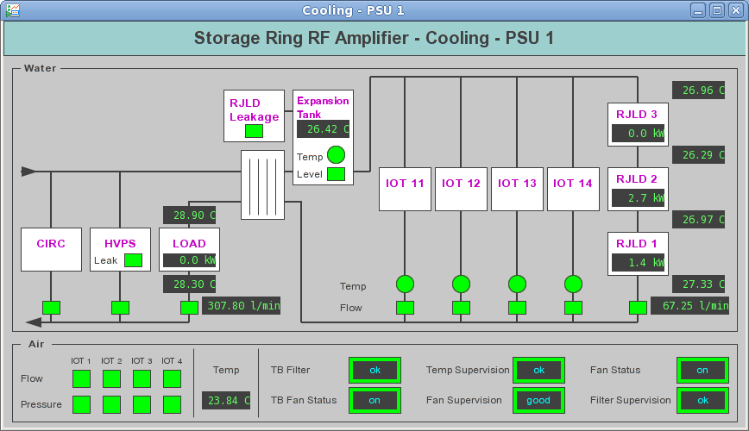
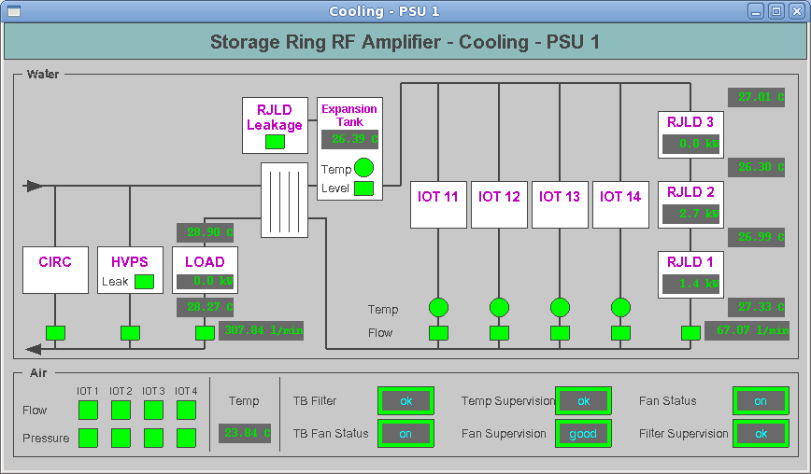

Slide 11
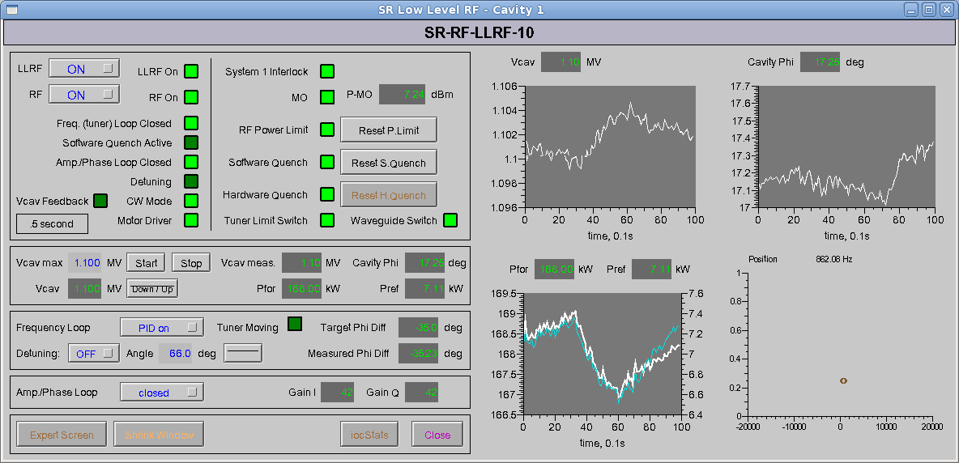
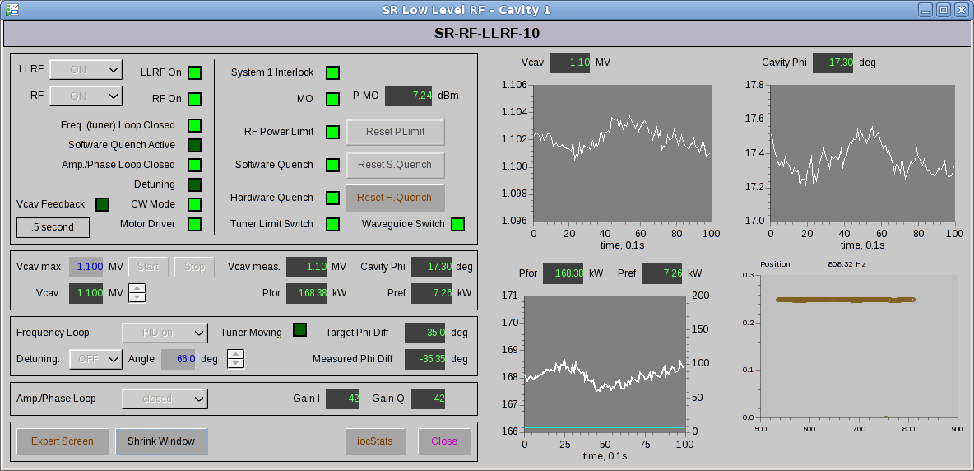

Slide 12
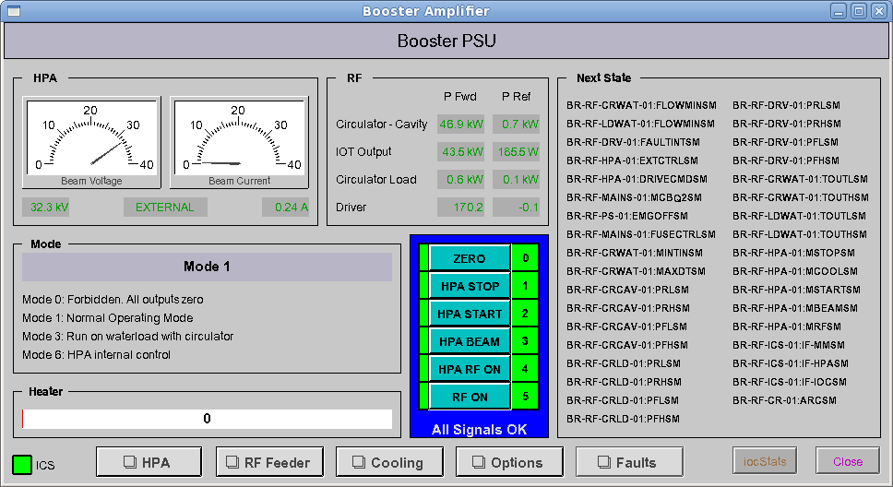
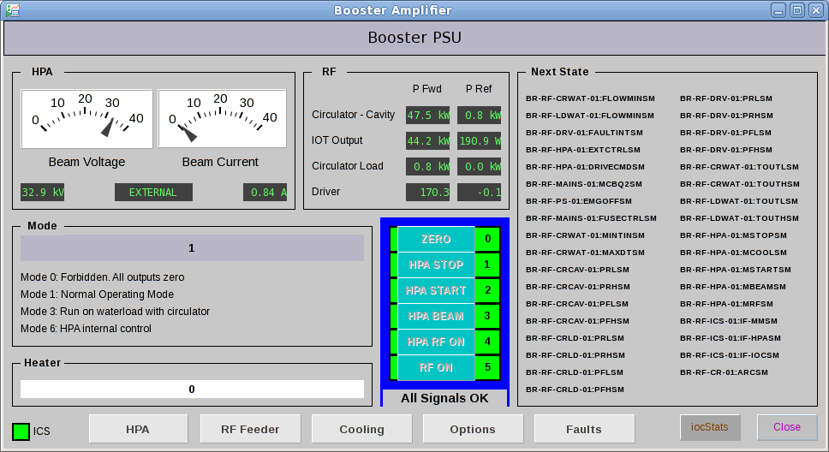

Slide 13
Introduction to GUI Builder
Diamond has two new beamlines that are currently being commissioned, I14 and I21.
These beamlines have no legacy usage of EDM and so were ideally suited to a CS-Studio only interface.
A framework has been developed at Diamond to automate GUI generation for beamlines, dls_guibuilder, and used on these two beamlines.

Slide 14
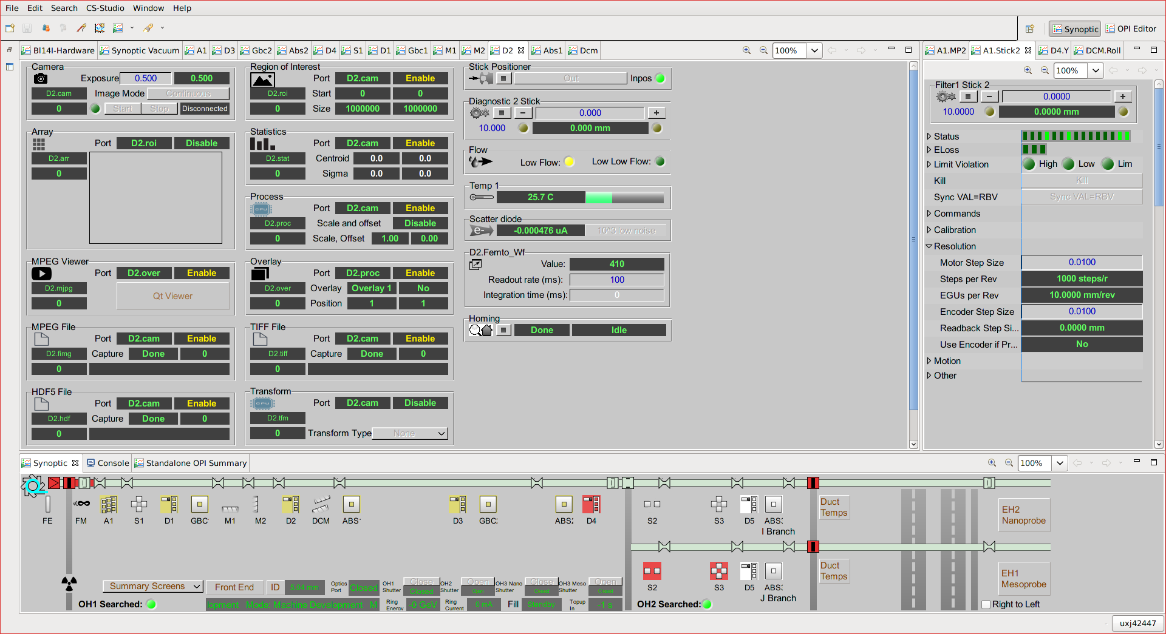
Beamline GUI overview

Slide 15
Beamline GUI overview
The synoptic overview remains open at all times. If the user closes this accidentally they can reset the perspective. Clicking on each icon brings up the GUI for that component ...
Synoptic Overview
Notes:
Remains open and visible at all times. If the user closes this then resetting the perspective will restore it.

Slide 16
Beamline GUI overview
Component Overview
Get information about devices for controlling slits, monochromators, mirrors, cameras, and other beamline hardware. Clicking on each device brings up additional controls specific to that device...
Notes:
Remains open and visible at all times. If the user closes this then resetting the perspective will restore it.

Slide 17
Beamline GUI overview
Device Controls
Detailed controls and information for each device. Information is kept manageable using an expandable view,this is a custom DLS ‘detailpanel’ widget.
Scientists run on dual headed workstations, devices can be dragged onto the second monitor when required.
Notes:
Remains open and visible at all times. If the user closes this then resetting the perspective will restore it.

Slide 18
DLS GUI Builder: how it works
Create tags in template files, in support modules, to describe the simple components that will be created when an instance of the template is instantiated.
Create an expanded database in the usual way, then use dls_epicsparser to parse this with the gui handler to create an XML file consisting of named groups of PVs and screens to represent the simple components that have been created.
Make a python script that uses dls_guibuilder to add definitions of the components from the XML file, and create new complex component screens and PVs by grouping definitions contained within.
Any changes made to the OPI by hand will be kept and the OPI will just be validated against the current database.

Slide 19
Summary
Making progress on automated conversions, but the process still requires some manual tweaks. RF and timing are almost ready to be rolled out to machine operators, following lattice modification.
CS-Studio on new beamlines is working well.

