Slide 1
Service-layer IOCs and their implementation in Python
EPICS Collaboration Meeting 2016
September 19-23, 2016
Bogdan Vacaliuc
With special thanks to:
Mathieu Doucet, Kay Kasemir, Matt Pearson, and Marie Xingxing Yao

Slide 2
Overview
Problem
Solution
Features
Engineering Details
Examples
Summary

Slide 3
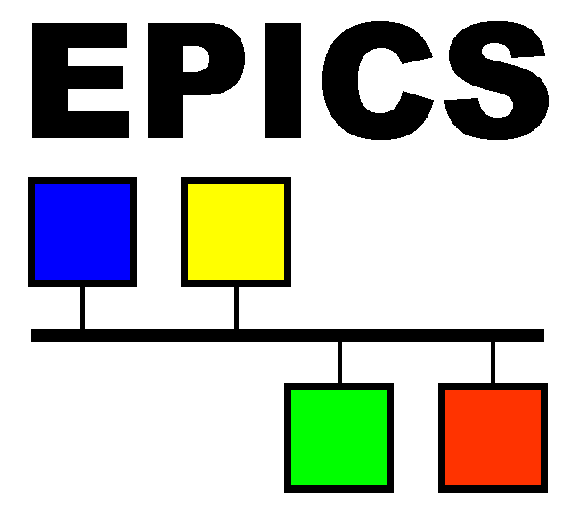
The Problem
Beamline instrumentation system needs high levels of automation
EPICS is a client/server system
Lots of server codes to support many types and models of hardware.
“Advice: put functionality in the server” [1, slide 51]
If we need automation, and we heed the advice, we end up with a lot of instrument-specific functionality in the servers...
[1] M. Rivers, “Using EPICS for Beamline Control and Data Acquisition”, Australian Synchroton Beamline Control Workshop, April 2005, available=https://www.synchrotron.org.au/media/tz_portfolio/attachments/52d4c57b9579atz_portfolio_1389675906.ppt
Notes:
http://www.aps.anl.gov/epics/docs/epics-logo.php

Slide 4
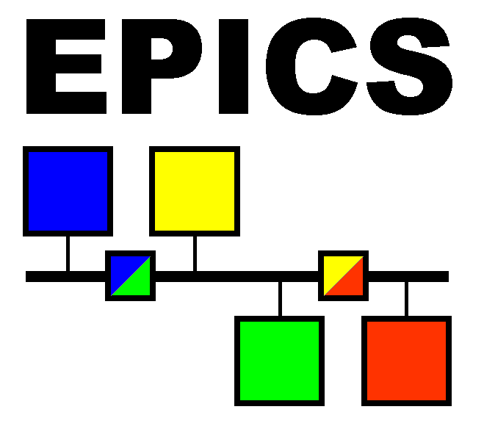
A Solution
Service-layer IOCs
“bump in the wire”
Are both client and server facing
Implemented in Python
Enables server IOCs to focus on that which is needed for operation of the hardware
Enables instrument-specific behavior and automation to exist separately from equipment support.
Use of the Python language is ideal for a high-degree of functionality and capability.
Notes:
https://en.wikipedia.org/wiki/Smiley

Slide 5
Features
String manipulation operations are easy
Autosave via an in-house implementation
Easily incorporate put-callback notification
(Easier to) include non-channel access protocols
Easily make complex calculations (numpy, scipy)
Foster integration with high level applications
codify sequencing needed or enforcing the ‘n+1th’ PV to initiate an action
“... it is important to guarantee that we synchronize acquisition of all these property values with the specified triggering event.” [2]
[2] J. Hill, R. Lange, “Next Generation EPICS Interface to Abstract Data”, Publication LA-UR-01-6172, Jan 2001, available=http://www.osti.gov/scitech/biblio/975859

Slide 6
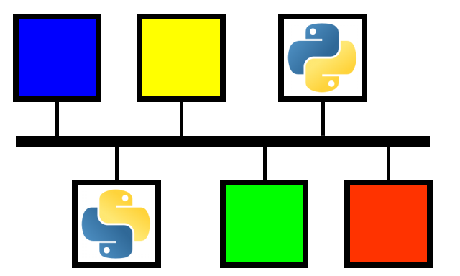
Engineering Details “news you can use...”
Our work is based on pcaspy [3] and PyEpics [4].
All interactions with the IOC occur via PVs
All lengthy operations invoked by ::write() spawn a thread that issues a put-callback when complete.
Lengthy operations can perform computations, communicate with external systems using CA or non-CA protocols and otherwise use any Python module available in the environment.
[3] X. Wang, “pcaspy: Portable Channel Access Server in Python”, 2011-2016, available=https://pcaspy.readthedocs.io/en/latest/index.html
[4] M. Newville, “pyepics: EPICS Channel Access for Python”, CARS, University of Chicago, 2010-2016, available=http://cars9.uchicago.edu/software/python/pyepics3/index.html

Slide 7
Engineering Details (cont)
Subclass from pcaspy.Driver
global
establish dictionary to describe PVs [3] to be served by this IOC
establish autosave
establish logging
__init__(self):
call .setParam() on all PVs defined
use Autosave.get() to initialize PVs from autosave store
create background thread to update log PV from logging buffer
read(self, reason):
call .getParam() to return the value of the unprefixed PV, ‘reason’
write(self, reason, value):
call .setParam() to write value of the unprefixed PV, ‘reason’
call .updatePVs() to update any callbacks
if action is lengthy, spawn thread with CAThread() [4] to perform

Slide 8
Implementation Advice
use “common” variables for Log, Status, Simulate
provide an engineering UI for each IOC that displays the Log, toggle Simulate, set and observe the served PVs
use ‘Status’ enum variable to track IOC state and encapsulate alarm
we chose [ ‘Idle’, ‘OK’, ‘Working’, ‘Error’ ]
Think about the way to invoke a “lengthy” job [2]
we chose to use the ‘n+1th’ PV idiom
it matched well with our ‘Scan Server’-based experiment control model

Slide 9
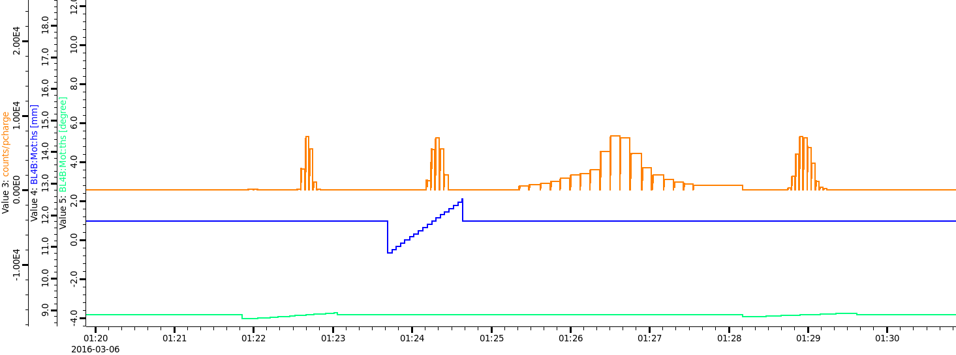
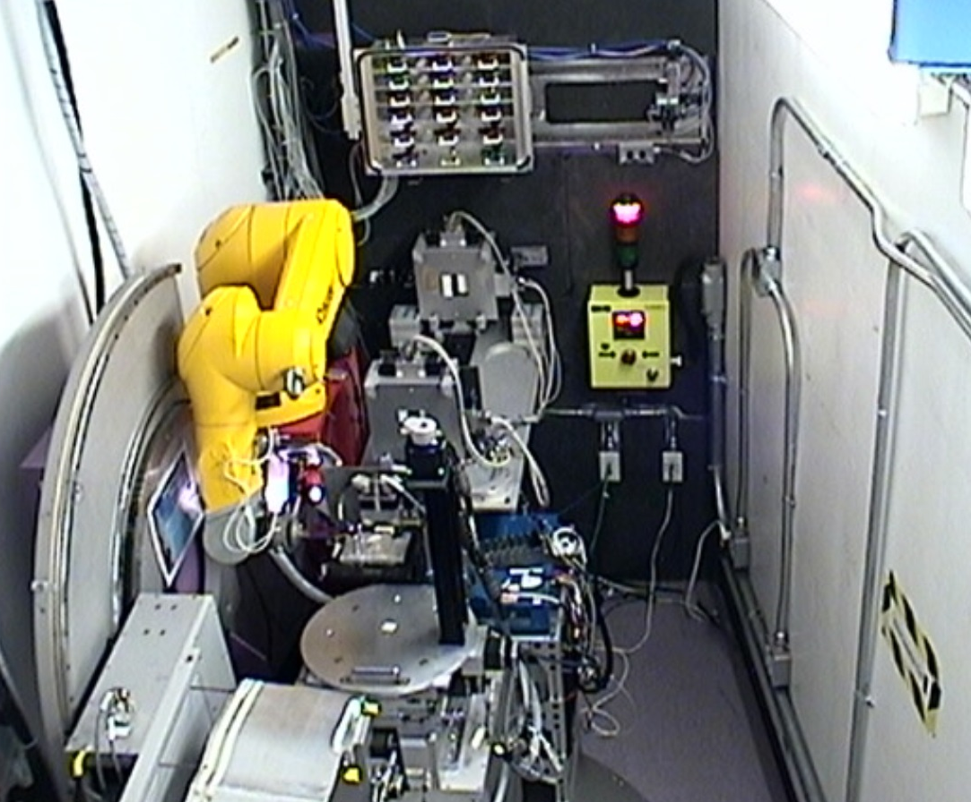
Example: Automated 3-axis Alignment
Annotation
Annotation
too
Parametric algorithm [5]
Curve fit (numpy)
Acceptable fit criteria
Enables sample changes and unattended operation
Annotation
Three
[5] B. Vacaliuc, et. al, “Experiment Automation with a Robot Arm using the Liquids Reflectometer at the SNS”, Proceedings of ICALEPCS2013, San Francisco, CA, USA, 2013, available=http://accelconf.web.cern.ch/AccelConf/ICALEPCS2013/papers/tuppc077.pdf
More Yada
Notes:
algorithm defined by scientists

Slide 10
Example: Nested Scan Generator
Queues operations with scan server
Sequences several operations including automatic alignment and sample environment ops
Reduces likelihood of user entry error
Notes:
Performs various ‘editing’ operations on the user-submitted experiment guide file (“table scan”): adds a command to re-center the slits, adds a command to invoke an automatic alignment (see previous slide), recalculates ‘ths’ and ‘tthd’ motors according to the instrument operating mode (reflect up/dn).
After submissinon, monitors the submitted scan id for status and performs an experiment completion calculation (predict ETA)
Works very well with the UI component provided by Marie in the Experiment Planning tool.

Slide 11
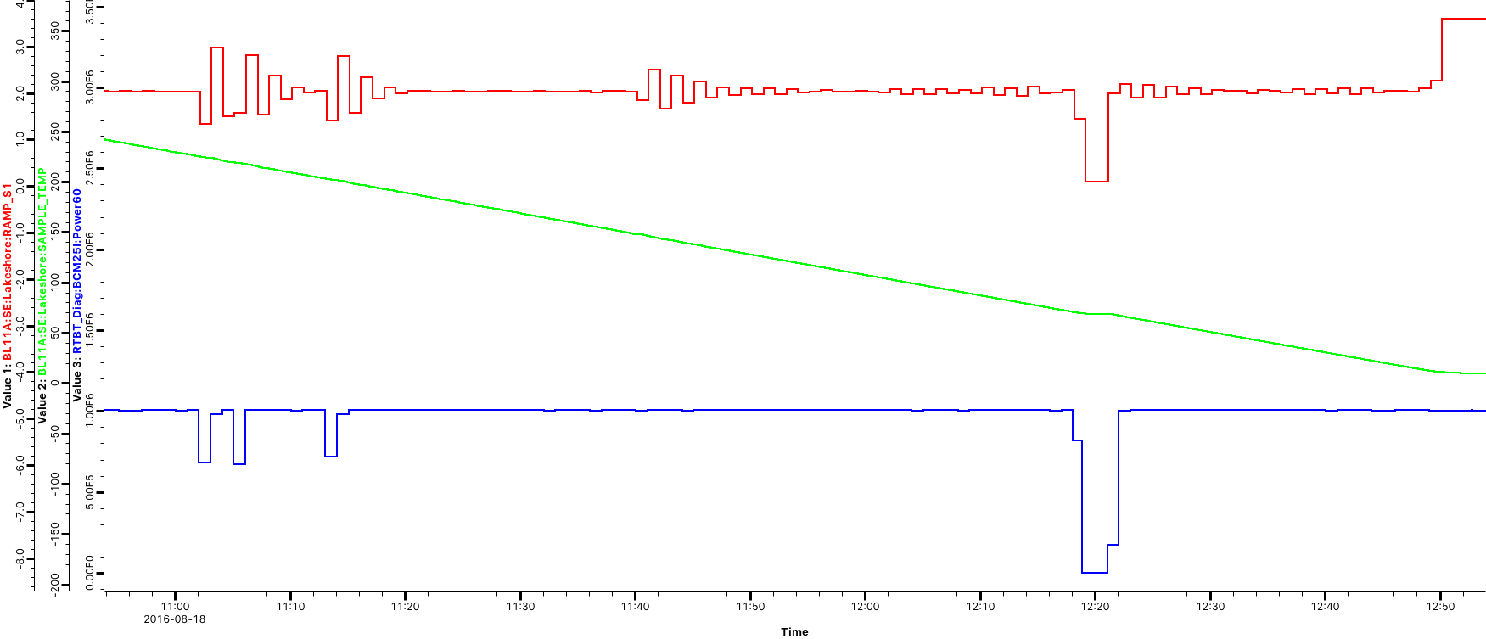
Example: Temperature-Compensated DAQ
Monitors experiment progress and adjusts PVs to compensate for beam power variances [6]
[6] P. Whitfield, et. al, “Extending the Collection and Analysis of Non-Ambient Diffraction Measurements by Time and Temperature-slicing of Event-mode Time-of-flight Neutron Data”, Journal of Applied Crystallography, Submitted for publication
Notes:
Typically invoked by users’ experiment table file to enable/disable set ramp criteria.
Key capability when studying phase transitions to ensure that counting statistics are met

Slide 12
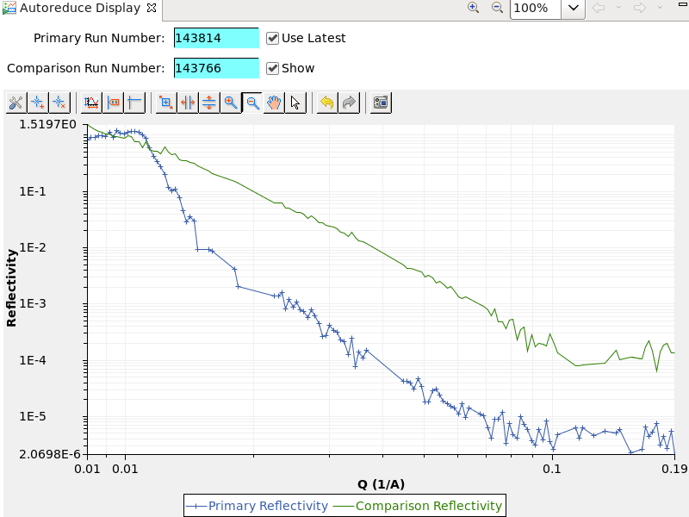
Example: Autoreduction Visualization
Communicates with restful web service to download reduced data and format into PVs for visualization
[9] Reference
[10] Reference

Slide 13
Summary
Solved the automation of experiments problem in a simple yet highly extensible way
Built upon robust and stable implementations
Operates at the timescale of human activity
Leverages the use of the Python language for rapid development and deployment
Measureable gains in Scientific Productivity
Notes:
“... and *that* makes our Scientists and our Sponsors very happy”

Slide 14
Thank You
This document has been authored by the Oak Ridge National Laboratory, managed by UT-Battelle LLC under Contract No. DE-AC05-00OR22725 with the U.S. Department of Energy. The U.S. Government retains and the publisher, by accepting the article for publication, acknowledges that the US Government retains a nonexclusive, paid-up, irrevocable, worldwide license to publish or reproduce the published form of this manuscript, or allow others to do so, for US Government purposes.

