Slide 1
CI Setup for EPICS Base
Ralph Lange (ITER),
Andrew Johnson (APS),
Michael Davidsaver (Osprey DCS)

Slide 2
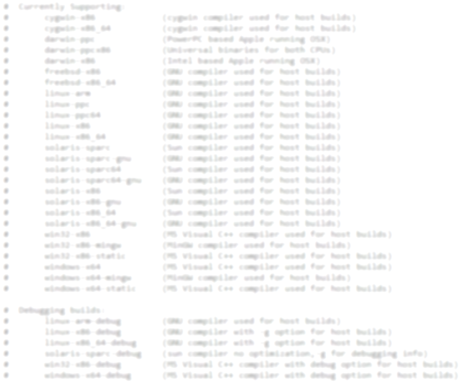
EPICS Platforms
Native platforms: Linux, Solaris, FreeBSD, MacOS, Windows, Cygwin
Cross compilation target systems: Linux, Windows, iOS, vxWorks, RTEMS
Cross compilation target architectures: intel x86, arm, cris, microblaze, 68k, ppc

Slide 3
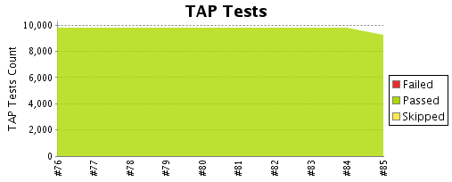
Unit Tests in Base
Number of tests and test coverage are increasing 3.14: 2.6k → 3.15: 8.5k → 3.16: 9.2k
Test output is formatted as TAP (Test Anything Protocol)

Slide 4
Java Parts of V4
Maven as build tool
Two layers of Maven submodules: Aggregation and inheritance
Parent project contains Git submodules
Does not play well with some Maven plugins
Deployment to Maven Central

Slide 5
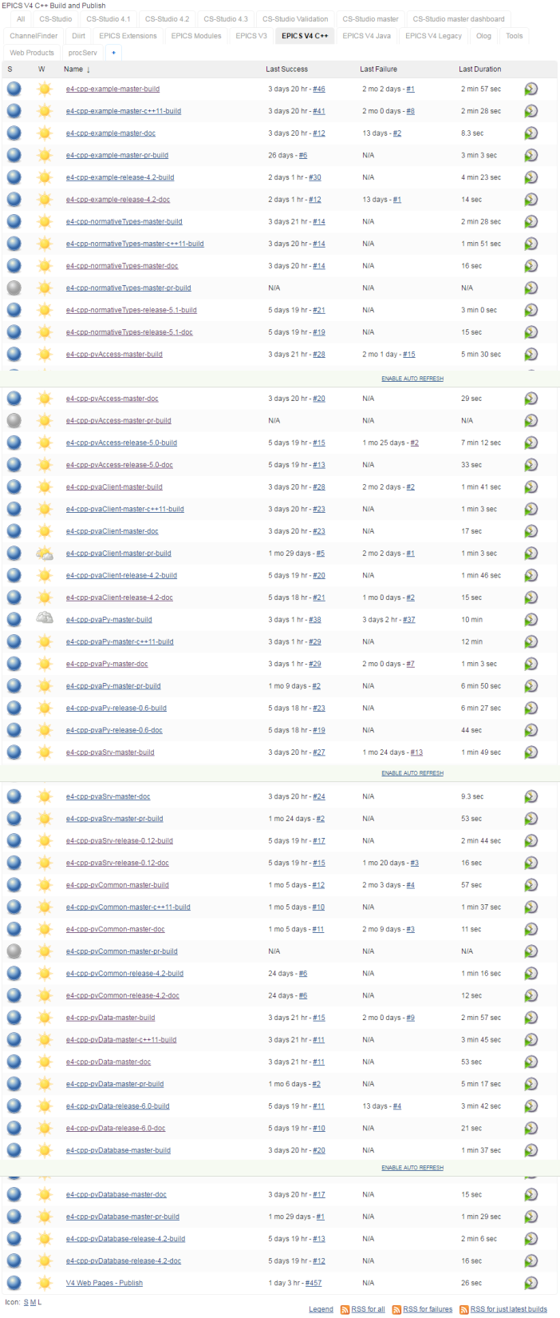
Two Jenkins Instances
CloudBees:
C++ and Java
Linux host
Release builds
Pull request builds

Slide 6
Two Jenkins Instances
APS:
C++ builds
Only master
Host builds: Linux, MacOS, Solaris, Windows
Cross builds to many targets

Slide 7
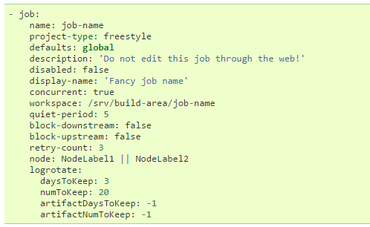
Generating CloudBees Jenkins Jobs
CloudBees does not allow the Job DSL Plugin
Script running on the server is too powerful
Jenkins Job Builder
Script creates job XML from YAML declarations (client side), then uploads to Jenkins

Slide 8
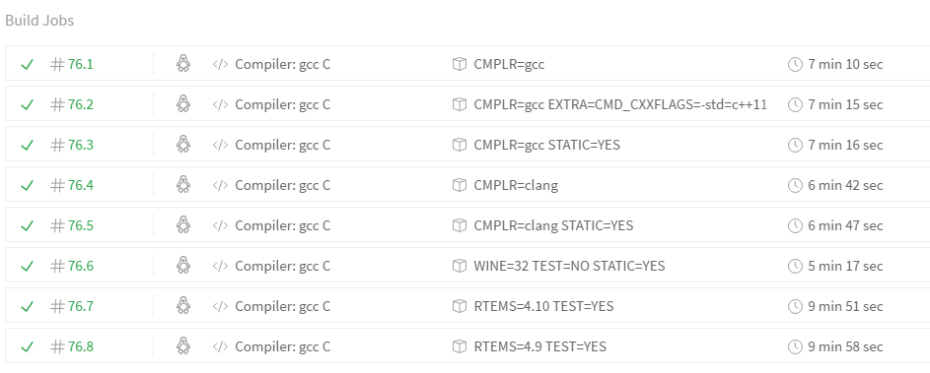
Next Generation CI
Travis CI – cloud based builds
host builds for Linux (gcc, clang), WINE
cross builds for RTEMS

Slide 9
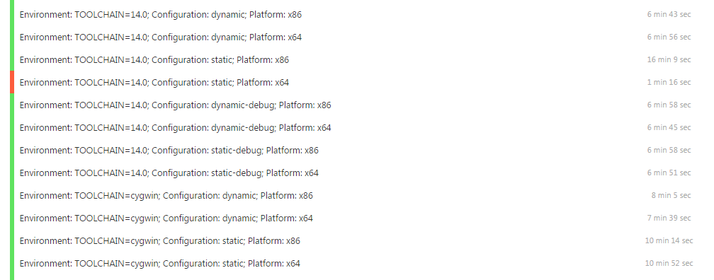
Next Generation CI
AppVeyor: Travis for Windows
VS 2008, 2010, 2012, 2013, 2015, Cygwin, MinGW
32bit, 64bit – DLL, static build – debug, nodebug
Full matrix: ~50 jobs, taking ~7 hours

Slide 10
Conclusion
Build systems for both C++ and Java are in a good state
Test coverage is good and improving
Current Jenkins based CI systems already cover a lot
Work to be done for next generation CI tools
Please copy and contribute

