Slide 1
Signal Archiving System Setup and Test
September 2016
RISP /IBS
Seung Hee Nam
Notes:
Hi, i am very nervous because it is my first english presentation.
let me start by saying just a few word about myself
my name is seeing hee nam and my major is department of accelerator science. oh sorry i am ph.d candidate student at korea university in Korea.
i am going to present signal archiver system setup and test using archiver appliance

Slide 2
Contents
Archiver Appliance
Archiving System Configuration
Single Node Archiver Appliance Setup and Test
Multiple archiver appliance Setup and Test
Notes:
i have divided my presentation into three parts.
first, signal archiver system configuration
Second, single node archiver appliance setup and test
finally multiple archiver appliance setup and test. but it is not depth test just using multiple archer appliance test.

Slide 3
Archiving System Configuration
Using archiver appliance for signal archiving system
 | Storage | File System
STS | RAM Disk | tmpfs (RAM File System)
MTS | SAS Disk | ext4 (Extended File System)
LTS | SAN (Storage Area Network) | Cluster File System | GPFS (General Parallel File System)
Notes:
i am using archiver appliance for signal archiving system.
as you know archiver appliance storage area consist of STS, MTS and LTS.
STS region uses ram file system it is used to maximize the file I/O performance in the local area. MTS region use extended file system and LTS region use Cluster file system.
green line is fiber cable and blue line is gigabit ethernet cable. network storage was configured to use the GPFS. and SAN switch was used for communication between SAN storage and server and connected directly to the server.

Slide 4
Single Node Archiver Appliance Test
Test Environment (GPFS Node1)
Intel(R) Xeon(R) CPU E5-2650 v2 2.6GHz(16-core)
STS : tmpfs / MTS : SAS / LTS : GPFS
Test IOC
Operating speed : 10Hz
PV number : 5000 (double type)
IOC number : 9
Total 45000 PV
Archiving Mode Test
Scan mode
Monitor mode
Notes:
we can obtain the basic data through the single node archiver appliance test.
i created testIOC for testing single node archiver appliance.
test ioc 읽기
and it was tested scan mode and monitor mode.

Slide 5
Scan Mode Test
Mode : Scan mode, sampling period : 0.1 sec, ETL policy : default
Time
The number of PV gradually increases, the time for counting PV increases.
Max connection time : 54 min 24sec (36000PV -> 37000PV)
Notes:
we tested the archiving of 45000PV operated at 10Hz. sampling period is 0.1sec, policy default.
as the number of pv gradually increases, the time for counting pv increases. it is disadvantage of scan mode. I think scan mode is not suitable for storing a large amounts of data.

Slide 6
Scan Mode Test
Max data rate (36000 PV)
3767794 byte/sec (3.5932 MB/sec)
303.18 GB/day
110660.82 GB/year
Data do not increase constantly -> data loss
Notes:
this graph show that the data do not increase constantly.
it is because the data loss.

Slide 7
Scan Mode Test
Max event rate : 190145.12 (36000 PV)
Event loss : 169854.88 (36000 PV)
Notes:
event rate is also do not increase constantly

Slide 8
Scan Mode Test
data loss showed up at regular intervals
(about every 10 seconds)
Why data loss occurs?
Buffer problem?
Appliance algorithm?
Test
Sampling period : 0.1 sec, 1000 PV
Sampling period : 0.2 sec, 2000 PV
Sampling period : 1 sec, 10000 PV
If buffer problem
Data loss showed up at regular intervals every test
If Appliance algorithm problem
Data loss depends on the test
0.1 sec, 1000 PV
Notes:
I got a another problem. data loss showed up at regular
intervals, so we tested this if it was affected by buffer or
problem of the archiver appliance algorithm.
i have conducted several tests with the same event rate.

Slide 9
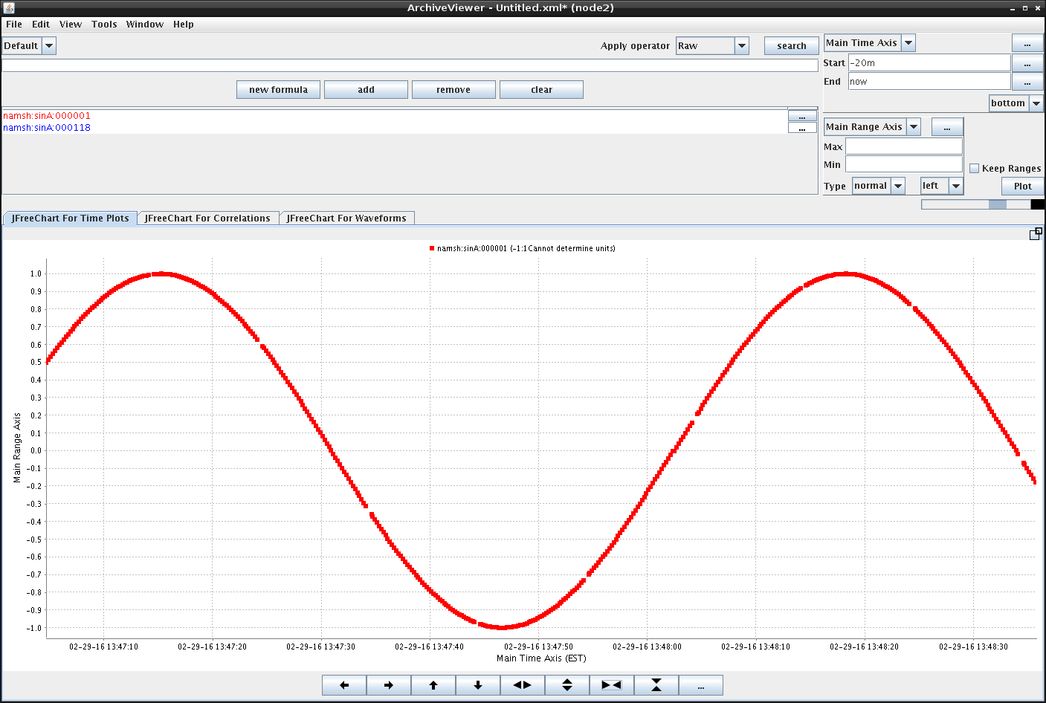
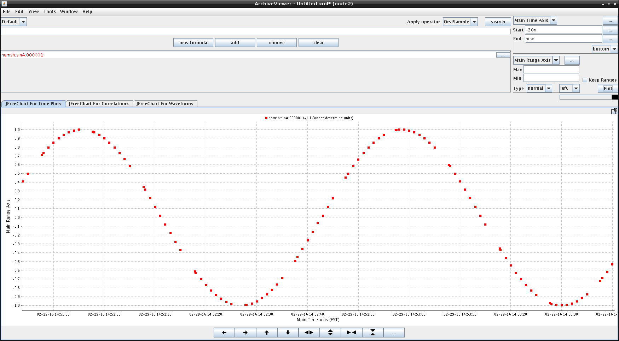
Scan Mode Test
0.2 sec
2000 PV
1 sec, 10000 PV
The reason for the periodic data loss caused by this is not an internal algorithm matter of the archiver appliance. The reason of data loss was caused by a buffer
Notes:
The reason for the periodic data loss caused by this is not
an internal algorithm matter of the archiver appliance. The
reason of data loss was caused by a buffer overflow. Data
loss due to the buffer overflow could be improved with the
addition of a system memory. A key of the signal archiving
system is to design the system memory.

Slide 10
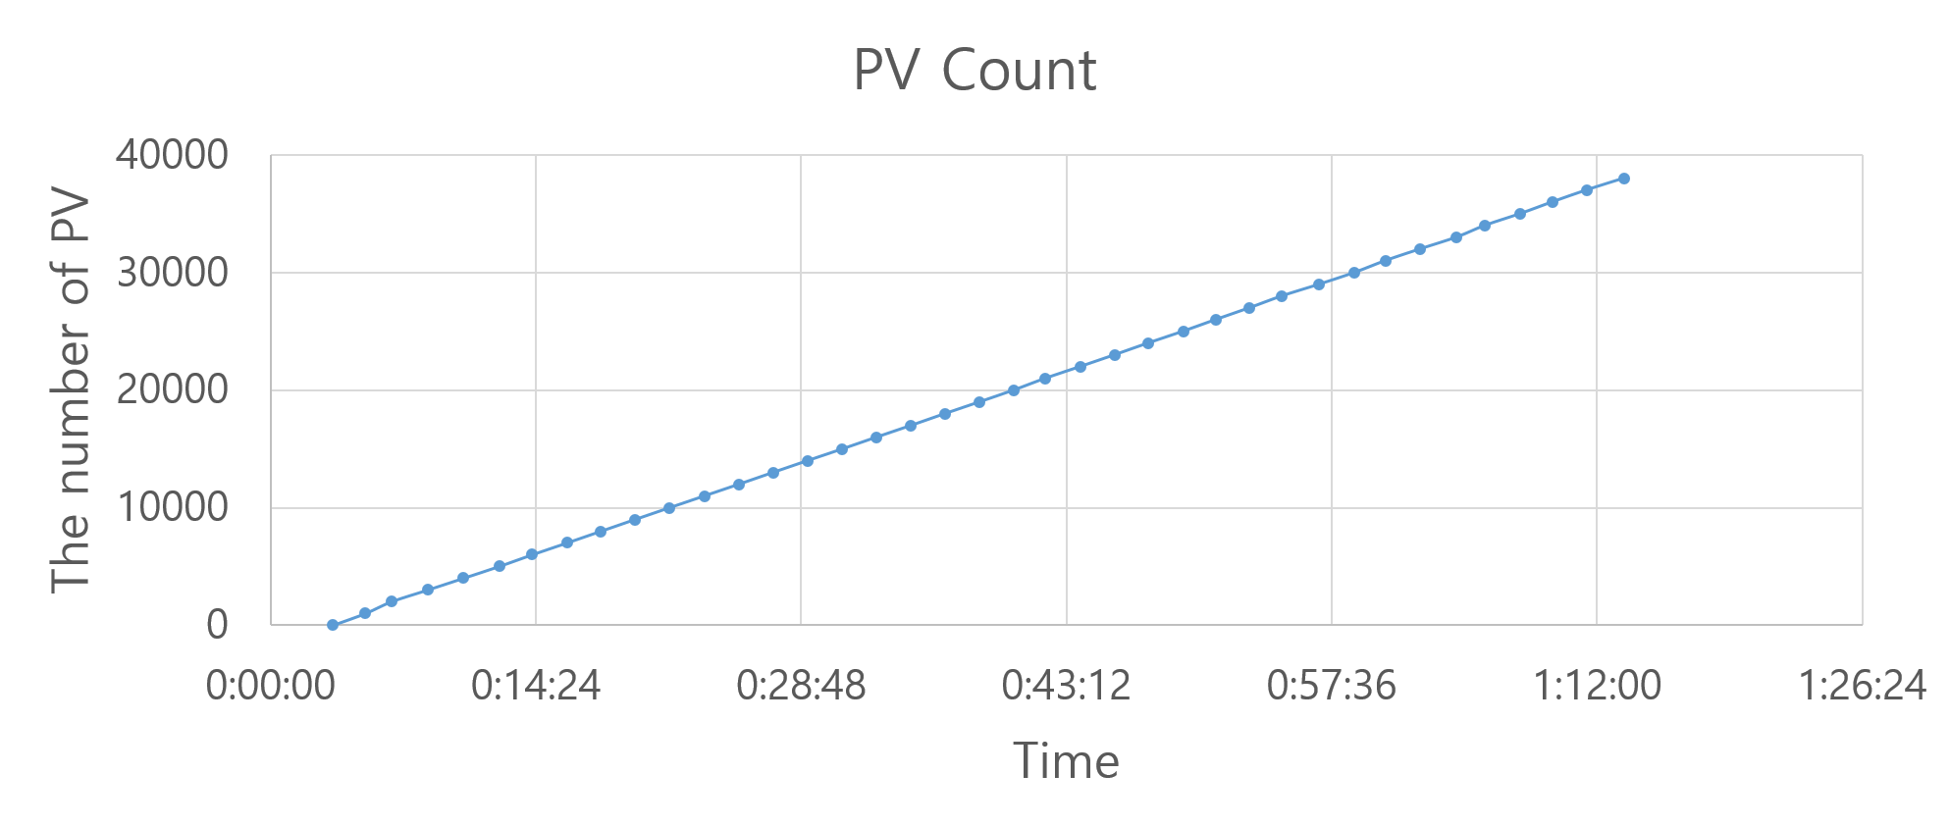
Monitor Mode Test
Mode : Monitor mode, sampling period : 0.1 sec, ETL policy : default
The time taken for counting PV is almost constant at about 2 minutes
(This is can be explained due to pre-calculation of capacity of the buffer in the monitor mode, regardless of the engine thread)
Notes:
This is can be explained due to pre-calculation of capacity of the buffer in the monitor mode, regardless of the engine thread

Slide 11
Monitor Mode Test
Max data rate (38000 PV)
7199415.52 byte/sec (6.8658 MB/sec)
579.31 GB/day
211448.19 GB/year
The data is increased almost constantly as PV increased
(This means that the loss of data is small to store a large amount of PV
)
Notes:
This means that the loss of data is small to store a large amount of PV
The data is increased almost constantly as PV increased.
This means that the loss of data is small to store a large
amount of PV. The highest data rate appeared to 7199415.52
byte / sec (6.8658 MB / sec), 579.31 GB / day, 211448.19
GB / year (206.4923TB / year) at 38000 . PV in excess
of 38,000 could not be confirmed because of insufficient
PVmemory in the server. More PV event can be stored if we
increase server’s memory

Slide 12
Monitor Mode Test
Max event rate : 363405.53 (38000 PV)
PV in excess of 38,000 could not be confirmed because of insufficient memory in the server
More PV event can be stored if we increase server’s memory
Event loss : 16594.47
Notes:
More PV event can be stored if we increase server’s memory
Event drop was occurred much less than the scan mode. Because monitor mode is used with pre-calculation of buffer capacity
Event rate of monitor mode was superior to that of scan
mode as 363405.53 when 38000 PV are counted. Event rate
is expected to be much higher if the system has sufficient
memory. When the archiving of 38,000 PV event rate was
confirmed in 363495.53, it means that data loss 16504.47
per second.

Slide 13
Single Node Test Conclusion
Data loss can be solved this way
One can increase buffer capacity by shortening sampling period
(Archiver appliance can be set as minimum sampling period 0.1 and maximum sampling period 86400)
Using the Multiple archiver appliance
Conclusion
Monitor mode has better performance than scan mode, and it is suitable for the storage of large amounts of data. However, the monitor mode has also node down due to insufficient system memory, therefore it is necessary to design the node memory and use multiple archiver appliance.

Slide 14
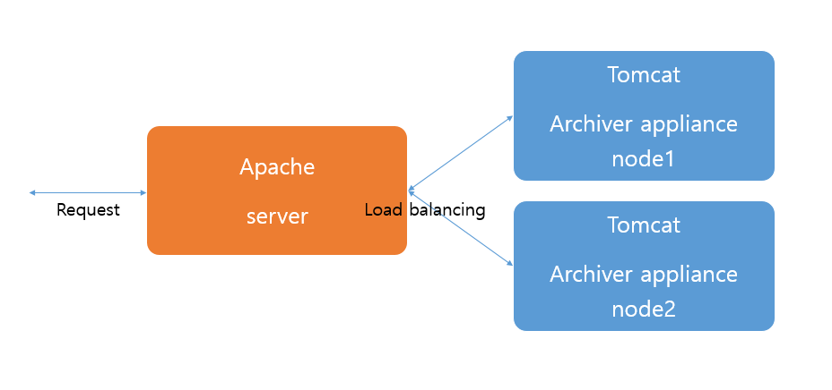
Multiple Archiver Appliance Configuration
Using 2 single node archiver appliance
Test environment
Archiver appliance node1 (GPFS Node1)
Intel(R) Xeon(R) CPU E5-2605 v2 2.6GHz(16-cores)
STS : tmpfs, MTS : SAS, LTS : GPFS
Archiver appliance node2 (GPFS Node2)
Intel(R) Xeon(R) CPU E5-2602 v2 2.1GHz(12-cores)
STS : tmpfs, MTS : SAS, LTS : GPFS
Notes:
Multiple archiver appliance is a clustering of several single node archiver appliance. Each node in the cluster is
independent, but can be controlled through load balancing.
Load balancing is a service that distributes traffic properly
by considering increase of server’s load rate and speed deterioration when high traffic occurs in one service. Multiple archiver appliance node can be extended as required

Slide 15
Check the PV Load Balancing
Input PV divided the each node to through the load balancing
Data has been stored in the specified each node STS

Slide 16
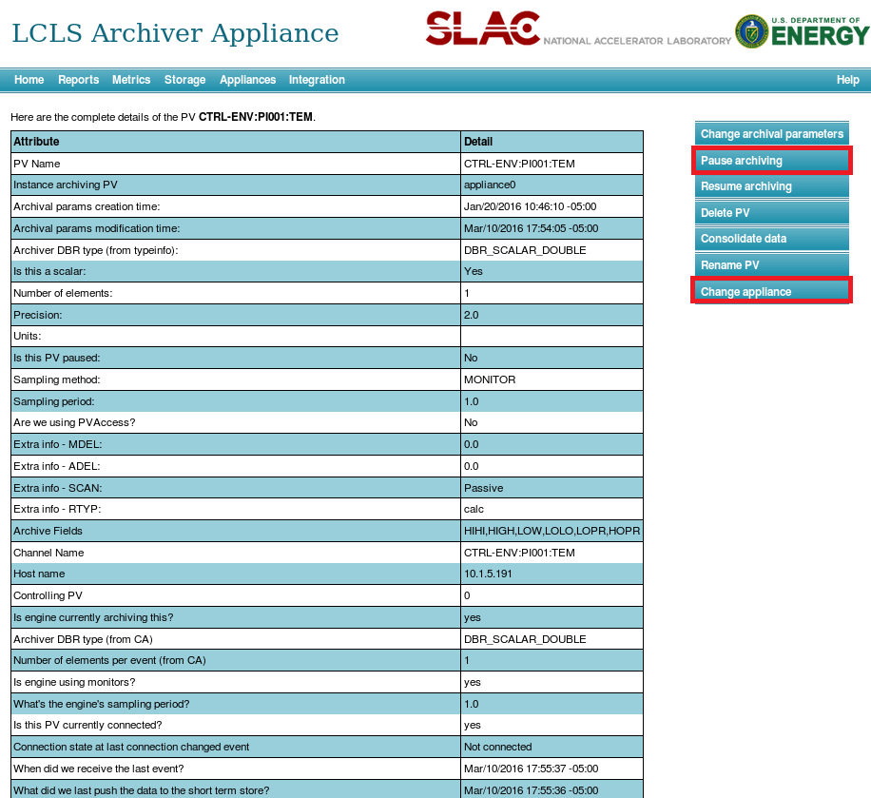
Confirmation of PV information
Details of PV is possible to check and change the part in detail.

Slide 17
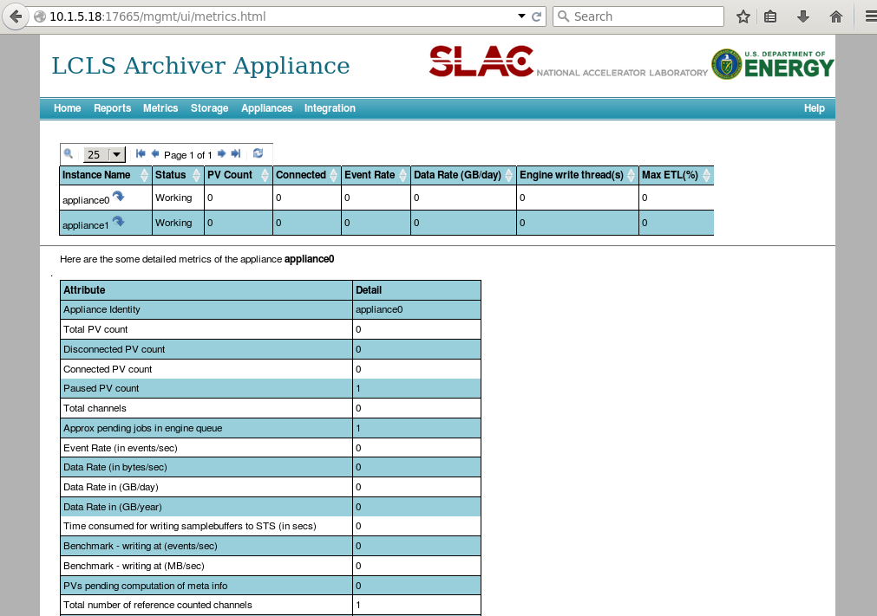
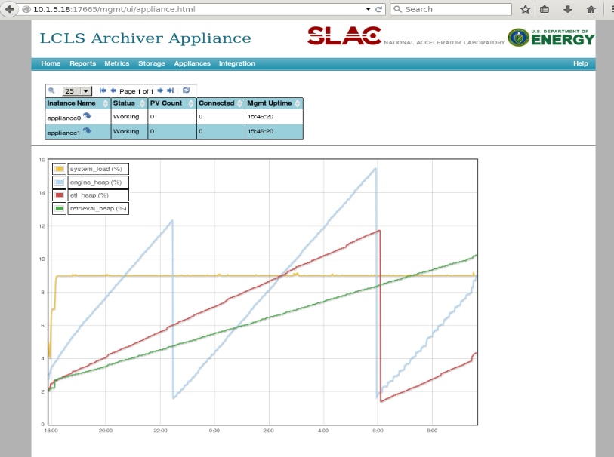
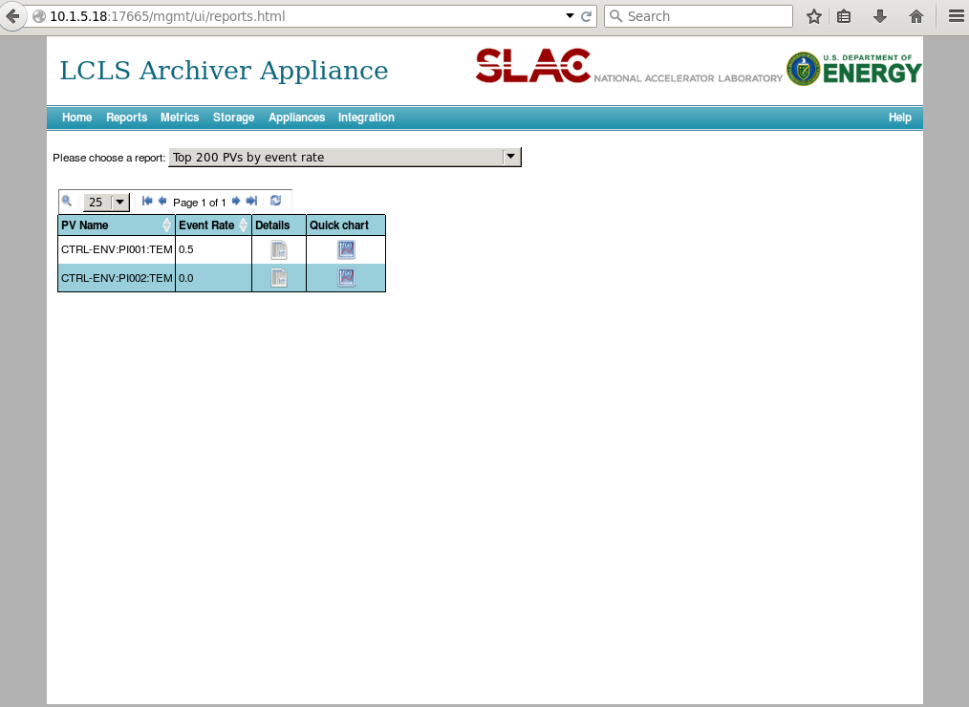
Check state information of each node
Each appliance information can be found in the apache

Slide 18
Appliance Node Down
When a node down, we can see ‘Appliance Down’ message in the status area.
In this case the downed node control is not possible, but it is possible control the other nodes.
When a node restart, we can see ‘Appliance assigned’ message in the status area.
It operated with saved archiver appliance node setting

Slide 19
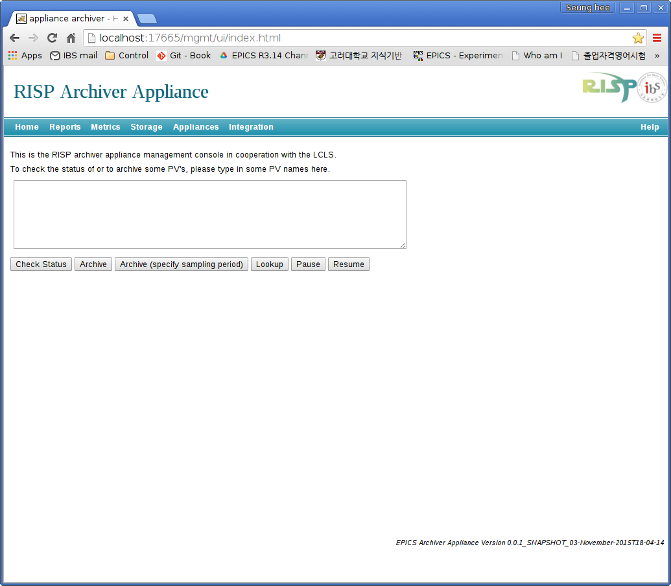
Goal
Lossless data store service for RAON archiving system
24/7 days data service
Fast response for large amount of data

Slide 20
Q&A (namsh@ibs.re.kr)
Thank you

