Slide 1
Further uses of fast orbit feedback controllers
Matthew Furseman
16:30, Tuesday 20th September, 2016
Notes:
Diamond has had an operational fast orbit feedback system since 2007 which has proved to be reliable through routine use since that time. The implementation of the feedback controllers uses distributed VxWorks IOCs for calculating the required correction values in each corrector magnet. These IOCs are more easily modified than systems using FPGAs, allowing us to introduce additional features into our soft real time control system and control these features using EPICS. We have used this functionality to produce dynamic closed bumps into our electron beam orbit, measure the BPM to corrector response matrix and characterise the response of our corrector magnets. In the future an additional feature we would like to implement is feed-forward suppression of electron beam noise introduced by I10's fast switching chicane.

Slide 2
Contents
Overview of FOFB system
Excitation behaviour and interface
Dynamic closed bumps
Response matrix measurement
Dynamic response of corrector magnets
I10 switching suppression
Notes:
Diamond has had an operational fast orbit feedback system since 2007 which has proved to be reliable through routine use since that time. The implementation of the feedback controllers uses distributed VxWorks IOCs for calculating the required correction values in each corrector magnet. These IOCs are more easily modified than systems using FPGAs, allowing us to introduce additional features into our soft real time control system and control these features using EPICS. We have used this functionality to produce dynamic closed bumps into our electron beam orbit, measure the BPM to corrector response matrix and characterise the response of our corrector magnets. In the future an additional feature we would like to implement is feed-forward suppression of electron beam noise introduced by I10's fast switching chicane.

Slide 3
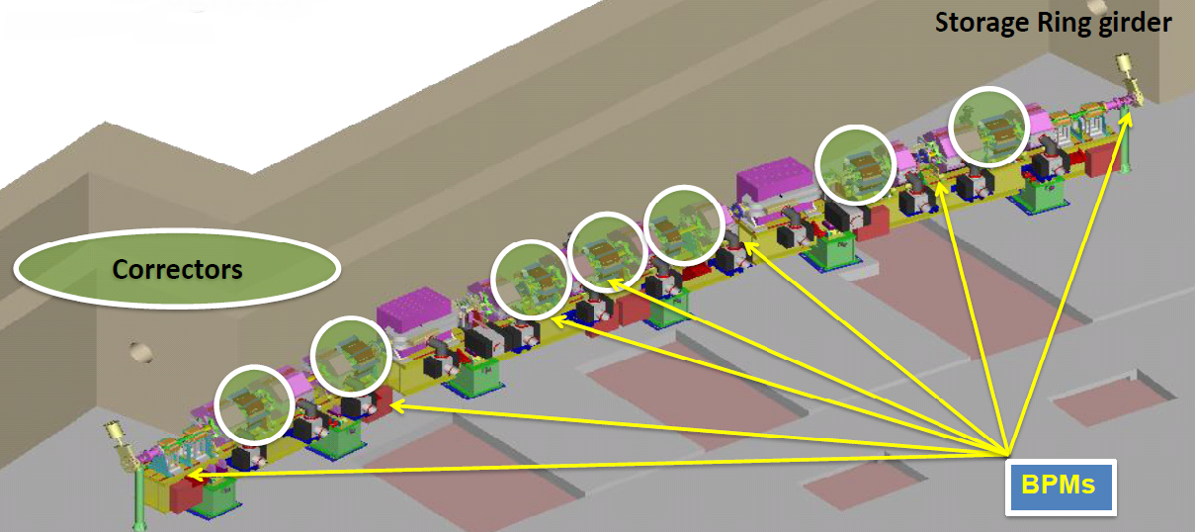
Layout of FOFB components
Global orbit correction at 10kHz
172 BPMs, 172 Correctors within sextupoles
Notes:
Typical arc of our 24 cell machine. Each cell has 7 BPMs and Correctors. (yes we have broken the symmetry with 9/9 for two ‘mini-beta’ cells).

Slide 4
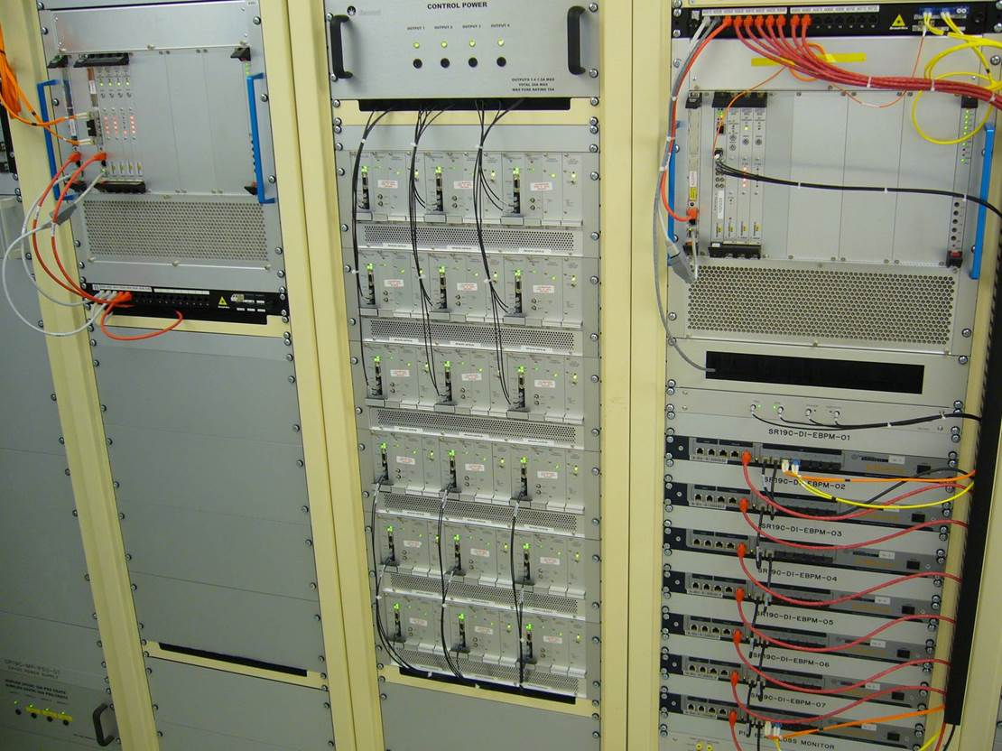
Corrector Power Supplies
Diagnostics Rack
Power Supply
VME Crate
Notes:
Arrangement of equipment for each cell. BPMs connect to Libera, which connect to FOFB IOC, which connect to PS.

Slide 5
Corrector Power Supplies
Diagnostics Rack
Power Supply
VME Crate
Notes:
Location of networking cables

Slide 6
Notes:
Connections between BPMs are arranged in a star network between each cell. The FOFB communications controller and BPM communications controller transfer packets on a synchronised tick.

Slide 7
Corrector Power Supplies
Diagnostics Rack
Power Supply
VME Crate
Notes:
Location of FOFB IOC. Each IOC is responsible for setting the demand of all the correctors in its cell.

Slide 8
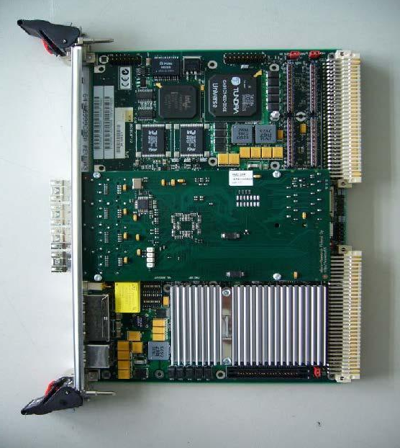
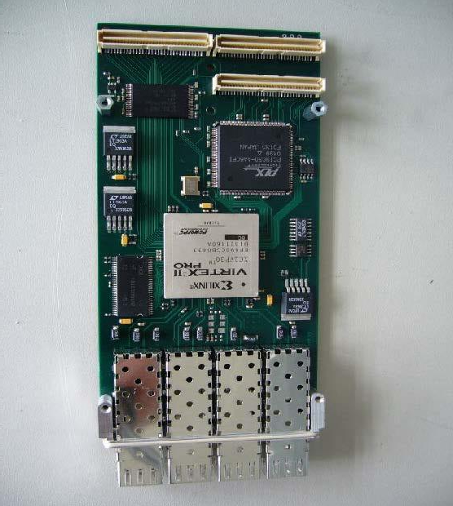
Fast orbit feedback IOC and PMC
EPICS IOC
Communications Controller (FPGA)
Notes:
Left: FOFB IOC running VxWorks. Right: PMC card, responsible for communications controller, transfers data via DMA. The IOC is responsible for calculating the correction, giving us easy prototyping compared to all FPGA solutions.

Slide 9
Fast acquisition archiver
Notes:
Archiver records data

Slide 10
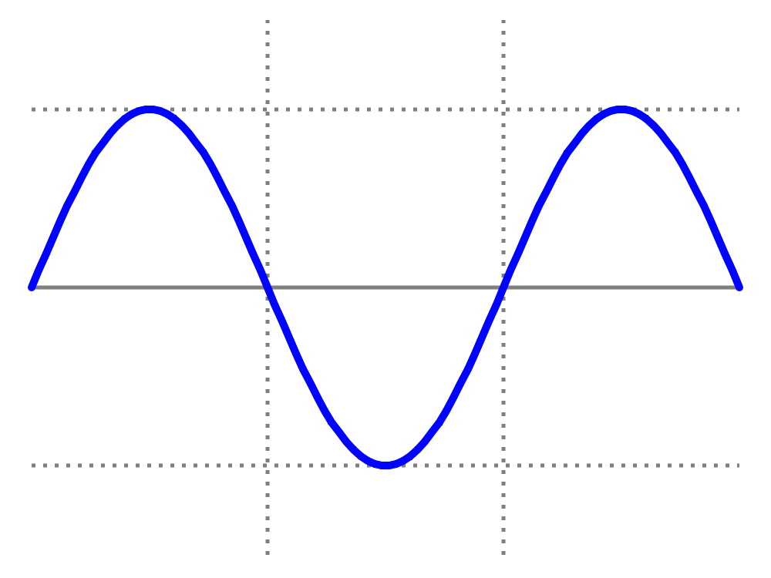
What is an excitation?
Perturb the electron beam using a corrector magnet so that the reading from a BPM follows a sine wave:
BPM
reading
time

Slide 11
Excitation interface
Each IOC is running a synchronised 10 kHz loop connected to power supply controllers. Why not modify it to provide a sinusoidal disturbance around the ring?
Excitations are programmed into the IOC via PVs.
The start times of excitations are specified in synchronised ‘FA’ ticks.
Almost arbitrary frequencies are achieved using a phase advance per tick.
Separate frequency, amplitude and start time control for each horizontal and vertical corrector.

Slide 12
Uses of excitations
Dynamic closed bumps
Response matrix measurement
Dynamic response of corrector magnets
I10 switching suppression

Slide 13
Dynamic closed bumps
Corrector
Corrector
Corrector
e
EBPM
EBPM
EBPM

Slide 14
Dynamic closed bumps
Create electron beam disturbance on isolated BPMs.
Invert the BPM to corrector response matrix.
Take a row of the inverted matrix, these are the corrector values required to change the reading on a single BPM.
Apply a synchronised excitation to the correctors using the magnitudes received from the inverse response matrix.

Slide 15
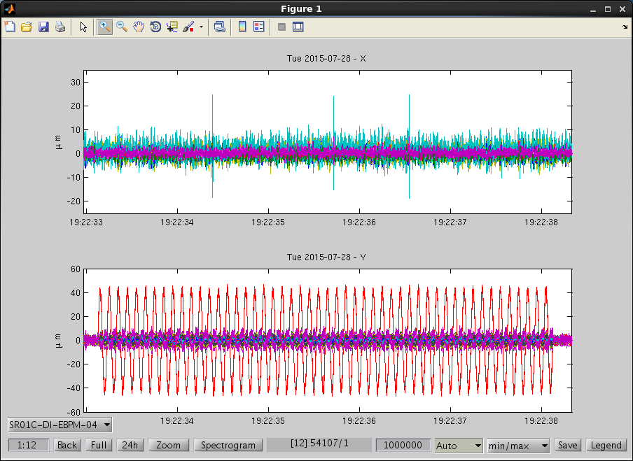
Dynamic closed bumps
Single BPM being driven by correctors at 10Hz

Slide 16
Dynamic closed bumps
Subtract the IRM rows for two neighbouring BPMs either side of an insertion device straight.
Apply to the ring to ‘see-saw’ through the ID creating an oscillating photon beam.
Electron path, assuming the majority of deflection is achieved using just two correctors.
XBPM
γ
EBPM
EBPM
Insertion Device
e
γ

Slide 17
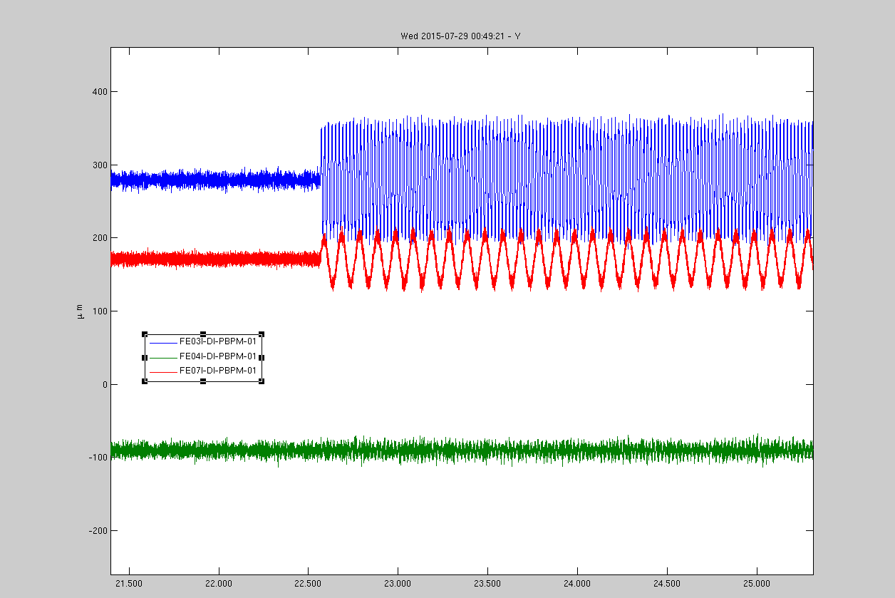
Dynamic closed bumps
XBPM traces for three beamlines
Fast bump
Slow bump
No bump

Slide 18
Uses of excitations
Dynamic closed bumps
Response matrix measurement
Dynamic response of corrector magnets
I10 switching suppression

Slide 19
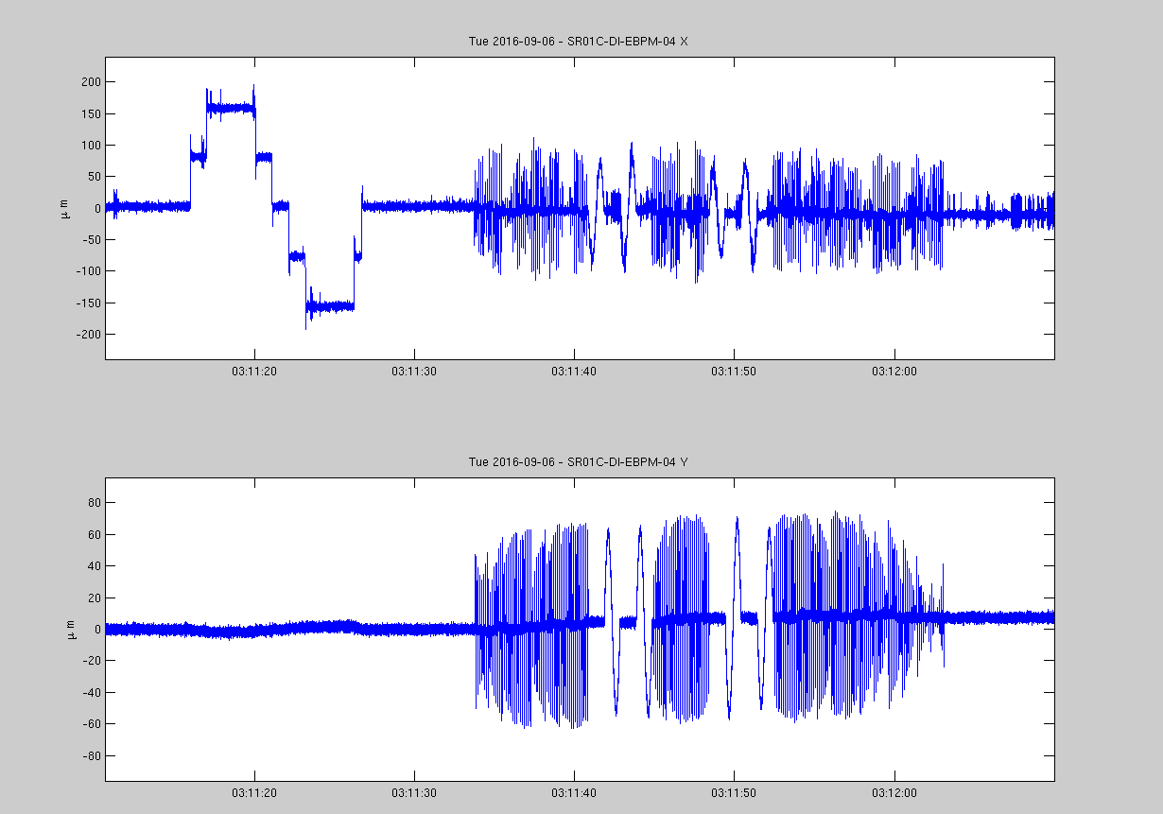
Response matrix measurement
Dispersion measurement
Each corrector driven in turn
Four correctors have slower dynamics

Slide 20
Response matrix measurement
Load BPM data from the FA archiver
Calculate each response matrix element

Slide 21
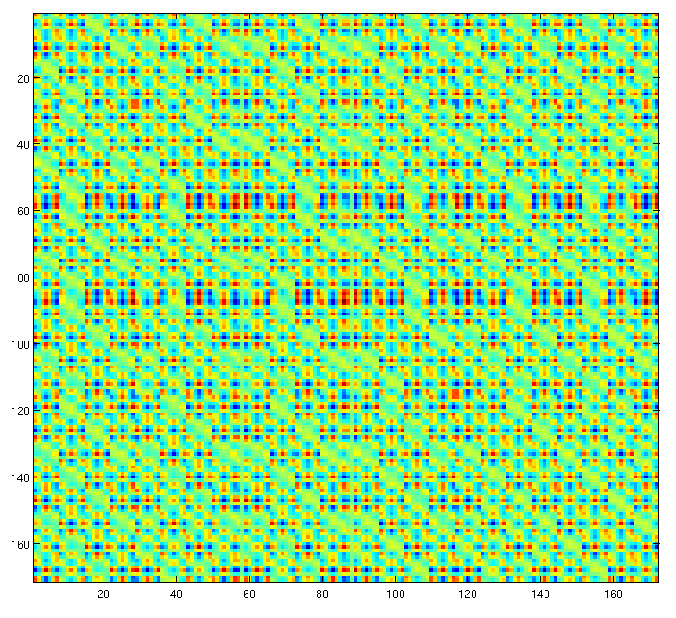
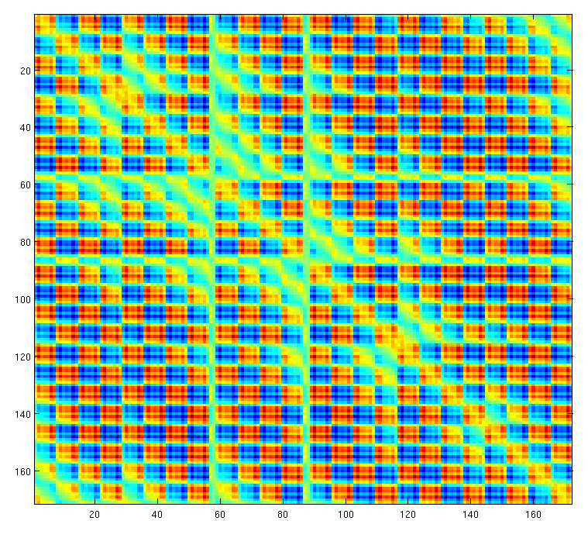
Response matrix measurement
On axis response matrices in both planes, measured in 50 seconds.

Slide 22
Uses of excitations
Dynamic closed bumps
Response matrix measurement
Dynamic response of corrector magnets
I10 switching suppression

Slide 23
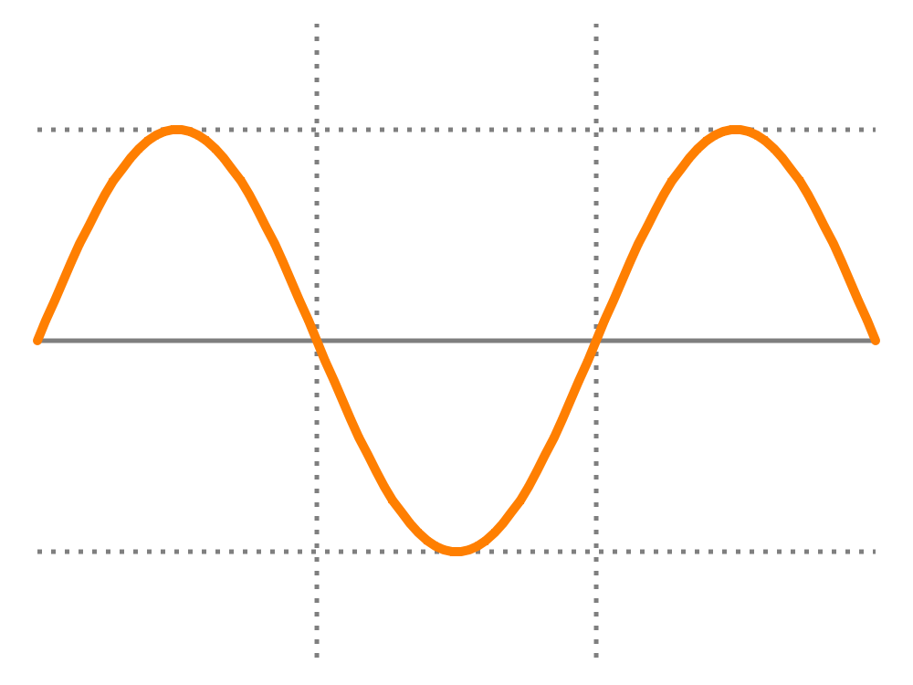
Dynamic response of corrector magnets
Low frequency
Magnet keeps up with demand
High frequency
Magnet lags

Slide 24
Dynamic response of corrector magnets
Excite a corrector with a constant frequency sine wave.
Mix the BPM data from the FA archiver with a synthesized sine and cosine wave as per the response matrix measurement.
The generating wave is constant phase and magnitude, so we return a single IQ data pair representing each excitation.
Increase frequency of excitations in steps, up to our nyquist frequency of ~5 kHz.

Slide 25
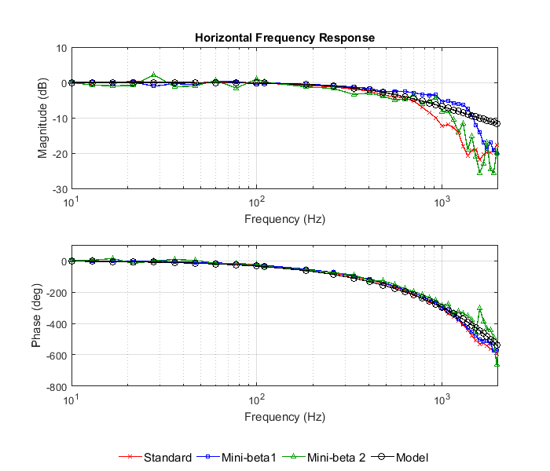
Dynamic response of corrector magnets

Slide 26
Uses of excitations
Dynamic closed bumps
Response matrix measurement
Dynamic response of corrector magnets
I10 switching suppression

Slide 27
I10 fast chicane switching

Slide 28
I10 switching suppression
I10 Fast switching chicane: Dedicated dipole magnets installed for switching electron beam off axis between two insertion devices in different polarizations.
Magnets are cycled at 10 Hz and are designed to act in a horizontal plane.
Small leakage into vertical plain remains uncorrected.
Envisage a plan to measure non-closed component and then correct with a feedforward scheme using FOFB controllers.

Slide 29
Thanks for listening!
Overview of fast orbit feedback system
Excitation behaviour and interface
Dynamic closed bumps
Response matrix measurement
Dynamic response of corrector magnets
I10 switching suppression

