Slide 1
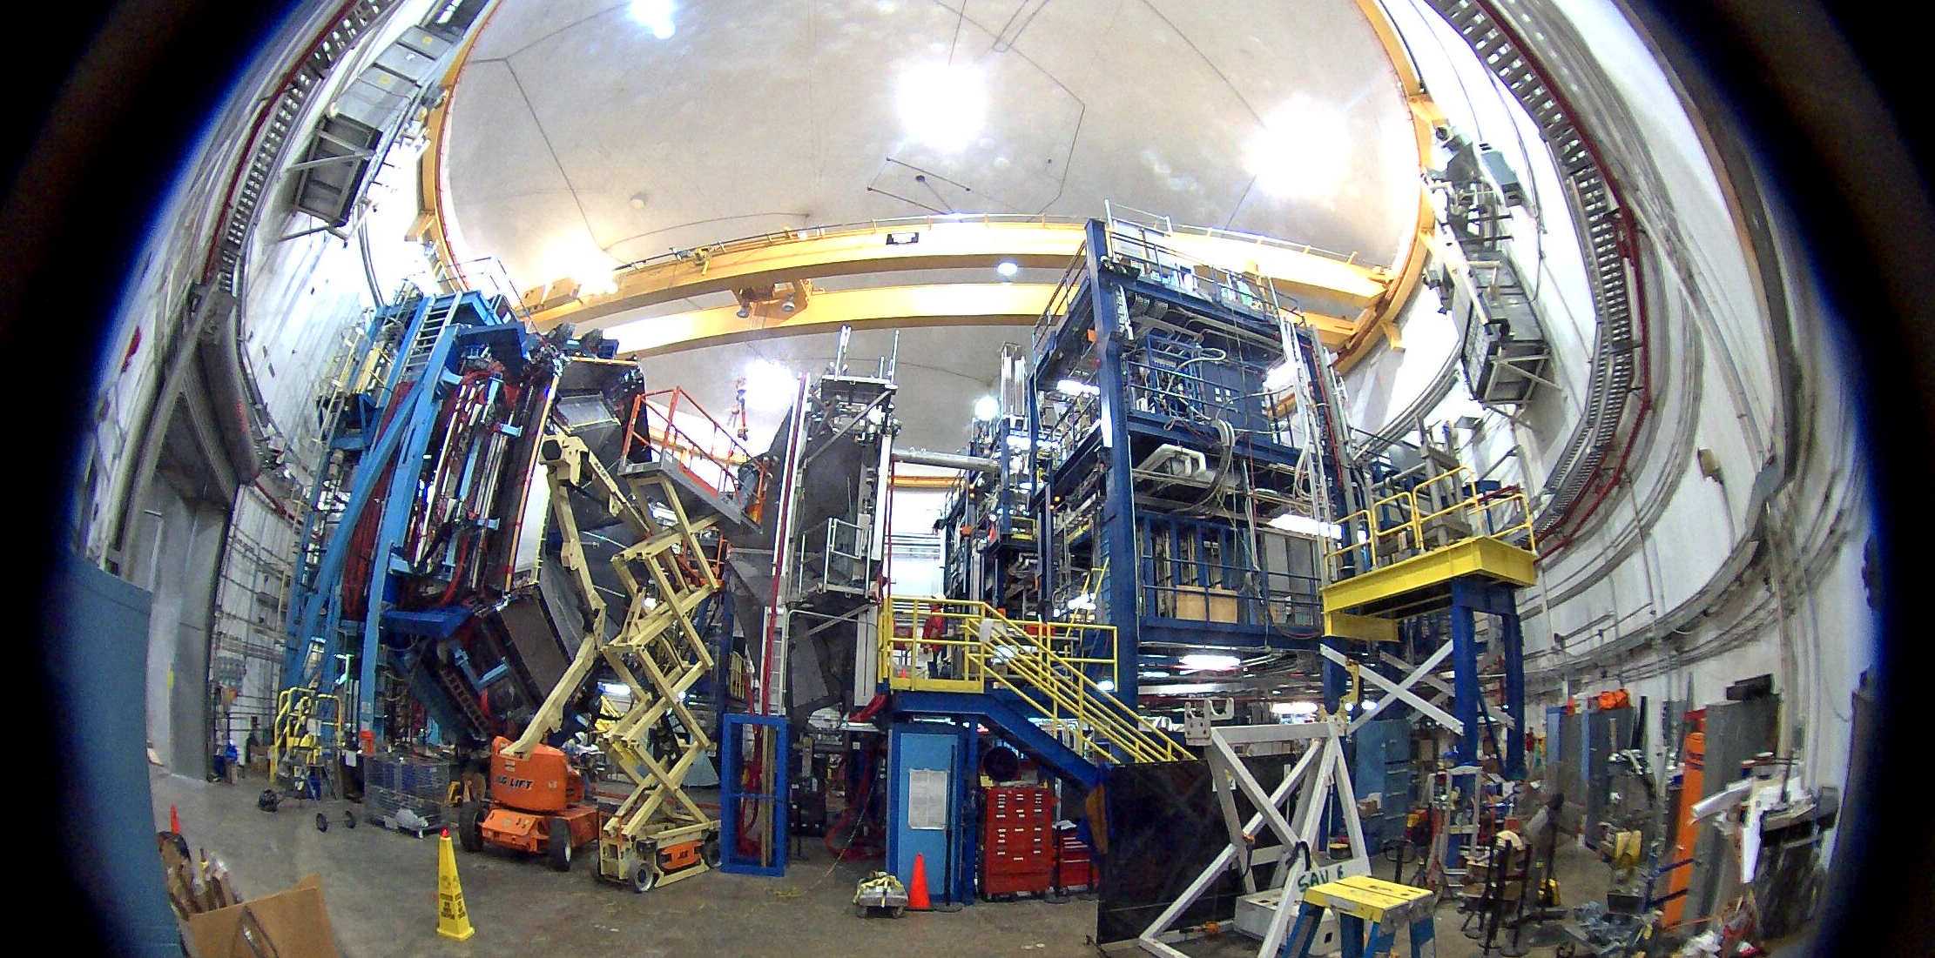
JLab Hall B Controls: Infrastructure and IT Integration
Wesley Moore
JLab CNI
EPICS Collaboration Meeting
September 2016 - ORNL

Slide 2
Overview
Hall B at JLab
Migration to modern software
EPICS, GUIs, etc
Useful utility scripts
How we leveraged IT and security expertise
Host Management
Monitoring
Remote Access
Future plans
Wesley Moore
wmoore@jlab.org

Slide 3
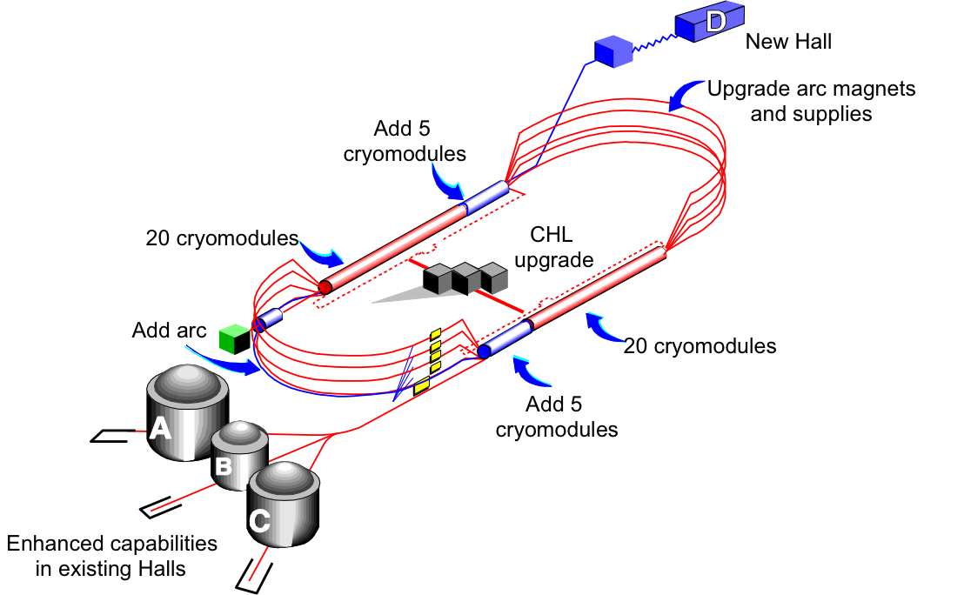
Hall B at JLab
CEBAF
Hall B
Google Maps: taken 09/08/2016
Wesley Moore
wmoore@jlab.org

Slide 4
Hall B at JLab
20-ton Radial Crane
CLAS12 Detector
Torus Magnet
(while under construction)
Beamline
Wesley Moore
wmoore@jlab.org

Slide 5
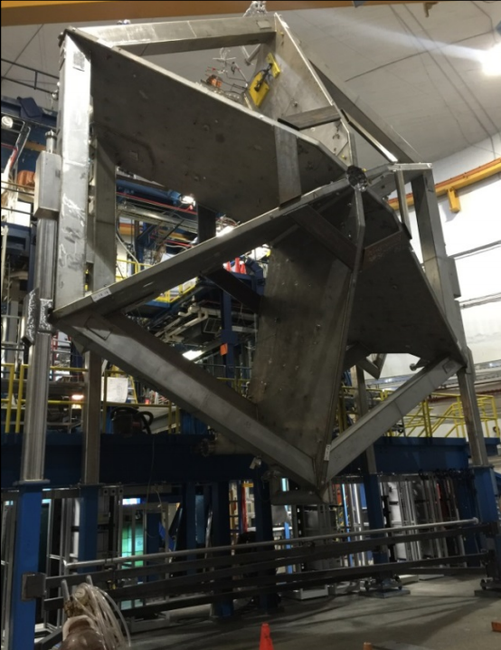
Hall B at JLab
CLAS12 Detector
Beam Direction
Torus Magnet
(commissioning)
Torus Magnet
(front view)
Taken 09/08/2016
Wesley Moore
wmoore@jlab.org

Slide 6
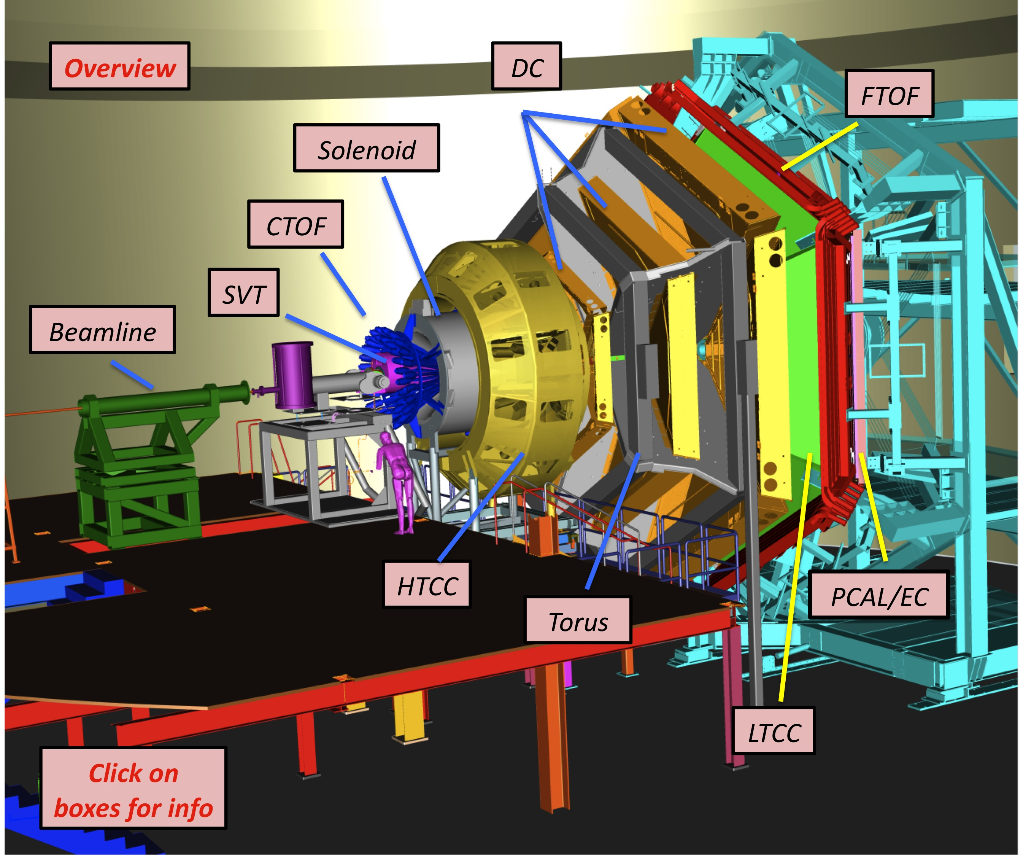
Hall B at JLab
Slow controls supports beamline,
detectors, and experiments
>50 apps/drivers, >65 IOCs
Diverse subsystem support:
Cryogenics (mostly PLC-based)
Detectors, targets
Magnets
Vacuum
Motors (collimators, harps, targets)
Scalers
Gas (He, N, etc)
High/Low voltage
Chillers
HPS
Slow Controls Team:
Wesley Moore, Nathan Baltzell (JLab)
Ken Livingston, Bryan McKinnon (Glasgow)
PLC Programming:
Nicholas Sandoval, Pablo Campero (JLab)
Wesley Moore
wmoore@jlab.org

Slide 7
EPICS
Migration
Before…
After…
<2yr migration
EPICS R3.13.4
VME-centric (VxWorks)
MEDM 3.1.9
ALH
No web interfaces
CVS for most code
Some with no version control
EPICS R3.14.12.5
softIOC-centric (RHEL7 64-bit)
CS-Studio 4.1.1
Wrapper script generates tmp workspace
Open MEDM-style Menu or Alarm Perspective
BEAST/Notifier
Some script generated configs
WebOPI
Read-only gateway access
Used for Management Staff and basic monitoring
Git for all code
Branching (master, develop, hotfix)
Archiving done with JLab’s Mya Archiver/Viewer
Wesley Moore
wmoore@jlab.org

Slide 8
CS-Studio
Migration
CSS launcher scripts
clascss , opens CSS with MEDM-style.
clascss-alarm, opens CSS in alarm perspective with menu to the left.
Both generate temporary Workspaces, provides consistent behavior and user experience.
1
2
Wesley Moore
wmoore@jlab.org

Slide 9
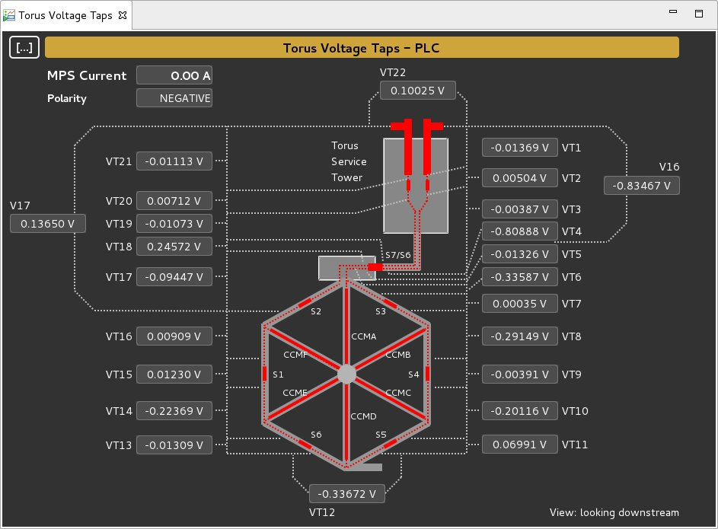
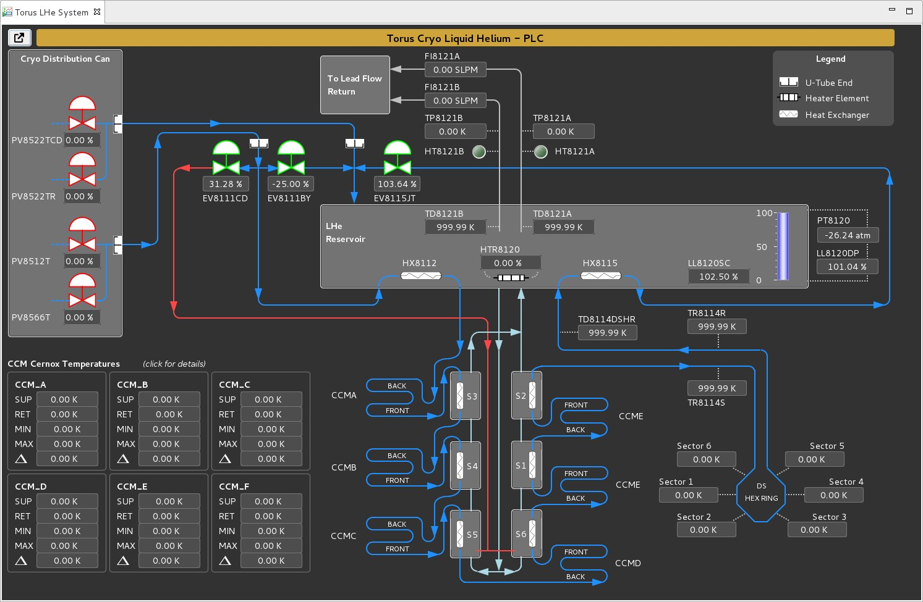
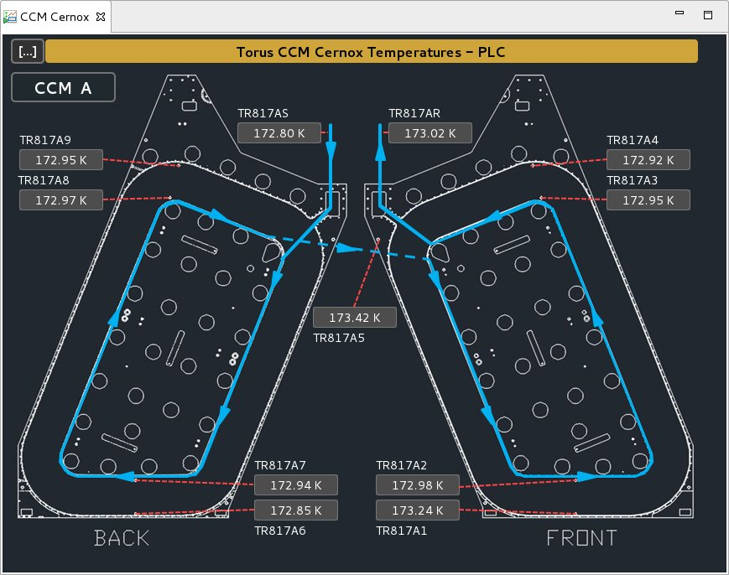
CS-Studio
Migration
GUIs a combination of:
Script generation, internal and external to CSS
Image overlays
Hand drawn
Wesley Moore
wmoore@jlab.org

Slide 10
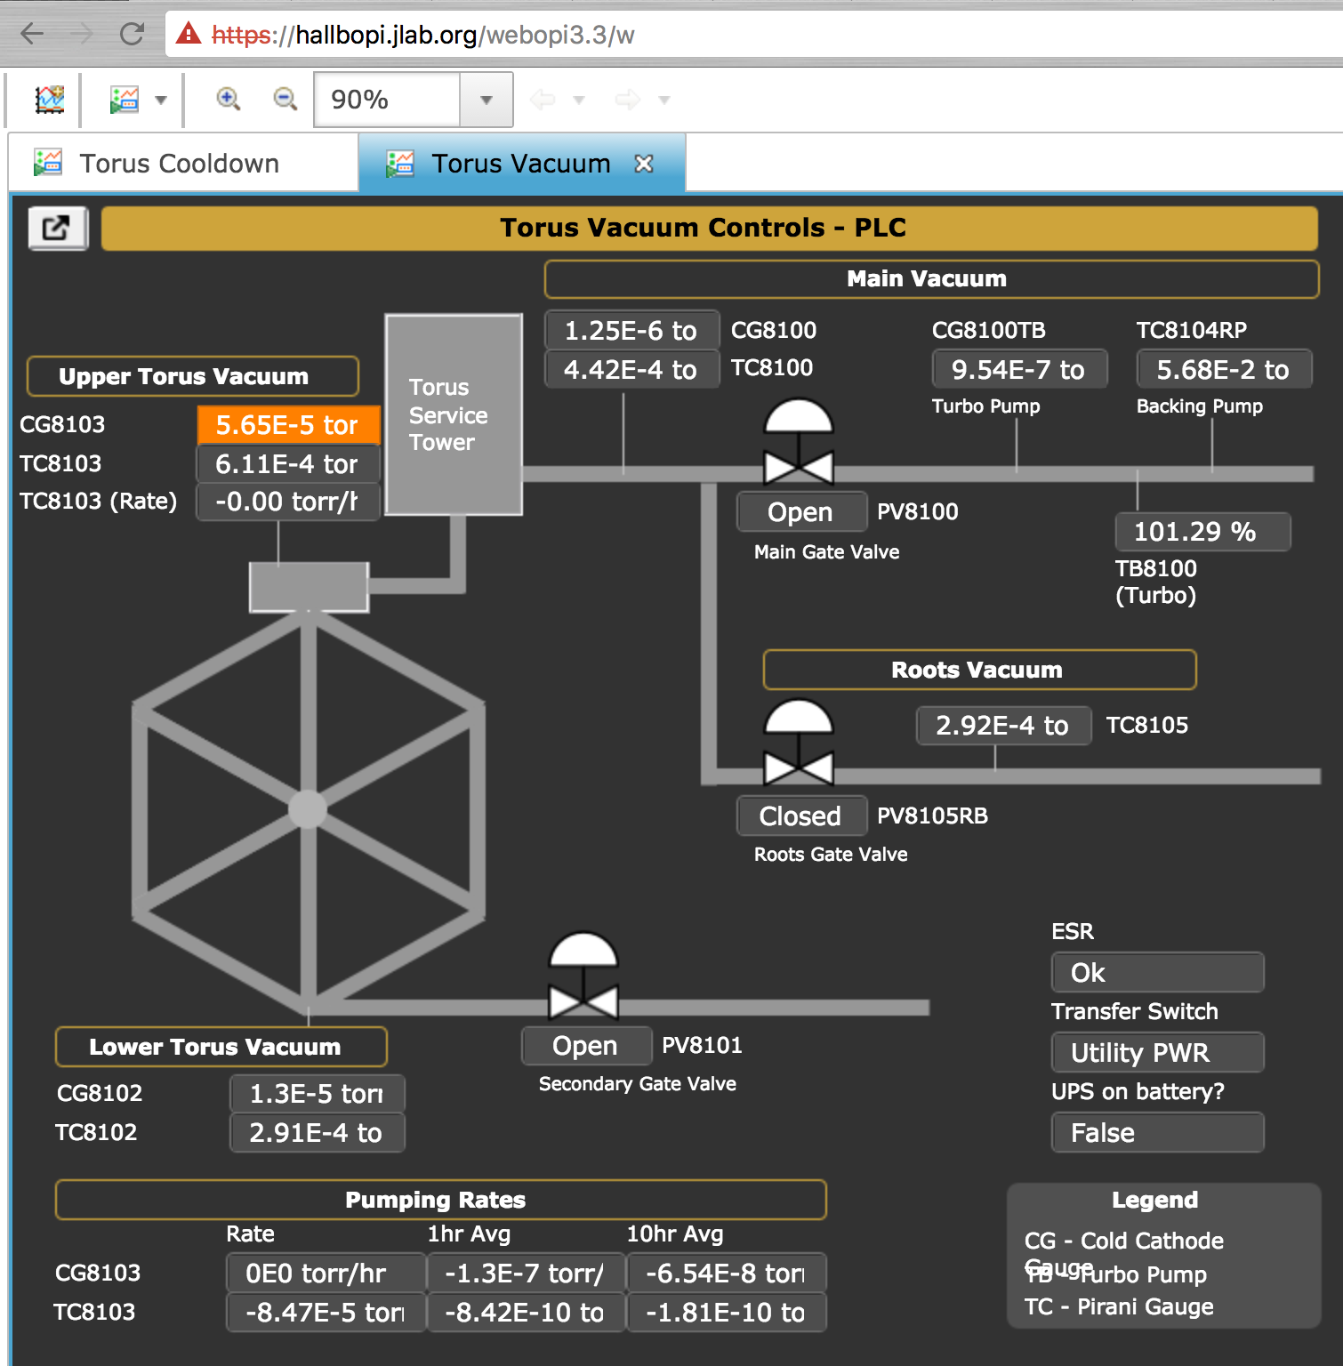
WebOPI
Migration
Configuration
RHEL7 VM, 8-Core, 8GB
Tomcat reverse proxyed behind Apache for access control.
Firewall rules allow access to Read-only CA Gateway.
Available off-site.
Findings
Images with PVs didn’t display.
Have seen linked OPIs not resolve.
Macro inheritance issues.
Had to use relative paths, we copied our full CSS Share to webserver.
font.def still needs tuning.
Apache/Tomcat: Marty Wise (JLab)
Wesley Moore
wmoore@jlab.org

Slide 11
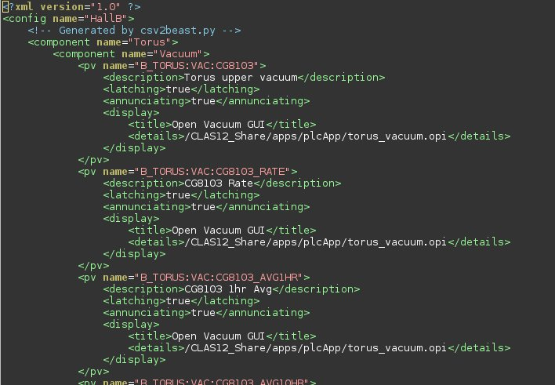
BEAST XML Generator
Utilities
csv2beast.py
Import/export spreadsheet as CSV for convenience.
CSV converted to BEAST XML.
Sub-elements found by column headers.
Anyone have similar tools?
Wesley Moore
wmoore@jlab.org

Slide 12
softIOC Management
Utilities
procServMgr*
Launcher for procServ
Uses a simple config file to manage:
Server hostname
telnet port number
IOC enable/disable
etc...
Key actions:
start/stop/restart
check (start if not running)
softioc_console*
Uses procServ.conf as “lookup table”
Issues ssh/telnet commands to softIOC host and port number
ssh –xt <hostname> telnet localhost <port>
Puppet
Installs cronjobs on softIOC servers, for polling procServMgr
procServ.conf snippet
*Written by: Anthony Cuffe (JLab)
Wesley Moore
wmoore@jlab.org

Slide 13
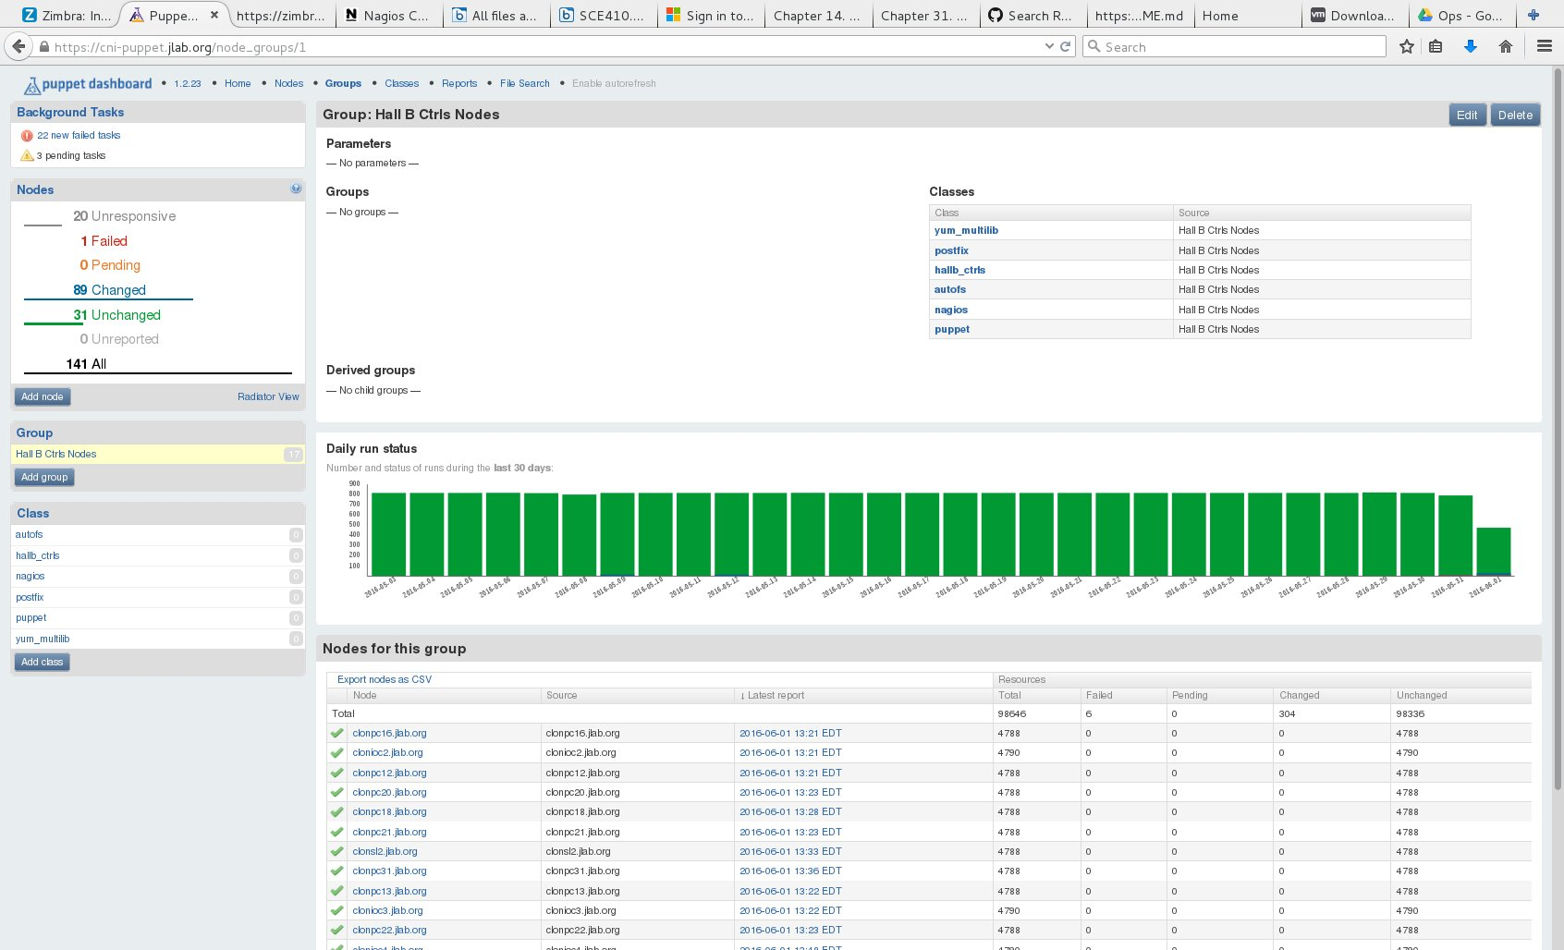
Host Management
IT Integration
Configuration
RHEL6 VM
Puppet
Puppet Dashboard
Facter (system profiling)
All open source
Notes
Host naming scheme makes Puppet config easier, allowing regex matching.
Not used for IOCs. Maybe in the future.
Manages
Installed packages, yum repos
NFS mount points, autofs
Group accounts/passwd
cron jobs for IOC startups
Ensures services running. Ex:
CA Gateways
iocLogServer
Logrotate
Puppet Server: Sherman White (JLab)
Wesley Moore
wmoore@jlab.org

Slide 14
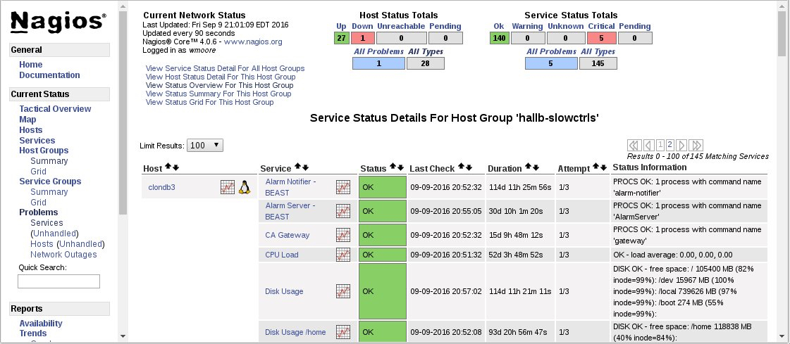
Monitoring
IT Integration
Configuration
RHEL6 VM
Nagios 4.0.6
NRPE 2.15
Apache
All open source
Notes
Sends Email and SMS alerts.
Monitors
Resources including:
CPU load
Disk space
Process count
Services including:
Alarm Server/Notifier
CA Gateways
Verify 2-factor logins
Wesley Moore
wmoore@jlab.org

Slide 15
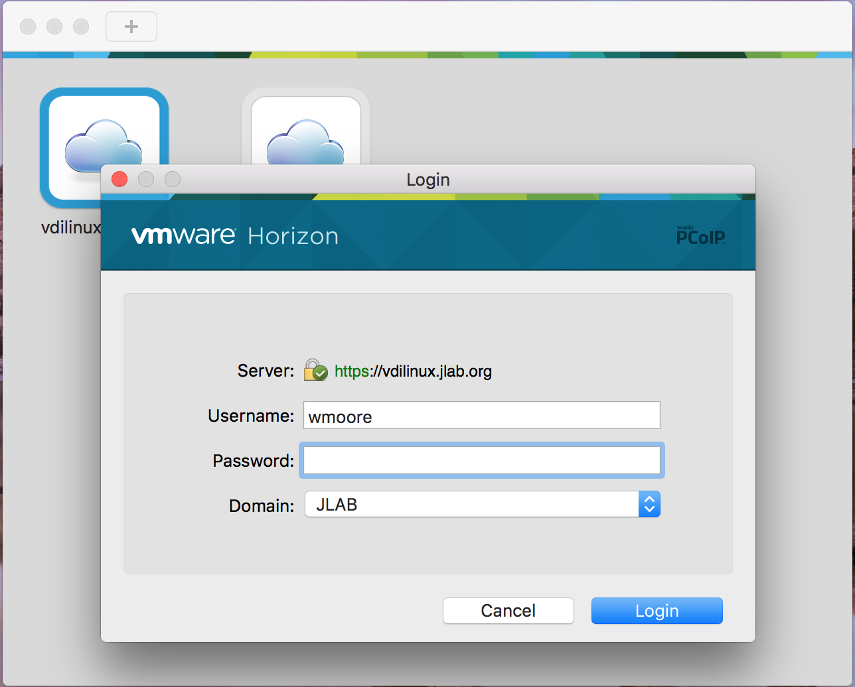
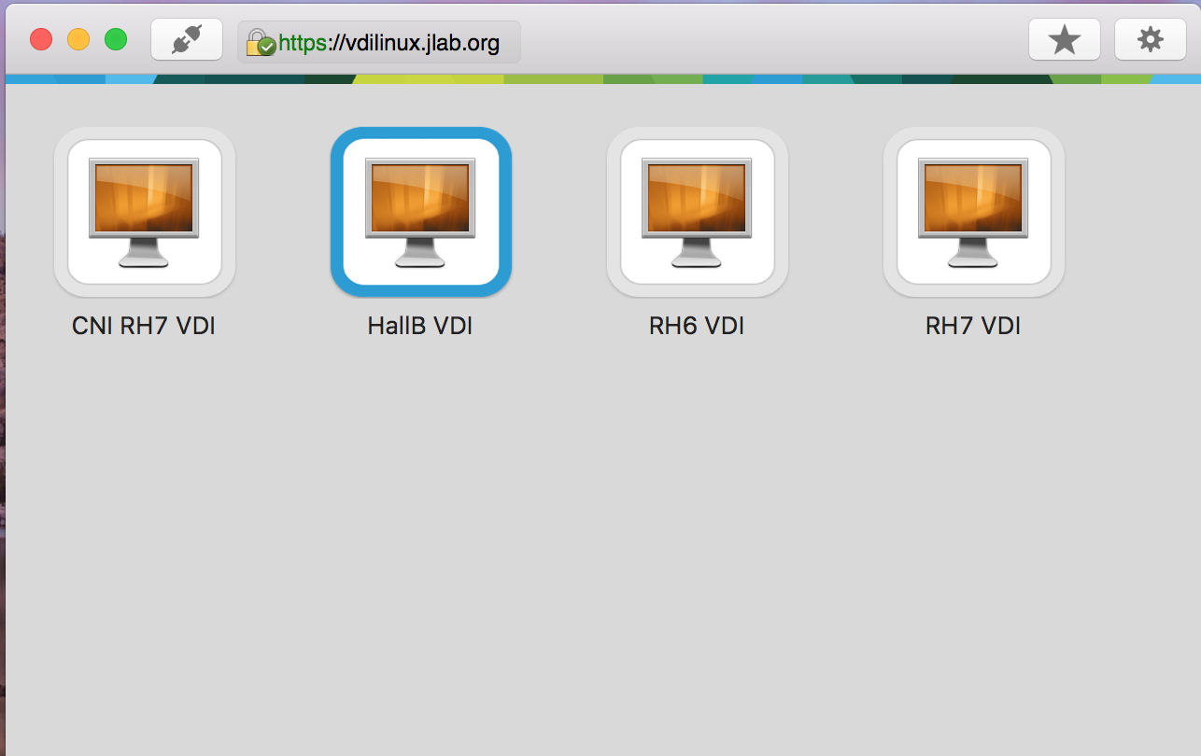
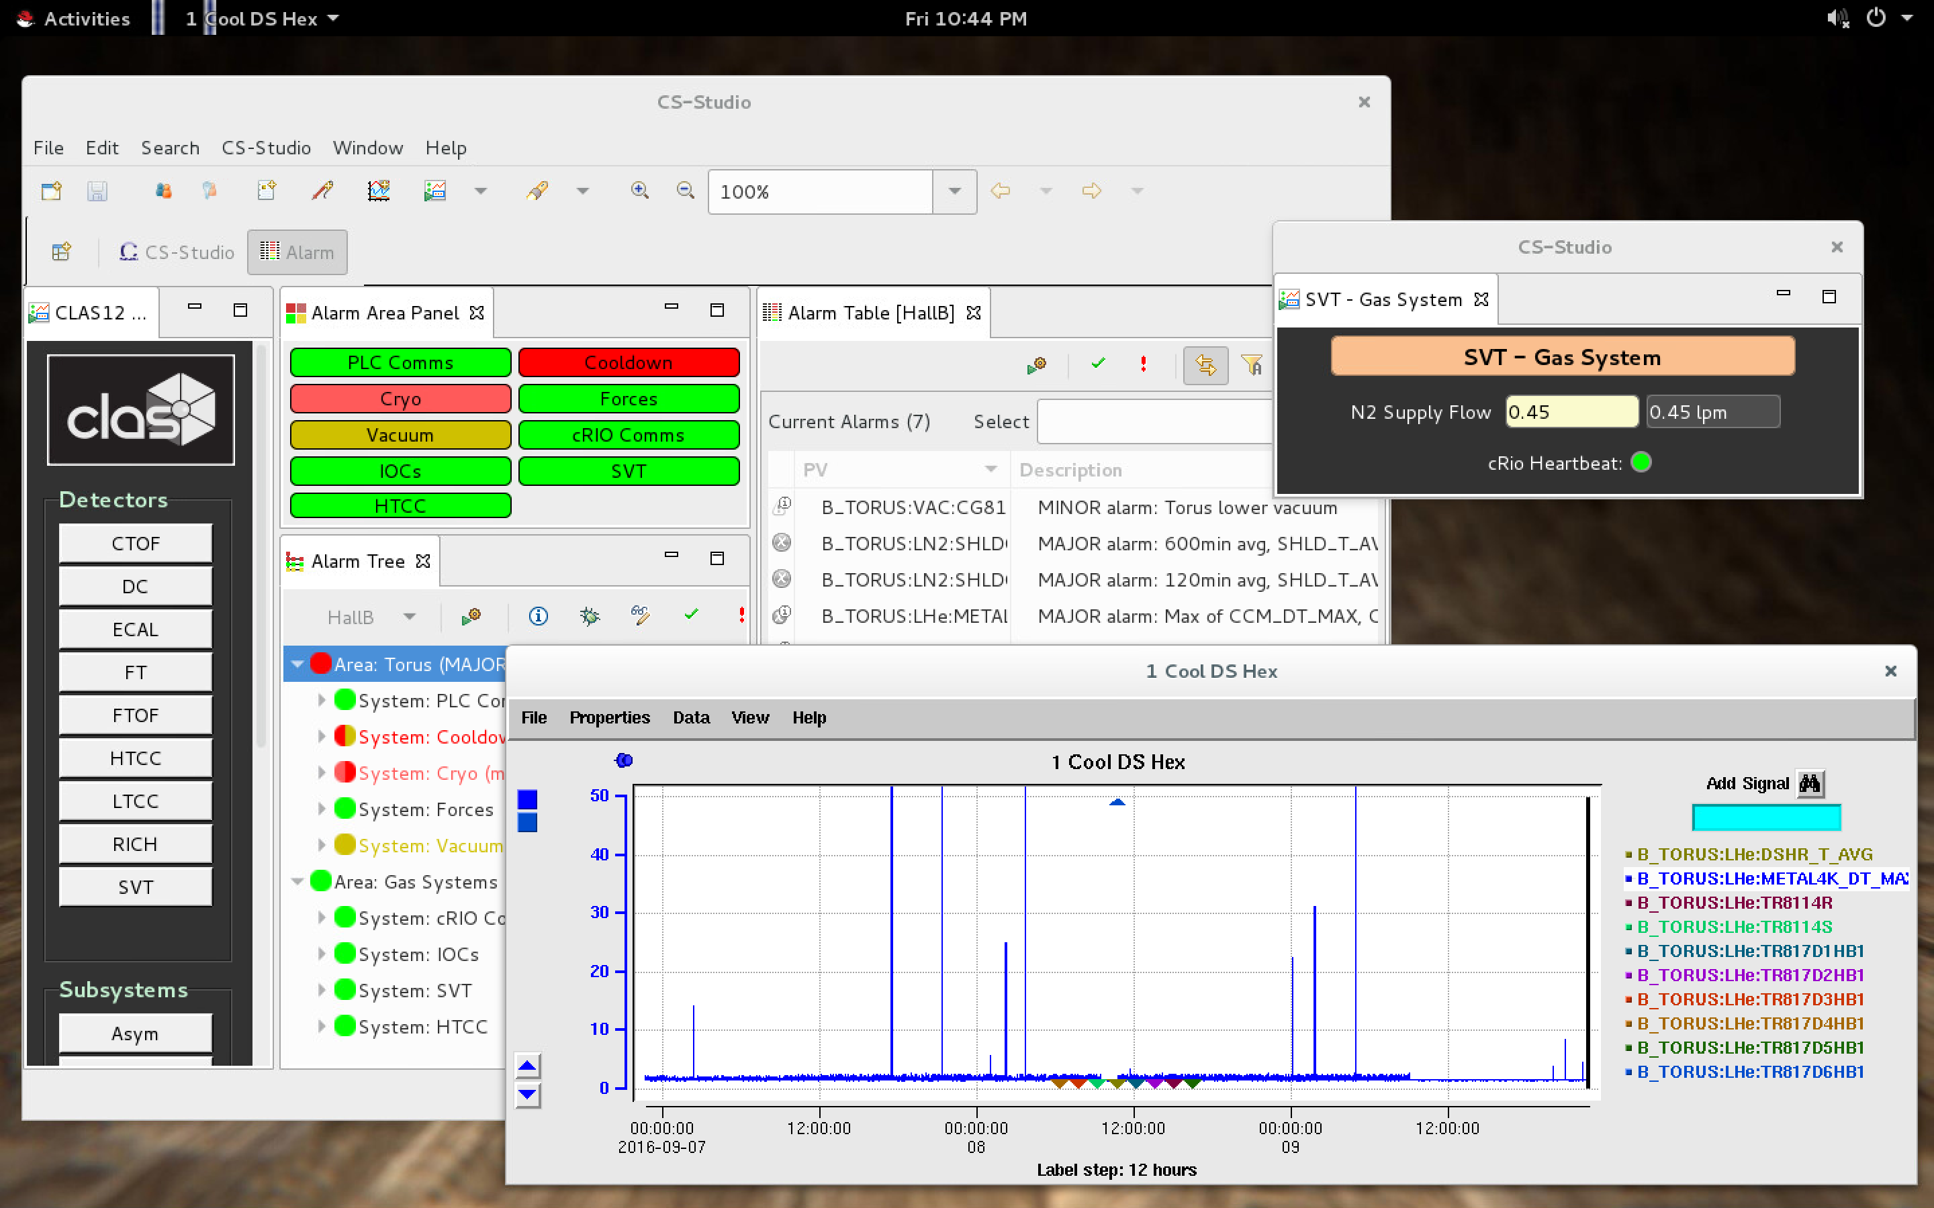
Linux VDI
IT Integration
Virtual Desktop Infrastructure
After installing client app:
Login to VDI connection server (password)
Select a VM-pool from list
Login to Linux VM (2-factor)
Hosted on our existing VM infrastructure
Cross-platform clients
Reconnect to existing sessions
Used for remote r/w access
VMs managed by Puppet, monitored by Nagios
1
Linux uses VMware Blast protocol
Windows uses PCoIP
2
RHEL7 VM
3
Infrastructure: Myung Bang (JLab)
Wesley Moore
wmoore@jlab.org

Slide 16
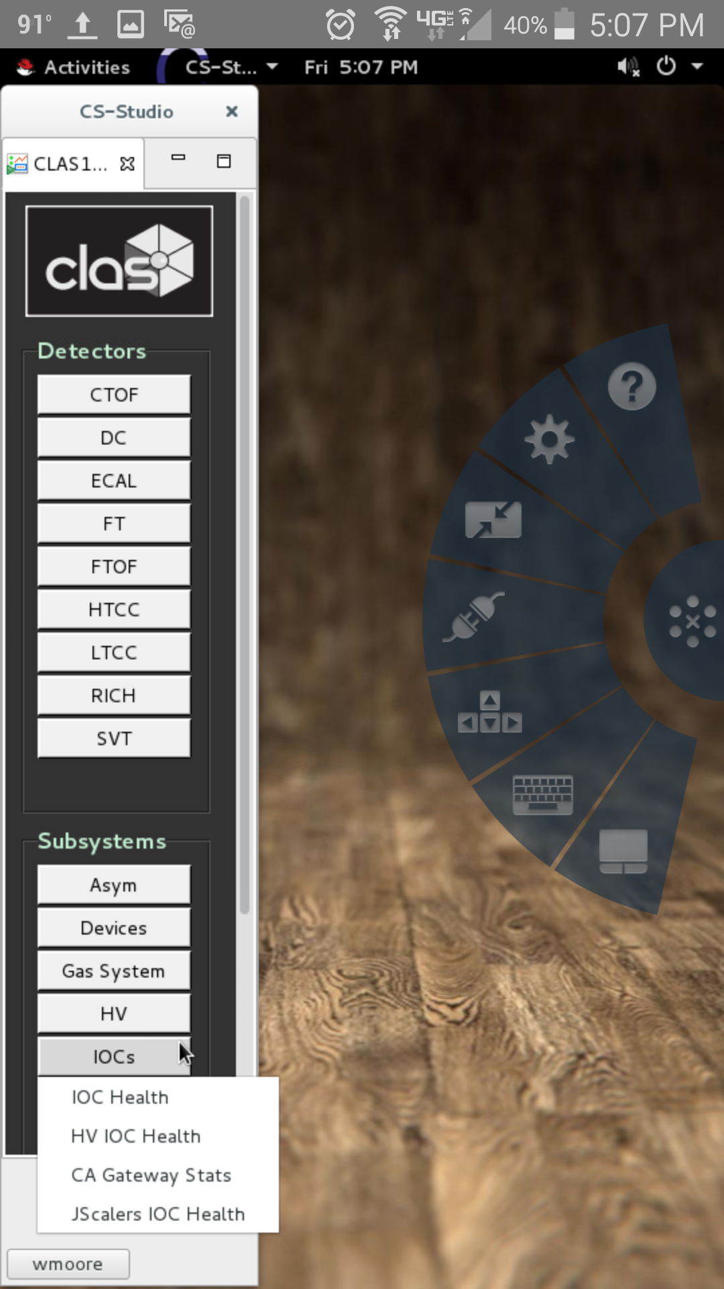
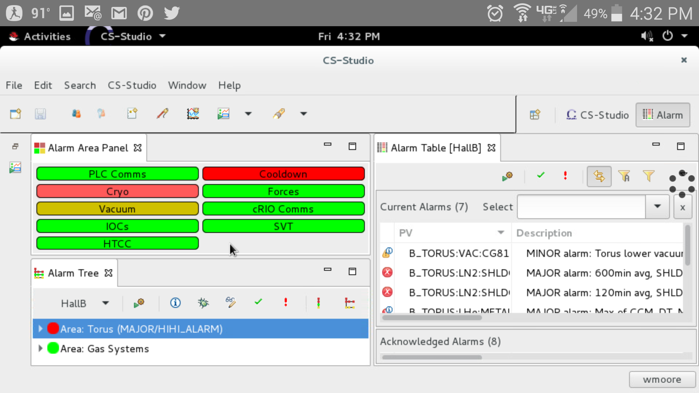
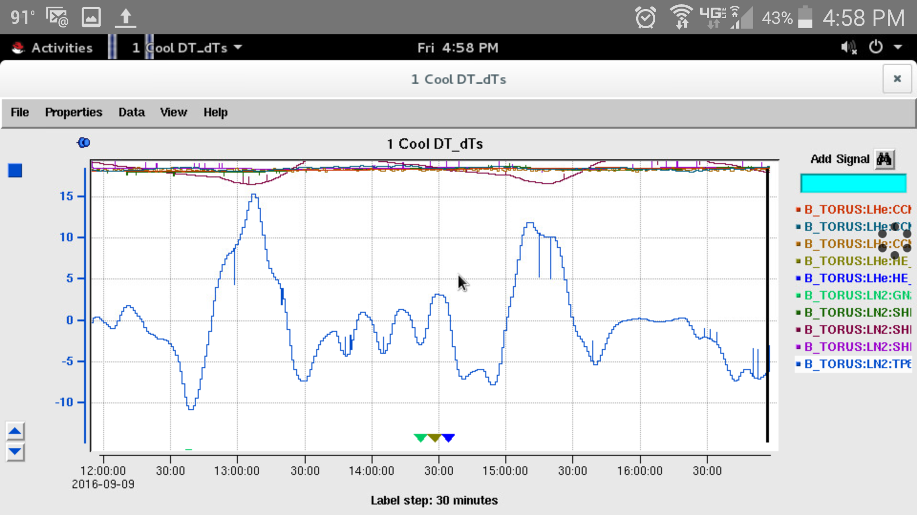
Linux VDI Mobile
IT Integration
Horizon Toolbar
Samsung s5
Wesley Moore
wmoore@jlab.org

Slide 17
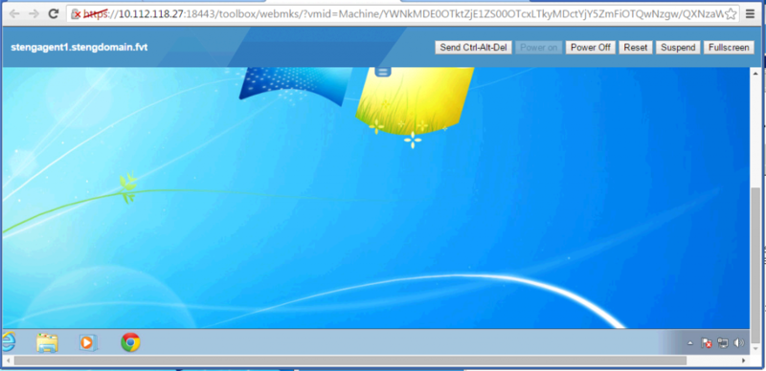
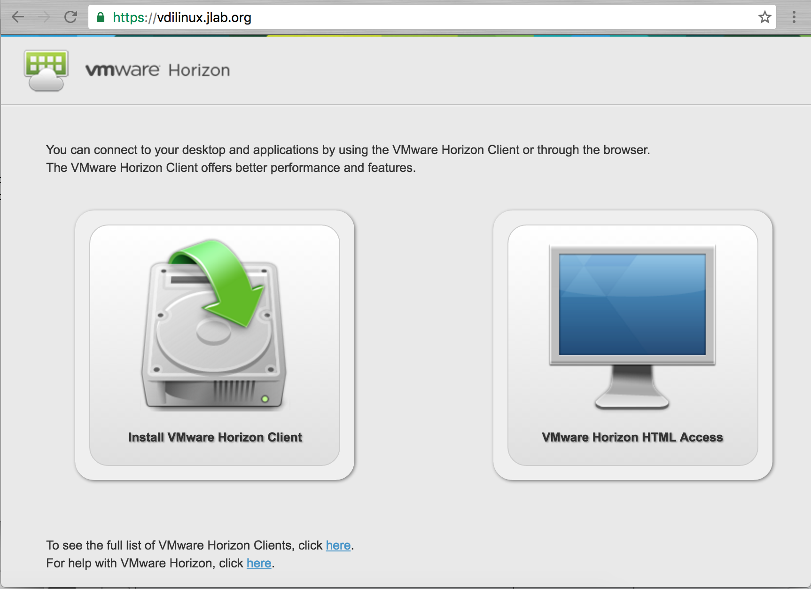
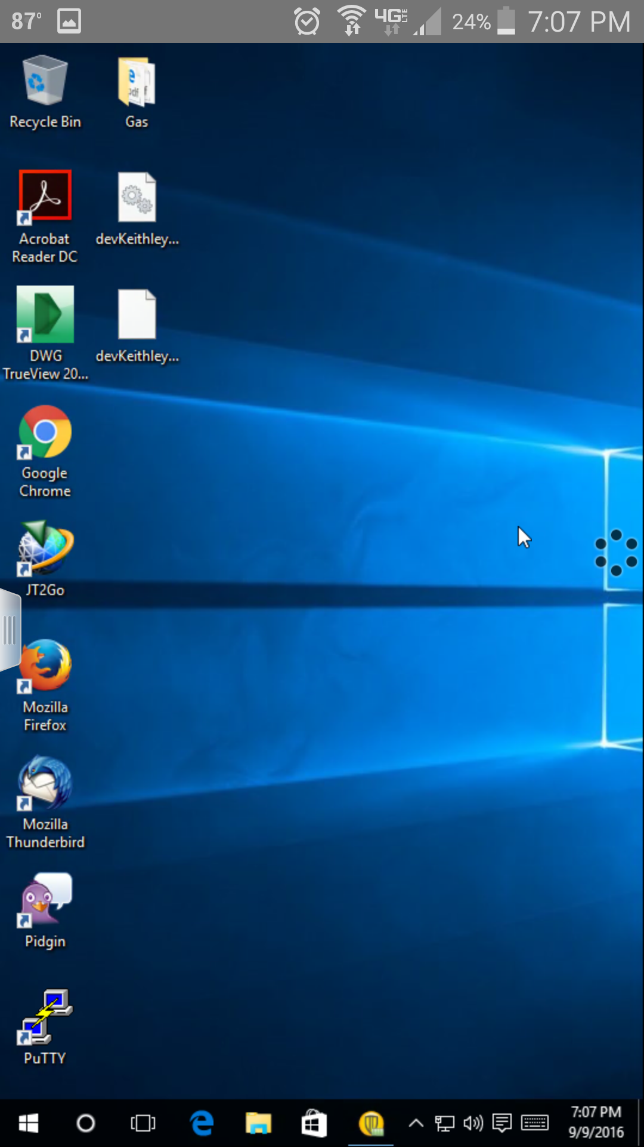
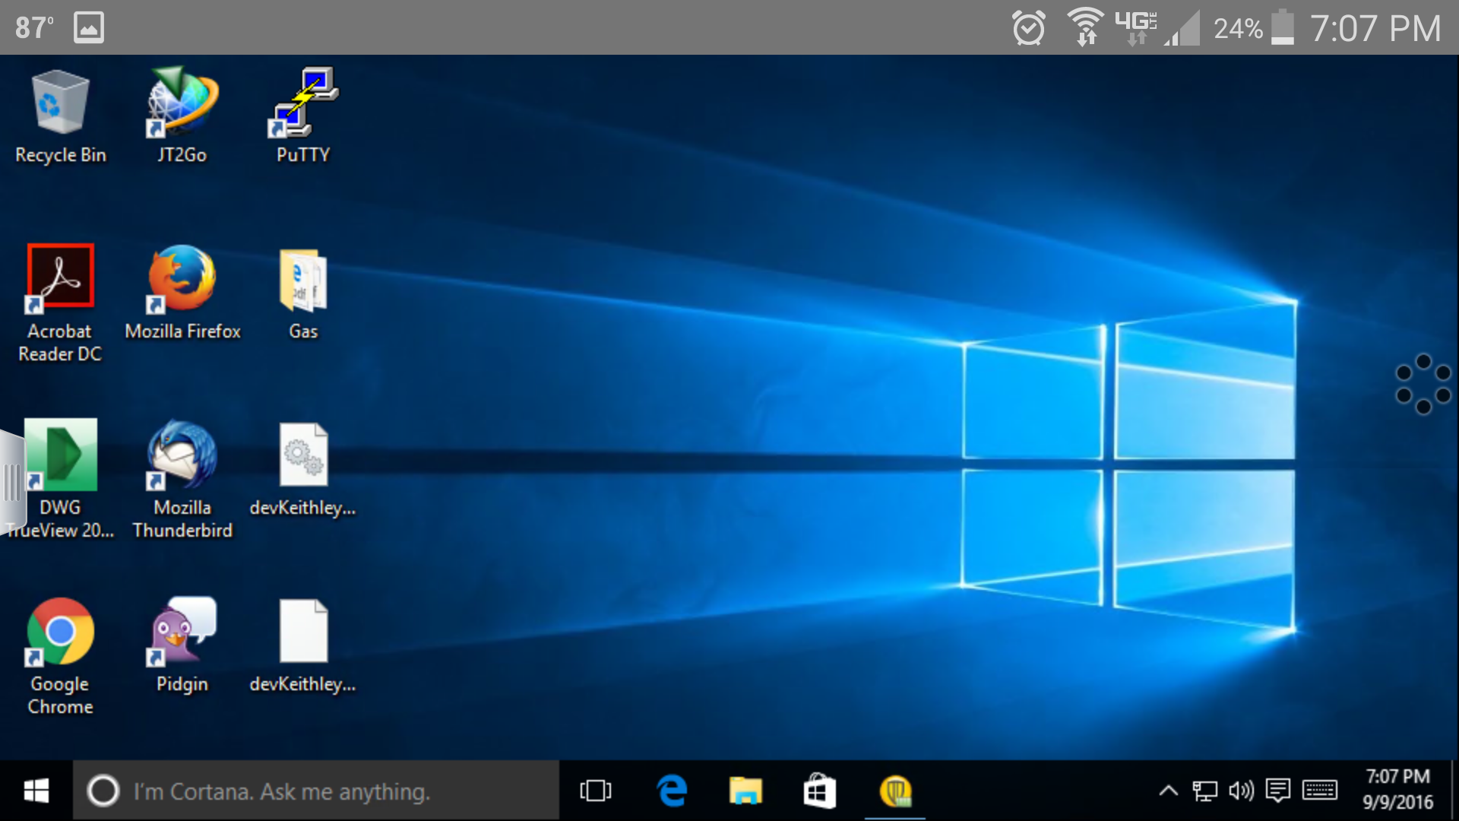
VDI Misc.
IT Integration
HTML Access
Connect to Virtual Desktop using only a browser
No client install required
We haven’t configured, but on the TODO list.
Win8, Firefox
Credit: labs.vmware.com
Win10, Samsung s5
Just to show Windows works fine too....
Windows
Better support than Linux (No zero-clients yet)
Used for thin-clients and zero-clients at JLab
Wesley Moore
wmoore@jlab.org

Slide 18
Future Plans
Integrate JLab tools with CS-Studio
Logbooks
Mya Archiver
Split alarm configuration
Provide separate trees for main detectors
Improve deployment of new releases
CS-Studio
BEAST
WebOPI and OPI tree to webserver
Configure VDI HTML access
Wesley Moore
wmoore@jlab.org

Slide 19
Questions?
Acknowledgements:
Nathan Baltzell (JLab, Hall B)
Myung Bang (JLab, CNI)
Marty Wise (JLab, CNI)
Wesley Moore
wmoore@jlab.org

