Slide 1
Building EPICS Databases From Excel
Jim Stevens
APS Controls Group
EPICS Collaboration Meeting; Oak Ridge National Laboratory
September 2016

Slide 2
Why Build Databases From Excel?
Huge # of Process Variables
Discrete Records (ai, bi, longin)
Unique Process Variable Names
Simplify Process Variable Selection
Simplify Database Changes
Simplify Troubleshooting

Slide 3
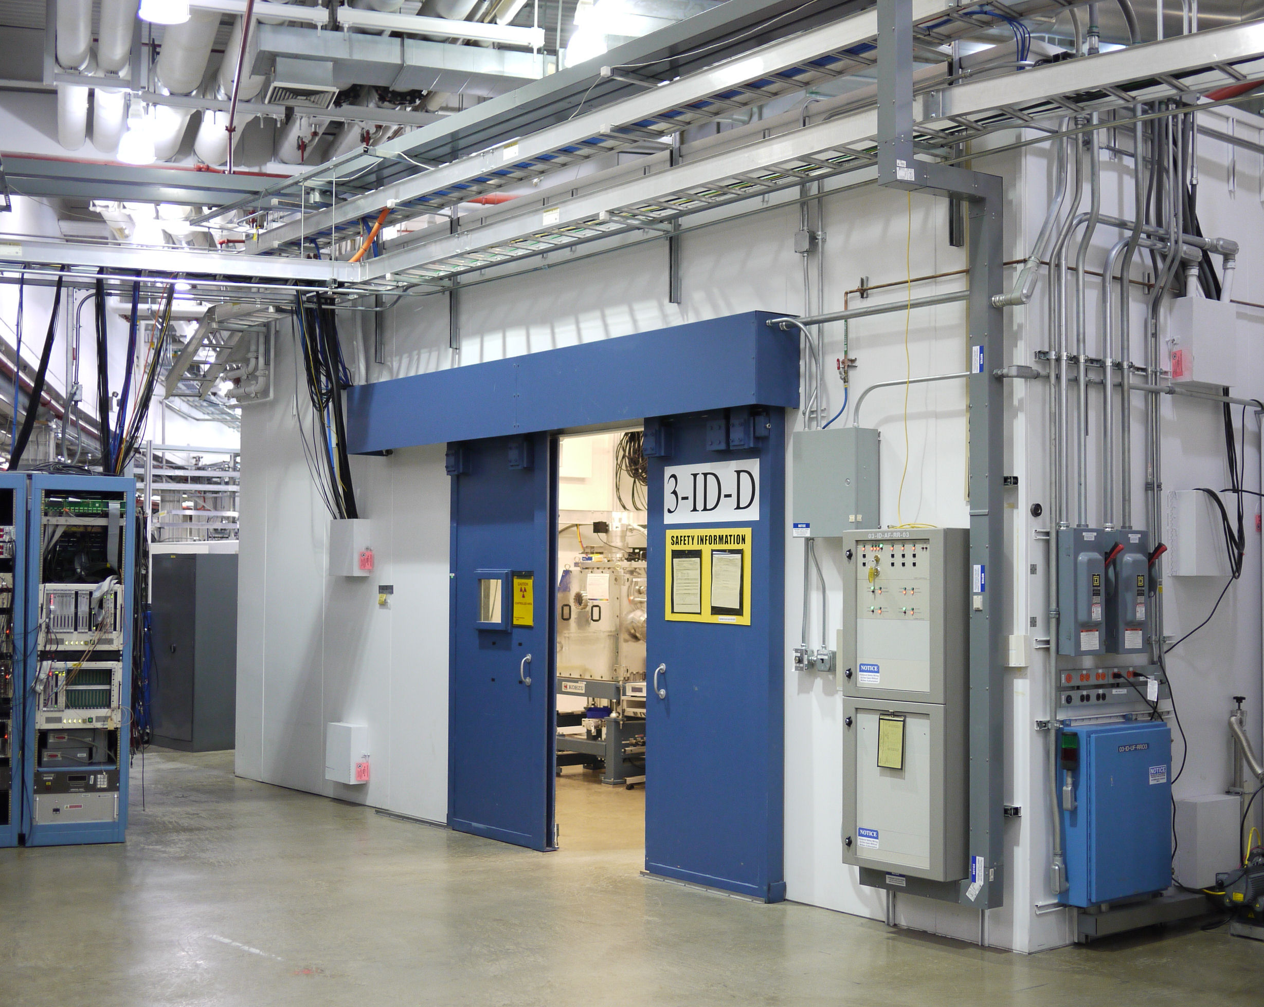
APS Experimental Beamline Station

Slide 4
Background
APS Experimental Beamline Personal Safety System (PSS):
35 “Sectors” of Experimental Beamlines

Slide 5
Background
APS Experimental Beamline Personal Safety System (PSS):
35 “Sectors” of Experimental Beamlines
ID = Insertion Devices BM = Bending Magnets

Slide 6
Background
APS Experimental Beamline Personal Safety System (PSS):
35 “Sectors” of Experimental Beamlines
ID = Insertion Devices BM = Bending Magnets
Maximum of Six Stations Per Beamline

Slide 7
Background
APS Experimental Beamline Personal Safety System (PSS):
35 “Sectors” of Experimental Beamlines
ID = Insertion Devices BM = Bending Magnets
Maximum of Six Stations Per Beamline
Two PLC’s Per Beamline to Monitor Safe Entry & Exit
  * Chain ‘A’ Allen-Bradley PLC5’s
  * Chain ‘B’ General Electric Fanuc PLC’s

Slide 8
Background
APS Experimental Beamline Personal Safety System (PSS):
35 “Sectors” of Experimental Beamlines
ID = Insertion Devices BM = Bending Magnets
Maximum of Six Stations Per Beamline
Two PLC’s Per Beamline to Monitor Safe Entry & Exit
  * Chain ‘A’ Allen-Bradley PLC5’s
  * Chain ‘B’ General Electric Fanuc PLC’s
Doors, Crash Buttons, Limit Switches, Strobes, Water Flow, etc.

Slide 9
Background
APS Experimental Beamline Personal Safety System (PSS):
35 “Sectors” of Experimental Beamlines
ID = Insertion Devices BM = Bending Magnets
Maximum of Six Stations Per Beamline
Two PLC’s Per Beamline to Monitor Safe Entry & Exit
  * Chain ‘A’ Allen-Bradley PLC5’s
  * Chain ‘B’ General Electric Fanuc PLC’s
Doors, Crash Buttons, Limit Switches, Strobes, Water Flow, etc.
70 X (# of Stations) X (# of Doors) X (# of Buttons) X (# of Switches) etc.
The # of EPICS Database Combinations is Staggering!!

Slide 11
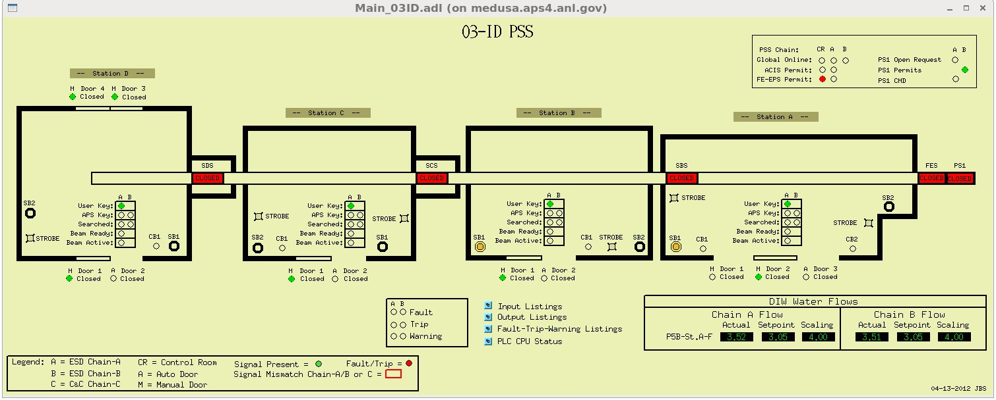
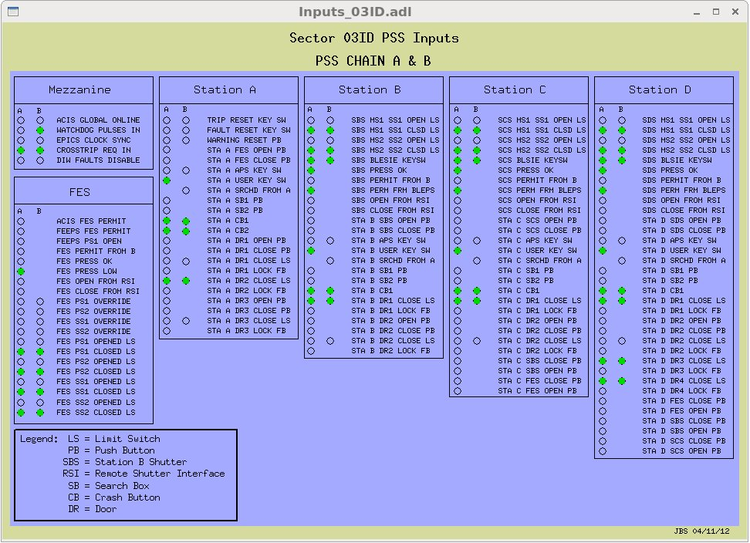
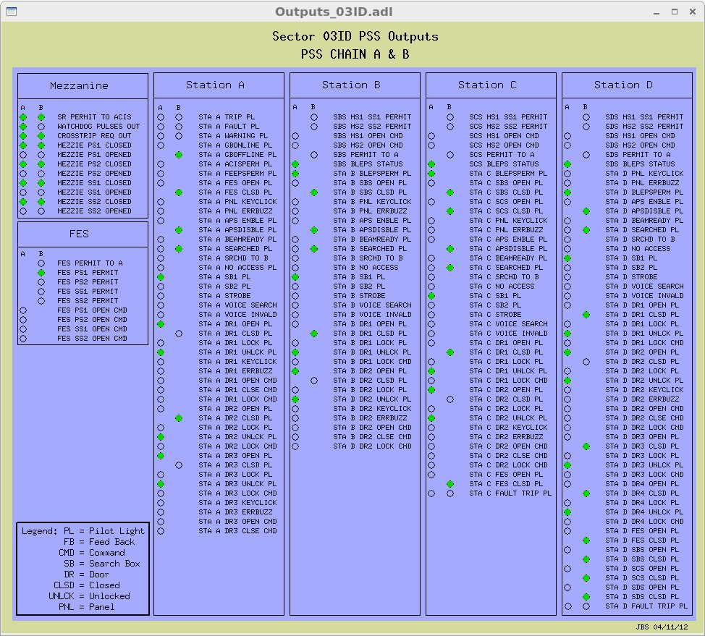
03-ID PSS Control Display

Slide 12
EPICS From Excel Database “Ingredients”
Excel Formatted Spreadsheet
Record Template Files (ai,bi,longin…)
Database Makefile
Perl Script “PSSxls2db.pl”
‘Spreadsheet-ParseExcel’ module

Slide 13
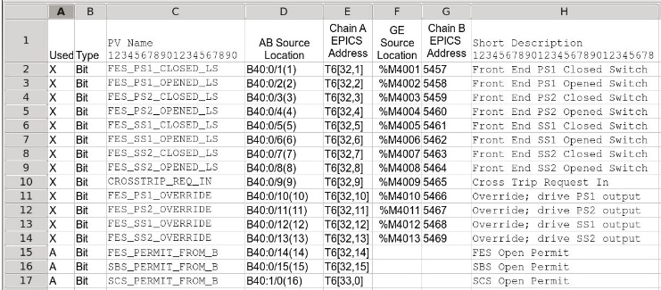
PSS Excel “Worksheet” Format
Name Address Description

Slide 14
Binary Input Record Template File
~ioc/pss/2/pssApp/xls/PA_BinaryInput.template
record(bi, "PA:$(xx)$(yy):$(name)") {
field(DESC, "$(desc)")
field(SCAN, "I/O Intr")
field(DTYP, "Ab Dcm")
field(INP, "@PA:$(xx)$(yy):dcm.$(dcmAddr)")
field(ZSV, "MAJOR")
field(ZNAM, "OFF")
field(ONAM, "ON")
}
Name Address Description

Slide 15
Database Makefile
~ioc/pss/2/pssApp/Db/Makefile
DB += 03ID.db
PA_01BM_IO_TEMPLATE = PA_BinaryInput.template
include $(TOP)/configure/RULES
#----------------------------------------
# ADD RULES AFTER THIS LINE
PA_TEMPLATES+=PA_IO=$(PA_$*_IO_TEMPLATE)
$(COMMON_DIR)/PA_%.db:$(TOP)/xls/%.xls
@$(RM) $@ $(notdir $@)$(DEP)
@$(PERL)$(TOP)/xls/PSSxls2db.pl $@ $< $(PA_TEMPLATES)

Slide 16
Perl Script
~ioc/pss/2/pssApp/xls /PSSxls2db.pl
use strict;
use Spreadsheet::ParseExcel;
use File::Basename;
# Convert excel worksheet name to template file ID.
my %sheetID=()
$sheetID{‘Analog’} =‘ANALOG’;
$sheetID{‘IO’} =‘IO’;
$sheetID{‘Beamline|PLC Status’} =‘PLC’;
$sheetID{‘Warning Bits|PLC Bits’} =‘WARNING_PLC_BITS’;
$sheetID{‘Fault|Trip Bits’} =‘FTBITS’;
$sheetID{‘FIFOs’} =‘FTW’;

Slide 17
Perl Script
~ioc/pss/2/pssApp/xls/PSSxls2db.pl
# Loop over each line of template file
my $newline;
foreach $line (@lines) {
$newline = $line;
$newline = ~s/\$\(name\)/$name/;
$newline = ~s/\$\(desc\)/$desc/;
$newline = ~s/\$\(dcmAddr\)/$dcmAddr/;
$newline = ~s/\$\(prec\)/$prec/ if $prec;
$newline = ~s/\$\(aslo\)/$aslo/ if $aslo;
$newline = ~s/\$\(fanAddr\)/$fanAddr/;
print OUT $newline
Name Address Description

Slide 18
Perl Script
~ioc/pss/2/pssApp/xls /PSSxls2db.pl
# Loop over each line of template file
my $newline;
foreach $line (@lines) {
$newline = ~s/\$\(prec\)/$prec/ if $prec;
$newline = ~s/\$\(aslo\)/$aslo/ if $aslo;
print OUT $newline

Slide 19
Perl Script
~ioc/pss/2/pssApp/xls /PSSxls2db.pl
# Loop over each line of template file
my $newline;
foreach $line (@lines) {
$newline = $line;
$newline = ~s/\$\(name\)/$name/;
$newline = ~s/\$\(desc\)/$desc/;
$newline = ~s/\$\(dcmAddr\)/$dcmAddr/;
$newline = ~s/\$\(prec\)/$prec/ if $prec;
$newline = ~s/\$\(aslo\)/$aslo/ if $aslo;
$newline = ~s/\$\(fanAddr\)/$fanAddr/;
print OUT $newline

Slide 20
Database Binary Input Record
~ioc/pss/2/pssApp/db/03ID.db
record(bi, "PA:$(xx)$(yy):FES_PS1_CLOSED_LS") {
field(DESC, "Front End PS1 Closed Switch")
field(SCAN, "I/O Intr")
field(DTYP, "Ab Dcm")
field(INP, "@PA:$(xx)$(yy):dcm.T6[32,1]")
field(ZSV, "MAJOR")
field(ZNAM, "OFF")
field(ONAM, "ON")
}

Slide 21
Why Build Databases From Excel?
Huge # of Process Variables
Discrete Records (ai, bi, longin)
Unique Process Variable Names
Simplify Process Variable Selection
Simplify Database Changes
Simplify Troubleshooting

Slide 22
Why Build Databases From Excel?
Simplify Database Changes
Simplify Troubleshooting

Slide 23
Reference Documents
Spreadsheet-ParseExcel
  https://github.com/runrig/spreadsheet-parseexcel
EPICS Application Developer’s Guide
  EPICS Base Release R3.14.12.5
XLS EPICS DEMO DATABASE
  xls.tar.gz

Slide 24
Credits
Ned Arnold
Janet Anderson
Andrew Johnson
Mike Fagan
Van Nguyen
Phil McNamara

Slide 25
