Slide 1
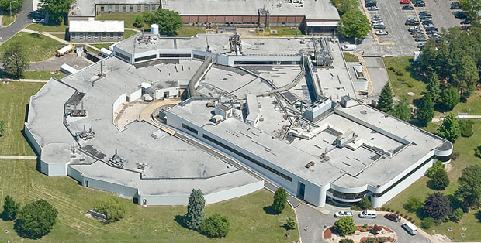
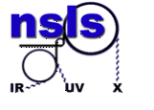
New beamline from refurbished NSLS1 components. BDN (NextGen)
NSLS1 beamlines, second life.
Oksana Ivashkevych, Controls’ Engineer
9/22/2016

Slide 2
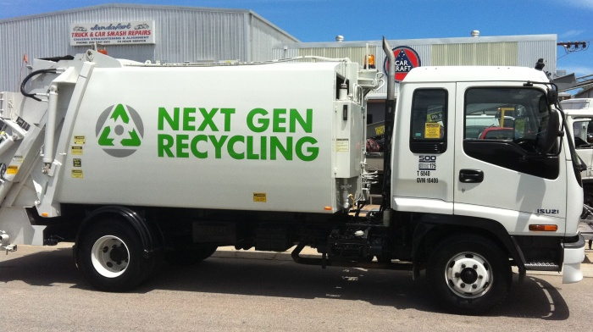
BDN project summary
BDN, Beamlines Developed by NSLS2
Ex NextGen

Slide 3
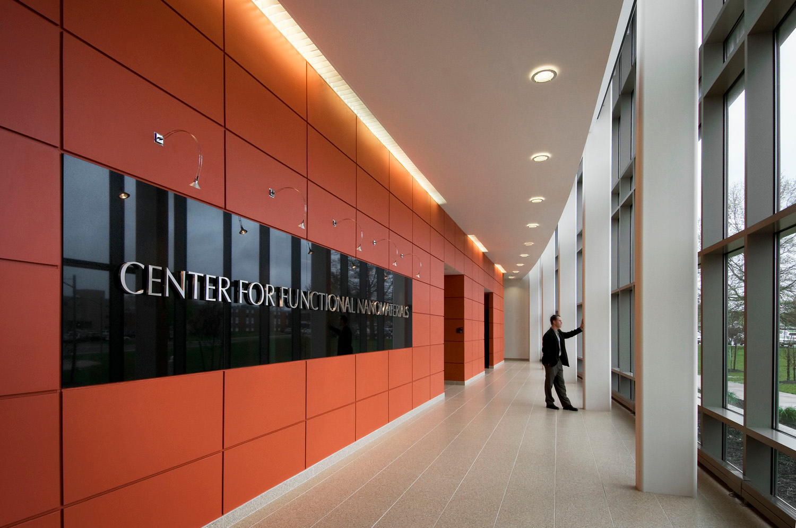
BDN project summary
BDN, Beamlines Developed by NSLS2
Ex NextGen
Project manager: Julian Adams
CMS is partner with Center of Functional Nanomaterials CFN.
Had First Light:
CMS - Complex Material Scattering
TES - Tender X-ray Absorption Spectroscopy
Will be build in 2017
QAS - Quick X-ray Absorption and Scattering
XFM - X-ray Fluorescence Microprobe

Slide 4
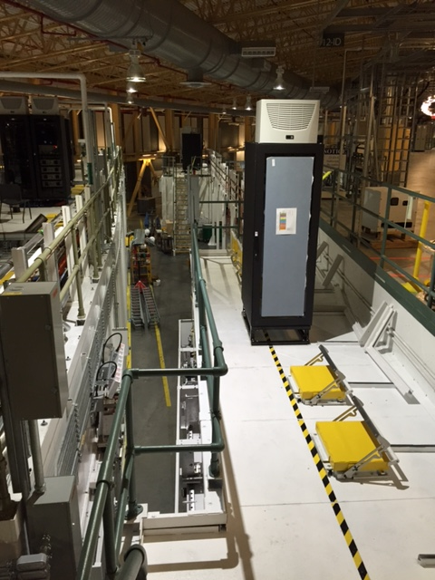
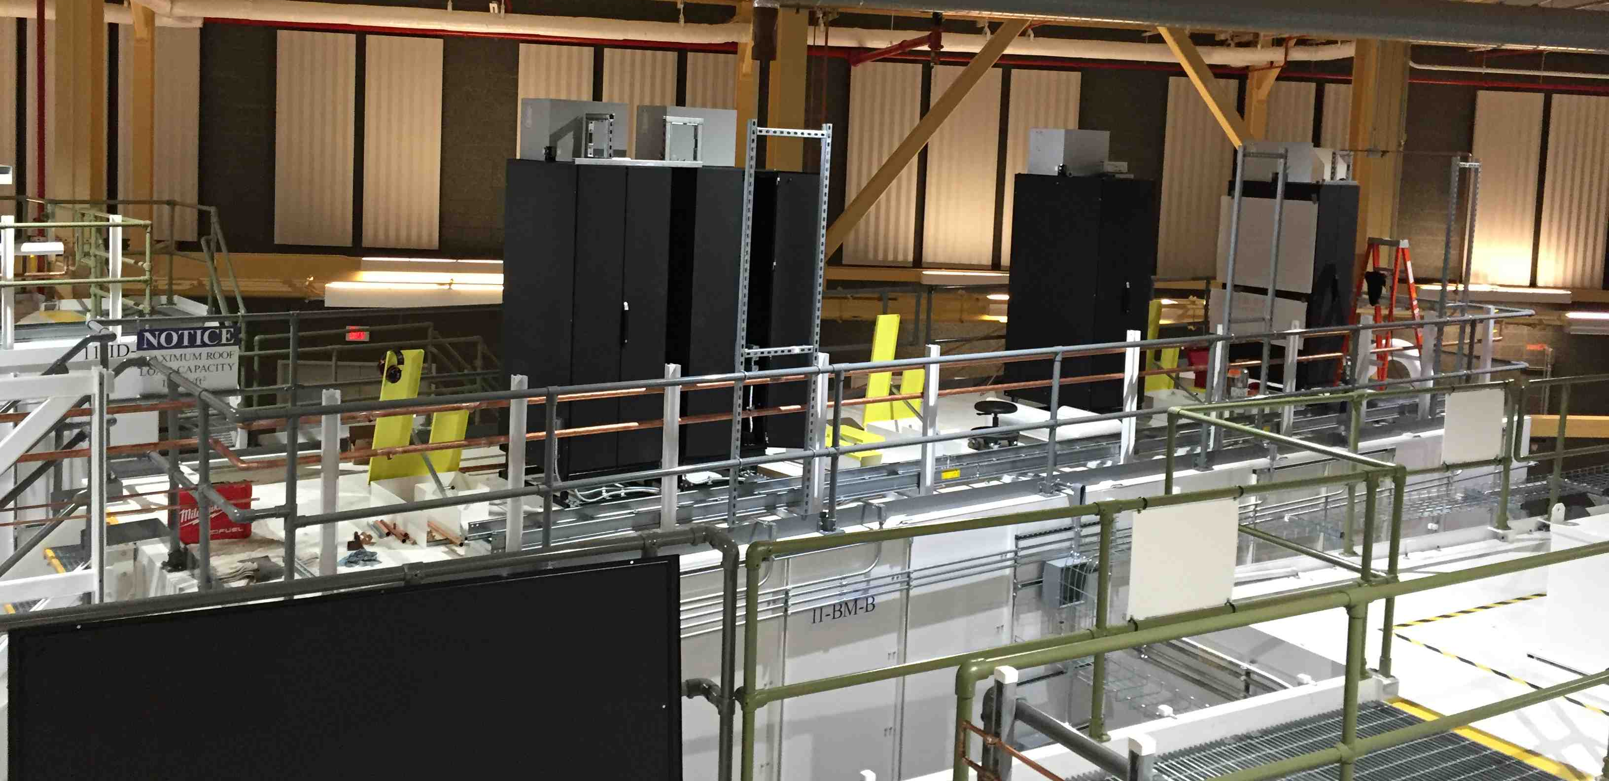
Beamline outlook
CMS controls efforts started in March 2016
There were hutches, racks, no power till mid. May.
UHV Slits arrived first week of March.
IRR scheduled for August.

Slide 5
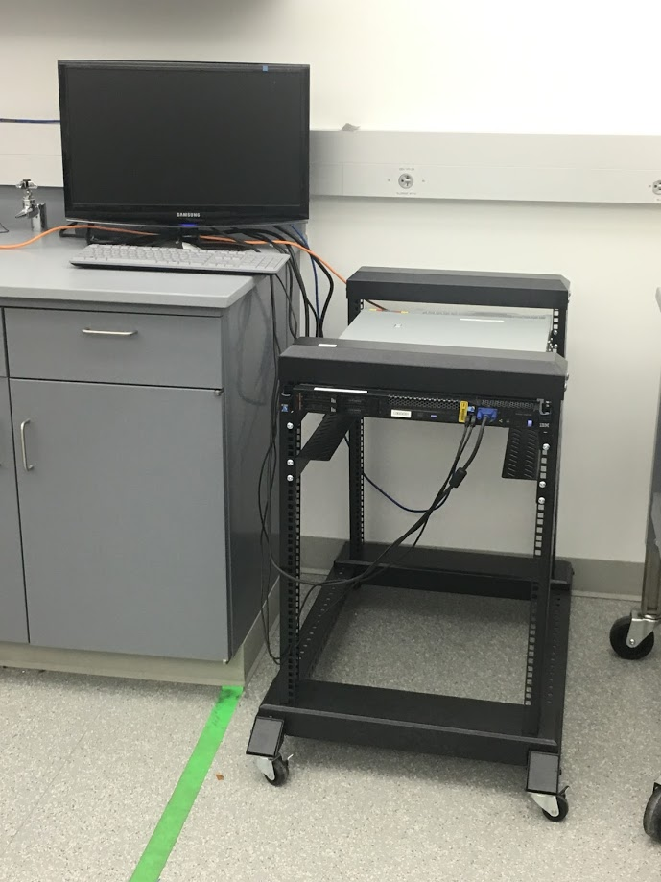
Optimizing the efforts
Found a server
IOCs and GUIs were developed and tested once.
Independent of construction hiccups.
The server is on the
campus
Lab, beamline identical

Slide 6
A – Hutch reused components
- A Hutch Network Switch
DMM Monochromator
Focusing mirror

Slide 7
B – Hutch reused components
Flight path
Sample chamber
Micro-focusing KB mirror
SAXS detector
WAXS detector

Slide 8
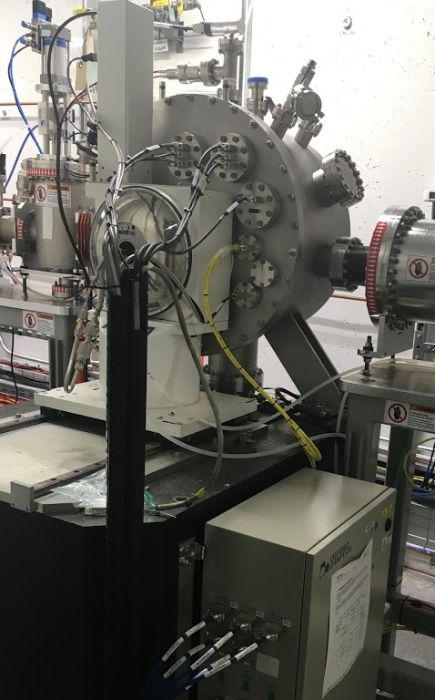
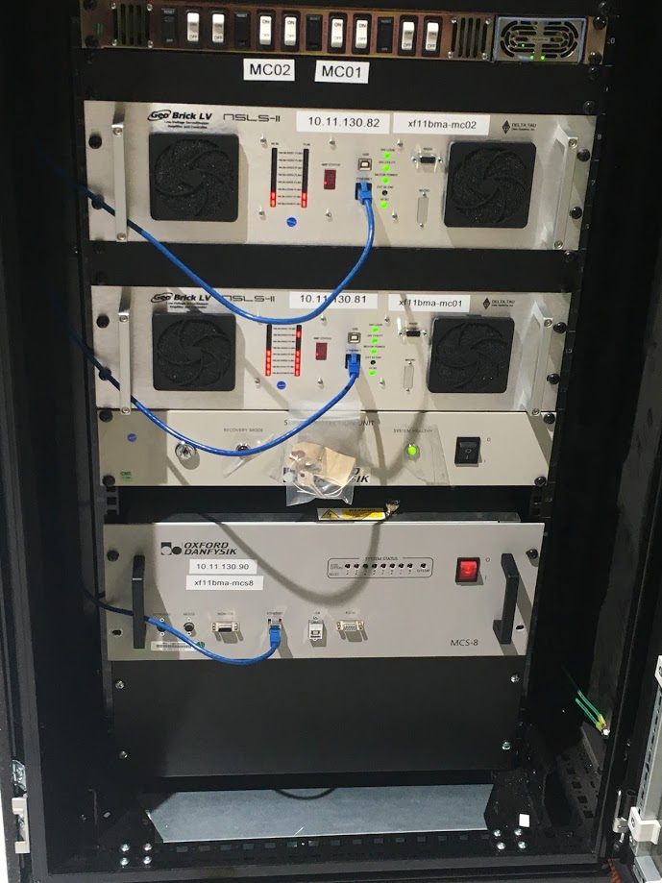
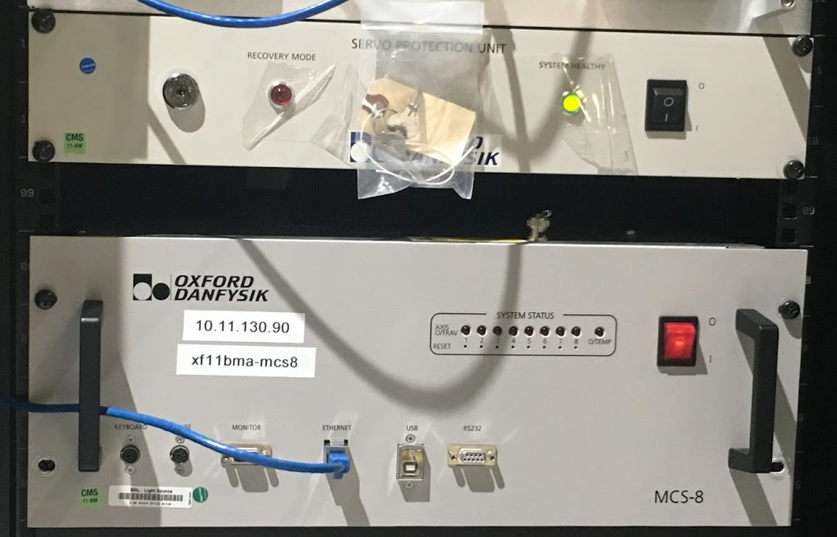
Monochromator
built by FMB Oxford 10 y. ago
Controlled by MCS8 with servo protection unit.

Slide 9
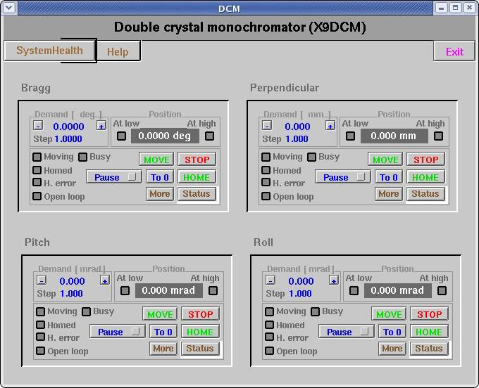
Was……
EDM GUI

Slide 10
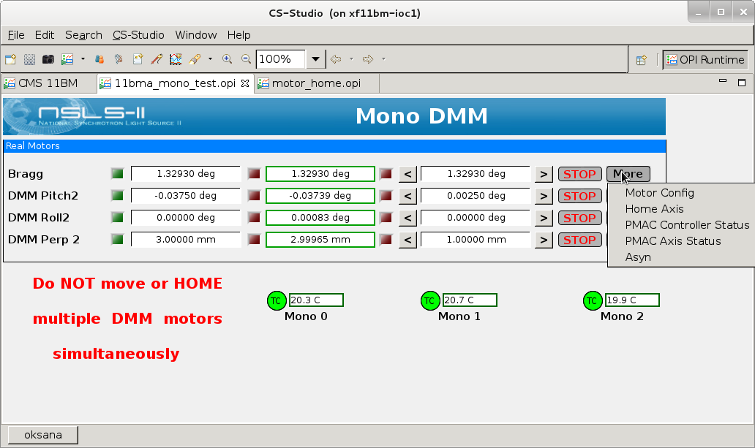
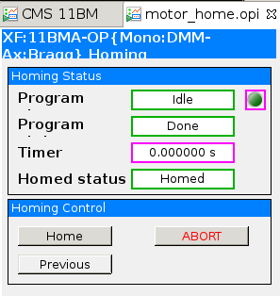
Monochromator at the end
; Homing PLC for Axis 1 (PLC 8)
OPEN PLC 8 CLEAR
COMMAND"&1#1->X"
COMMAND"&1 B1 R"
DISABLE PLC8
CLOSE

Slide 11
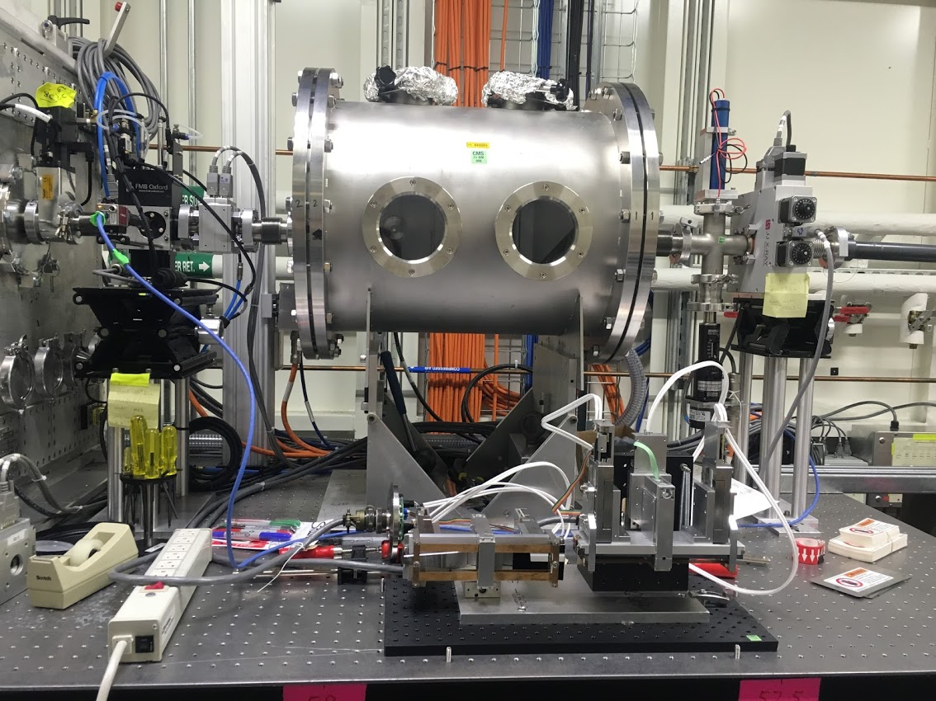
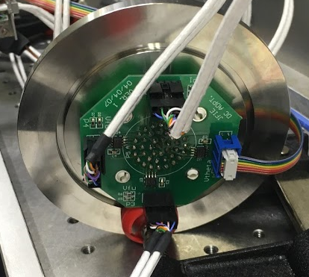
KB micro-focusing mirrors
Designed by APS Beamline Controls & DAQ group some ~10 years ago.
Controller was a custom made servo drive in VME crate
Electronics and the interface card were designed by James Franck Research Institute University of Chicago.
Horizontal x4 + Vertical x4 low current 160mA DC Servos with rotary encoders + 5V limit switches.

Slide 12
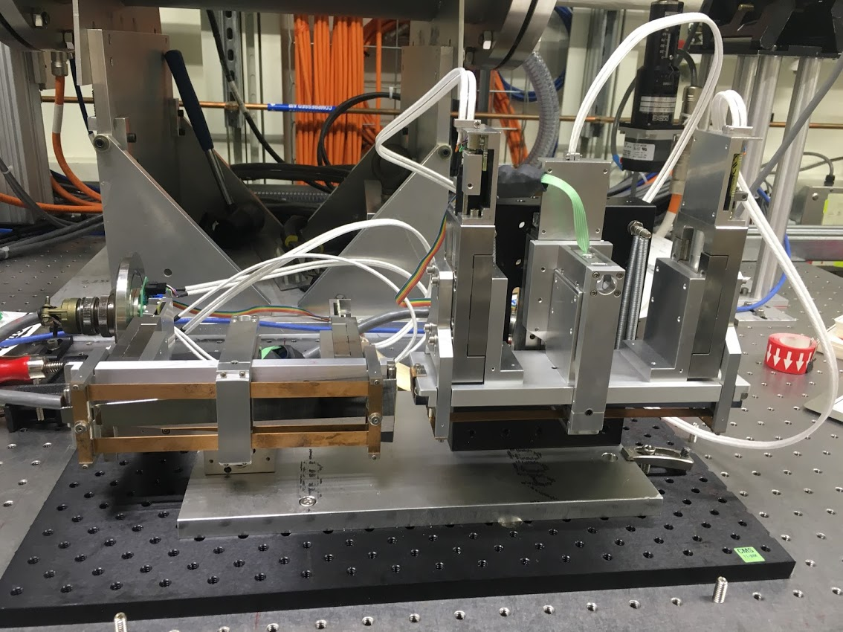
KBs with NSLS2 standard controls
Abandoned old controls.
Used Delta Tau low current version

Slide 13
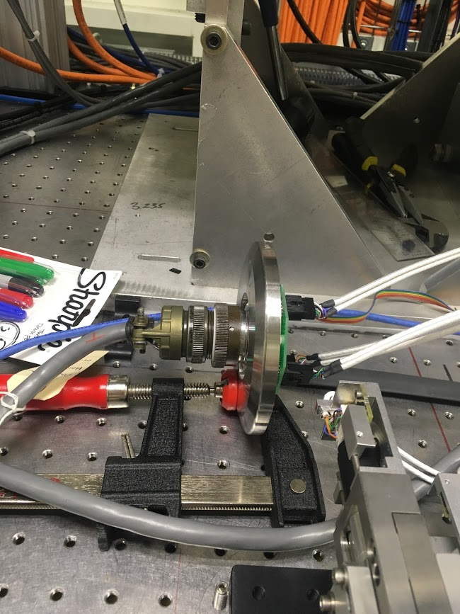
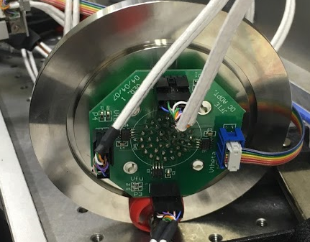
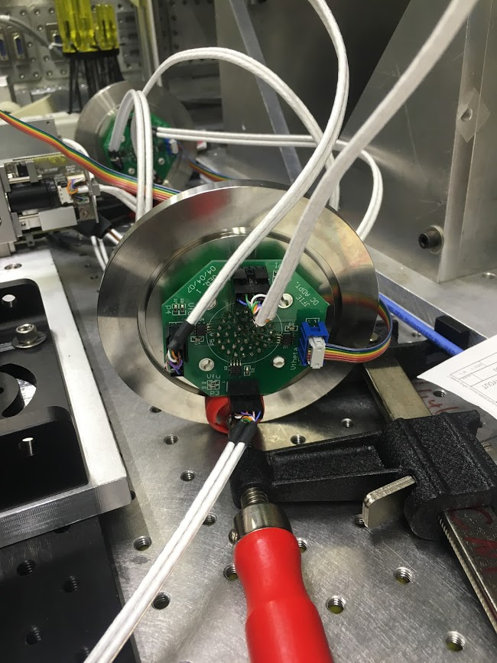
What went wrong….
41 pin horizontal and vertical connectors have different colors uses for the same pins.
Cable termination mistake caused a little smoke.
After fixing everything ……
One motor didn’t and still doesn’t work properly.
Observing bizarre interference between the channels.

Slide 14
Looking for this board
Still looking for this board, unpopulated PCB, design document.
Planning to solder new part on existing board.
Believe UA9638 is a faulted part

Slide 15
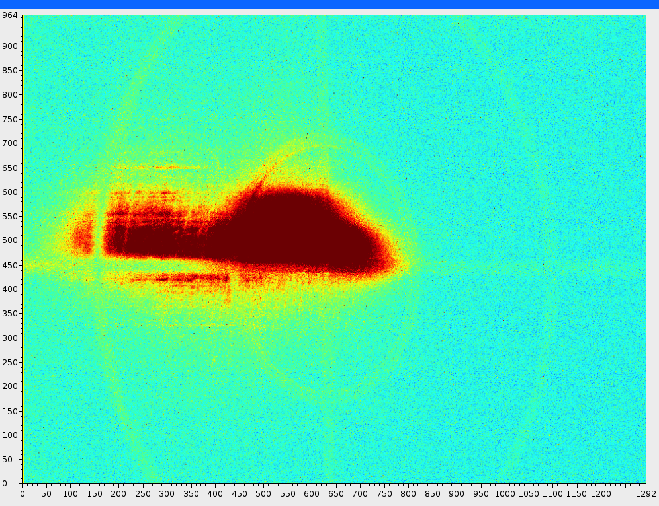
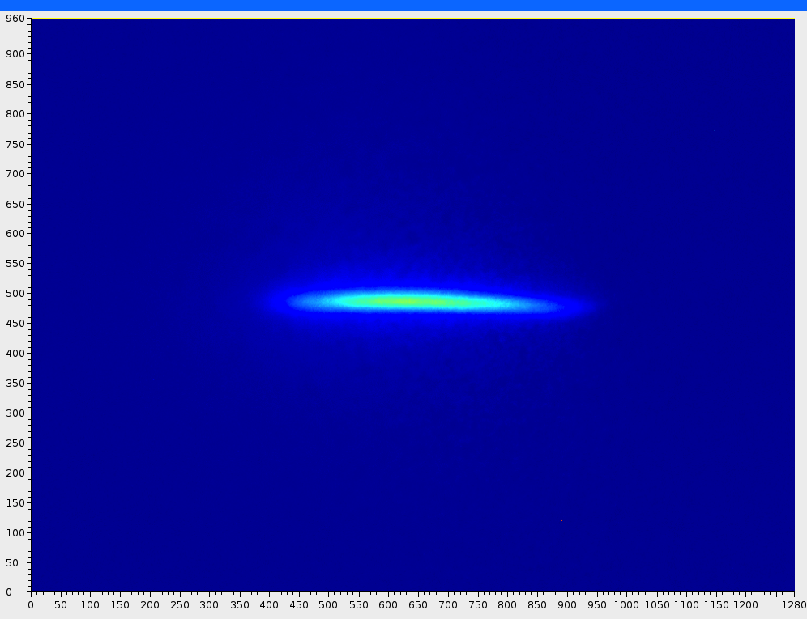
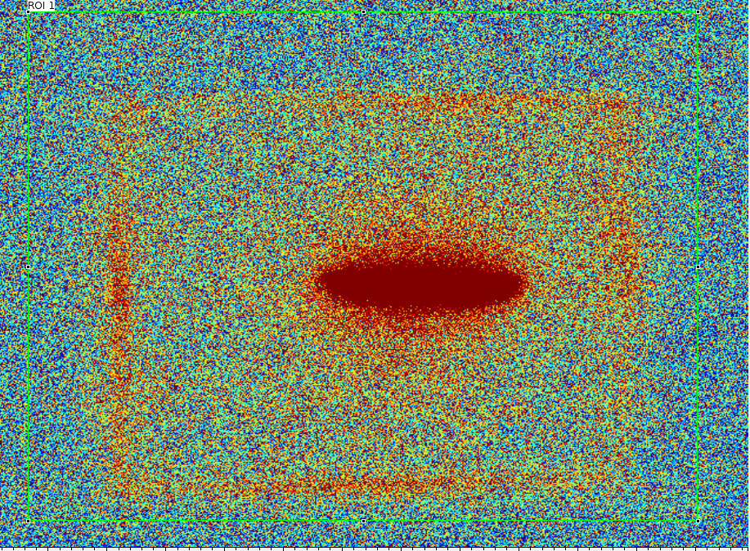
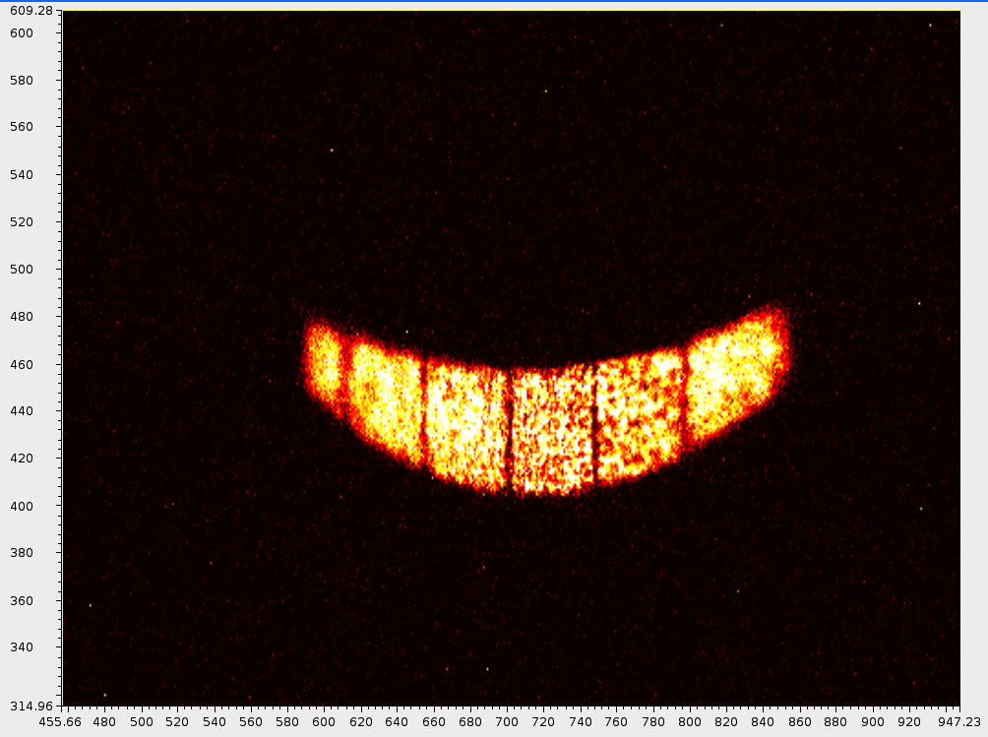
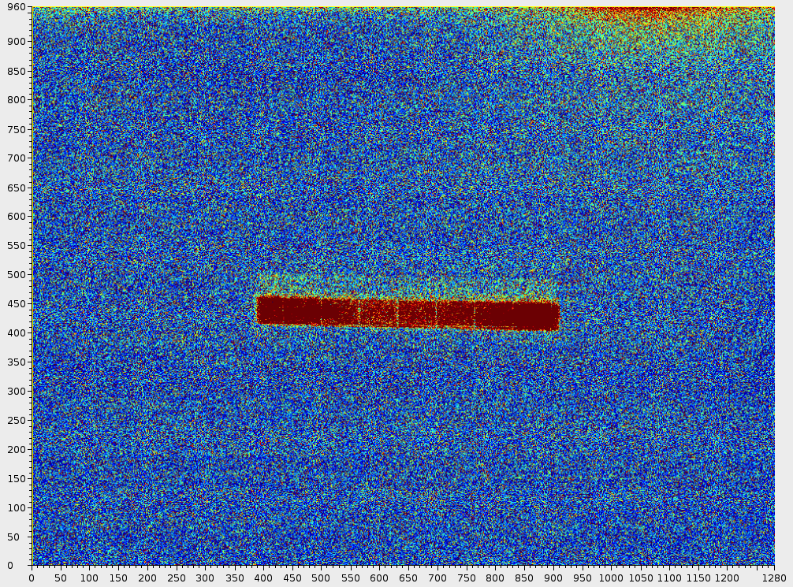
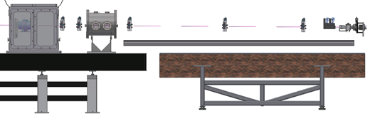
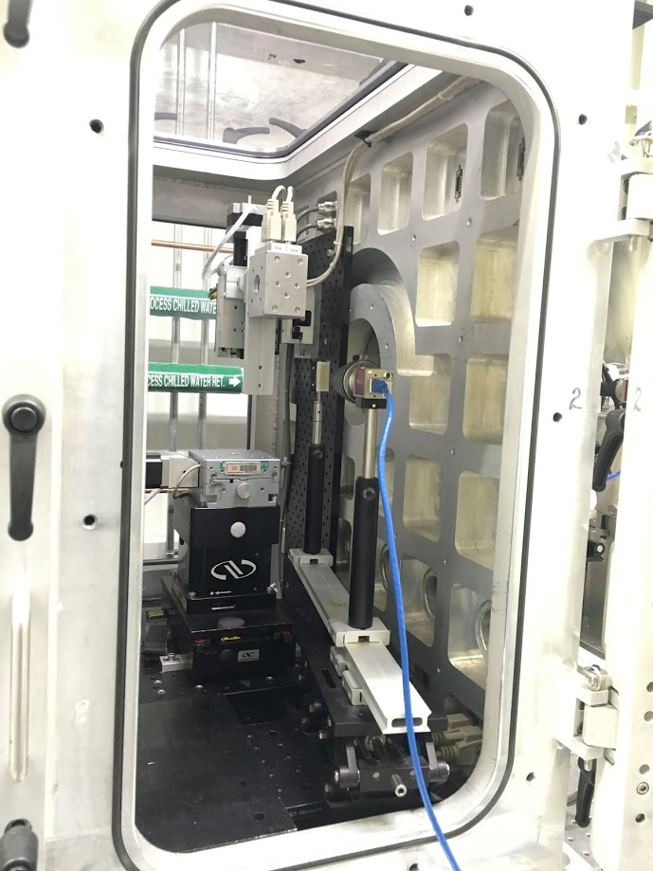
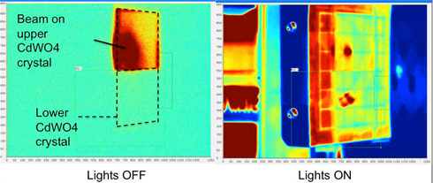
First Light log…
8/29/16, 6:12 pm
8/29/16, 5:53 pm
8/29/16, 5:16 pm
8/26/16, 6:32 pm
8/26/16, 6:13 pm
From beamline scientists: “Thanks for the Log Book, it is awesome!”
8/29/16, 6:36 pm

Slide 16
Was is easier to build a beamline from refurbished components?
All major components were previously commissioned: they already worked.
All components were on site, No vendor dependencies, self paced, self planned.
Termination issues due to nonstandard equipment.
Controls efforts needed as usual were underestimated.
EASIER…

Slide 17
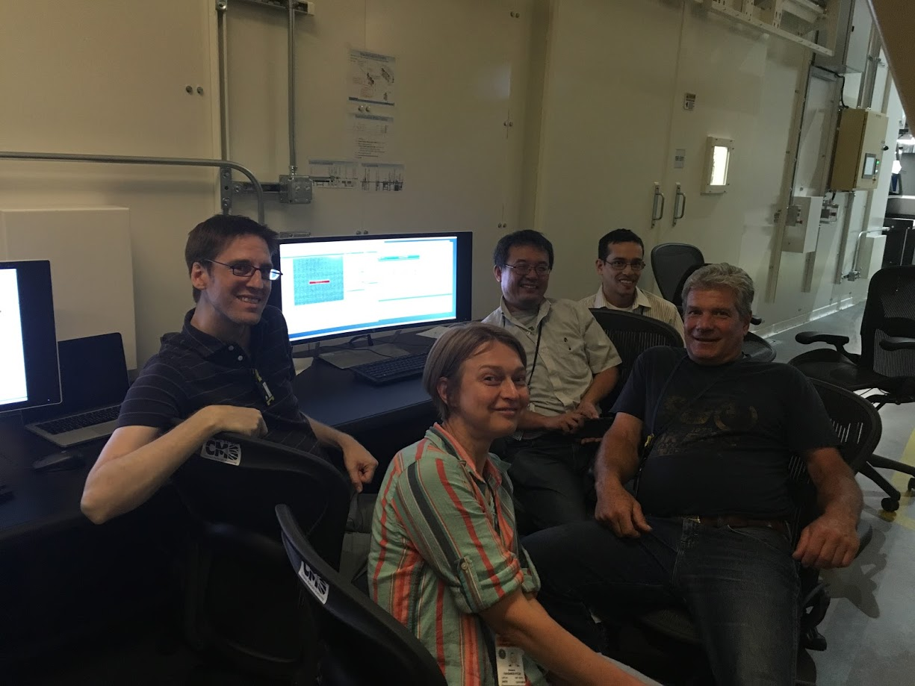
First Light on Aug., 26 2016
Lukas Lienhard – mechanical engineer
Kevin Yager –CFN partner
Masa Fukuto – Lead Beamline Scientist
Rick Greene – beamline tech. coordinator
Oksana Ivashkevych - controls engineer

