Slide 1
EPICS control system for ELI-NP Gamma Beam System (GBS)
Rok Šabjan on behalf of Cosylab team, ORNL, 2016-09-20

Slide 2
Other ELI machines

Slide 4
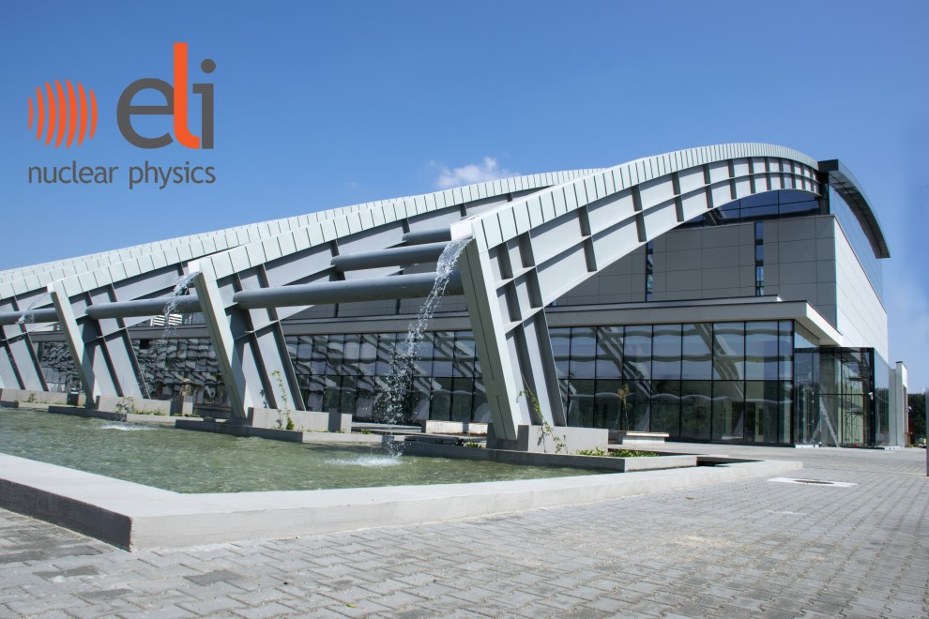

Slide 5
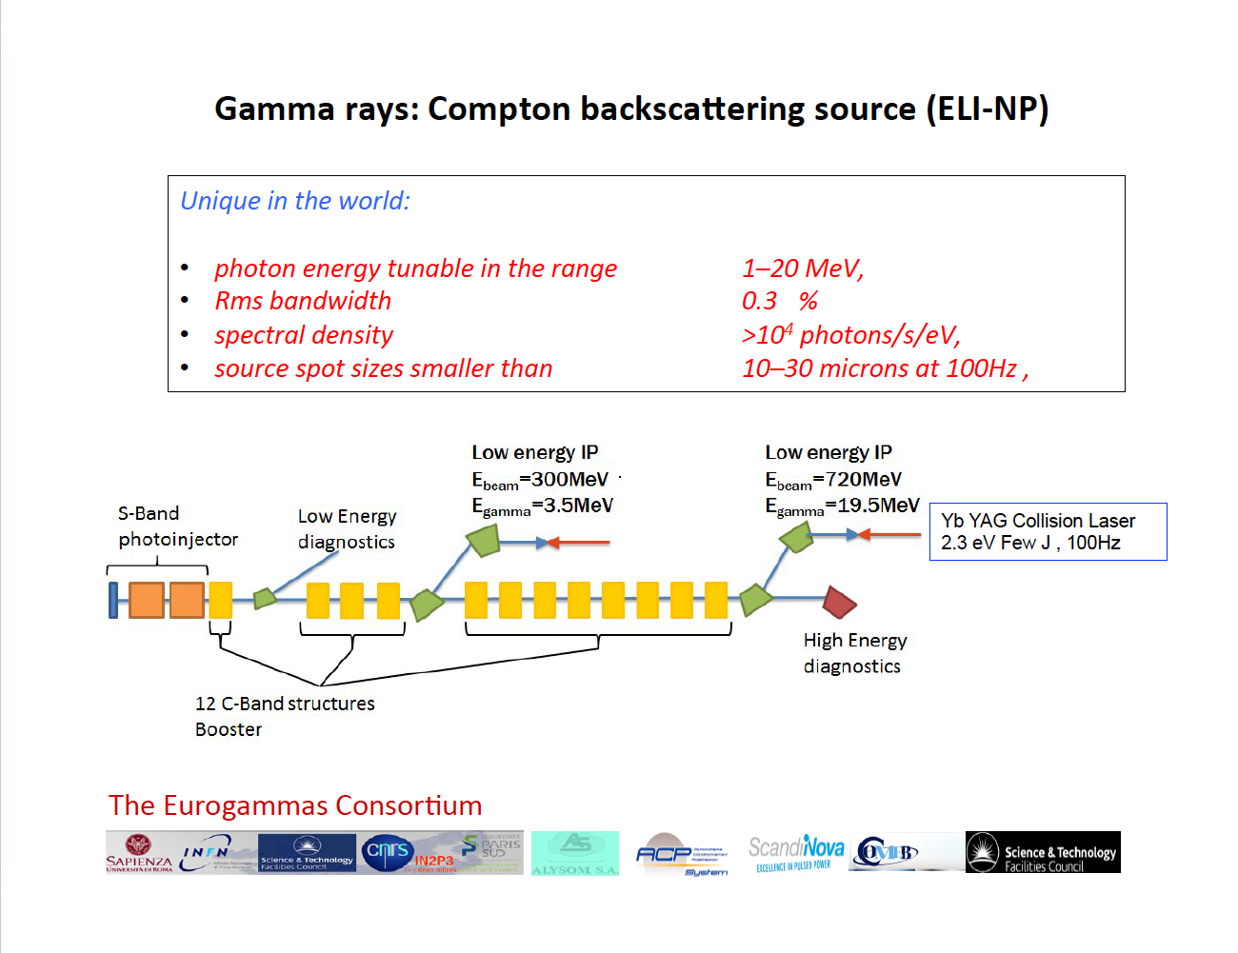

Slide 7
EuroGammaS Consortium
Amplitude
Alsyom
CNRS
COMEB
INFN – Consortium Leader
Sapienza
Scandinova
ALBA
Cosylab
Danfysik
Instrumentation Technologies
M+W
Menlo Systems
Research Instruments
STFC“

Slide 8
Control System Scope
System level integration on-site (TBD)
Commissioning tools (Matlab / Middle Layer)
Control System Infrastructure (services, timing system, development environment, standards and templates)
Application and device specific functionality
Engineering GUI
Matlab Interface (labCA)
Device level integration (EPICS)
HW Interfacing

Slide 9
Integrating different contributions

Slide 10
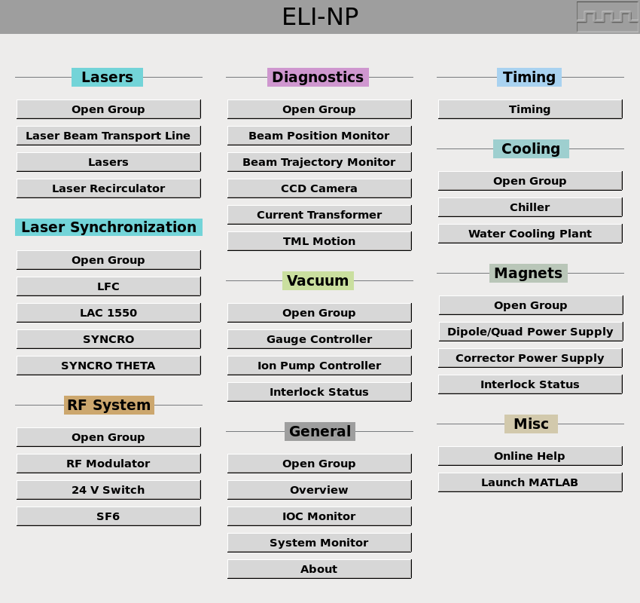
Devices

Slide 11
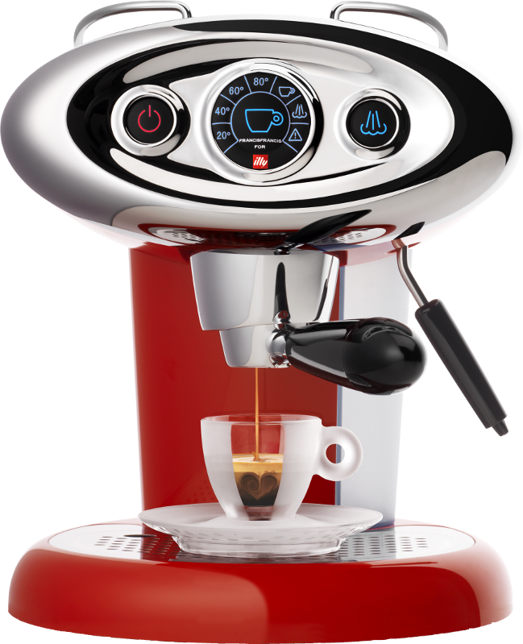
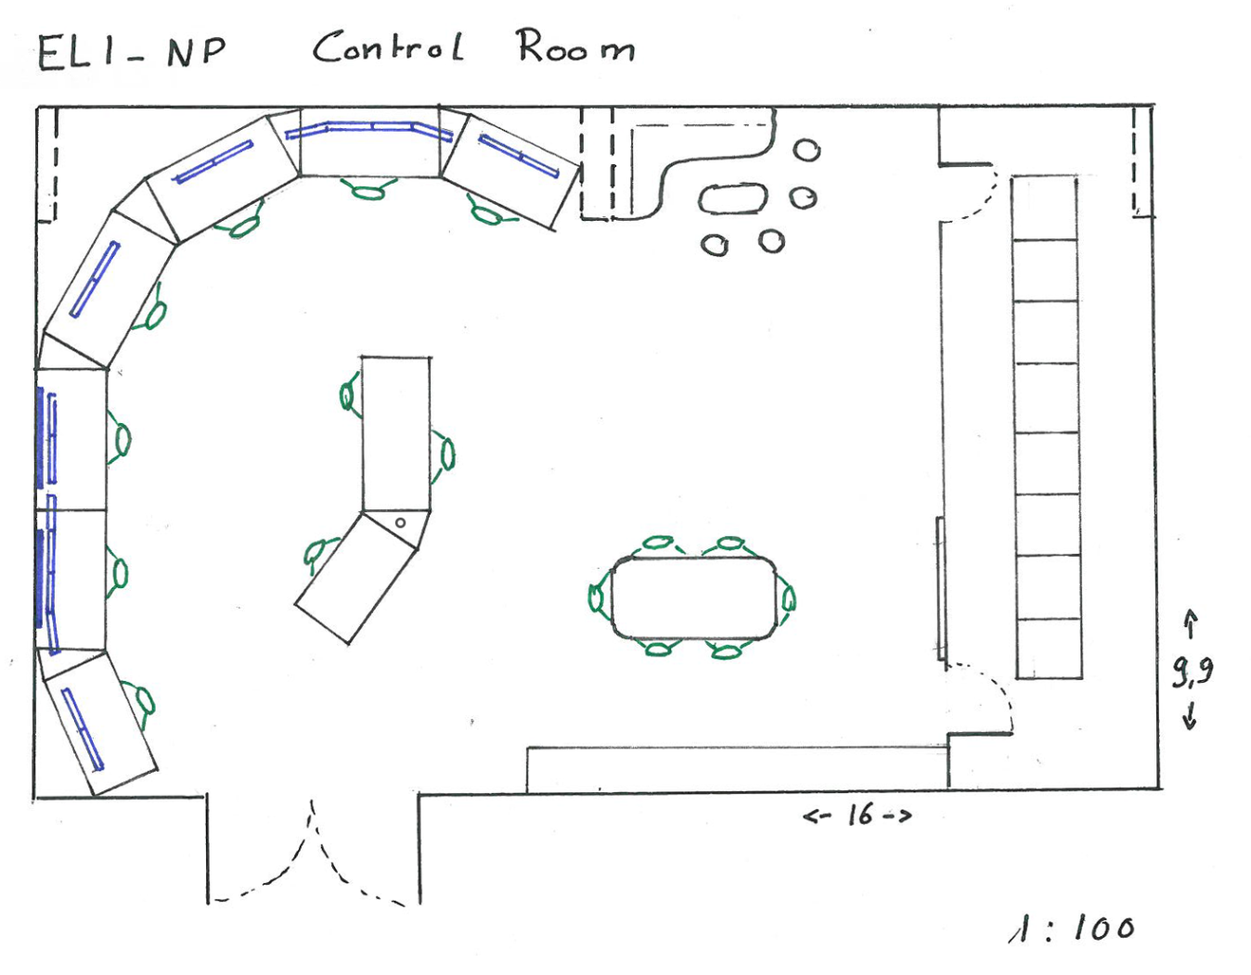
Control Room Layout
Design Direction for
  Room Dimensions: 16m x 10m
  Dry wall server room, space for 8 racks
  7 OPI workstations
    default 2x2 screens
    4x1 possible
  2 overheads
Optimal use of space
Extra middle work-desks
  Commissioning
  Central Control Option
Room foreseen for
  Meeting room corner
  Resting corner

Slide 12
Vertical Column
A vertical column is an abstraction which describes how the concrete device type is integrated into the control system. It starts from the device sensors and progresses up to the GUI

Slide 13
Parallelized Development Process
Requirements gathering
Development
Test procedures
FAT
VC1
Requirements gathering
Development
Test procedures
FAT
VC2
Requirements gathering
Development
Test procedures
FAT
VC3
Final FAT document is just a document with reference to all VC FATs.
After all VCs were FAT tested, actual IOC configuration was produced.

Slide 14
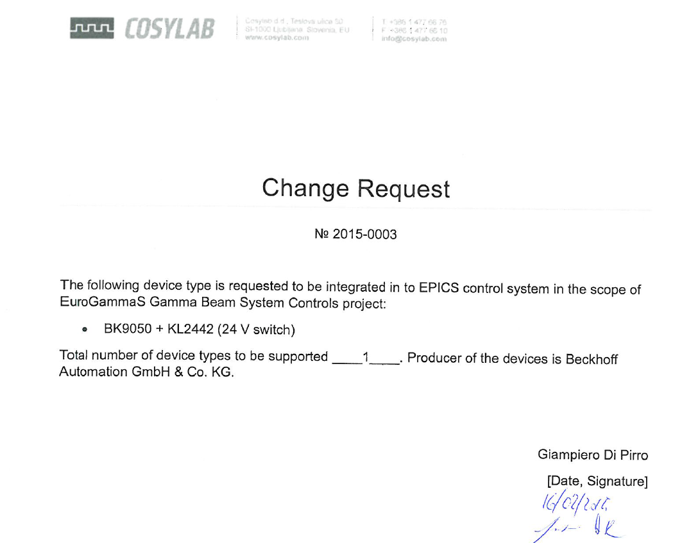
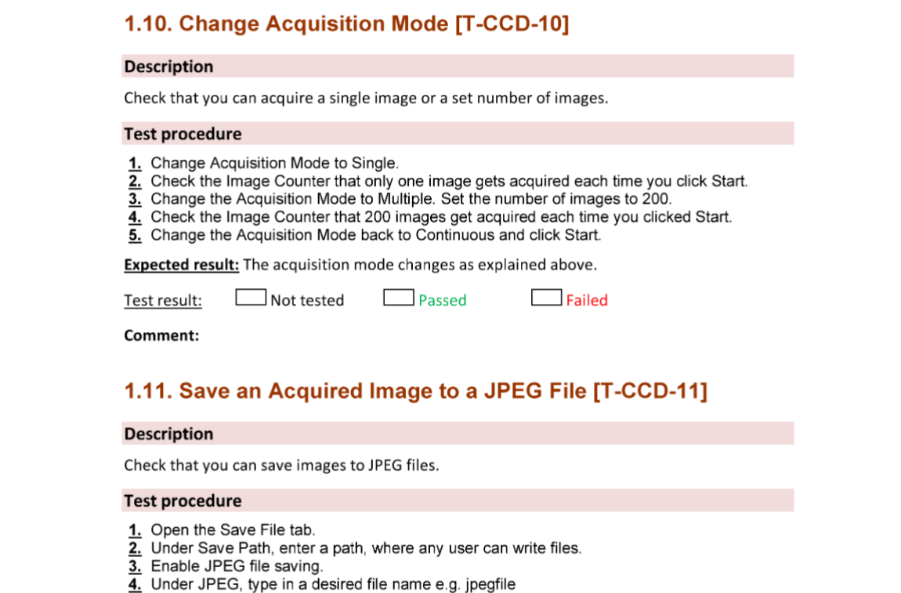
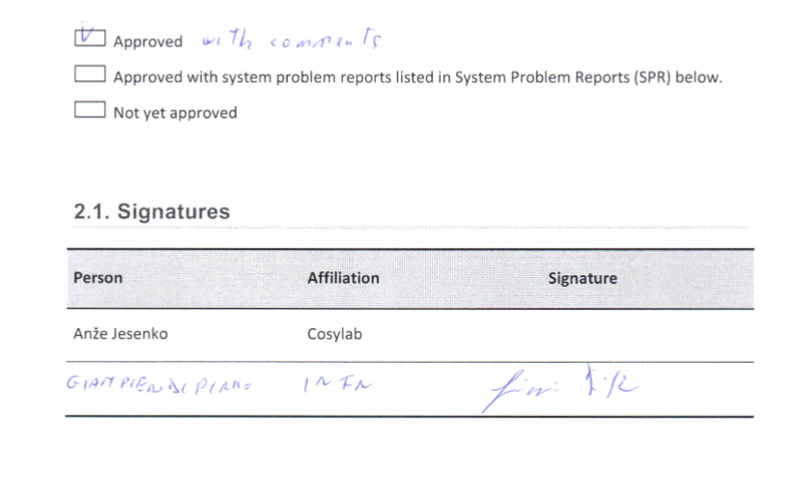
Transparent Scope and Deliverables Management

Slide 15
Scope by Subsystems
Control System Infrastructure
Diagnostic Devices
Laser Subsystem
RF System
Picosecond Timing Triggering System
Vacuum System and Magnet Power Supplies
IOC Health Monitoring
Laser Synchronization System
Conventional Facilities (Chiller)
Gamma Beam Characterization

Slide 16
Integrated devices
Fast digitizers (4 GS/s) for current transformers
Basler GigE Vision Cameras
I-Tech Liberas
I-Tech LLRF
Scandinova RF Modulators
Simple motion controller, in/out (iPOS3604 HX-CAN)
Beckhoff modules for simple I/O
Siemens PLCs for Vacuum and Magnet PS
MRF Timing
…

Slide 17
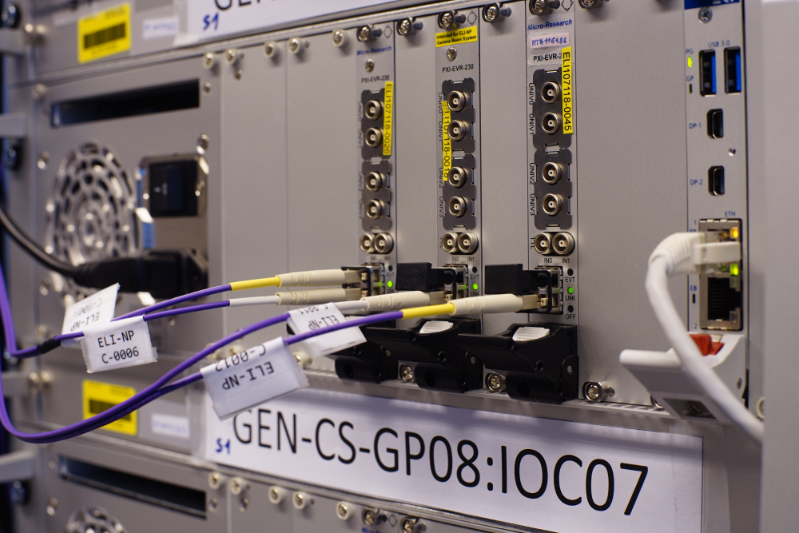

Controls Hardware
cPCI is the main form factor used:
MRF timing
Keystone digitizers
Ethernet devices
Pizza boxes for soft IOCs (Siemens PLC and Beckhoff, some Modbus/IP interfacing: Chiller, Vacuum, Magnets)

Slide 18
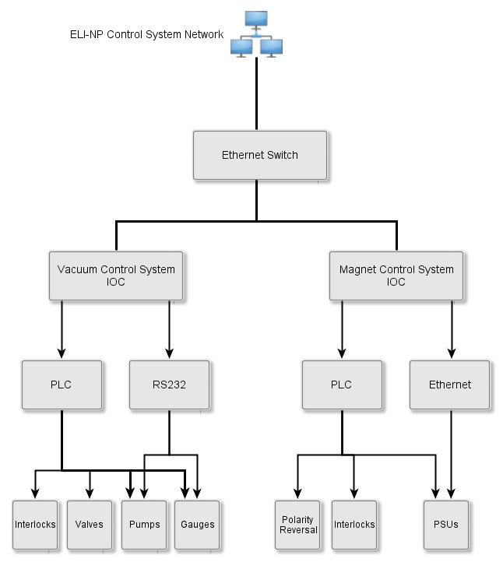
Vacuum and Magnet Controls (STFC)

Slide 19
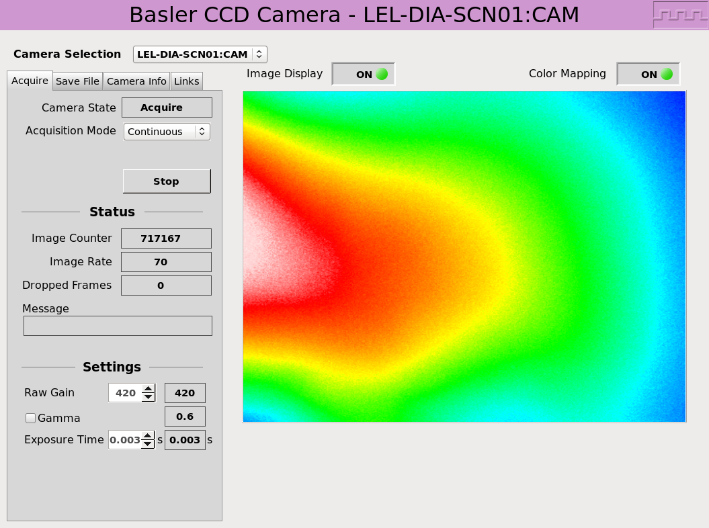
Diag: Basler camera interfaced via areaDetector

Slide 20
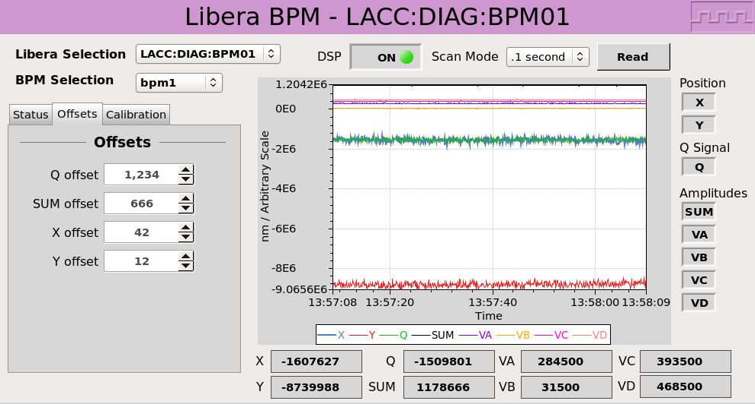
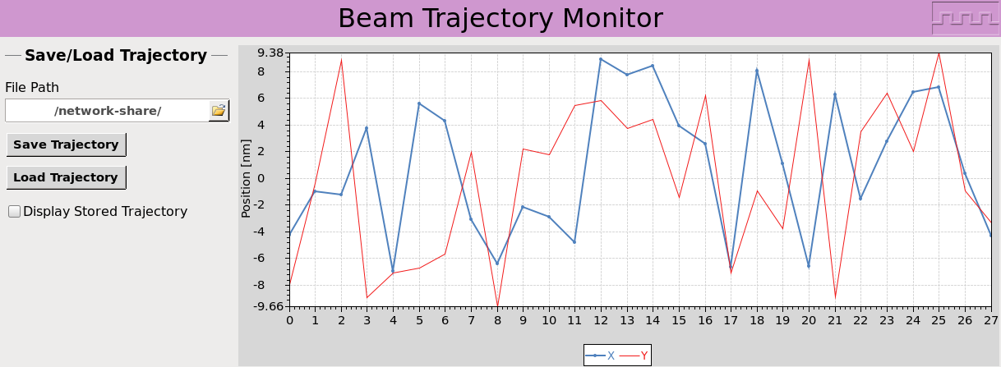
Diag: Libera BPMs

Slide 21
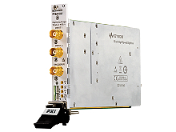
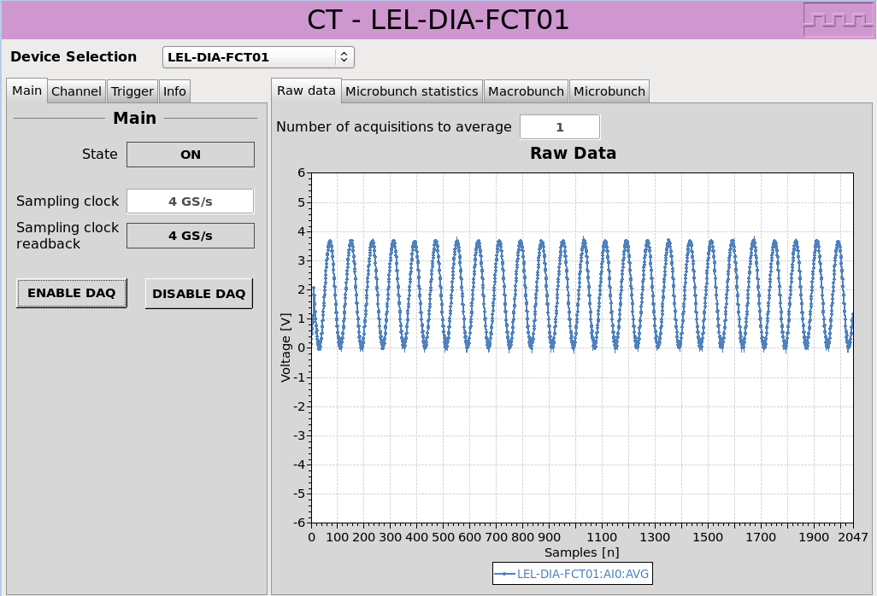
Diag: Current Transformers
Time situation
Bergoz sensor elongates the pulse by factor of ~100 => 5ns
At 10 measurements per pulse (0.5 ns => 2 GS/s)
2-4 GS/s solution was chosen
  Not many cards in this range, additional complication is the platform (reduces possibilities) and desired voltage range (even further reduction)
Nominal Device Support was used

Slide 22
Picosecond Timing Triggering System
Client Device | Count | Type | Comment
CCD Cameras | 23 | TTL | Assuming each camera needs one trigger [RD78]
Beam Position Monitor | 7 | TTL | Info obtained from A. Falone, April 24, 2015 11:11:53 AM, Subject: Re: System integration of Libera BPM; "…the Libera units (7) will be installed in two adjacent racks in GP08"
Current Transformer (FCT, ICT) | 4 | TTL | Assuming each Digitizer requires one trigger [RD78]
Laser subsystem (IP, LBTL) | 12 | TTL | system shown in [RD78] Figure 20: Interaction point components; trigger count and equipment location "GP-P-08" obtained from Kevin Cassou during skype meeting on 6 Mar 2015
RF Modulator | 15 | TTL | Assuming each modulator requires one trigger line, number of triggers is a sum of instances [RD78], Ch. 11.1.5. installed instances, HW is connected to ROOF level rack room
LLRF | 15 | LVPECL | Information on trigger count and type provided by I-Tech, 12 Mar 2015
HI efficiency camera | 2 | TTL | one per camera
Gamma | 8 | TTL | 4 in ACC bay 1, 4 in ACC bay 2
Experiment | 4 | TTL | 1 EVR board in experimental area, timing fiber optics is provided
Spare | 16 | TTL | one EVR with 4 TTL triggers per RACK room: 04, 06, 08 and ROOF

Slide 23
RF: Scandinova Modulators
LLRF was implemented via Libera-LLRF (black box system)

Slide 24
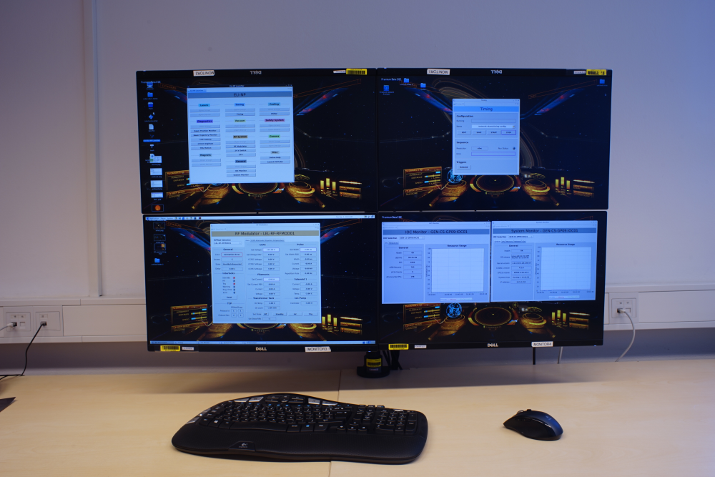
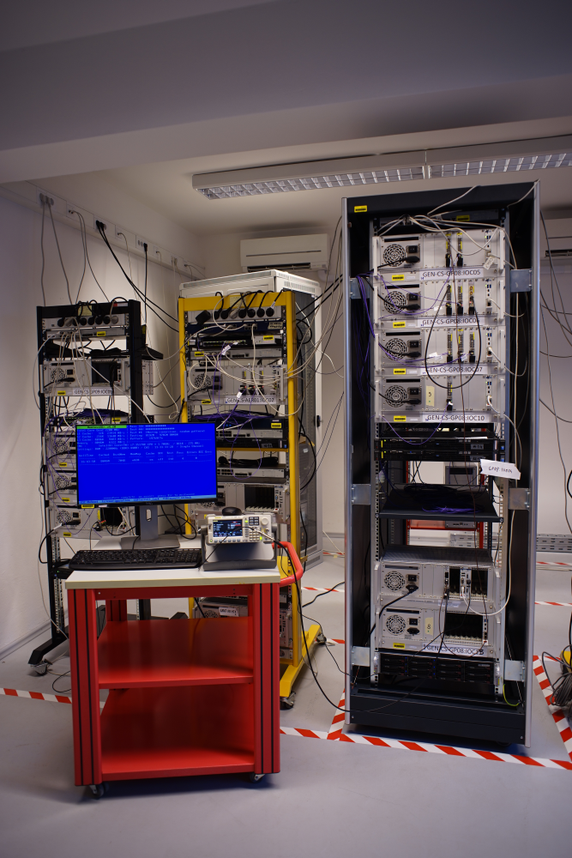
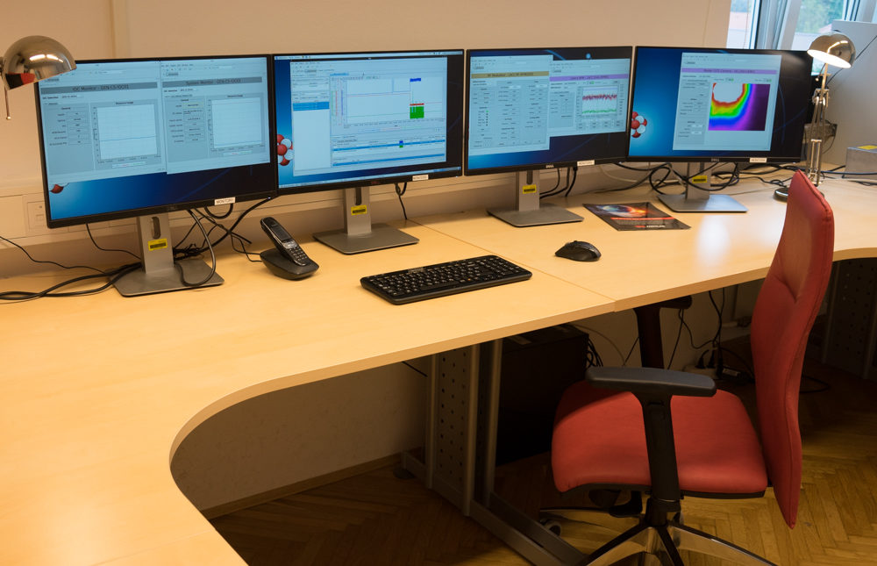
Development and testing

Slide 25
Dealing with project delays

Slide 26
February/March 2014

Slide 27
Timeline for control system
May 5 2014 : Preliminary design review
  all data on devices, interfaces collected
  missing data marked with responsible stakeholders, clear action items and deadlines
15 intensive months of
Specifications, Architecture, Design, Prototyping,
Test procedures, Implementation (coding),
Documentation, Testing, Debugging, Acceptance
August 28 2015 : Acceptance test 1 at INFN
September 2015 : Installation and test at Magurele
October 2015 : Acceptance test 1 at Magurele
November 20 2015 : Acceptance test 2 at INFN
December 2015 : Installation and test at Magurele
December 2015 : Acceptance test 2 at Magurele

Slide 28
May 2014

Slide 29
Status
Plan from February meeting:
  May 5 2014 : Preliminary design review
    all data on devices, interfaces collected
    missing data marked with responsible stakeholders, clear action items and deadlines
Status
  Good progress on first set of deliverables (documents)
    Due to release draft/RFC documents in May
      Design and conventions
    Review meeting on May 6
  Alarmingly low information on CS interfaces and application requirements

Slide 30
September 2014

Slide 31
Overall Status
Plan from February meeting:
  May 5 2014 : Preliminary design review
    all data on devices, interfaces collected
    missing data marked with responsible stakeholders, clear action items and deadlines
Status
  Good progress during summer
  However lack of information on CS interfaces and application requirements are bringing our work to stand—still in September/October

Slide 32
November 2014

Slide 33
Overall Status
Plan from February meeting:
  May 5 2014 : Preliminary design review
    all data on devices, interfaces collected
    missing data marked with responsible stakeholders, clear action items and deadlines
Status
  Some dates on components requirements finalization are specified thanks to Antonio Falone
  Some are still not

Slide 34
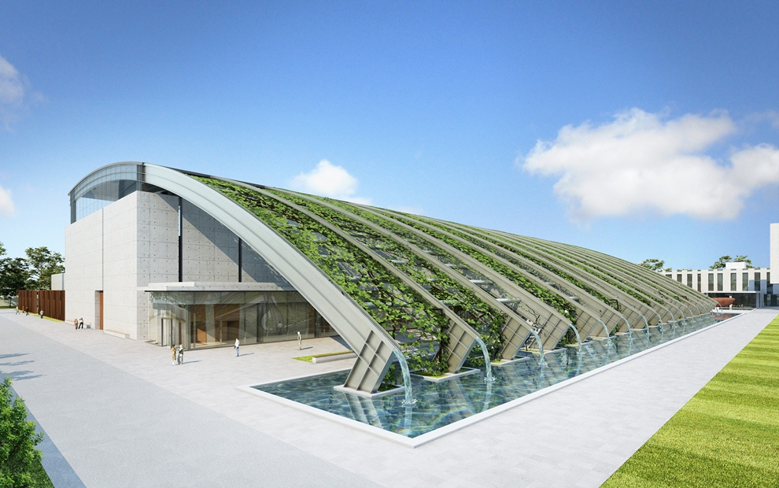
Building hand-over May (2015)

Slide 35
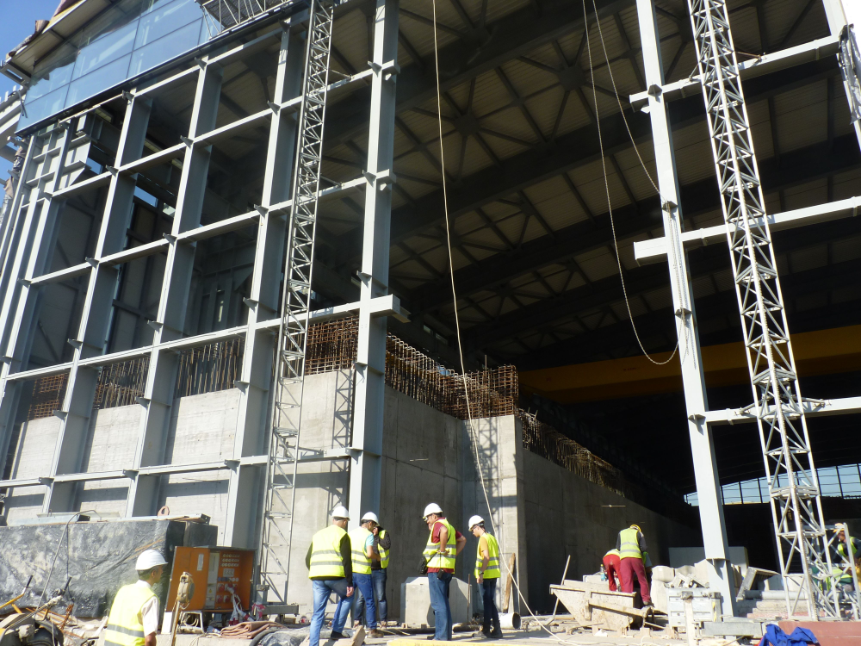
September 2015

Slide 37
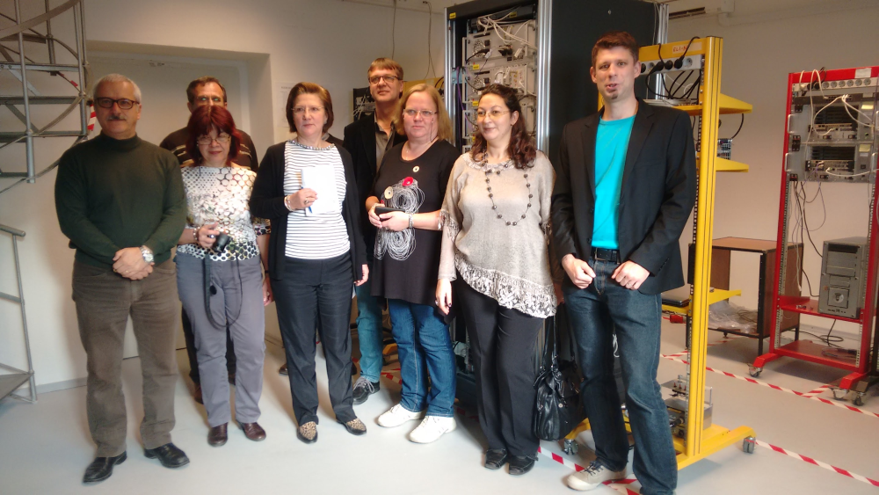
Successful control system FAT

Slide 38
Conclusion
EPICS once again proved as a robust and easy to use control system framework that provided no risks to the project
  Cosylab has a the world’s largest group of EPICS projects architects, developers and project managers with experience from dozens of projects worldwide
Transparent and disciplined project setup and management was required to cope with the complicated project setup
The final on-site part of the project is still ahead of us
Acknowledgement to members of EuroGammaS Consortium and Cosylab project team
  More details by slava.isaev@cosylab.com

Slide 39
Thank you!

Slide 42
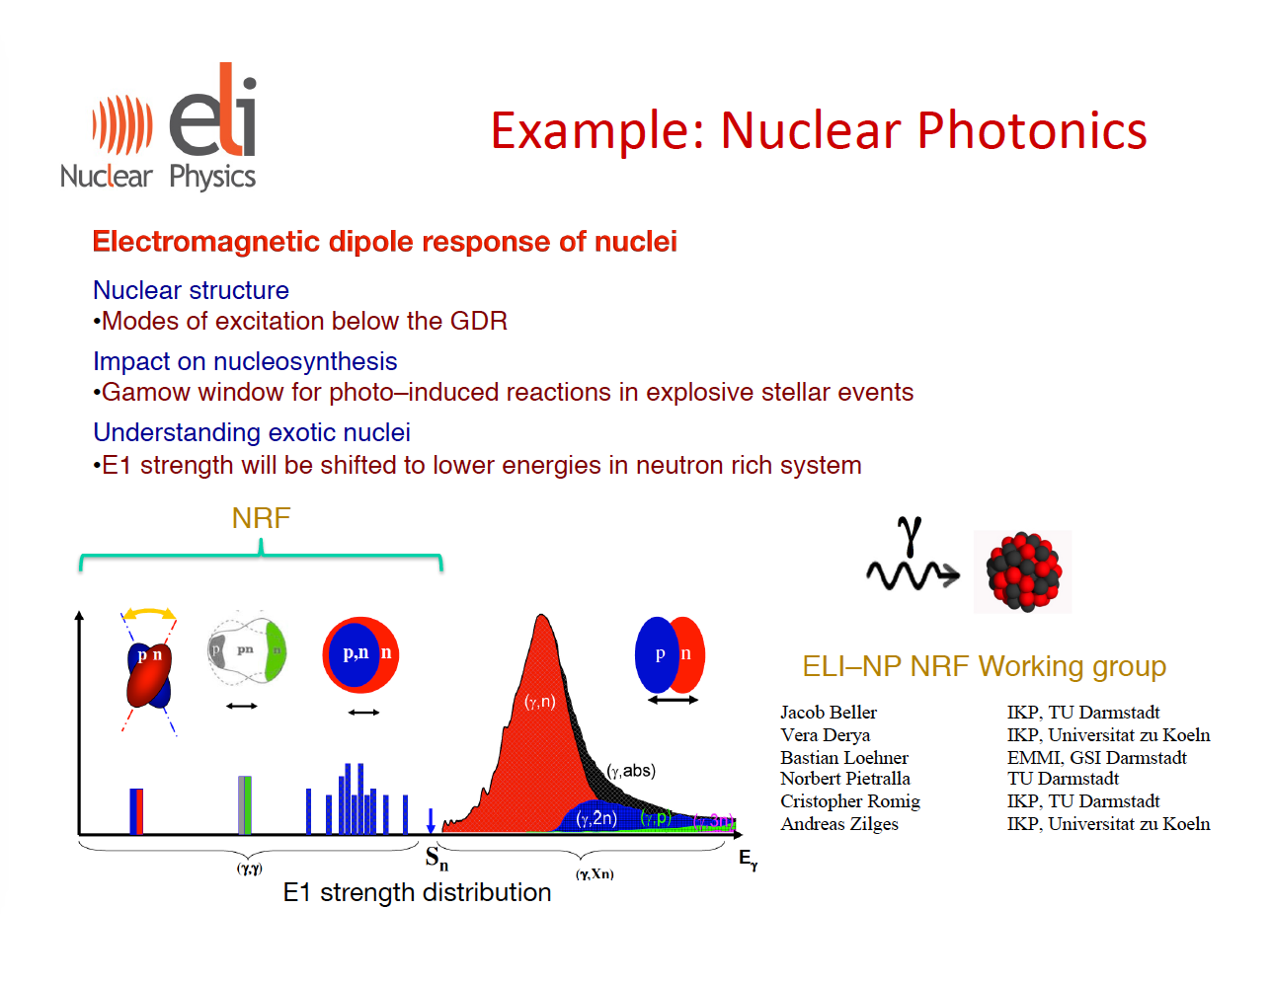
Notes:
GDR = Giant Dipole Resonance

Slide 43
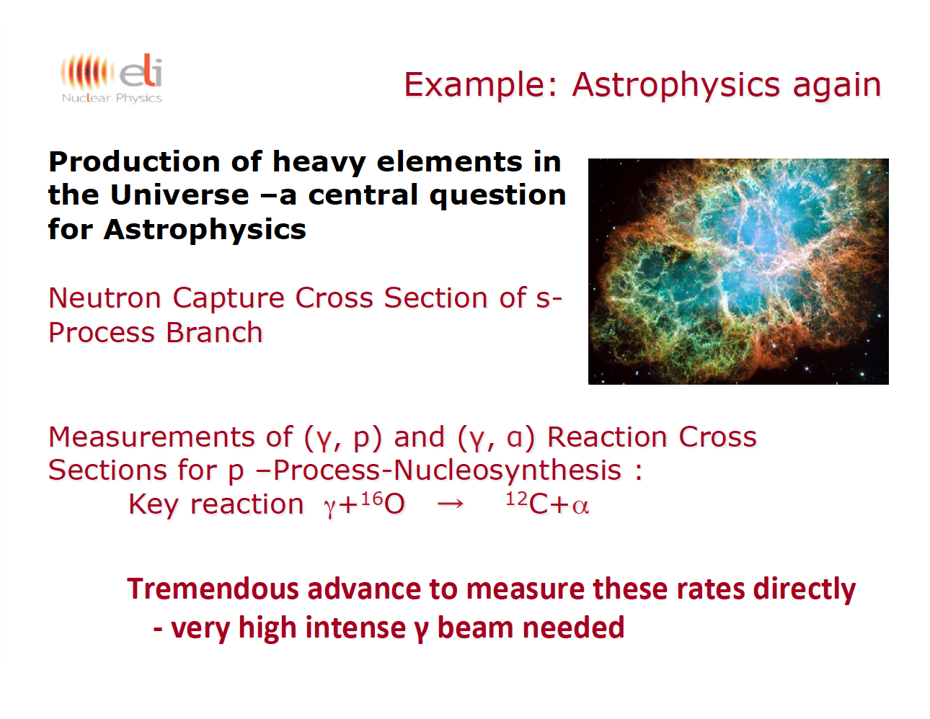

Slide 44
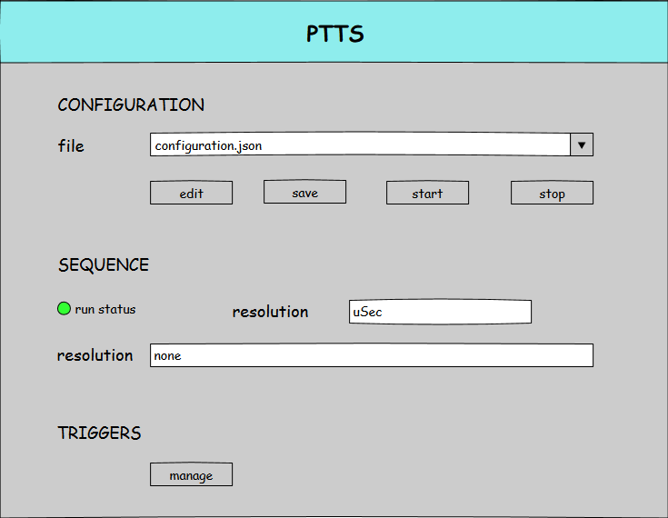
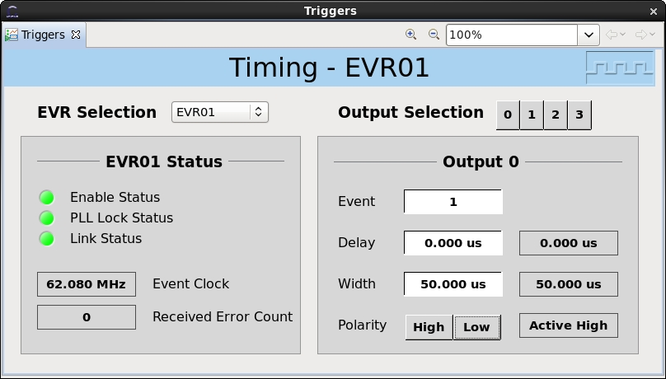
Online Timing Configuration

Slide 45
Laser Subsystem (QT) – integrated as black box

