Slide 1
MQTT Support for CS Studio
Megan Grodowitz
grodowitzml@ornl.gov

Slide 2
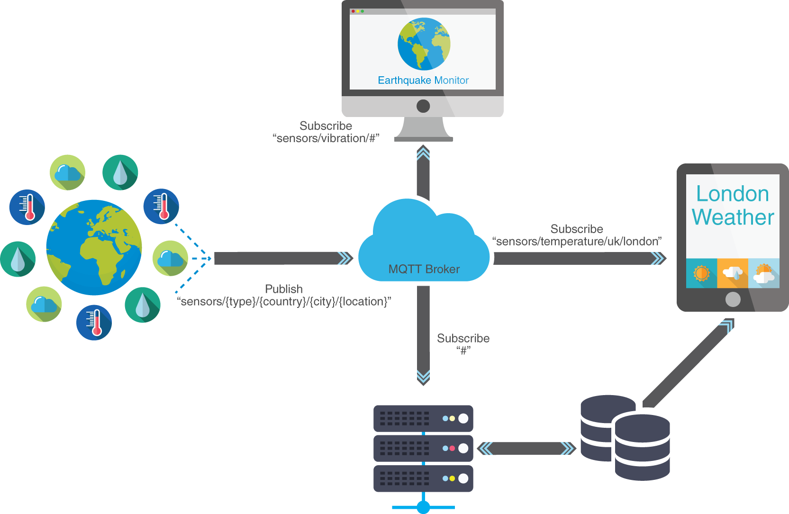
What is MQTT?
Sensor devices publish messages to topics that describe the device or reading attributes
Applications receive updates to specific topics
A broker retains messages to reduce network traffic and power, while increasing reliability when devices drop out
Servers and storage can be used to log all messages in a central location

Slide 3
MQTT Concepts
Topic
A string identifier of the form “a/b/c/d/e”, where slashes separate subtopics
Clients publish or subscribe to topics
# is the glob symbol, i.e “a/#” means all subtopics of “a”
Broker
Server program that receives, buffers, and send messages based on topic
Each topic may contain up to 1 message value at a time, which may be retained
Client
Anything that connects to the MQTT broker: serial devices, python scripts, java programs, etc.
Clients send a unique identifier when they connect to the broker, e.g. MAC address

Slide 4
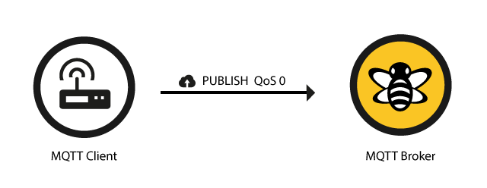
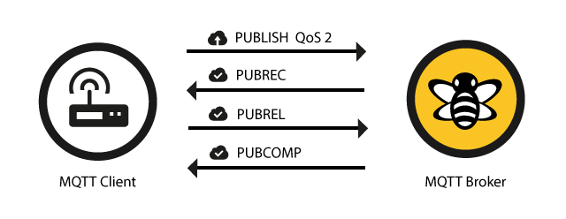
MQTT Concepts
QoS
Level 0: Deliver message at most once (fire and forget)
Level 1: Deliver message at least once
Level 2: Deliver message exactly once
EPICS does not make message guarantee, uses put-callback to verify activity
QoS only describes client/broker guaruntees… No such thing as, say monitor/sensor or controller/motor guaruntee
Images from www.hivemq.com

Slide 5
MQTT Concepts
Persistent Sessions
Client can connect to broker with the clean session flag set false
Messages are retained even if the client disconnects
Clients must also maintain messages when broker disconnects
Standard does not define how many or how long (until we run out of resources)
Message Retention
Individual messages have a retention flag
Message is retained indefinitely
EPICS does not have central server, so traffic does not get retained anywhere unless something connects to channels, e.g. archiver
LWT (Last Will & Testament)
A device can indicate a final message to send when it disconnects from the broker
Often used to set status to “offline”
EPICS device that drops out just disappears
No concept of Put-callback
E.g. I cannot get a set acknowledgement that the servo has moved
Best effort is to have the servo publish its position back to the same or other topic
This has room for error/race conditions

Slide 6
MQTT vs. EPICS Comparison
MQTT always has a broker
No searching process where we try to discover devices: better for wide area network.
EPICS does not need a broker, no single point of failure: good for local area network
MQTT broker is the only “connection”
No such thing as disconnected PV
To detect whether device is connected to broker, use status topic
MQTT messages are all plain text
No type information (e.g. double, string, table)
No meta-data fields (e.g. timestamp, alarm values)

Slide 7
PVs and Widgets in CS Studio
PVs are attached to widgets using the PV property value
At runtime, PV value automatically updates widget, or can be used in rules or scripts.

Slide 8
MQTT PV for CS Studio
VType PV plugin provides channel access, pv access, local, and simulated values
Examples values of PVs attached to widgets:
loc://myvariable
pva://SOME_CHANNEL
sim://sine(1, 1, 10)
MQTT PVs are defined as:
mqtt://topic[<type>]
Examples:
mqtt://servo/rotation
mqtt://servo/status<VString>
MQTT type names are the same as local PV values (VDouble, VString, etc)

Slide 9
Encoding/Decoding PV Values from the Broker
Broker only sends text string
We would like to maintain type info: Double, String, etc
Indicated in PV name with <type>
Default type when not indicated is a Double
What happens when a string arrives from broker?
More robust additions could include metadata
E.g. timestamping
Problem: Each device would need to conform to consistent string formatting
This would require, for example, Python library to format PV metadata to string in a way consistent with CS Studio
When in doubt, set the PV to type VString and process the input in a script

Slide 10
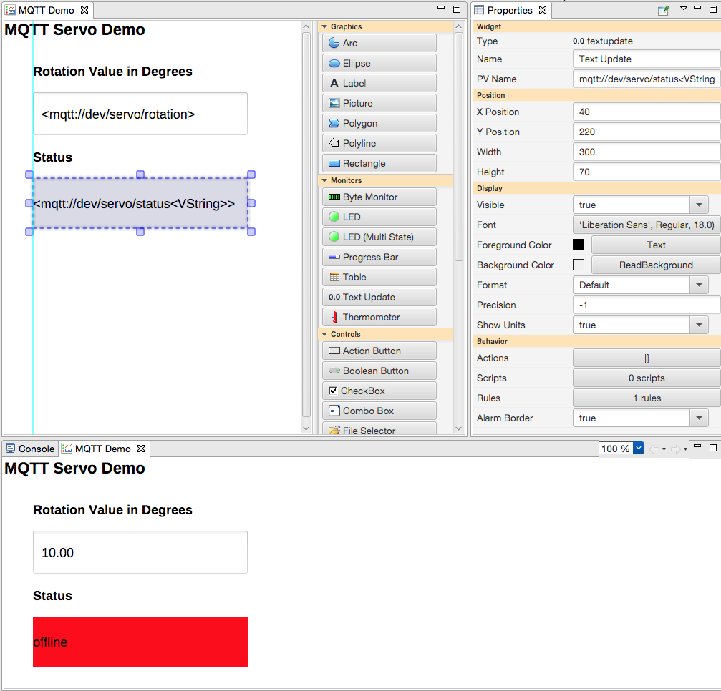
MQTT PV for CS Studio
Specify a control widget to publish changes to a topic
Specify a monitor widget to view changes to a topic
Change PV value to publish to specified topic
Monitor status to get update from LWT when device disconnects

Slide 11
Conclusions
Now CS Studio can open garage doors!
Actually MQTT is used in a variety of real world applications
EVERYTHNG, Amazon IoT, OpenStack, Open Geospatial Consortium SensorThings
Support in many languages, WebSocket for MQTT for browsers
To use:
Setup broker URL in preferences
Use PV name mqtt://topic
Integrates well into existing VType PV plugin
Type support within CS Studio

