Slide 1
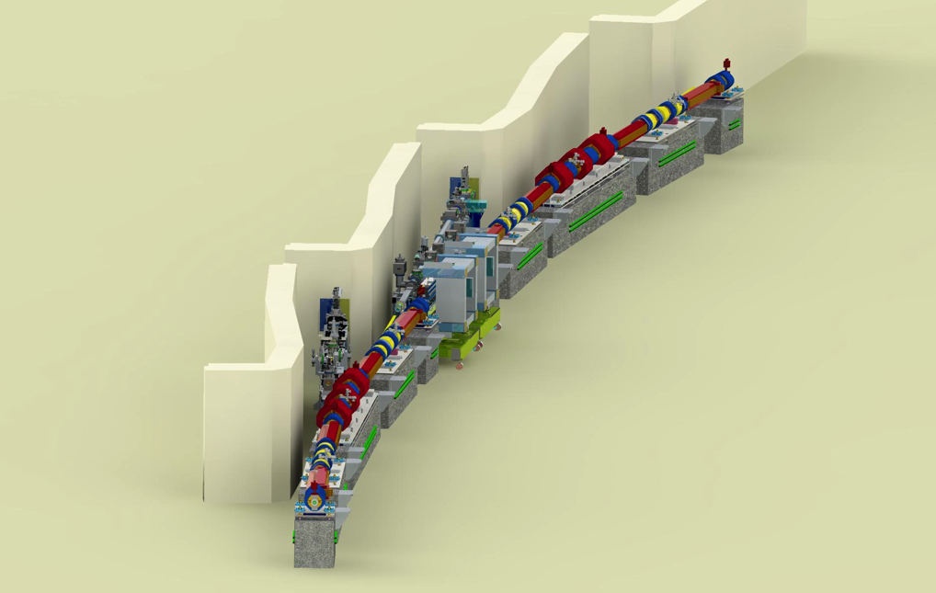
APS-U Controls
Time Correlated Data Acquisition
[DAQ]
Advanced Photon Source Upgrade Project:
The World’s Leading Hard X-ray Light Source
Ned Arnold
Siniša Veseli
Andrew Johnson
Argonne National Laboratory
EPICS Collaboration Meeting; Oak Ridge National Laboratory
Sept 20-22, 2016
Notes:
Univ of Chicago Review, Aug. 30, 2010
1

Slide 2
APS-U MBA Control System Design Challenges
From a recent review slide …
  APS-U Accelerator Control System Considerations
      Enhancements are driven by APS-U technical system needs
      Ubiquitous IOCs and FPGA-based systems
      Higher data rates and larger volumes of data from embedded systems
      Development of new custom interfaces
      Fast synchronous data acquisition and processing
How do we prepare for “ubiquitous embedded systems generating higher data rates and larger volumes of data” ? < prudent to think about this ahead of time >

Slide 3
Time-correlated Data Acquisition System (DAQ) for MBA
  Separate fast/large volume data from slow control of technical system
  Dedicated IOCs, separate servers, separate subnets, …
  Ensure scalability
  Common implementation across subsystems!

Slide 4
Time-correlated Data Acquisition System (DAQ) for MBA
Other features …
  Acquire data from subsystems @ various sample rates; correlate within 3.6µs (turn-by-turn) or better.
  Ensure scalability (aggregate data rate may exceed 4 GB/s)
  Support continuous or triggered acquisition limited only by available storage
  Any number of applications can subscribe to the data without additional load on IOCs
  Separate from “operations” networks and servers; allow maintenance/enhancements during ops
  May impact technical subsystem designs, concept needed before technical system design is too far along

Slide 5
Time-correlated Data Acquisition System (DAQ) for MBA
DAQ Data
(encapsulated NDArray)
Typical DAQ IOC …
Varies by technical system
Prototyped several options:
Custom TCP
EPICS V4 PVA
AMQP (QPID)
Varies by technical system:
MRF Event Receiver
APS Event Receiver
NTP/PTP

Slide 6
Time-correlated Data Acquisition System (DAQ) for MBA
DAQ Data Packet …
List of Parameters (NDArray Attributes)
(including list of channels that follow)
Block of Time-series Data
…
Timestamp
Channel 1
Channel 2
Channel 3
Channel 4
Channel N
.
.
.
.
.
.
.
.
.
.
.
.
.
.
.
.
.
.
Since absolute timestamps are recorded, plotting channels from different files/systems against “Timestamp” provides immediate time-correlated plots .

Slide 7
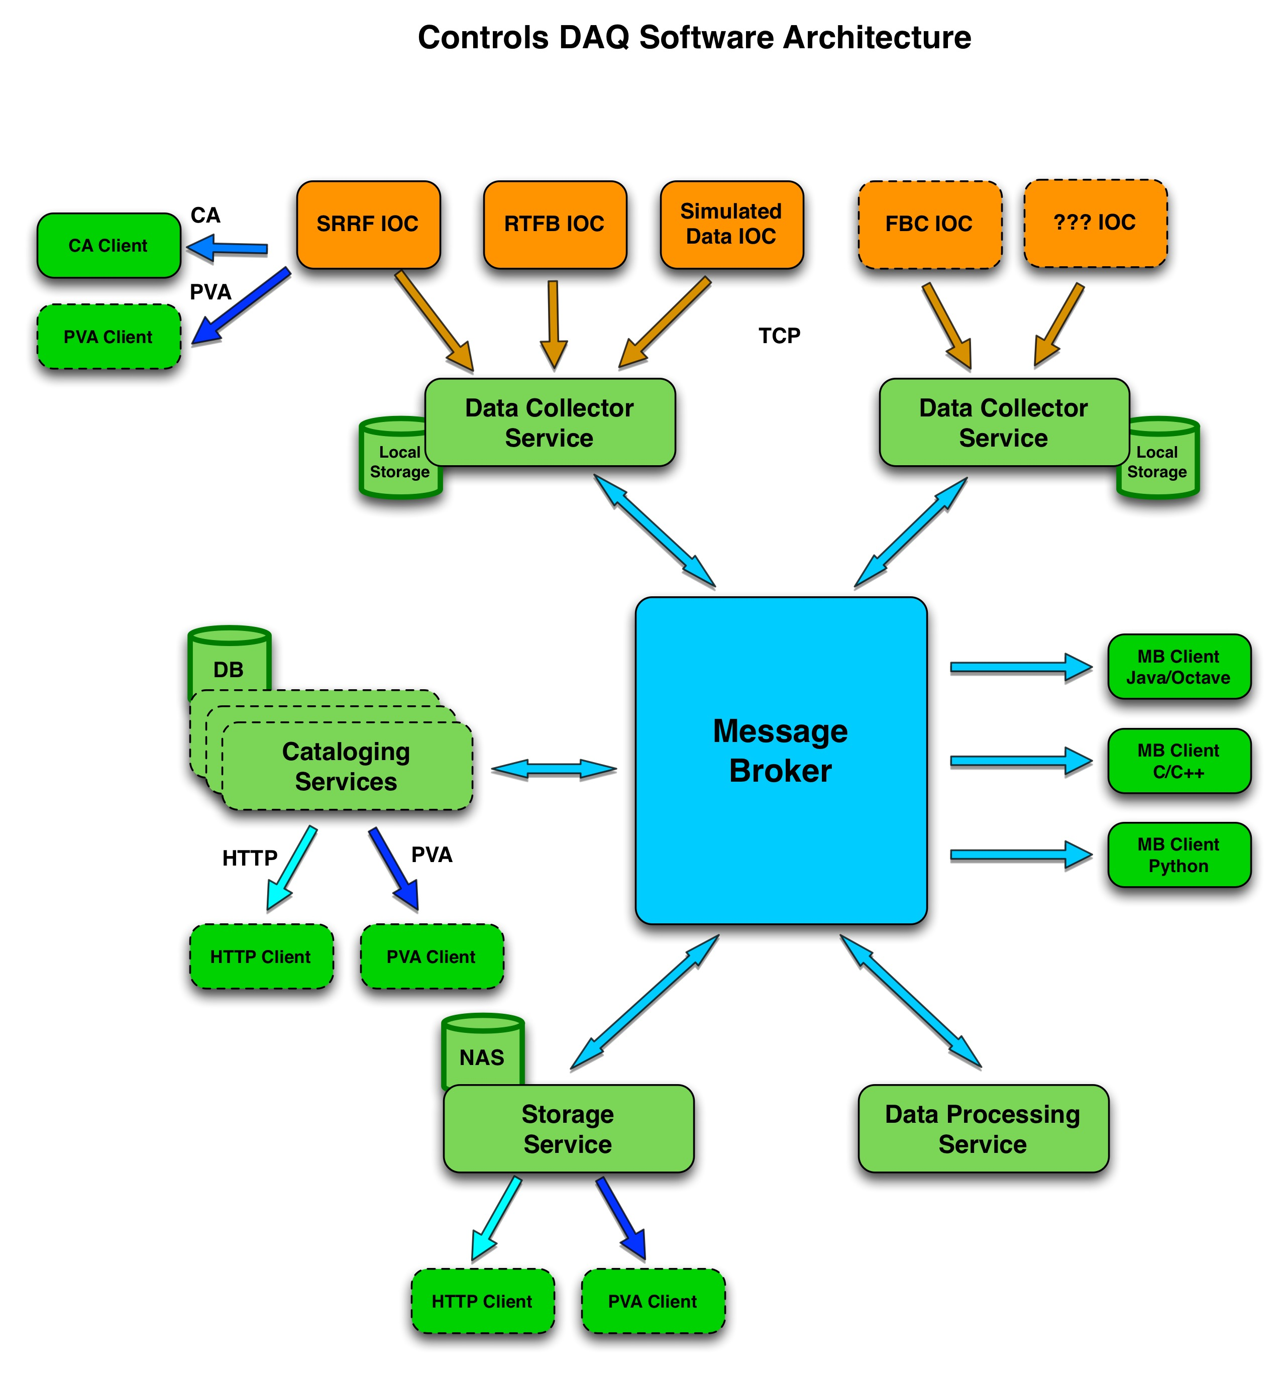
Time-correlated Data Acquisition System (DAQ) for MBA
Services …

Slide 8

APS-U R&D Includes Five DAQ IOCs
Timing systems evaluation
Data streaming
Integration with orbit feedback ‘4x4’ prototype
Integration of Libera BPM electronics
DAQ is now in routine use for APS-U machine studies

Slide 9
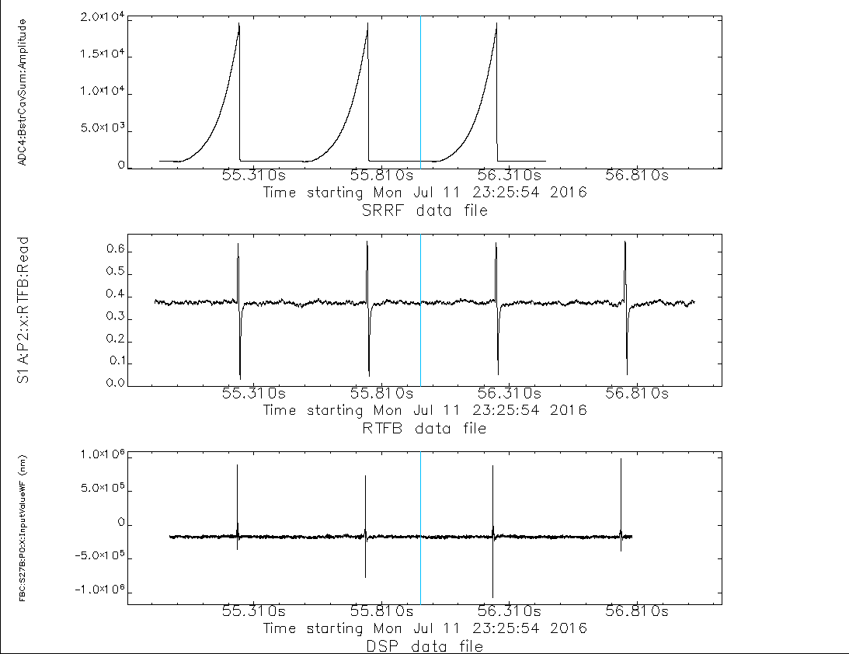
DAQ Use Case: Monitoring SR Injection
Acq. Trigger
Booster RF Cavity Amplitude
(during injection)
[ 8 chan @ 271KHz ]
Pre-trigger
Post-trigger
.5 sec
SR BPM acquired from
Existing Feedback System
[ 2616 chan @ 1.5KHz ]
SR BPM acquired from
APSU Prototype Feedback System
[ 48 chan @ 22.4KHz ]

Slide 10
Time-correlated Data Acquisition System (DAQ) for MBA
Future plans (near-term)…
  Allow different data types for different channels (NDArray constraint)
  Allow dynamic channel selection so only the data of interest is sent
  Trigger acquisition on internal pre-defined conditions
  Provide mechanism for including “slow changing” data (parameters that might change during acquisition, but not at fast sampling rate) in the same data packet
  Evaluate upcoming Area Detector functionality (for example, NDPluginTimeSeries)
  Add TBT and Bi-polar PS IOCs

