Slide 1
Plans for EPICS Version 4 at ESS
Timo Korhonen
Integrated Control System Division
European Spallation Source ERIC
www.europeanspallationsource.se
20 September 2016

Slide 2
Outline
Why Version 4
Why at ESS?
The REAL goal is…
Some plans
Services
“Big Data”
Atomic actions
Summary

Slide 3
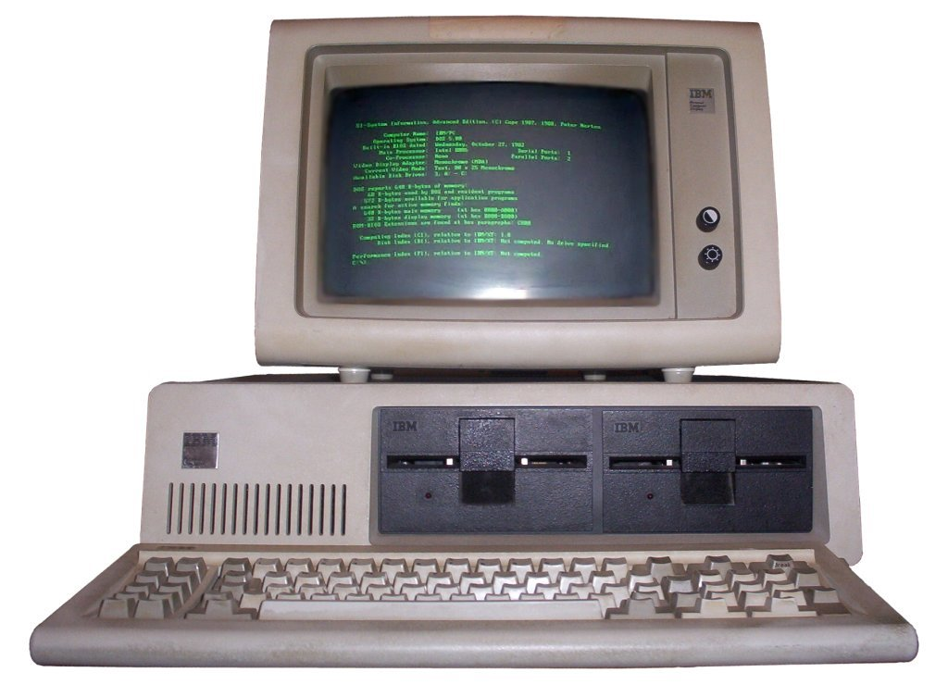
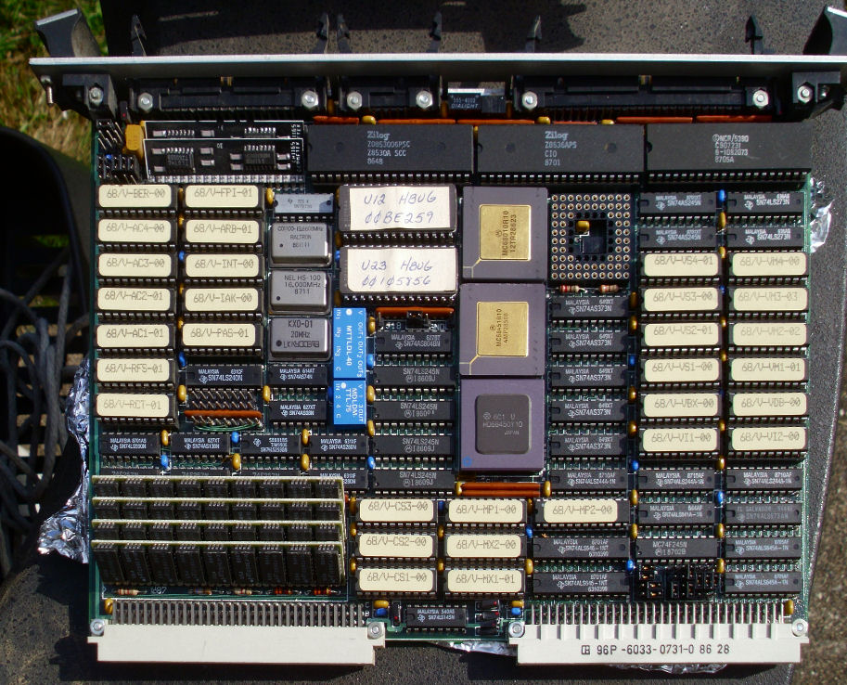
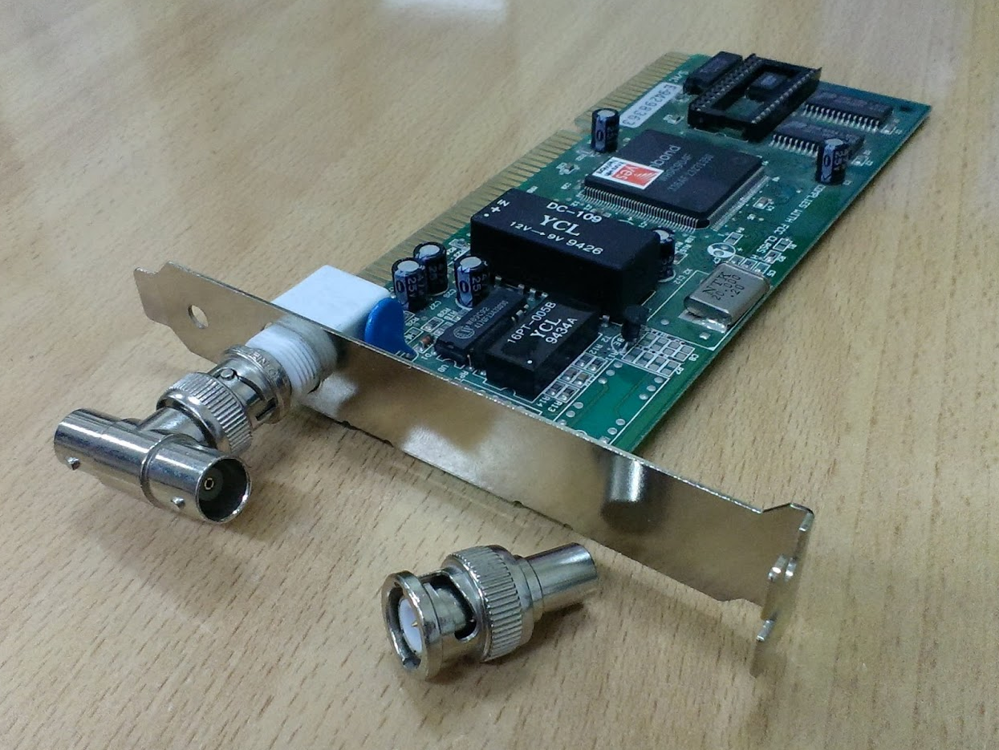
Why Version 4?
At the time EPICS was created, computers looked different…
In the past 30 years, capacities have change several orders of magnitude:
Storage capacities: Mbytes to Gbytes to Tbytes
Processor speeds from a few MHz to several GHz, multicore
Software technologies have taken great leaps
Network speeds 10 Mbit/sec to 10 (or soon 100) Gbit/sec
Our facilities have changed, too – a lot!
Data transport of EPICS, Channel Access has served the community really well
Even too well? Is there a problem, after all?
But: we should take advantage of the progress that has taken place

Slide 4
Why V4 at ESS?
ESS is a facility with a planned lifetime of 40 years
Starts to produce science in early/mid 2020’s
How often is there a chance to start really from scratch?
Not very…
ESS however has almost no legacy constraints
Apart from the technical reasons:
This is a chance to give a push to move to a new standard that takes us…quite some way into the future. Next 30 years?

Slide 5
EPICS 4 at ESS
The ESS targets to be fully EPICS 4 compliant
Use EPICS 4 (pvAccess) for all control system applications
No Channel Access or “implanted” other protocols
pvAccess can replace CA functionality today – we think
Performance, reliability, functionality
Some enhancements needed
Interoperability needs to be demonstrated
IOC development is not (much) affected
IOCs will work as before, drivers, etc., need no change
CS-Studio needs some additional work
Archiver Appliance will/does support V4 structures

Slide 6
A confession
I do not have a perfect plan for all the things we want to do with V4 in ESS
However, the real goal is that:
new young people enter the field and implement things that I cannot even imagine today
My ambition is to help to make this happen
Build an infrastructure that opens new possibilities
Nevertheless, there are a few ideas
So that I can claim my salary…

Slide 7
Plans for V4
Use services extensively
Improve integration of dynamic and static data
Use the new capabilities to improve data quality
Better handling of measurement data (even in accelerator)
Rich metadata, synchronous data
Data is the key to performance improvement
As we heard in the opening talk
V4 can effortlessly handle big data volumes
Buzzword array:
Big data – data mining – machine learning
Jokes aside, there is potential here
it does not cost much extra to use the new potential

Slide 8
Services
What are “services”, after all?
an IOC is a service that processes the input/output data
I/O is not the only data that a (modern) control system needs to use or manipulate
Services isolate a certain function
As long as the interface stays the same, no recompilation or any other changes needed
Data consumer does not need to know how the data is produced
For example a service that combines live and archive data; user does not need to know that data sources are different

Slide 9
Some ideas with services
Uniform access to process and configuration data
IOC can dynamically access its configuration data
Magnet field conversion, RF field maps, etc.
Managing of collected data
Experimental data, accelerator characterization data
Machine snapshots (e.g. MASAR)
Consistent storage, indexing and retrieval
MetaDataStore and HDF5 files
Accelerator online model as a service
Makes application writing easier

Slide 10
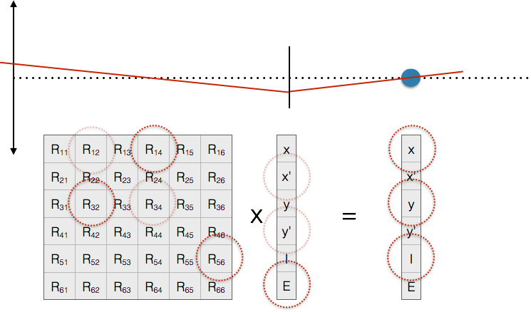
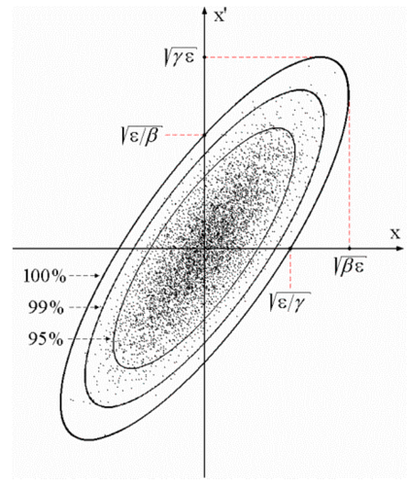
Modeling example
Transverse
beam offset
“A”
“B”
Z
$ eget -s XCOR:IN20:491:RMAT -a b BPMS:IN20:525
0.669591 0.694604 0 0 -3.08532e-19 2.41325e-19
-0.570851 0.901275 0 0 -1.23627e-19 1.45491e-19
0 0 1.33379 0.966896 0 0
0 0 0.358415 1.00957 0 0
-2.29302e-24 8.92892e-20 0 0 1 1.20724e-05
1.00974e-28 0 0 0 0 1
From N. Delerue, Oxford Univ.
$ eget XCOR:LI24:900:TWISS
energy 5.00512
psix 37.7625
alphax 13.6562
betax -2.78671
etax -0.00698294
etaxp 0.00107115
psiy 31.9488
alphay 116.762
betay 5.2592
etay 0
etayp 0
z 2438.72
Figure: EPICS V4 modelling service giving orbit response matrices and Twiss parameters for given devices. These are the basis of 95% of emittance minimization applications – feedback, steering, bumps, etc
Greg White, Murali Shankar, Ivo List

Slide 11
Devices, objects and so on
How many definitions of the term “device” you know?
Depending on your point of view:
A power supply is a device
An (accelerator) cell is a device
The whole accelerator is a device. And so on.
This may sound like stretching a bit but:
Combining EPICS PVs you can create any device view that you like
A pvData structure can become a device
Perhaps even on the fly: use ChannelFinder to get the PVs
Flexible access to infrastructure data can make this possible

Slide 12
Access to infrastructure & archive data
Directory Service (based in EPICS V4 channelFinder) examples:
# The names of PVs, by device name pattern:
$ eget -s ds -a name=XCOR:LI21:135:%
name
XCOR:LI21:135:ABORT
XCOR:LI21:135:ACCESS
XCOR:LI21:135:ALLFUNCGO
XCOR:LI21:135:BACT
XCOR:LI21:135:BACTFO
# Regular expression (restrict to sectors LI25-LI29)
eget -s ds -a regex='XCOR:LI2[5-9]:.*:BDES’
# Device names of the instruments in the laser heater
$ eget -s ds -a etype INST -a tag LSRHTR -a show dname
# A recent search for invalid data in corrector PVs
$ eget -tTs ds -a name %COR:LTU%:%:%DES | \ eget -p ca -f - | grep nan
XCOR:LTU1:558:BDES nan
XCOR:LTU1:558:IDES nan
Database example
$ eget -s LCLS:ELEMENTS
ELEMENT ELEMENT_TYPE EPICS_DEVICE_NAME S_DISPLAY OBSTRUCTION
CATHODE MAD CATH:IN20:111 2014.7 N
SOL1BK MAD SOLN:IN20:111 2014.7 N
CQ01 MAD QUAD:IN20:121 2014.9 N
SOL1 MAD SOLN:IN20:121 2014.9 N
XC00 MAD XCOR:IN20:121 2014.9 N
... (many rows snipped)
Figure: Access to Database gives device infrastructure, magnet calibrations, drawing names, etc. Will be used in LCLS-II for cryogenic plant system hierarchy etc.
Greg White, Murali Shankar, Ivo List

Slide 13
“Big data”
V4/pvAccess can effortlessly handle large data volumes
This gives totally new possibilities
Data that was not possible to collect can be made available for analysis
Data mining, machine learning
I am not a big believer of AI imminent success but there is potential to be discovered and used

Slide 14
Atomic actions
How many times have you had to work around:
Sending several data items that actually are a unit, and try to make an action
Getting several pieces of data that belong together
Yes, it is possible to work around
But you could use that time for something more productive – working on the actual issue!
Recent changes in EPICS make atomic actions possible (3.16)
See Michael Davidsaver’s talk from Lund EPICS meeting
Within one IOC – but this is already a lot!
Cross-IOC atomicity still needs work(arounds)

Slide 15
From a recent V4 presentation
Performance is excellent
Reliability needs have been met or exceeded
Easy programming and scripting, once you’ve got started
Complex data and RPC enables one, simple, high performance, infrastructure across the whole controls and online scientific system. Utility of this effect previously overlooked, but in practice seen to be key
Normative Types enable systems of narrowly defined services to be applied generally to many experiment user problems
Streaming supports big online data processing. Beats tested alternatives in ease of use and performance.

Slide 16
Summary
ESS will be going fully for EPICS 4 (or 3+4…)
The foundations are available
Have to be put into a stress test
Some functionality can be used straight away
Archiver, CS-Studio, many services
Main issue is to build the potential for
Modern methods
Handling large datastreams
Making things easier
The plan is not clear
I am looking forward to things we will find out !

