Slide 1
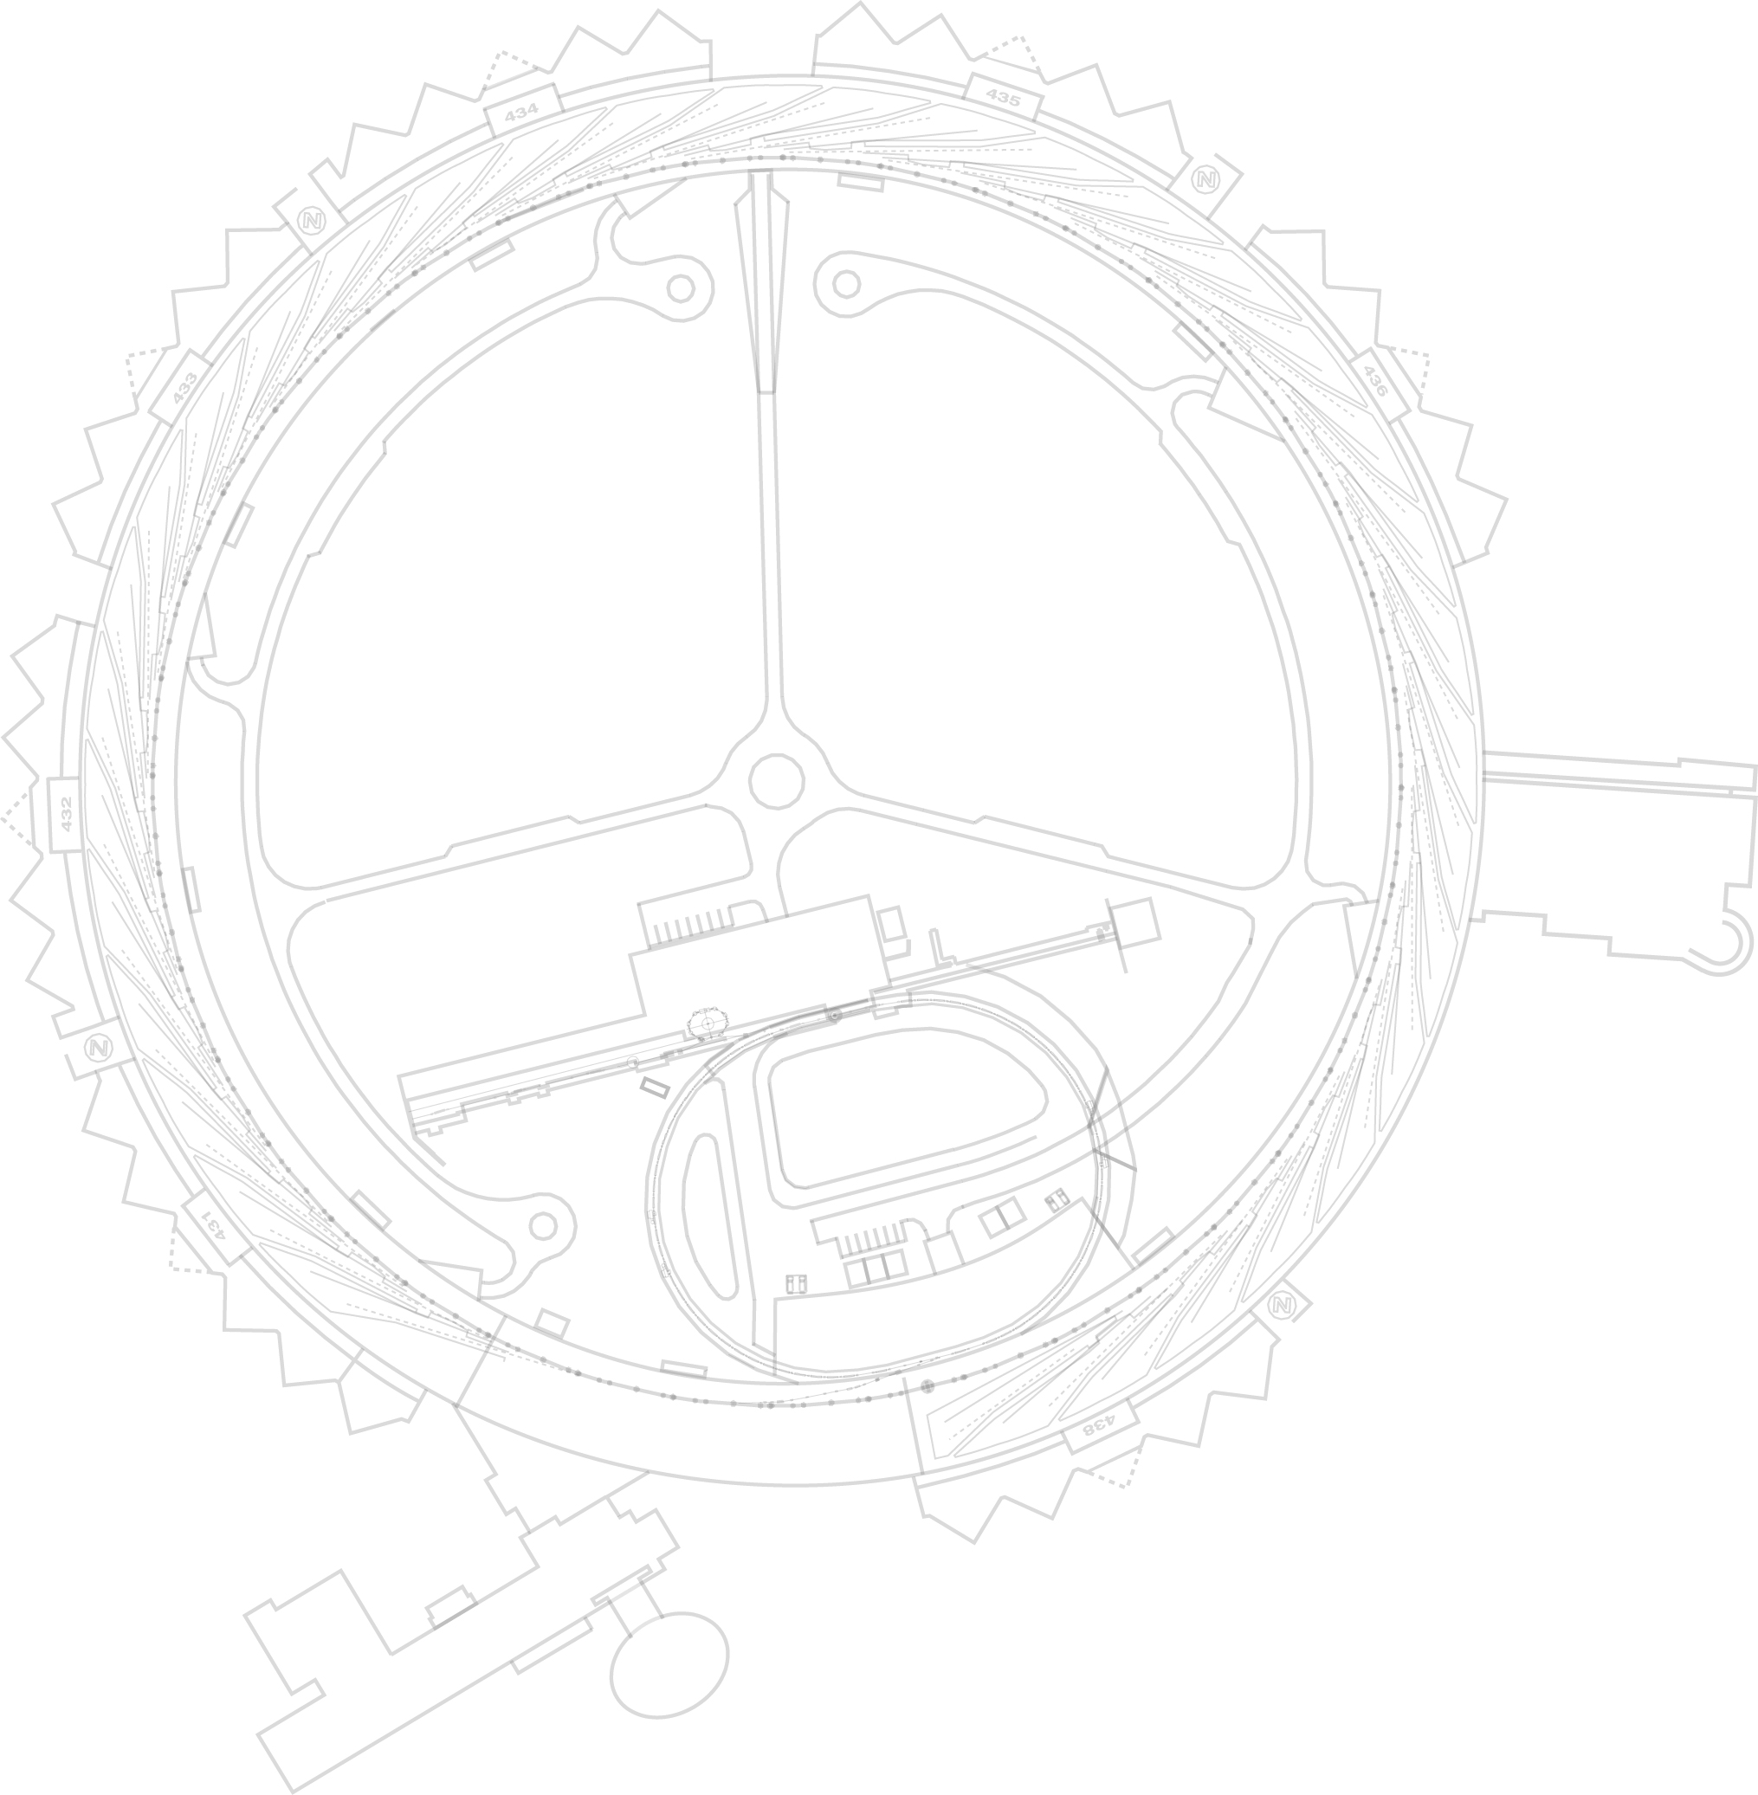
Using Area Detector As A General Purpose Processing Framework
Ned Arnold
Siniša Veseli
Argonne National Laboratory
EPICS Collaboration Meeting
September 2016
EPICS Collaboration Meeting - September 2016

Slide 2
Data Acquisition System for APSU MBA
Handles several technical subsystems
Each subsystem has multiple data channels
Sample rates vary across subsystems
Must provide time-correlated DAQ (3.6μs)
Must provide support for continuous and triggered DAQ
Must provide support for static parameters, fast and slow data
EPICS Collaboration Meeting - September 2016
2
Notes:
Go to ”Insert (View) | Header and Footer" to add your organization, sponsor, meeting name here; then, click "Apply to All"
2

Slide 3
Typical DAQ IOC
Based on Asyn/AD Framework
DAQ Data
(encapsulated NDArray)
Varies by technical system
Prototyped several options:
Custom TCP
EPICS V4 PVA
AMQP (QPID)
Varies by technical system:
MRF Event Receiver
APS Event Receiver
NTP/PTP
EPICS Collaboration Meeting - September 2016
3
Notes:
Go to ”Insert (View) | Header and Footer" to add your organization, sponsor, meeting name here; then, click "Apply to All"
3

Slide 4
Asyn/AD Framework Usage
DAQ System uses Asyn/AD Framework to collect and process data from technical subsystems
  Driver packs channel data into ND Arrays, and passes it to real-time processing plugins
  ND Array attributes describe the content (i.e., what data is in ND Array, how is it packed)
  Communication plugin streams ND Arrays to remote Data Collector service where it is unpacked, stored, and (possibly) forwarded to Message Broker
DAQ Data Packet
List of Parameters (NDArray Attributes)
(including list of channels that follow)
Block of Time-series Data
…
Timestamp
Channel 1
Channel 2
Channel 3
Channel 4
Channel N
.
.
.
.
.
.
.
.
.
.
.
.
.
.
.
.
.
.
EPICS Collaboration Meeting - September 2016
Since absolute timestamps are recorded, plotting channels from different files/systems against “Timestamp” provides immediate time-correlated plots .
EPICS Collaboration Meeting - September 2016
4
Notes:
Go to ”Insert (View) | Header and Footer" to add your organization, sponsor, meeting name here; then, click "Apply to All"
4

Slide 5
Challenges
  How do we pack data?
  ND Array was designed for homogeneous data; DAQ must handle multiple data types
  Timestamps are doubles, channel data may not be
  DAQ channels may have different data types
How do we handle runtime configuration changes?
  Must be able to turn on/off different channels without restarting various system components
  Configuration changes result in ND Array packing scheme changes
How do we provide DAQ users with easy access to individual channel data?
  Cannot be done without custom clients that know how ND Array was packed
How do we handle slow vs fast data?
  Must avoid significant overhead in memory/network bandwidth
How do we efficiently access/process channel data in real-time DAQ processing plugins?
  Unpacking ND Array data in plugins themselves is very inefficient
Possible Solution
Modify AD framework to pass DAQ structures through plugins; those could then be easily exposed as EPICS v4 structures over PV Access protocol
EPICS Collaboration Meeting - September 2016
5
Notes:
Go to ”Insert (View) | Header and Footer" to add your organization, sponsor, meeting name here; then, click "Apply to All"
5

Slide 6
Extended AD Core Prototype
Prototype Goals:
  Minimal modification of AD core code that allows us to pass arbitrary data through processing plugins (without having to pack/unpack ND arrays in plugins themselves)
  Backwards compatibility: no existing AD plugins need to change
  Ability to retrieve data from IOC via standard PVA APIs and tools like pvget
Strategy: use NDArray/NDArrayPool as base classes for extending the AD Core functionality
AD Core modifications: 6 lines of code in NDArray.h and about 25 lines of code in NDArrayPool.cpp:
  New NDArrayPool class methods for management of extended ND arrays
  Modifications to keep track of ELL node offset
Custom DAQ Code:
  RtfbNDArray (derived from NDArray, incorporates custom v4 structure) and RtfbNDArrayPool classes (derived from NDArrayPool, manages RtfbNDArrays)
  Driver code uses custom pool and manipulates RtfbNDArray
  RtfbNDPluginPva exposes RtfbNDArray via PV Access channel (plugin uses dynamic cast to convert NDArray pointer to RtfbNDArray pointer)
EPICS Collaboration Meeting - September 2016
6
Notes:
# Prototype is based off AD Core v4-plugin branch (July 2016)
# AD Core Changes in NDArray.h (6 lines)
bluegill1> diff ./ADApp/ADSrc/NDArray.h ./ADApp/ADSrc/NDArray.h.orig
94c94
< virtual ~NDArray();
---
> ~NDArray();
101c101
<
---
>
152,155d151
< protected:
< virtual NDArray* createArray();
< virtual void onAllocateArray(NDArray *pArray);
< virtual void onReleaseArray(NDArray *pArray);
164d159
< size_t ellNodeOffset;
# AD Core Changes in NDArrayPool.cpp (25 lines)
bluegill1> diff ./ADApp/ADSrc/NDArrayPool.cpp ./ADApp/ADSrc/NDArrayPool.cpp.orig
10d9
< #include <dbDefs.h>
43,54d41
< NDArray* NDArrayPool::createArray()
< {
< return new NDArray;
< }
< void NDArrayPool::onAllocateArray(NDArray *pArray)
< {
< }
< void NDArrayPool::onReleaseArray(NDArray *pArray)
< {
< }
<
<
84,88c71
< ELLNODE* ellNode = ellFirst(&freeList_);
< pArray = NULL;
< if (ellNode) {
< pArray = (NDArray *)((char*)ellNode-ellNodeOffset);
< }
---
> pArray = (NDArray *)ellFirst(&freeList_);
98,102c81
< //pArray = new NDArray;
< pArray = this->createArray();
< if (numBuffers_ <= 1) {
< ellNodeOffset = (char*)(&(pArray->node)) - (char*)pArray;
< }
---
> pArray = new NDArray;
187d165
< onAllocateArray(pArray);
285d262
< onReleaseArray(pArray);
Go to ”Insert (View) | Header and Footer" to add your organization, sponsor, meeting name here; then, click "Apply to All"
6

Slide 7
Extended AD Core Prototype
Advantages:
  Approach is completely backwards compatible (no need to change existing plugins)
  Requires minimal modifications to AD Core
  No loss in performance due to packing/unpacking ND Arrays in plugins
  Custom plugins can expose data as v4 structures easily; those can be accessed using standard client tools:
  $ pvget rtfb_ext_ndarray
  rtfb_ext_ndarray
  structure
  uint ArrayId 0
  double[] TimeStamp []
  float[] PosX_0 []
  float[] PosY_0 []
  float[] PosX_1 []
  float[] PosY_1 []
  …
Drawbacks:
  Custom plugins that use classes derived from NDArray must downcast (performance hit)
  Design not quite suitable for a general purpose processing framework
  Better solution would require AD Core refactoring/redesign, and would not be backwards compatible
EPICS Collaboration Meeting - September 2016
7
Notes:
Go to ”Insert (View) | Header and Footer" to add your organization, sponsor, meeting name here; then, click "Apply to All"
7

Slide 8
Discussion
Would it be acceptable to modify AD Core with minimal changes that would support APSU DAQ use cases?
Is anyone else interested in AD Core being converted to (or used as a base for) a more general purpose processing framework?
EPICS Collaboration Meeting - September 2016
8
Notes:
Go to ”Insert (View) | Header and Footer" to add your organization, sponsor, meeting name here; then, click "Apply to All"
8

