Slide 1
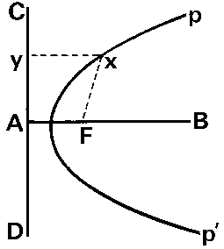
Facility Segmentation:
An enriched U parable
2019 DOE Accelerator Safety Workshop
John Houck
Senior Facility Representative, Argonne Site Office
Notes:
Parable – Not a fabulous story with religious overtones, rather more related to parabola – a curve that arises from a point source and a linac co-existing when both need to use Enriched U
How many familiar with segmentation? a nuclear safety concept in the hazard categorization practice – accelerator exemption

Slide 2
Why Segment?
Older facility, Building 211 two accelerator facilities, one radiation generating device (RGD, the “point”).
Accelerators: 60 MeV electron linac (the “line”) & 3 MeV electron Van de Graaff - two SADs
RGD: Sealed tube neutron generator – meets DOE O 420.2C exemption, LMS-PROC-109 Procedures, Training, Interlocks, Postings
RGD & Linac both use enriched U, total quantity challenges Argonne inventory limits for nuclear criticality control
CHOICE: Implement an alt std (ANSI-ANS-8.1) for this one building OR Perform analysis and request segmentation.
Notes:
420.2C, § 3.C.1(c) X-ray generators (below 10 MeV) or neutron generators (accelerating potential below 600 keV) that are bench top in size and that have a single external/extractable beam and a single operator such as those that are operated in accordance with American National Standards Institute (ANSI) N43.3-2008, or National Council on Radiation Protection and Measurements
(NCRP) Report 72-1983 or other applicable Program consensus standard;

Slide 3
What is Segmentation?
Radiological Safety 10 CFR 835
Physical Separation ** between “segments” such that:
  Separation or features preclude interaction of material from different segments, i.e.
    No common ventilation system, or process piping. . .conduit?
    Neutronic interaction is negligible
    Fire in one segment doesn’t cause failure of another
    Preclusion >> Impossible (~10⁻⁶/yr)
Facility Safety Procedure 1. Reviewing and Approving Nuclear Facility Safety Basis Documentation per SCience Management System, so 10 CFR 830 invades accelerator safety space
**(see DOE-STD-1027-2018, § 3.1.1, 3.2.2)
Accelerator Safety DOE O 420.2C
Nuclear Safety 10 CFR 830 B

Slide 4
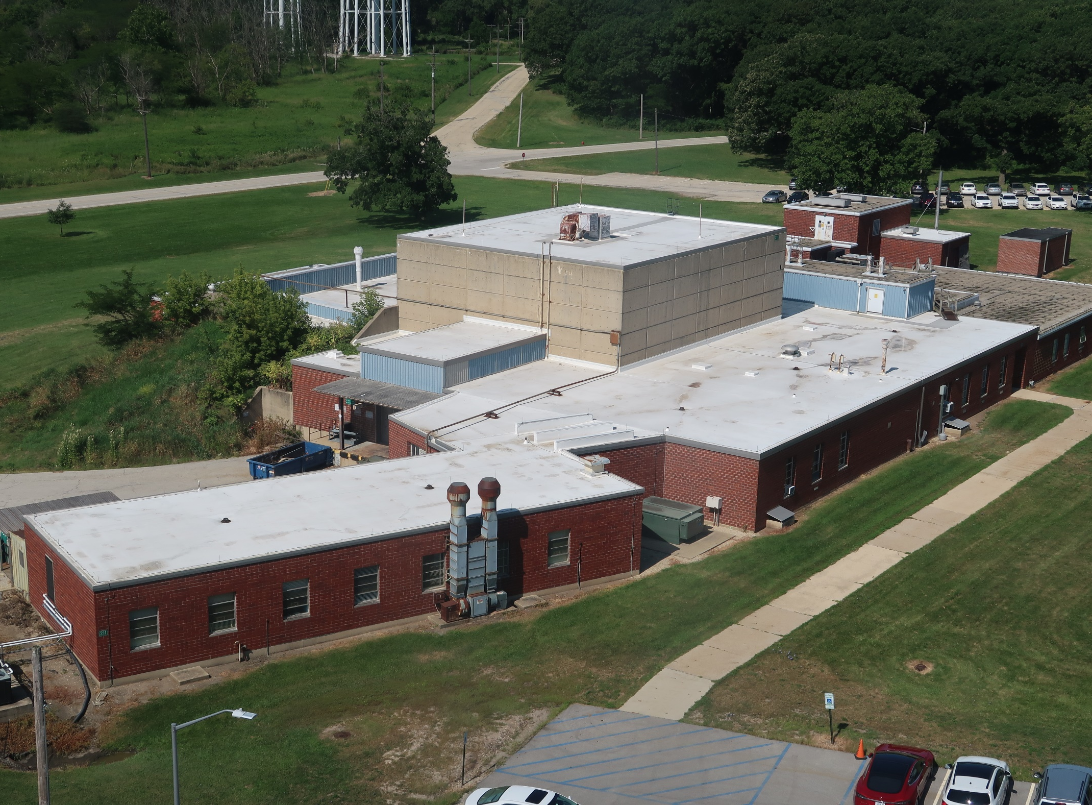
NAUTICUS
LINAC
Linac Segment Boundary
Van de Graaff

Slide 5
Notes:
Above grade floor – linac on W (left) side and NAUTICUS on E (right)
U inventories are stored, used in below grade areas of each facility

Slide 6
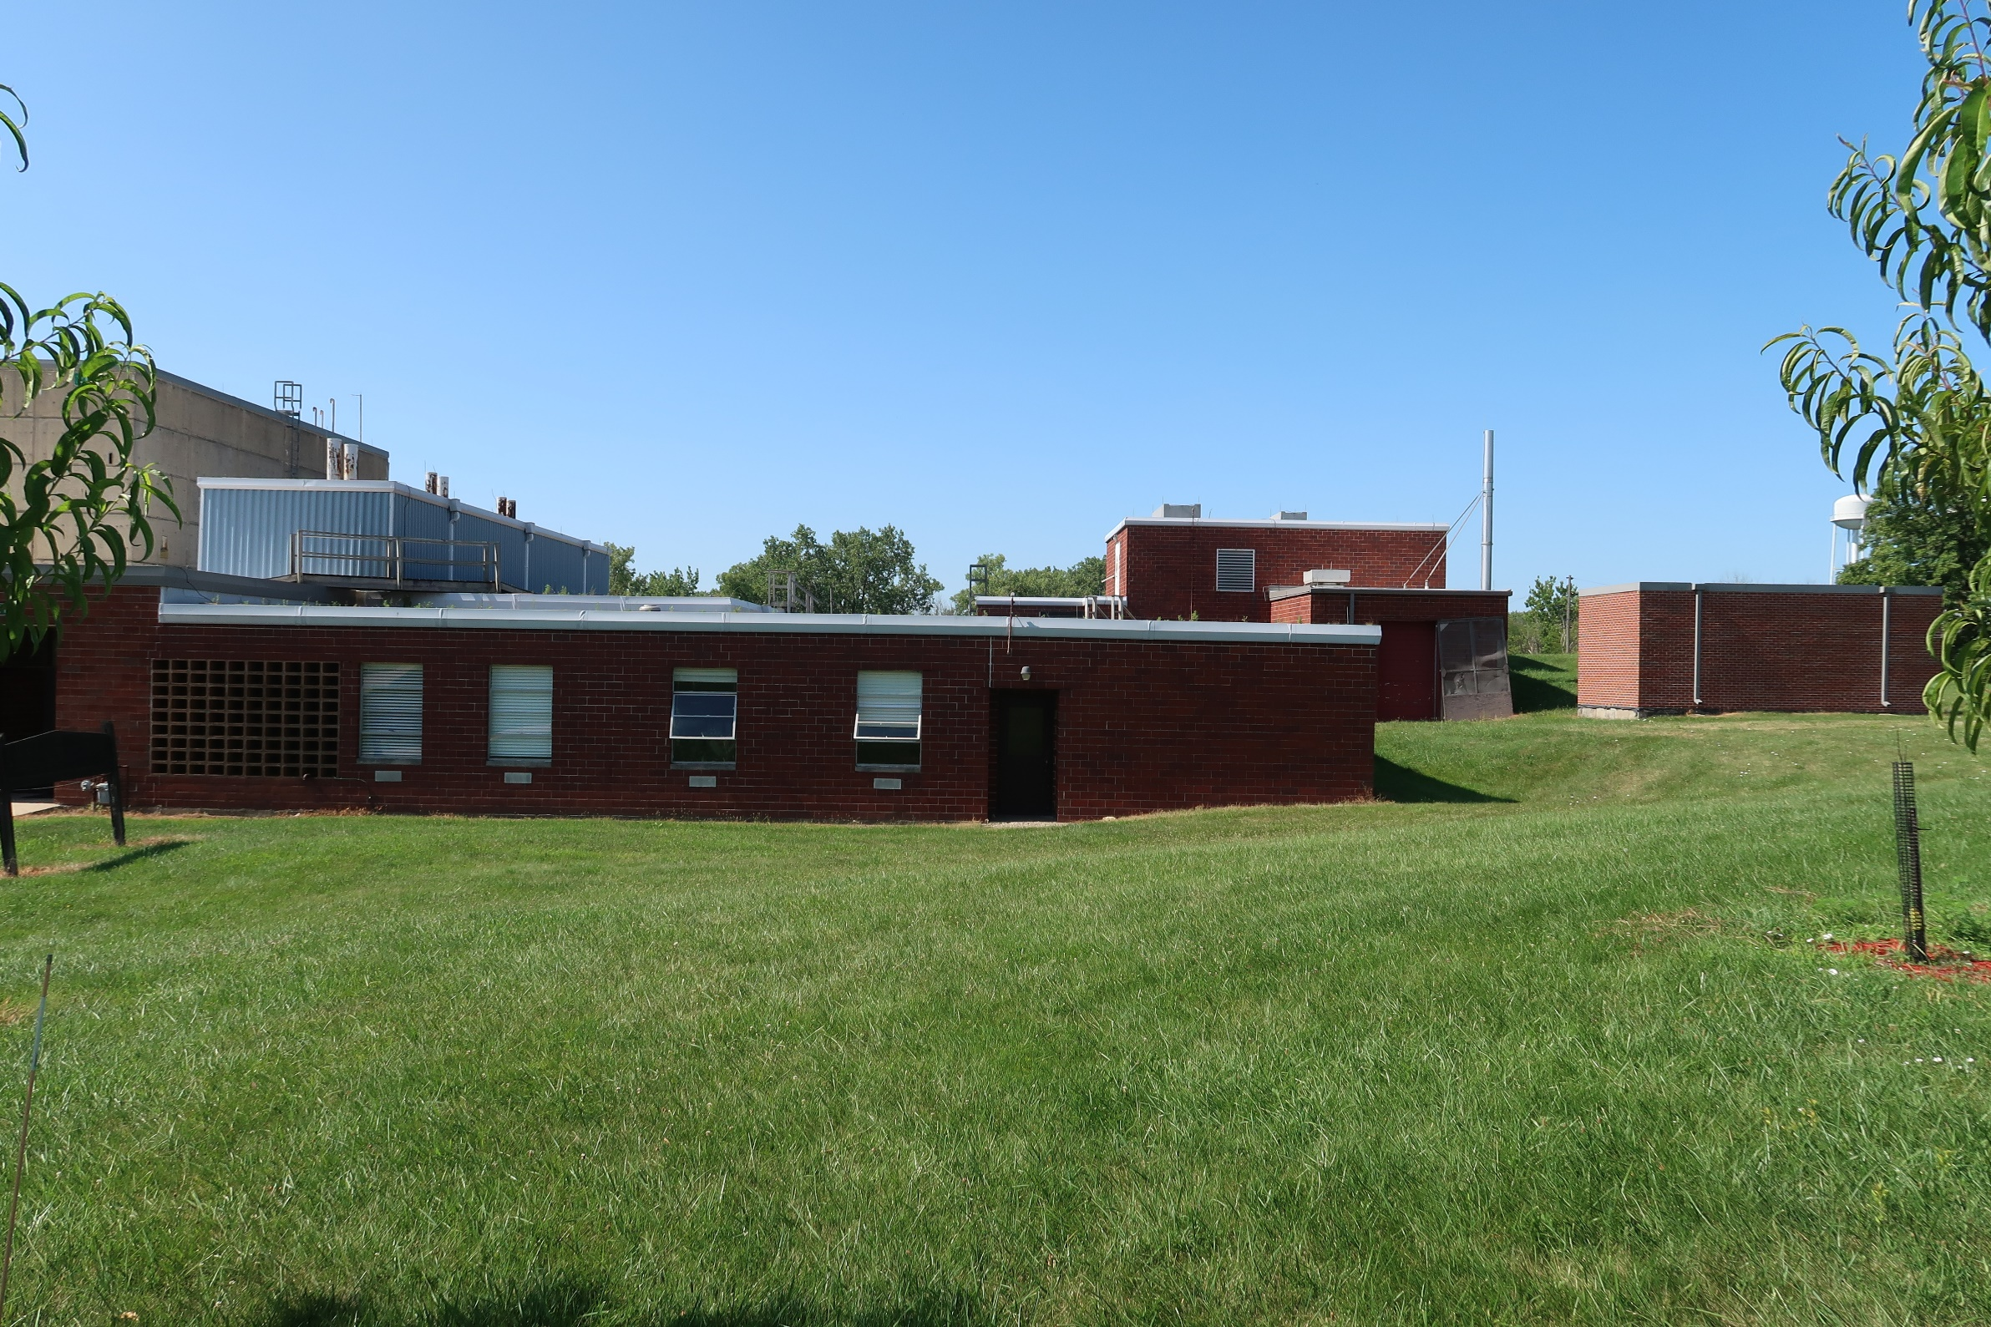
D-024 Stack
LINAC Segment (except hallway toward us)

Slide 7
Ground = Below grade
Stack
Notes:
Note all the unexcavated areas – these were key features to a successful segmentation analysis

Slide 8
How to create a Segment?
Evaluate current and possible separation features and energy sources that could create interaction across separation:
  fire, natural phenomena (seismic, derecho), high-pressure, explosion
Upgrade separation features to segmentation boundaries
  Designate boundary wall(s),
  Sever and seal fluid systems, e.g. drains, condensate,
  2-hr fire barrier for ALL boundary penetrations,
  Maintain the boundary through modification control, inspections.

Slide 9
Segment Approval & Maintenance
In Bldg 211, pressurized cooling water and electrical conduit are OK, but:
Unexcavated earth was the key to DOE acceptance!
Segmentation Process:
  Prepare analysis, establish boundary,
  Submit to DOE Site Office (approval cycle time depends on Nuclear Safety track),
  Obtain DOE Site Office approval (with an SER)
  Maintain segmentation boundary – labels, inspections,
  Maintain Segmentation Evaluation consistent with facility configuration/hazard profile.

Slide 10
Backup Slides

Slide 11
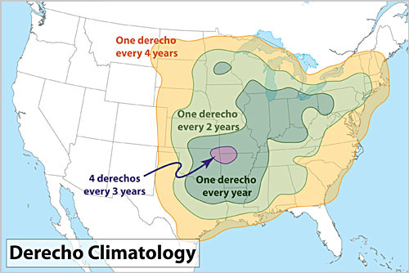
Derechos can occur anywhere, but are most commonly identified in North America.
Climate change will not affect intensity, but is frequency curves are anticipated to shift poleward. Only one derecho has been recorded north of 60° latitude. https://www.spc.noaa.gov/misc/AbtDerechos/derechofacts.htm#climatology

