Slide 1
ESS Safety Readiness for Operations
Peter Jacobsson
Head of Environment, Safety & Health
Thomas Hansson
Senior Engineer, Radiation Safety
www.europeanspallationsource.se

Slide 2
Outline
ESS project
ESS Licensing
The purpose of a Safety Readiness Review (SRR)
Lessons learned from SRR-1, July 2018
Improvements made for the SRR for Test Stand 2 (TS2), August 2019
Ideal approach for gradual commissioning
Set of documents reviewed during the SRR for TS2
Outcome of the SRR for TS2 and the next step

Slide 3
ESS basic design principle
Target Station:
- He-gas cooled rotating W-target (5MW average power)
- 42 beam ports
High Power Accelerator:
Energy: 2 GeV
Rep. Rate: 14 Hz
Current: 62.5 mA
16 Instruments in Construction budget
Committed to deliver 22 instruments by 2028
~30-100 higher performance than at ILL
Ion Source
Total cost: 1843 MEuros ₂₀₁₃

Slide 4
ESS Schedule
2013
2014
2015
2016
2017
2018
2019
2020
2021
2022
2023
2024
2025
Jun 2014
Sep 2016
Oct 2017
Dec 2019
Jan 2021
July 2022
Dec 2025
Ground break
First installations on-site (Accelerator)
Start of user program
SOAP
First installations on-site (Target & NSS)
Beam on Temporary Dump
Beam on Dump
First instrument ready for hot commissioning
Last Construction Phase
Instrument handover
to Operations
Beam on Target

Slide 5
Licensing timeline for trial operations
projections Aug 2019
Ref Doc 2019-03-18
Ref Doc 2020-06-15
Ref Doc 2021-02-28
ESS
Submission 2019-07-15
Submission 2020-11-15
Submission 2021-08-01
SRR2
SRR3
SRR4
SRR5
SRR1
RFQ Beam
DTL4 Beam
BoD
BoT
IoS Beam
Klystron test
RF cond
RBoT
TS2b
2018
2019
2023
2019
2022
2021
2022
2020
2021
2020
IoS
permit
Conditional permit
Conditional permit
Conditional permit
Warm LINAC trial operation review
SC LINAC trial operation review
Intentional neutron production trial operation review
SSM
RFQ – Radio Frequency Quadropole
BoD – Beam on Dump
BoT - Beam on Target
RBoT - Ready for Beam on Target
PSAR – Preliminary Safety Analysis Report
SRR - Safety Readiness Review
SSM – Swedish Radiation Safety Authority

Slide 6
Safety Readiness Review (SRR)
The purpose is to review readiness to safely commission/operate.
The SRR is primarily intended for activities involving the proton beam, but could in specific cases also be applied for other systems.
The SRR is an independent review of the safety aspects, performed after the Test Readiness Review (TRR) or corresponding activity.
It is a process by which HARDWARE, PERSONNEL and PROCEDURES associated with commissioning/operation are verified.
The scope is safety, both conventional safety and ionizing radiation.
The ownership of the process lies within ESH division.

Slide 7
Inputs
Design descriptions
Architecture description
Concept of Operations
Requirements Specification
Interface descriptions
Integration Plan
Operation and maintenance documents
Verification Plan
Risk assessment
CE marking/Declaration of Conformity

Slide 8
History
First SRR (SRR1), was for the Ion Source and LEBT, July 2018
SRR-1 Committee report
First beam from the Ion Source, roughly 6 weeks later..
Decision to do a SRR for our Test stand performing test of klystrons (Test Stand 2)
Together with internally gained experiences, lessons learned meetings and also discussions working our way through received recommendations from ESHAC and the SRR reports.
The SRR for the test stand was conducted 30 and 31 of August 2019, chaired by John Anderson leading a committee of in total 6 persons (2 internal staff)

Slide 9
Improvements made for SRR TS2 (Test Stand 2)
Clarifications in the governing documents; ESS-0123091 rev 2 and ESS-0177837 rev 3
Identify involved systems and the breakdown structure 6 months in advance.
Necessary to daily and more clearly state and implement work according to ESS-0016468 (Classification) and ESS-0041755 (Hazard analysis).
Identify needed SRR committee competencies 3 months in advance.
Start weekly SRR in-house preparations at the latest 3 months before SRR-2.
Review documents available for the SRR committee 2 weeks in advance.

Slide 10
Ideal approach for gradual commissioning
System owner responsible.
Scope: Performance and safety
proton beam commissioning
TRR
SRR
Verify C+D = Complete system
Commissioning
SRR
ESH coordinates independent review
Scope: Safety
TRR
Integrate C+D = Complete system
(install)
Verify A+B
(testing)
Verify D
(testing)
TRR
C
TRR
D
Integrate A+B
(install)
Integrate = install
Verify = test/commision
Verify A
(testing)
Verify B
(testing)
TRR
A
TRR
B
Installation

Slide 11
Ideal approach for gradual commissioning
Draft
Understanding
December 2018
Integrate = install
Verify = test/commision
SRR
Commissioning
TRR
TS2
Verify Cryomodule, including
insulation vacuum and
beam vacuum
Integrate Bunker + CDS valve box + Signal cabling + LLRF + RF distribution + Medium temp circuit = Cryomodule with insulation vacuum and beam vacuum
Verify
Bunker
Verify
CDS
Valve box
Verify
Signal
cabling
Verify
RF
distribution
Example
TRR
Bunker
TRR
CDS valve
box
TRR
Signal cabling
TRR RF distribution
Documents required | Bunker | Shielding | PSS
Design descriptions
Architecture description
Concept of Operations
Req. Spec, incl. Hazard identification
Classification doc (rad safety)
Interface descriptions
Integration Plan
Operation & maintenance documents
Verification Plan
Verification Report
Validation Report
CE marking / Declaration of conformity
Other documents
Integrate
Klystron + Medium temp circuit
Integrate
Shielding + PSS
Verify
Klystron
TRR Klystron
Integrate
PSS + LLRF + Modulator + Medium temp circuit
Verify
LLRF
Verify
Modulator
Verify
Shielding
Verify
PSS
Verify
Transfer Line
TRR LLRF
TRR Modulator
Integrate
Power cabling
+ Medium temp circuit
TRR
Shielding
TRR
PSS
TRR
Transfer Line
Integrate
ICS controls + LLRF
Verify
Power cabling
Verify
Medium temp circuit
Verify
Cryoplant
Verify
ICS controls
TRR Power cabling
TRR Medium temp
circuit
TRR
Cryoplant
TRR ICS controls
Verify
Electrical
substation
Verify
LCW
substation
TRR Electrical substation
TRR LCW substation
Installation

Slide 12
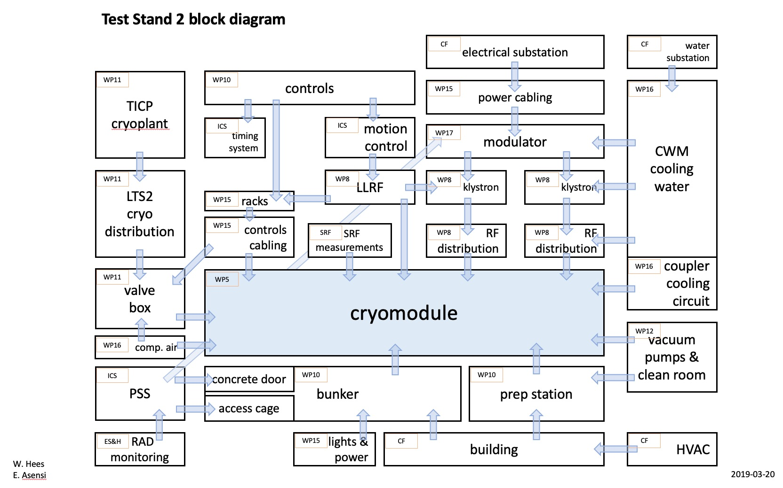
TS2 and involved sub-systems

Slide 13
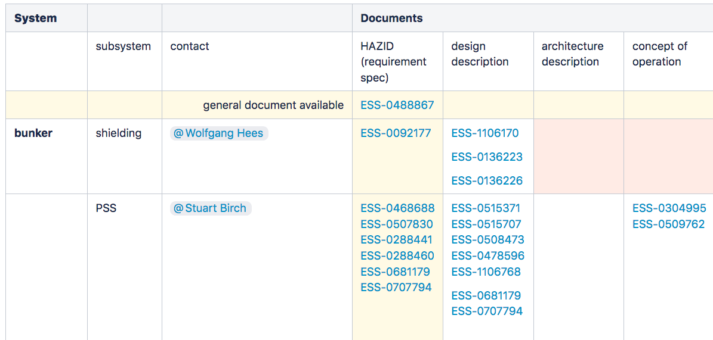
Set of documents to be reviewed, 1(2) TS2 Document Matrix at Confluence

Slide 14
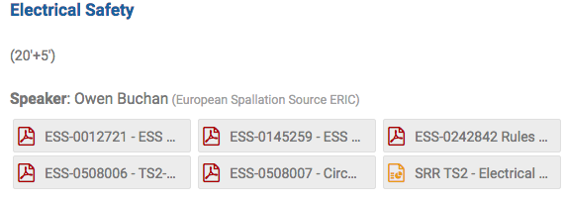
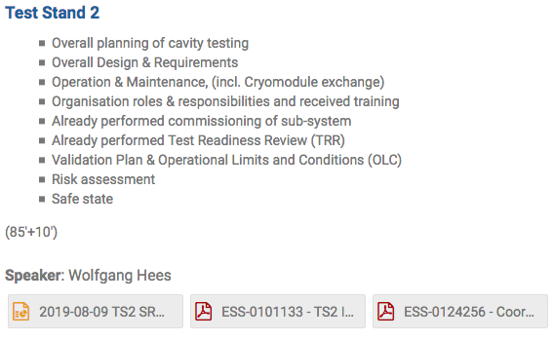
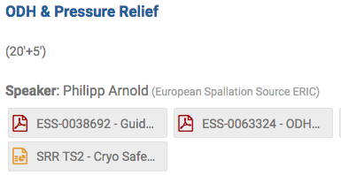
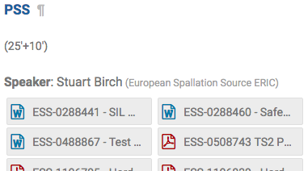
Set of documents to be reviewed, 2(2) TS2 presentations and belonging references at Indico
Identified safety measures

Slide 15
Outcome of the SRR for TS2
SRR report with:
Pre-start items
Post-start items
SRR committee report conclude that the Test Stand 2 would be ready for commissioning if the pre-start items are done.
ESS follow-up meetings after the SRR for TS2 are already scheduled. ESS to start the commissioning by the end of September.
ESS start-up meetings for SRR-2 for the Normal Conducting Linac (NCL) to be scheduled asap, with the ambition to start in early September.
First dialogue held with NCL Machine Section Coordinator April 2019.

Slide 16
Reflections from our TSS committee chair
System documentation has improved since the first SRR
Typical minor document inconsistencies
Nothing that was of a significant concern
Roles and Responsibilities better defined for TS2 SRR
Electrical coordination
Test stand commissioning coordination
System installation continues to be of the highest calibre
Quality of work is excellent
Housekeeping looked very good
Delays in component deliverables causing schedule pressures
Need to resist temptations to operate with compromised systems to the extent possible
If system changes are required, changes need to be fully reviewed, accepted and approved
Additional effort is needed to better establish commissioning plans and procedures necessary to support commissioning activities
Work toward process driven vs expert driven systems
Promotes a common direction and understanding
Fosters reduced unwanted outcome

Slide 17
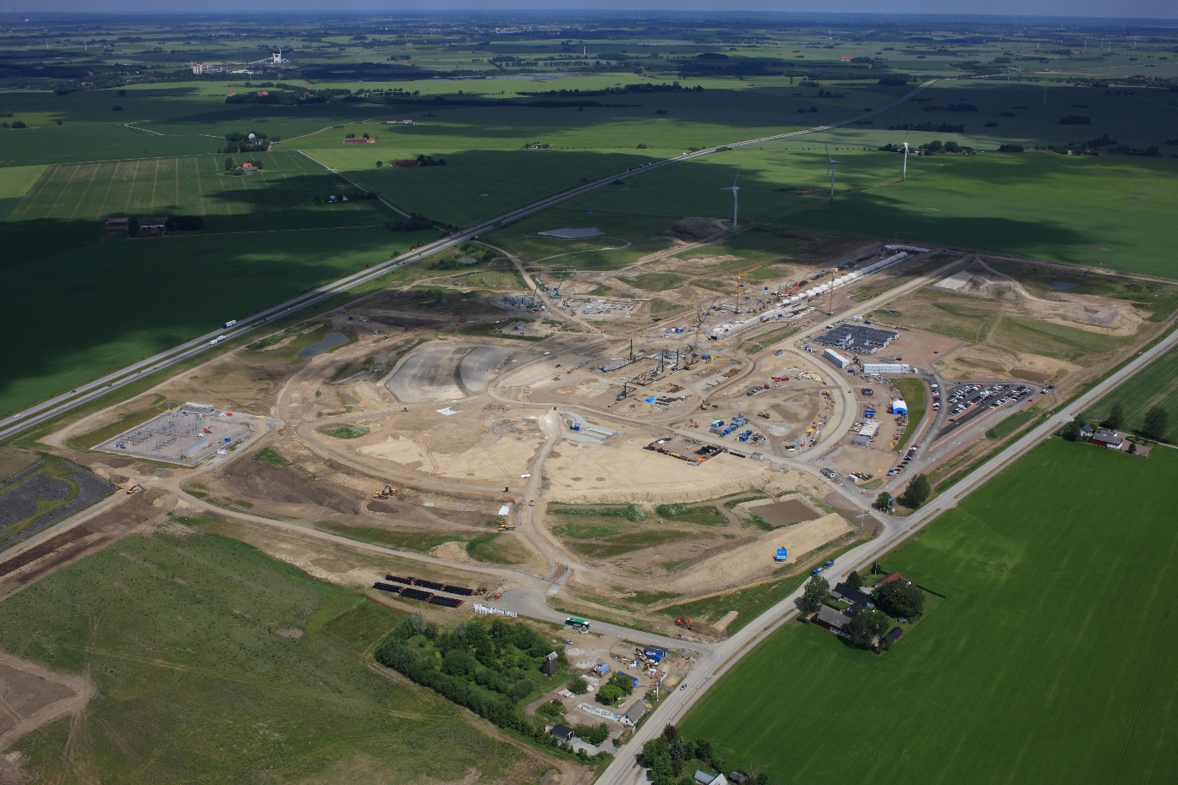
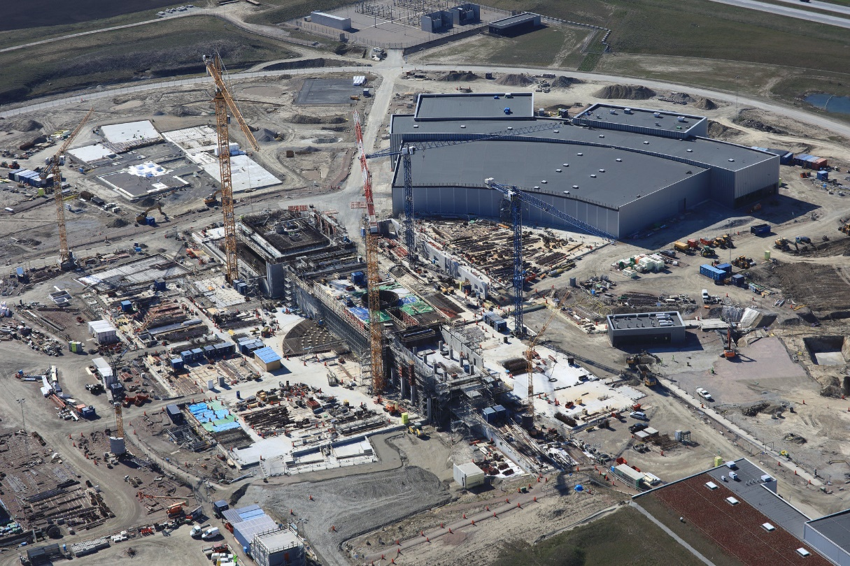
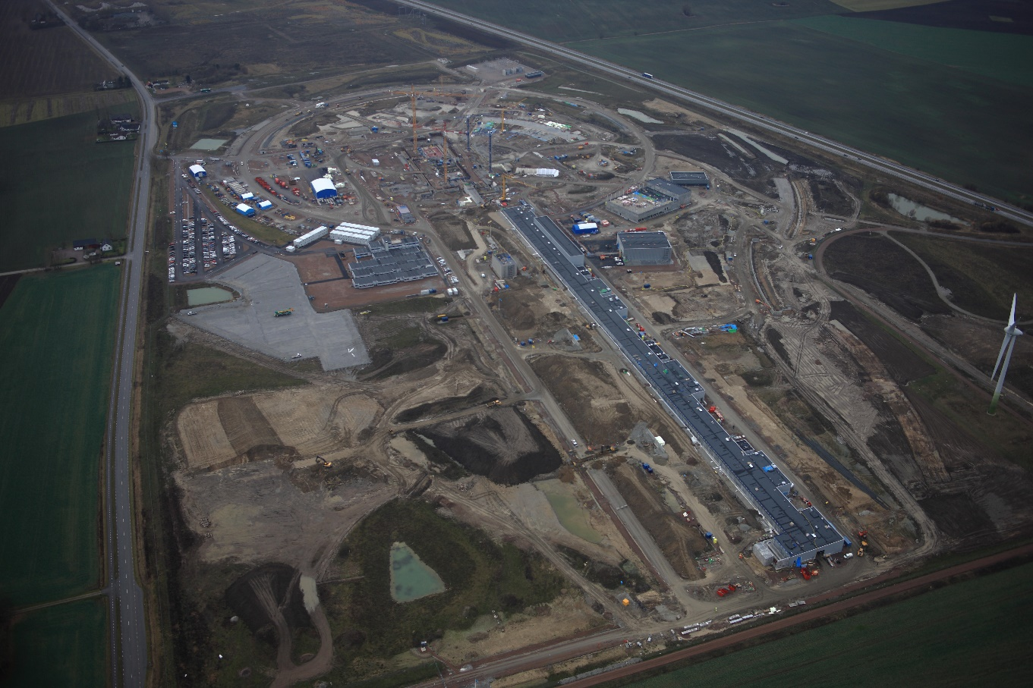
ESS – Aerial photographs

