Slide 1
Argonne Molybdenum Research Experiment (AMORE) Accelerator readiness Review
Accelerator safety workshop 2019
erhtjhtyhy
Sergey Chemerisov
Facility Manager
IVEM/LEAF
September 11, 2019

Slide 2
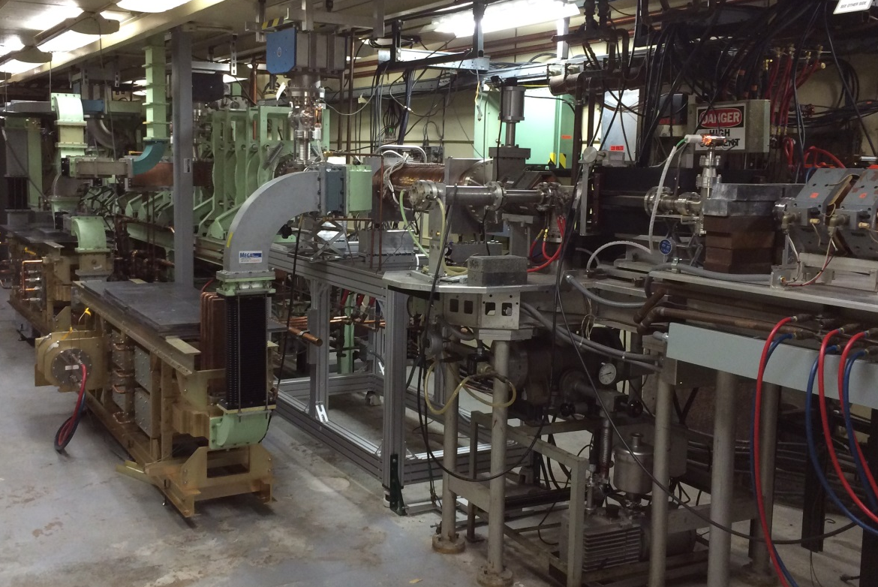
Outline
Background information
AMORE ARR
Planning
Execution
Findings
AMORE Commissioning

Slide 3
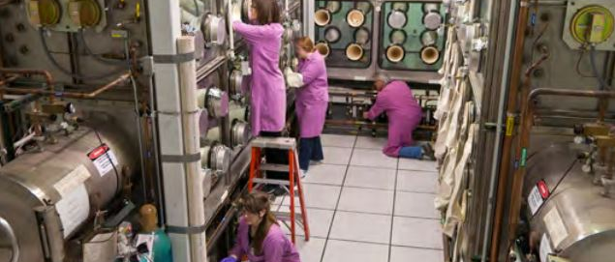
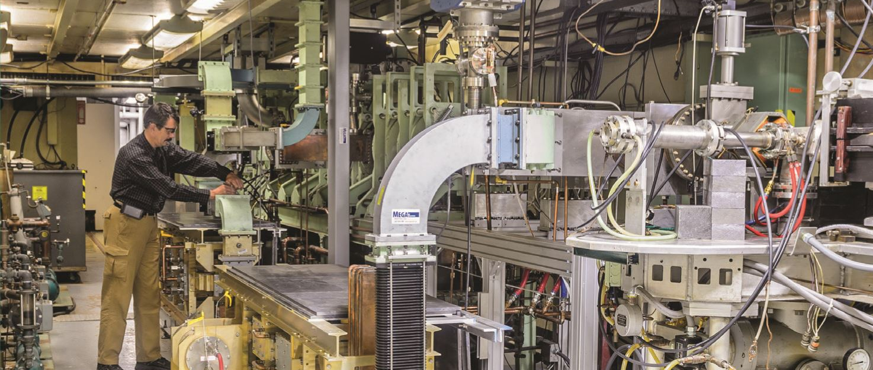
Radiochemistry research at Argonne
Materials characterization
Chemical process development and engineering
Nuclear fuel development and qualification
55 MeV/25 kW electron linear accelerator (Linac)
Radioisotope production for medical, national security, basic science, and industrial applications

Slide 4
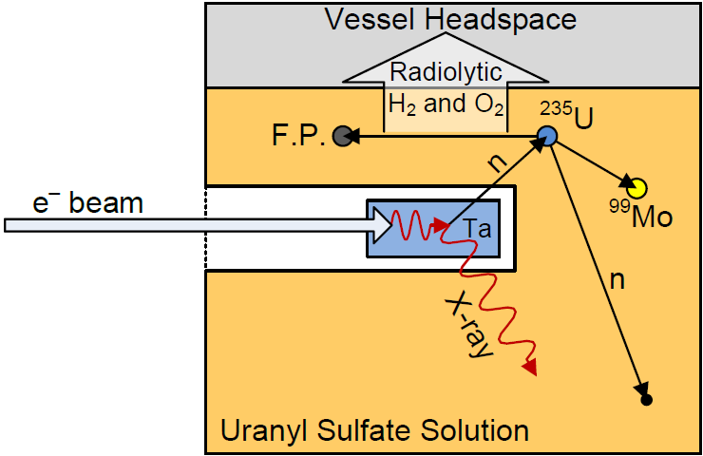
AMORE overview
Experimental parameters
20 L solution will be irradiated with neutrons generated in a depleted-uranium (DU) target
Up to 20 Ci of Mo-99 will be produced
Purpose of the experiment
Development and design of the Mo-recovery and purification systems
Developing an understanding of radiolysis effects on solution chemistry, gas generation, and precipitation
DU

Slide 5
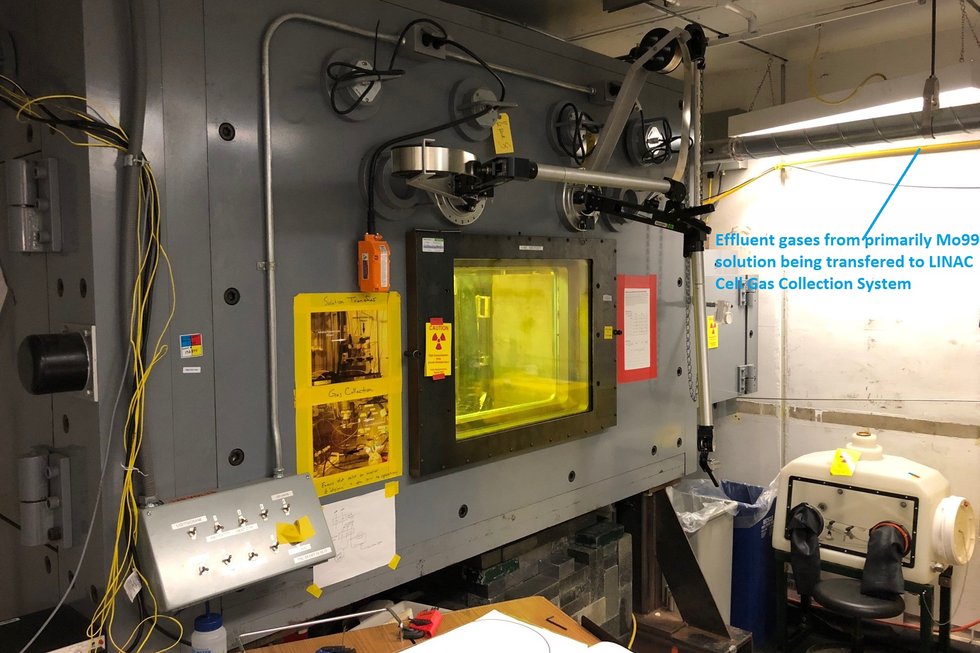
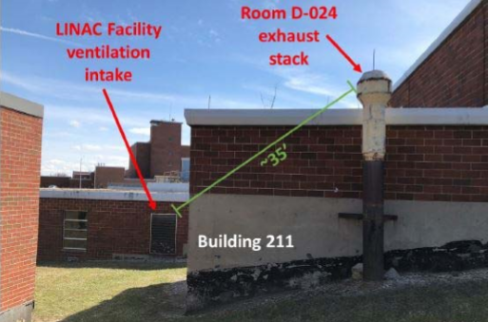
Fission Gas Release Event
March 9, 2018: Hot cell processing following scale-up of AMORE
Vessel containing solution inadvertently vented when pH probe removed
Fission gases released out the stack and re-circulated back into facility
Radiation monitor in facility showed elevated background radiation levels
Personnel removed from area and monitored – no dose assigned
Resulted in positive USI and pause of Linac ops

Slide 6
Revised Safety Analysis
Expanded Process Descriptions
Provides greater detail of liquid separation and transfer processes
Defines interfaces of Gas Collection System (GCS) with other systems
Updated Hazard Analysis
Applied similar methodology as used in Hazard Category (HC)-3 DSAs

Slide 7
Revised Accelerator Safety envelope
Credited Controls
Personnel Safety System (PSS)
Gas Collection System (GCS)*
AMORE Process Beam Interlocks*
Linac Shielding*
Linac Facility Segmentation Boundary*
AMORE Experimental Parameters*
Fissionable Material Inventory Limit*
Beam Limits
*denotes controls that were most significantly changed since the previous revision of the ASE and warrant additional focus during the review

Slide 8
Revised Accelerator Safety envelope
Safety Management Programs
Procedure Generation, Review, and Implementation*
Fire Protection Program
Hydrogen Monitoring
Fire Suppression System
Combustible Material Control
Radiation Protection Program
Supplemental Radiation Monitoring*
Process Exhaust Ventilation with Silver Zeolite Filtration*
Quality Assurance
Configuration Management*
Safety Organization Roles and Responsibilities
Waste Management
Training and Qualification*

Slide 9
Configuration Management
A new configuration management (CM) program was written
Consistent with DOE-G-420.2-1A
Also consulted DOE-STD-1073-2016 for further guidance
New control mechanisms include:
Special labeling/signage in the facility
CM work permit
Personnel trained
Facility workers (more in-depth)
Users (awareness level training)

Slide 10
Assessment Team and observers
Review team
Observers
Bill Beach, Team Lead
Wayne Schmitt, FNAL
Bob Jubin, ORNL
Dick Werbeck
Michael Epps, DOE-SC
Maria Dikeakos, BHSO
Joe Cracco, BHSO
Patrick Sullivan, BHSO
Lee Hammons, BNL
Jessica Malo, PPPL

Slide 11
Assessment purpose
Inadvertent fission gas release event last March led to voluntary pause of Linac operations
All Linac operations have since been restarted with the exception of AMORE
The purpose of this assessment is to confirm readiness to restart the AMORE work
Assess readiness to restart utilizing criteria from DOE-G420.2-1A
Overall approach
Review of SAD, ASE, and implementing procedures
Interviews of LEAF and AMORE management and staff
Walk-down of AMORE project areas

Slide 12
Accelerator readiness review schedule
Day 1: Monday, April 29
Presentations
Event and lessons learned
Experiment Overview
Facility Overview
Facility Tour
Interviews, procedure walkthroughs, etc. as determined by team
Day 2: Tuesday, April 30
Interviews, procedure walkthroughs, etc. as determined by team
Day 3: Wednesday, May 1
Interviews, procedure walkthroughs, etc. as determined by team
Development of findings and conclusions
Out-brief at 16:00

Slide 13
OVERALL RESULTS or readiness review
The team recognizes the amount of work and effort put into improving procedures and processes
Good team of people who want to move forward-experienced and committed to the improvements
Management team is cohesive and, rightfully so, proud of the accomplishments made to date
Two Pre-start issues, one post-start issue, several observations and several opportunities for improvement

Slide 14
results
ARR Criteria from DOE G 420.2-1A
Item | Criterion | MA Result
1 | Approved procedures, including an appropriate Unreviewed Safety Issue (USI) process. | Pre-Start
2 | Approved training and qualification program. | Yes
5 | Reviewed and approved SAD adequate to support approval of the ASE. | Yes
6 | Approved ASE, including an effective credited control program. | Yes
9 | Institutional Configuration Management (CM) program for safety systems/programs and credited controls. | Yes
11 | An acceptable SAD developed in accordance with DOE Order 420.2C that has been reviewed and approved by contractor management. | Yes
12 | An acceptable ASE developed in accordance with DOE Order 420.2C. | Yes
13 | Roles and responsibilities are clearly defined for activities under the ASE , including those for training and procedures as related to accelerator safety. | Yes
14 | An appropriate Unreviewed Safety Issue (USI) process is developed in accordance with DOE Order 420.2C. | Yes

Slide 15
results
ARR Criteria from DOE G 420.2-1A
Item | Criterion | MA Result
11 | An acceptable SAD developed in accordance with DOE Order 420.2C that has been reviewed and approved by contractor management. | Yes
12 | An acceptable ASE developed in accordance with DOE Order 420.2C. | Yes
13 | Roles and responsibilities are clearly defined for activities under the ASE , including those for training and procedures as related to accelerator safety. | Yes
14 | An appropriate Unreviewed Safety Issue (USI) process is developed in accordance with DOE Order 420.2C. | Yes
17 | Equipment and systems having safety importance (including credited engineered controls) meet criteria established in the SAD and have been appropriately tested. | Pre-Start
18 | Facility is in compliance with ASE requirements. | Yes
19 | Facility conforms to the requirements of LMS-PROC-45, Managing Radioactive Material Inventories. | Yes

Slide 16
AMORE Commissioning
Commissioning plan for AMORE was developed
Purpose:
To validate procedures
To test hardware and processes
Plan was reviewed and submitted to DOE ASO with results of ARR
DOE issued the letter permitting commissioning of AMORE
AMORE commissioning was completed on August 16
Commissioning report and request for resuming routine operations was submitted on August 30th
Full restart of AMORE is expected in September

Slide 17
questions

