Slide 1
NSTX-U Readiness for Operations
R. Camp
& the NSTX-U Operations Team

Slide 2
Outline
Scope of Readiness
Introduction to NSTX-U
NSTX-U Pre-Operational Testing & Commissioning Plan
NSTX-U Phases Leading to Operation
Readiness of People
Readiness of Equipment
Summary and Questions

Slide 3
What is the goal?
Performance-based Readiness for Operations
Remember the ARR and the ACC (the PPPL internal readiness process) are validations of work already performed
The Scope of Readiness:
People – operator qualifications, training and demonstration
Equipment – subsystem and integrated systems testing to demonstrate operational capability within the authorized limits
Procedures – NSTX-U has a plan to review 200+ procedures for compatibility with ASO

Slide 4
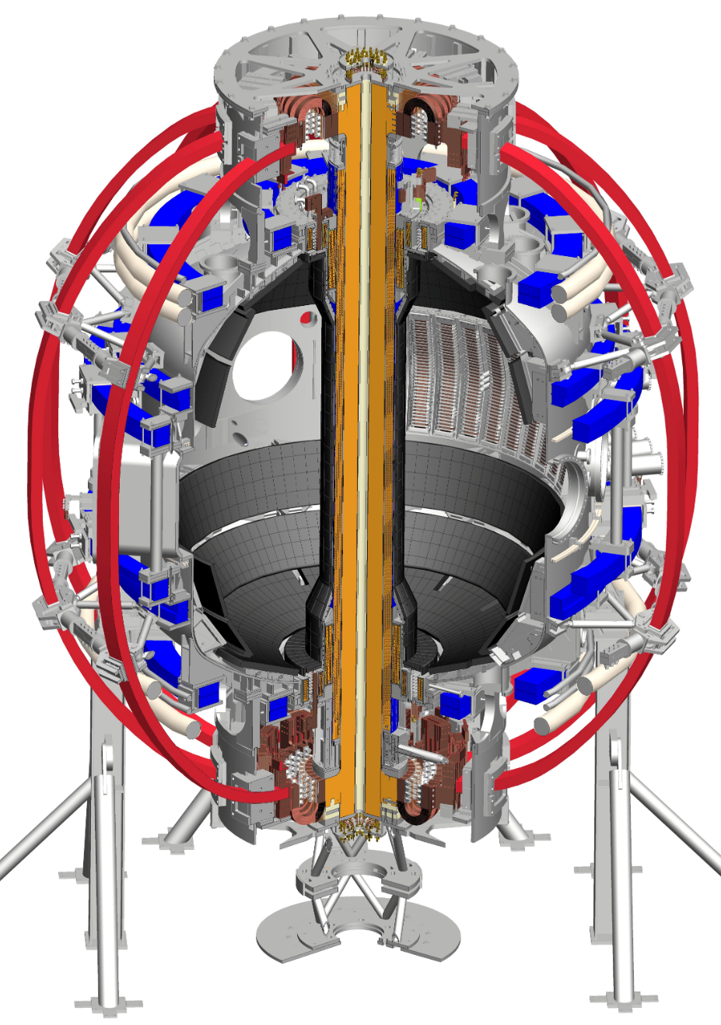
Introduction: Characteristics of NSTX-U
Deuterium-Deuterium Pulsed Plasma Physics Fusion Experiment (Direct Ionizing Radiation only when pulsed)
5 second pulse; 20 minute cycle with upgrade to TF conductors
Experimental campaigns typically 10-20 weeks per year on NSTX
Typical 9 hour run day; 25 shots per day; 5 days/week
Under vacuum and cryo on 6-7 months per research year
Magnetic Confinement
Pulsed, water-cooled, copper-wound electromagnets
Toroidal Field, Poloidal Field, Ohmic Heating, RWM magnets
Up to 2 MA of electrical current flowing in the plasma itself
Background fields on order of 1 T
10-14 MW Neutral Beam heating depending on pulse length
Typically 90 kV accelerating voltage; 100 kV max on NSTX
Up to 6 MW RF heating @ 30Mhz

Slide 5
NSTX-U Pre-operational Testing and Commissioning Plan
Based on the Accelerator Safety Order Implementation Plan (ASOIP) – see J. Malo talk for more info
It is a mapping of the pre-operational phases, with their modes of operation, with the pre-requisite documents and authorizations to proceed.
Covers operations of both the Recovery Project and systems not impacted by recovery.

Slide 6
Readiness Assessment
ARR
Permission to Commission
Permission to Operate
Pre-Operational Testing
Accelerator Pre-Commissioning
Accelerator Commissioning
Routine Operations
MG Startup
Section 6.1.2
FCPC Startup
Section 6.1.6
Single and Paired Coil Pulses
Section 6.2.1
Combined Field Pulses
KPP #3
Section 6.3.2
First Plasma
KPP #4
Section 6.3.3
Development of plasmas generating >10¹⁵ N/day
Section 6.3.4
Dummy Load Testing
Section 6.1.6
Bakeout
KPP#2
Section 6.2.2
RC&P Startup
Section 6.1.3
Routine Operations
Section 6.4.3
Safety System Startup
Section 6.1.5
Auxiliary System Startup
Section 6.1.4
Neutral Beam Low Voltage Conditioning
Section 6.2.3
Neutral Beam High Voltage Conditioning
Section 6.3.1
Neutral Beam PTPs
Section 6.1.1
Neutral Beam Cryogenic System Operations
Section 6.1.1

Slide 7
Comments to Operational Phases
There are a lot of preparation-for-operation activities to get to NSTX-U research levels of operation
None of these activities is new to PPPL
What is new are the authorizations for the phases described in the order and how we defined the various operations for inclusion in the phases.

Slide 8
Readiness of People
There here is a Training and Qualification Plan, covering everyone who must access the experimental site
For NSTX-U Operators, there is a procedure describing each operator position and the training and experience necessary to be Qualified using standardized list of training requirements.
The Challenge of Ageing Operators

Slide 9
Operators Required Training Elements
System Description and Overview
Basic Principles of the System
Purpose of the System
Major Components and their functions within the System
Operations Personnel pertinent to this system’s operation
Supporting Subsystems and Interfaces relative to the system
System drawings, component diagrams of the system
Related systems
Automatic protective features--personnel and/or equipment (engineered control that automatically initiates without op. intervention)
Acronyms and system-specific nomenclature of this system
System Modes of Operation
Routine Modes of Operation and associated procedures
Atypical Modes of Operations (e.g. testing, maintenance, etc.) and associated procedures
System Operations
Operator roles and responsibilities
Pertinent Operating Procedures
Operator Controls
Monitored Parameters and Instrumentation
Expected operating bands
Limits
Protective Feature Setpoints
Off-normal event response procedures
Alarms and Indications
Operator response
Required Operator intervention points

Slide 10
Operators Required Training Elements (cont’d)
Conduct of Operations
Controls
Equipment & Status
Maintenance Activities
Management Oversight
ES&H Practices
Event Investigation & Notification
Interrelated Process Control
2.Communications
3.Documentation & Archiving
Log-keeping
Labeling
Procedure Run Copies
Operator Aids
4.Operations Fitness
Fitness for Duty
Shift Responsibilities
Shift Practices
Operator Rounds
Independent Verification
Shift Turnover
Lockout/Tagout Implementation
Systems Maintenance, Testing, and Inspection Requirements
Access procedures
Safety and Systems Integration
Credited Control/ASO Implications (if applicable)
“Worst Case” outcomes for NSTX-U (Equipment Failure Modes & Operational)
System impact on NSTX-U

Slide 11
Equipment Readiness
Procedure NSTX-02 is the Chief Operations Engineer’s script for demonstrating equipment readiness for Operations: a procedure of procedures
Equipment readiness is demonstrated at the subsystem level by completed maintenance procedures, operations procedures and Pre-operational Test Plans (PTP’s)
Integrated Systems Testing Procedures (ISTP’s) are performed as part of the NSTX-U startup to demonstrate capability, test operational interlocks and achieve key performance parameters of the Recovery Project

Slide 12
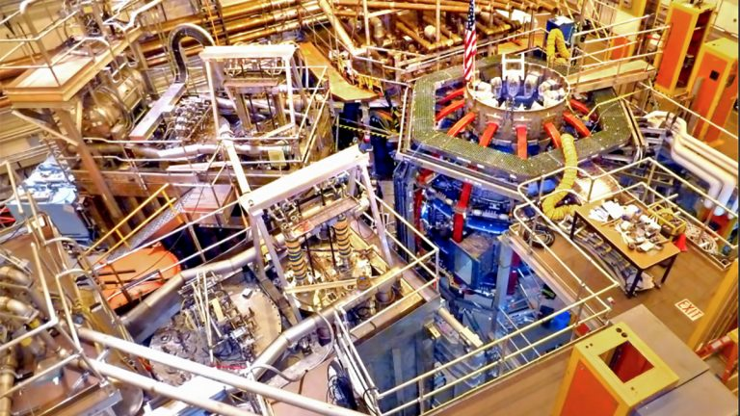
Neutral Beam #1
NSTX-U
Ion Sources
Calorimeter Stands
Beamlines
Neutral Beam #2

Slide 13
Summary
NSTX-U is actively working on preparations and readiness for operations (before construction!)
The Pre-operational Testing and Commissioning Plan lays out the phases of operations – unique to NSTX-U
Planning includes systems for the training and qualification of Operators to demonstrate readiness for operations
Equipment readiness is demonstrated using existing procedures and protocols with provisions for ASO required approvals for operations
Questions?

Slide 14
Backup Slides

