Slide 1
Readiness Verification After a Maintenance Outage
Geoff Milanovich, SNS

Slide 2
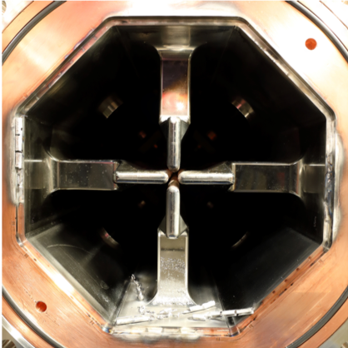
How do we get from this?

Slide 3
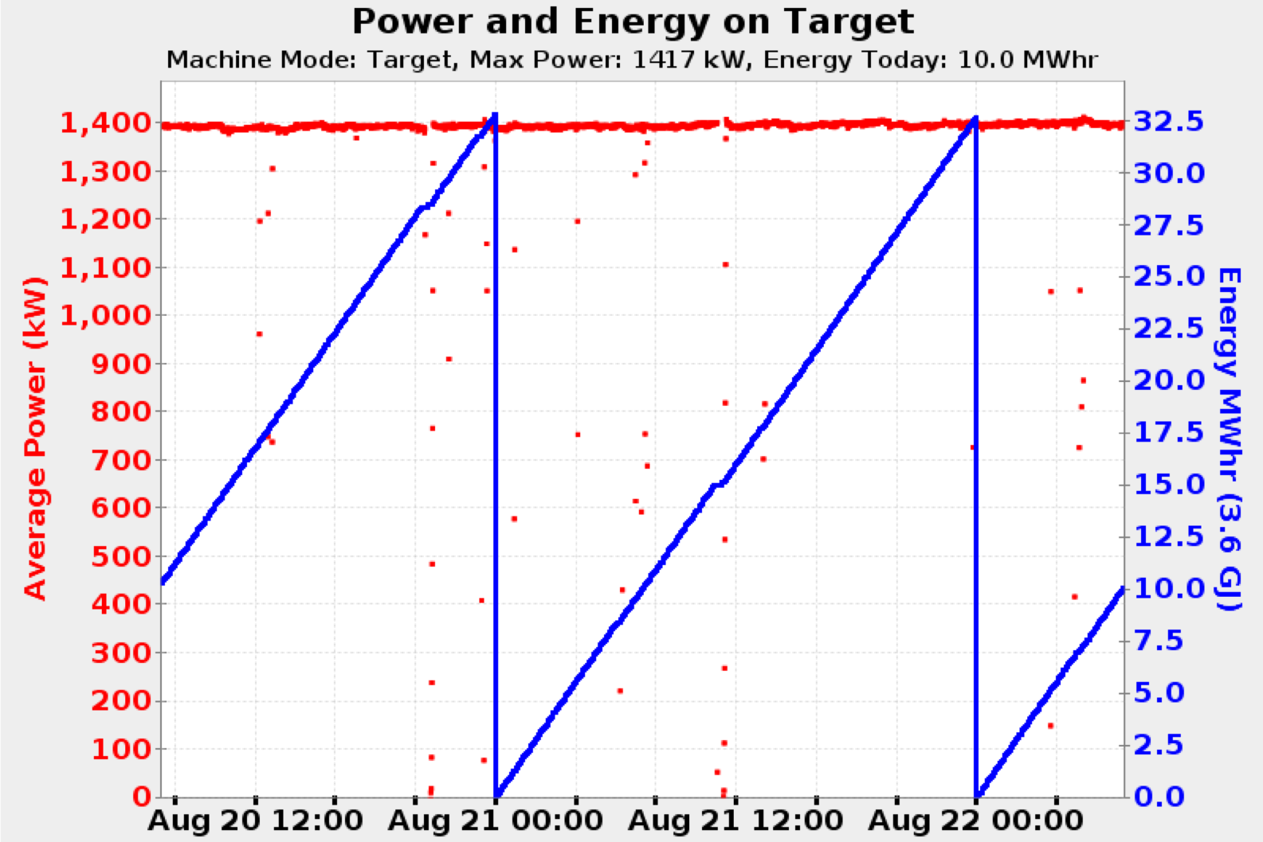
To this?

Slide 4
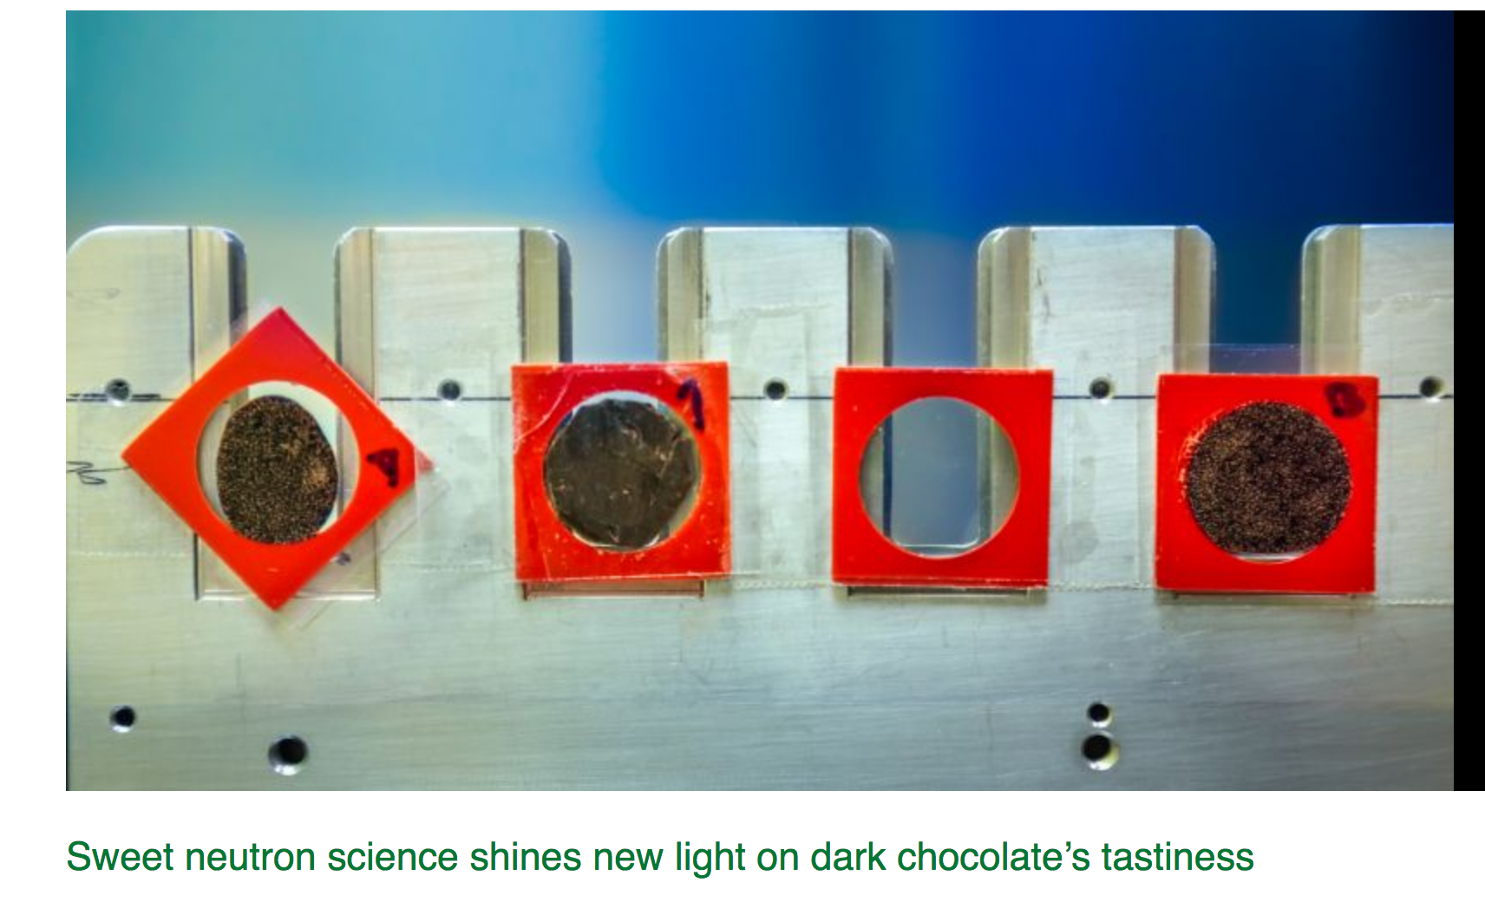
To this?

Slide 5
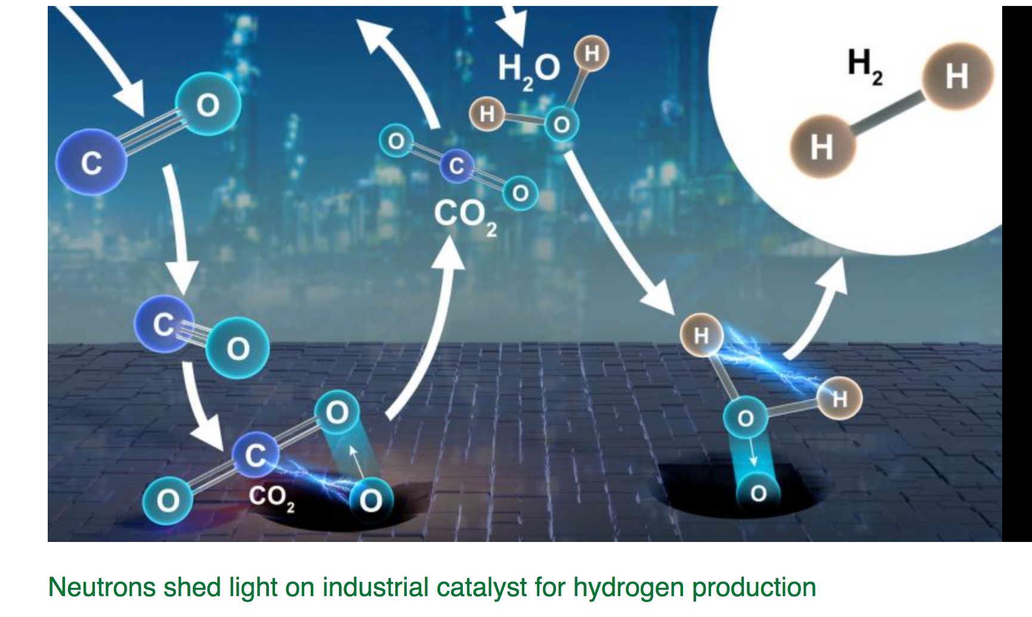
Ok, this.
Journal of the American Chemical Society 2019 141 (19), 7990-7999

Slide 6
Authorization Workflow
Startup Checklists
OPM 6-F.1.1
OPM 7-T.22
< 25 kW on Target
Full power on target
Management Self Assessment
OPM 6-F.1.2
Neutrons on Sample
Instrument MSA
OPM 6-F.2.1
Instrument Checklist
OPM 7-U.*.1
Shutter Open

Slide 7
Accelerator Startup Checklists
Organized by beamstop from ion source to target
Filled out by Ops
Previous beamstop checklist must be completed before next can be fully completed
Exception process exists, requires management approval
Beam on target limited to 25 kW

Slide 8
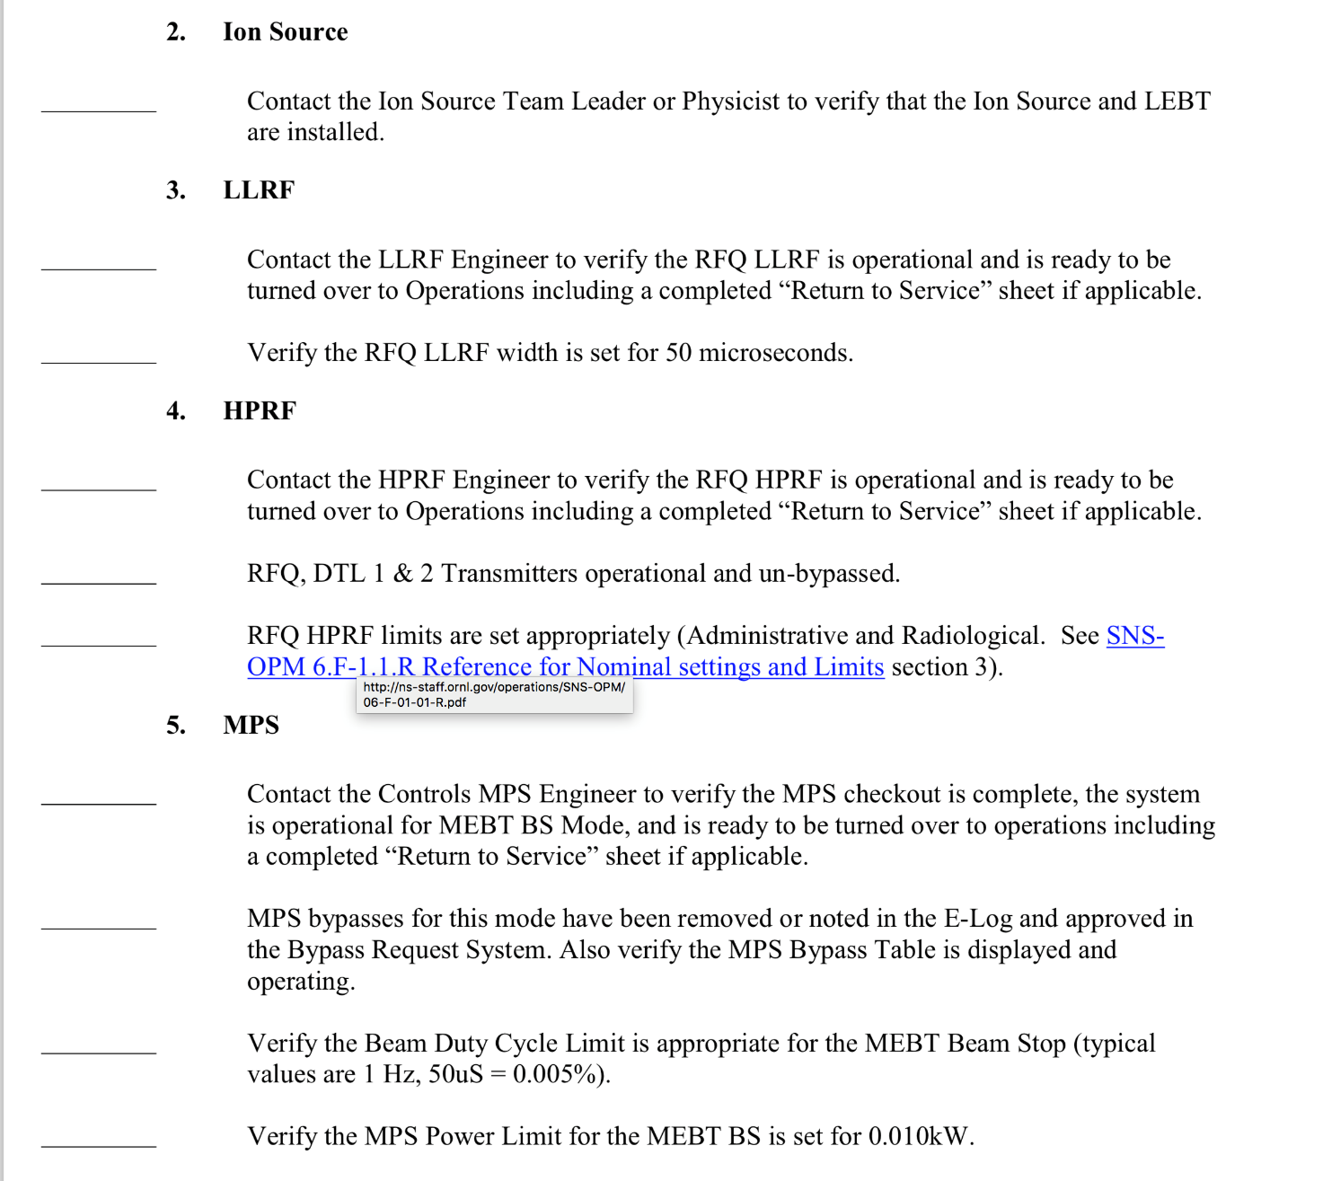
Accelerator Startup Checklists
OPM 6.F-1.1

Slide 9
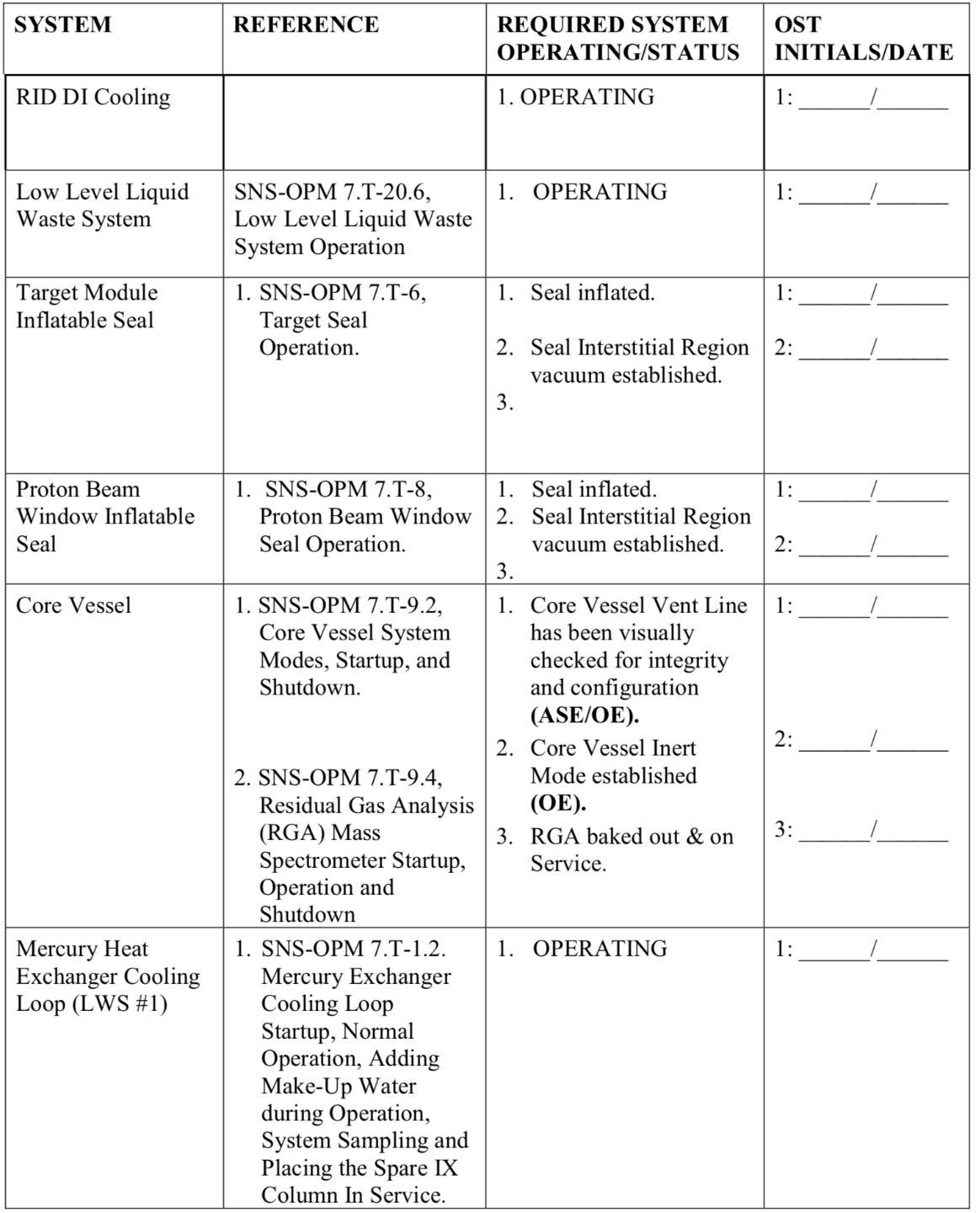
Target Startup Checklist
OPM 7-T.22

Slide 10
Accelerator Management Self Assessment
Management sets operational goal for the run
  Beam Power, Availability
Group leaders present work accomplished, deferred maintenance, risks to operational schedule to a local committee
Sign off that technical systems are ready (separate from operations checklist)
Sign off that safety systems are ready
Upon approval, beam power >> 25 kW

Slide 11
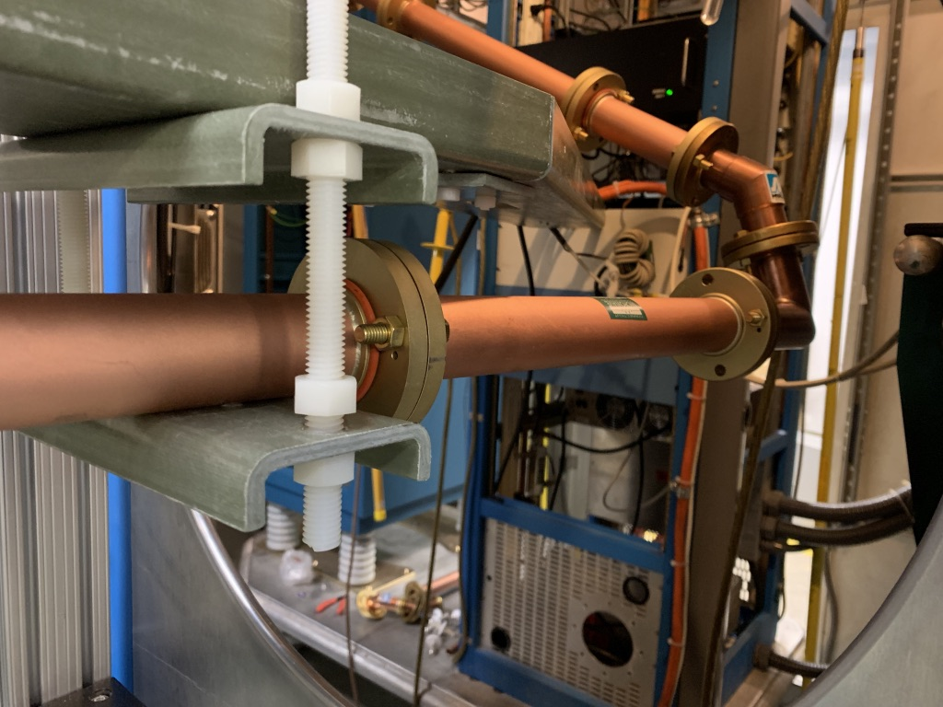
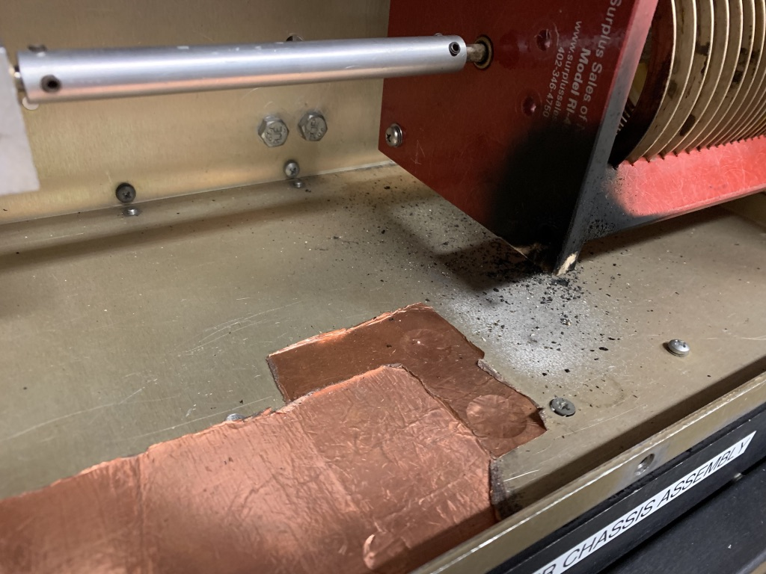
Example slide:
Front End RF Systems (Excluding RFQ)
Replaced RG-218 output cable with rigid coaxial transmission line
  Connects the isolation transformer to the ion source
  Also used in the BTF Ion Source
Performed routine PM and testing on QEI amplifier
Performed routine PM on MEBT amplifiers
Operational Risks
  Medium Risks
    Plasma outages cause high reflected power on 2 MHz system which can cause equipment damage and downtime
    High reflected alarm requires prompt operational intervention
      Working on software control to set power to 0 W
  No deferred maintenance
1-5/8” EIA rigid copper coaxial transmission line
Damage caused by high reflected power

Slide 12
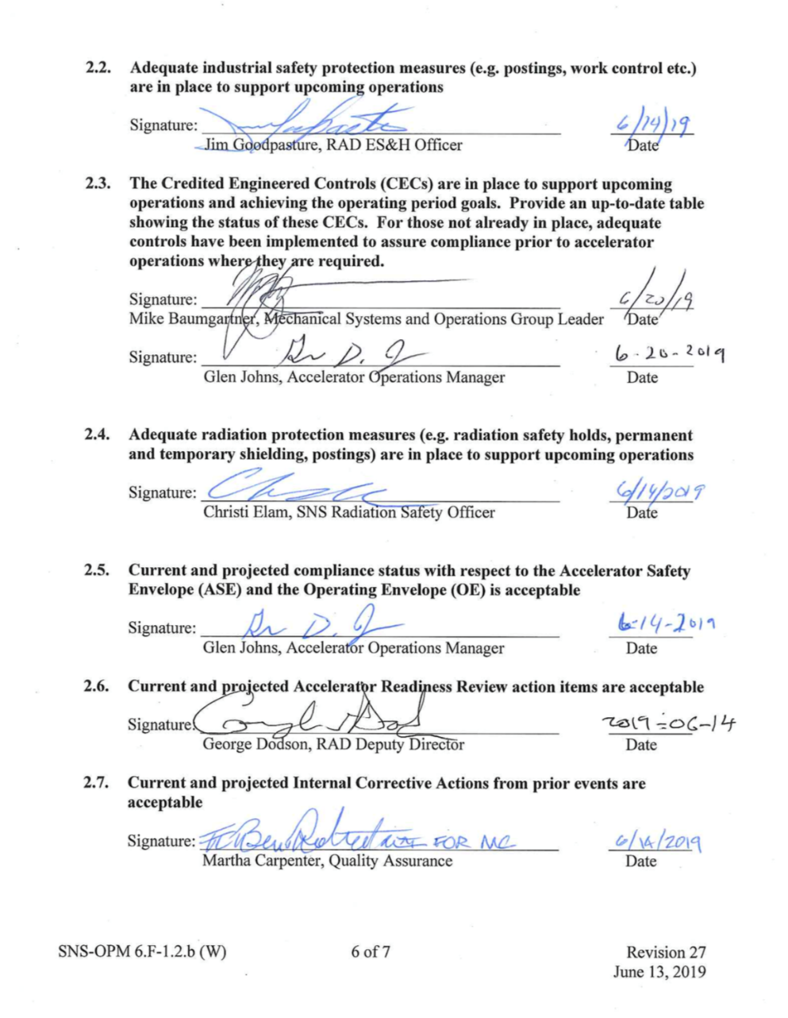
MSA Safety Sign-Offs
ES&H
Credited Engineering Controls
Radiation Safety
ASE and OE
ARR action items
Corrective Actions
fire protection, quality, etc.

Slide 13
Instrument Management Self Assessment
Scientific Associate for each beamline presents work, risks
Sign off that systems are ready (choppers, detectors, etc)
Sign off for instrument hall safety
Instrument Operations Manager signs off final approval

Slide 14
Example instrument MSA slide

Slide 15
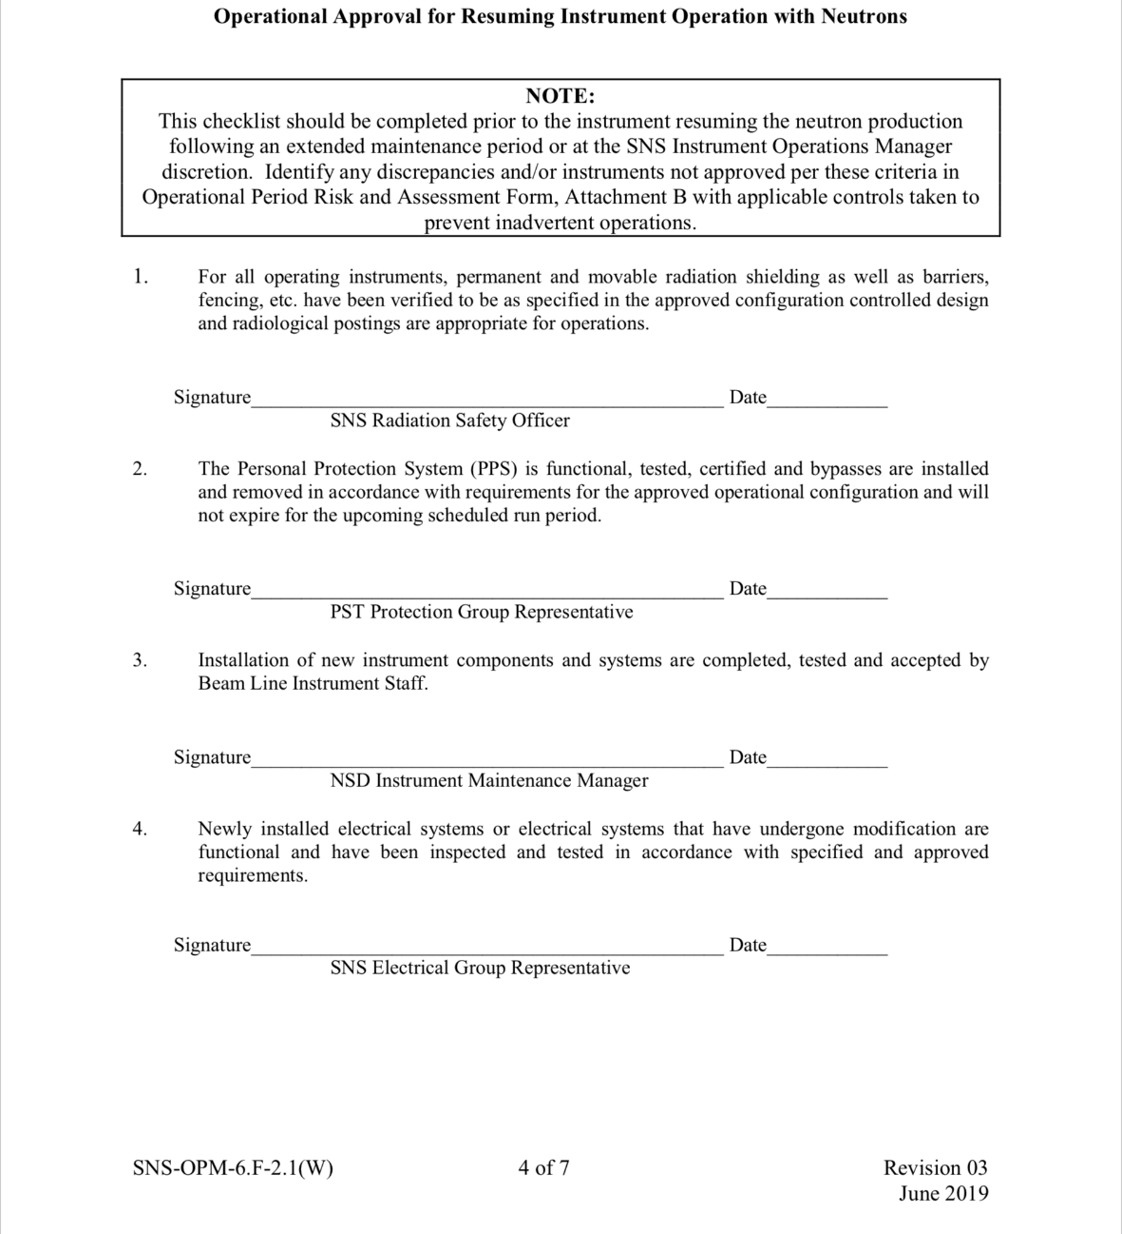
Instrument Hall Safety Signoffs
Radiation Safety
PPS
New Installations
Electrical Safety

Slide 16
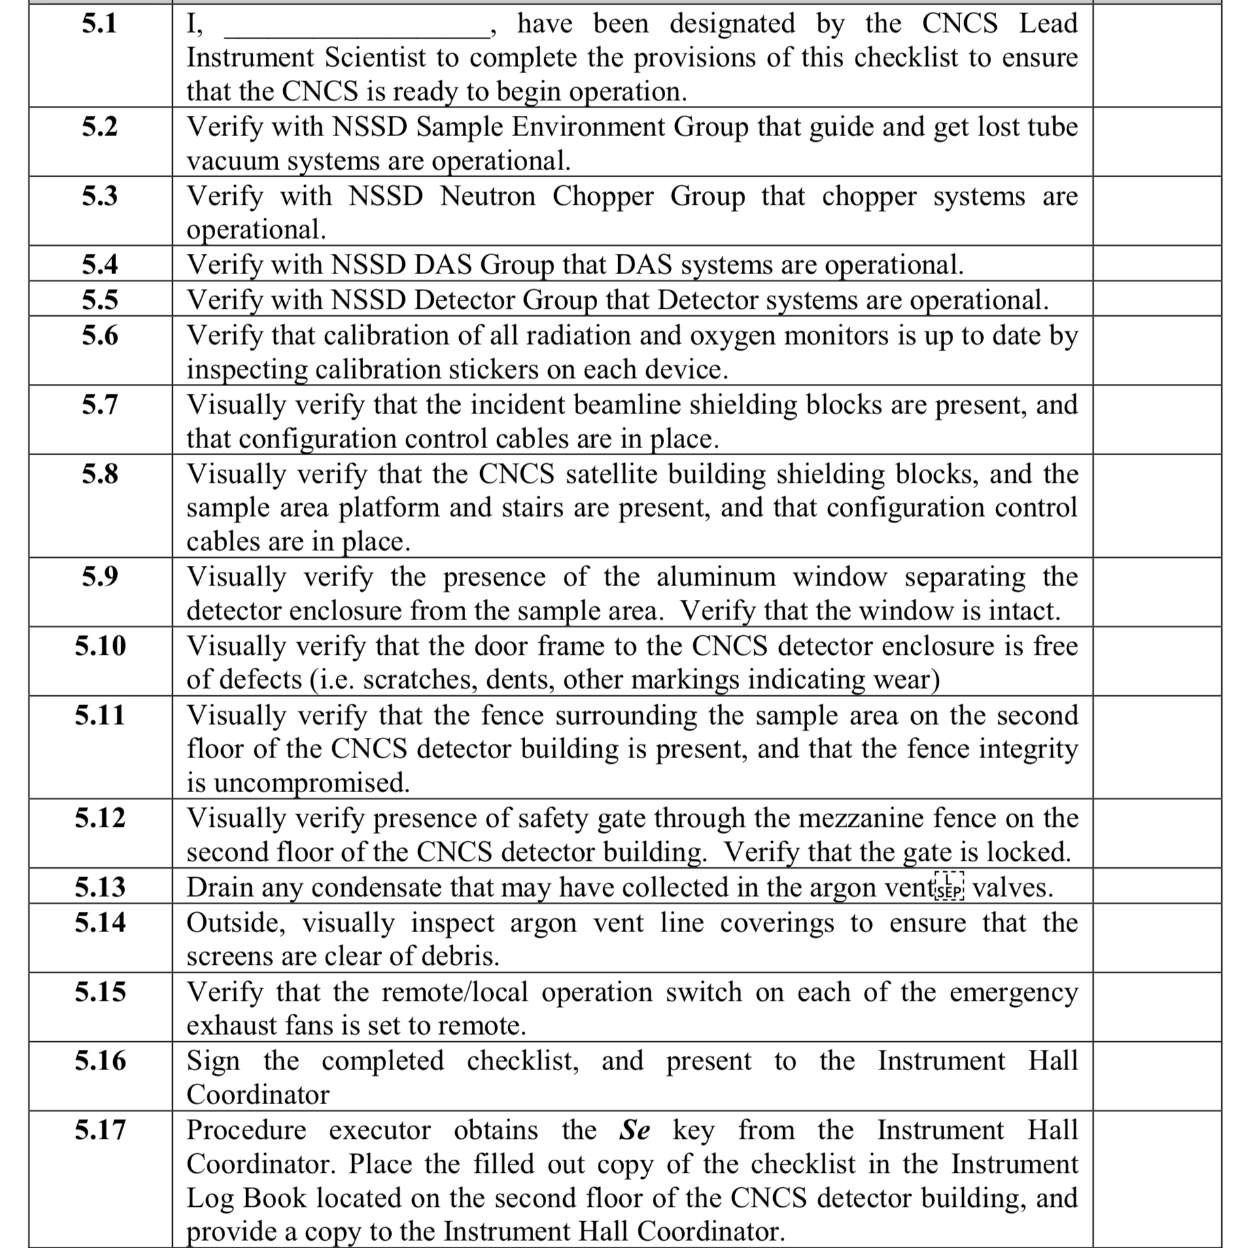
Instrument Startup Checklists

Slide 17

Neutrons Making the World a Better Place

