Slide 1
Implementation of ASO at PPPL
2019 DOE Accelerator Safety Workshop – September 10-12, 2019
Jessica Malo - NSTX-U Accelerator Safety Specialist

Slide 2
PPPL is Implementing DOE O 420.2C with Extensive Planning and Community Outreach
We have an integrated ASO implementation team that spans across laboratory departments. Team meets at least weekly and includes DOE-PSO participation.
2 subcontracted accelerator community members (Scott Davis & Frank Kornegay) provide valuable executive level input during ASO Implementation.
PPPL has attended annual DOE Accelerator Safety Workshop since 2015.
DOE O 420.2C added to PPPL contract after 2016 run of NSTX-U. ASO compliance is required prior to restart.
Participated in monthly accelerator community calls since 2017.
I have attended 2 ARRs at other facilities so far. Lessons learned regarding content and conduct of ARR have driven development of a comprehensive performance-based readiness approach focusing on people, processes, and equipment.

Slide 3
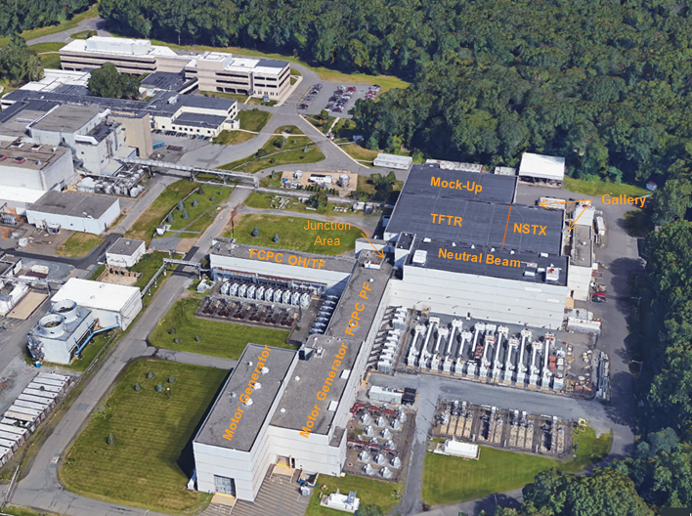
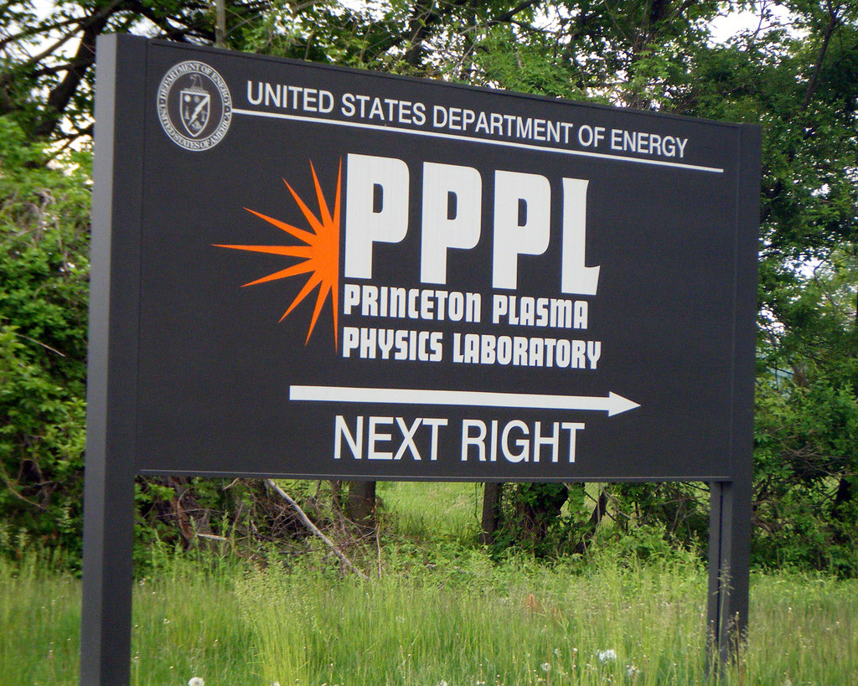
PPPL Site Overview and NSTX-U Infrastructure
N
NSTX-U Control Room
LSB
Underground Tunnel
Engineering
RF
ESAT
D-Site Pump House

Slide 4
NSTX-U ASO Implementation Objectives are Synchronized with Commissioning of NSTX-U
This is the first implementation of ASO on a tokamak fusion device (NSTX-U).
ASO implementation activities are planned to mesh with technical restart activities to deliver safe operation for commissioning, Project Key Performance Parameters (KPPs), and research goals.
Objective 1 | Prepare NSTX-U for commissioning and restart technically
Objective 2 | Prepare NSTX-U for Readiness per ASO
Objective 3 | Complete IRR and ARR with approved ASE
Objective 4 | Obtain DOE-PSO approvals to i) commission and ii) operate
Objective 5 | Commission, KPPs, and then operate

Slide 5
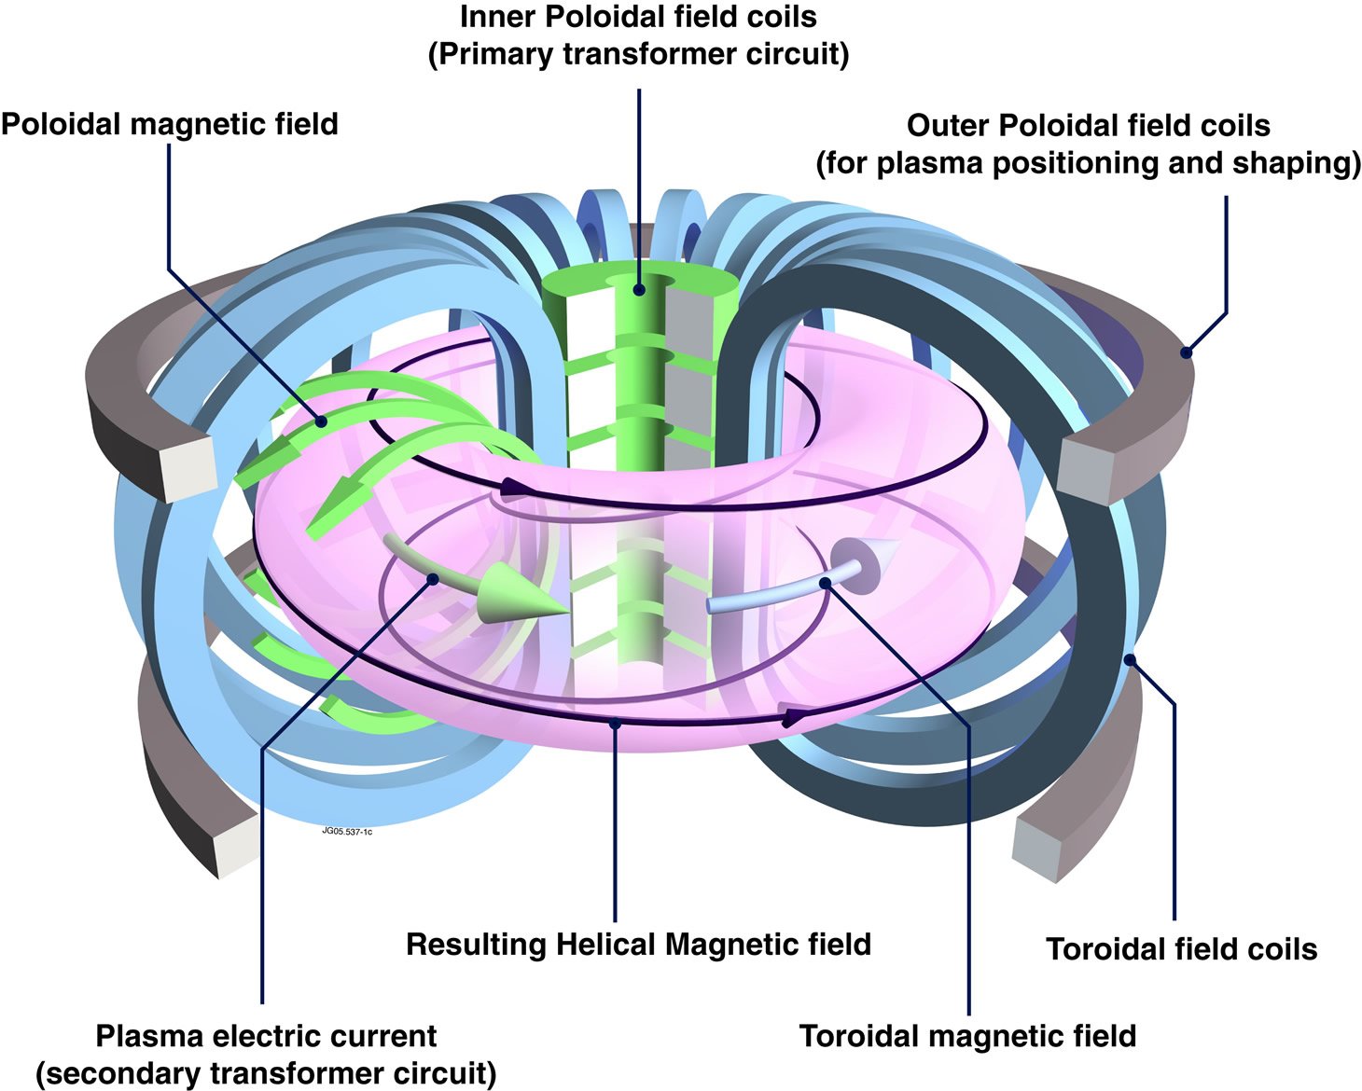
What is a Tokamak?
A device that uses a powerful magnetic field to confine heated plasma in a toroidal (doughnut) shape.
Plasma fills a large volume within the vacuum chamber.
One of several types of magnetic confinement devices.
Design intended to drive future development of controlled fusion power.

Slide 6
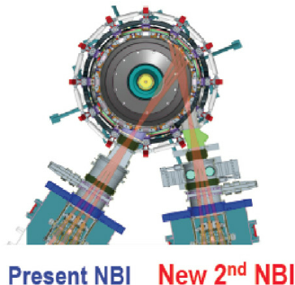
Comparing NSTX-U to a Traditional Accelerator
Unlike a traditional accelerator’s continuous operation, NSTX-U operates in short pulses, resulting in 1-5 second plasmas separated by 20-40 minutes
Accelerator “beam” can be best compared to NSTX-U “plasma current”
An accelerator is “on” when beam is present, whereas NSTX-U is “on” when there is plasma current present.
Accelerator beams are ~100 mA
NSTX-U plasma current is ~1-2 MA - charge carriers generally have lower energy than in an accelerator, but there are more of them
We use what we refer to as “Neutral Beams” to heat the plasma.
6 NB Sources (3 per NB line) = Total of 5-10 MW of neutral deuterium atoms, injected into the plasma; ~60 A neutral current at ~90 kV acceleration voltage
NB Injection into NSTX-U Torus.

Slide 7
Supporting Infrastructure Converges in the NSTX-U Test Cell
NB Beamline 1
NSTX-U
Vacuum Vessel
NB Beamline 2

Slide 8
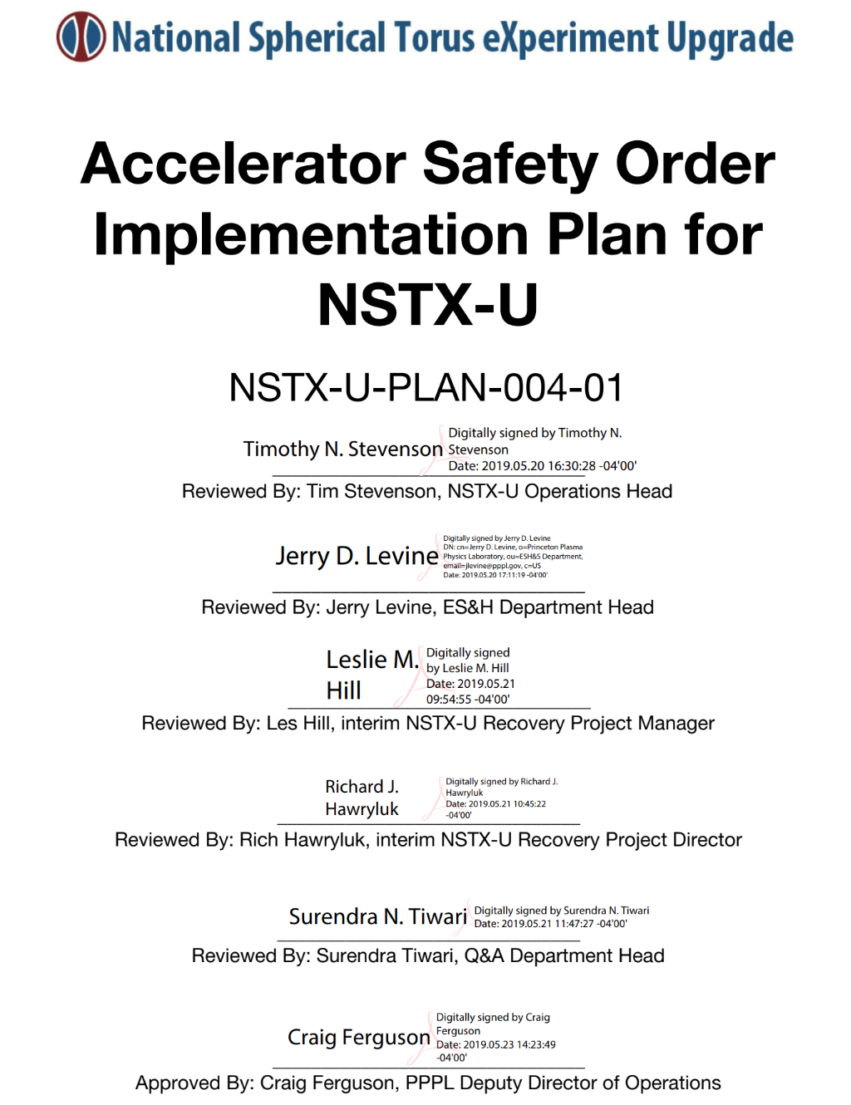
Accelerator Safety Order Implementation Plan
An Accelerator Safety Order Implementation Plan document (ASOIP) has been developed and approved.
The ASOIP includes:
Steps necessary to implement ASO program elements
Steps to prepare for a successful ARR
Reviews, concurrences, and approvals by the various internal PPPL organizations and external organizations (e.g. Accelerator Readiness Review (ARR) team and DOE/PSO)
Once this Plan is fully implemented, PPPL & NSTX-U will be ready to operate NSTX-U with an approved Accelerator Safety Envelope (ASE).
Concurrence from DOE-PSO - Satisfied the 2019 PEMP Notable Outcome

Slide 9
ASO Implementation developed with DOE-PSO Awareness and Concurrence
ASO Implementation Plan concurrence received from PSO meeting a Notable Outcome
ASO Implementation Team activity includes Princeton Site Office in attendance for observation as part of:
Plan development
ASO Implementation Team meetings
Topical working meetings
Conference calls with our contractors
TQ and Procedure development
SAD development
ASO Implementation debrief meetings with PSO representative weekly
Full PSO access to files, documents, and dashboards for transfer of up to date information and transparency

Slide 10
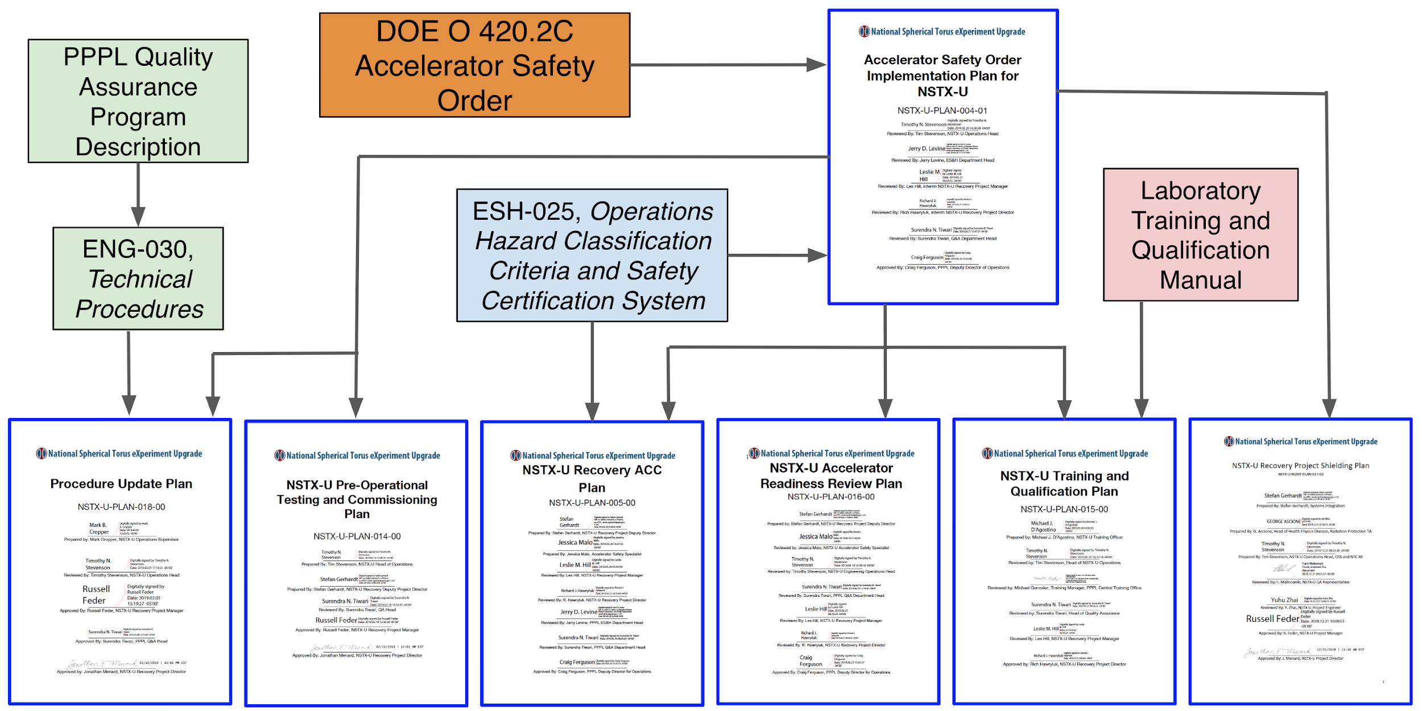
ASO Implementation Plan is Executed using 6 Additional Focused Plans Needed to Accomplish ASO Implementation
Notes:
NB+ plasma - indicate that this is the dominant radiation term (so-called "beam target" reaction).
And note this produces a 2.45 MeV neutron.

Slide 11
NSTX-U Accelerator Hazards
Noteworthy NSTX-U Hazards:
When we produce a plasma and/or operate a neutral beam, we make direct ionizing radiation.
We have compressed gases and cryogenics and therefore we have potential ODH concerns.
We use magnetic fields that are potentially hazardous to individuals with pacemakers and medical devices.
In addition to the accelerator hazards above, we also have a number of industrial hazards typical of most accelerators (e.g. electrical, pressure, vacuum, thermal, etc.)
Notes:
NB+ plasma - indicate that this is the dominant radiation term (so-called "beam target" reaction).
And note this produces a 2.45 MeV neutron.

Slide 12
ES&H: The ASO Implementation builds on and supplements existing PPPL safety programs for accelerator specific hazards
Mature ES&H safety management programs to address industrial hazards have existed at the lab for decades and will continue to support safe operations.
A comprehensive hazard analysis has been performed (NSTX-U Recovery Project HAR). This documents hazards and associated mitigations present during both the execution of NSTX-U Recovery Project scope and during subsequent pre-operational testing, commissioning, and routine operations.
A new NSTX-U SAD is being developed consistent with the ASO (Order and Guide), and community expectations.
From the new SAD, the Accelerator Safety Envelope will be generated.
The SAD and ASE will be maintained using an established USI program.
Notes:
NB+ plasma - indicate that this is the dominant radiation term (so-called "beam target" reaction).
And note this produces a 2.45 MeV neutron.

Slide 13
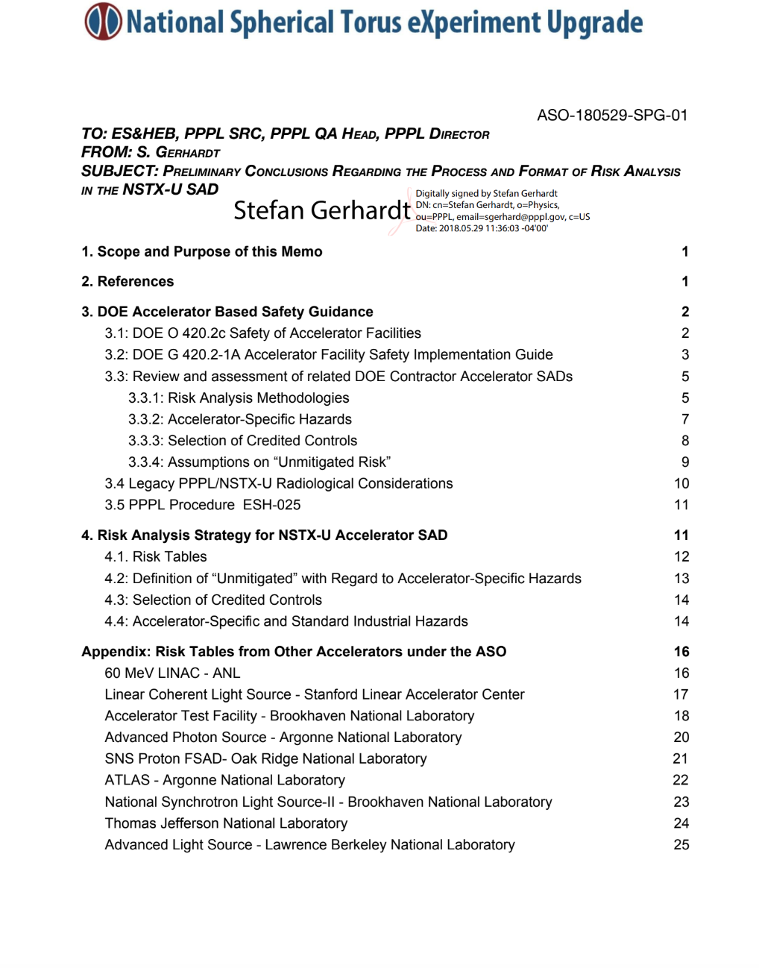
HAR Risk Analysis Methodology - Risk, Probability, & Consequence
A Risk Analysis Memo was drafted & issued describing methodology to drive safety analysis.
Reviewed 10 SADs from 6 DOE O 420.2C compliant facilities & legacy PPPL policies.
Derived a set of consequence, probability, and risk tables consistent with both accelerator community practice and PPPL practice.
Developed methodology for evaluating mitigated vs. unmitigated risks.
Developed methodology for determining when a formal credited control is required.
Note: this Risk Analysis memo, which was used for the HAR, has been further expanded into a Recovery Project FMECA and Hazard Analysis Plan
Notes:
put it before the set of "SAD Approval" slides?

Slide 14
SAD Development Methodology for the ASO
A legacy SAD served as the safety basis for previous NSTX-U operations. The legacy SAD was not required to be ASO compliant. It now serves as reference material for the new Accelerator SAD.
Process:
Review legacy SAD chapters
Analyze gaps in legacy SAD (changes driven by Recovery Project scope, ASO compliance)
Determine required changes
Implement changes into new SAD using legacy SAD as reference
Project review of new chapter
Notes:
put it before the set of "SAD Approval" slides?

Slide 15
Team of Safety, Quality, and Engineering Experts Support SAD Development
Role | Contribution
Accelerator Safety Specialist (That’s me!) | Responsible for overall content and development of the SAD
NSTX-U Head of Engineering Operations | Operational and technical contributions, APM/CAM
NSTX-U Deputy Head of Engineering Operations | Technical contributions
Chief Operations Engineer | Technical contributions
ES&H Department Head | Safety and Compliance review of Draft Content
Quality Assurance Engineer | Quality Assurance, Compliance
Head of Environmental Services | Environmental Compliance
Additional engineers, physicists, and other SMEs will be brought in to address specific issues as appropriate. Our contractors and community outreach also provide feedback.
Notes:
put it before the set of "SAD Approval" slides?

Slide 16
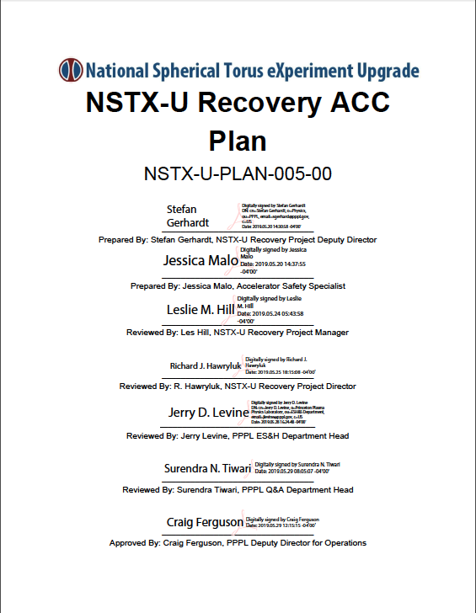
Internal Readiness Review Process
Internal Readiness Process is foundational to ensuring readiness for safe commissioning and operations.
Internal Readiness Process defined in ESH-025, implemented via Project ACC Plan.
ACC: Activity Certification Committee
Roles of the ACC for Internal Readiness:
Review the SAD and ASE
Recommend to ES&H Executive Board readiness for pre-accelerator commissioning
Recommend to call for the Readiness Assessment and ARR
Recommend when to call for the start of accelerator commissioning
Recommend when to call for the start of operations
DOE-PSO participates in the ACC as ex-officio members
Notes:
put it before the set of "SAD Approval" slides?

Slide 17
The NSTX-U Recovery Project has an Approved Plan Defining ARR Process
An ARR Plan developed to define ARR Process; will be revised once ARR Team Lead provides input.
The ARR will be preceded by a Readiness Assessment (RA), with both events comprised of consistent team membership to the maximum possible extent.
The Lines of Inquiry will be consistent for both the RA and ARR.
The ARR is scheduled to take place in early 2021.
Notes:
put it before the set of "SAD Approval" slides?

Slide 18
Summary
We have planned the ASO implementation in a series of detailed project plan documents - we are executing that plan.
Community outreach continues to be an integral part of ASO Implementation efforts.
We have a complete & comprehensive HAR to support 413.3B & the creation of an ASO-compliant SAD.
We are actively working on the development of an ASO-compliant SAD
We have developed a readiness process which is synchronized with restart technical operations
We are committed to safe and successful commissioning & operations.

Slide 19
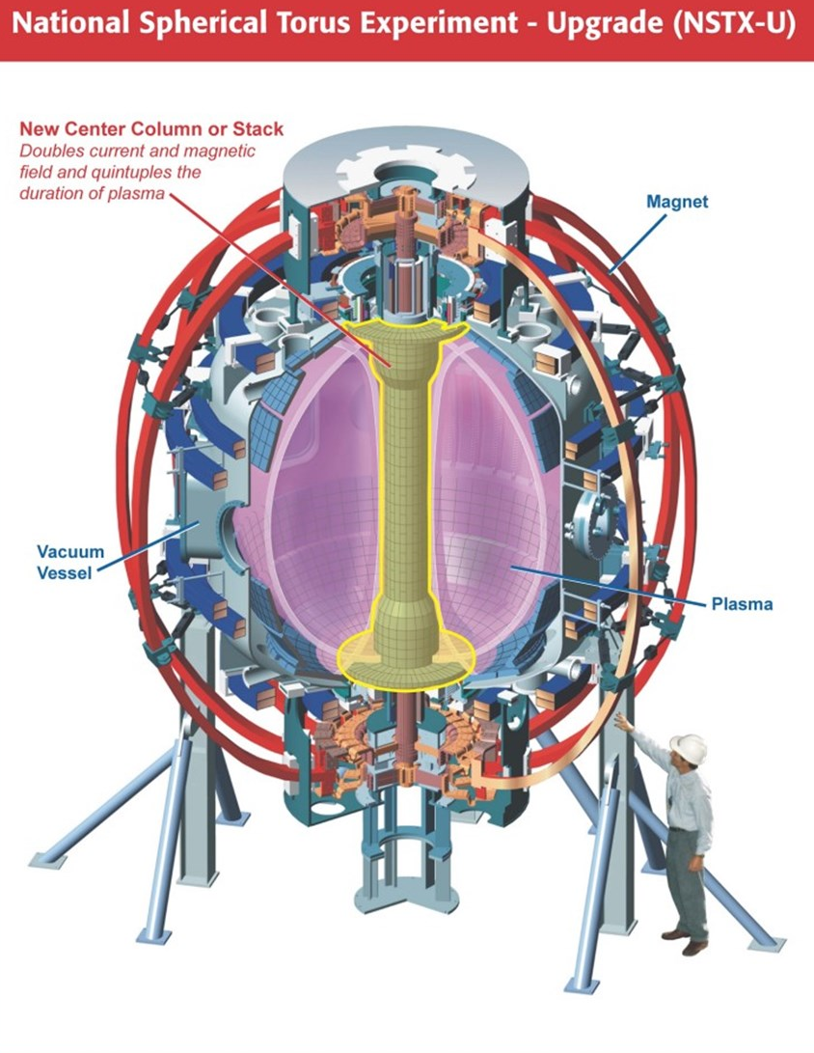
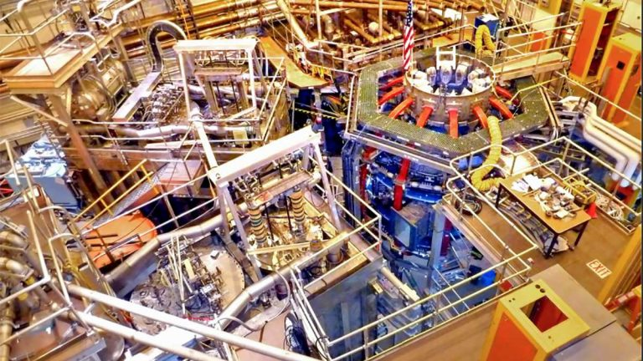
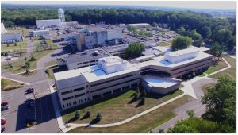
Questions?

Slide 20
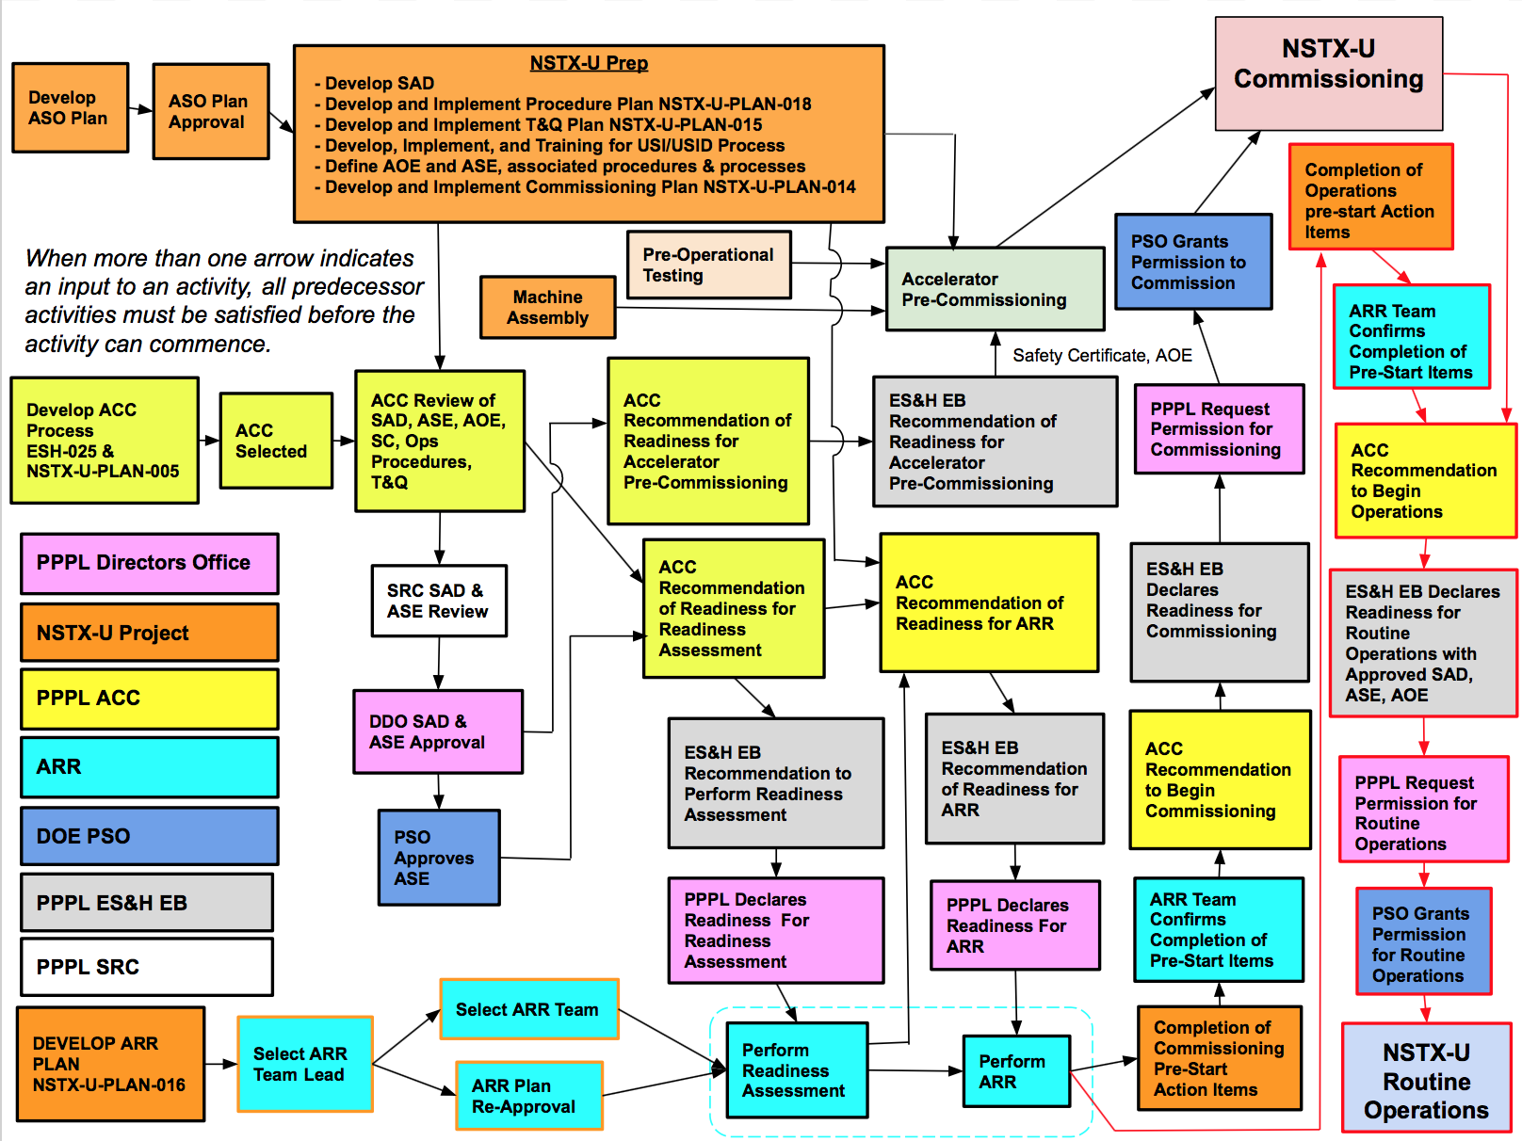
Backup
Operational activities and Readiness Process have been synchronized.
Seven key groups identified with Implementation responsibilities.
Key Organizations and Groups

