Slide 1
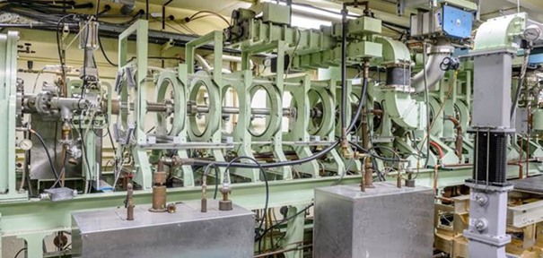
Fission gas release incident at LEAF
Accelerator safety workshop 2019
erhtjhtyhy
Sergey Chemerisov
Facility Manager
IVEM/LEAF
September 11, 2019

Slide 2
AMORE experiment
NNSA Material Management and Minimization (MMM) funded project to support U.S. industry to establish domestic production of Mo-99 medical isotope
Argonne performs R&D to support SHINE Medical Technologies:
  Design and test the Mo-recovery and purification systems
  Study radiolysis effects on solution chemistry and gas generation
  Provide technical data that SHINE can use for communication with regulatory agencies
20L
~2L
~50mL
~50mL

Slide 3
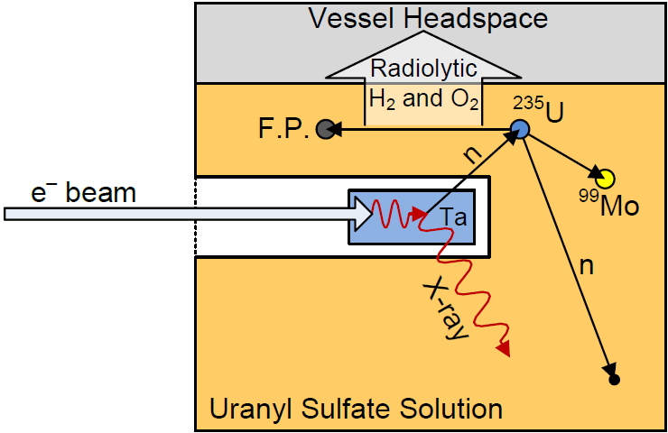
Phase I vs phase ii experiments
Phase | Status | Energy (MeV) | Beam Power (kW) | Volume and Maximum Mo-99 Produced | Peak Neutron Flux (n/cm²•sec) | Neutron Flux in solution (n/cm²•sec) | Neutron Flux in mini-AMORE (n/cm²•sec)
I | Complete | 35 | 10 | 5 L & 2 Ci | 1 x 10¹² | 0.1-0.2 x 10¹¹ | 0.1 x 10¹²
II | Underway | 35 | 20 | 20 L and 20 Ci | 5 x 10¹² | 0.5-1 x 10¹¹ | 0.5-1 x 10¹²
Solutions irradiated at 35 MeV
  Phase I target: Ta
  Phase II target: DU
Study the effects of fission on U target-solution chemistry and radiolytic off-gas generation
Demonstrate the recovery and purification of ⁹⁹Mo from an irradiated target solution
Ship ⁹⁹Mo product to potential ^{99m}Tc generator manufacturer partners
DU

Slide 4
the Gas handling system

Slide 5
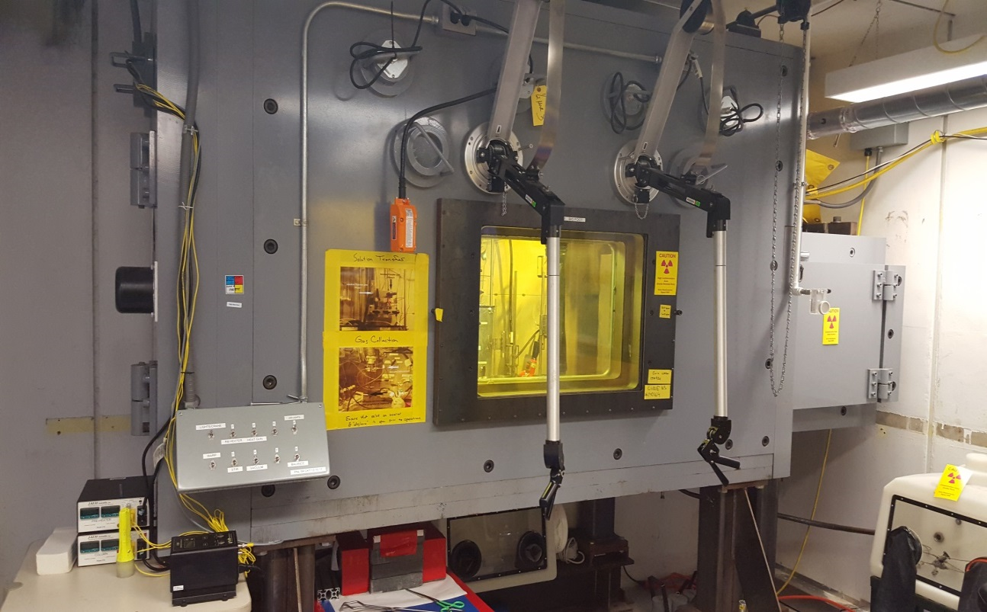
D-024 HOT CELL
Initial transfer of Mo solution from extraction column in D-035 glove box
Acidification of Mo solution to pH=2
Concentration column (CC) - TiO₂ based - reduces volume of solution and removes impurities
Product from CC is acidified to 1M HNO₃ and loaded into LEU Modified Cintichem Process (LMC)
Samples from CC and LMC retrieved for analyses

Slide 6
Elevated Radiation detected at Linear Accelerator, BLDG. 211
On Friday, March 9, a hand and shoe monitor and hand held detection instrumentation in the Low-Level Energy Accelerator Facility (LEAF) Linear Accelerator (LINAC) indicated elevated background radiation levels while Molybdenum-99 (Mo-99) solution was being processed. The Mo-99 product had been generated the day before by irradiation of a uranyl sulfate solution as part of an experimental scale up to demonstrate production of the medical isotope Mo-99.
The facility was evacuated and radiation levels went back to background levels within 60 minutes. No surface contamination was found and no measurable dose was assessed for the staff in the area. The amount of radiation released (primary isotopes Xe-133 and Xe-135) was conservatively estimated to be 4 orders of magnitude (~20,000 times) below DOE reporting limits and posed no onsite or offsite consequence.

Slide 7
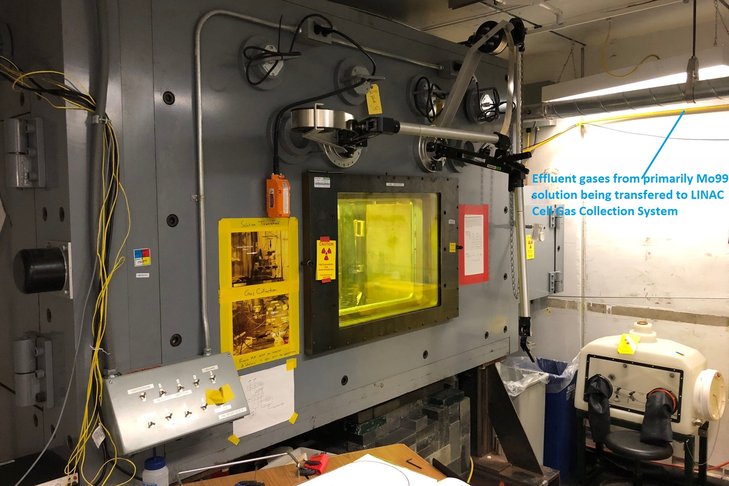
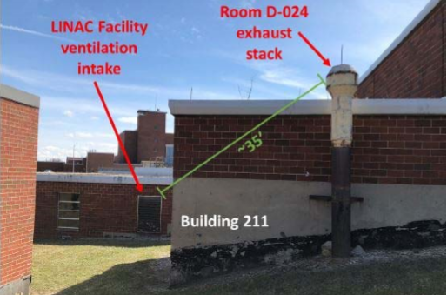
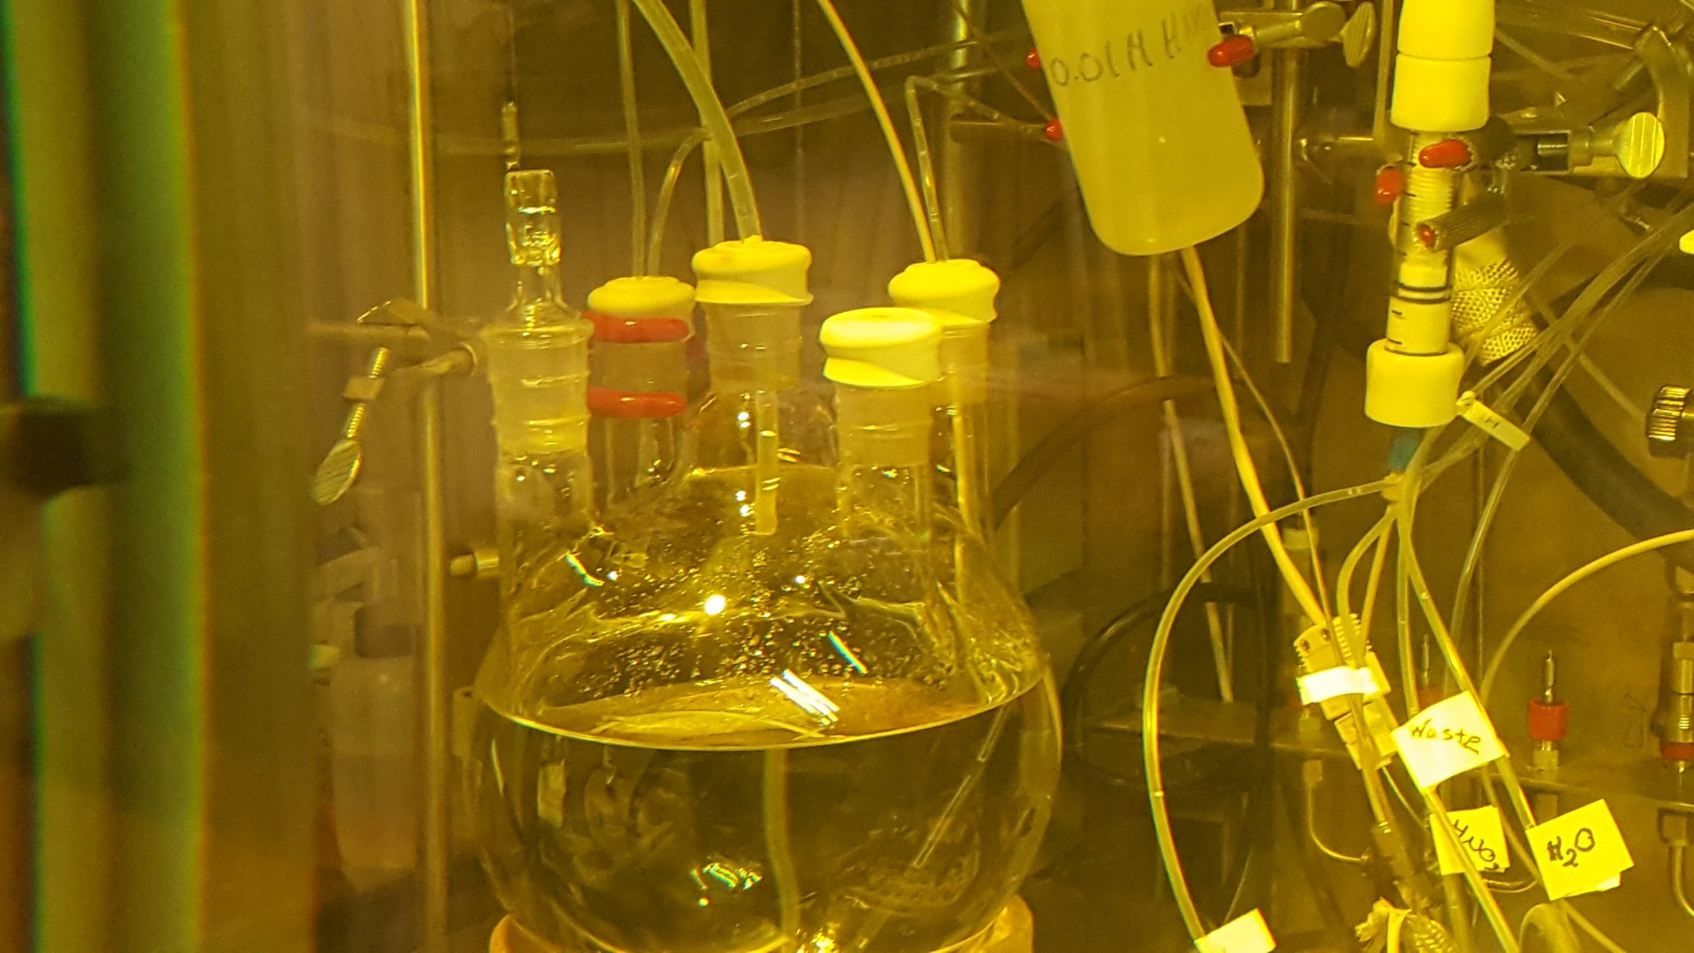
Fission Gas Release Event
Event resulted in positive USI and pause of Linac operations

Slide 8
Fission gas release event internal review team findings
Incident Causes:
  Less than adequate (LTA) design and procedure reviews of the scale up of the Mo-99 processing, solution mixing system and pH probe installation into 3 liter (L) vessel.
  LTA testing of the design and installation of gas collection system and gas mixing system with the 3L glass vessel that led to gas release into hot cell enclosure.
  Consequences for repurposing an existing building exhaust was not adequately reviewed to determine whether the exhaust stack system was properly designed to avoid re-entrainment of gases released.
  Other Issues for consideration:
  Develop incident reporting structure that allows sufficient time for responders to gather and provide information that is accurate rather than speculative.
  Clarify response procedures to adequately cover level of engagement of emergency services required to assist in the response.
  Provide advance notice of upcoming experiments/irradiations to Building Manager, Health Physics (HP), Fire Dept., co-located building personnel, and custodial/infrastructure support organizations.

Slide 9
Fission gas release event internal review team findings
  Lessons Learned:
  Complete design reviews and leak checks on all systems connected to gas collection system to contain radioactive gases in hot cells/gloveboxes.
  Perform a design review of building exhaust and modify appropriately.
  Monitor hot cell and/or exhaust stack radiation levels in LEAF using dedicated equipment for that purpose.
  Integrate lessons learned from similar performed experiments into work planning.
Successful Work Processes:
  Experiment designed with “defense-in-depth” philosophy that properly vented the release to atmosphere after safe capture of iodine via zeolite filter system.
  Personnel immediately recognized the increased background, stopped work, evacuated areas with elevated background, and notified supervisors and HP personnel.
  HP comprehensively surveyed areas; monitored spaces for airborne radioactivity; surveyed personnel for contamination and ruled out iodine uptake; controlled access; and cleared spaces for re-entry only.

Slide 10
External Review findings
Management/Communication
  Rush to get answers, lead to assumptions
  Stagnation points within communication flow up/down chain
  Follow procedure for event reporting
Work Planning & Control
  Inconsistently applied, viewed as a hindrance
  Include USI trigger, routine pre-job briefs
Facility Design
  Ventilation system design/modification, monitoring
Experimental Approach to R&D
  Evaluate scale-up, encourage staff to seek advice
  Ensure a questioning attitude, evaluate changes/modifications

Slide 11
Response to Findings
Management/Communications
Restructured directorate to reduce layers of management and improve flow of communications
Reinforced need to report events using 911
If an event occurs:
  Call 911
  Inform your immediate supervisor
  Supervisor informs DD
  DD informs other DD and RSO
  DDs and RSO inform senior Lab management together

Slide 12
Response to findings
Work Planning & Control
Identify R&D Activity
Field Assist Review
Hazard Analysis and
Work Planning Process
Management Assessment
AMORE Restart Only
If additional hazards are identified
Design Review
Readiness Review
Experimental Safety Review Committee
Pre-Job Briefing
Work Control Document Approved
Work Authorized

Slide 13
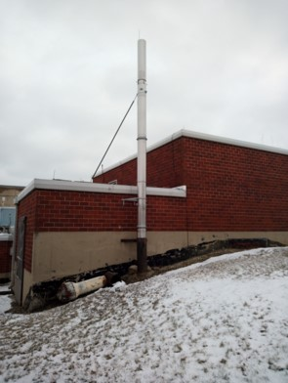
Response to Findings
Re-performed design reviews for all experimental systems associated with AMORE
Utilized failure modes and effects analysis to identify risk
Resulted in several improvements being made to the system
Procedures were also revised accordingly
Fission gas release scenarios were analyzed
New, taller stuck was installed

Slide 14
Revised Safety Analysis
Expanded Process Descriptions
  Provides greater detail of liquid separation and transfer processes
  Defines interfaces of Gas Collection System (GCS) with other systems
Updated Hazard Analysis
  Applied similar methodology as used in Hazard Category (HC)-3 DSAs
Successful Accelerator Readiness review was performed

Slide 15
Questions?

