Slide 1
Management of Radioactive Materials at Accelerator Facilities: The Fermilab Example
Don Cossairt, PhD, CHP, Distinguished Scientist
Fermi National Accelerator Laboratory
2019 DOE Accelerator Safety Workshop at Oak Ridge National Laboratory
September 10, 2019

Slide 2
Outline
The Fermilab Facility
Fermilab SAD and Radioactive Materials
RM at Fermilab: Nuclear Materials
RM at Fermilab: Radioactive Sealed Sources
RM at Accelerators Radioactivated Accelerator Components
RM at Fermilab: Fermilab Classification System
RM at Fermilab: Additional Precautions
Final Remarks and Questions

Slide 3
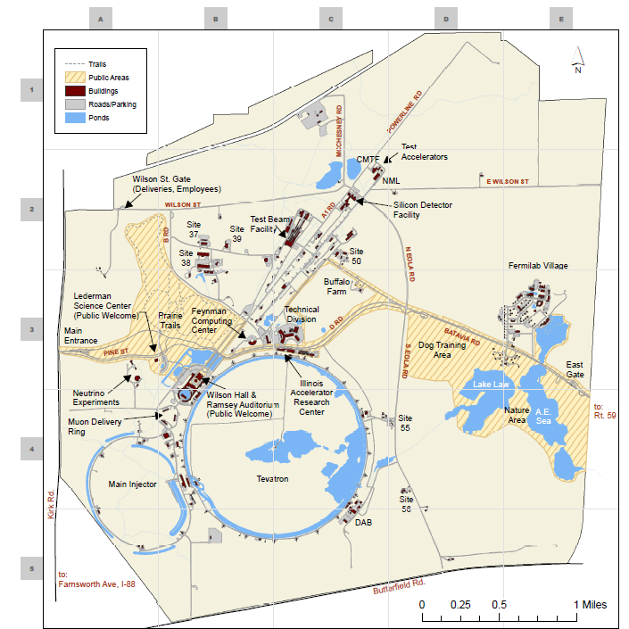
The Fermilab Facility
6800 acres (2752 hectare)
≈14 mi (22.5 km) of structures with radioactive materials
120 GeV, ≈1 MW protons
International user community
Onsite housing
Public Access
Public events
Bike paths
Woodland &
prairie trails

Slide 4
Fermilab SAD and Radioactive Materials (RM)
One accelerator, one SAD & ASE, many Chapters (i.e.,”modules”)
Main Injector, R&D devices, experiments
“Defunct” facilities, “mothballed” awaiting $s to demolish!
Support facilities; storage, shipping and receiving, etc.
Radiation protection support work; radionuclide analysis & instrumentation calibration, waste management activities
All facilities & activities involving accelerator-produced radioactive material per the 10 CFR 830 exclusion:
Nonreactor nuclear facility…does not include accelerators and their operations and does not include activities involving only incidental use and generation of radioactive materials or radiation such as check and calibration sources, use of radioactive sources in research and experimental and analytical laboratory activities, electron microscopes, and Xray machines
We have no “non-incidental” production of RM by our accelerators. ☺
This differs from conditions at some other DOE accelerators. ☹

Slide 5
RM at Fermilab: Nuclear Materials
No Accountable Special Nuclear Materials (SNM) J
4 types of nuclear materials
Depleted uranium, mostly in Tevatron Collider D0 Experiment
261,000 kg, was used in liquid argon, now stored in dry air. For this we have an Office of Science DOE-STD 1027 Cat 3 exemption.
4 ²⁴¹Am-Be neutron sources only used by at ES&H Section Radiation Physics Calibration Facility (RPCF).
11 g ²⁴¹Am total, used for instrument calibrations.
Deuterium gas (D₂) (nonradioactive nuclear materials)
80 kg held in storage, Unique: ³H-free from pre-fallout sources, but not ¹H free!)
All nuclear materials managed in accordance with DOE Orders and Guidance in formal MC&A Program.
Special assessment by DOE-Office of Science in May 2014, passed with flying colors. J

Slide 6
RM at Fermilab: Radioactive Sealed Sources
≈1800 sealed sources in inventory.
≈ 230 “Accountable”; above 10 CFR 835 Appendix E activity thresholds after correcting for radioactive decay
≈ 750 on radiation safety instrumentation
≈ 420 are “heartbeat sources” on beam-on instruments interlocked to the beam (≈ 88 % in service at all times).
Others are “check sources” on beam-off survey instruments or used at RPCF calibration range or Radionuclide Analysis Facility.
≈ 400 are issued to experimenters to develop & monitor apparatus.
Source activities: “negligible” up to 167 Ci @ calibration range.
Source users are rad workers, get source training every 2 years
All sources are inventoried, not just those > 835 App. E thresholds.
Program managed by ES&H Section.
Radiological Control Technicians (RCTs) supervise use of all industrial radiography and soil density measurement sources employed on construction projects. J

Slide 7
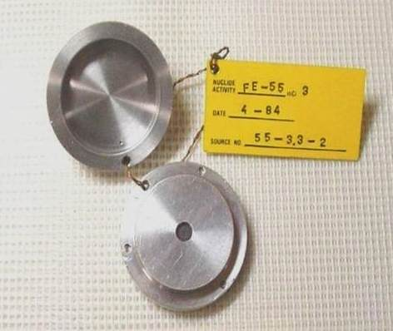
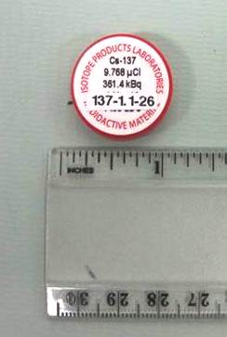
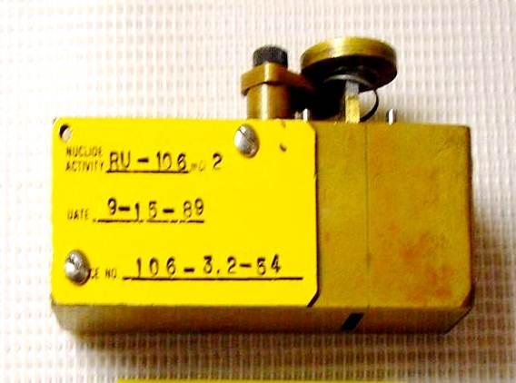
RM at Fermilab: Radioactive Sealed Sources (examples)
All sources are labeled as radioactive material on the other side!

Slide 8
RM at Accelerators: Radioactivated Accelerator Components
For incident particles > a few hundred MeV, all radionuclides with atomic mass less than that of the irradiated material can be made.
Secondary interactions further serve to rather uniformly irradiate essentially everything in the beam enclosure.
Rough Scaling of activated volumes from localized irradiations:
Protons or ions on material, with hadronic interaction length λ, use λ³
Electrons on material, with radiation length X, use X³-Examples:
For Al: (λ/X)³=(107.2 g cm⁻²/24.1 g cm⁻²)³=88
For Fe: (λ/X)³=(132.1 g cm⁻²/13.84 g cm⁻²)³=870
For Pb: (λ/X)³=(199.6 g cm⁻²/6.37 g cm⁻²)³=30,800
Result: Activity volumes at proton, ion accelerators are MUCH LARGER than at electron facilities at similar beam powers.
Good news, usually have no α-emitters. ☺
More good news, most of the radioactivity is tied up in the material, very little is removable surface contamination. ☺

Slide 9
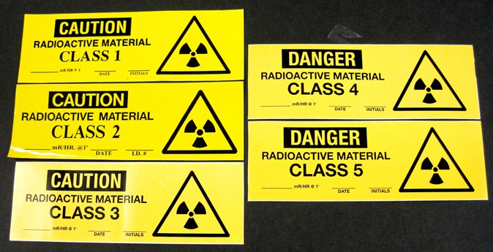
RM at Fermilab: Fermilab Classification System
Classification and Labeling
All labels compliant with 10 CFR 835 and DOE-approved.
Use a Fermilab-specific radioactivity class system. J
Surveys performed by radiological workers at beam enclosure exits.
Included in Radiological Worker Practical Factors training.
Labels are applied at enclosure exits, items inside assumed to be RM.
Our labels:
ID #
Date
Dose
Rate @
1 ft/30 cm

Slide 10
RM at Fermilab: Fermilab Classification System
Class Label | At Least | Less Than
 | Exposure Rate (mR/hr)
CAUTION: RADIOACTIVE MATERIAL CLASS 1 Measured at Contact Roughly 90 % of items are Class 1. | 50 cpm above background on a Frisker pancake instrument OR 2000 cpm above background on a Bicron Analyst NaI probe, X10 scale, if background is 2000-3000 cpm OR Count rate on the Bicron Analyst is greater than twice the mean background rate in a low background area (< 2000 cpm) | 1 mR/hr
CAUTION: RADIOACTIVE MATERIAL CLASS 2* | 1 | 10 mR/hr
CAUTION: RADIOACTIVE MATERIAL CLASS 3* | 10 | 100 mR/hr
DANGER: RADIOACTIVE MATERIAL CLASS 4* | 100 | 1000 mR/hr (= 1 R/hr)
DANGER: HIGHLY RADIOACTIVE MATERIAL CLASS 5* | 1 R/hr | ----
*Measured at 30 cm = 1 ft

Slide 11
RM at Fermilab: Additional Precautions
All areas are snooped regularly for unauthorized radioactive materials. All waste containers & trash dumpsters are surveyed for radioactivity before being dumped into the trash truck.
Simultaneously, dumpsters are also inspected for regulated chemical waste, household trash, etc.
Some “culprits” self-identify by disposing of personal mail with addresses in our dumpsters!
The organization “owning” the dumpster must go “dumpster-diving”, an unpopular sport, to remove forbidden items.
Outdoor storage is minimized.
Follow 10 CFR 835 with respect to locked & labeled rooms, cabinet with small parts, etc.
Special precautions are taken to lock up indoors “high value” RM that is “theft bait”, notably copper.

Slide 12
Final Remarks and Questions
???

Slide 13
First Workshop Group Photo, Fermilab 2004

