Slide 1
Incidents and Incident management @ ESS Presentation to DOE Accelerator Safety Workshop 2019
Helen Boyer
Occupational Health and Safety Group leader
European Spallation Source ERIC
11 September 2019

Slide 2
Overview
Health and Safety organisation at ESS
Development of an OHS handbook for ESS
Incident reporting
Examples of incidents and lessons learned
Communication
Risk assessment

Slide 3
ESH&Q Organization
ESH & Q
Security
Licensing
ESH Division
Training
Environment
Radiation Safety
Quality
Radiation Protection
Occupational Health & Safety
- 35 staff plus some consultancy
- Ramping up in line with project phases

Slide 4
ESH&Q Scope
4

Slide 5
Developing a management system - OHS
Incident management
Work permits
(eg Hot works)
First responders & Emergency organisation
Developing procedures, rules, guidance, communication & training
Risk Assessment
Chemical management
Electrical safety rules

Slide 6
Incident Reporting
ESS use an information system (IA) made available by the Swedish insurance company AFA. TIA is derived from Swedish: ” Teknisk informationssystem om Arbetsmiljö”.
Everyone at ESS can report incidents using this tool.
An incident management database that also allows direct reporting of claims to the insurance company.
An e-learning training has been put in place to guide you on how to report an incident.

Slide 7
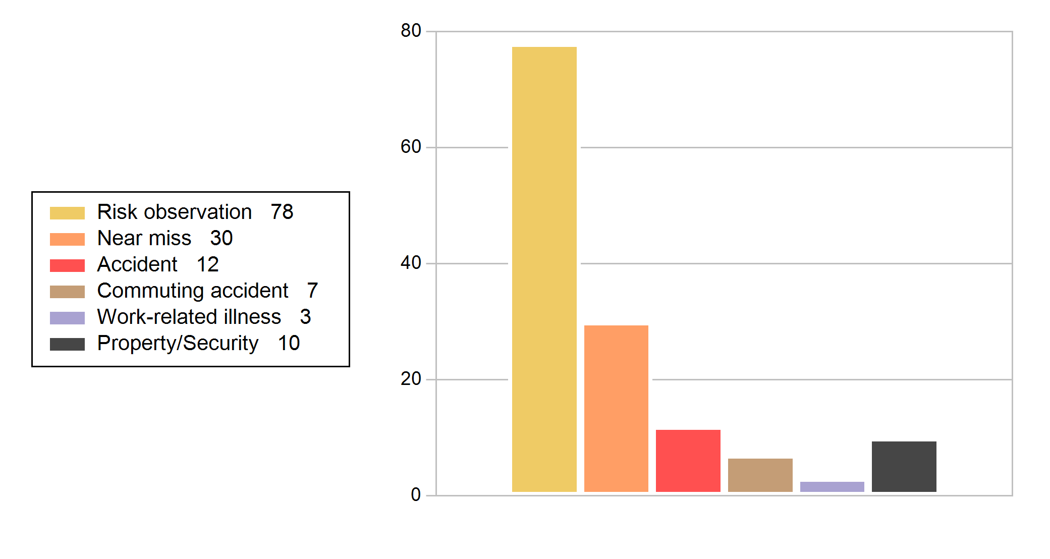
Incident Statistics: Jan to May 2019

Slide 8
Accidents registered in last 12 months
ID | Occurrence title | Occurrence unit
2019-92 | Scrape on shin | Server room
2019-80 | Employee fell down the stairs outside the entrance | Offices
2019-75 | Office chair back breaks | External to ESS
2019-74 | Fall | Parking
2019-65 | Minor hit to the head | Server room
2019-47 | Fainted in the conference room | Offices
2019-46 | Fainted in the corridor | Offices
2019-4 | Leg injury | Outside area – Offices / labs
2018-186 | Tripped and fell hitting jaw | Travel on business
2018-183 | Cleaner pricked self on a disposed diabetic syringe needle | Offices
2018-148 | Worker collapsed | Site
2018-98 | Worker fainted in kitchen area | Offices

Slide 9
Investigation of Incidents
Near Misses are good to learn from
Subcontractor cut fence to access machinery that had been left in area *
Incorrect fall prevention method *
Oxygen deficiency alarm ’dogshed’ *
Pressure incident in dryer *

Slide 10
Subcontractor cut fence to access machinery that had been left in area
The incident occurred due to a subcontractor’s ignorance of ESS safety instructions given formally and by ESS staff present on the occasion. It is noted that the incidence is of high severity as the person knowingly violated a safety barrier.
Recommendations from incident investigation included:
Ensure prompt follow up of incidents
Implement a way of reprimanding anyone that knowingly fails to follow ESS Safety Rules on ESS premises including roles and responsibilities for this procedure.
Verify that ESS line management have informed members of personnel about the existing incident reporting system and encourages reporting.
Strengthen the line-management involvement in safety by, for example, regular site safety walks by ESS line management is recommended.

Slide 11
Rigger incident (1)
The "rigger" attached his harness to the crane chain when entering the hatch. When the chains were disconnected from the hatch; the lifting supervisor ordered "lift" to the crane operator. When the crane lifted the rigger was hoisted up in the air (around 0.5m) and swung. When the crane driver lowered the chain the rigger partly went down the open hole and grabbed the edge, and was pulled up.
The rigger was not hurt, but he was shaken up
Immediate recommendations from incident investigation included:
Site walk.
Updated method statement and risk assessment with work regarding reinstallation of the hatch.

Slide 12
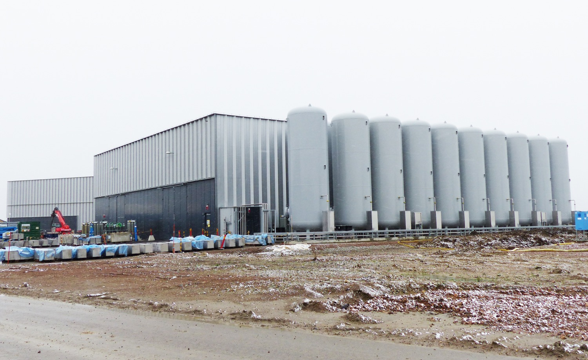
Oxygen Deficiency Hazard (ODH) incidents - Nitrogen ingress into working area (1)
The incident occurred at G04, in an area known as the dogshed. This area is where the regulators for the helium gas system are located.
As part of commissioning nitrogen was being exhausted outside building.
Poor sealing of pipework into the dogshed building then allowed the nitrogen that had built up in this ’box’ to enter the dogshed.
Oxygen deficiency alarm for the area activated and the person left the area.

Slide 13
Oxygen Deficiency Hazard (ODH) incidents - Nitrogen ingress into working area (2)
Recommendations from incident investigation included:
Redesign of exhaust pipework
ODH alarm outside dogshed area
Repositioning of alarm detection
Improved sealing of pipework
Ensure that modifications to design are considered by all parties

Slide 14
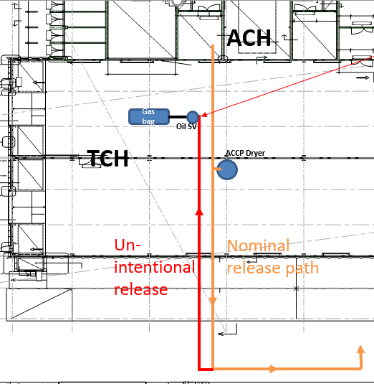
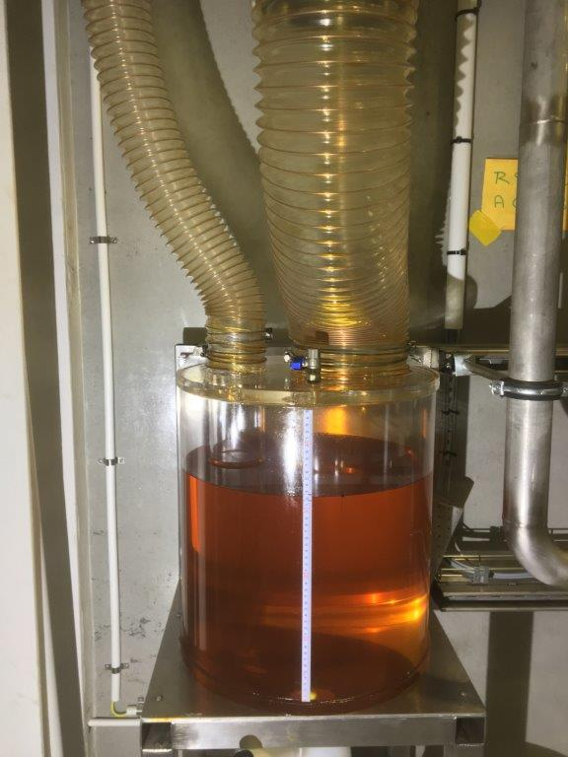
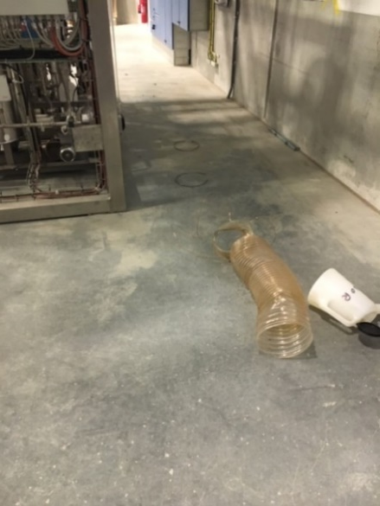
ODH Incidents – incorrrect dryer depressurisation (1)
Incorrectly performed dryer depressurisation (in <1 second instead ~15 minutes) caused pipe disconnection,
serious pressure relief incident
ODH Warning (sensor position 6 < 19.5 % for ~40-50 seconds) and
Fire alarm (presumably caused by oil vapour cloud)

Slide 15
ODH Incidents – incorrrect dryer depressurisation (2)
Recommendations from incident investigation included:
Immediate stop of commissioning and machinery
Removing root cause by putting a blind flange on the safety relief header
Check for further flow restrictions
Design of a separate safety relief line only for the gas bag relief
HAZOP of dryer system

Slide 16
Communication of lessons learned
Local briefings
Management meetings
Work Environment Committee
Crisis Management team table top exercise

Slide 17
Risk assessment
Going forward identify hazards before installation by having a global risk assessment (example from Test Stand 2).
No. | Hazard | Cause | Who might be harmed and how | L | S | Risk | Risk mitigation | L | S | Risk
1.5.1 | ODH | Release of helium into bunker (250 L of He per cryo module) | Low oxygen levels in bunker causing ODH symptoms, possibly ultimately death, to personnel in the bunker | D | 3 | H | He to be routed outside bunker from relief valves. An ODH system and alarm to be installed inside the bunker | D | 4 | M
1.2.1 | Pressure | Release of 14 bar pressurised helium in cryomodules | Breach of cryomodule could lead to pressurised gas being released and injury to personnel in the bunker. | C | 4 | M | The cryomodules are inside the vacuum envelope. Safety Valves and rupture discs are installed on the cryomodule Rupture discs are routed inside G02 outside of the bunker. The safety relief valves go to a gas bag in the compressor hall. | C | 5 | L

Slide 18
Any questions

