Slide 1
Implementing and Validating Cyber Threat Protection in Engineered Safety Systems
John Bombard
Protection Systems Engineer
Spallation Neutron Source, ORNL

Slide 2
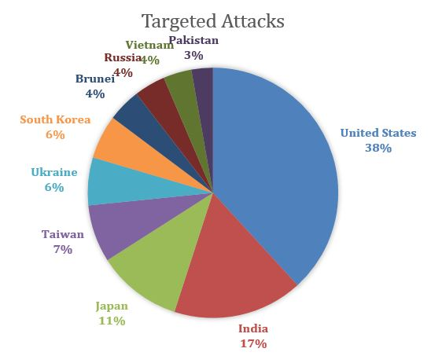
Cyber Incidents On The Rise
The US is the #1 Target for Cyber Attacks, many state-sponsored
IoT attacks up by almost 600% !
80% increase in malware attacks on Mac computers
31% of organizations have experienced cyber attacks on operational infrastructure.
Source: https://www.cyberdefensemagazine.com/cyber-security-statistics-for-2019/

Slide 3
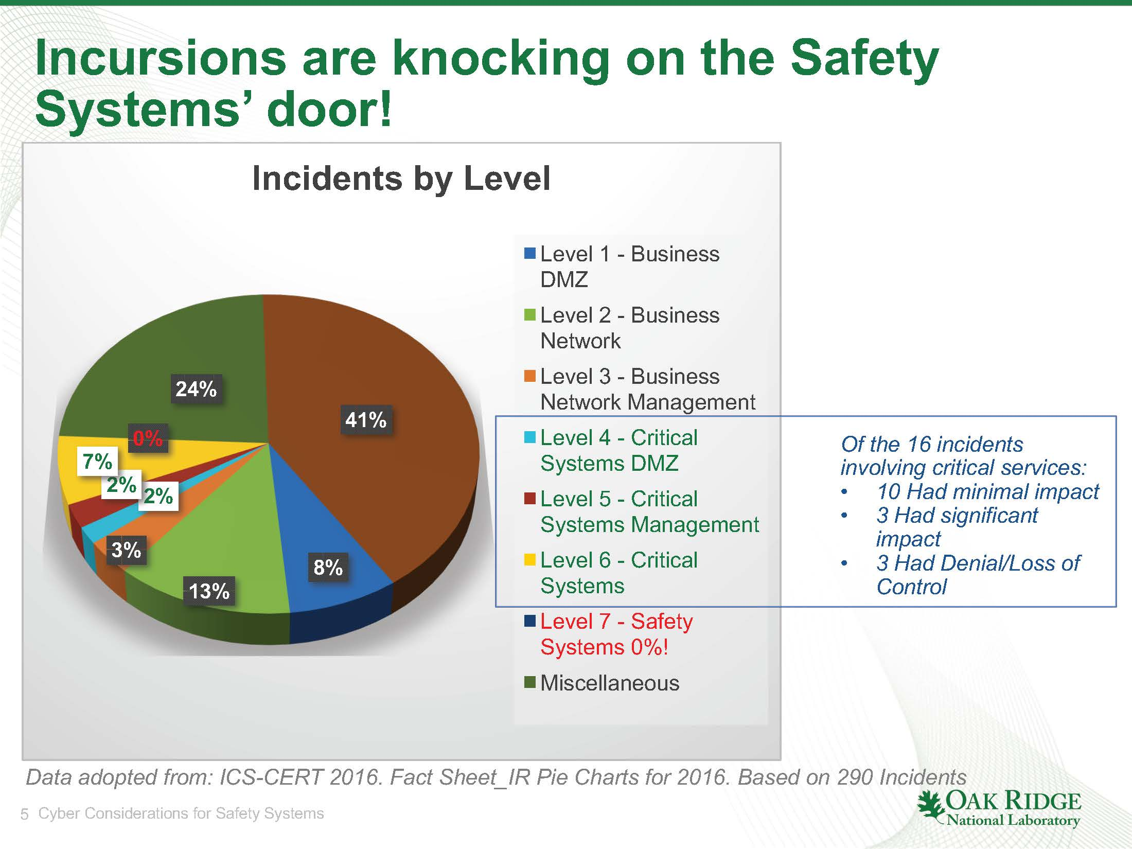
Safety System intrusions aren’t knocking, they’re here!
In his 2017 ASW talk on Cyber Security, Kelly Mahoney noted that as of 2016, no safety system incursions had occurred
  Unfortunately, this is no longer the case
“Trisis” has entered the game…

Slide 4
HATMAN / TRITON / TRISIS
HatMan, discovered in 2018, is the first malware that specifically targets a “Safety PLC”
  Affects Schneider Electric “Triconex” Safety Processors
Originally found in an industrial plant in the Middle East
Malware running on a PC attached to the SIS network exploits a vulnerability in the controller, allowing memory to be read/written
Likely part of a multi-pronged advanced persistent threat to degrade industrial processes
  Typically referred to as a “Loss of Control” (LoC) scenario
Source: CISA MAR-17-352-01 “HatMan—Safety System Targeted Malware (Update B)”

Slide 5
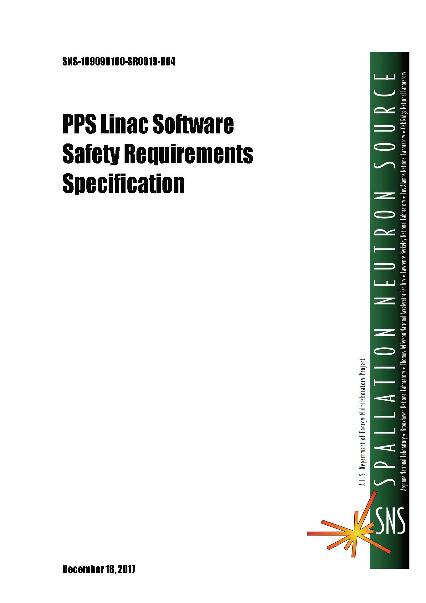
Good Cyber Security Starts At The Base
Requirements Documentation
  Cyber Security should be engineered into the system from the start
  Safety Requirements should specify a cyber security plan, engineered network security measures, and requirements for maintenance of programming workstations.
  Safety systems should include the potential for cyber compromise in safety analysis.

Slide 6
Security Testing and Quality Assurance
Include verifiable security requirements in base requirements specifications.
Once the requirements reflect the need for security, test them
When validating the functions of the system against the specification, everything should be integrated and tested, including cyber security measures

Slide 7
Tips for Security Focused Quality Assurance
Understand your Organization’s Security Policies
  Most major labs or universities have entire departments willing to help
  They can help identify frequently used attack vectors and
Create test cases that challenge security
  Most testers create “use cases” when developing functional tests. Develop “misuse” cases and challenge the system.
  Don’t dismiss any attack vectors, no matter how extreme or nonsensical
  NEVER rely on “security through obscurity” as a protection measure.

Slide 8
Protecting Safety Systems from Cyber Threats
Safety systems on isolated networks
  Firewalled
  Airgapped
Physical control of safety controllers, safety equipment, and the safety network
  Locked cabinets
  Tamper proof mounting hardware, equipment guards
  Building and site security

Slide 9
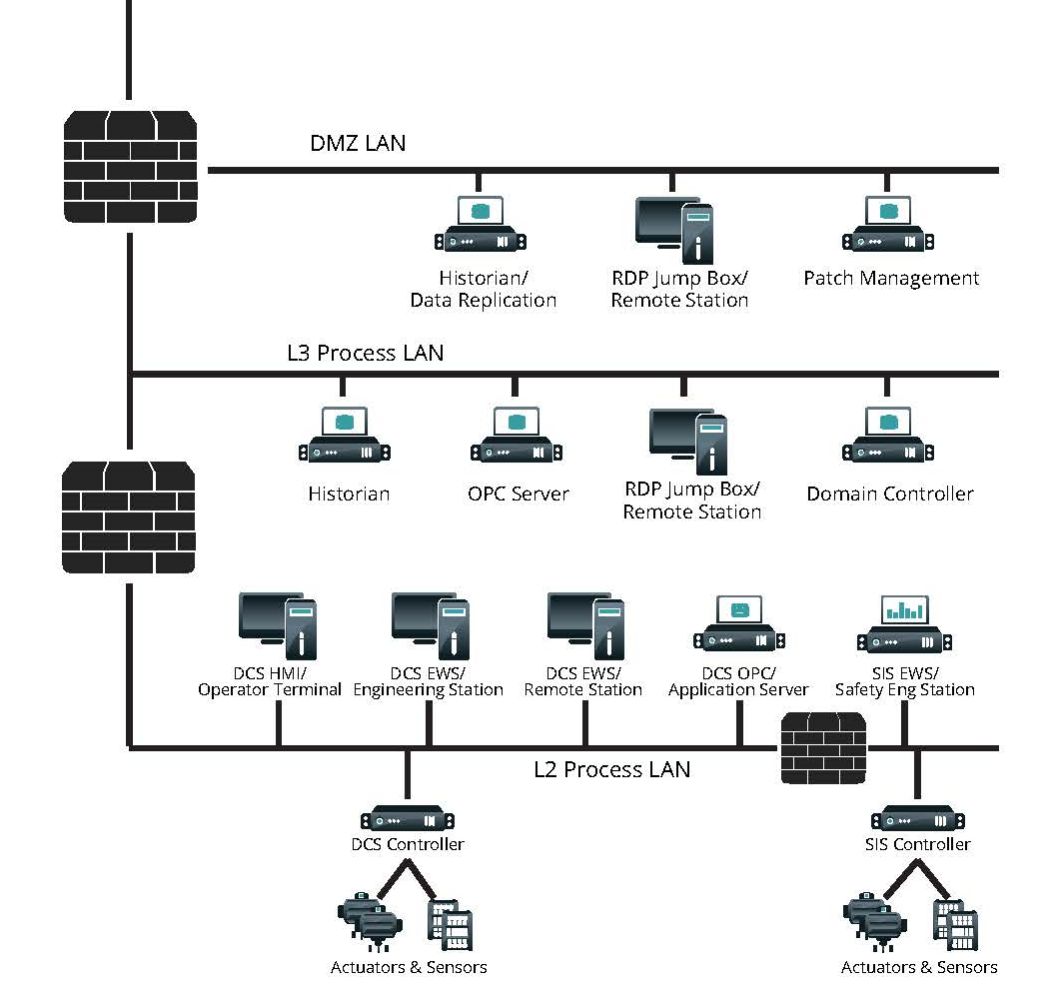
Securing The Barriers
Firewalls are great…unless you just walk around them.
  A proper management plan for programming stations is crucial to the security of an SIS.
Source: “TRISIS Malware - Analysis of Safety System Targeted Malware” Dragos Inc. 2017

Slide 10
Programming Station Security
Programming computers should be kept physically secure when not in use
  Stored in locked cabinets or offices
  Remain under control of a responsible and authorized engineer
  Not connected to the safety network except when actively programming or troubleshooting!
Programming computers should never be connected to any network other than the safety network for routine work
  Some exceptions apply…keeping OS and antivirus/antimalware up to date
  Updates should be scheduled, once approved by IT and software vendors after testing in a development environment.
Perform proper sanitation whenever a programming computer is connected to a different network
  Running anti-virus or anti-malware is a great start, but not a perfect solution.
  Check for other changes to the system: new software installed, new processes running in the background, restore/repair PLC programming software from known secure installation media.

Slide 11
Graded Approach to Updates
Historically, security has been maintained via “air gap”
But in an increasingly connected society, is that sustainable?
  Online Updates
  Online License Validation, SaaS, etc
Teams should take a graded approach to software updates
  How critical is the security problem being patched
    Should we do a little testing and upgrade immediately?
    Should we test for multiple months/years to ensure sustainable quality?

Slide 12
Control and Security of Software Code
Many cyber attacks start with surveillance!
  You can’t build a sophisticated HATMAN / TRITON / TRISIS type malware without intimate knowledge of the system.
In addition to protecting the systems themselves, you should also secure and control the source code for software running on them.
  Keep manually controlled source code physically locked/secured from unauthorized access
  Keep software version control systems patched and secured, maintain the same level of isolation and security as the programming stations.
    Don’t leave online version control systems directly connected to the PLCs, perform updates manually to be certain of what is being deployed where.

Slide 13
Security of Other Safety Equipment
Securing and patching PLC Processors and Programming Stations is important…but there are many other vectors to keep in mind!
  Remember the 600% increase in “IoT” attacks? There are more of those in your ICS systems than you think.
  PLC modules, HMI’s, Cameras, Printers, Managed Network Switches all have built in web servers to make configuration and management easy
    But these are also some of the most insecure parts of a system! Many of these interfaces use Javascript or other active web technologies that are easily exploited.
    Disable Them When Not In Use!

Slide 14
Conclusions
Cyber Security threats are increasing…and specifically targeting interlock systems to provide “loss of control” attacks.
Stay security focused during the development of requirements and include testing and challenging of security measures in validation, checkout, and other quality assurance activities.
Configuration management systems and processes need to consider cyber risks
  Include cyber risk in safety analysis
  Take a graded approach to Programmer PC and firmware updates
  Maintaining a complete “air gap” with modern technology is difficult, OT and IT need to work together to maintain the connectivity for the security updates modern technology requires while preventing other access.

